Slide 1


CYCLODUCK:
A DEPTH SENSOR IMPLEMENTATION JOURNEY
Günsu Bilge Dal & Emre Eren | 18/6/2023 | INFINIA Hackathon Series x Kargakarga

Slide 2
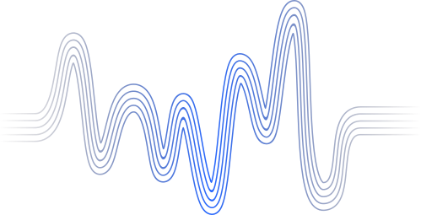
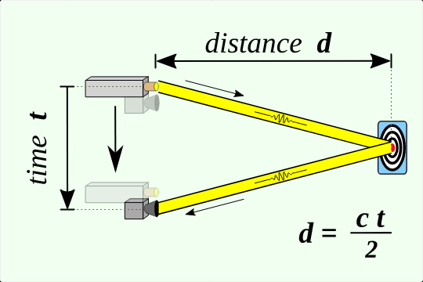
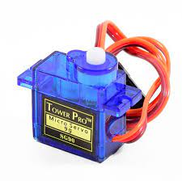
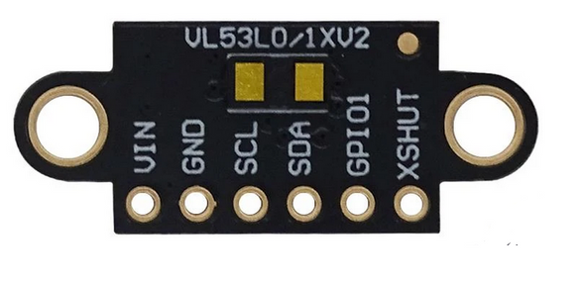
THE PROBLEM
depth map creation with wide range using 2 servo motors and one ToF depth sensor.

Slide 3
EXISTING STUDIES
People Tracking Using a Time-of-Flight Depth Sensor A Modular, Direct Time-of-Flight Depth Sensor in 45/65-nm 3-D-Stacked CMOS Technology Multi-view image and ToF sensor fusion for dense 3D reconstruction An overview of depth cameras and range scanners based on time-of-flight technologies

Slide 4
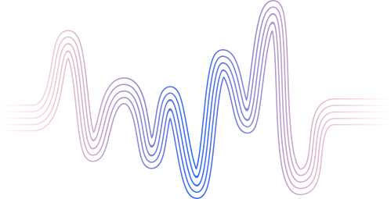
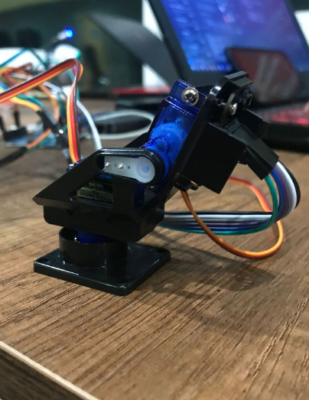
OUR SOLUTION: CYCLODUCK
a project that creates blue to red heat map, reading values from a rotary pan/tilt platform , puts into an array updating continuously and rendering a depth map. for better results we have used bilinear interpolation and gaussian filter on the output on the mentioned work.

Slide 5
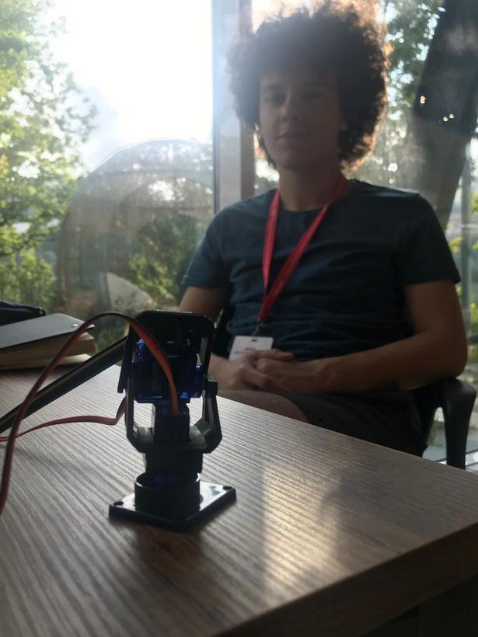
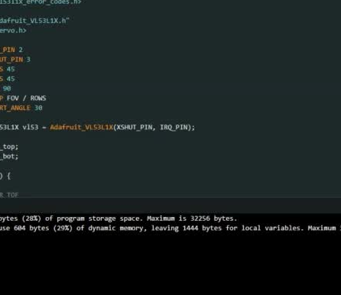
HOW IT WORKS?

Slide 6
LIMITATIONS
physical speed limit of servo motors pyhsical limit of ToF sensor (its capabilities are limited to 4 meters) computation power of Arduino

Slide 7
OUR STRUGGLES
Different Libraries caused different problems. Unstability of Arduino, its IDE and/or sensors. (solved with default case and error handling)

Slide 8


FUTURE POSSIBILITIES
This project can be improved with: sensor fusion approach better hardware

Slide 9

Thank you for listening!
/in/eerenn
/in/gbilge

