Slide 1
ICT-PreAward- Overview_of_Pre_award_process-Framework-1.0.1
Version: 4.0.0 Status: In use
Editors: Giancarlo De Stefano, Consip
Leonardo Bertini, Consip

Slide 2
Statements
Statement of originality
This deliverable contains original unpublished work except where clearly indicated otherwise. Acknowledgement of previously published material and of the work of others has been made through appropriate citation, quotation or both.
Statement of copyright
This deliverable is released under the terms of the Creative Commons Licence accessed through the following link: http://creativecommons.org/licenses/by/3.0/.
In short, it is free to
Share — to copy, distribute and transmit the work Remix — to adapt the work
Under the following conditions
Attribution — You must attribute the work in the manner specified by the author or licensor (but not in any way that suggests that they endorse you or your use of the work).

Slide 3
Revision History
Version | Date | Editor | Org | Description
1.00 | 01.06.2011 | Giancarlo De Stefano, Leonardo Bertini | Consip | First release
1.0.1 | 30.06.2012 | Giancarlo De Stefano | Consip | Editorial update for full alignement with PEPPOL EIA Release 4 and Transfer of Ownership

Slide 4



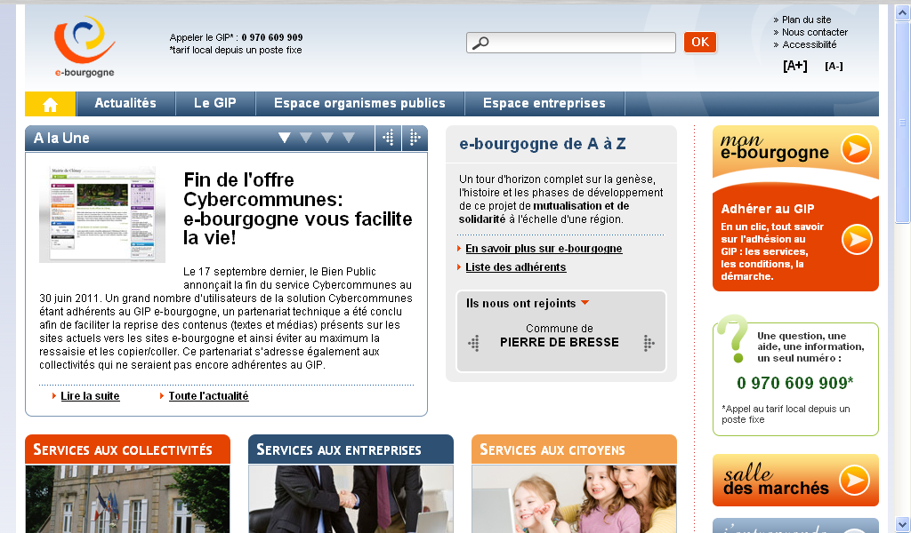

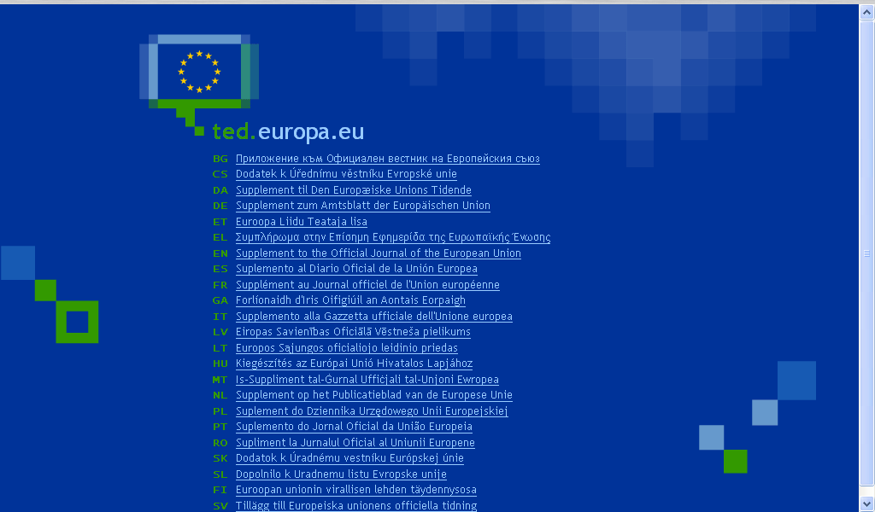
The Pre-award process 1/2– Preparing the call for tender
Contracting
Authority
Economic
Operators
eCatalogue componentsor tool
Specify goods and services required
a | s | ss | a | s
List qualification
criteria and requested documents
VCD tool or components
Evidences
Attestations
Qualifications
Publish tender
notice in OJEU (+NAT)
Retrieve tender
notice from OJEU (or NAT)
Publish/send tender documentation
Retrieve/receive tender documentation
Notes:
4

Slide 5
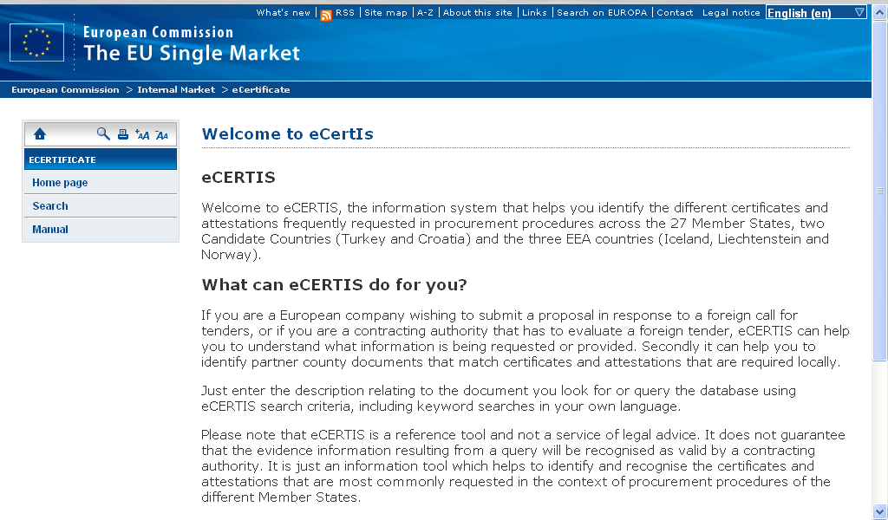



The Pre-award process 2/2– Preparation and submission of tender
Contracting
Authority
Economic
Operators
Evaluate tender & select supplier
Check Evidences (VCD tool)
Visualize Goods and services
Check Other documentation
Prepare evidences
for qualification
VCD tool
(or components)
VCD tool
(or comp.)
eCat components (or tool)
a | s | ss | a | s
1 | 3 | d | 3 | 4
2 | 2 | as | D | E
eCatalogue components (or tool)
Specify
goods and
services
eSignature
validation
tool and
service
a | s | ss | a | s
1 | 3 | d | 3 | 4
2 | 2 | as | D | E
Sign all and
Submit tender
Notes:
5

Slide 6

eProcurement without borders in Europe
www.peppol.eu

