Slide 1
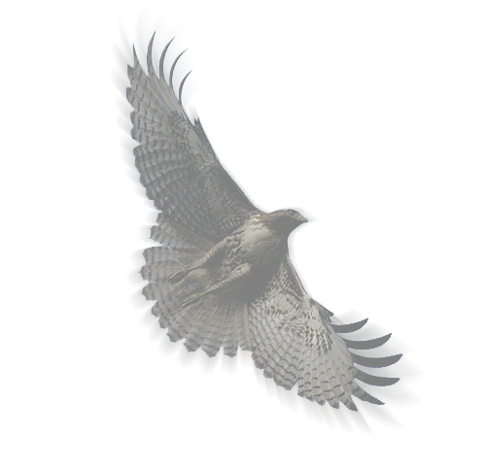
The Firehawk Toolbar Final Presentation
John Foushee
Andrew Hulbert
Brian Louden

Slide 2

Problem: Web Accessibility
Web Accessibility
Traditional Methods of Navigating the Web
Mouse clicks and hyperlinks
What if you had no mouse?
Disabled user input is often limited to speech or switch input
Project Goal
Allow Users to Access Web Content and Browser Functionality with non-traditional input
Notes:
***Mention Client (Literacy Center, their website)
***Named after Stephen Hawking (why)

Slide 3
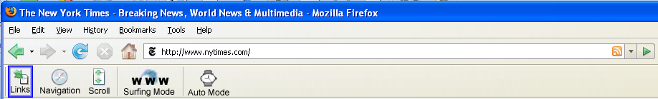
Solution: Hawking Toolbar
Allows disabled users to cycle through links on a webpage using only two input switches/keys
Works on any computer platform (Mac, Windows, Linux) running Firefox browser
Notes:
Serves as an interface between user input and the webpage seen on the screen

Slide 4

How it Works
Two Basic Operations
Move (between links or toolbar buttons)
Engage (click links or toolbar buttons)
Balance between function and simplicity
Use for toolbar, extensions and links
Scrolling
Bookmarks
Navigation (Forward, Backwards, Refresh)

Slide 5
Hawking Extensions
Each extension implemented as a separate toolbar.
Toolbars become visible when the user selects an extension on the main toolbar.
Built to be extensible
The Center for Literacy and Disability Studies
Notes:
Demo:
Literacy Center in Read by Myself Mode
Mention website design principles to maximize accessibility
Sites: DTH, bbc

