Slide 1

The Firehawk Toolbar Final Presentation
John Foushee
Andrew Hulbert
Brian Louden

Slide 2

Problem: Web Accessibility
Web Accessibility
Traditional Methods of Navigating the Web
Mouse clicks and hyperlinks
What if you had no mouse?
Disabled user input is often limited to speech or switch input
Project Goal
Allow Users to Access Web Content and Browser Functionality with non-traditional input
Notes:
***Mention Client (Literacy Center, their website)
***Named after Stephen Hawking (why)

Slide 3
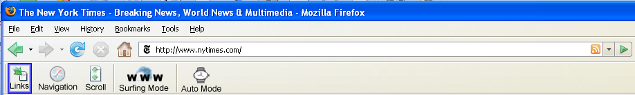
Solution: FireHawk Toolbar
Allows disabled users to cycle through links on a webpage using only two input switches/keys
Works on any computer platform (Mac, Windows, Linux) running Firefox browser
Notes:
Serves as an interface between user input and the webpage seen on the screen

Slide 4

How it Works
Two Basic Operations
Move (between links or toolbar buttons)
Engage (click links or toolbar buttons)
Balance between function and simplicity
Use for toolbar, extensions and links
Scrolling
Bookmarks
Navigation (Forward, Backwards, Refresh)

Slide 5
Hawking Extensions
Each extension implemented as a separate toolbar.
Toolbars become visible when the user selects an extension on the main toolbar.
Built to be extensible
The Center for Literacy and Disability Studies
Notes:
Demo:
Literacy Center in Read by Myself Mode
Mention website design principles to maximize accessibility
Sites: DTH, bbc

Slide 6
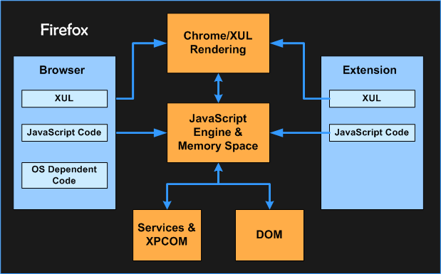
Firefox Extensions
Notes:
Creating Extensions
-Easy to use interface for designing / installing extensions
-Direct Access to browser components
-Profile Manager
-Allows for rapid development, implementation of multiple user preference sets
-XUL
XML User Interface Language
-defines GUI layout of firefox
-Use Javascript and CSS to develop extensions
6

Slide 7
Navigation Mechanism Move and Engage
The Basic Input Operations
Move
Engage
Goal: Be able to use and navigate the internet and browser functionality using the simple operations of move and engage.

Slide 8
Basic Architecture Sub-Toolbars and Modules
The Sub Toolbar Architecture
Basic Menu Design – Using Move and Engage
Meets Design Challenges
Usability & Intuitive Interface vs. Functionality
Maximize both…Tradeoffs
Context Manager Framework
Abstraction → Framework → Extensibility
Provides a Black-box for Additional Components
Development Process = Development of Modules
Notes:
Mention Sub Toolbars In Demo
8

Slide 9
Essential Components
Event Capturing
Highlighting
Surf Mode
Auto Mode
Sound Manager
Notes:
Mention Sub Toolbars In Demo
9

Slide 10

Demo
Notes:
Creating Extensions
-Easy to use interface for designing / installing extensions
-Direct Access to browser components
-Profile Manager
-Allows for rapid development, implementation of multiple user preference sets
-XUL
XML User Interface Language
-defines GUI layout of firefox
-Use Javascript and CSS to develop extensions
10

Slide 11
Challenges and Future Dev
Challenges
Web Content (Pop-ups, AJAX, Constantly Changing Web Design)
Usability (Simplicity versus Functionality)
Interesting Quirks (Removing Preferences)
Future Development
Power of Extensions
Sound Interface, Screen Readers, etc.
Notes:
11

Slide 12
Reflections
What was hard
Lack of Documentation
Unknown functionality of Technologies
Debugging in JavaScript
What is causing errors
What was Easy
JavaScript
What SHOULD we have done differently
Document along the way
More communication with actual users
Notes:
12

