Slide 1
Sami Says
Corey Davis
Patrick Reynolds
Adam Roberts
Edward Rowe

Slide 2


What is Sami Says?
A learning tool for visually-impaired children.
A audio story creation interface
  With the ability to insert exciting and creative sounds.
A fun game!

Slide 3

Why do we need Sami Says?
Teachers need to prepare their visually impaired students for creative writing tests.
Visually-impaired children need access to a creative outlet similar to that provided by drawing.

Slide 4
Use Cases: Teachers
Teachers should have the ability to:
  Keep a group of students’ work organized
  Manage the sound library
    Import sounds
    Prioritize specific sounds (i.e., for an assignment)
  Export stories to a standard format (e.g., mp3)
Teacher may also have ability to:
  Make story templates for fill-in-the-blank-or-Q-&-A-type stories

Slide 5
Use Cases: Students
Students should have the ability to:
  Record their own stories made up of
    Recorded voice clips
    Pre-recorded clips from sound library
  Edit their stories by
    Inserting clips
    Deleting clips
    Modifying clips with effects
  Navigate through a list of their stories and create, open, close, and delete stories

Slide 6
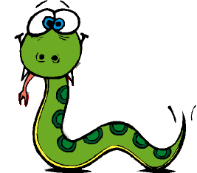
Technologies Used
Python
  Power, simplicity, ease of extension
PySonic and Pymedia
  Recording, playing, resampling, and encoding of sounds
Wx
  GUI
PyTTS
  Text to speech

