Slide 1
STABLEHACKS 2026 · DORAHACKS
Solana
ISO 20022 Message Gateway
Bidirectional bridge between Solana stablecoins and ISO 20022 banking messages.
TEAM GBITS.IO · ZÜRICH · DUBAI · SEOUL
iso.gbits.io
Gbits.io · Solana ISO 20022 Gateway · StableHacks 2026

Slide 2
01 — CONTEXT
What is ISO 20022?
The universal language banks, ERPs, and treasury systems use to talk to each other.
🏦
SWIFT · SEPA · SIC
🏢
ERP & Accounting
📜
Audit & Regulators
Mandatory since 2023.
SAP, Oracle, Bexio, Abacus.
FINMA, BaFin, ECB.
EXAMPLE · camt.053 BANK STATEMENT (XML)
<BkToCstmrStmt>
<Stmt>
<Acct><Id><IBAN>CH9300762011623852957</IBAN></Id></Acct>
<Ntry>
<Amt Ccy="CHF">1949.75</Amt>
</Ntry>
</Stmt>
</BkToCstmrStmt>
Gbits.io · Solana ISO 20022 Gateway · StableHacks 2026
2 / 7

Slide 3
02 — THE PROBLEM
Ask any AI: which blockchains do ISO 20022?
THE STANDARD ANSWER
NOT IN THE CONVERSATION
Ripple
Stellar
Solana
XDC
Algorand
Quant
Hedera
~400ms settlement · ~$0.001 per tx · 24/7
Faster and cheaper than every name on the left — but invisible in the ISO 20022 conversation.
Same across ChatGPT, Gemini, Claude, Grok.
This is a narrative problem, not a tech problem. Until now.
Gbits.io · Solana ISO 20022 Gateway · StableHacks 2026
3 / 7

Slide 4
03 — THE VISION
Translate Solana into the bank's language.
Solana stablecoin transactions become ISO 20022 messages that any ERP can import.
SOLANA
RPC
ISO 20022
XML
ERP
Stablecoin payments
on-chain
GATEWAY
Accounting &
treasury
Translation engine
USDC · USDT · EURC · VCHF
iso.gbits.io
SAP · Bexio · Abacus
Solana becomes a Global RTGS — real-time gross settlement at ~$0.001 per message. No bank permission needed.
Gbits.io · Solana ISO 20022 Gateway · StableHacks 2026
4 / 7

Slide 5
04 — HOW IT WORKS
Solana transaction → ISO 20022 camt.053
Every on-chain stablecoin transfer maps to a structured bank statement entry.
SOLANA RPC · ON-CHAIN
ISO 20022 camt.053 · XML
{
"signature": "4sGjMW1..."
"amount": 1949.75
"token": "VCHF"
"from": "7xKXtg2C..."
"to": "9mYR4jLe..."
"memo": "QRR:21000..."
}
<BkToCstmrStmt>
<Stmt>
<Ntry>
<Amt Ccy="CHF">1949.75</Amt>
<AcctSvcrRef>
4sGjMW1sU...
</AcctSvcrRef>
<CdtrRefInf><Ref>
21000000000313...
</Ref></CdtrRefInf>
</Ntry>
</BkToCstmrStmt>
→
QR Reference in memo → <CdtrRefInf> · Auto-reconciliation in any ERP
Gbits.io · Solana ISO 20022 Gateway · StableHacks 2026
5 / 7

Slide 6
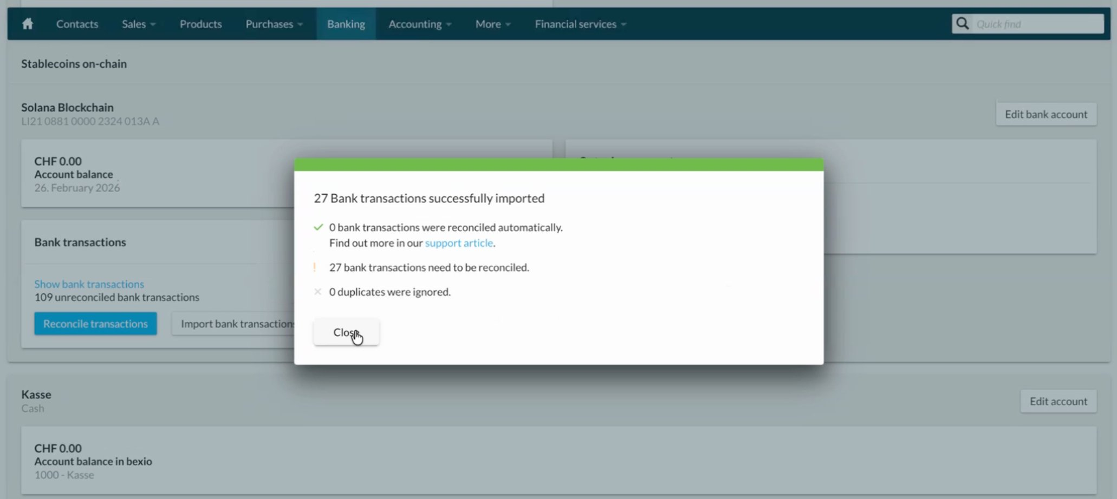
05 — PROOF
Proof of the pudding: it works in Bexio.
Generated camt.053 from a Solana wallet. Imported into Bexio. 27 transactions reconciled as a normal bank account.
27
transactions imported
100%
of fields parsed by Bexio
0
manual fixes needed
Gbits.io · Solana ISO 20022 Gateway · StableHacks 2026
6 / 7

Slide 7
06 — TEAM & TRACK RECORD
Built by payment enthusiasts.
Proven in competition. Live in production.
RB
AK
RS
Roman Bischoff
Alexandr Kazakov
Rosa Seok
Founder & PM
Fullstack Developer
Business Development
Zürich, Switzerland
Dubai
South Korea & Switzerland
20+ years TradFi
Web3 & Solana specialist
8 years in crypto · Women in Web3
🏆
Solana FM Track Winner
🇨🇭
Blockchain Nation Switzerland — Winner 2024
Encode Hackathon 2024
Innosuisse grant recipient
iso.gbits.io →
github.com/gbits-io
Gbits.io · Solana ISO 20022 Gateway · StableHacks 2026
7 / 7

