Slide 1
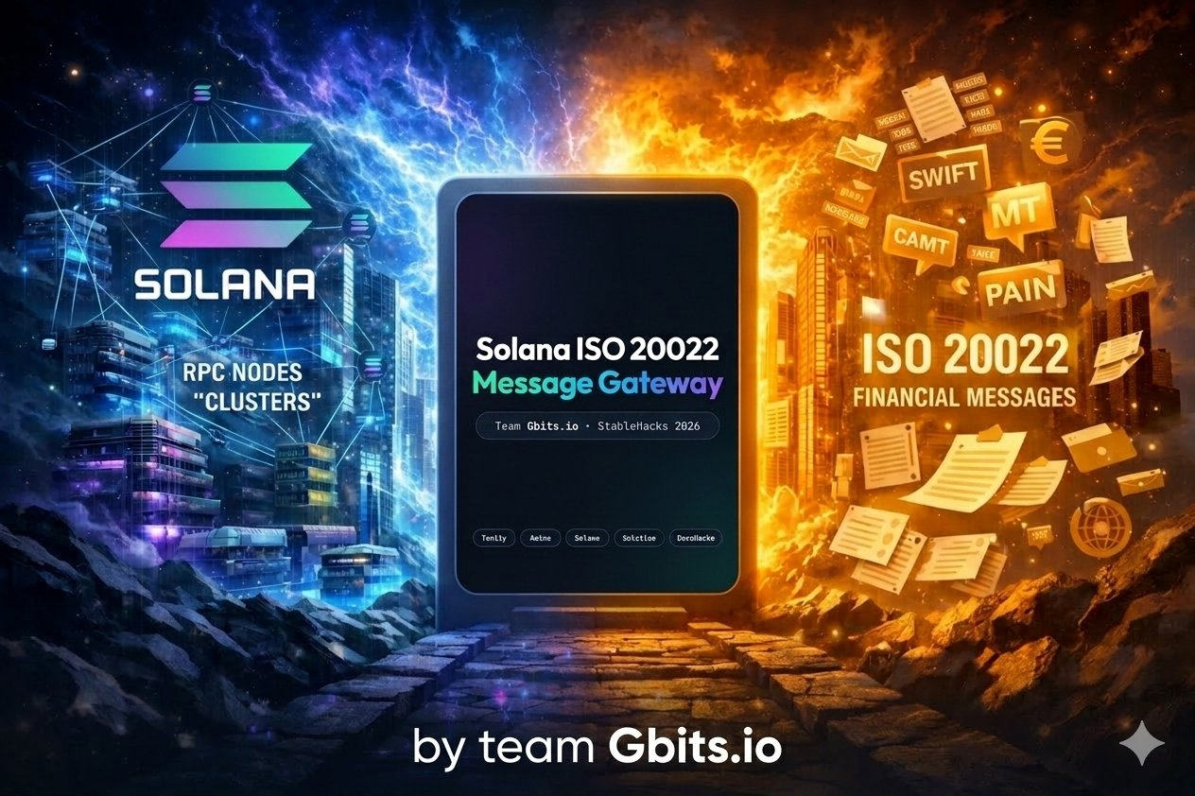
STABLEHACKS 2026
iso.gbits.io

Slide 2



06 — TEAM & TRACK RECORD
Team Gbits
RS
Roman Bischoff
Alexandr Kazakov
Rosa Seok
Developer
Developer (remote)
Business Development
Zürich, Switzerland
Dubai
South Korea & Switzerland
Trading, Payments, Solana
Web3 & Solana specialist
8 years in crypto · Women in Web3
🏆
Solana FM Track Winner
🇨🇭
Blockchain Nation Switzerland — Winner 2024
Encode Hackathon 2024
Innosuisse grant recipient
iso.gbits.io
github.com/gbits-io
1 / 8

Slide 3
01 — CONTEXT
ISO 20022 — the financial messaging standard in TradFi
ISO 20022 is the successor to SWIFT MT messages
🏦
Bank ↔ Corporate Client
🏦
Bank ↔ Bank
Statements, payments, notifications
Interbank payment networks
camt.053 · pain.001
SIC,SEPA,SWIFT,FedNow
ISO 20022
financial messaging
⚙️
ERP & Accounting
📊
Portfolio Mgmt Systems
Auto-import & reconciliation
Holdings, custody, securities
SAP · Oracle · Bexio · Abacus
semt.002
It connects banks, corporates, ERPs, and portfolio managers.
2 / 8

Slide 4
02 — THE VISION
Translate Stablecoin Payments into the TradFi language.
Gbits’ Hackathon Submission
SOLANA
RPC Endpoint
ISO 20022
ERP
RPC
XML
GATEWAY
Stablecoin payments
Translation engine
Accounting &
treasury
Bidirectional bridge
3 / 9

Slide 5
03 — HOW IT WORKS
Solana transaction → ISO 20022 camt.053 | camt.054
Every on-chain Stablecoin transfer maps to a structured bank statement entry.
SOLANA RPC · ON-CHAIN
ISO 20022 camt.053 · XML
{
"signature": "4sGjMW1..."
"amount": 1949.75
"token": "VCHF"
"from": "7xKXtg2C..."
"to": "9mYR4jLe..."
"memo": "QRR:21000..."
}
<BkToCstmrStmt>
<Stmt>
<Ntry>
<Amt Ccy="CHF">1949.75</Amt>
<AcctSvcrRef>
4sGjMW1sU...
</AcctSvcrRef>
<CdtrRefInf><Ref>
21000000000313...
</Ref></CdtrRefInf>
</Ntry>
</BkToCstmrStmt>
→
QR Reference in memo → <CdtrRefInf> · Auto-reconciliation in any ERP
4 / 9

Slide 6
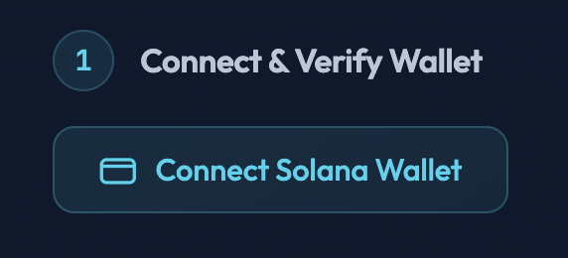
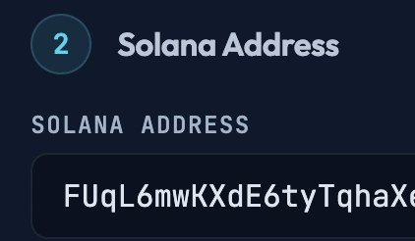
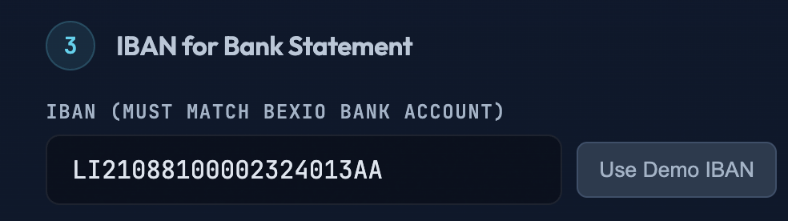
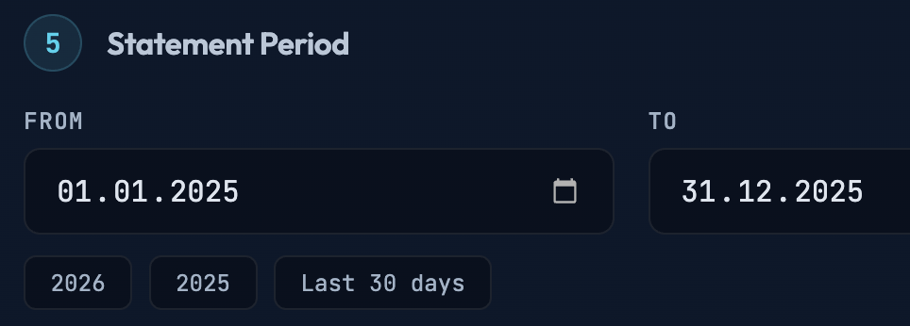
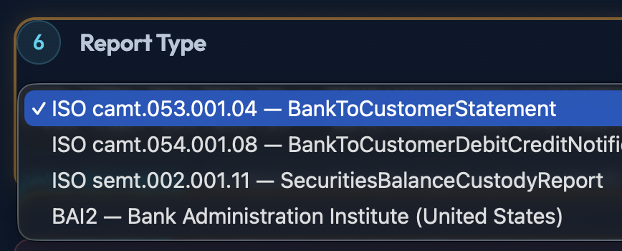
04 — LIVE APP
How it works for the user
The gateway runs live at https://iso.gbits.io
5 / 9

Slide 7
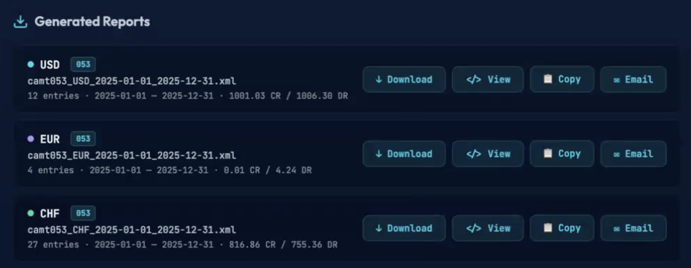
04 — LIVE APP
The result: ISO 20022 reports ready for download, import
4
report types
3
currencies (USD · EUR · CHF)
6
stablecoins supported
6 / 9

Slide 8
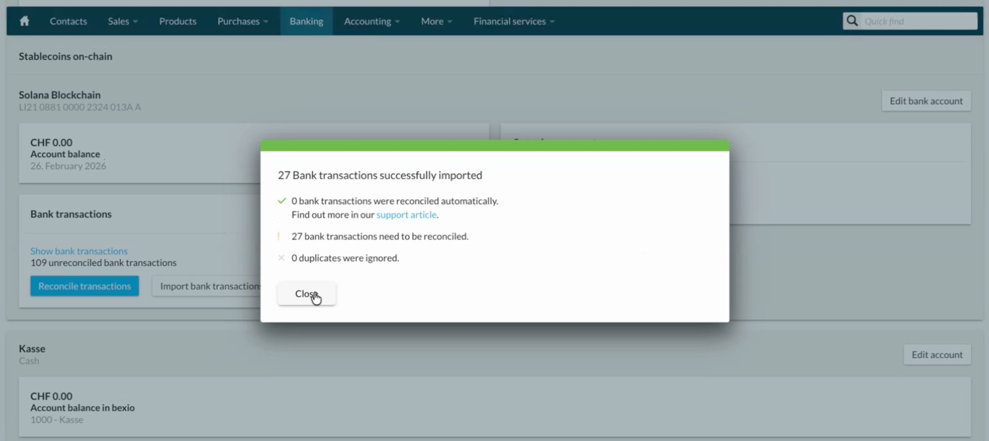
05 — PROOF
Successfully imported into Bexio Accounting SaaS App.
27
transactions imported
Field mapping documented in detail
ⓘ
Disclaimer: some field mapping issues still to be fixed
7 / 9

Slide 9
07 — ROADMAP
Roadmap
previous hackathons
* this hackathon *
Upcoming
DONE — 2024
NOW — HACKATHON
NEXT — Q3 2026
LIVE
Beta
TODO
Pay Swiss QR invoices with Stablecoins
Solana
VCHF, USDC, PyUSD, EURC,
ISO 20022 Gateway for
Solana
VCHF, USDC, PyUSD, EURC,
ISO 20022 Gateway for Ethereum for CHF Stablecoins
AllUnity - CHFAU
Frankencoin - ZCHF
Swiss Stablecoin from banks
app.gbits.io
iso.gbits.io
8 / 9

Slide 10
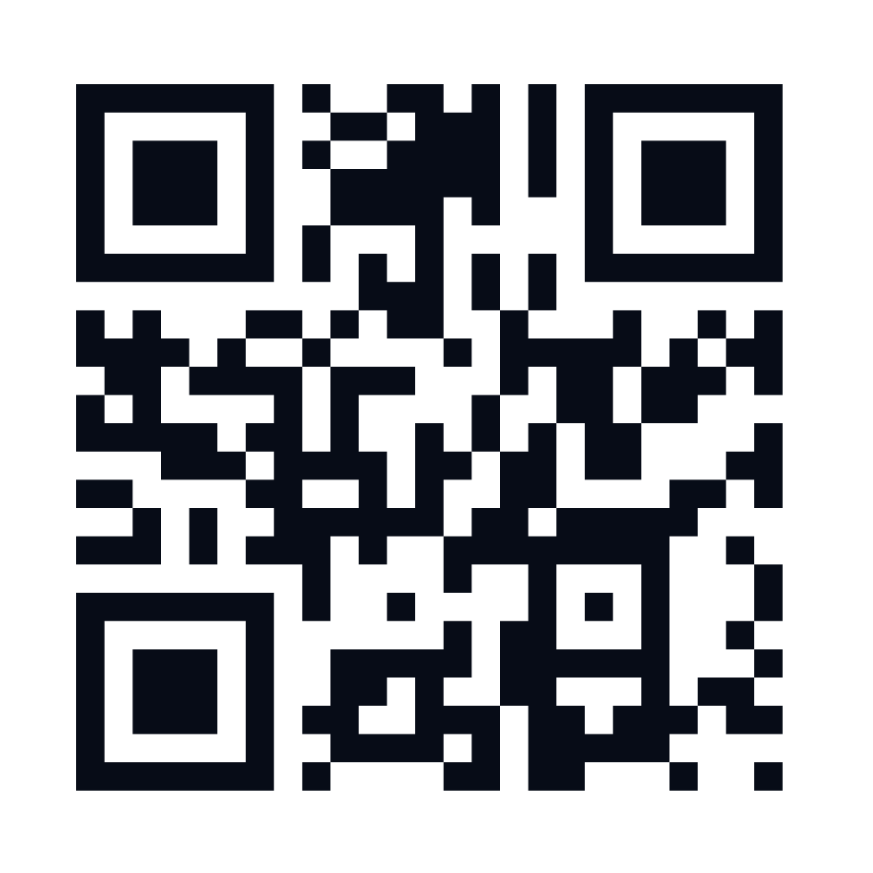
07 — ROADMAP
Try it ✨
Solana speaks ISO 20022 today.
EVM chains coming next.
https://iso.gbits.io
github.com/gbits-io/isofix
romanix@gbits.io
9 / 9

