Slide 1
AIT 500 · WESTCLIFF UNIVERSITY · WEEK 8
VitalScan
Face video → biomarker JSON
Vital signs from a 30-second webcam video
Webcam capture
GROUP 1 · rPPG SIGNAL EXTRACTION
Face + ROI tracking
POS rPPG extraction
HRV + stress index
FastAPI /scan
vitalscan.bkre8tive.com
Germaine · Jason · Daray · Abner

Slide 2
The assignment
VitalScan · AIT 500 · Group 1 · Week 8
presented by Germaine
What the project brief asked Group 1 to deliver
GROUP 1 · rPPG SIGNAL EXTRACTION
WHAT WE BUILT
Face detection on each video frame
ROI bounding boxes on forehead + cheeks
Extract a remote-PPG signal from ROIs
Output HR, HRV, stress index, BP placeholder
Return shared biomarker JSON contract
Python rPPG pipeline: face + POS + HRV
FastAPI /scan endpoint
React dashboard + browser webcam capture
Live deployment behind Cloudflare Tunnel
Evaluation report with MAE / RMSE
We took the minimum deliverable and turned it into a product demo that the class can open and test.
vitalscan.bkre8tive.com · github.com/gbiz21/vitalscan

Slide 3
Datasets retrieved
VitalScan · AIT 500 · Group 1 · Week 8
presented by Jason
Pulled per the project brief — real + synthetic evaluation data
UBFC-rPPG
SCAMPS
Real human subjects · Univ. de Bourgogne
Synthetic avatars · Microsoft Research
42
30
GT
10
PPG
1
subjects
fps webcam
pulse-ox
public examples
simulated truth
shared reader
Primary real-world test set
Synchronized ground-truth heart rate
Used to evaluate pipeline accuracy
Synthetic baseline for testing
Same evaluation harness reads both datasets
Full dataset access was limited publicly
Same code path reads both datasets, so our evaluation is consistent.
vitalscan.bkre8tive.com · github.com/gbiz21/vitalscan

Slide 4
rPPG extraction flow
VitalScan · AIT 500 · Group 1 · Week 8
presented by Daray
Face → ROI → POS signal processing → BPM / HRV / stress
1
Detect face
2
Pick ROIs
3
Clean signal
4
FFT → BPM
MediaPipe FaceMesh
468 landmarks / frame
Real-time CPU
Forehead + cheeks
Better capillary signal
Less motion artifact
POS projection
Bandpass 0.7–4 Hz
Pulse up, noise down
Search 60–210 BPM
Peak × 60
Reuse waveform for HRV
The same cleaned pulse waveform produces heart rate, HRV SDNN, and the stress-index calculation.
vitalscan.bkre8tive.com · github.com/gbiz21/vitalscan

Slide 5
System architecture — full backend + rPPG pipeline
VitalScan · Group 1 · AIT 500
Professor focus: system design, data flow, backend logic, and how the pieces connect
LIVE DEMO REQUEST FLOW
/scan POST
PROJECT STRUCTURE PROOF
1 User Browser
Webcam capture File upload 30-sec video
2 React Frontend
Vite + TypeScript Dashboard + cards Body figure UI
3 Secure Edge
Cloudflare TLS WAF / DDoS Tunnel: no open ports
4 FastAPI Backend
backend/main.py Validates video Runs /scan service
frontend/
React UI · browser capture · dashboard
backend/
main.py · FastAPI /scan · rppg/ Dockerfile + requirements.txt
BACKEND AI PROCESSING CORE
FaceMesh
468 facial landmarks per frame
ROI Extract
Forehead + cheeks mean RGB per frame
POS Algorithm
Plane orthogonal to skin tone
Filter + FFT
0.7–4.0 Hz peak → BPM
HRV / Stress
IBI + SDNN LF/HF ratio
data/
UBFC · UBFC_full · SCAMPS examples CSV evaluation outputs
Shared JSON Contract
{ heart_rate, hrv_sdnn, stress_index, blood_pressure }
Returned to frontend and consumable by other VitalScan groups
Frontend Results UI
Biomarker cards + body figure + developer JSON view Makes the backend output easy to demo live
docs/
technical_writeup.md evaluation_results.md
deploy/
Docker / homelab / tunnel deployment
Evaluation
UBFC + SCAMPS datasets → offline evaluation scripts → MAE / RMSE CSVs → evaluation_results.md
Takeaway: the frontend is only the presentation layer; the graded core is the backend rPPG signal extraction and validation pipeline.

Slide 6
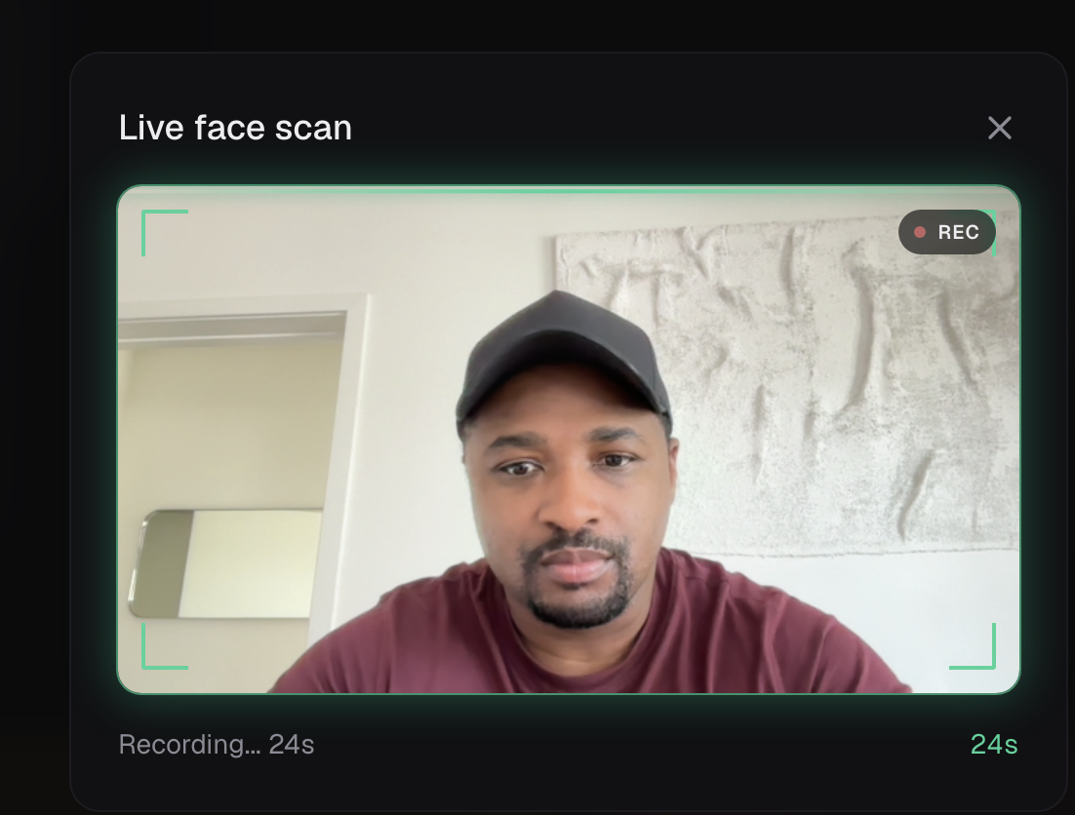
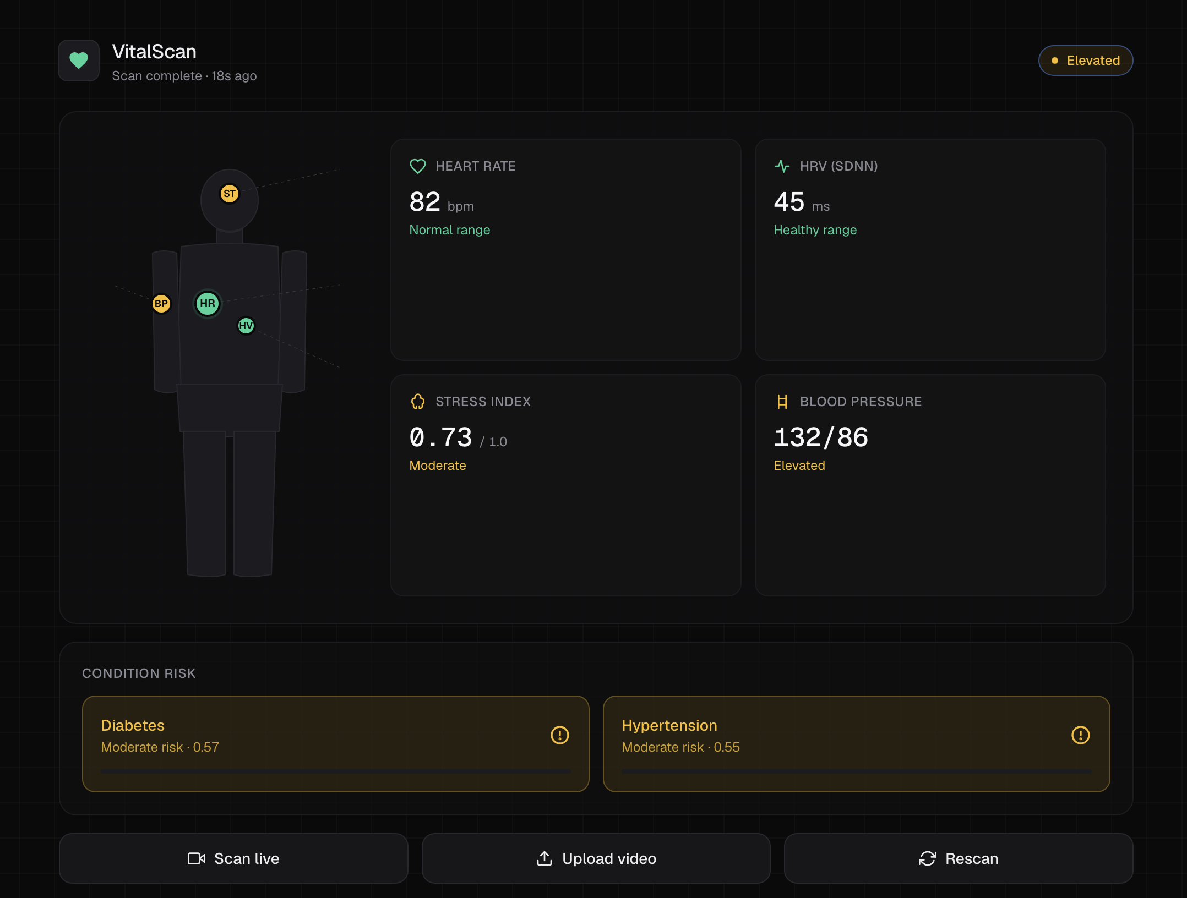
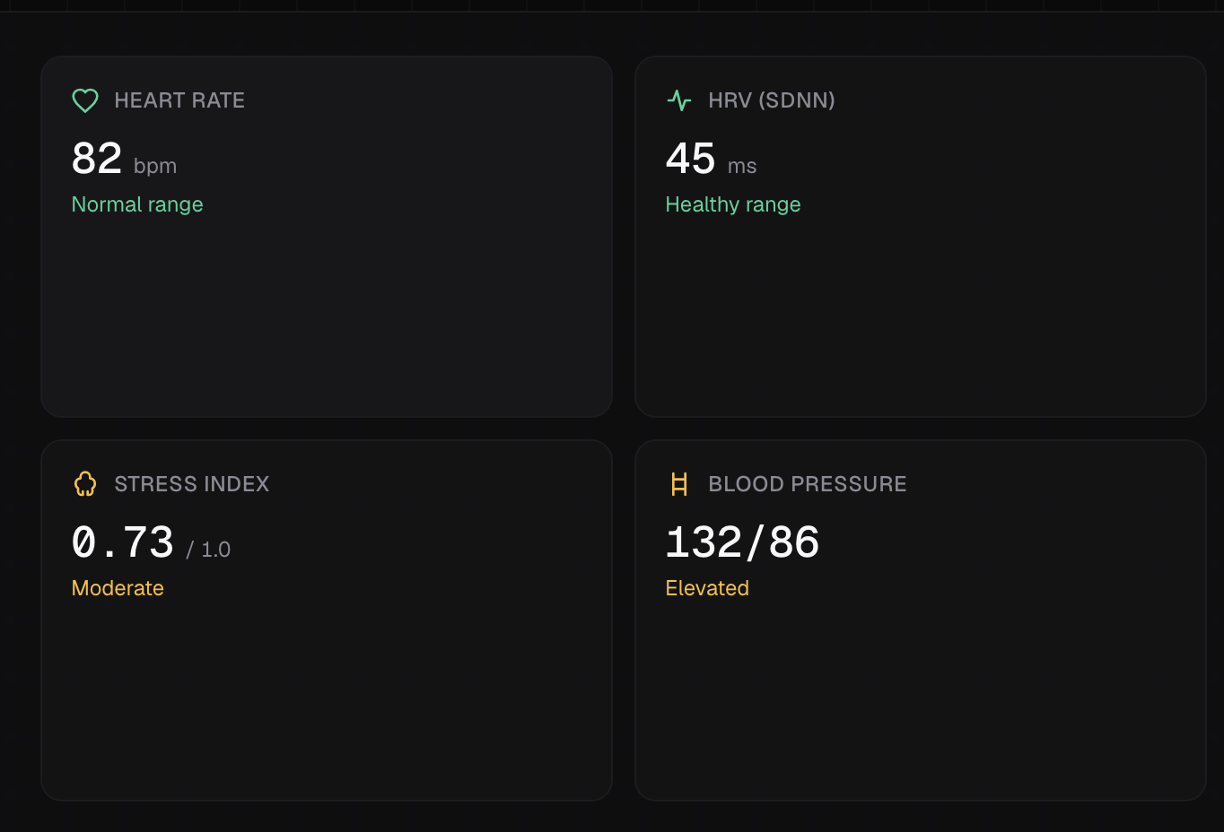
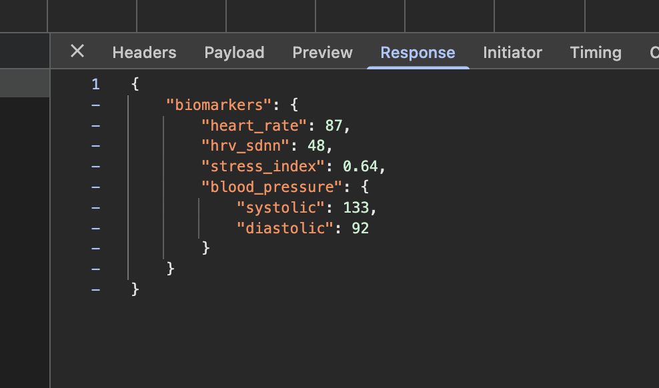
The live site
VitalScan · AIT 500 · Group 1 · Week 8
presented by Germaine
Use screenshots here so the professor sees working progress, not just code
Drop screenshot here
Drop screenshot here
Drop screenshot here
Drop screenshot here
1 · Webcam capture
2 · Dashboard
3 · Biomarkers
4 · JSON
30-second countdown + camera permission
Body figure + biomarker cards
HR, HRV, stress, BP flag
/scan response view
Suggested proof screenshots: landing page → dashboard → biomarker values → network tab showing /scan and JSON.
vitalscan.bkre8tive.com · github.com/gbiz21/vitalscan
Notes:
SLIDE 6 — LIVE SITE SCREENSHOTS
How to capture each of the 4 placeholders on this slide. The deck is at
docs/VitalScan_Group1_Backend_System_Architecture.pptx — drop screenshots in
by right-clicking each placeholder → "Change Picture" → "From File".
═══════════════════════════════════════════════════════════════════════
1 · WEBCAM CAPTURE (30-second countdown + camera permission)
═══════════════════════════════════════════════════════════════════════
a. Open Chrome → https://vitalscan.bkre8tive.com on a Mac/PC with webcam.
b. Click the "Scan live" button.
c. Allow camera permission when the browser asks.
d. The recording UI appears: face preview, corner viewfinder brackets,
red REC dot top-right, sweeping scan line, countdown ticking down.
e. Capture mid-recording (so the REC dot + countdown are both visible):
Cmd + Shift + 4 → drag a rectangle around the camera modal
(or hit Space after Cmd+Shift+4 to switch to window-capture mode)
f. Saves to Desktop as "Screenshot YYYY-MM-DD at HH.MM.SS.png".
═══════════════════════════════════════════════════════════════════════
2 · DASHBOARD (body figure + biomarker cards — the hero shot)
═══════════════════════════════════════════════════════════════════════
a. After a scan completes, OR just use the persisted state on first load.
b. Make sure all 4 biomarker cards show real values (HR, HRV, stress, BP)
and the body-figure markers are colored (green / amber / red).
c. Capture:
Cmd + Shift + 4 → drag a rectangle around the WHOLE main panel:
body figure on the left + 4 biomarker cards on the right
d. Frame tight — don't include the bookmarks bar or browser chrome.
═══════════════════════════════════════════════════════════════════════
3 · BIOMARKERS (zoomed-in view of HR / HRV / stress / BP cards)
═══════════════════════════════════════════════════════════════════════
Two ways to do this — pick whichever looks crisper:
Option A (preferred — sharper text):
a. In Chrome, press Cmd + Plus a couple of times to zoom to ~150 %.
b. Cmd + Shift + 4 → drag a rectangle around just the 4 cards.
c. Reset zoom with Cmd + 0 when done.
Option B (faster):
a. Cmd + Shift + 4 → drag a tight crop around just the 4 cards.
Make sure the status labels are visible ("Normal range", "Healthy
range", "Moderate", "Elevated") — those carry the meaning.
═══════════════════════════════════════════════════════════════════════
4 · JSON (/scan response in Chrome DevTools)
═══════════════════════════════════════════════════════════════════════
a. On vitalscan.bkre8tive.com, open DevTools: Cmd + Option + I (or F12)
b. Click the "Network" tab.
c. In the filter box, type: scan
d. Click "Scan live" or "Upload video" to trigger a scan request.
e. When the /scan POST completes, click the request row.
f. Click the "Response" tab in the DevTools right panel — you'll see:
{
"biomarkers": {
"heart_rate": 72,
"hrv_sdnn": 45,
"stress_index": 0.6,
"blood_pressure": { "systolic": 138, "diastolic": 88 }
}
}
g. Capture:
Cmd + Shift + 4 → drag a rectangle around the DevTools panel,
framing BOTH the request row at the top and the JSON response below.
h. If the JSON is collapsed, click the disclosure triangles to expand it
before capturing — readability over completeness.
═══════════════════════════════════════════════════════════════════════
INSERTING INTO THIS SLIDE
═══════════════════════════════════════════════════════════════════════
• Open this deck in PowerPoint or Keynote.
• Slide 6.
• For each placeholder: right-click → "Change Picture" → "From File"
→ select the screenshot from your Desktop.
• Alternative: drag-and-drop the PNG file directly onto the placeholder.
• The placeholder boxes are pre-sized 6.0 × 2.5 inches — match that
aspect ratio (~12:5) on your screenshot crops so they don't distort.
═══════════════════════════════════════════════════════════════════════
TALKING POINTS WHILE PRESENTING THIS SLIDE (Germaine)
═══════════════════════════════════════════════════════════════════════
1. The webcam capture screen — point out the in-browser recording, no
app to install, 30-second clip, the corner brackets + REC dot are
UI feedback we built to make the recording state obvious.
2. The dashboard — body figure with marker positions, four biomarker
cards showing values pulled live from the backend's JSON response.
3. The biomarkers up close — call out heart rate in BPM, HRV in ms,
stress on a 0–1 scale, and BP. Flag that BP is currently mocked
because classical rPPG can't derive it without cuff calibration.
4. The /scan JSON — for developers in the room: this is the shared
API contract any other group can consume. Multipart POST in,
biomarker JSON out, ~5 seconds end-to-end on real video.
Close this slide by saying: "the site is live right now — open
vitalscan.bkre8tive.com on your phone."

Slide 7
Build phases
VitalScan · AIT 500 · Group 1 · Week 8
presented by Germaine
From project brief → live product → evaluated rPPG pipeline
BUILD SEQUENCE
React UI mock
WHAT THIS PROVES
✓
Phase 1
Dashboard, body figure, and biomarker cards working first with sample JSON.
frontend/
React UI + webcam dashboard
✓
Phase 2
FastAPI /scan
backend/
main.py + FastAPI + rppg/
Backend endpoint receives video and returns the shared biomarker JSON contract.
data/
UBFC + SCAMPS evaluation files
✓
Phase 3
Real rPPG core
docs/
writeup + evaluation results
FaceMesh → ROI → RGB time series → POS filter/FFT → BPM, HRV, stress.
deploy/
Docker / tunnel deployment
✓
Phase 4
Live deployment
Docker + Cloudflare Tunnel on homelab; TLS at edge, no open home ports.
Takeaway
✓
Phase 5
Browser capture
Frontend is the demo layer; the graded core is backend rPPG.
30-second in-browser recording with getUserMedia + MediaRecorder.
vitalscan.bkre8tive.com · github.com/gbiz21/vitalscan
Build progression shows controlled system engineering — mock first, backend next, then real signal processing and evaluation.

Slide 8
Accuracy and progress
VitalScan · AIT 500 · Group 1 · Week 8
presented by Abner
Where we are vs. the rubric
HEADLINE ACCURACY
PROGRESS CHECKLIST
4.06 BPM
✓
Datasets retrieved (UBFC + SCAMPS)
✓
rPPG pipeline: face → POS → BPM
Mean absolute error on 42 UBFC subjects
✓
FastAPI /scan endpoint live
Rubric target: < 10 BPM · Median: 1.05 BPM
✓
React dashboard + webcam capture
Distribution on UBFC:
50% within ±1 BPM
67% within ±3 BPM
90% within ±10 BPM
✓
Accuracy report: MAE / RMSE
•
Blood pressure is a flagged placeholder
•
Deep-learning upgrade is stretch only
vitalscan.bkre8tive.com · github.com/gbiz21/vitalscan

Slide 9
AIT 500 · WESTCLIFF UNIVERSITY · GROUP 1
Thank you! Any questions?
Try the site right now
Code
vitalscan.bkre8tive.com
github.com/gbiz21/vitalscan
Group 1 — Germaine · Jason · Daray · Abner
Recap: full rPPG pipeline, API, dashboard, live deployment, and evaluation loop.

