Slide 1
Neural Networks

Slide 2
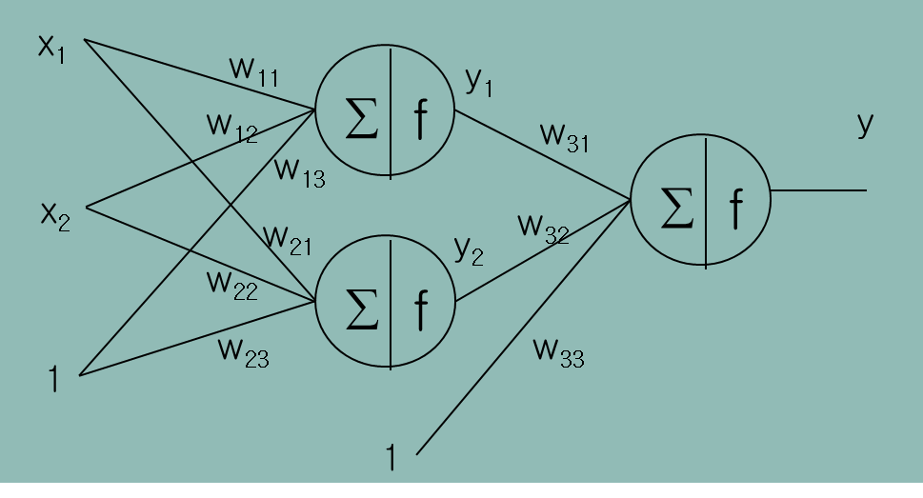
Regression
Following Neural Network is OK for regression?
Maybe NO!! Why?
The activation functions produces a value between [0,1]

Slide 3
Regression
Solution
Normalize the outputs into [0,1]
Or, use a linear output node
x₁
w₁₁
∑
f
w₁₁
y
w₁₂
w₁₃
x₂
∑
w₂₂
w₂₁
w₂₁
∑
f
w₂₃
w₃₁
1
1

Slide 4
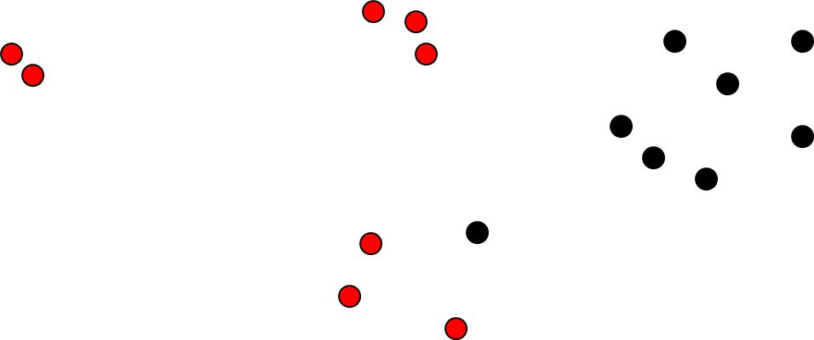
Two-Class Classification
Problem
NN cannot produces nominal values
$\left(x_{1},Red\right)$, $\left(x_{2},Red\right)$, $\left(x_{3},Black\right),$ $\left(x_{4},Red\right),\left(x_{5},Black\right),⋯$

Slide 5

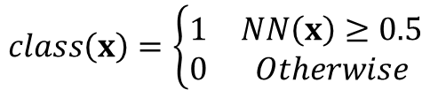
Two-Class Classification
Problem Conversion
Use 0 and 1 for class labels
Use one node at the output layer
Prediction
$\left(x_{1},Red\right)$, $\left(x_{2},Red\right)$, $\left(x_{3},Black\right),$ $\left(x_{4},Red\right),\left(x_{5},Black\right),⋯$
$\left(x_{1},1\right)$, $\left(x_{2},1\right)$, $\left(x_{3},0\right),$ $\left(x_{4},1\right),\left(x_{5},0\right),⋯$
$$class\left(x\right)=\left\{\begin{matrix}1 & NN\left(x\right)≥0.5 \\ 0 & Otherwise\end{matrix}\right.$$

Slide 6


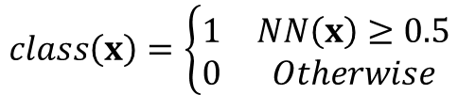
Two-Class Classification
Do you think MSE is good as an Error function?
$\left(x_{1},1\right)$, $\left(x_{2},1\right)$, $\left(x_{3},0\right),$ $\left(x_{4},1\right),\left(x_{5},0\right),⋯$
$$class\left(x\right)=\left\{\begin{matrix}1 & NN\left(x\right)≥0.5 \\ 0 & Otherwise\end{matrix}\right.$$
$$E=\frac{1}{2}\sum_{n=1}^{N}{{\left(t_{n}−y_{n}\right)}^{2}}$$

Slide 7
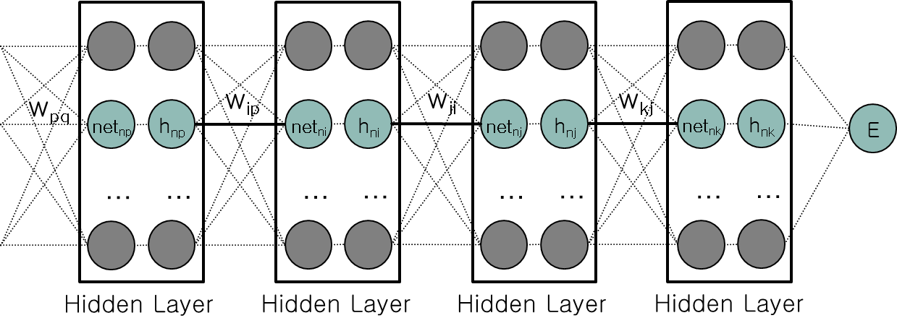





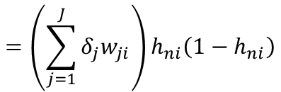

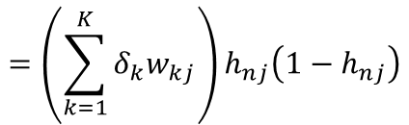


Two-Class Classification
Reminding: Weights between deep layers
If
$$h=Sigmoid\left(net\right)$$
$$\frac{∂E}{∂w_{kj}}=\frac{∂E}{∂{net}_{nk}}\frac{∂{net}_{nk}}{∂w_{kj}}=δ_{k}h_{nj}$$
$$δ_{k}=\frac{∂E}{∂h_{nk}}\frac{∂h_{nk}}{∂{net}_{nk}}$$
$$=−\left(t_{n}−h_{nk}\right)h_{nk}\left(1−h_{nk}\right)$$
$$δ_{j}=\left(\sum_{k=1}^{K}{δ_{k}w_{kj}}\right)\frac{∂h_{nj}}{∂{net}_{nj}}$$
$$=\left(\sum_{k=1}^{K}{δ_{k}w_{kj}}\right)h_{nj}\left(1−h_{nj}\right)$$
$$\frac{∂E}{∂w_{ji}}=\frac{∂E}{∂{net}_{nj}}\frac{∂{net}_{nj}}{∂w_{ji}}=δ_{j}h_{ni}$$
$$δ_{i}=\left(\sum_{j=1}^{J}{δ_{j}w_{ji}}\right)\frac{∂h_{ni}}{∂{net}_{ni}}$$
$$=\left(\sum_{j=1}^{J}{δ_{j}w_{ji}}\right)h_{ni}\left(1−h_{ni}\right)$$
$$\frac{∂E}{∂w_{ip}}=\frac{∂E}{∂{net}_{ni}}\frac{∂{net}_{ni}}{∂w_{ip}}=δ_{i}h_{np}$$

Slide 8
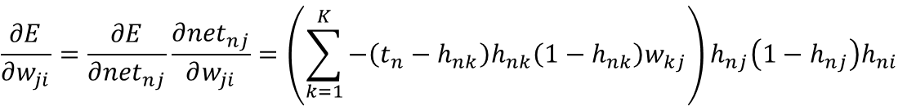


Two-Class Classification
Reminding: Weights between deep layers
$$\frac{∂E}{∂w_{kj}}=\frac{∂E}{∂{net}_{nk}}\frac{∂{net}_{nk}}{∂w_{kj}}=−\left(t_{n}−h_{nk}\right)h_{nk}\left(1−h_{nk}\right)h_{nj}$$
If
$$h=Sigmoid\left(net\right)$$
$$\frac{∂E}{∂w_{ji}}=\frac{∂E}{∂{net}_{nj}}\frac{∂{net}_{nj}}{∂w_{ji}}=\left(\sum_{k=1}^{K}{−\left(t_{n}−h_{nk}\right)h_{nk}\left(1−h_{nk}\right)w_{kj}}\right)h_{nj}\left(1−h_{nj}\right)h_{ni}$$
$$\frac{∂E}{∂w_{ip}}=\frac{∂E}{∂{net}_{ni}}\frac{∂{net}_{ni}}{∂w_{ip}}=\left(\sum_{j=1}^{J}{\left(\sum_{k=1}^{K}{−\left(t_{n}−h_{nk}\right)h_{nk}\left(1−h_{nk}\right)w_{kj}}\right)h_{nj}\left(1−h_{nj}\right)w_{ji}}\right)h_{ni}\left(1−h_{ni}\right)h_{np}$$

Slide 9
Two-Class Classification
Not Good…
If h_{nk} is close to 1 or 0, all gradients for n-th training data is 0
What if h_{nk} is close to 1 or 0 but it’s wrong?
If most of data are mis-learned,
NN cannot escape from the mis-learning
$$\frac{∂E}{∂w_{kj}}=\frac{∂E}{∂{net}_{nk}}\frac{∂{net}_{nk}}{∂w_{kj}}=−\left(t_{n}−h_{nk}\right)h_{nk}\left(1−h_{nk}\right)h_{nj}$$
If
$$h=Sigmoid\left(net\right)$$
$$\frac{∂E}{∂w_{ji}}=\frac{∂E}{∂{net}_{nj}}\frac{∂{net}_{nj}}{∂w_{ji}}=\left(\sum_{k=1}^{K}{−\left(t_{n}−h_{nk}\right)h_{nk}\left(1−h_{nk}\right)w_{kj}}\right)h_{nj}\left(1−h_{nj}\right)h_{ni}$$
$$\frac{∂E}{∂w_{ip}}=\frac{∂E}{∂{net}_{ni}}\frac{∂{net}_{ni}}{∂w_{ip}}=\left(\sum_{j=1}^{J}{\left(\sum_{k=1}^{K}{−\left(t_{n}−h_{nk}\right)h_{nk}\left(1−h_{nk}\right)w_{kj}}\right)h_{nj}\left(1−h_{nj}\right)w_{ji}}\right)h_{ni}\left(1−h_{ni}\right)h_{np}$$

Slide 10

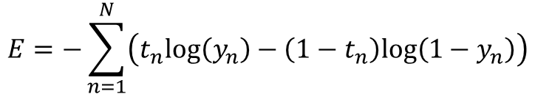
Two-Class Classification
Recommend NOT to use SIGMOID function and MSE at the same time!!
Usually, for two-class classification
Activation function: Sigmoid
Error function: Cross Entropy
$$E=−\sum_{n=1}^{N}{\left(t_{n}log\left(y_{n}\right)−\left(1−t_{n}\right)log\left(1−y_{n}\right)\right)}$$
$$where{ t}_{n}∈\left\{0,1\right\} and{ y}_{n}∈\left[0,1\right]$$

Slide 11

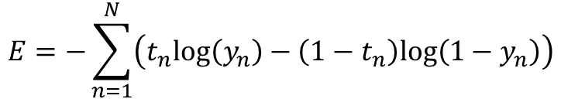

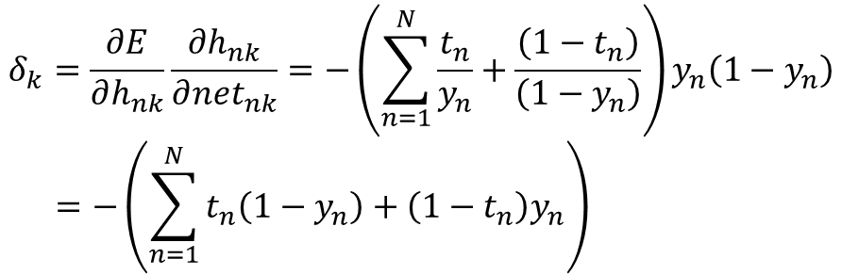
Two-Class Classification
Cross Entropy as an Error Function
$$E=−\sum_{n=1}^{N}{\left(t_{n}log\left(y_{n}\right)−\left(1−t_{n}\right)log\left(1−y_{n}\right)\right)}$$
$$where{ t}_{n}∈\left\{0,1\right\} and{ y}_{n}∈\left[0,1\right]$$
$${ y}_{n}=Sigmoid\left(net\right)$$
$$δ_{k}=\frac{∂E}{∂h_{nk}}\frac{∂h_{nk}}{∂{net}_{nk}}=−\left(\sum_{n=1}^{N}{\frac{t_{n}}{y_{n}}+\frac{\left(1−t_{n}\right)}{\left(1−y_{n}\right)}}\right)y_{n}\left(1−y_{n}\right)$$
$$=−\left(\sum_{n=1}^{N}{t_{n}\left(1−y_{n}\right)+\left(1−t_{n}\right)y_{n}}\right)$$

Slide 12
Two-Class Classification
Cross Entropy
Try to maximize the probability
Probability to be RED
Probability to be BLUE

Slide 13
Two-Class Classification
Cross Entropy

Slide 14
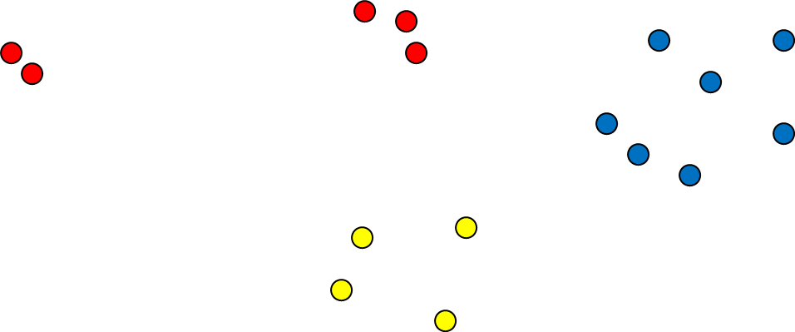
Multi-Class Classification
Problem
Easy...
$\left(x_{1},Red\right)$, $\left(x_{2},Yellow\right)$, $\left(x_{3},Blue\right),$ $\left(x_{4},Red\right),\left(x_{5},Blue\right),⋯$

Slide 15

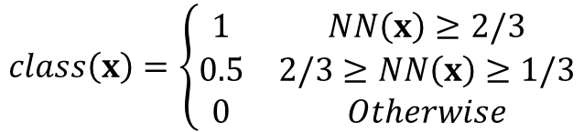
Multi-Class Classification
Problem Conversion
Linear conversion of class labels
Use one node at the output layer
Prediction
$\left(x_{1},Red\right)$, $\left(x_{2},Yellow\right)$, $\left(x_{3},Blue\right),$ $\left(x_{4},Red\right),\left(x_{5},Blue\right),⋯$
$\left(x_{1},1\right)$, $\left(x_{2},0.5\right)$, $\left(x_{3},1\right),$ $\left(x_{4},0\right),\left(x_{5},1\right),⋯$
$$class\left(x\right)=\left\{\begin{matrix}1 & NN\left(x\right)≥2/3 \\ 0.5 & 2/3≥NN\left(x\right)≥1/3 \\ 0 & Otherwise\end{matrix}\right.$$

Slide 16
Multi-Class Classification
Not Good… why?
There is no order between Red, Yellow, Blue
They are just names. We cannot say that Red < Yellow < Blue
Linear conversion changes the original problem.

Slide 17
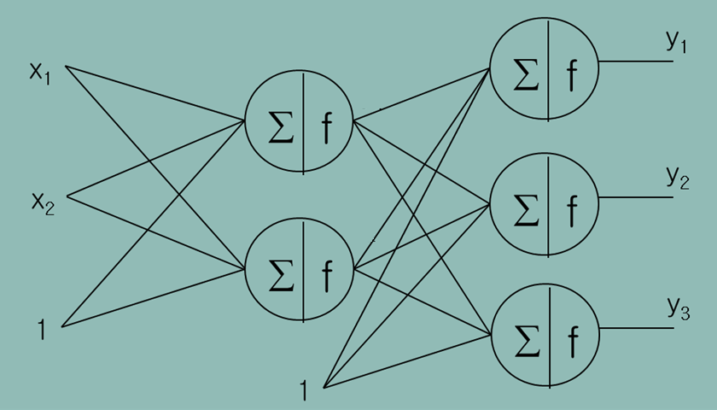


Multi-Class Classification
Then?
Create virtual outputs
Place nodes at the output layer as many as virtual outputs
$\left(x_{1},Red\right)$,
$\left(x_{2},Yellow\right)$,
$\left(x_{3},Blue\right),$
$$\left(x_{4},Red\right),$$
$$\left(x_{5},Blue\right),$$
$$⋯$$
$\left(x_{1},1, 0, 0\right)$,
$\left(x_{2},0, 1, 0\right)$,
$\left(x_{3},0, 0, 1\right),$
$$\left(x_{4},1, 0, 0\right),$$
$$\left(x_{5},0, 0, 1\right),$$
$$⋯$$

Slide 18
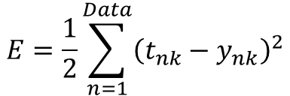
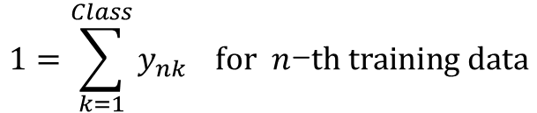
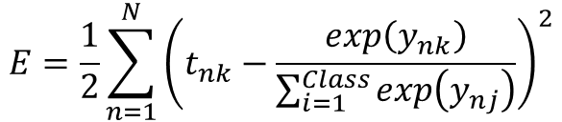
Multi-Class Classification
How about Error Function?
MSE is not bad but ..
It does not guarantee
Usually use
$$E=\frac{1}{2}\sum_{n=1}^{Data}{{\left(t_{nk}−y_{nk}\right)}^{2}}$$
$$1=\sum_{k=1}^{Class}{y_{nk}} for n\text{−}th training data$$
$$E=\frac{1}{2}\sum_{n=1}^{N}{{\left(t_{nk}−\frac{exp\left(y_{nk}\right)}{\sum_{i=1}^{Class}{exp\left(y_{nj}\right)}}\right)}^{2}}$$

Slide 19
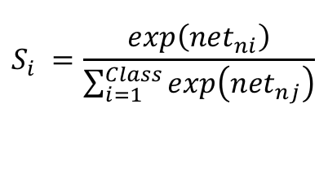
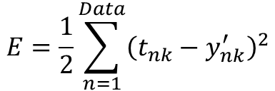
Multi-Class Classification
How about Error Function?
It is equivalent to using Softmax layer + MSE
$$E=\frac{1}{2}\sum_{n=1}^{Data}{{\left(t_{nk}−y_{nk}^{′}\right)}^{2}}$$
$$S_{i} =\frac{exp\left({net}_{ni}\right)}{\sum_{i=1}^{Class}{exp\left({net}_{nj}\right)}}$$
Softmax layer

Slide 20
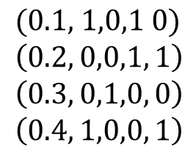
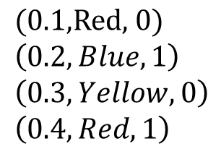
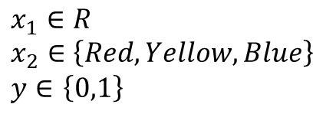
Nominal Inputs
What if you have categorical inputs
Two inputs and one output
Create a new input variable for each categorical value
$$x_{1}∈R$$
$$x_{2}∈\left\{Red, Yellow, Blue\right\}$$
$y∈$ $\left\{0,1\right\}$
$$\text{(0.1,}\text{Red}\text{, 0)}$$
$$\left(0.2,Blue, 1\right)$$
$$\left(0.3,Yellow, 0\right)$$
$$\left(0.4,Red, 1\right)$$
$$\text{(0.1, 1,0,1 0)}$$
$$\left(0.2, 0,0,1, 1\right)$$
$$\left(0.3, 0,1,0, 0\right)$$
$$\left(0.4, 1,0,0, 1\right)$$

