Slide 1
Gradient Descent Methods

Slide 2
차례
Stochastic Gradient Descent Method
Better Gradient Descent Methods
Momentum
Nesterov Accelerated Gradient (NAG)
Adagrad
RMSprop
Adam

Slide 3
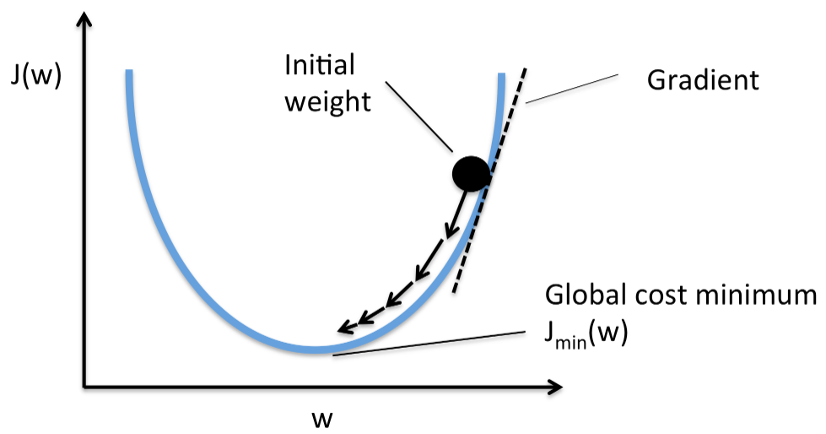
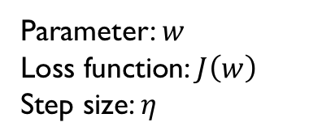

Gradient Descent Method
Gradient Descent
Method using gradient to minimize Loss function
$w=w−η∇_{w}J(w)$
Parameter: $w$
Loss function: $J\left(w\right)$
Step size: $η$

Slide 4
Stochastic Gradient Descent
Batch Gradient Descent
For one update, gradients are calculated for the whole dataset
Batch gradient descent is guaranteed to converge to a local minimum
Redundant computations for large redundant dataset
Repeat
for n =1 to N (for all training data)
end
Until end condition satisfied

Slide 5
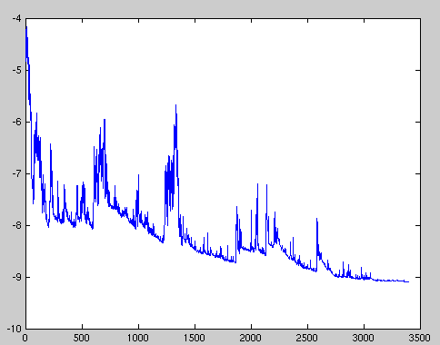
Stochastic Gradient Descent
Stochastic Gradient Descent
For one update, gradients are calculated for one sample
Usually faster and can be used to learn online
Fluctuations: Maybe good or maybe bad
With a small learn rate, show similar performance
Repeat
for n =1 to N (for all training data)
end
Until end condition satisfied

Slide 6
Stochastic Gradient Descent
Mini-batch Gradient Descent
For an update, gradients are calculated for a batch
Repeat
for b =1 to B (for all batches)
for n=1 to N_{b} (for all training data in batch b)
end
end
Until end condition satisfied

Slide 7
Stochastic Gradient Descent
Usual Batch Size
Dependent on datasets from several thousands to several tens
Advantage
Good estimation of real gradient
High throughput: may use the large number of cores at once in a GPU.
Faster convergence: Good estimation + High throughput
Disadvantage
Inaccurate: dataset with large variances

Slide 8
Better Gradient Descent Methods
How to Escape Local Optimum
Cross the hills to go better places
All parameters are not equally updated!!
In Neural Network (especially Deep Networks), there are too many parameters.
Some are frequently updated and some are not for some reason

Slide 9
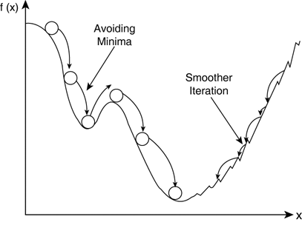
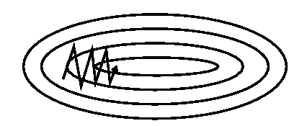
Better Gradient Descent Methods
Simple Gradient Descent method
갱신의 방향이 현재 위치에만 종속적이다
과거로부터 지금까지 움직여 온 방향으로 가는 것이 더 적합하지 않을까?
Oscilation

Slide 10




Better Gradient Descent Methods
Momentum
Momentum is the exponential average of the past gradients
Update parameters considering both the momentum and the gradient of the current position
Momentum rate
$g^{t}:$ 시간 t에서의 기울기
Learning rate
$$m^{t}=γ{ m}^{t−1}+ηg^{t}$$
$$w^{t}=w^{t−1}−ηg^{t}$$
$$w^{t}=w^{t−1}−m^{t}$$
표준 방법
Momentum
$$m^{t}=ηg^{t}+γ ηg^{t−1}+γ^{2}ηg^{t−2}+…$$

Slide 11
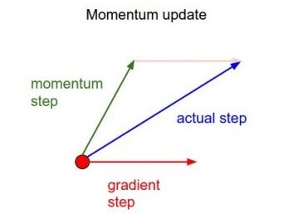
Better Gradient Descent Methods
Disadvantage of Momentum
Simple addition of momentum may cause excessive update
We may miss the position where to stop

Slide 12
Better Gradient Descent Methods
Nesterov Accelerated Gradient (NAG)
Not a simple addition of momentum
Update the current position considering the momentum
Evaluate the gradient at the new position
Update the position consider the gradient
Step 2
Step 1
Step 3

Slide 13
Better Gradient Descent Methods
Nesterov Accelerated Gradient (NAG)

Slide 14
Better Gradient Descent Methods
Why do we use the SAME learning rate for all the weights?
Can we use different learning rate?
Hmm.. Interesting, but why do we need different learning rate?
Some weight are frequently updated and some are not
What if some inputs may be 0 but some may have none-zero values in most of training data
OK.. Let’s make a large update for the less updated parameters

Slide 15



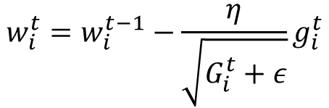

Better Gradient Descent Methods
Adagrad
Update much less-updated parameters
Update less much-updated parameter
$g_{i}^{t}:$ parameter i의 시간 t에서의 기울기
$G_{i}^{t}:$ parameter i가 지금까지 update된 총량
$$G_{i}^{t}=G_{i}^{t−1}+{\left(g_{i}^{t}\right)}^{2}$$
$$w_{i}^{t}=w_{i}^{t−1}−ηg_{i}^{t}$$
$$w_{i}^{t}=w_{i}^{t−1}−\frac{η}{\sqrt{G_{i}^{t}+ε}}g_{i}^{t}$$
표준 방법
Adagrad
Very small value

Slide 16

Better Gradient Descent Methods
Disadvantage of Adagrad
Eventually, $G_{i}^{t}$ becomes large as time goes on
Parameters are rarely updated at some time
$g_{i}^{t}:$ parameter i의 시간 t에서의 기울기
$G_{i}^{t}:$ parameter i가 지금까지 update된 총량
$$G_{i}^{t}=G_{i}^{t−1}+{\left(g_{i}^{t}\right)}^{2}$$
$$w_{i}^{t}=w_{i}^{t−1}−ηg_{i}^{t}$$
$$w_{i}^{t}=w_{i}^{t−1}−\frac{η}{\sqrt{G_{i}^{t}+ε}}g_{i}^{t}$$
표준 방법
Adagrad
Very small value

Slide 17

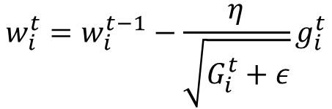


Better Gradient Descent Methods
RMSProp
Instead of considering the total amount of updates, let’s consider the amount of recent updates
$g_{i}^{t}:$ parameter i의 시간 t에서의 기울기
$G_{i}^{t}:$ parameter i가 update된 양
$$G_{i}^{t}=G_{i}^{t−1}+{\left(g_{i}^{t}\right)}^{2}$$
$$G_{i}^{t}=γG_{i}^{t−1}+{\left(1−γ\right)\left(g_{i}^{t}\right)}^{2}$$
$$w_{i}^{t}=w_{i}^{t−1}−\frac{η}{\sqrt{G_{i}^{t}+ε}}g_{i}^{t}$$
$$w_{i}^{t}=w_{i}^{t−1}−\frac{η}{\sqrt{G_{i}^{t}+ε}}g_{i}^{t}$$
NAG
RMSProp
Very small value

Slide 18




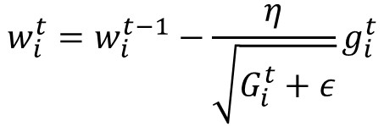



Better Gradient Descent Methods
Adam
RMSProp + Momentum
$g_{i}^{t}:$ parameter i의 시간 t에서의 기울기
$G_{i}^{t}:$ parameter i가 update된 양
$$m_{i}^{t}=γm_{i}^{t−1}+ηg_{i}^{t}$$
$$m_{i}^{t}=β_{1}m_{i}^{t−1}+\left(1−β_{1}\right)g_{i}^{t}$$
Momentum
$$w_{i}^{t}=w_{i}^{t−1}−m_{i}^{t}$$
$$G_{i}^{t}=γG_{i}^{t−1}+{\left(1−γ\right)\left(g_{i}^{t}\right)}^{2}$$
$$G_{i}^{t}=β_{2}G_{i}^{t−1}+{\left(1−β_{2}\right)\left(g_{i}^{t}\right)}^{2}$$
RMSProp
$$w_{i}^{t}=w_{i}^{t−1}−\frac{η}{\sqrt{G_{i}^{t}+ε}}g_{i}^{t}$$

Slide 19
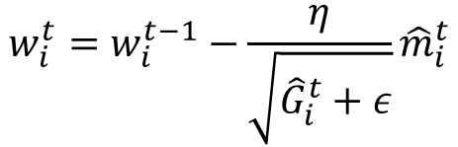




Better Gradient Descent Methods
Adam
RMSProp + Momentum
Unbiased expectation
$$m_{i}^{t}=β_{1}m_{i}^{t−1}+\left(1−β_{1}\right)g_{i}^{t}$$
$${\hat{m}}_{i}^{t}=\frac{m_{i}^{t}}{1−{\left(β_{1}\right)}^{2}}$$
$${\hat{G}}_{i}^{t}=\frac{G_{i}^{t}}{1−{\left(β_{2}\right)}^{2}}$$
$$G_{i}^{t}=β_{2}G_{i}^{t−1}+{\left(1−β_{2}\right)\left(g_{i}^{t}\right)}^{2}$$
$$w_{i}^{t}=w_{i}^{t−1}−\frac{η}{\sqrt{{\hat{G}}_{i}^{t}+ε}}{\hat{m}}_{i}^{t}$$

Slide 20


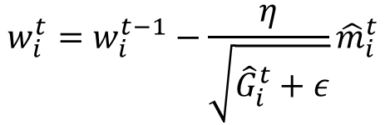




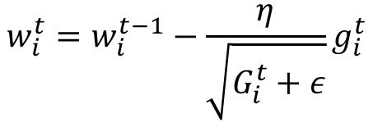

Better Gradient Descent Methods
Adam
RMSProp + Momentum
$$m_{i}^{t}=γm_{i}^{t−1}+ηg_{i}^{t}$$
$$m_{i}^{t}=β_{1}m_{i}^{t−1}+\left(1−β_{1}\right)g_{i}^{t}$$
$$w_{i}^{t}=w_{i}^{t−1}−m_{i}^{t}$$
$$G_{i}^{t}=β_{2}G_{i}^{t−1}+{\left(1−β_{2}\right)\left(g_{i}^{t}\right)}^{2}$$
Momentum
$${\hat{m}}_{i}^{t}=\frac{m_{i}^{t}}{1−{\left(β_{1}\right)}^{2}}$$
$${\hat{G}}_{i}^{t}=\frac{G_{i}^{t}}{1−{\left(β_{2}\right)}^{2}}$$
$$G_{i}^{t}=γG_{i}^{t−1}+{\left(1−γ\right)\left(g_{i}^{t}\right)}^{2}$$
$$w_{i}^{t}=w_{i}^{t−1}−\frac{η}{\sqrt{G_{i}^{t}+ε}}g_{i}^{t}$$
$$w_{i}^{t}=w_{i}^{t−1}−\frac{η}{\sqrt{{\hat{G}}_{i}^{t}+ε}}{\hat{m}}_{i}^{t}$$
RMSProp
Adam

Slide 21
Better Gradient Descent Methods
Comparison: Long valley

Slide 22
Better Gradient Descent Methods
Comparison: Beale’s Function

Slide 23
Better Gradient Descent Methods
Comparison: Saddle Point

Slide 24
Question and Answer

