Slide 1
CNN Structures

Slide 2
Overview
Various Models of CNNs
LeNet-5
AlexNet
VGGNet
GoogLeNet
ResNet
Densely Connected CNN

Slide 3
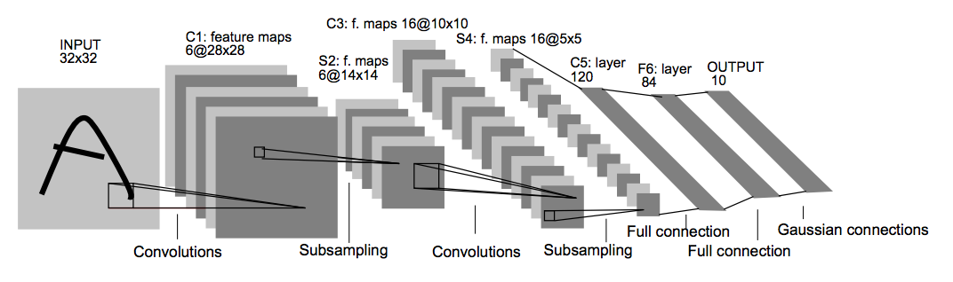
LeNet-5
LeCun et al., 1998
A pioneering 7-level convolutional
It is applied to 32x32 pixel images such as hand-written numbers

Slide 4
AlexNet
Krizhevsky et al. 2012
ImageNet ILSVRC challenge 2012 1st prize
2 GPUs because of memory lack (GTX 580 w/ 3GB)
Dataset: zero-centered
ReLU

Slide 5
[227x227x3] INPUT [55x55x96] CONV1 : 96@ 11x11, s = 4, p = 0 [27x27x96] MAX POOL1 : 3x3, s = 2 [27x27x96] NORM1 : [27x27x256] CONV2 : 256@ 5x5, s = 1, p = 2 [13x13x256] MAX POOL2 : 3x3, s = 2 [13x13x256] NORM2 : [13x13x384] CONV3 : 384@ 3x3, s = 1, p = 1 [13x13x384] CONV4 : 384@ 3x3, s = 1, p = 1 [13x13x256] CONV5 : 256@ 3x3, s = 1, p = 1 [6x6x256] MAX POOL3 : 3x3, s = 2 [4096] FC6 : 4096 neurons [4096] FC7 : 4096 neurons [1000] FC8 : 1000 neurons
Total Parameters: 35K

Slide 6
Trained on GTX 580 with 3GB of memory
CNN spread across 2 GPUs (half and half)
CONV1, CONV2, CONV4, CONV5:
performed on feature maps on same GPU
CONV3, FC6, CF7, FC8:
performed on feature maps across GPUs
Data augmentation
256X256 to 224X224 by cropping, upside down and RGB color shift

Slide 7
AlexNet
Details of Learning
First use of ReLU
Used Norm laysers (not common anymore)
mini-batch size: 128
SGD Momentum: 0.9,
Learning rate: 0.01, reduced by 10 manually when validation error plateatus.
Weight decay(L2): 0.0005
Weight initialization: zero-mean gaussian * 0.01
Dropout: 0.5
7 CNN ensemble: 18.2% -> 15.4%

Slide 8
ImageNet
ImageNet Large Scale Visual Recognition Challenge

Slide 9
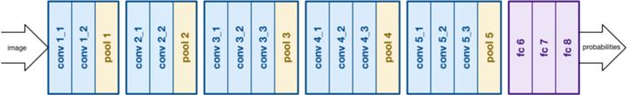
VGGNet
Simonyan and Zisserman, 2014
ILSVRC challenge 2014 2nd prize
VGGNet consists of 16 convolutional layers and is very appealing because of its very uniform architecture
Simple architecture with small filter size and all ReLU activations

Slide 10
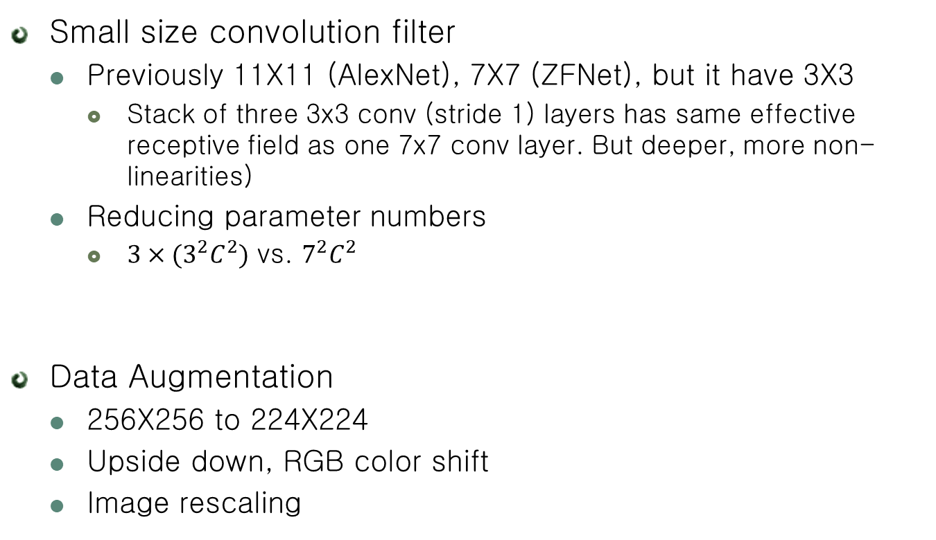
VGGNet
Small size convolution filter
Previously 11X11 (AlexNet), 7X7 (ZFNet), but it have 3X3
Stack of three 3x3 conv (stride 1) layers has same effective receptive field as one 7x7 conv layer. But deeper, more non-linearities)
Reducing parameter numbers
$3×(3^{2}C^{2})$ vs. $7^{2}C^{2}$
Data Augmentation
256X256 to 224X224
Upside down, RGB color shift
Image rescaling

Slide 11
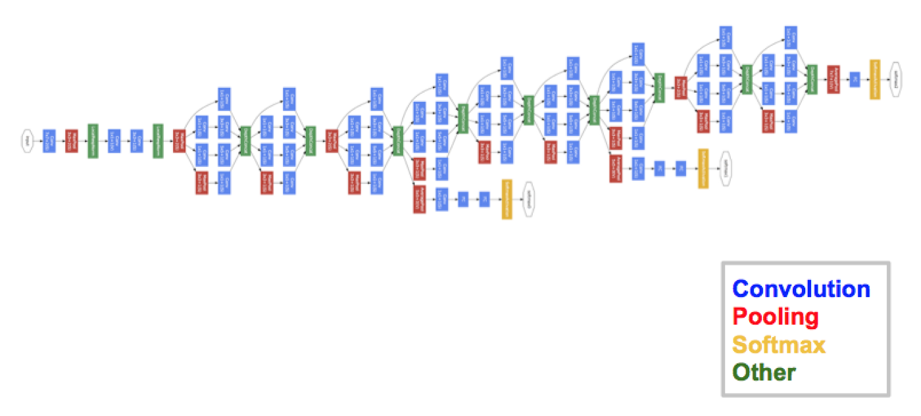
GoogLeNet
Szegedy et al., 2014
ILSVRC challenge 2014 1st prize
It was very close to human level performance
Efficient “Inception” module
No FC layers
22 Layers Deep network but reduced the number of parameters from 60 million (AlexNet) to 4 million

Slide 12
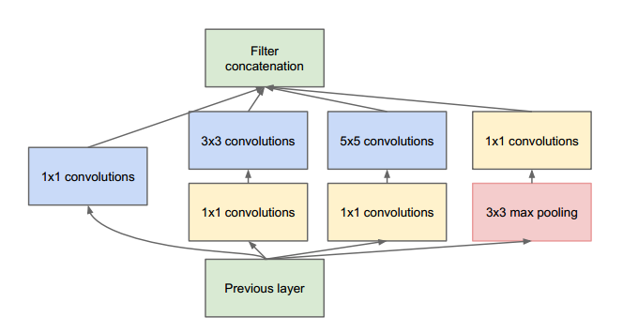
GoogLeNet
Inception module
Approximates a sparse CNN with a normal dense construction
Since only a small number of neurons are effective, width/number of the convolutional filters of a particular kernel size is kept small. Also, it uses convolutions of different sizes to capture details at varied scales(5X5, 3X3, 1X1)
Concatenate all filter outputs together depth-wise
1x1 conv 후 nxn conv
1x1 conv 후 nxn를 하면 computation 면에서 효율적
3x3 maxpool, stride 1
강한 Feature를 더 강하게 kasems다.
1x1 conv
채널 축소
요약하는 채널

Slide 13
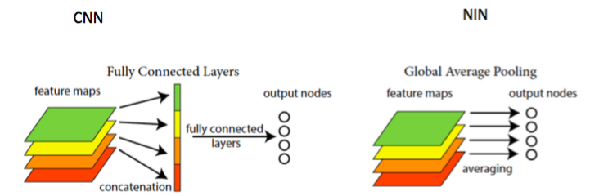
GoogLeNet
Inception module
Bottleneck Layer
1X1 convolutions
It helps in massive reduction of the computation requirement
Reducing the dimension of the input channels, before feeding into convolutions
Global average Pooling
Avoid overfitting
Connect between feature maps and categories

Slide 14
GoogLeNet
Tweak for Training Deeper Structure
Auxiliary classification outputs to inject additional gradient at lower layers
AvgPool-1x1Conv-FC-FC-Softmax

Slide 15
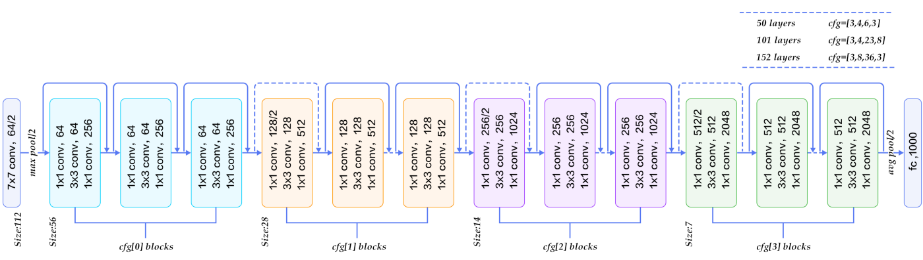
ResNet
He et al., 2015
ILSVRC challenge 2015 1st prize
Introduced a novel architecture with “skip connections”
152 Layers Network but lower complexity than VGGNet
No dropout used!

Slide 16
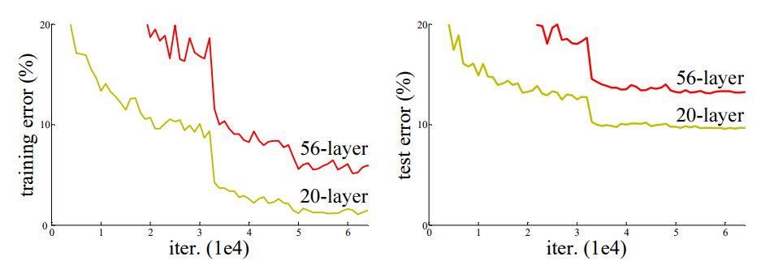
ResNet
Is the Deeper Structure Good?
Maybe.. But deeper model performs worse, but it’s not caused by overfitting
Degradation Problem
The deeper network has higher training error

Slide 17
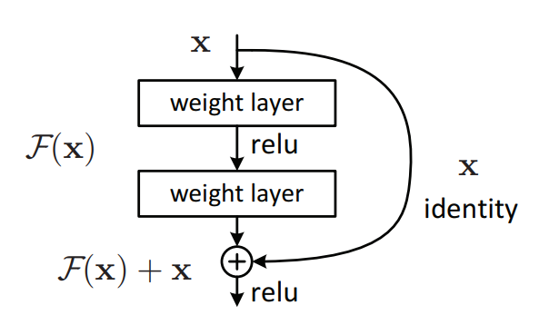
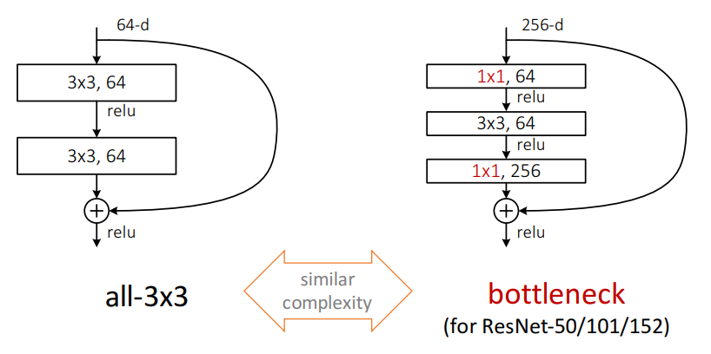
ResNet
Residual Block
If identity were optimal, easy to set weights as 0
If optimal mapping is closer to identity, easier to find small fluctuations
Appropriate for treating perturbation as keeping a base information
Residual Block with Bottleneck
Similar to GoogLeNet

Slide 18
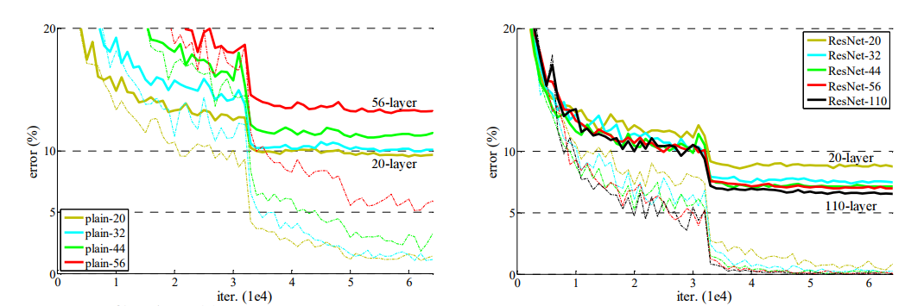
ResNet
Performance
Cifar-10
Dashed: Training error
Bold: Testing error
Plain network
ResNets

Slide 19
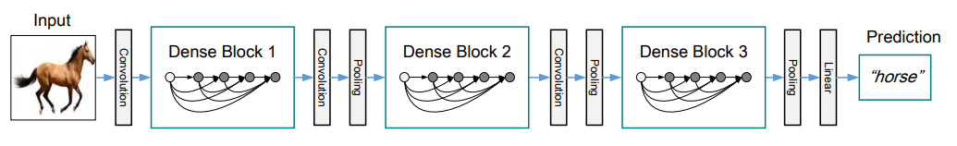
Densely Connected CNN
Huang et al., 2017
Dense blocks where each layer is connected to every other layer in feedforward fashion
Alleviates vanishing gradient, strengthens feature propagation, encourages feature reuse

Slide 20
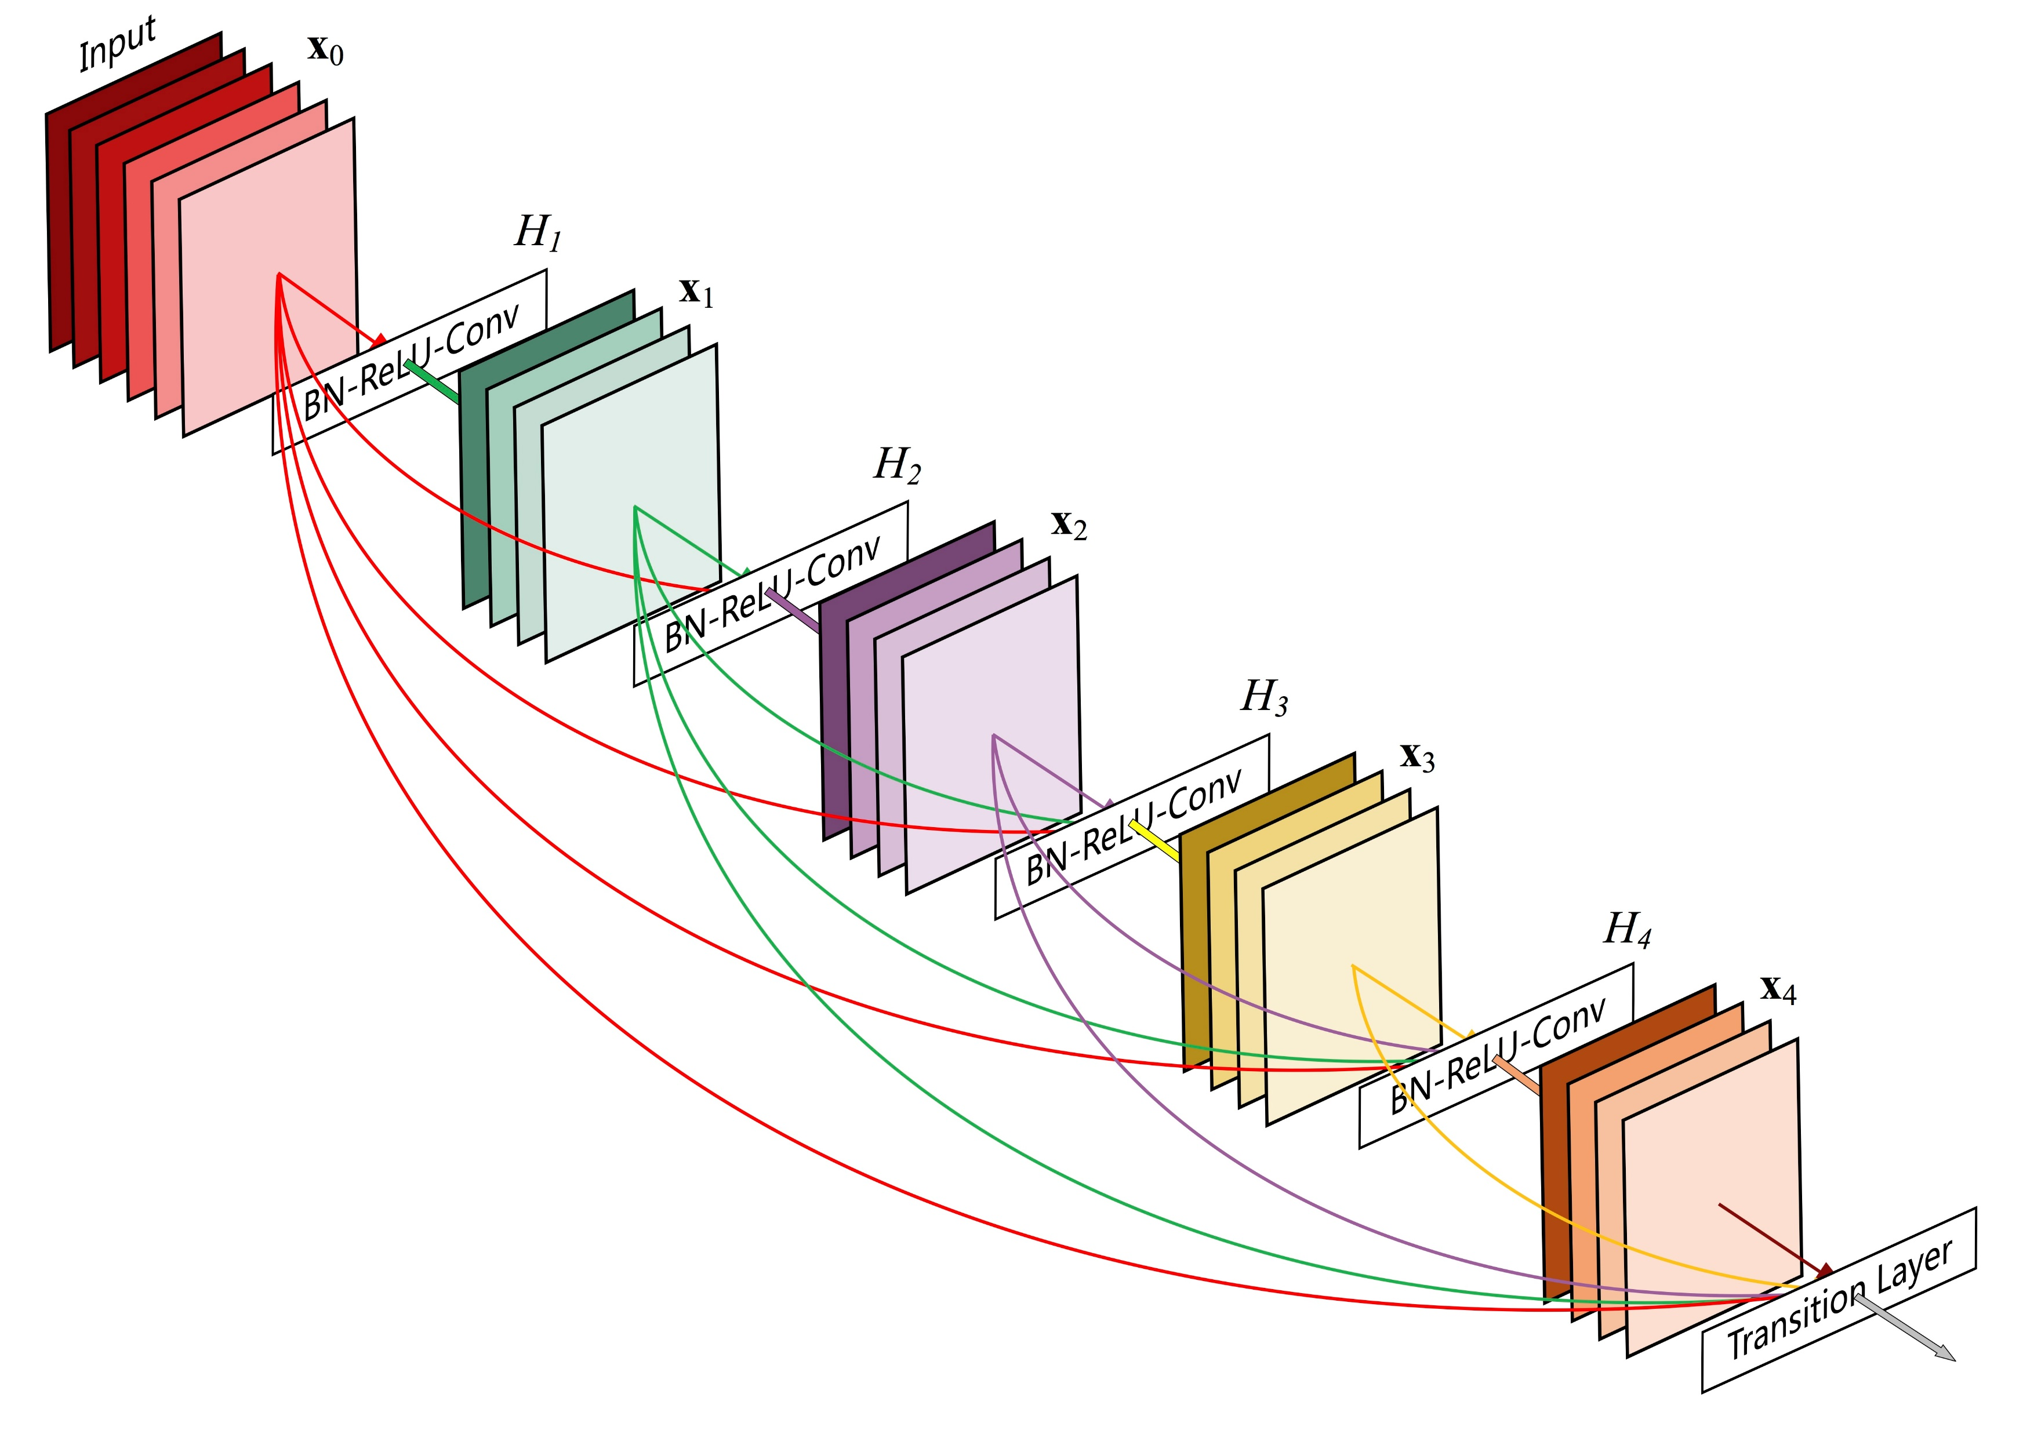

Densely Connected CNN
Dense Block
Skip connection vs. Dense connectivity
$x_{l}=H_{l}\left(x_{l−1}\right)+x_{l−1}$ vs. $x_{l}=H_{l}(\left[x_{0}, x_{1}, …, x_{l}\right])$
Bottleneck
BN-ReLU-1X1Conv-BN-ReLU-3X3Conv

Slide 21
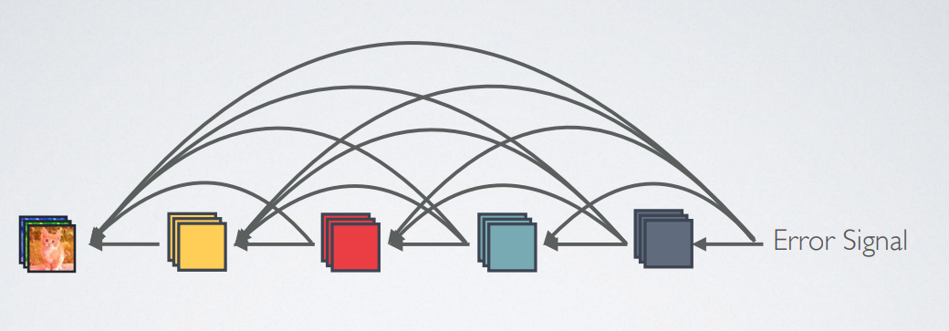
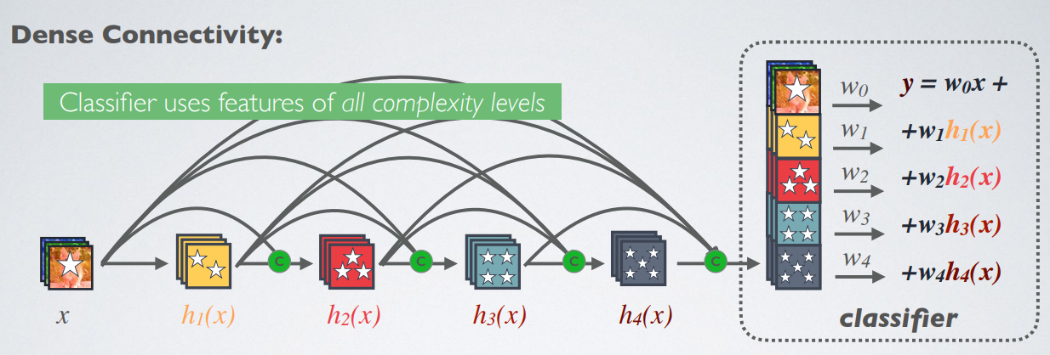
Densely Connected CNN
Advantages
Strong Gradient Flow
Maintains Low Complexity Features

Slide 22
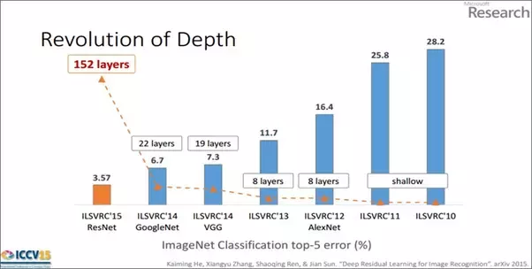
Conclusion
Performance Comparison

Slide 23
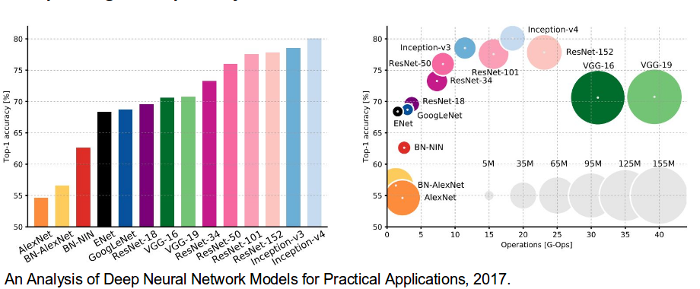
Conclusion
Performance Comparison

Slide 24
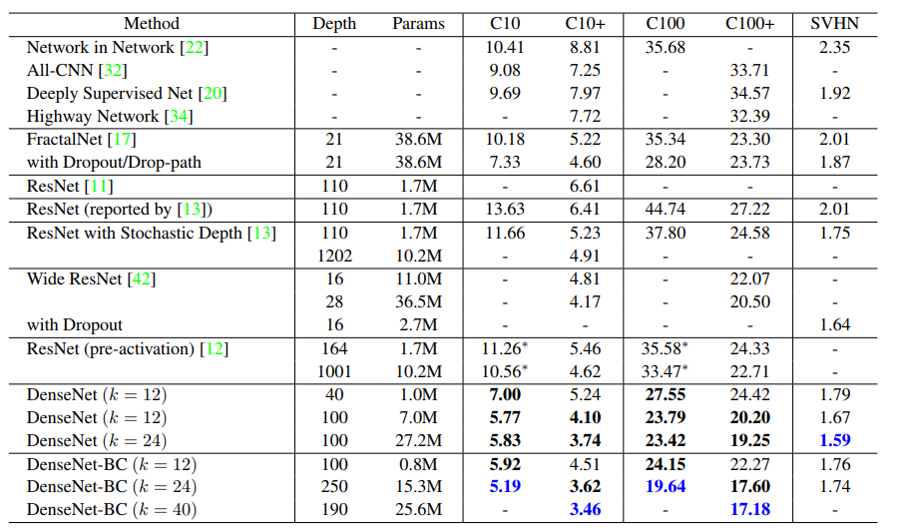
Conclusion
Performance Comparison
Error rates (%) on CIFAR and SVHN datasets

Slide 25
참고자료
http://nmhkahn.github.io/Casestudy-CNN
http://cv-tricks.com/cnn/understand-resnet-alexnet-vgg-inception/
http://kaiminghe.com/icml16tutorial/icml2016_tutorial_deep_residual_networks_kaiminghe.pdf
http://cs231n.stanford.edu/slides/2317/cs231n_2017_lecture9.pdf
https://medium.com/@siddharthdas_32104/cnns-architectures-lenet-alexnet-vgg-googlenet-resnet-and-more-666091488df5
http://www.cs.cornell.edu/~gaohuang/papers/DenseNet-CVPR-Slides.pdf

