Slide 1
Recurrent Neural Networks
성균관대학교 소프트웨어학과
이 지 형

Slide 2
Contents
Recurrent Neural Networks
Long Short-Term Memory (LSTM)
Attention Model

Slide 3
Sequential Data Modeling
Sequential Data
Most of data are sequential
Speech, Text, Image, …
Deep Learnings for Sequential Data
Convolutional Neural Networks (CNN)
Try to find local features from a sequence
Recurrent Neural Networks: LSTM, GLU
Try to capture the feature of the past

Slide 4
Sequential Data Modeling
Three Types of Problems
Next Step Prediction
Classification
Sequence Generation
Sequence
Model
A B C D E
F
Sequence
Model
A B C D E
Good/Bad
Sequence
Model
A B C D E
1 2 3 4 5 6 7

Slide 5

Sequential Data Modeling
Sequence Generation
Machine Translation
Speech Recognition
Image Caption Generation
This is a very good wine
C’est un très bon vin
This is a very good wine
A bird is flying

Slide 6
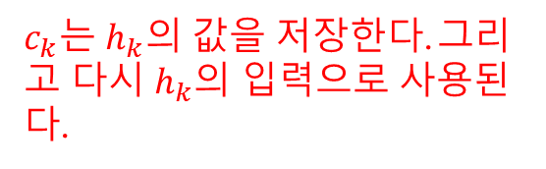
Recurrent Neural Networks
Connections form cycles
x₁
h₁
o₁
x₂
h₂
o₂
…
…
…
x_{m}
h_{k}
o_{n}
c₁
$c_{k}는$ $h_{k}의$ 값을 저장한다. 그리고 다시 $h_{k}$의 입력으로 사용된다.
c₂
…
c_{k}

Slide 7
Recurrent Neural Networks
Connections form cycles
x₁
h₁
o₁
x₂
h₂
o₂
…
…
…
x_{m}
h_{k}
o_{n}
c₁
c₂
…
c_{k}

Slide 8
Recurrent Neural Networks
Connections form cycles
x₁
h₁
o₁
x₂
h₂
o₂
…
…
…
x_{m}
h_{k}
o_{n}
c₁
c₂
…
c_{k}

Slide 9
Recurrent Neural Networks
Connections form cycles
x₁
h₁
o₁
x₂
h₂
o₂
…
…
…
x_{m}
h_{k}
o_{n}
c₁
c₂
…
c_{k}

Slide 10
Recurrent Neural Networks
Connections form cycles
x₁
h₁
o₁
x₂
h₂
o₂
…
…
…
x_{m}
h_{k}
o_{n}
c₁
c₂
…
c_{k}

Slide 11
Recurrent Neural Networks
Connections form cycles
x₁
h₁
o₁
x₂
h₂
o₂
…
…
…
x_{m}
h_{k}
o_{n}
c₁
c₂
…
c_{k}

Slide 12
Recurrent Neural Networks
Connections form cycles
x₁
h₁
o₁
x₂
h₂
o₂
…
…
…
x_{m}
h_{k}
o_{n}
c₁
c₂
…
c_{k}

Slide 13
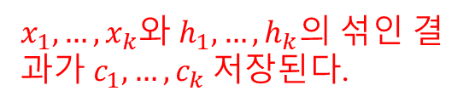
Recurrent Neural Networks
Connections form cycles
x₁
h₁
o₁
x₂
h₂
o₂
…
…
…
x_{m}
h_{k}
o_{n}
c₁
$x_{1}, …,x_{k}와$ $h_{1}, …,h_{k}의$ 섞인 결과가 $c_{1}, …,c_{k}$저장된다.
c₂
…
c_{k}

Slide 14
Recurrent Neural Networks
Connections form cycles
x₁
h₁
o₁
x₂
h₂
o₂
…
…
…
x_{m}
h_{k}
o_{n}
c₁
x_{t}
h_{t}
o_{t}
c₂
…
h_{t-1}
c_{k}

Slide 15





Recurrent Neural Networks
전반적으로 RNN에서는 Parameter를 Share한다.
Encoder, Decoder 파트는 나눠서 Share한다. Encdoer, Decoder 파트의구조 (노드 수)가 같을 필요는 없다.
결국 Vector 차원이 입력 차원 보다 작아지면, Encoder-Decoder 제약 조건을 만족한다고 할 수 있다.
Connections form cycles
𝒙_{𝒕}: input at time 𝒕
h_{𝒕}: hidden state at time 𝒕
𝒇: is an activation function
U, V, W: network parameters
RNN shares the same parameters across all time steps
g: activation function for the output layer
o_{t}
$$V$$
$$W$$
$$h_{t}=f\left(Ux_{t}+Wh_{t−1}\right)$$
h_{t-1}
h_{t}
$$\left.o_{t}=g(Vh_{t}\right)$$
$$U$$
x_{t}

Slide 16
Recurrent Neural Networks
Connections form cycles
o_{t}
$$V$$
$$W$$
$$h_{t}=f\left(Ux_{t}+Wh_{t−1}\right)$$
h_{t-1}
h_{t}
$$\left.o_{t}=g(Vh_{t}\right)$$
$$U$$
x_{t}
x₁
x₂
x₃
x₄
x₅

Slide 17
Recurrent Neural Networks
Connections form cycles
o_{t}
$$V$$
$$W$$
$$h_{t}=f\left(Ux_{t}+Wh_{t−1}\right)$$
h_{t-1}
h_{t}
$$\left.o_{t}=g(Vh_{t}\right)$$
$$U$$
x_{t}
o₁
h₁
x₁
x₂
x₃
x₄
x₅

Slide 18
Recurrent Neural Networks
Connections form cycles
o_{t}
$$V$$
$$W$$
$$h_{t}=f\left(Ux_{t}+Wh_{t−1}\right)$$
h_{t-1}
h_{t}
$$\left.o_{t}=g(Vh_{t}\right)$$
$$U$$
x_{t}
o₁
o₂
h₁
h₂
x₁
x₂
x₃
x₄
x₅

Slide 19
Recurrent Neural Networks
Connections form cycles
o_{t}
$$V$$
$$W$$
$$h_{t}=f\left(Ux_{t}+Wh_{t−1}\right)$$
h_{t-1}
h_{t}
$$\left.o_{t}=g(Vh_{t}\right)$$
$$U$$
x_{t}
o₁
o₂
o₃
h₂
h₃
x₁
x₂
x₃
x₄
x₅

Slide 20
Recurrent Neural Networks
Connections form cycles
o_{t}
$$V$$
$$W$$
$$h_{t}=f\left(Ux_{t}+Wh_{t−1}\right)$$
h_{t-1}
h_{t}
$$\left.o_{t}=g(Vh_{t}\right)$$
$$U$$
x_{t}
o₁
o₂
o₃
o₄
h₃
h₄
x₁
x₂
x₃
x₄
x₅

Slide 21
Recurrent Neural Networks
Connections form cycles
o_{t}
$$V$$
$$W$$
$$h_{t}=f\left(Ux_{t}+Wh_{t−1}\right)$$
h_{t-1}
h_{t}
$$\left.o_{t}=g(Vh_{t}\right)$$
$$U$$
x_{t}
o₁
o₂
o₃
o₄
o₅
h₄
h₅
x₁
x₂
x₃
x₄
x₅

Slide 22
Recurrent Neural Networks
Connections form cycles
o_{t}
$$V$$
$$W$$
$$h_{t}=f\left(Ux_{t}+Wh_{t−1}\right)$$
h_{t-1}
h_{t}
$$\left.o_{t}=g(Vh_{t}\right)$$
$$U$$
x_{t}
o₁
o₂
o₃
o₄
o₅
h₁
h₂
h₃
h₄
h₅
x₁
x₂
x₃
x₄
x₅

Slide 23
Recurrent Neural Networks
Long Term Dependency
x₁~x_{t-1} are encoded into h_{t-1}
h_{t-1} has the information on the past
It is a context to process x_{t}
Shallow RNN을 써도 괜찮다. 왜냐하면,전체적인 관점에서 보면 여러 Hidden Layer를 거친 것과 유사한 결과를 가진다.
o₅
h₁
h₂
h₃
h₄
h₅
x₁
x₂
x₃
x₄
x₅

Slide 24
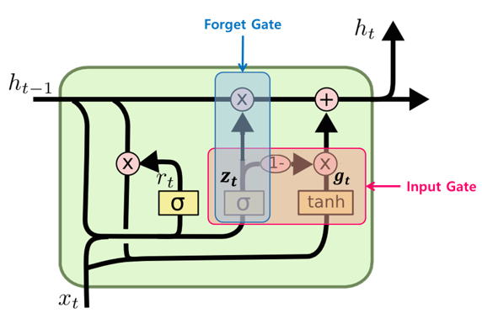
x₁
h₁
h₁
h₁
h₁
h₁
o₁
o₁
x₂
h₂
h₂
h₂
h₂
h₂
o₂
o₂
…
…
…
…
…
…
…
…
…
…
…
x_{m}
h_{k}
h_{k}
h_{k}
h_{k}
h_{k}
o_{n}
o_{n}
c₁
c₁
c₁
c₁
c₁
c₂
c₂
c₂
c₂
c₂
…
…
…
…
…
c_{k}
c_{k}
c_{k}
c_{k}
c_{k}

Slide 25
<Stacked GRU>
x₁
h₁
h₁
h₁
h₁
h₁
o₁
o₁
x₂
h₂
h₂
h₂
h₂
h₂
o₂
o₂
…
…
…
…
…
…
…
…
…
…
…
x_{m}
h_{k}
h_{k}
h_{k}
h_{k}
h_{k}
o_{n}
o_{n}
c₁
c₁
c₁
c₁
c₁
c₂
c₂
c₂
c₂
c₂
…
…
…
…
…
c_{k}
c_{k}
c_{k}
c_{k}
c_{k}
<Stacked GRU>
# layers: 5
# hidden nodes of each layer: 200
dropout rates: 0.3
<Fully Connected Layer>
# layers: 1
# hidden nodes: 400

Slide 26
[노트]Stacked RNN
Connections form cycles
o₁
o₂
o₃
o₄
o₅
h₁
h₂
h₃
h₄
h₅
h₁
h₂
h₃
h₄
h₅
x₁
x₂
x₃
x₄
x₅

Slide 27




Recurrent Neural Networks
Long Term Dependency of Standard RNN
However, it may exponentially decade or grow
Usually it is limited to 10 steps
o₁
o₂
o₃
o₄
o₅
$$W$$
$$W$$
$$W$$
$$W$$
h₁
h₂
h₃
h₄
h₅
x₁
x₂
x₃
x₄
x₅
여러 Layer를 Forwarding하면서 Vanishing 현상이 발생. 최대 10 step이다.
다른 네트워크보다 Vanishing 문제가 극심해진다.
타 네트워크 gW1W2W3W4
RNN gW4
같은 것을 여러 번 곱하기 때문이다.
타 네트워크 같은 경우는 1000 * 0.1 * 2000 * 0.4
반면에 rnn은 0.1 * 0.1 * 0.1

Slide 28
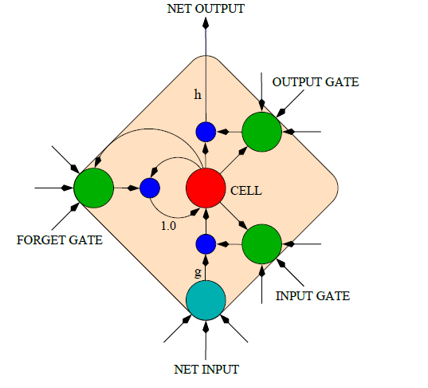
Long Short-Term Memory (LSTM)
Capable of learning long-term dependencies.
LSTM networks introduce a new structure called a memory cell
An LSTM can learn to bridge time intervals in excess of 1000 steps
Gate units that learn to open and close access to the past
Input gate
Forget gate
Output gate
Neuron with a self-recurrent

Slide 29
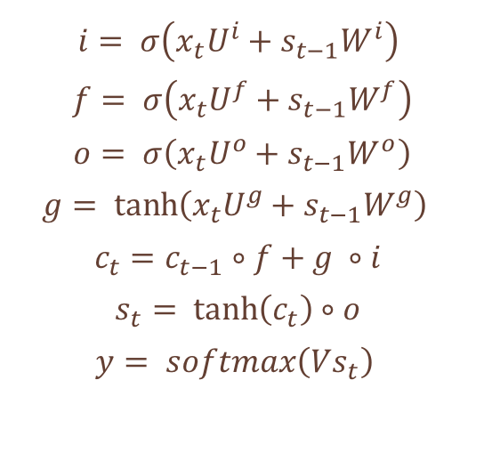
Long Short-Term Memory (LSTM)
Equations
𝒊: input gate to accept the new
𝒇: forget gate to forget the past
𝒐: output gate, how much of the information will be passed to expose to the next time step.
𝒈: self-recurrent which is equal to standard RNN
𝒄_{𝒕}: internal memory
𝒔_{𝒕}: hidden state
𝐲: final output
$$i= σ\left(x_{t}U^{i}+s_{t−1}W^{i}\right)$$
$$f= σ\left(x_{t}U^{f}+s_{t−1}W^{f}\right)$$
$$o= σ\left(x_{t}U^{o}+s_{t−1}W^{o}\right)$$
$$g= \tanh\left(x_{t}U^{g}+s_{t−1}W^{g}\right)$$
$$c_{t}=c_{t−1}∘f+g ∘i$$
$$s_{t}= \tanh\left(c_{t}\right)∘o$$
$$y= softmax\left(Vs_{t}\right)$$

Slide 30
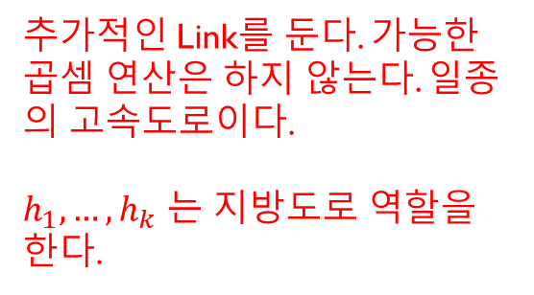




[노트] LSTM 직관
o₁
o₂
o₃
o₄
o₅
$$W$$
$$W$$
$$W$$
$$W$$
h₁
h₂
h₃
h₄
h₅
x₁
x₂
x₃
x₄
x₅
x₂
x₃
x₄
x₅
추가적인 Link를 둔다. 가능한 곱셈 연산은 하지 않는다. 일종의 고속도로이다.
$h_{1}, …,h_{k}$ 는 지방도로 역할을 한다.

Slide 31



Long Short-Term Memory (LSTM)
o_{t}
$$V$$
How to work
$$W$$
h_{t-1}
h_{t}
$$U$$
x_{t}
h_{t-1}
h_{t}
x_{t}
y_{t}

Slide 32
Long Short-Term Memory (LSTM)
o_{t}
$$V$$
How to work
$$W$$
h_{t-1}
h_{t}
$$U$$
x_{t}
c_{t-1}
c_{t}
h_{t-1}
h_{t}
x_{t}
y_{t}

Slide 33
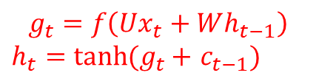
Long Short-Term Memory (LSTM)
o_{t}
$$V$$
How to work
$$W$$
$$g_{t}=f\left(Ux_{t}+Wh_{t−1}\right)$$
$h_{t}=$ $tanh(g_{t}+$ $c_{t−1})$
h_{t-1}
h_{t}
$$U$$
x_{t}
c_{t-1}
+
c_{t}
tanh
g_{t}
h_{t-1}
h_{t}
x_{t}
y_{t}

Slide 34
Long Short-Term Memory (LSTM)
o_{t}
$$V$$
How to work
$$W$$
h_{t-1}
h_{t}
$$U$$
x_{t}
c_{t-1}
*
+
c_{t}
tanh
f_{t}
g_{t}
h_{t-1}
h_{t}
x_{t}
y_{t}

Slide 35
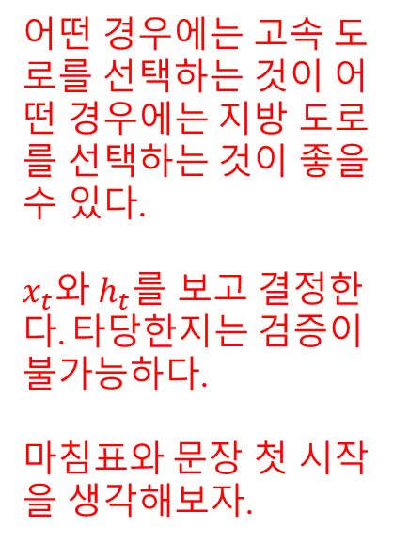
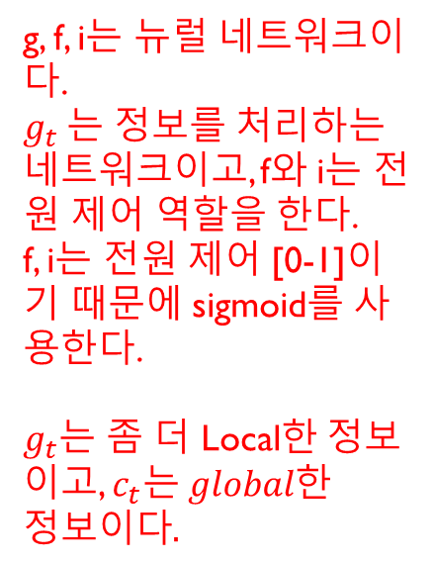
Long Short-Term Memory (LSTM)
어떤 경우에는 고속 도로를 선택하는 것이 어떤 경우에는 지방 도로를 선택하는 것이 좋을 수 있다.
$x_{t}와$ $h_{t}를$ 보고 결정한다. 타당한지는 검증이 불가능하다.
마침표와 문장 첫 시작을 생각해보자.
o_{t}
$$V$$
How to work
$$W$$
h_{t-1}
h_{t}
$$U$$
x_{t}
c_{t-1}
*
+
c_{t}
tanh
*
f_{t}
g_{t}
i_{t}
g, f, i는 뉴럴 네트워크이다.
$g_{t}$는 정보를 처리하는 네트워크이고, f와 i는 전원 제어 역할을 한다.
f, i는 전원 제어 [0-1]이기 때문에 sigmoid를 사용한다.
$g_{t}$는 좀 더 Local한 정보이고, $c_{t}는 global한 정보이다.$
h_{t}
h_{t-1}
x_{t}
y_{t}

Slide 36
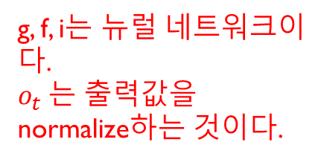
Long Short-Term Memory (LSTM)
o_{t}
$$V$$
How to work
$$W$$
g, f, i는 뉴럴 네트워크이다.
$o_{t}$는 출력값을 normalize하는 것이다.
h_{t-1}
h_{t}
$$U$$
x_{t}
c_{t-1}
*
+
c_{t}
여기서 곱하기 Term은 얼마 되지 않는다. 이걸로 Vanishing Gradient 문제가 심화되지는 않는다.
tanh
*
f_{t}
g_{t}
i_{t}
o_{t}
*
ResNet과 LSTM은 거의 유사하다. LSTM이 먼저 발행되었다.
h_{t-1}
h_{t}
x_{t}
y_{t}

Slide 37
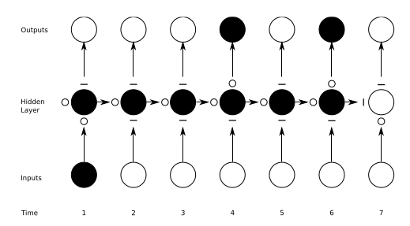
Long Short-Term Memory (LSTM)
Preserving Sequence Information
O : entirely open
— : entirely closed
Traditional RNNs are a special case of LSTMs:
Input gate set to 1 (passing all new information)
Forget gate set to 0 (forgetting all of the past)
Output gate set 1 (exposing the entire memory)

Slide 38
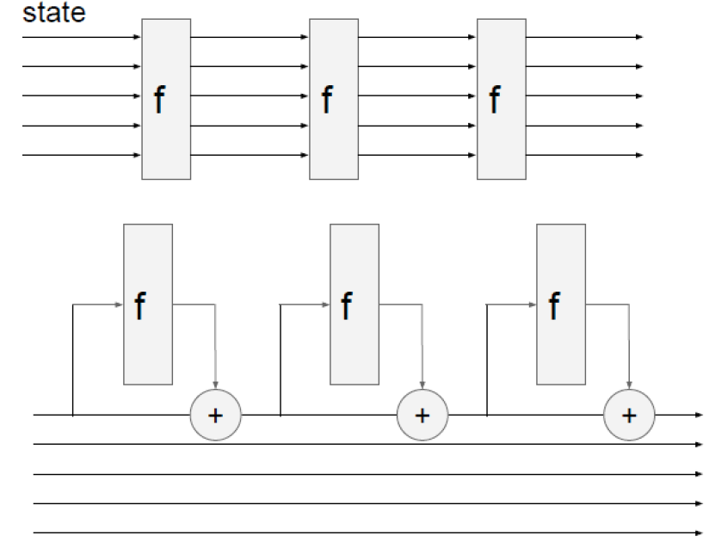
Long Short-Term Memory (LSTM)
RNN vs LSTM
RNN
LSTM

Slide 39
Long Short-Term Memory (LSTM)
Gradient Flow
Backpropagation from c_{t} to c_{t-1} only elementwise multiplication by f, no matrix multiply by W
c_{t-1}
*
+
c_{t}
tanh
*
f_{t}
g_{t}
i_{t}
o_{t}
*
h_{t-1}
h_{t}
x_{t}
y_{t}

Slide 40
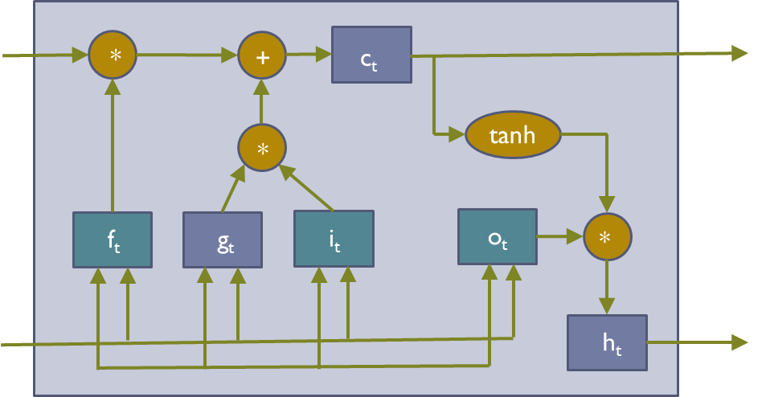
Long Short-Term Memory (LSTM)
Gradient Flow
C₀
C₁
C₂
C₃
h₀
h₁
h₂
h₃

Slide 41
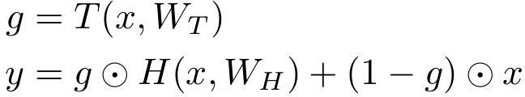
Long Short-Term Memory (LSTM)
Gradient Flow
Uninterrupted Gradient Flow
C₀
C₁
C₂
C₃
h₀
h₁
h₂
h₃
In between:
Highway Networks
Similar to ResNet!
3x3 conv, 128
3x3 conv, 128
3x3 conv, 128
3x3 conv, 128
3x3 conv, 128
3x3 conv, 128 / 2
3x3 conv, 64
3x3 conv, 64
3x3 conv, 64
3x3 conv, 64
3x3 conv, 64
3x3 conv, 64
Pool
7x7 conv, 64 / 2 Input
Softmax FC 1000
Pool
3x3 conv, 64
3x3 conv, 64
3x3 conv, 64
3x3 conv, 64
3x3 conv, 64
3x3 conv, 64
...
Srivastava et al, “Highway Networks”, ICML DL Workshop 2015

Slide 42
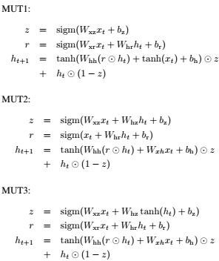
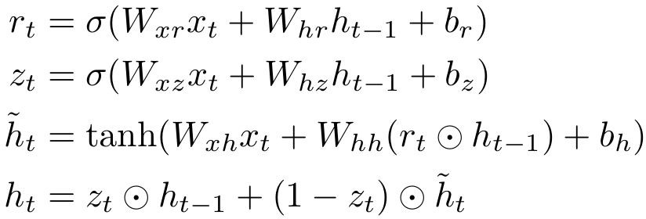
Other Variants
GRU

Slide 43
Question and Answer

