Slide 1
Sequence Modeling
성균관대학교 소프트웨어학과
이 지 형

Slide 2
Sequential Data Modeling
Sequential Data
Most of data are sequential
Speech, Text, Image, …
Deep Learnings for Sequential Data
Convolutional Neural Networks (CNN)
Try to find local features from a sequence
Recurrent Neural Networks: LSTM, GLU
Try to capture the feature of the past

Slide 3
Sequential Data Modeling
Three Types of Problems
Next Step Prediction
Classification
Sequence Generation
Sequence
Model
A B C D E
F
Sequence
Model
A B C D E
Good/Bad
Sequence
Model
A B C D E
1 2 3 4 5 6 7

Slide 4
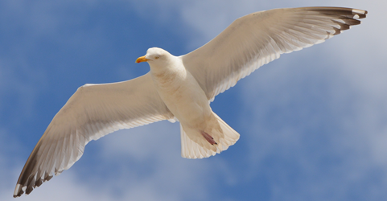
Sequential Data Modeling
Sequence Generation
Machine Translation
Speech Recognition
Image Caption Generation
This is a very good wine
C’est un très bon vin
This is a very good wine
A bird is flying

Slide 5
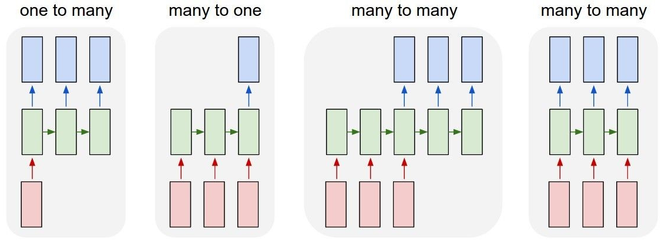
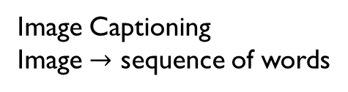
Types of Processes
synched many to many
Image Captioning
Image $→$ sequence of words
심플하다. 값을 버린다.

Slide 6
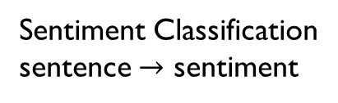
Types of Processes
synched many to many
Sentiment Classification
sentence $→$ sentiment

Slide 7
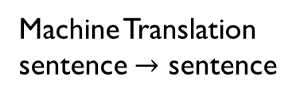
Types of Processes
synched many to many
Machine Translation
sentence $→$ sentence

Slide 8
Types of Processes
synched many to many
Stock Price Prediction,
Prediction of next word

Slide 9





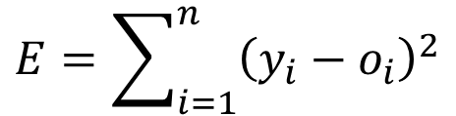










Synced Many to Many
Training
$$x_{1}x_{2}x_{3}⋯x_{n}→y_{1}y_{2}y_{3}⋯y_{n}$$
o₁
o₂
o₃
o₄
o₅
$$V$$
$$V$$
$$V$$
$$V$$
$$V$$
$$W$$
$$W$$
$$W$$
$$W$$
h₁
h₂
h₃
h₄
h₅
$$U$$
$$U$$
$$U$$
$$U$$
$$U$$
x₁
x₂
x₃
x₄
x₅
$$E=\sum_{i=1}^{n}{{\left(y_{i}−o_{i}\right)}^{2}}$$

Slide 10





Synced Many to Many
Training
$$E$$
o₁
o₂
o₃
o₄
o₅
$$V$$
h₁
h₂
h₃
h₄
h₅
$$U$$
$$W$$
x₁
x₂
x₃
x₄
x₅
$$\frac{∂E}{∂w}=?$$

Slide 11
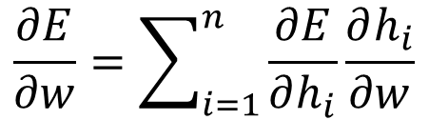
Synced Many to Many
Training
$$E$$
o₁
o₂
o₃
o₄
o₅
h₁
h₂
h₃
h₄
h₅
$$W$$
$$\frac{∂E}{∂w}=\sum_{i=1}^{n}{\frac{∂E}{∂h_{i}}\frac{∂h_{i}}{∂w}}$$

Slide 12
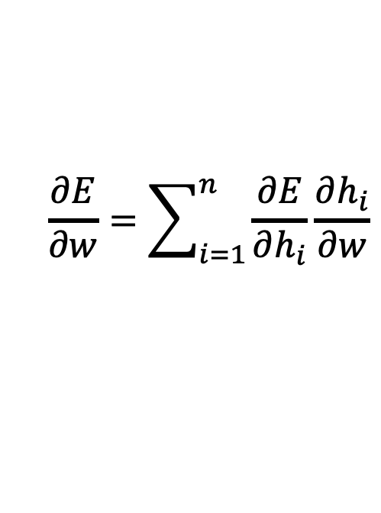
Synced Many to Many
Training
$$E$$
o₁
o₂
o₃
o₄
o₅
h₁
h₂
h₃
h₄
h₅
$$W$$
$$\frac{∂E}{∂w}=\sum_{i=1}^{n}{\frac{∂E}{∂h_{i}}\frac{∂h_{i}}{∂w}}$$

Slide 13
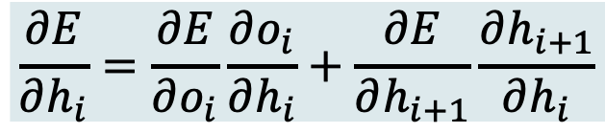
Synced Many to Many
Training
$$E$$
o₃
o₄
o₅
h₃
h₄
h₅
$$\frac{∂E}{∂h_{i}}=\frac{∂E}{∂o_{i}}\frac{∂o_{i}}{∂h_{i}}+\frac{∂E}{∂h_{i+1}}\frac{∂h_{i+1}}{∂h_{i}}$$
$$\frac{∂E}{∂w}=\sum_{i=1}^{n}{\frac{∂E}{∂h_{i}}\frac{∂h_{i}}{∂w}}$$

Slide 14

One to Many
Training
$$x→y_{1}y_{2}y_{3}⋯y_{n}$$
o₁
o₂
o₃
o₄
o₅
$$V$$
$$V$$
$$V$$
$$V$$
$$V$$
$$W$$
$$W$$
$$W$$
$$W$$
h₁
h₂
h₃
h₄
h₅
$$U$$
$$U$$
$$U$$
$$U$$
$$U$$
x
?
?
?
?

Slide 15
One to Many
Training
$$x→y_{1}y_{2}y_{3}⋯y_{n}$$
o₁
o₂
o₃
o₄
o₅
$$V$$
$$V$$
$$V$$
$$V$$
$$V$$
$$W$$
$$W$$
$$W$$
$$W$$
h₁
h₂
h₃
h₄
h₅
$$U$$
$$U$$
$$U$$
$$U$$
$$U$$
x
y₁
y₂
y₃
y₄
$$E=\sum_{i=1}^{n}{{\left(y_{i}−o_{i}\right)}^{2}}$$

Slide 16
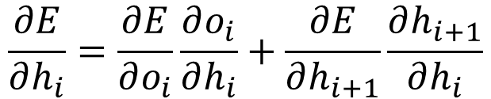
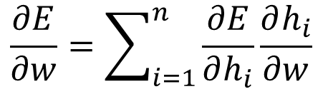
One to Many
이전 Time Step의 Lable을 입력데이터로 사용한다.
Training
$$E$$
o₁
o₂
o₃
o₄
o₅
$$V$$
h₁
h₂
h₃
h₄
h₅
$$U$$
$$W$$
x₁
y₁
y₂
y₃
y₄
$$\frac{∂E}{∂w}=\sum_{i=1}^{n}{\frac{∂E}{∂h_{i}}\frac{∂h_{i}}{∂w}}$$
$$\frac{∂E}{∂h_{i}}=\frac{∂E}{∂o_{i}}\frac{∂o_{i}}{∂h_{i}}+\frac{∂E}{∂h_{i+1}}\frac{∂h_{i+1}}{∂h_{i}}$$

Slide 17

One to Many
Testing
$$x→??????$$
o₁
o₂
o₃
o₄
o₅
$$V$$
$$V$$
$$V$$
$$V$$
$$V$$
$$W$$
$$W$$
$$W$$
$$W$$
h₁
h₂
h₃
h₄
h₅
$$U$$
$$U$$
$$U$$
$$U$$
$$U$$
x
?
?
?
?

Slide 18
One to Many
Test 시에는,
이전 Time Step의 모델의 출력값을
입력데이터로 사용한다.
Testing
$$x→??????$$
o₁
o₂
o₃
o₄
o₅
$$V$$
$$V$$
$$V$$
$$V$$
$$V$$
$$W$$
$$W$$
$$W$$
$$W$$
h₁
h₂
h₃
h₄
h₅
$$U$$
$$U$$
$$U$$
$$U$$
$$U$$
x
o₁
o₂
o₃
o₄

Slide 19


Many to One
중간 출력값은 단순히 버린다.
Training
$$x_{1}x_{2}x_{3}⋯x_{n}→y$$
o
$$V$$
$$W$$
$$W$$
$$W$$
$$W$$
h₁
h₂
h₃
h₄
h₅
$$U$$
$$U$$
$$U$$
$$U$$
$$U$$
x₁
x₂
x₃
x₄
x₅
$$E={\left(y−o\right)}^{2}$$

Slide 20
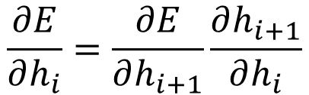
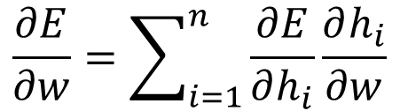

Many to One
Training
$$E$$
o₅
$$V$$
h₁
h₂
h₃
h₄
h₅
$$U$$
$$W$$
x₁
x₂
x₃
x₄
x₅
$$\frac{∂E}{∂w}=\sum_{i=1}^{n}{\frac{∂E}{∂h_{i}}\frac{∂h_{i}}{∂w}}$$
$$\frac{∂E}{∂h_{i}}=\frac{∂E}{∂h_{i+1}}\frac{∂h_{i+1}}{∂h_{i}}$$

Slide 21











Many to Many
Encoder-Decoder 구조이다.
Encoder-Decoder 구조는 혁명적으로 여겨진다.
Training
$$x_{1}x_{2}x_{3}⋯x_{n}→y_{1}y_{2}y_{3}⋯y_{n}$$
o₁
o₂
o₃
$$V$$
$$V$$
$$V$$
$$W1$$
$$W1$$
$$W2$$
$$W2$$
$$W2$$
h₁
h₂
h₃
h₄
h₅
h₅
$$U1$$
$$U1$$
$$U1$$
x₁
x₂
x₃

Slide 22
Many to Many
Training
$$x_{1}x_{2}x_{3}⋯x_{n}→y_{1}y_{2}y_{3}⋯y_{n}$$
o₁
o₂
o₃
$$V$$
$$V$$
$$V$$
$$W1$$
$$W1$$
$$W2$$
$$W2$$
$$W2$$
h₁
h₂
h₃
h₄
h₅
h₅
$$U1$$
$$U1$$
$$U1$$
x₁
x₂
x₃
Encoder

Slide 23
Many to Many
Training
$$x_{1}x_{2}x_{3}⋯x_{n}→y_{1}y_{2}y_{3}⋯y_{n}$$
o₁
o₂
o₃
$$V$$
$$V$$
$$V$$
$$W1$$
$$W1$$
$$W2$$
$$W2$$
$$W2$$
h₁
h₂
h₃
h₄
h₅
h₅
$$U1$$
$$U1$$
$$U1$$
x₁
x₂
x₃
Decoder
Encoder

Slide 24



Many to Many
Training
$$x_{1}x_{2}x_{3}⋯x_{n}→y_{1}y_{2}y_{3}⋯y_{n}$$
o₁
o₂
o₃
$$V$$
$$V$$
$$V$$
$$W1$$
$$W1$$
$$W2$$
$$W2$$
$$W2$$
h₁
h₂
h₃
h₄
h₅
h₅
$$U1$$
$$U1$$
$$U1$$
$$U2$$
$$U2$$
$$U2$$
x₁
x₂
x₃
S
?
?
$$E=\sum_{i=1}^{n}{{\left(y_{i}−o_{i}\right)}^{2}}$$

Slide 25

Many to Many
Training
$$x_{1}x_{2}x_{3}⋯x_{n}→y_{1}y_{2}y_{3}⋯y_{n}$$
o₁
o₂
o₃
$$V$$
$$V$$
$$V$$
$$W1$$
$$W1$$
$$W2$$
$$W2$$
$$W2$$
h₁
h₂
h₃
h₄
h₅
h₅
$$U1$$
$$U1$$
$$U1$$
$$U2$$
$$U2$$
$$U2$$
x₁
x₂
x₃
S
y₁
y₂
$$\frac{∂E}{∂w}=??$$
Combination of [Many to One] and [One to Many]

Slide 26

Many to Many
Testing
$$x_{1}x_{2}x_{3}⋯x_{n}→?????$$
o₁
o₂
o₃
$$V$$
$$V$$
$$V$$
$$W1$$
$$W1$$
$$W2$$
$$W2$$
$$W2$$
h₁
h₂
h₃
h₄
h₅
h₅
$$U1$$
$$U1$$
$$U1$$
$$U2$$
$$U2$$
$$U2$$
x₁
x₂
x₃
S
?
?

Slide 27
Many to Many
Testing
$$x_{1}x_{2}x_{3}⋯x_{n}→?????$$
o₁
o₂
o₃
$$V$$
$$V$$
$$V$$
$$W1$$
$$W1$$
$$W2$$
$$W2$$
$$W2$$
h₁
h₂
h₃
h₄
h₅
h₅
$$U1$$
$$U1$$
$$U1$$
$$U2$$
$$U2$$
$$U2$$
x₁
x₂
x₃
S
o₁
o₂

Slide 28
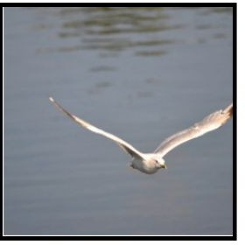
Example
Test 시에는 마지막 Timestamp를 알 수 있도록, EOF를 생성하도록 학습한다.
One to Many
Caption Generation
Image is represented by a CNN
Word Embedding at the input layer
Softmax at the output layer
A
bird
is
flying
CNN
h₁
h₂
h₃
h₄
”Start”
A
bird
is
Encoder-Decoder 구조이다.
Encoder-Decoder 구조는 혁명적으로 여겨진다.

Slide 29
Example
임베딩 레이어 (Word 임베딩) 심층신경망
1. Word를 Frequency 순으1로 Sorting.
2.빈도수가 낮은 놈들을 Unkown으로 대체.
3. One-hot-encoding
4. Neural Network 연산 (output 1)
5. No Activation (Linear)
6. 출력 저차원 (Embedding Vector)
https://subinium.github.io/Keras-6-1/
엄밀히 말하면, Sentence Embedding (Encoding)
Many to Many
Word Embedding
La
croissance
economique
s’est
h₁
h₂
h₃
h₄
”Start”
La
croissance
economique
h₁
h₂
h₃
h₄
h₅
h₆
h₇
h₈
Economic
growth
has
slowed
down
in
recent
years

Slide 30
Bidirectional RNN
Information flow is one directional
What if I need past and future information?
What if we need x₅ to produce o₁?
o₁
o₂
o₃
o₄
o₅
h₁
h₂
h₃
h₄
h₅
x₁
x₂
x₃
x₄
x₅

Slide 31
Bidirectional RNN
Let’s use reverse information flow
Not bad.. but
o₁
o₂
o₃
o₄
o₅
h₁
h₂
h₃
h₄
h₅
x₁
x₂
x₃
x₄
x₅

Slide 32













Bidirectional RNN
Let’s combine both
$$h_{i}=\left[{\vec{h}}_{i},{\overset{⃖}{h}}_{i}\right]$$
represents the past and future information
$${\vec{h}}_{i}$$
represents the past information
$${\overset{⃖}{h}}_{i}$$
represents the future information
o₁
o₂
o₃
o₄
o₅
$${\overset{⃖}{h}}_{1}$$
$${\overset{⃖}{h}}_{2}$$
$${\overset{⃖}{h}}_{3}$$
$${\overset{⃖}{h}}_{4}$$
$${\overset{⃖}{h}}_{5}$$
$${\vec{h}}_{1}$$
$${\vec{h}}_{2}$$
$${\vec{h}}_{3}$$
$${\vec{h}}_{4}$$
$${\vec{h}}_{5}$$
x₁
x₂
x₃
x₄
x₅

Slide 33
Bidirectional RNN
Simpler Representation
y
h
x

Slide 34
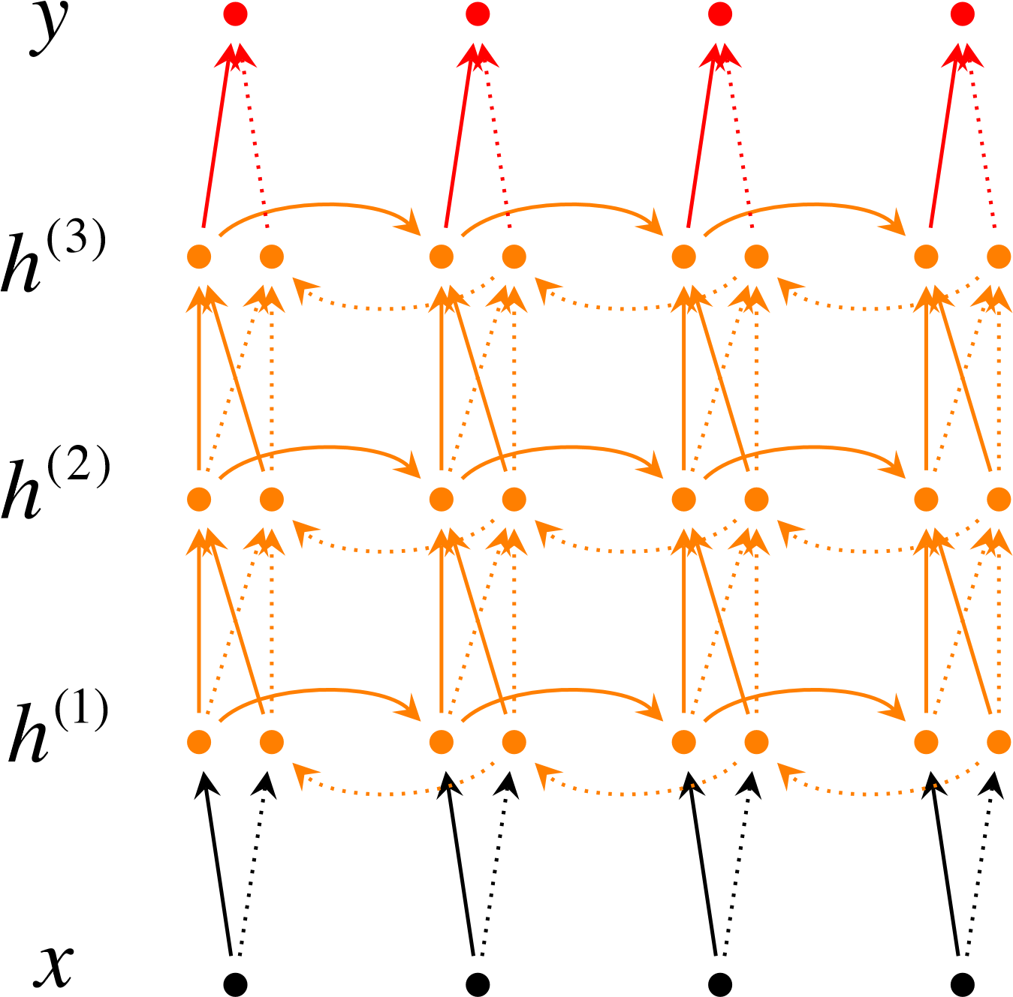
Bidirectional RNN
Deep Bidirectional RNN

Slide 35
Question and Answer

