Slide 1
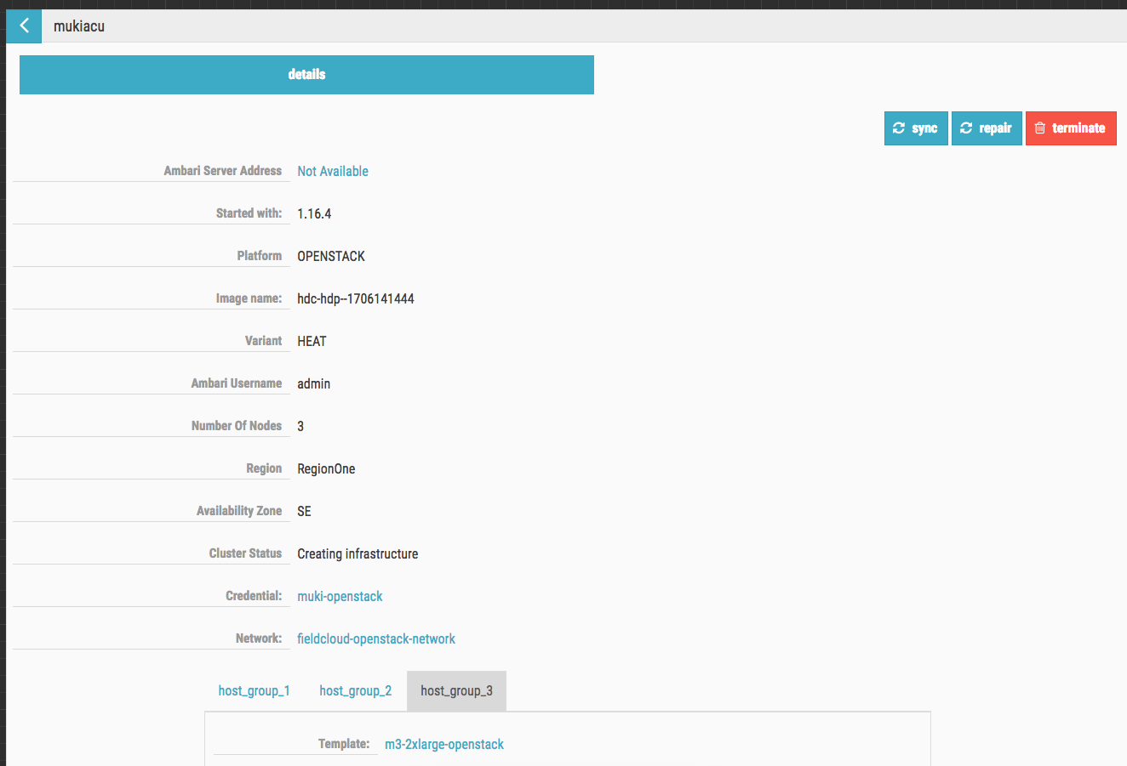
Cloudbreak: https://demo-store-cb.field.hortonworks.com/#!/
Use MukiOpenstack credentials and not mukiopenstack_V2
Use modern-data-application-security-group

Slide 2
Deploying the SAM App
Storm.atlas.hook
Disable this in storm configs
Change email address for notifications

Slide 3
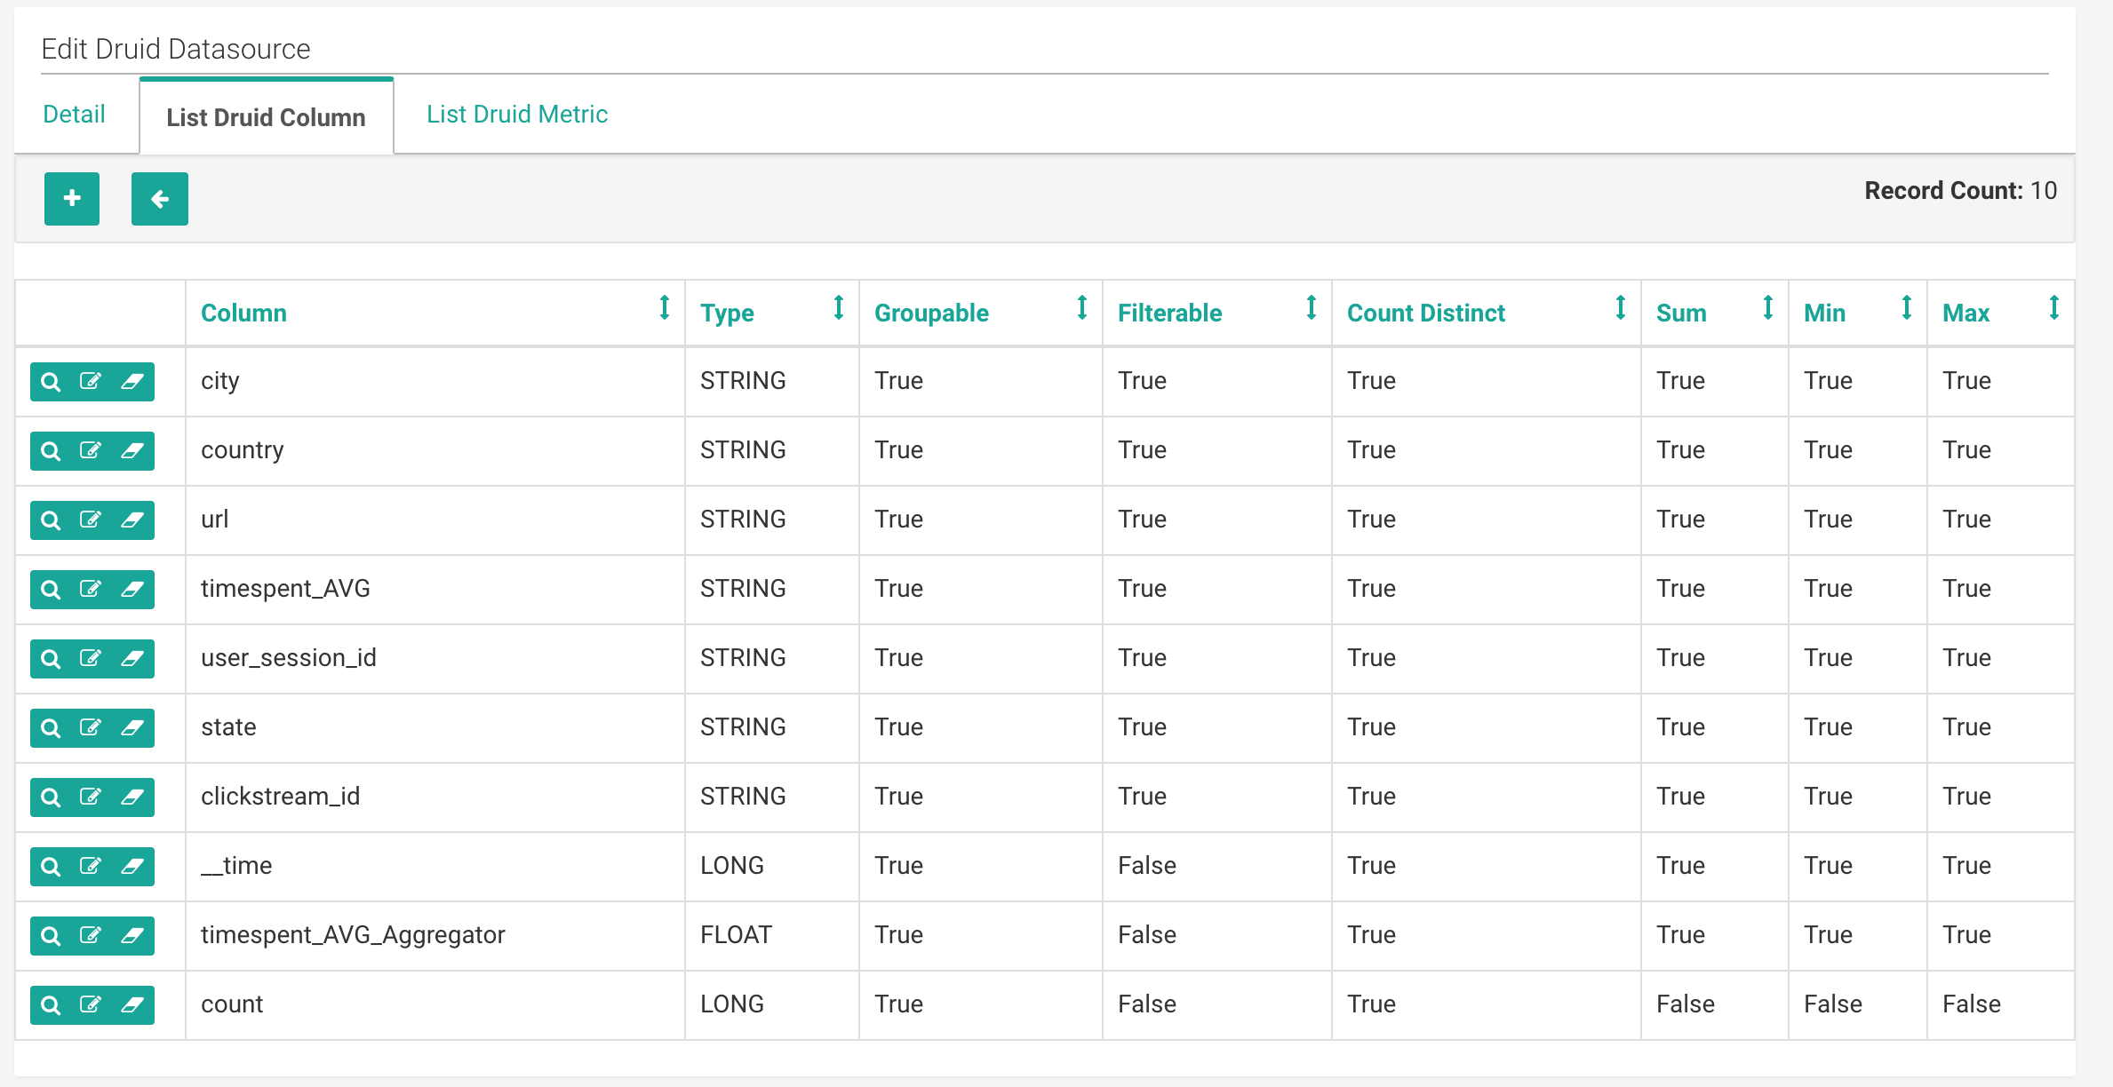

Slide 4
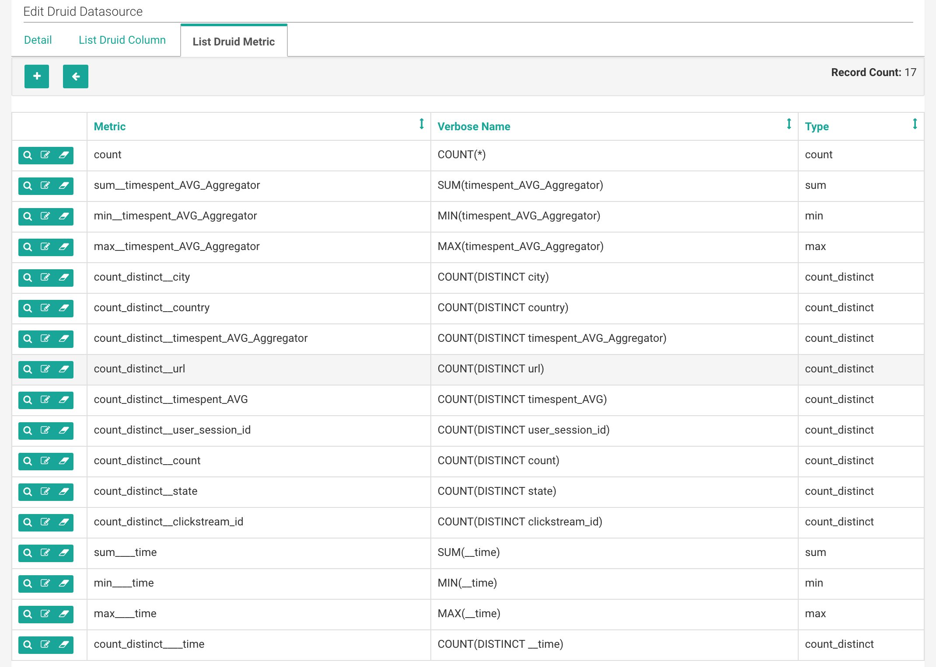

Slide 5
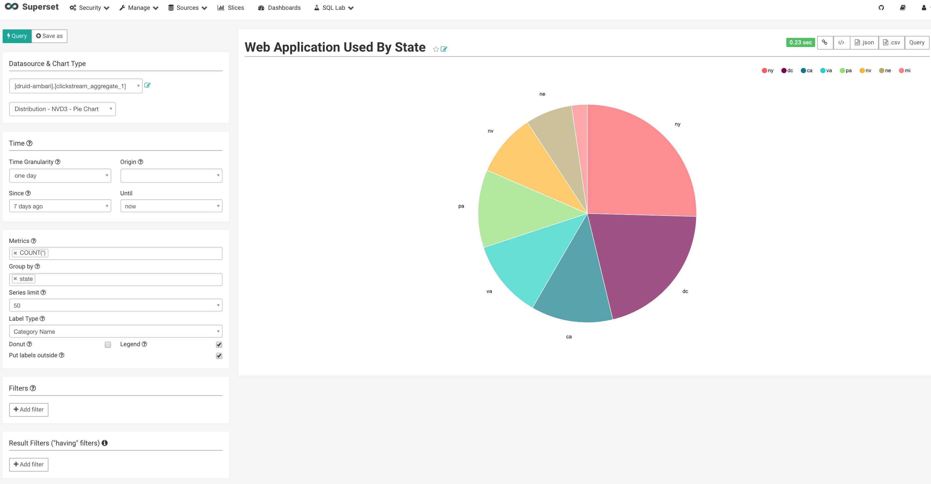

Slide 6
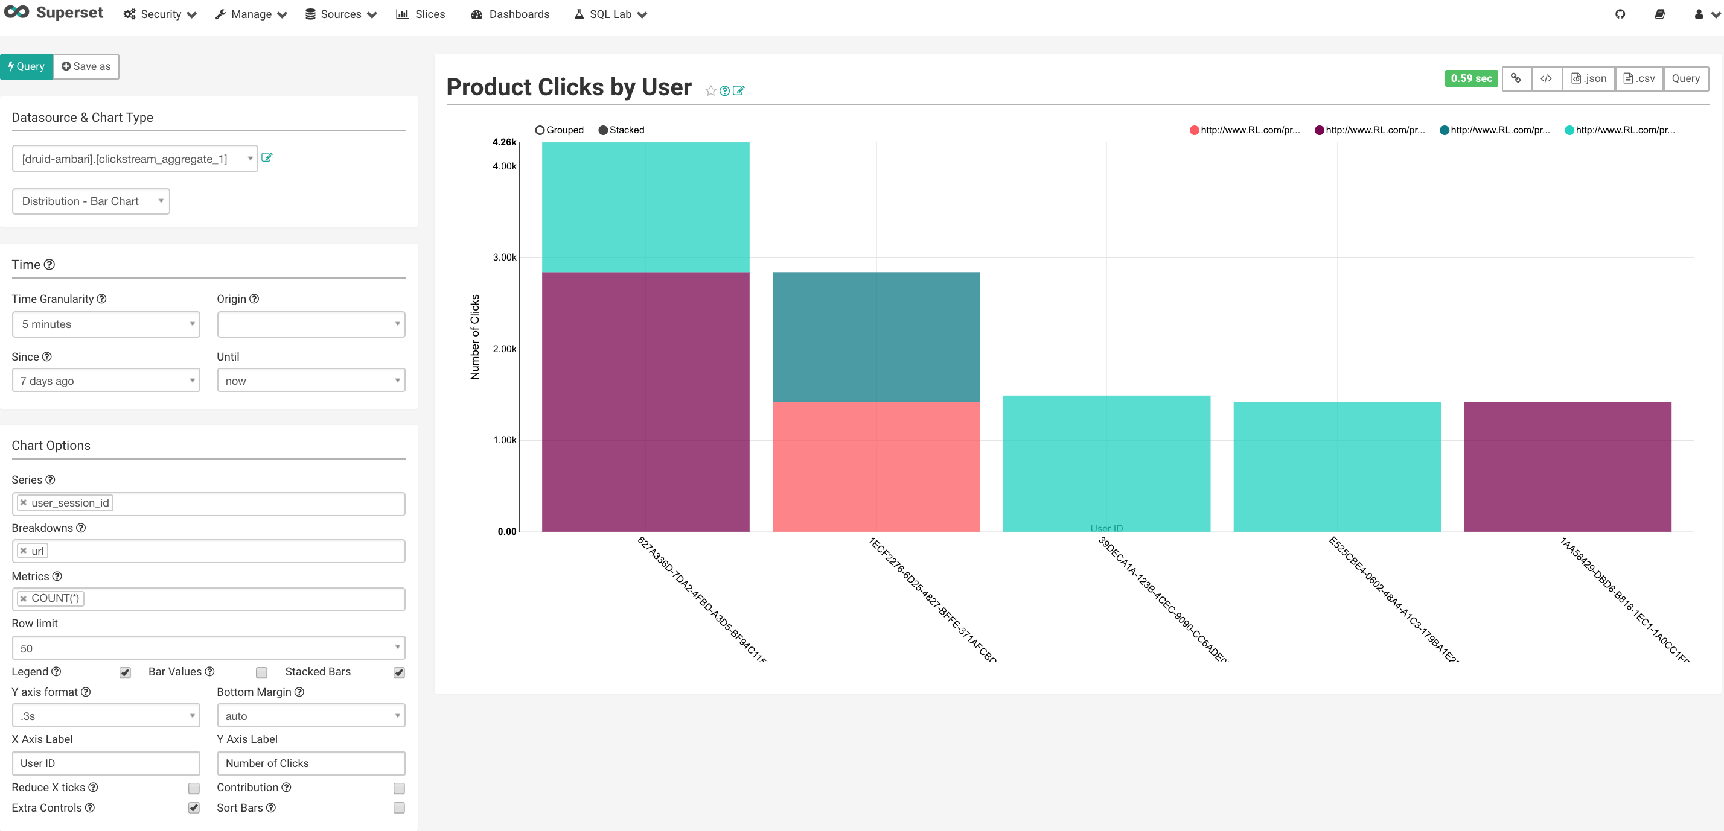
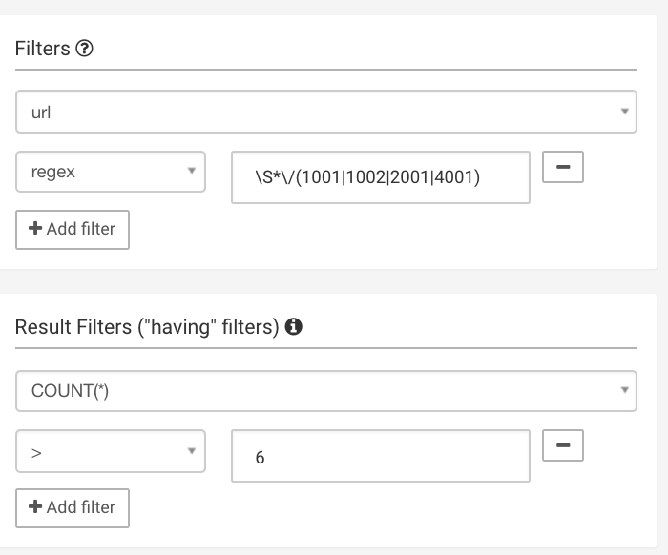

Slide 7
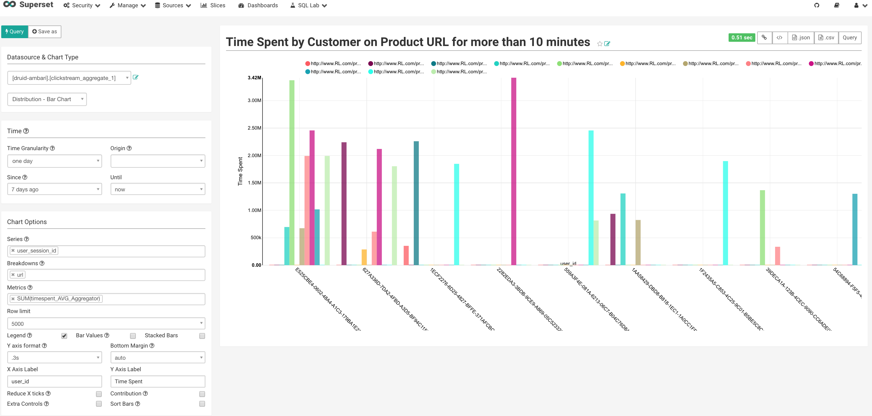
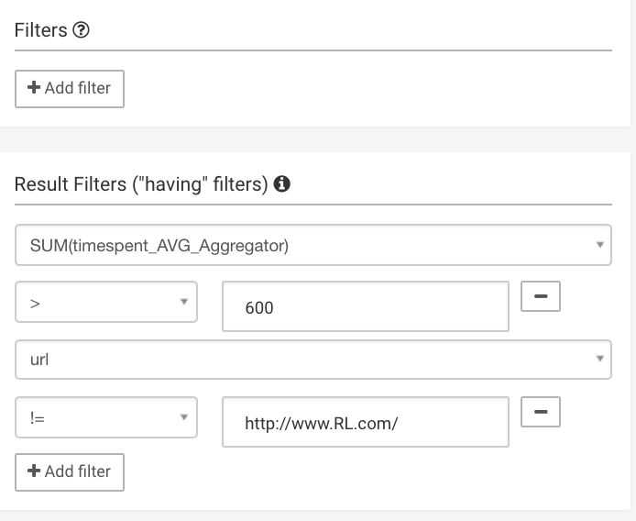

Slide 8
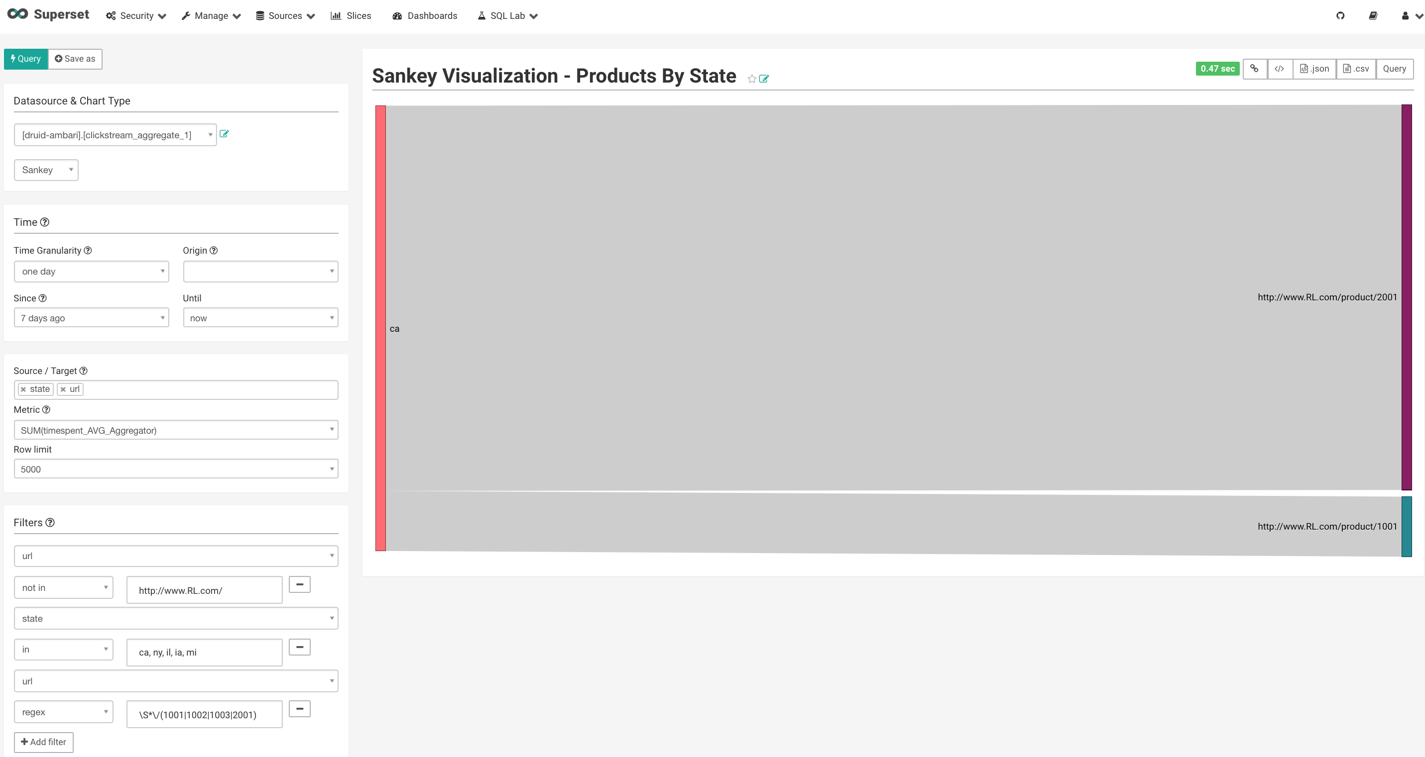
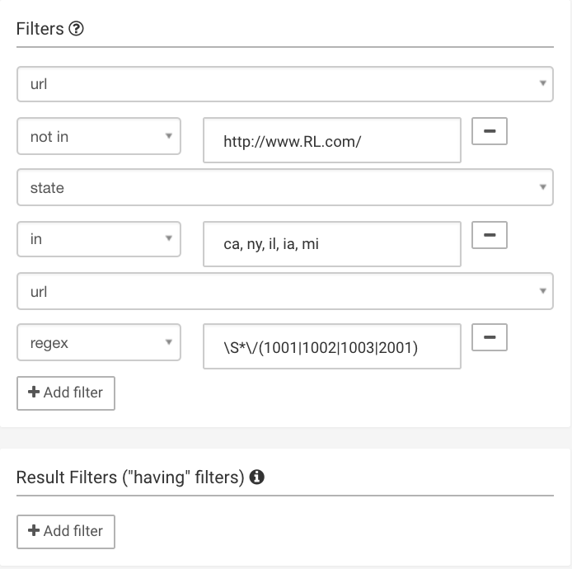

Slide 9
