Slide 1

SMART WEATHER STATION
TEAM AI4AFRICA
(Nigeria)
Isaiah Terhide Barnabas isaiahterhide@gmail.com
Aaron Emmanuel aaronemmanuel054@gmail.com
Michael Selnan Meshach michaelmeshach4545@gmail.com
Guda Blessed (Mentor)
gudablessed@gmail.com

Slide 2
TABLE OF CONTENTS
Problem statement
Approach taken by team
Result obtained
Hardware components
Future steps
References

Slide 3
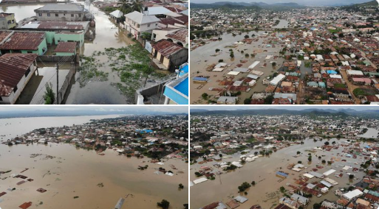
MOTIVATION (Kogi Ng, 2022)
3 persons lost their lives, over 10,000 persons were affected, 1,110 buildings were affected reported by NEMA
SEMA revealed at least 1,380 schools and an estimated 5,550 children were affected by the flood incidence.

Slide 4

PROBLEM STATEMENT
The measurement of weather parameters is informative in predicting future events and aid planning efforts.
Therefore, the goal of the project is to create a low-cost, low-power, reliable, accurate, easy to install and maintain weather station, with the focus on using acoustics of rain and wind intensities.
These weather parameters vary spatially, which causes a need for a dense concentration of weather stations to guarantee accuracy.
However, in developing countries like in Africa, these stations are very scarce due to their high cost and power requirements.

Slide 5
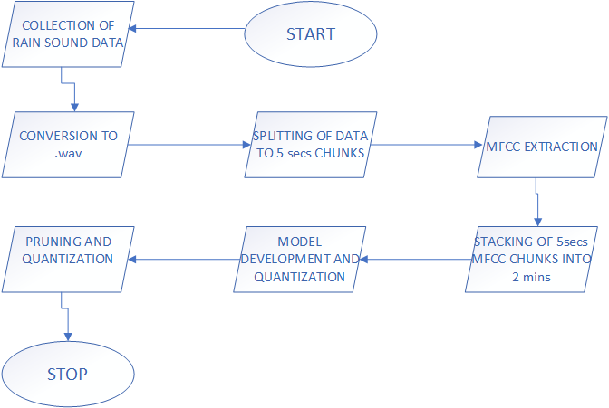
APPROACH TAKEN BY THE TEAM
High Level Flow Chart illustrating the various steps employed
The approach taken by the team are illustrated from step 1 to step 5
Step 1: Literature Survey
Step 2: Exploratory Data Analysis

Slide 6
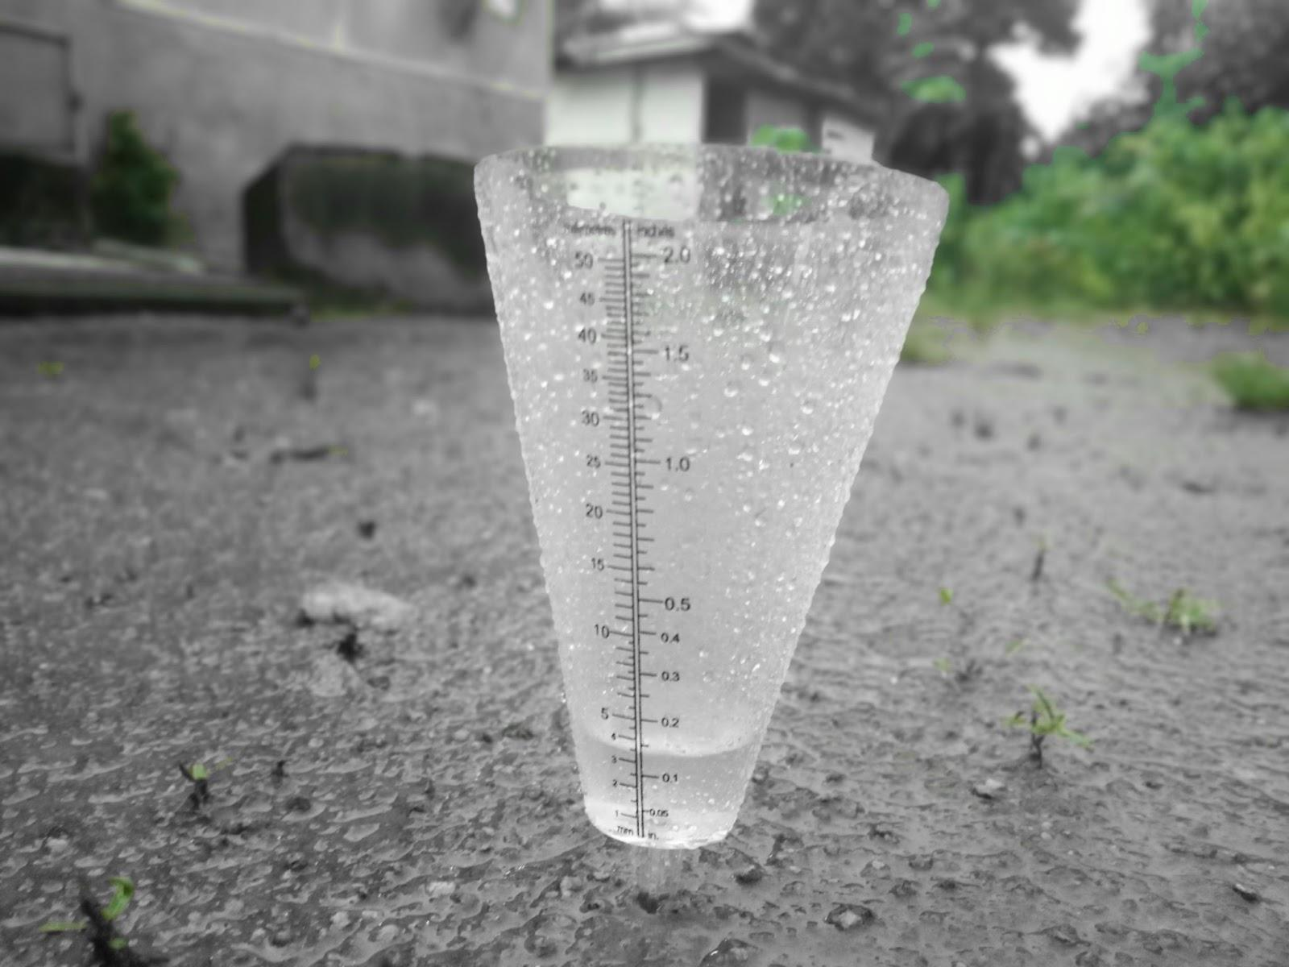
LOCATION | KOGI STATE, NIGERIA (7.7337N, 6.6906E)
MATERIAL FOR DATA COLLECTION | Galvanized ZINC Sheet
DURATION | 7,800 secs
DEVICE | TECHNO SPARK 7P MOBILE PHONE
FORMAT | .aac Format
BITRATE SAMPLING RATE | 22050 Hz
MONTH OF THE YEAR | SEPTEMBER, 2022
NUMBER OF DAYS | 12 days
RANGE OF RAINFALL INTENSITIES | 0.1-6.6mm/ 5mins
NUMBER OF SAMPLES COLLECTED | 25 (5 min per Sample)
Figure 1: Image showing Data Collection Site
Table 1: Properties of Collected Data

Slide 7
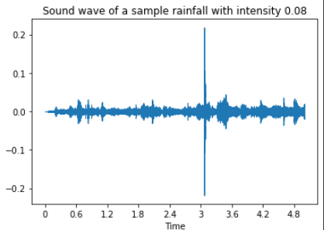
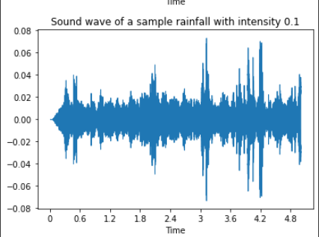
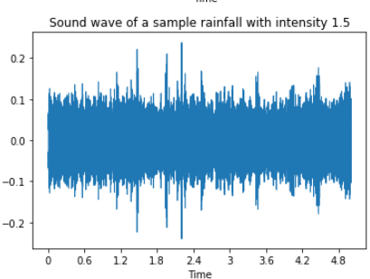
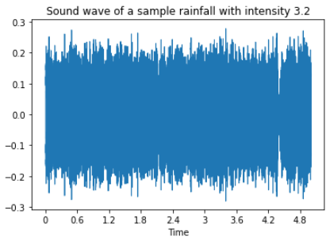
EXPLORATORY DATA ANALYSIS

Slide 8
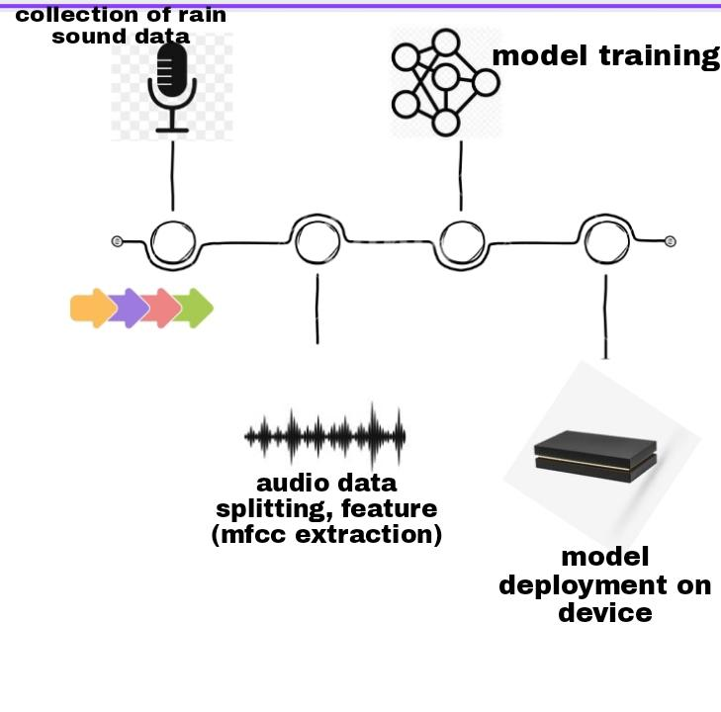
METHODOLOGY

Slide 9
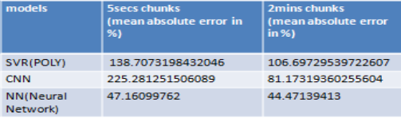
MODEL DEVELOPMENT
Step 4: Model deployment and testing
The train/test ratio is 4:1
The choice model was picked by comparing the performances of each of the SVR POLY, CNN and NN models, with the NN model being the best performing model because of its performance
We split the audio into 5s, 15s, 30s, 1min, and 2mins chunks. The best chunk using SVR was selected.
Table 2: Performance comparison of 5 secs and 2 mins chunks of audio samples

Slide 10
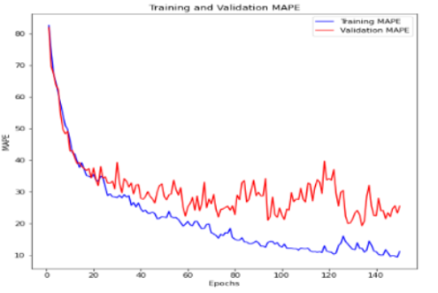
RESULTS OBTAINED
Mean Absolute Percentage Error:
MODEL | MAPE (%)
DNN | 44.47139413
SVR POLY | 106.69729539722607
Table 3 : Mean Absolute Percentage Error
Figure 3: Training and Validation MAPE

Slide 11
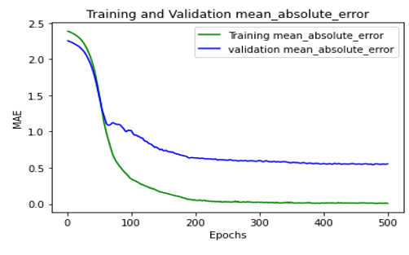
RESULTS OBTAINED
.
DNN MODEL | RMSE | INFERENCE TIME (Sec) | SIZE (Bytes)
Base Model | 1.4090323070707165 | - | 54224
Pruned Model | 1.3852217388396766 | 5.32884669303894 | 25184
Quantized Model | 1.3849611998976226 | 5.355182886123657 | 3832
Table 4: Properties of Base, Pruned and Quantized Model
Figure 4: MAE plot of the DNN Model

Slide 12
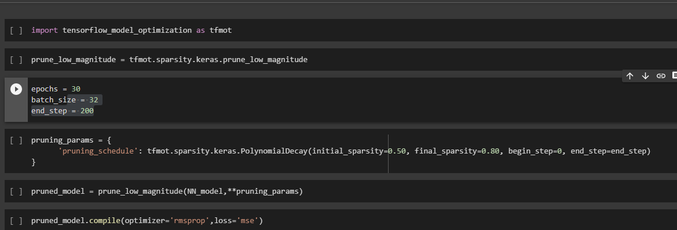
APPROACH TAKEN BY THE TEAM
Step 5: Pruning and quantization of the model
The prune_low_magnitude function wraps a tf.keras model or layer with pruning functionality which “sparsifies” the layer's weights during training
Figure 3: Pruning Process

Slide 13
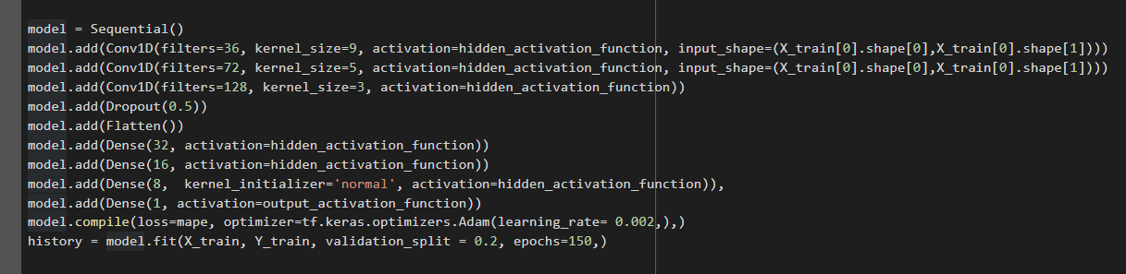
UPDATES AFTER SUBMISSION
Extracted 21 MFCCS, discarded the first one because is just an offset is not informative
Trained on the 5secs chunks << used all 1595 samples>>
MAPE is 35.20%
Model size is 863.928Kb, to 300.336Kb

Slide 14
HARDWARE COMPONENTS
The hardware section consists of the following parts:
ESP32 Microcontroller Board
INMP411 Board
Lion 18650 Battery
TP4056 Board
LM2596

Slide 15
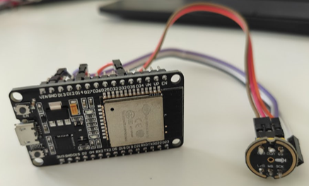
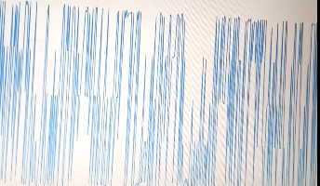
CONNECTION OF HARDWARE COMPONENT
Figure : Snapshot of the Hardware Connection
Figure : Output of the Serial Plotter from Arduino IDE

Slide 16
FUTURE STEPS
The deployment of the developed model on the device hardware.
Collection of more rain sound datasets in the next rainy season to improve the performance of the machine learning model.
Field tests to compare performance of the device with actual rain gauge readings

Slide 17
REFERENCES
Goedde, L., Ooko-Ombaka, A., & Pais, G. (2019). Winning in Africa’s agricultural market. McKinsey & Company.
Lukamba, M. T. (2010). Natural disasters in African countries: What can we learn about them?. TD: The Journal for Transdisciplinary Research in Southern Africa, 6(2), 478-495.
Ferroudj, Meriem, et al. "Detection of rain in acoustic recordings of the environment." Pacific Rim International Conference on Artificial Intelligence. Springer, Cham, 2014.

