Slide 1
A self-replenishing and optically-regulated CO₂ fixation system

Slide 5
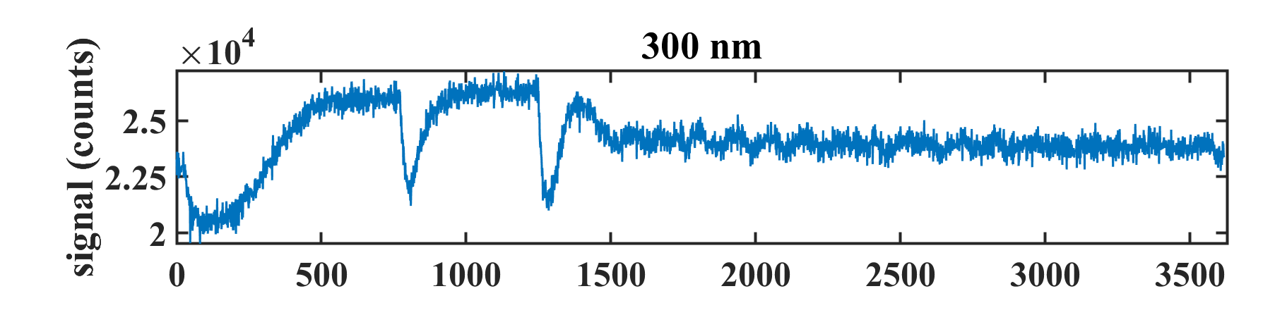
H2O2
H2O2
Crotonyl-CoA
Automation control
NADPH
M-C1-CoA
FADH₂
MS-CoA
Fc+
Threshold Line
FAD+
Fc
H₂O₂
Time(Sec)
FAD⁺ generation system:
FADH₂ + Fc⁺ -> FAD ⁺ + Fc
(spontaneous reaction)
Fc + H₂O₂ -> Fc ⁺ + H₂O (catalyzed by HRP)
Fc+ then UV300
UV300
> Threshold1 ?
NO
YES
Turn Off Pump
Turn On Pump

Slide 6
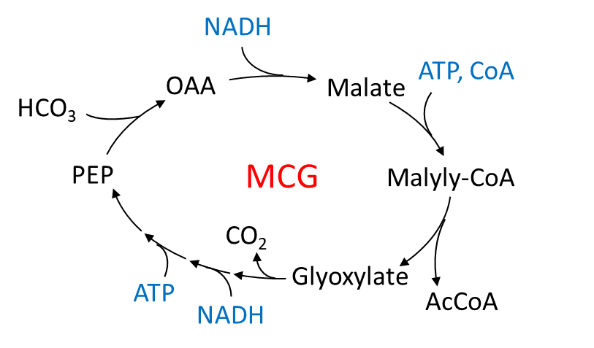
Challenge of H₂O₂ control concentration
H₂O₂ conc. should stay low for preventing protein damage
UV300 nm can be used for monitoring Fc⁺, but it is affected by CoA compounds (UV260), NAD(P)H (UV340) and FAD⁺ (UV370)
UV340 nm can be used for monitoring NAD(P), but it is affected by FAD⁺ (UV370)
Add NADH
Add ATP, CoA
Whole MCG cycle
Final steady state

Slide 7
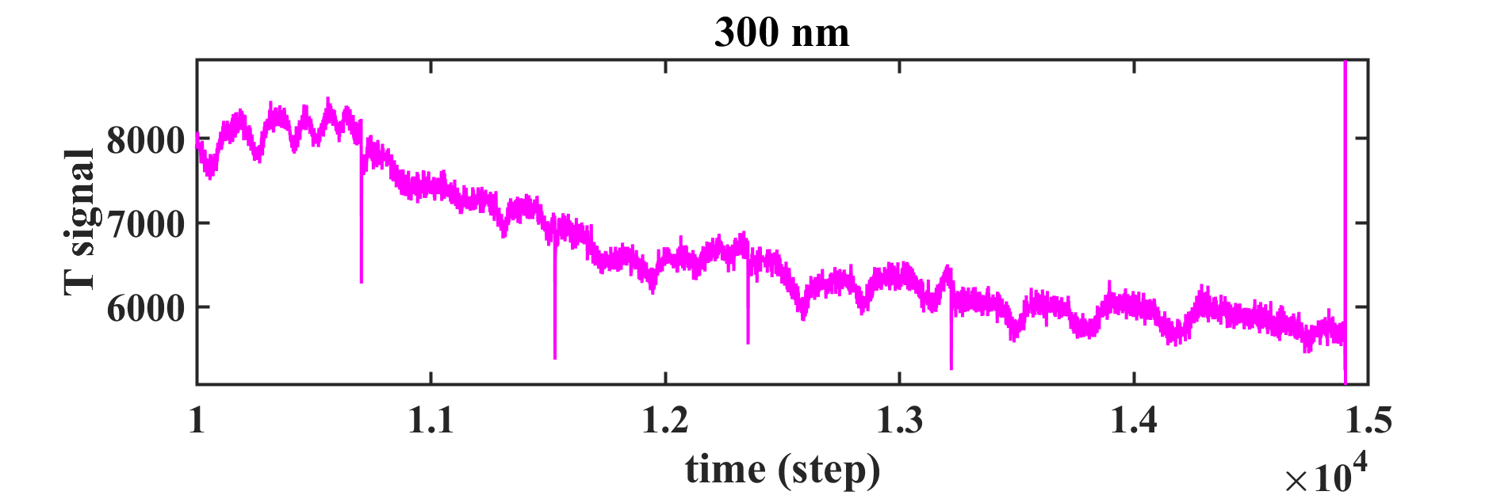
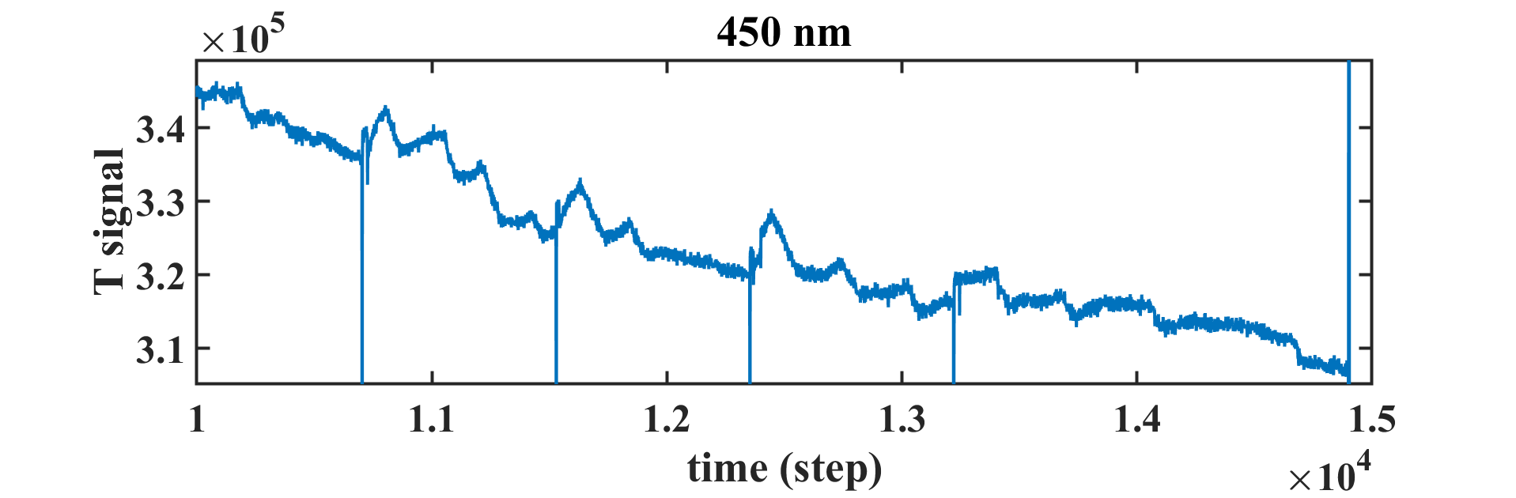
Using UV450 for controlling H2O2 is more sensitive than UV300
Mcd
FADH₂
FAD⁺
Fc⁺
HRP
Fc
Methylsuccinyl-CoA
Adding H₂O₂
Enable to manual control the automatic pump for 5 h
FAD⁺ absorbs at UV450
Fc ⁺ absorbs at UV300
CoA compounds also absorbs at UV300

Slide 8
Red Points: Slope > 0
Red Points: Slope > -20
Data from 3/15 experiment
Take the current point and the previous 50 points for linear
cure fitting
Turn on the H₂O₂ pump when the slope over a threshold value

Slide 10
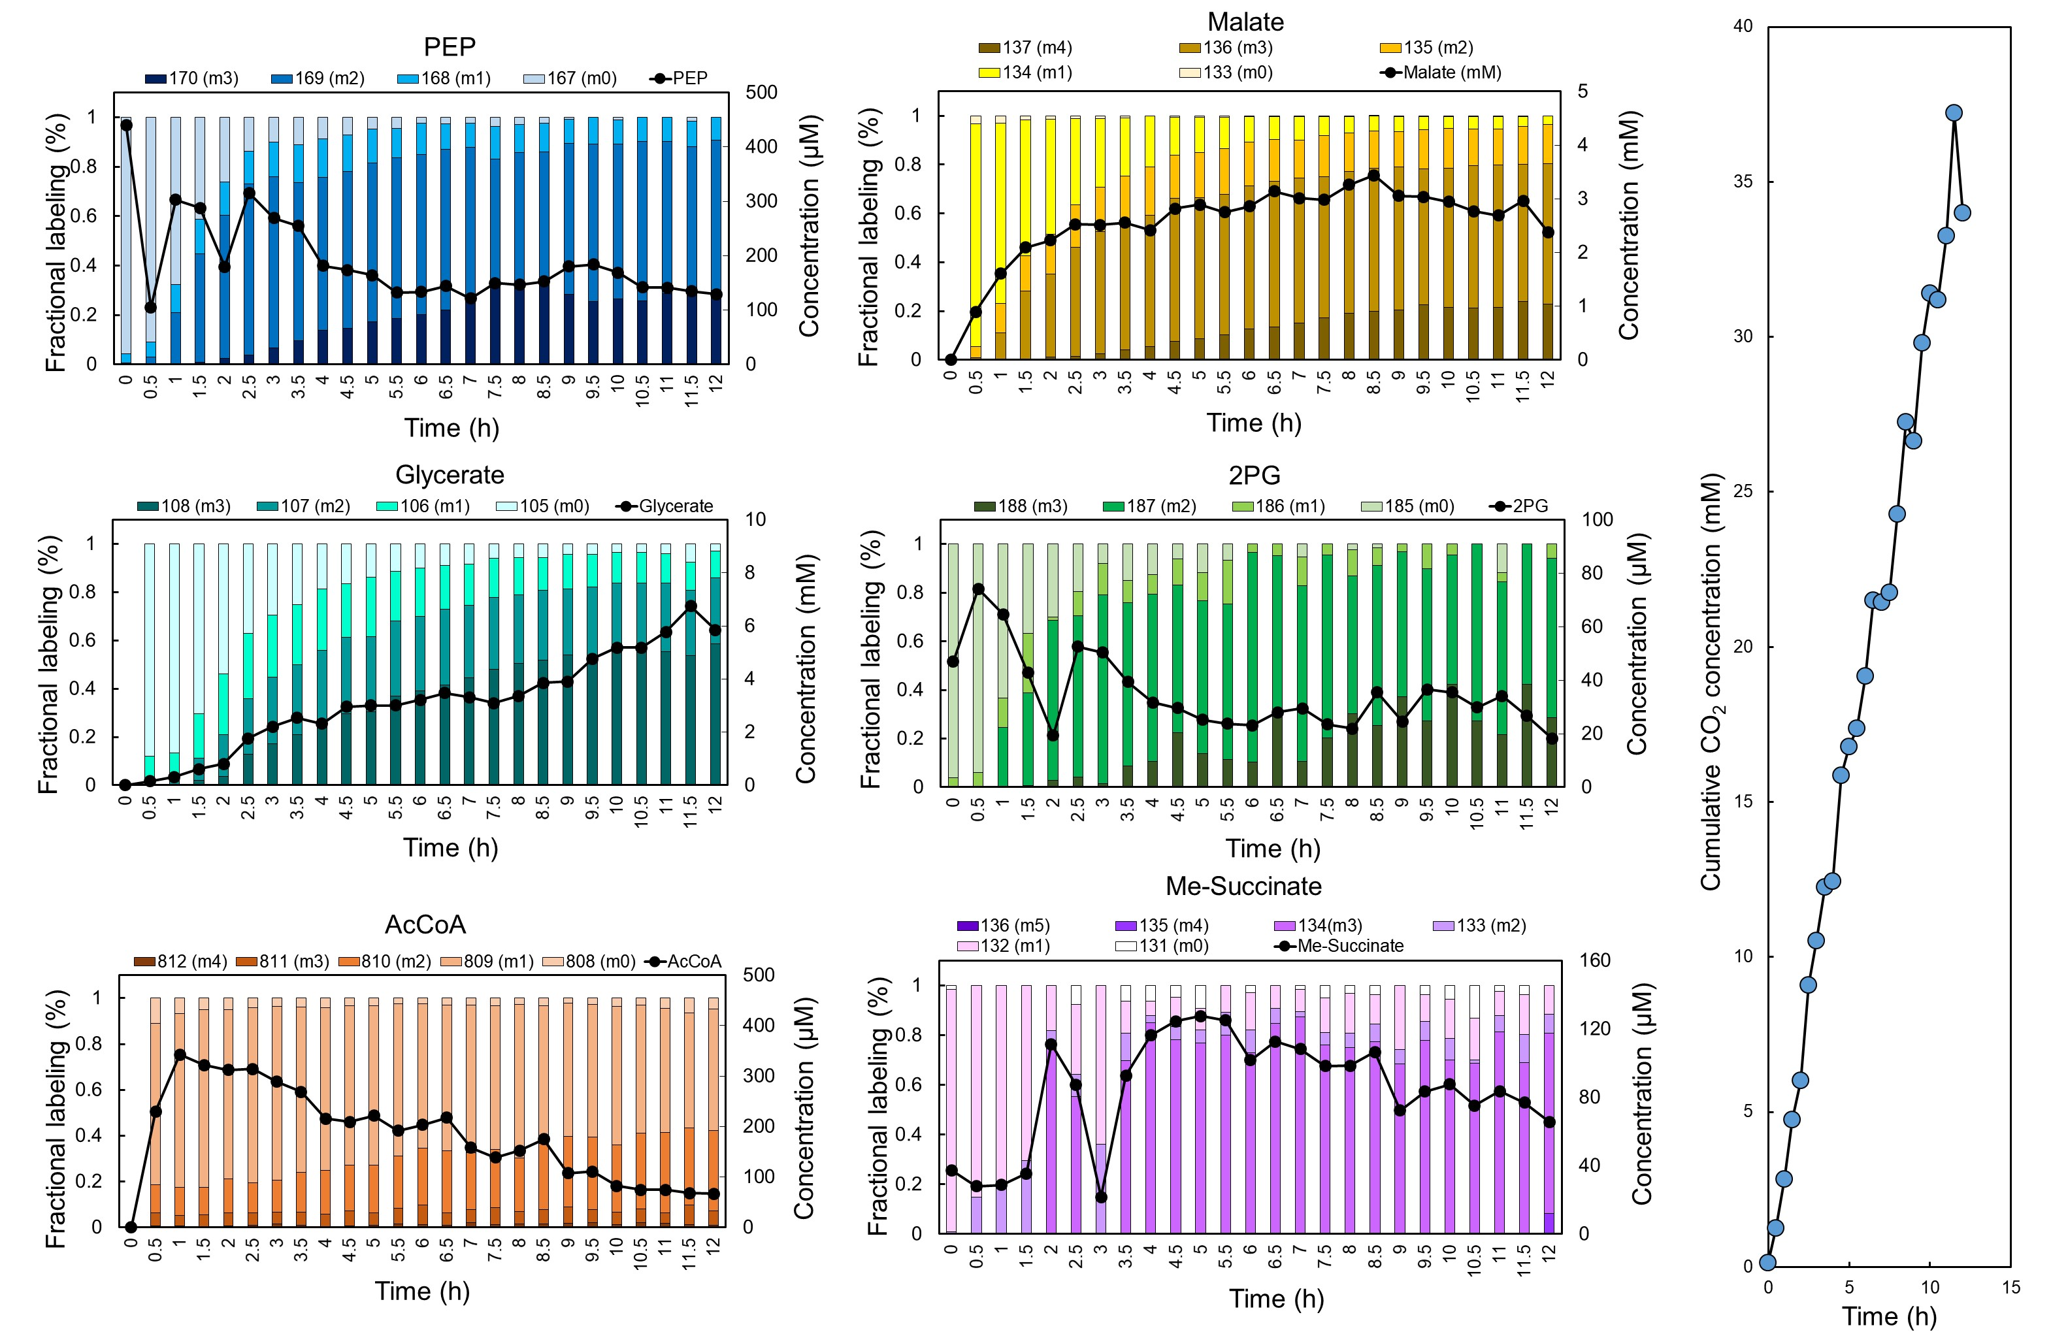

Slide 11

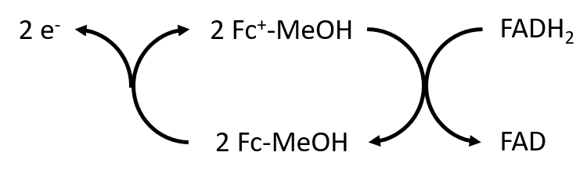
e⁻
Counter electrode
CEM
NAD(P)H
HCOO⁻
Fdh
Working electrode
Controlled volt
e⁻
Fdh
Monitored by UV 300
HCOO⁻
CO₂
rPS-MCG cycle
2 MV⁺
2 MV²⁺
Monitored
by 600 nm
e⁻
Counter electrode
Controlled volt
AEM
Working electrode
e⁻
AEM: Anion exchange membrane
CEM: Cation exchange membrane

