Slide 1
By 雅萍，錫璋
Urine+Am_100ug/ml
100ul
creatinine
methamphetamine
creatinine
methamphetamine

Slide 2

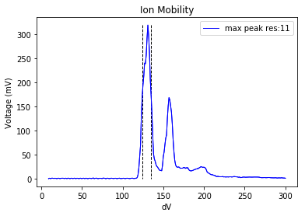
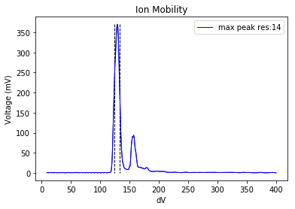
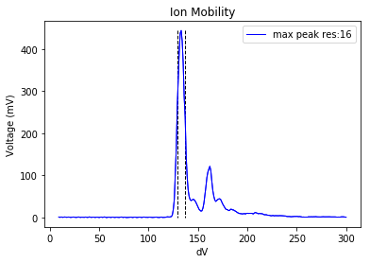
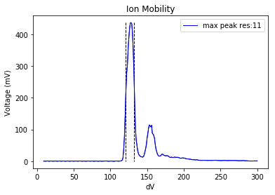
methamphetamine
methamphetamine
methamphetamine
methamphetamine

