Slide 1
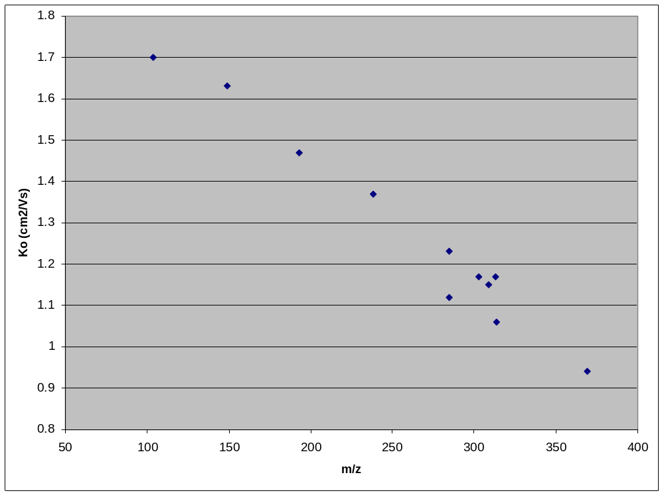
GHB
Metham
MDMA
Ketamine
Morphine
Cocaine
FM2
Diazepam
Alprazolam
THC
Heroin

