Slide 2
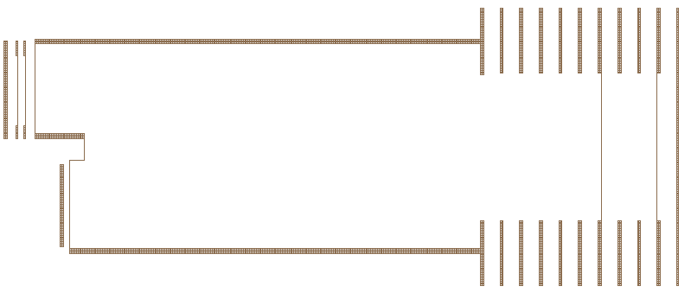

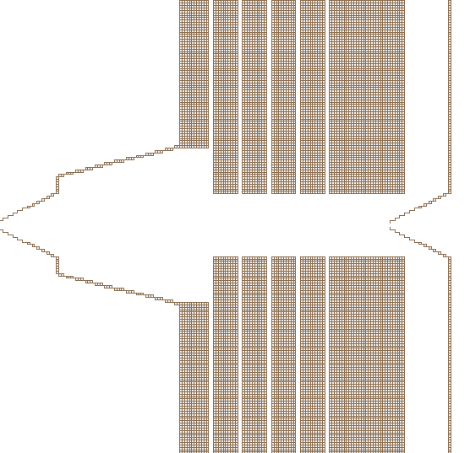

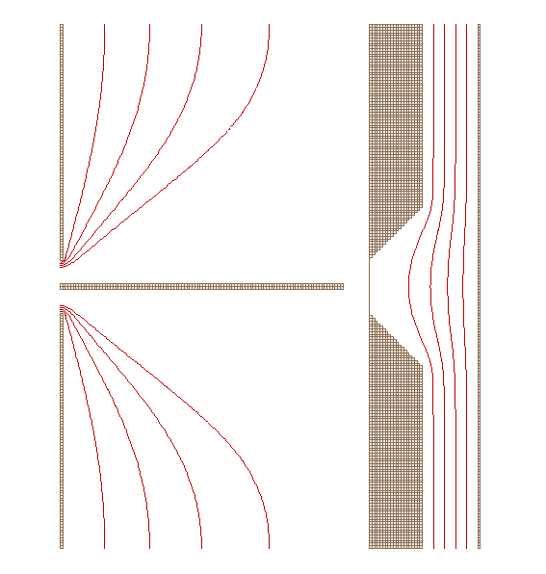

1
5
7
9
3
2
10
4
6
8

Slide 3
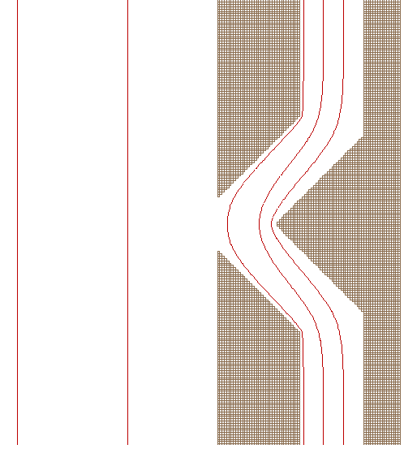
1
3
2

Slide 4


A
B
% Transmission
Drift Length (mm)

Slide 5
% Transmission
Volts

Slide 6
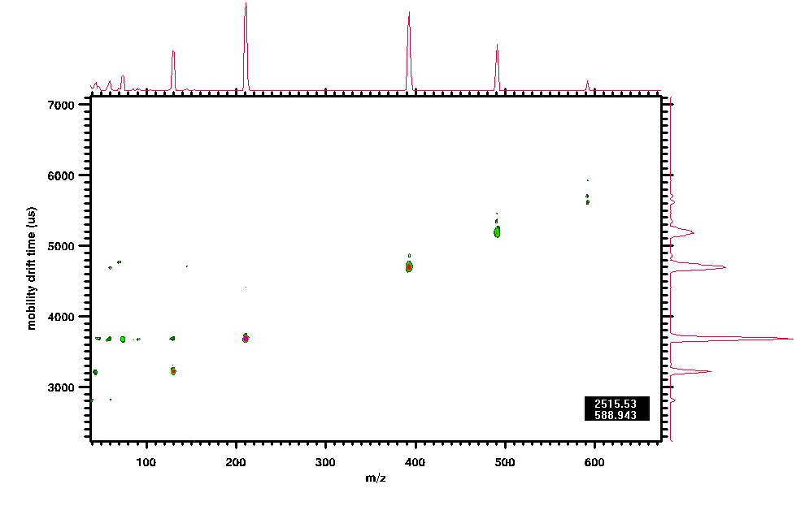
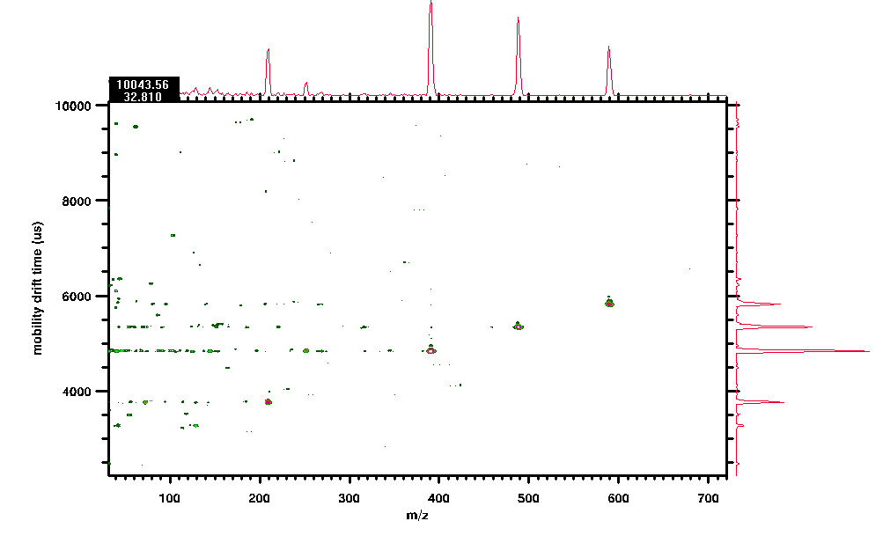

Slide 7
Resolution
Drift Length (mm)

