Slide 1
By 雅萍 鍚璋
Urine+Am_100ug/ml
creatinine
取100ul “Urine+Am_100ug/ml“,加入900ul 0.1%FA, 以SPE純化,收eluate (80%MeOH,0.1%FA)
methamphetamine

Slide 2
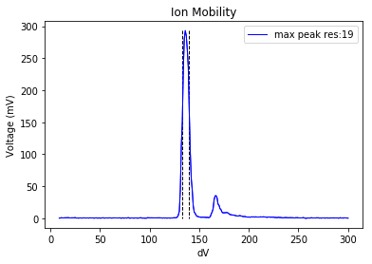
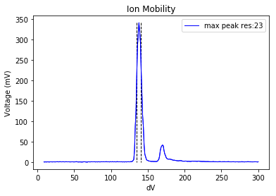
By 誠專

Slide 3
By 誠專
Pure Methamphetamine

