Slide 1
A7 B7
A6 B6
A5 B5
A4 B4
A3 B3
A2 B2
A1 B1
A0 B0
Full
Adder
Full
Adder
Full
Adder
Full
Adder
Full
Adder
Full
Adder
Full
Adder
Full
Adder
Cout
C6
C5
C4
Cin
C2
C1
C0
Cin
S7
S6
S5
S4
S3
S2
S1
S0

Slide 2
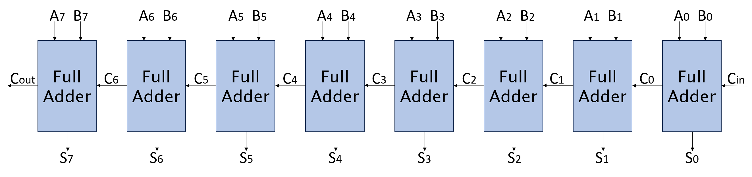
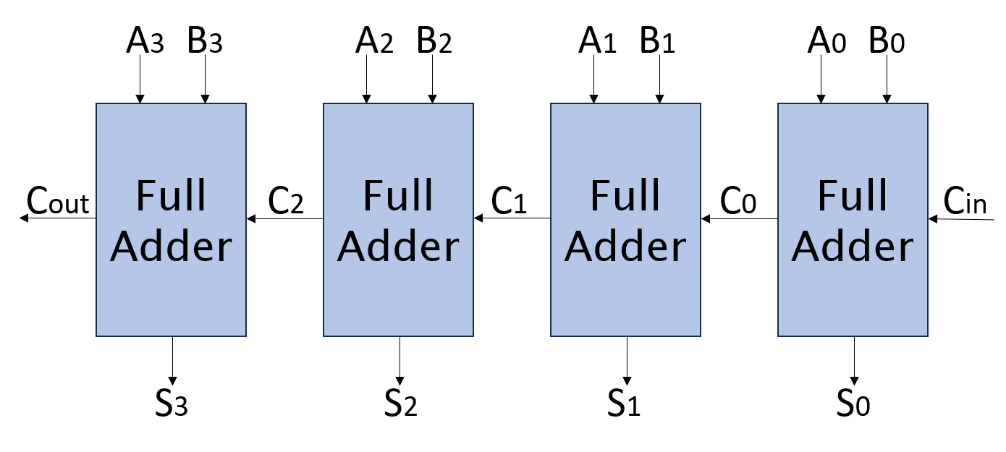

Slide 3
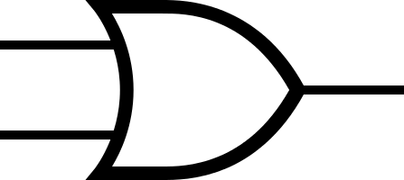



Slide 4
A7 B7
A6 B6
A5 B5
A4 B4
A3 B3
A2 B2
A1 B1
A0 B0
Full
Adder
Full
Adder
Full
Adder
Full
Adder
Full
Adder
Full
Adder
Full
Adder
Full
Adder
Cout
C6
C5
C4
0
Cout
C2
C1
C0
Cin
S7
S6
S5
S4
S3
S2
S1
S0
0
MUX
A7 B7
A6 B6
A5 B5
A4 B4
1
Full
Adder
Full
Adder
Full
Adder
Full
Adder
Cout
C6
C5
C4
1
S7
S6
S5
S4

Slide 5
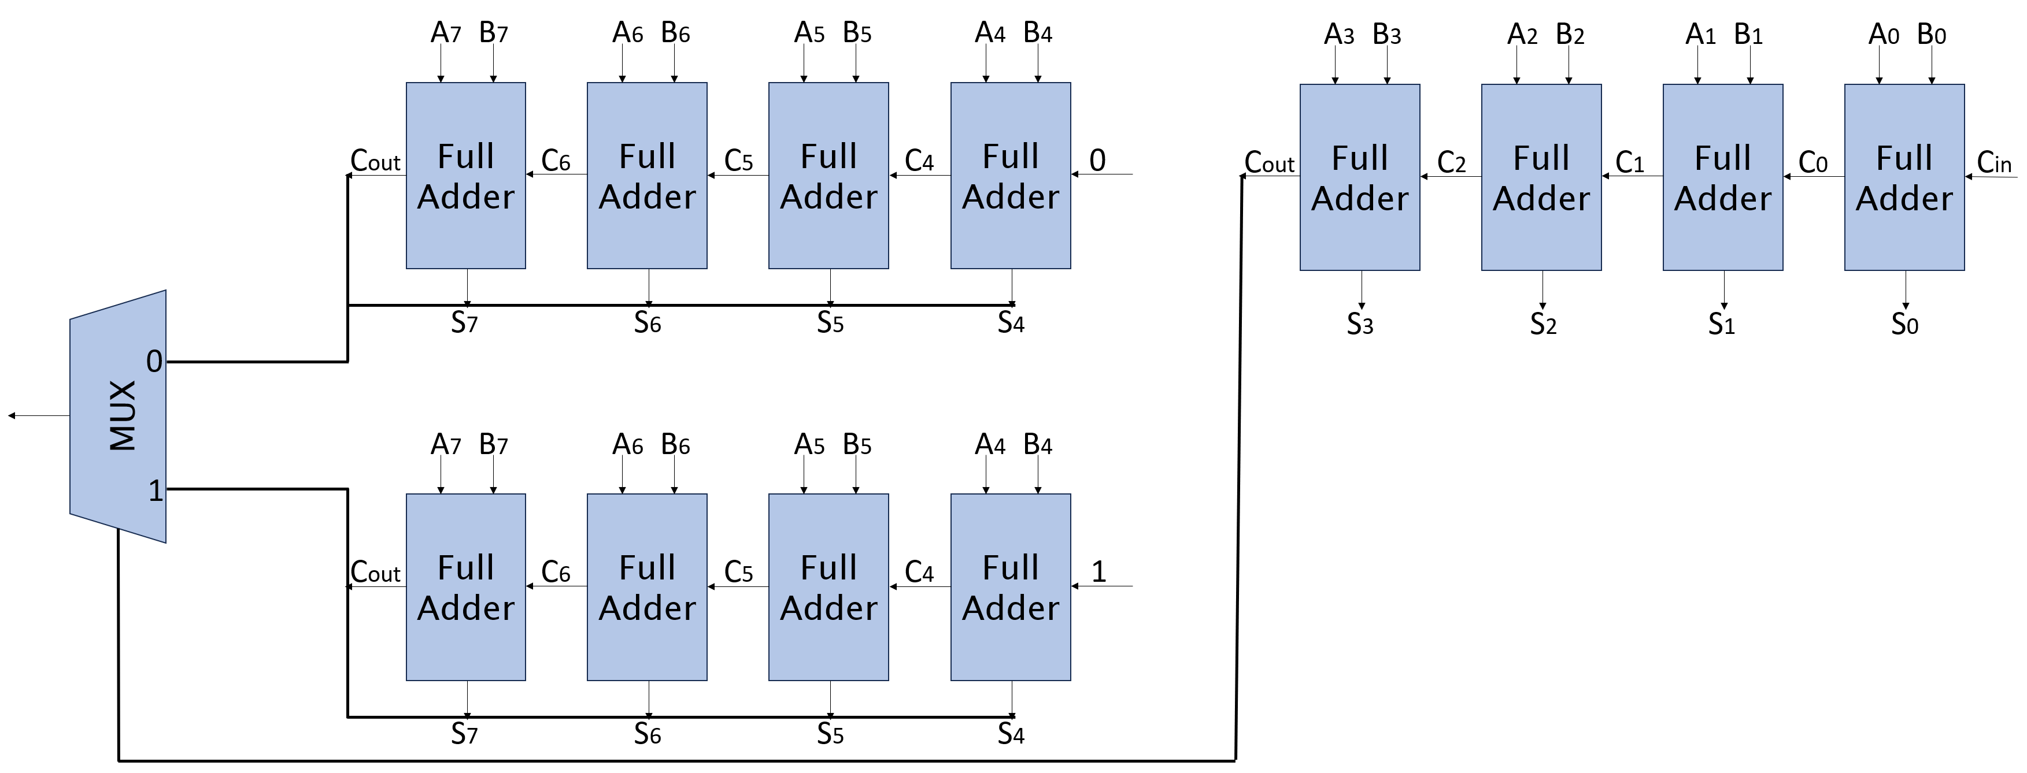

Slide 6
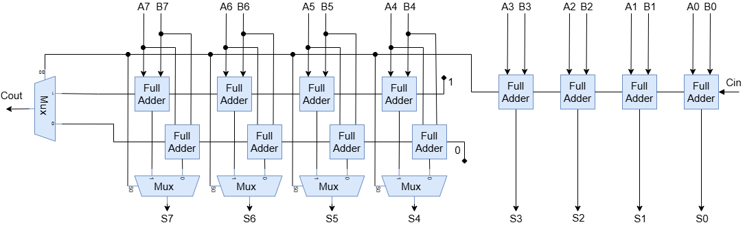

Slide 7
