Slide 1
Functional programming in Scala
A practical introduction

Slide 2
What we will build
A command-line Tic Tac Toe game that can be played both locally and on the local network
We’ll follow a purely functional style (no mutable state, strict encapsulation of side-effects)
The game logic will be properly tested
We’ll use common Scala libraries

Slide 3
What is Scala ?
Scala was born in 2003 at the EPFL
It’s programming language that mixes ideas from strongly typed functional programming languages such as Haskell and object oriented ones such as Java
Scala runs mostly on the JVM, but also in the browser through Scala.js, and natively through Scala Native.
On the JVM, Scala is completely interoperable with Java and its massive ecosystem

Slide 4
Scala in the wild
Scala is a general purpose language. Its main use cases are
  Web development
  Data engineering
  Highly concurrent applications more generally
It is the most widely used functional programming language today
It’s used in production by Twitter, Zalando, Walmart, Netflix, LinkedIn …

Slide 5
Meet SBT
Sbt is the de facto build tool for Scala.
  It defines the metadata (name, organization, version…) for your Scala project(s)
  It fetches your external dependencies
  It builds your .scala files into .class files
  It can run your tests
  It allows you to define custom tasks and run them in parallel
  It supports plugins to add useful features to your build pipelines such as
    Code coverage for your tests
    Docker image generation

Slide 6
Hello, World!
HelloScala.scala
In Scala, the simplest Hello World is written as follows:
  object Main extends App {
  println(“Hello world”)
  }
To run our project, we do
  sbt run

Slide 7
Expressions
Functions.scala
An expression in a combination of terms that can be reduced to a value. i.e.:
  45 + 3
  “Foo bar baz”
  “Hello” + “ “ + “World”
Named values are defined using the val keyword
  val a = 12
Named values are immutable
Every value has a type

Slide 9
Typing
All values have a type, including functions
Types in Scala are organized into a hierarchy
  Children of AnyVal : primitive value types such as Boolean, Unit, String, Int, Float, Double ...
  Children of AnyRef : object types such as List, Option, and user-defined classes
  Any is the root of all types : AnyRef, AnyVal and their children

Slide 10
Type inference
The type of a value can in many cases be inferred (“guessed”) by the compiler meaning
  You can define it explicitly :
    val name: String = “George”
  Or let the compiler do its work
    val name = “George”

Slide 11
Complex expressions
Functions.scala
Scala is an expressive language : is doesn’t make the distinction between expressions and statements that imperative languages make.
In other words, every construct in Scala yields a value, including control structures such as if/else
Complex expressions are delimited by curly braces
The last line of the block is the effective value

Slide 12
Functions
Functions.scala
Methods are defined with the def keyword like so:
  def square(value: Int) = value * value
You can define the return type of a method explicitly :
  def square(value: Int): Int = value * value
Methods and functions are actually slightly different things in Scala, but for now we’ll use both interchangeably

Slide 13
Different evaluation strategies
Functions.scala
Evaluation is the process by which expressions are reduced to values
Named values and methods can have different evaluation strategies

Slide 14
Val vs def
Functions.scala
vals are evaluated the moment they are defined
defs are evaluated every time they are accessed
lazy vals are evaluated when they are first accessed and then cached

Slide 15
Val vs def, an example
Functions.scala
This would crash immediately:
val a: String = throw new Exception(“BOOM”)
println(“Hello”)
println(a)
This would print “Hello” then crash:
def a: String = throw new Exception(“BOOM”)
println(“Hello”)
println(a)

Slide 16
Call-by-name, call-by-value
Functions.scala
By default, arguments are call-by-value, meaning the arguments are evaluated before the body of the function.
Call-by-name arguments are evaluated only when accessed within the body of the function, not before.
They are defined with a fat arrow like so
  def greet(name: => String) = println(“Hello “ + name)

Slide 17
What’s the billion dollar mistake ?

Slide 18
“I call it my billion-dollar mistake. It was the invention of the null reference in 1965. [...] This has led to innumerable errors, vulnerabilities, and system crashes, which have probably caused a billion dollars of pain and damage in the last forty years.”
Sir Tony Hoare

Slide 19
Options
Options.scala
Options are designed to avoid the infamous NullPointerException
Options can one of two things : Some or None
It makes the code more explicit, removes the need to search in documentation for possible nulls and removes the need for runtime exceptions in many cases

Slide 20
Working with Options
Options.scala
map
  If you have Option[A] and A => B, then you have Option[B]
flatMap
  If you have Option[A] and A => Option[B], then you have Option[B]
flatten
  If you have Option[Option[A]], then you have Option[A]
getOrElse
isEmpty

Slide 21
Case classes
Case classes.scala
Case classes are used to create immutable values out of multiple named fields
  case class Position(x: Int, y: Int)
Case classes fields are public
  val playerPosition = Position(18, 4)
  playerPosition.x
Case classes can be copied
  val nextPosition = playerPosition.copy(y = playerPosition.y + 1)
Case classes are compared structurally
  playerPosition == Position(18, 4) // => true

Slide 22
What is functional programming ?

Slide 23
Functional programming is a programming paradigm that treats computation as the evaluation of pure functions.
(Or, as we call them, functions)

Slide 24
What are functions ?
In imperative programming, the term function is often wrongfully used to mean procedure, a way of binding a set of instructions to a name and some variables
In FP, we treat functions as mere arrows between values of two sets
Functions are first-class citizens: they can be passed around as arguments, returned from other functions and composed

Slide 25
Visualizing functions
“fg78”
John
“fg78”
Ringo
Paul
“pfr6”
George

Slide 26
A bit of history : Lambda calculus
Lambda calculus is the foundation of all functional programming languages. It can be described as the most simple, universal programming language.
Everything that can be computed by a Turing machine can be expressed in a Lambda calculus form
Lambda calculus does not care about the machine. It abstracts away the computation steps under a purely expressive form, much like FP languages.

Slide 27
How does it work ?
Consider this function:
f(x) = x²
Implemented in Scala as
Def f(x: Int) = x * x
Then it can be expressed in λ-calculus as
λx.x²
Functions in λ-calculus don’t need to be named. It introduced anonymous functions as values for the first time. In some programming languages, anonymous functions are still called lambda expressions today.

Slide 28
How would one write a functions of two arguments in λ-calculus ?
f(x, y) = xy
Would become
λx.λy.xy
A function of two arguments x and y can be expressed as a function of a single argument x, returning a function of a single argument y, a property called currying.
Most importantly, λ-calculus introduced higher-order functions : functions that can return other functions, or take functions as arguments, something we do everyday in FP.

Slide 29
Some basic rules
α conversion : λx.x = λy.y
η reduction :

Slide 30
Thinking beyond the machine
Computers work imperatively. They execute instructions that change their state over time
Programming languages can be divided in categories
  Machine code inspired such as C, C++, Python …
  Lambda calculus inspired such as LISP, Haskell
  Those which are both, for better or worse
Functional programming languages are higher abstractions. They don’t care about the machine, they care very little for state, and even less for time … and it’s great!
Modern computers are more than capable of supporting these abstractions. Thinking abstractly opens up more possibilities for software

Slide 31
How to identify pure functions in a impure language such as Scala ?

Slide 32
Referential transparency
Referential transparency is a key property of pure functions
A function is referentially transparent if you can substitute its application (function call) for its corresponding value without changing the program’s behavior

Slide 33
Example
def square(a: Int) = a * a
val result = square(6)
────────── and ───────────
val result = 36
Are equivalent programs
def square(a: Int) = {
println(“Hi!”)
a * a
}
val result = square(6)
──── is not equivalent to ────
val result = 36

Slide 34
Why should I care ? Benefits of referential transparency
Pure functions are trivial to test
Pure functions are easy to execute in parallel
Predictability! You know exactly when the effects occur
Memoization : if a function is guaranteed to return always the same result for some input, it can be memoized without risks

Slide 35
Totality
A function of A => B must absolutely yield a value of B for any value of A
Partial functions (functions that operate on subsets of A or B) are unsafe, as they may break at runtime.
As a rule of thumb, it if compiles, it must work. Exceptions should be reserved for critical situations only.

Slide 36

Visualizing partial functions
“fg78”
John
“fg78”
Ringo
“pfr6”
“re45”
George

Slide 37
A short definition for pure functions
A function is pure if, and only if, it is both total and referentially transparent

Slide 38
Spotting impure functions in the wild
def max(a: Int, b: Int) =
if (b >= a) b
else a

Slide 39
Spotting impure functions in the wild
var counter = 0
def getName: String = {
counter += 1
”Jessica”
}

Slide 40
Spotting impure functions in the wild
def mean(numbers: List[Int]): Float = {
println(“Computing mean”)
numbers.sum.toFloat / numbers.length
}

Slide 41
Spotting impure functions in the wild
def mean(numbers: List[Int]): Float = {
numbers.sum.toFloat / numbers.length
}

Slide 42
Spotting impure functions in the wild
def getSecret(user: User): Secret =
if (user.isAdmin()) {
secret
} else {
throw new Exception(“You don’t have access”)
}

Slide 43
How am I supposed to do stuff if everything is forbidden ?

Slide 44
Functional programmers have strategies
Persistent Data Structures
Algebraic Data Types
Pattern matching
IO monads

Slide 45
Scala collections
Collections.scala
Scala provides several collections that can model lists of elements, ranges, sets of unique elements, maps …
Scala’s collections are persistent by default, you can’t modify them in place
Scala’s collection are organized into a hierarchy, meaning different concrete data structure may be manipulated through common interfaces

Slide 46
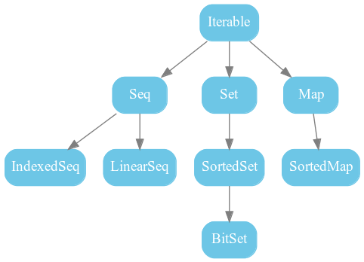
Collections.scala
Collections.scala

Slide 47
Which do I need ?
Collections.scala
Is your code’s performance critical ?
  Yes : check performance characteristics of all data structures in the documentation
  No :
    If you need a list of possibly duplicated elements, use List
    If you need a list of unique elements, use Set
    If you need to identify unique elements with a key, use a Map
If you’re not sure, or if you write a library, use interfaces such as Iterable or Seq

Slide 48
Working with Lists
Collections.scala
map
  If you have List[A] and A => B, then you have List[B]
flatMap
  If you have List[A] and A => List[B], then you have List[B]
filter
  If you have List[A] and A => Boolean, then you have a subset of your original List[A]
flatten
  If you have List[List[A]], then you have List[A]
headOption
lift
isEmpty
sum (on a numerical list only)

Slide 49
Structural sharing
Collections.scala
val a = List(2, 3, 4, 5)
val b = 1
val c = 1 :: a
- Lists are good at prepending (constant time) but not appending (linear time)
- Persistent data structures are space efficient : since every value is reputed immutable, they can be shared by reference across multiple structures
2
3
4
5
1
1
2
3
4
5

Slide 50
Building types

Slide 51
Product Types
ADT.scala
Tuples and case classes can encapsulate the values of several types into a single type
These types are called product types because it can be seen as a cartesian product of several types
  For instance, a tuple (Int, Boolean) can match any Int with any Boolean. The total number of values that this tuple can have will be
    The number of values a Int can have (Int.MaxValue * 2)
    Multiplied by the number of values a Boolean can have (2)

Slide 52
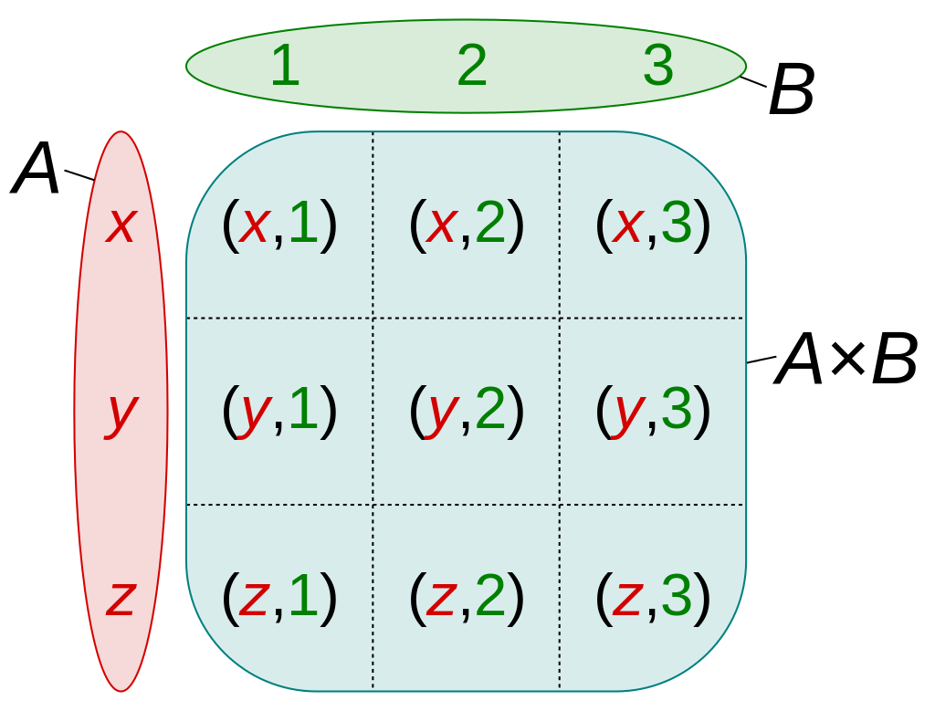
Visualizing the product
ADT.scala

Slide 53
Case classes are product types
ADT.scala
Case classes are tuples with labels
case class User(
firstName: String,
lastName: String
)
can be expressed as
type User = (String, String)
Case classes are more explicit than tuples. Keep tuples for very simple values and internal use only

Slide 54
Sum Types
ADT.scala
Sum types can hold values coming from several but fixed types
They’re sometimes called variants, discriminated unions, disjoint unions
Sum types can be recursive

Slide 55
A recursive sum type
Sealed trait Employee
Case class Manager(name: String) extends Person
Case class Student(name: String, taughtBy: T

Slide 56
Common sum types
ADT.scala
Option[A]: One of Some[A] or None
Either[A, B] : One of Left[A] or Right[B]
List[A] : One of Nil or ::(A, List[A])

Slide 57
A sum type for our Tic Tac Toe
ADT.scala
sealed trait Move
case object X extends Move
case object O extends Move
Case objects are singleton objects. You can see them as sets of exactly one element

Slide 58
Pattern matching
PatternMatching.scala
Pattern matching is a pure mapping between expression on the left side, and expressions on the right side
It can be used to deconstruct case classes and match their individual properties
It can have arbitrary guards (predicate)
Totality can be enforced at compile time

Slide 59
How does that help us ?
Persistent data structures give us
  Complex data transformations without the need for mutable state and its risks
ADTs and pattern matching give us
  Total functions
  Safety from runtime exceptions

Slide 60
What if when I really need this side-effect ?

Slide 61
IO monads
SideEffects.scala
The IO monad comes from Haskell, a purely functional language where imperative programming is strictly forbidden.
An IO[A] represents a program that will have some side-effects and eventually yield a value of type A
IOs compose with map and flatMap just like Option and List

Slide 62
Why do we care ?
SideEffects.scala
The #1 reason : Functions signatures are contracts. You perform side-effect without signaling it, you break the contract.
When your function returns an IO, you make it clear your program will have some side effect. This reduces the need for further documentation and removes the risk for unhandled exceptions
IOs are referentially transparent
In a FP team, other function are assumed to be pure

Slide 63
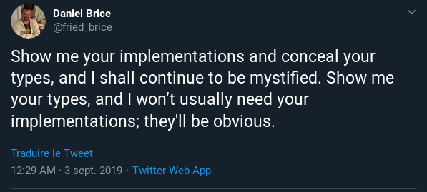

Slide 64
Other benefits from IO
SideEffects.scala
IOs can catch exceptions
They can easily be executed in parallel
They form a large ecosystem that makes concurrent applications easier
  Concurrency constructs from Cats effect such as Ref, MVar …
  Reactive Streams with fs2
  Purely functional database access with Doobie
  ...

Slide 65
Building a functional Tic Tac Toe
Tic Tac Toe can be modeled as a finite state machine
Possible states = a State ADT
The board, a matrix of “moves”, can be modeled as a two-dimensional List
State transitions = pure function of State => State
The user interface can be separated from the core logic using IO monads

