Slide 1
Trends in International Arrivals at US Airports
Marsalis Paige
Tony Fernandez
Geoffrey Booker

Slide 2
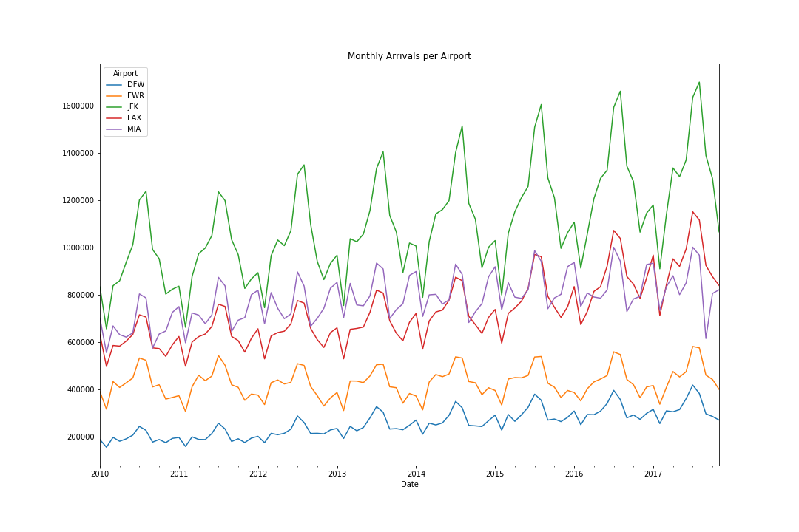
Monthly Total Arrivals by Airport
General upward trend for JFK, LAX, and DFW. EWR is flat over studied time period and MIA shows a slight decline from 2016.

Slide 3
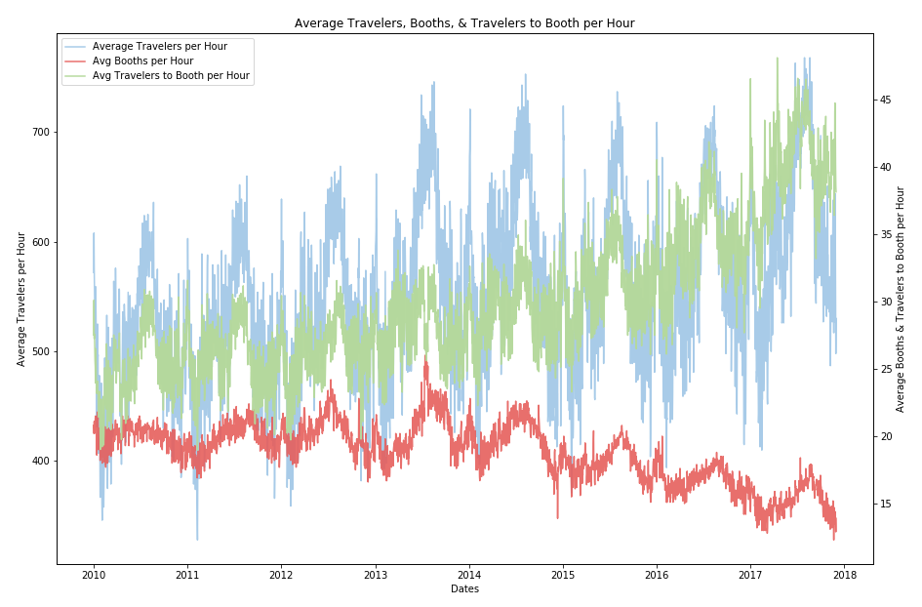
Travelers Compared to Booths per Hour
Average number of travelers per hour has increased by 21% from 2010 to 2017
Average number of travelers to booths per hour has increased by 59% from 2010 to 2017
However, the average number of booths per hour has decreased by 24% over this time frame

Slide 4
What Should You Expect from More Travelers and Less Available Booths?
LONGER WAIT TIMES?

Slide 5
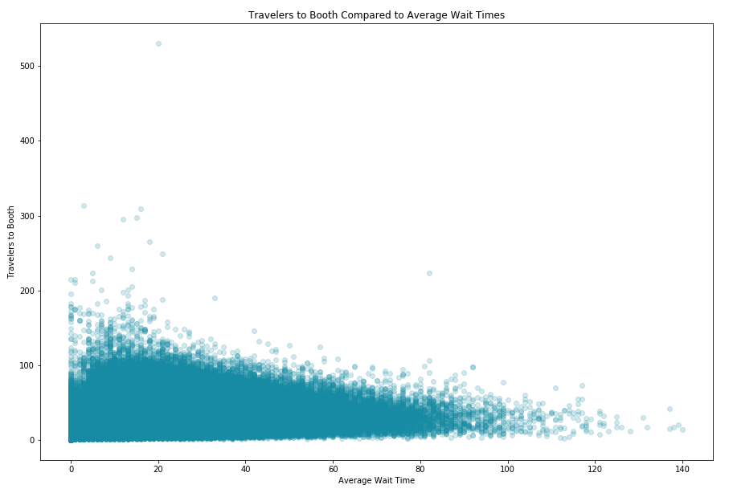
Traveler Wait Times
Average Wait Times do not increase when travelers to booth increases

Slide 6
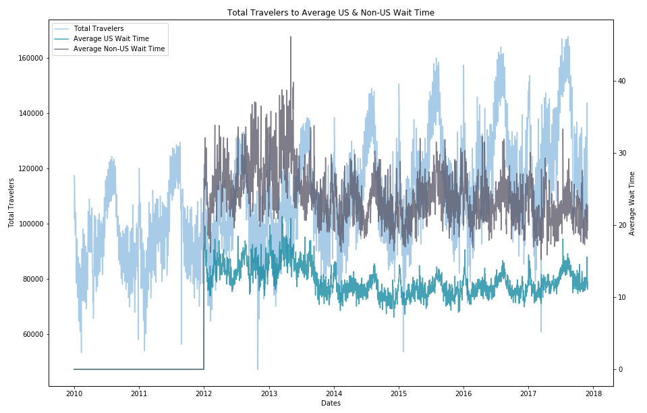
Arrival Clearance Times
Average wait times for US and Non-US travelers have decreased by 13% and 17%, respectively, from 2012 to 2017 with major shifts happening in late 2013

Slide 7
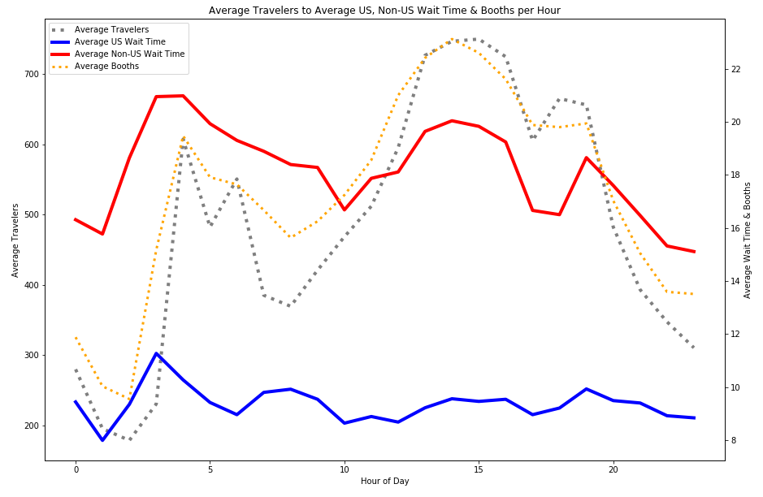
Customs & Border Protection’s Efficiency
US Wait Times are maintained even during peak hours
Improved Wait Times due to Custom & Border Patrol’s ability to meet traveler demand during Peak Hours
Introduction of Automated Passport Control (APC) kiosks and the expansion of those who can use the kiosks.

Slide 8
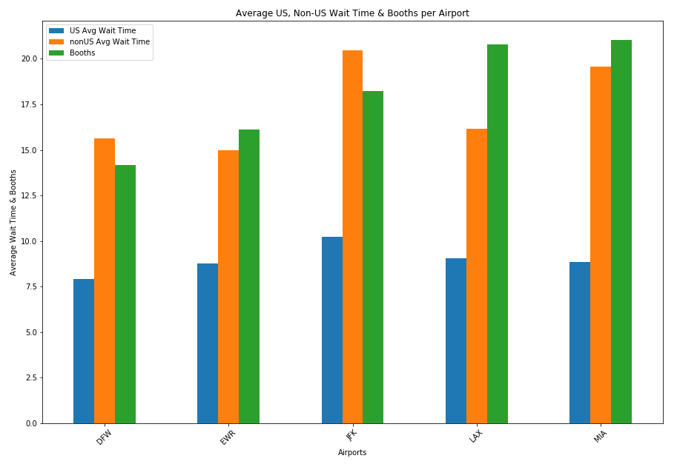
Fastest Clearance Times by Airport
DFW – US Citizens
EWR – Non-US

Slide 9
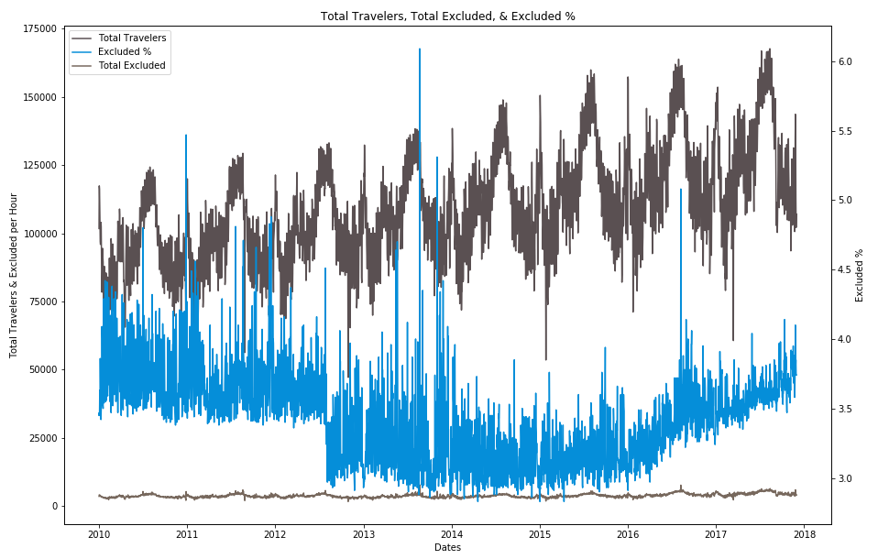
Excluded Travelers
Excluded percentage dropped significantly in mid-2012 but began to see an increase in 2016 back to previous mid-2012 levels.

Slide 10
Limitations of Data
No differentiation between manned booths and automated kiosks in data
Data does not segment Non-US citizen travelers
Data does not contain point of origin data

