Slide 1
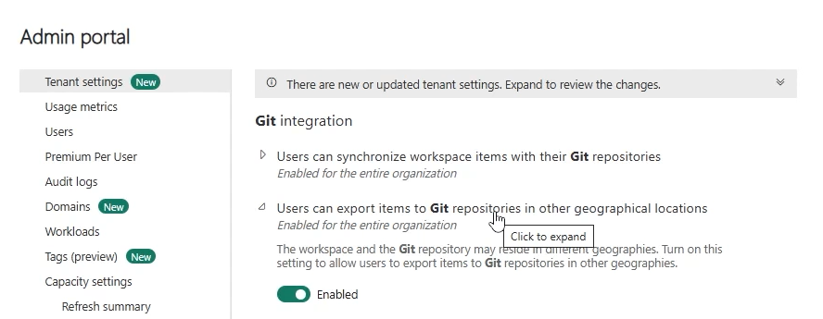
Fabric / Azure Devops So Far

Slide 2
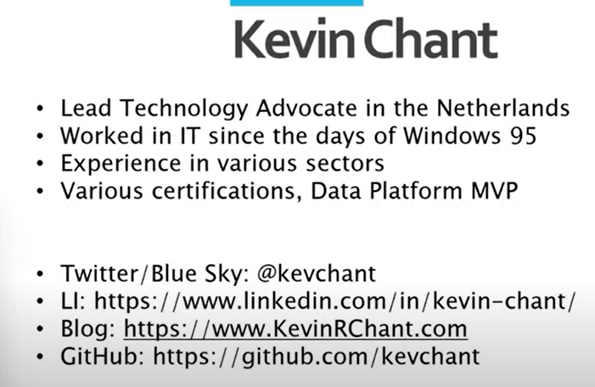

Slide 3
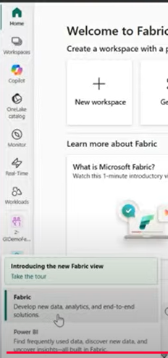
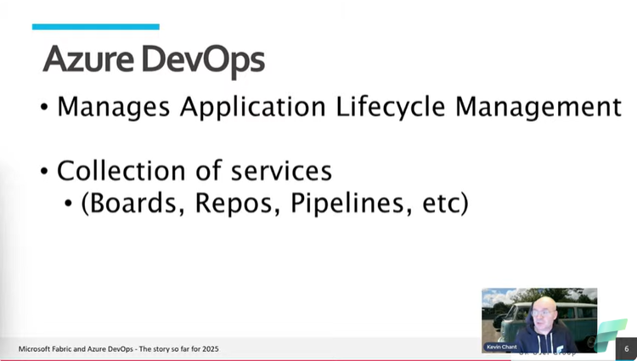

Slide 4
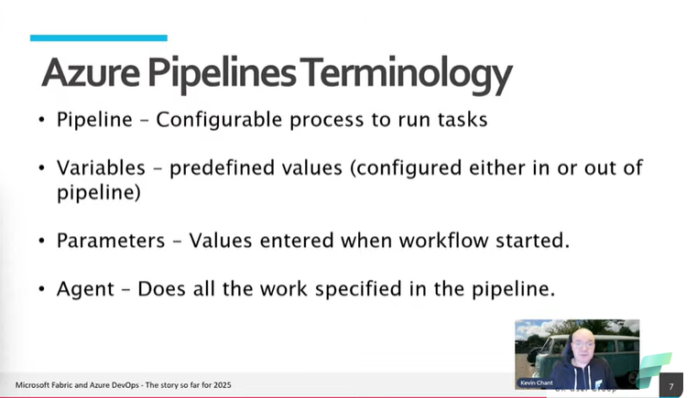

Slide 5
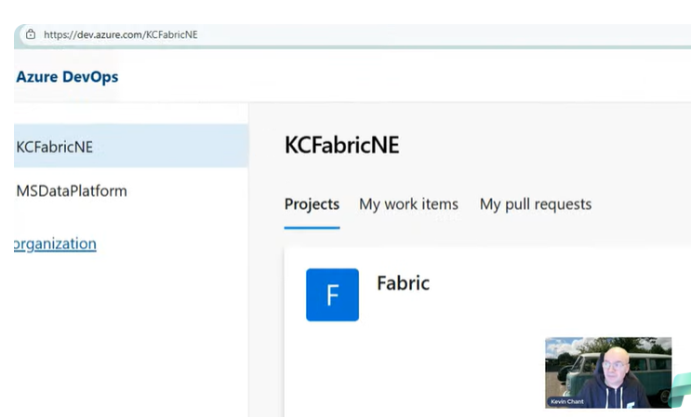

Slide 6
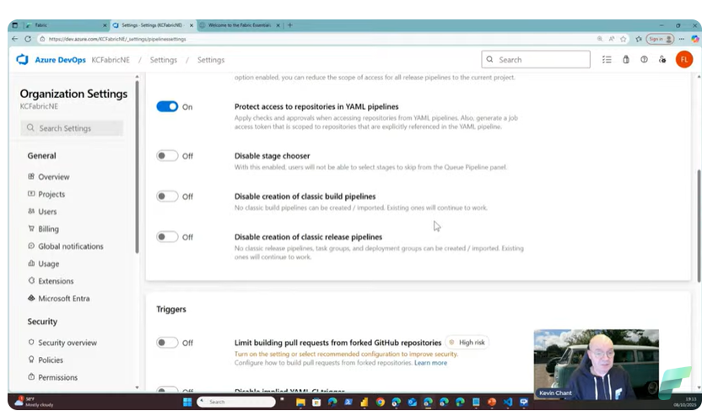

Slide 7
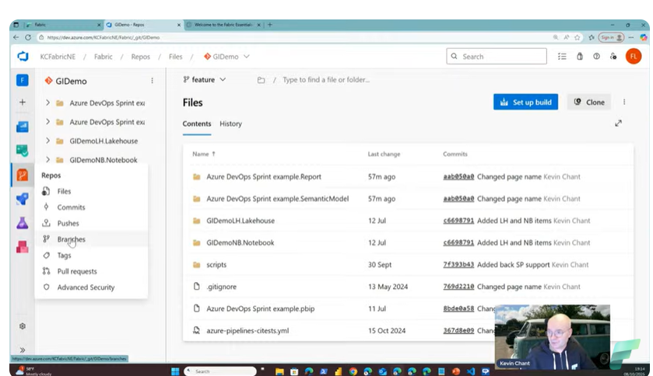

Slide 8
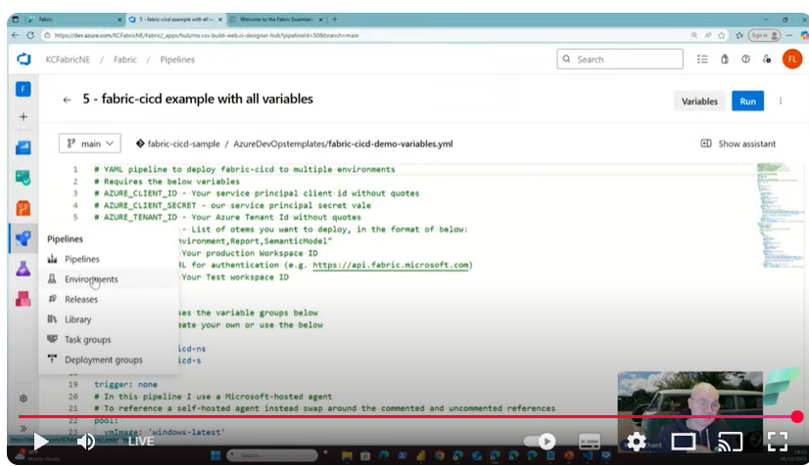

Slide 9
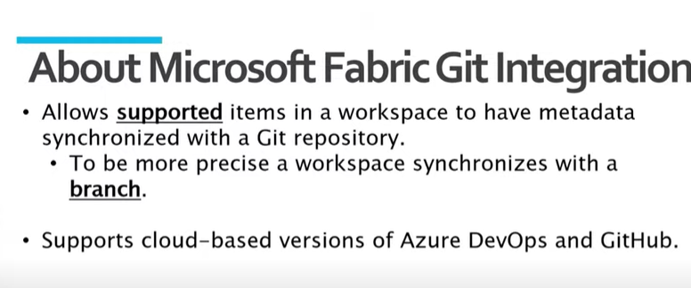

Slide 10
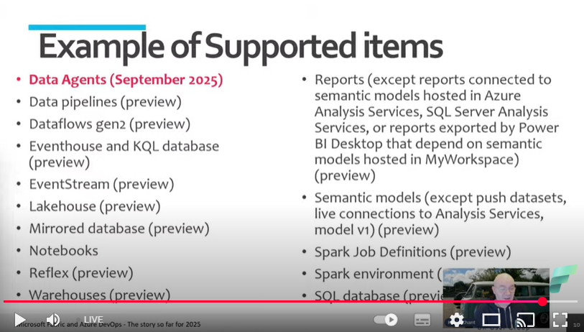

Slide 11
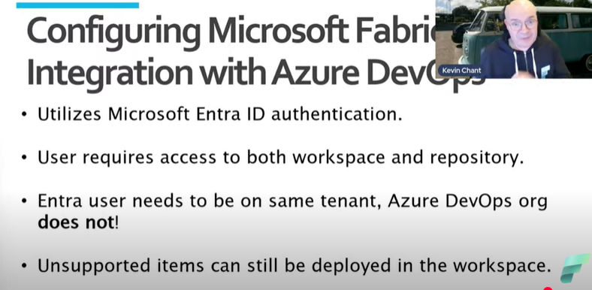

Slide 12
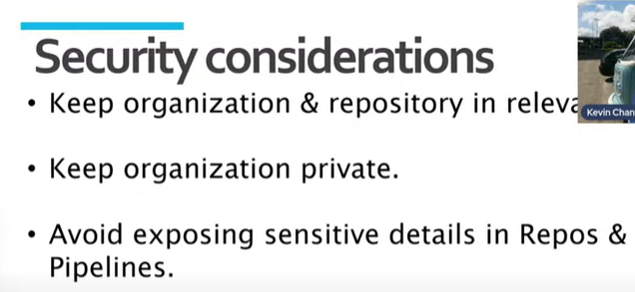

Slide 13
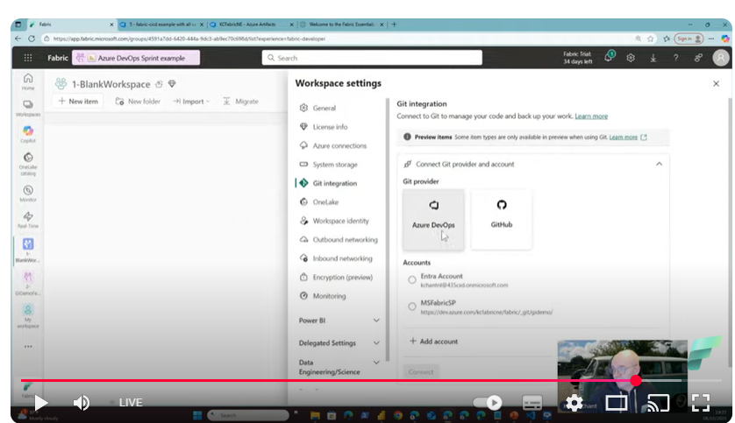
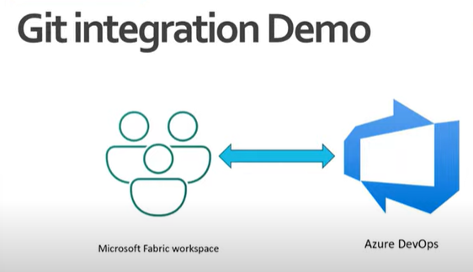
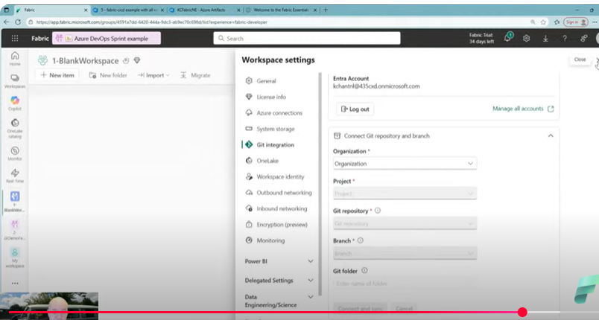

Slide 14
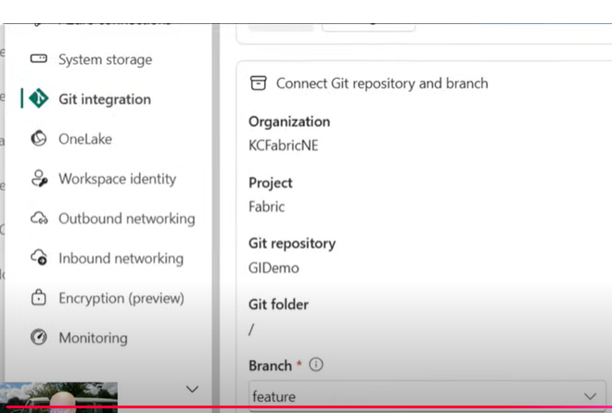
He goes to Wspace , then goes to git integration in settings

Slide 15
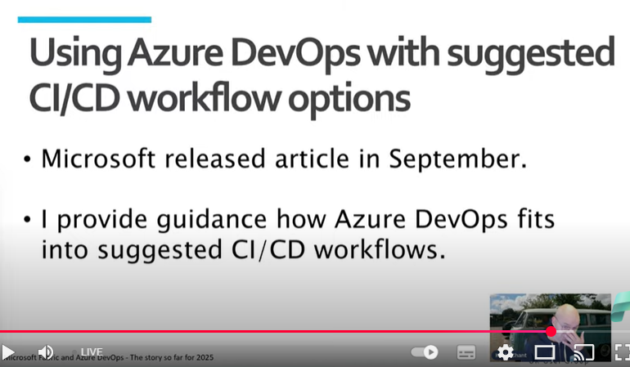
CICD Workflow Option

Slide 16
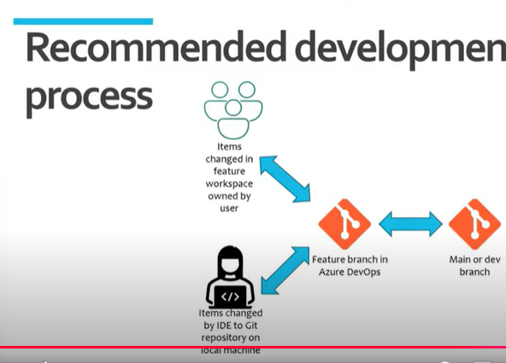

Slide 17
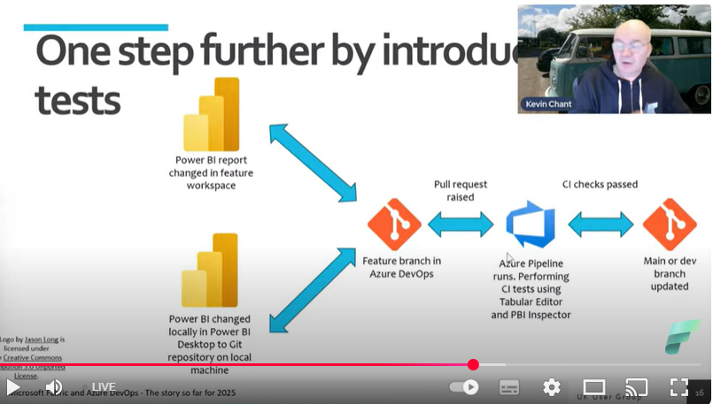
Integration Testing..ie testing reports
Notes:
Check Qulaity of report in PBI Inspector / Checks semantic Model!

Slide 18
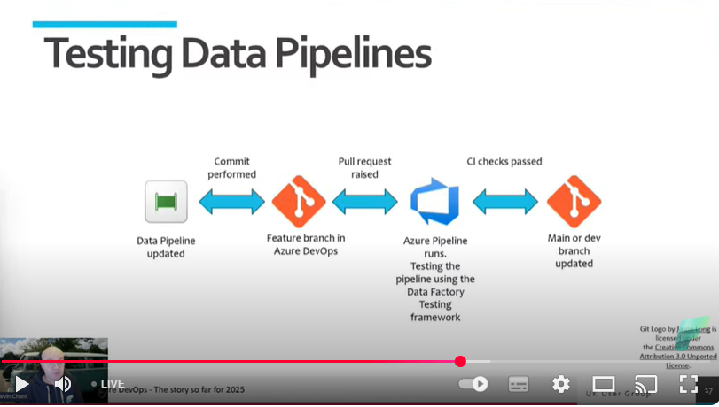
Can also testr data piplines
Notes:
Data pipeline updated , and therefore it is tested. Commit dataplipeline to Azure Dev Ops. To updates dev branch.
Data Factory testing Framework.

Slide 19
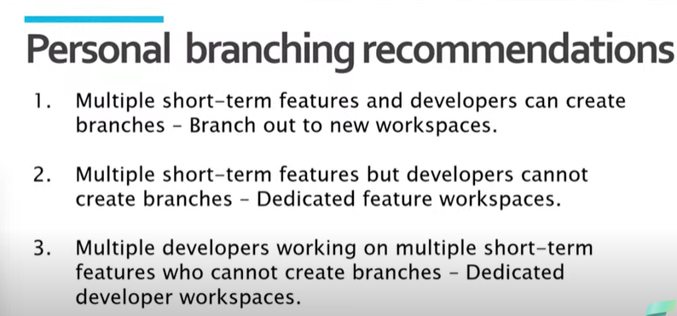
Branch Strategies
Notes:
See Fabric Essentials Listings: -- Guidance on Repositories configs.

Slide 20
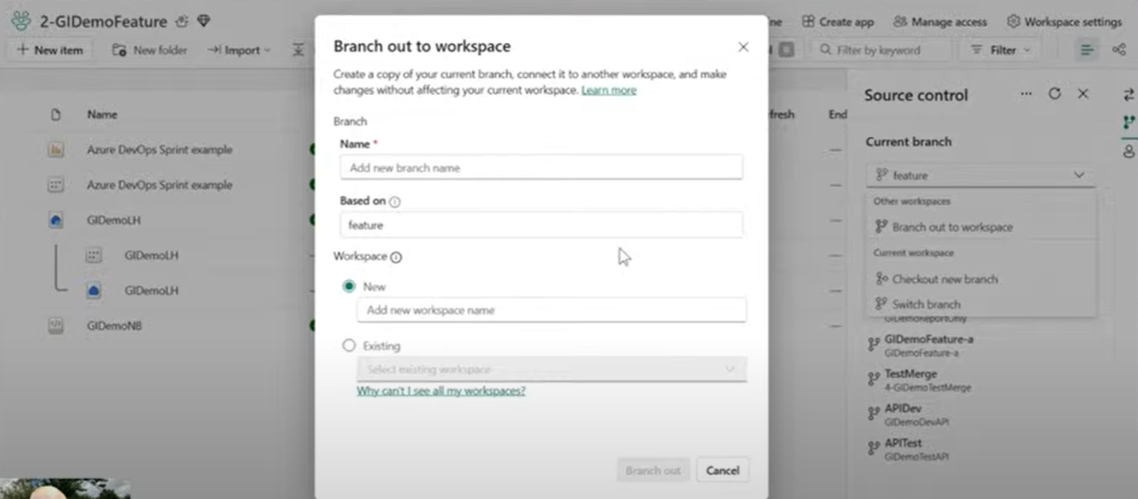
Note the Source Control – Do you only se that if Dev Ops is enabled, I don’t see it.
Notes:
Branching out to new workspace. It wil create Branch in Repository ..as well. Click on the Green Branch ICON.
It will synch over all the supported items.
Is only clones over Meta data, not the data itself.

Slide 21
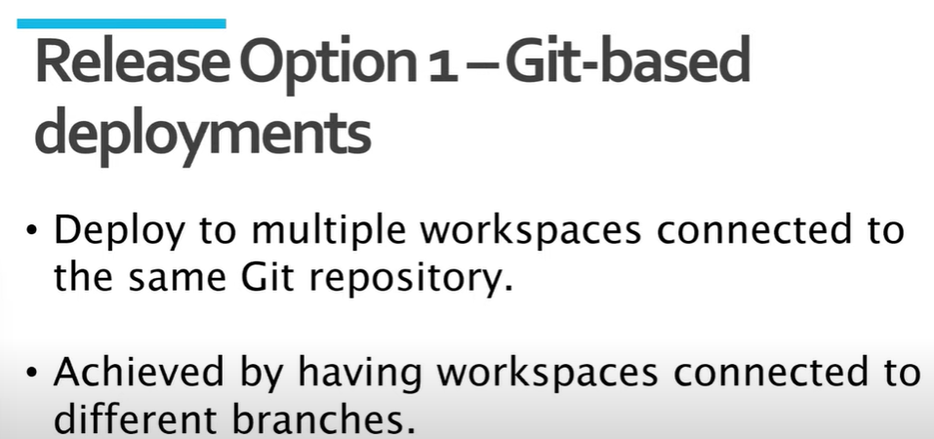

Slide 22
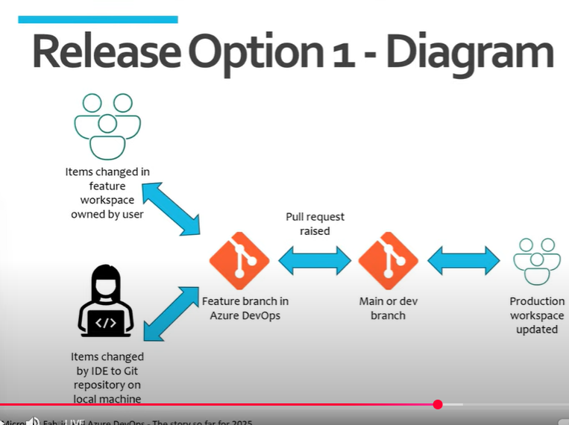

Slide 23
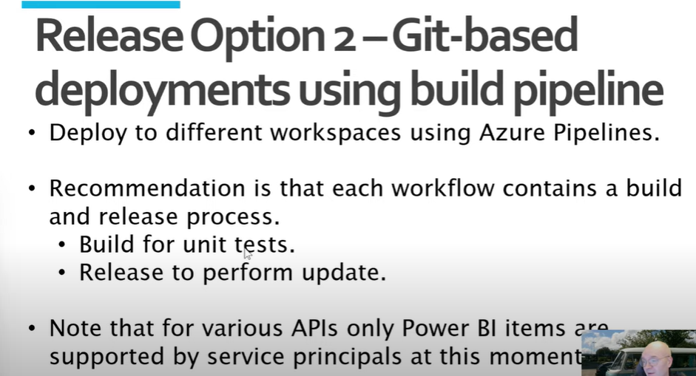

Slide 24
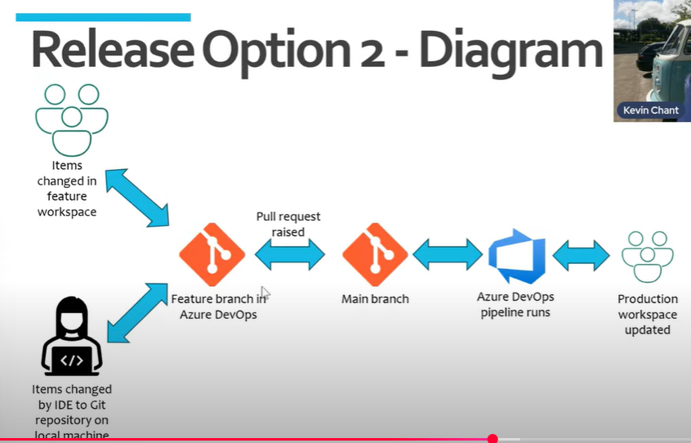

Slide 25
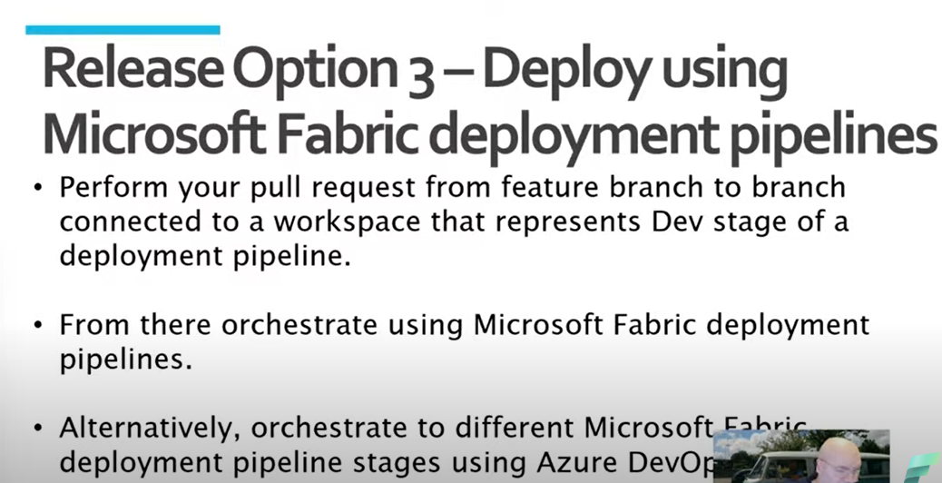

Slide 26
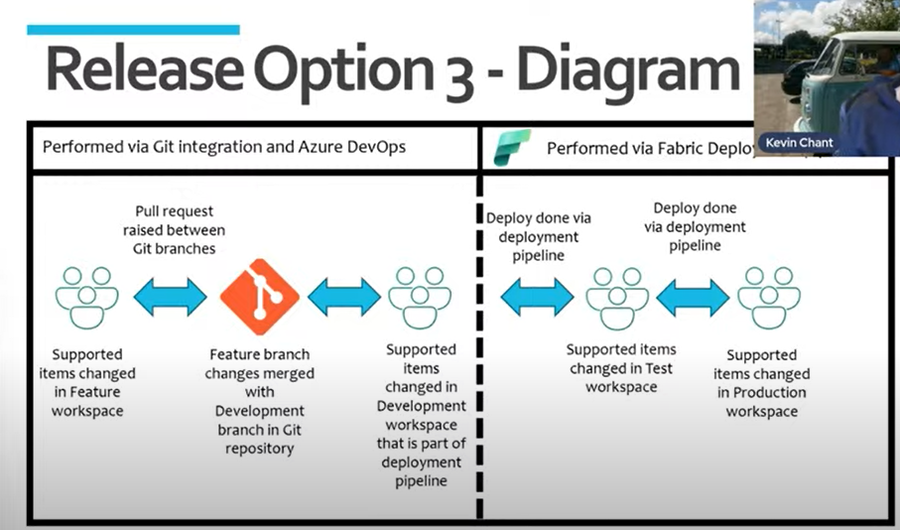

Slide 27
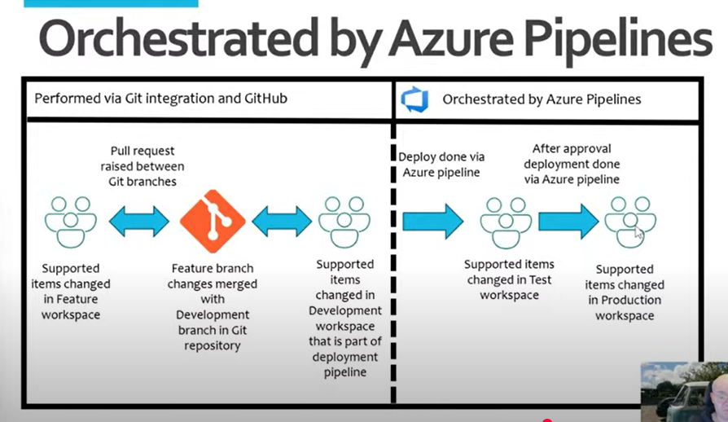

Slide 28
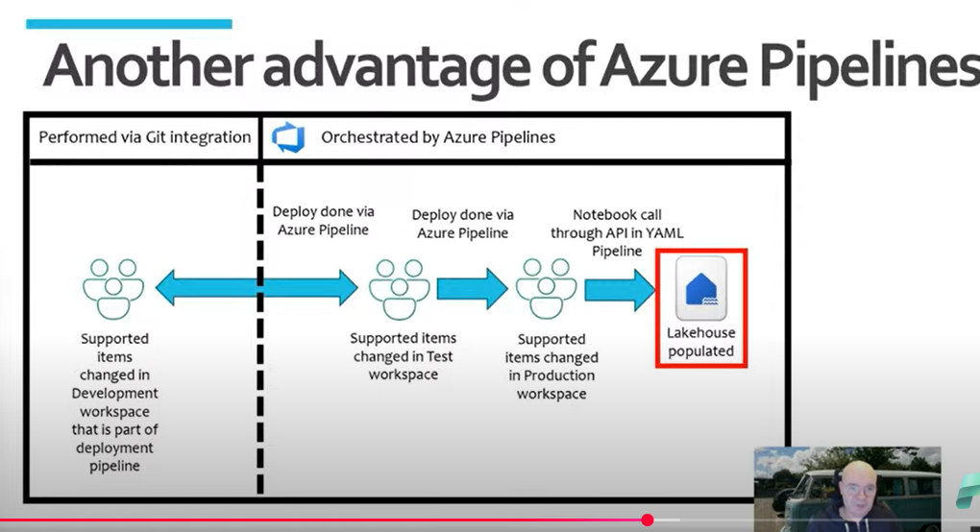

Slide 29
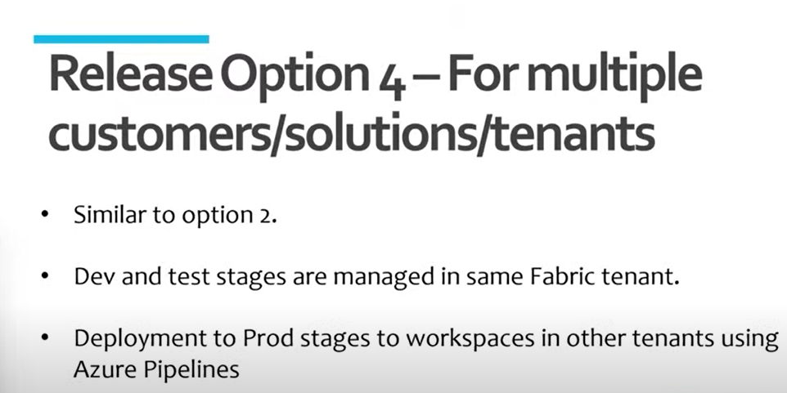

Slide 30
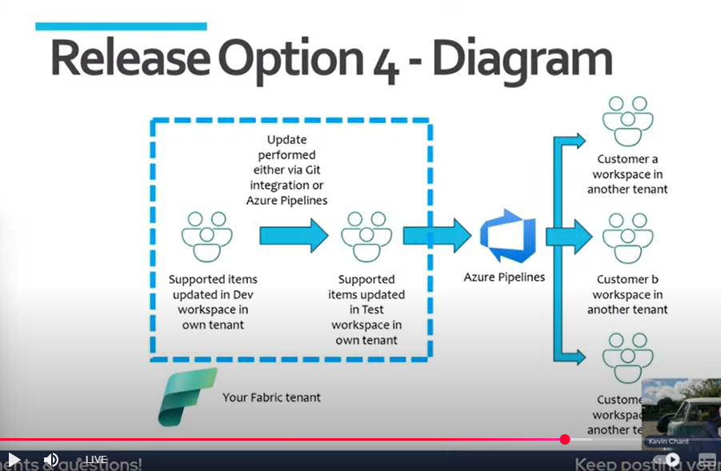

Slide 31
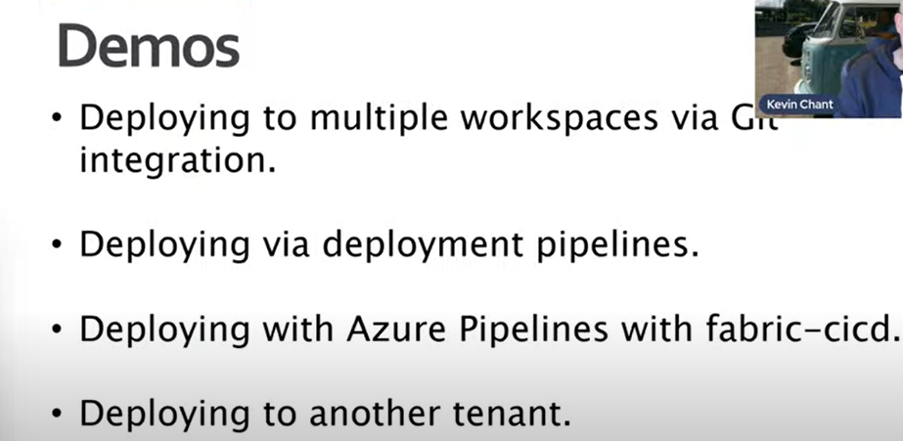

Slide 32
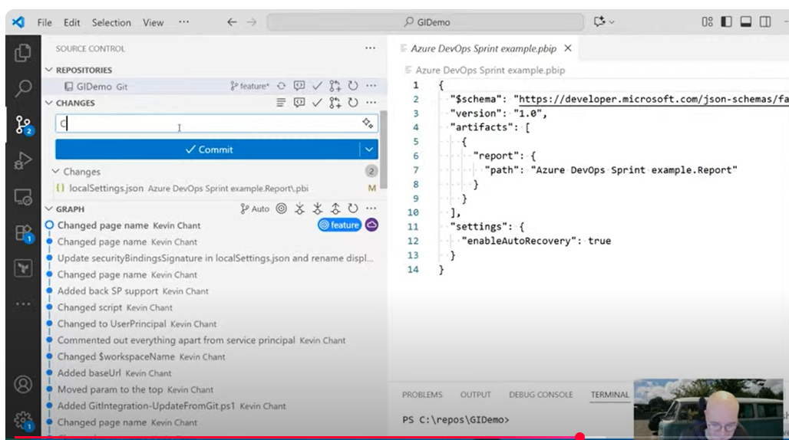
He made a change I PBIX ..Source contro;l recognizes it and logged in the Repo
Notes:
He commits the change…manually.

Slide 33
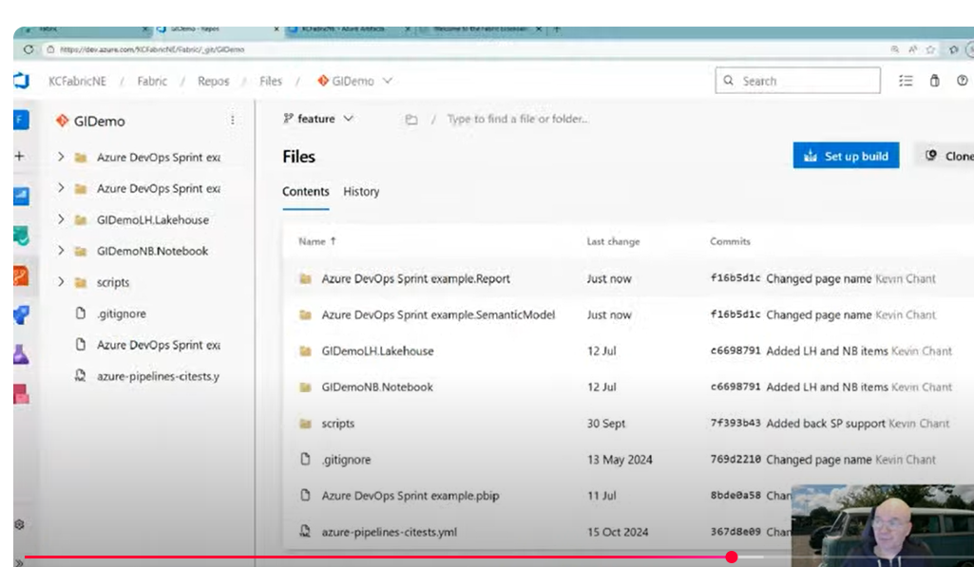
See change in Repo.

