Slide 1
Apache Airflow .

Slide 2
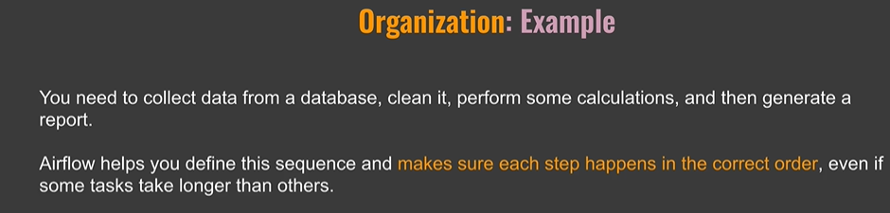
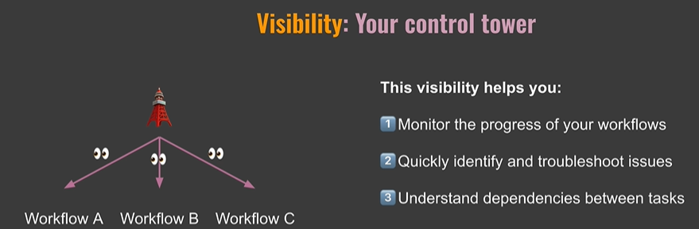
Why Airflow:

Slide 3
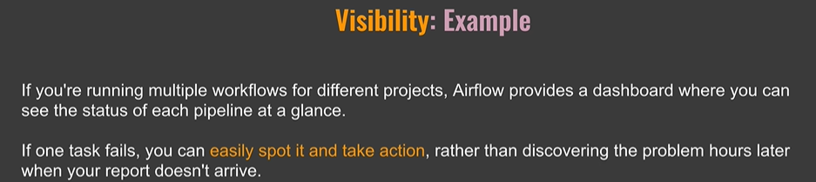
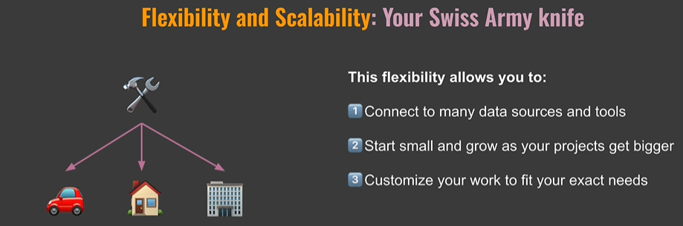
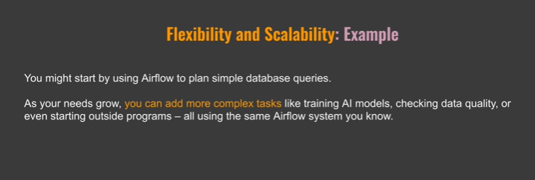
Visibility

Slide 4
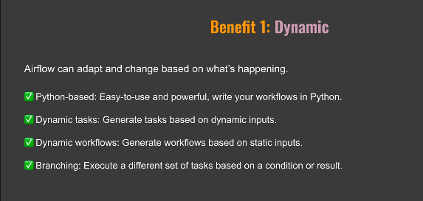
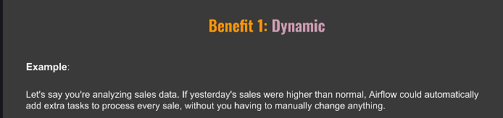
What is Airflow

Slide 5
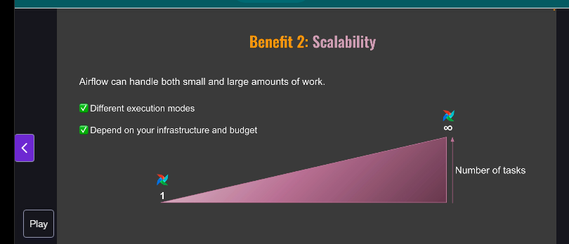
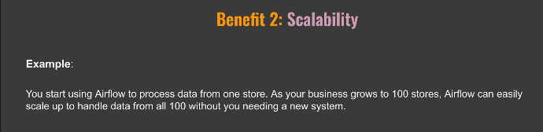
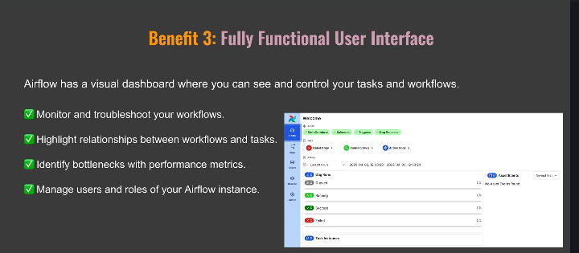
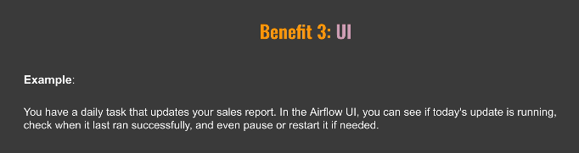

Slide 6
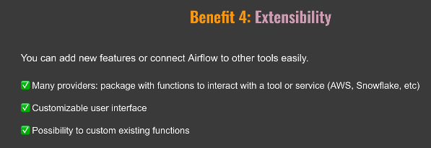
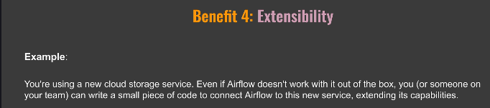

Slide 7
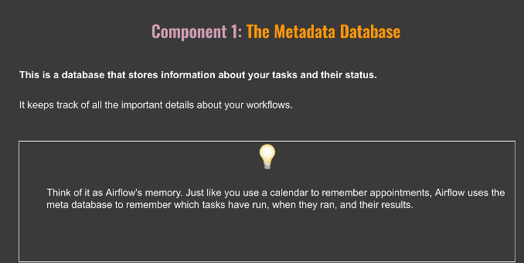
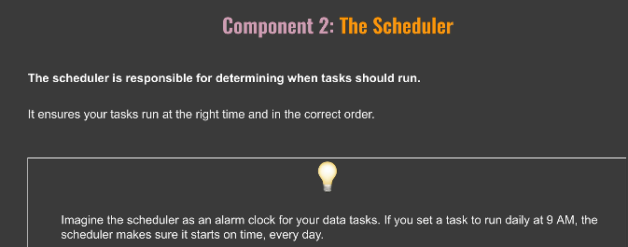
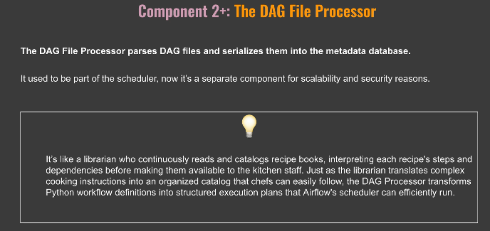
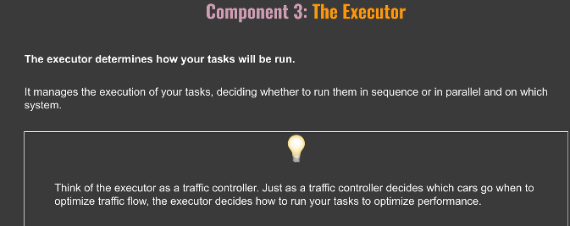
8. Core Components of Airflow:
Notes:
Metadata , also info about users and variables
Crucial components
Executor , how tasks will run , not execute tasks , and which system to execute the task. Like Kubetrnettes executor.. Different executors / different systems.
Ie how to run tasks to optimize performance

Slide 8
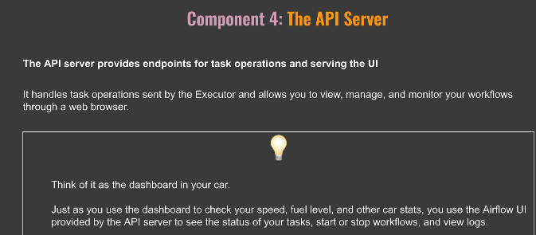
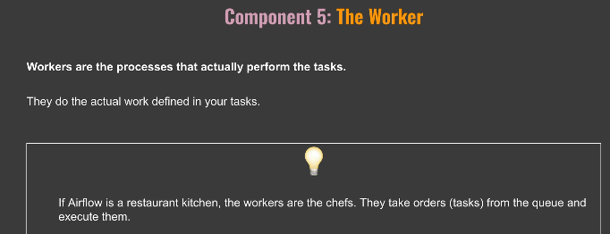
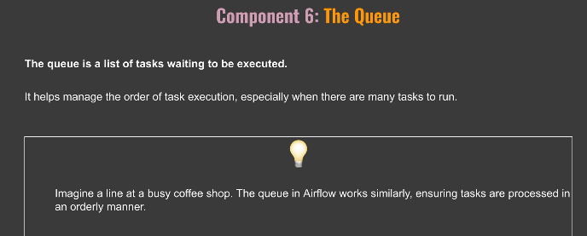
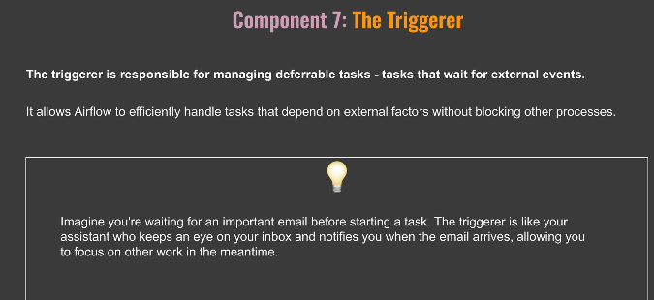
Notes:
The workers execute the tasks.
In Summary you need the API server to run tasks and access the UI , Scvhedulaer to schedule tasks , meat data server to store info, you need workers where tasks run. Ececutor and queue are internal , you don’t see them , when run airflow

Slide 9
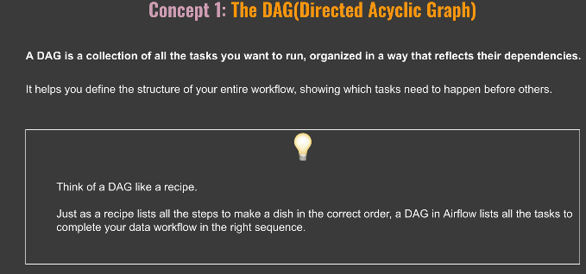
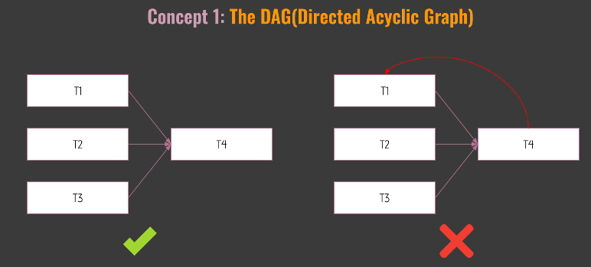
9. Core Concepts
Notes:
1) No Cycles .. In the tasks.

Slide 10
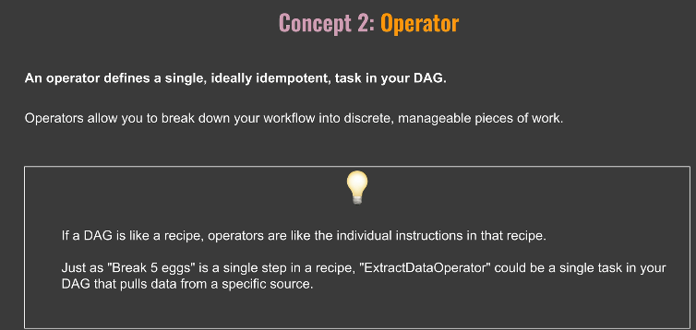
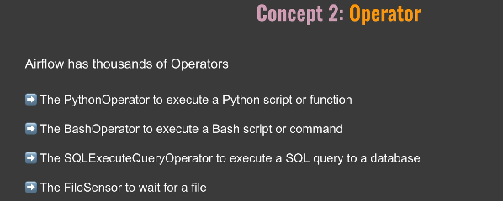
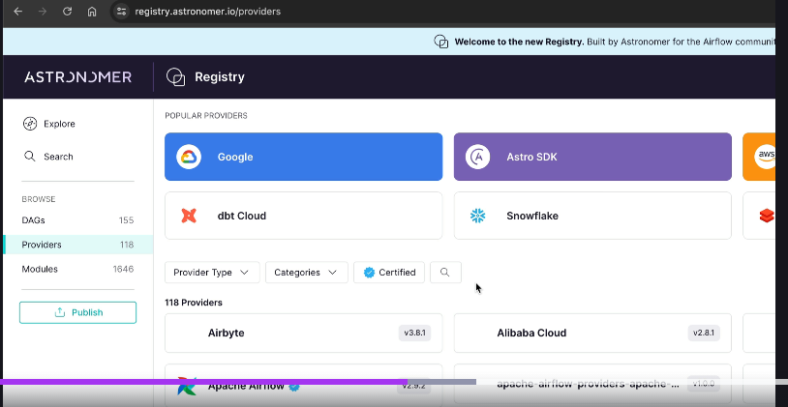
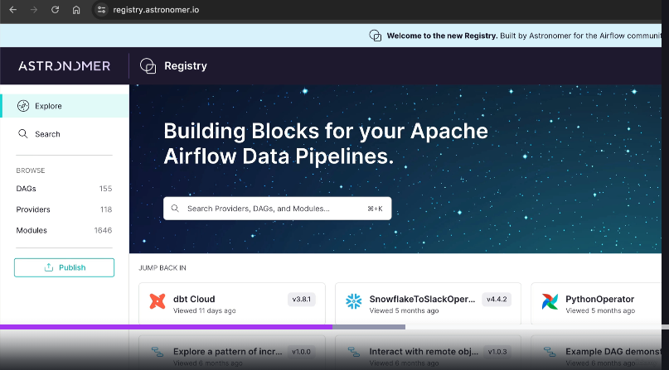
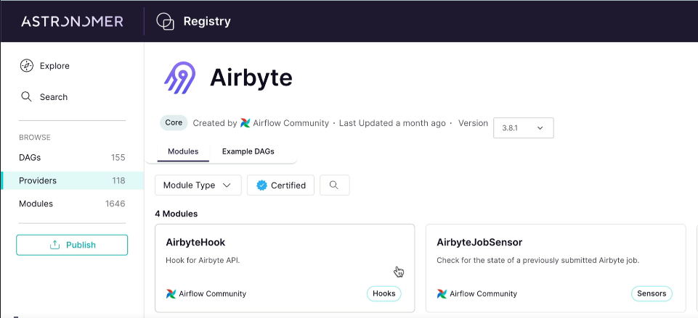
Operator.
Notes:
Opeartor Providers , see examples of Providers on the right.
Airbyte is one such provider as shown, say Airbyte may have its own operators.

Slide 11
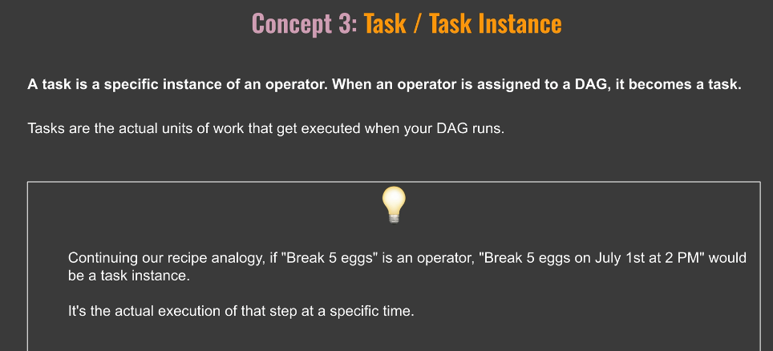
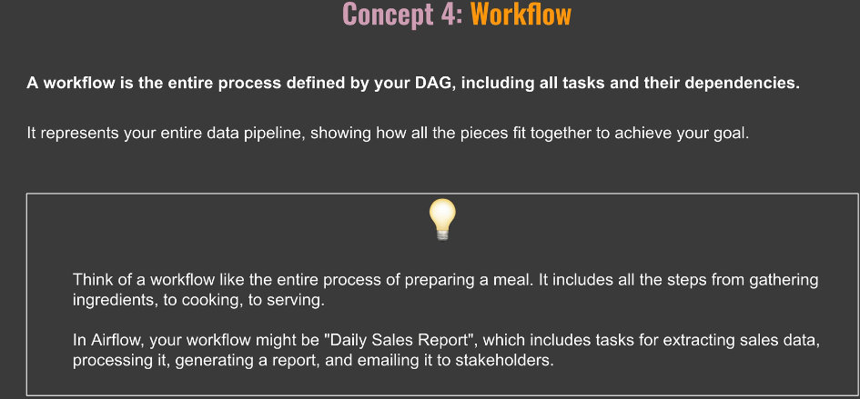

Slide 12
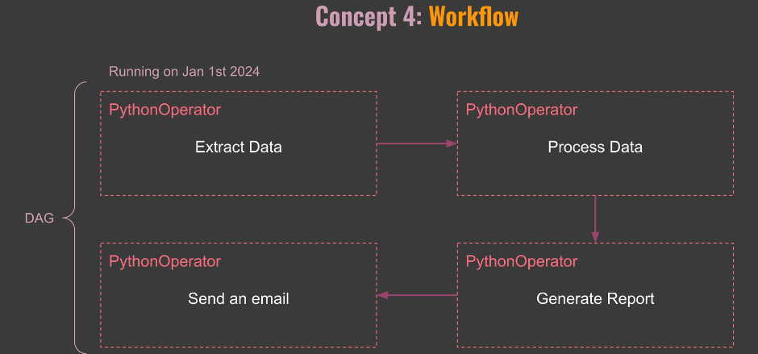
4 operators and how they fit together to define the workflow
Notes:
A dag is a workflow!! Operator is a task. The execution of an operator is an instance.

Slide 13
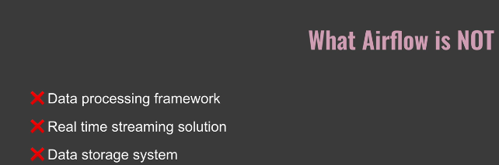
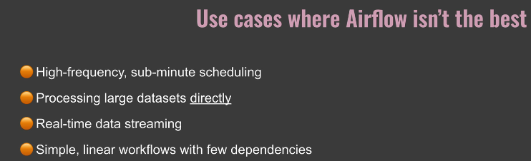
10. Airflow is not!
Notes:
Airflow meant to orchestrate , not perform jobs.
Airflow operates Batch , not streaming.

Slide 14
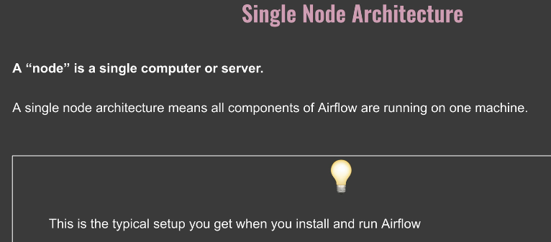
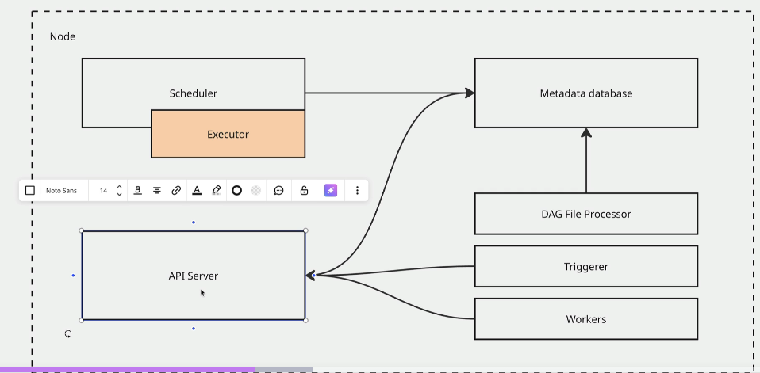
11. Different Architectures (Single / Multinode).
Notes:
Api server for access to Ui and provides end points for tasks.
Scheduler checks for tasks to be triggered, Executor is part of scheduler ..which system tasks to be run on
Metadata to store all the info..task instances, dag runs , users
Multiple workers , subprocessors of schedulers to run tasks ,
Triggere to run externally activated tasks.. Special tasks.
Dag file processor , parses and setilaizes the dag files
Which component to which component communicates?

Slide 15
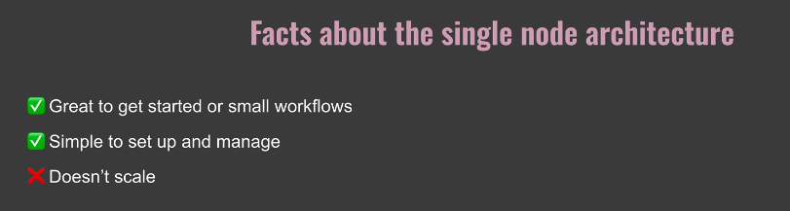
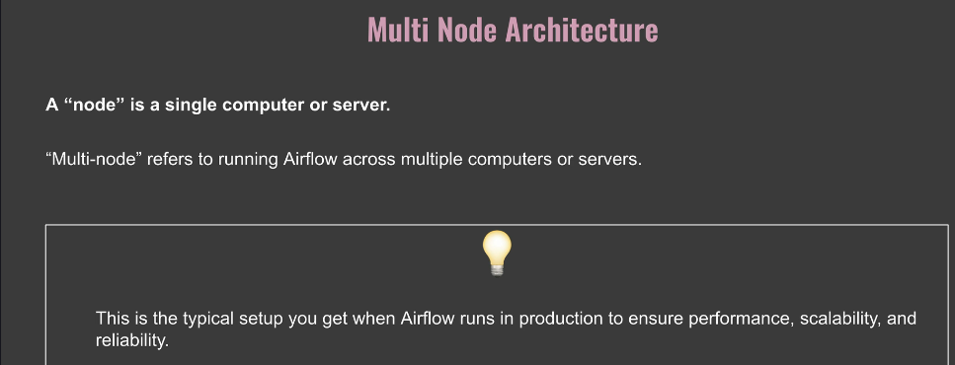

Slide 16
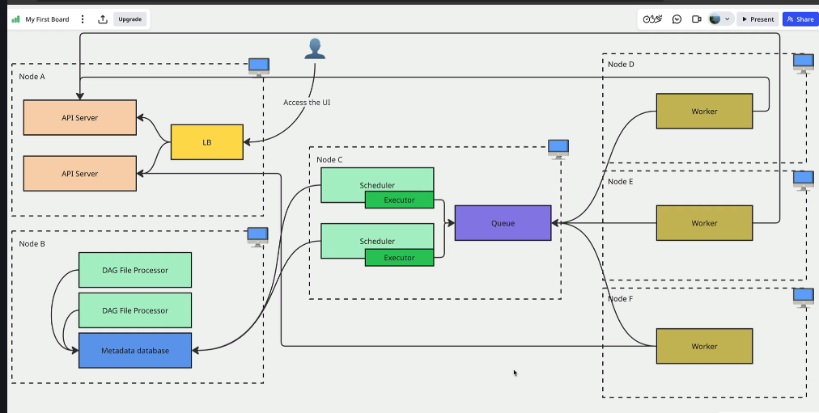
Multinode architecture.
Notes:
Many API servers , working through load balancer to Ui ..
Metadata base run on dedicated machine.
More than 1 scheduler on a single dedicated machine, fror redundancy puprposes.., executors are part of schedulers
Many Dag file processors on same machine as metadata databases ..seriliazes dag files in meta database.
Then have q, externa Q
Then you have workers that schedule the tasks , 1 worker per node , run from the q , from the executor
Wo9rkers communicate with API schedulrer to update task info in the database.
Workers don’t comms with DB directly

Slide 17
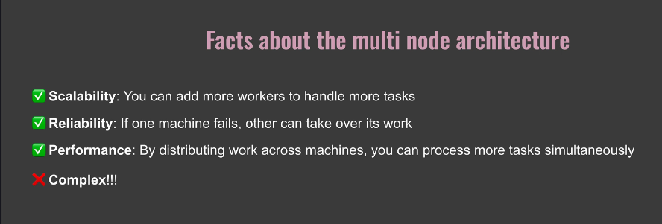

Slide 18
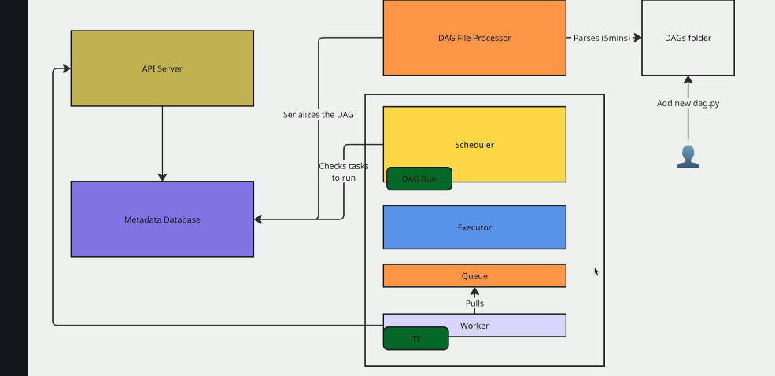
12. How Does it Work?
Notes:
We have the 5 components and Add the pythyon file to DAGS Folder , remember here they use docket and VSCode.
The Dags file processor parses Dags folder every 5 min. and if finds one serializes it in the Meta Database
The Api server then shows DAG on UI , and checks on Scheduler if tasks to run.., if task ready to run then Dag scheduler schedukler a Dag Run. The Dag object Runs , Scheduler creates task instance (TI), TI is sent to Executor by Scheduler , then its in Queud state, here its internal.
Now the Worker , the process that runs task , picks up TI , lands in Run State , completes and Worker comms with API Server to tell of completed state of TI , API server lets Database know , then scheduler knows it’s a success , Dag run is now completed ,
This is single instance..Scheduker to worker all in same processor

Slide 19
13 Install Docker ..Dont Need this Fabric Has it – will investigate if bnedede

Slide 20
Section 3- Important UI Views

Slide 21
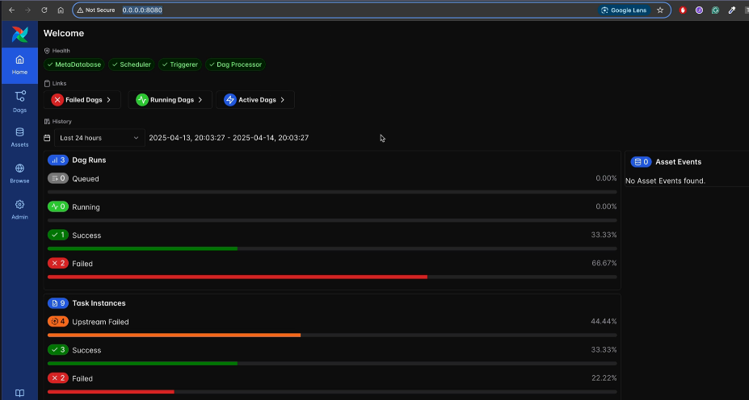
14. Home View
Notes:
This is his home page which is accessed via the ip 80.80 address above
We must look for this view in my dag 1 file
This is the Home page. Gives the health of your dags , if you cant schedule tasks the scheduler may be down
You can access any of the dags by clicking on the failed running and active dags. Active;not running yet
It also shows the tasks , failed success ..
You can also see materialized assets as well, on the right side.,

Slide 22
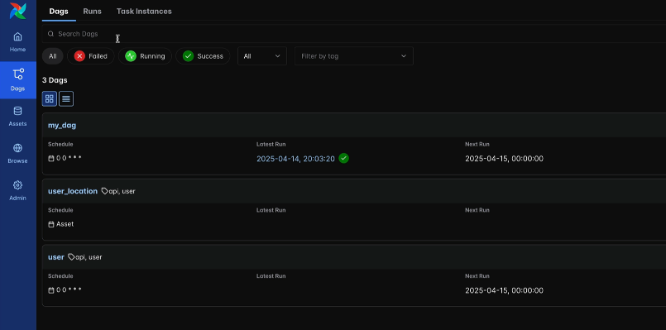
The Dags view.
Click on left for dags view and the dags tab.
Notes:
See all Dags
Yiou see buttons for the states of latest runs. So you can filter for the latest run that failed , or latest successful run. C

Slide 23
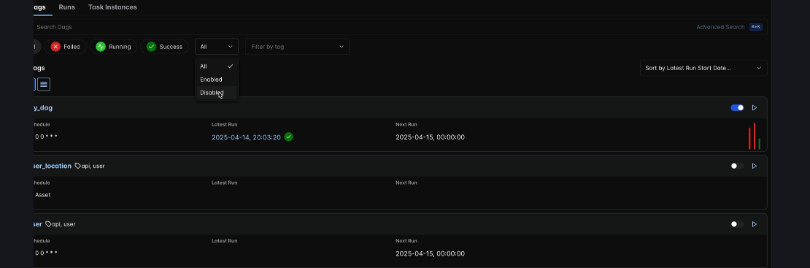
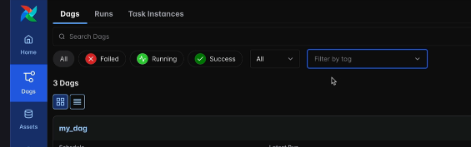
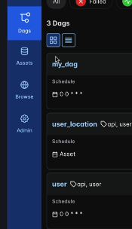
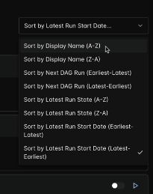
You can filter for enabled / or disabled Dags
Notes:
See the botton on the right of the dag , before the play icon
You camn alsp filter by tags , if you tagged you dag.
Don’t forget to remove the tag filter
Yiu can display by tile or list. See rhs bottom
Can also sort DAGS , see rhs bottom.

Slide 24
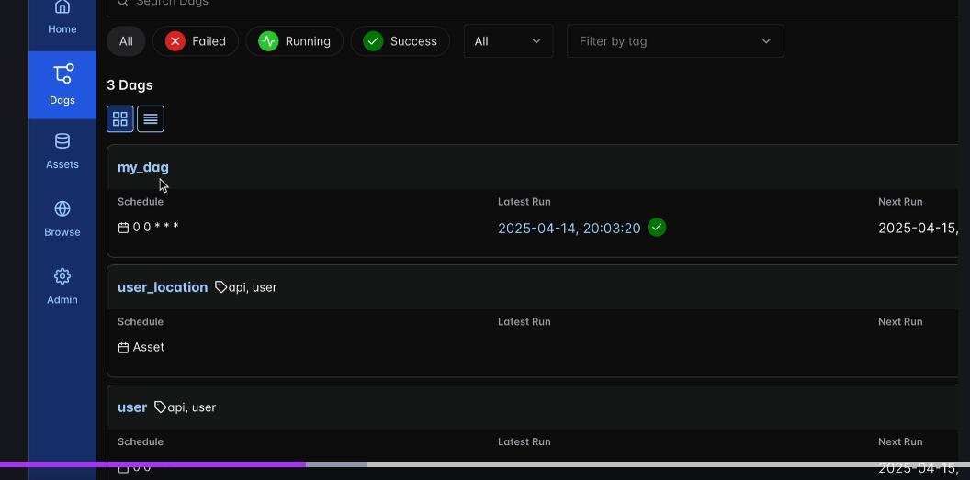
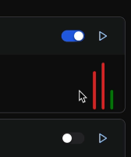
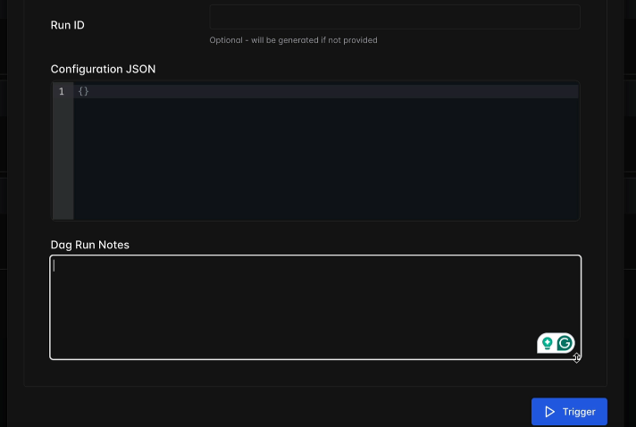
Dag View.
Notes:
What u see is display name or unique ID , below is schedule if scheduled , and other info
Bars on rioght ..hovere over to get stae info and run times , duration, click on the one you want to access.
You can pause the schedule , just toggle the button. You can manually trigger it, with options. You can parmetyerize the dag , Json and make dag run notes. On the trigger menu.

Slide 25
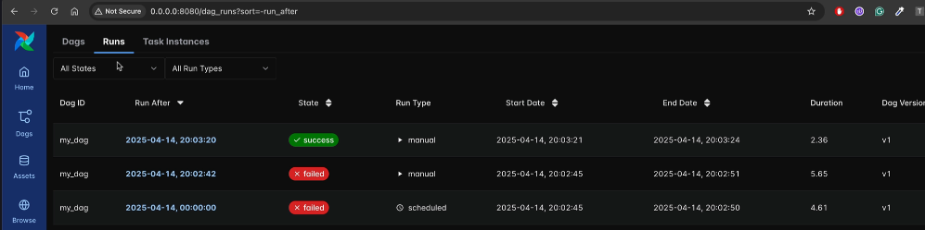
Dag runs View , the next menu items
Notes:
Filter By state and Run Type , you can see the dag IDS. Yjthere /
It also shows you the version , so if you altered your dag ..it would show different version
You can clear a dag run ..swee end icon.,

Slide 26

IN dag view you can see ttaszk instances
Notes:
Can see many details , the Id , and also the operator of the dag.
You can Search task by name and filter by state.

Slide 27



The asset view
Notes:
Asset , is a dataset , we are on an oldere version
Yiou can custom group your assets
Yiu can see dependencies , ie thye consuming dag hears was user user location , user location consumes user , se on hover
You have the arrow icon to , to trigger event or create tyhge assedet
When you materialize an asset you trigger dag event behind the asset. Youi will run a dag with 1 task to materiaze the asset.
Manual , you want to simulate the event to materializsre the asset.

Slide 28


If you click on the user asset , you get this view
Notes:
Here you see the user dag that materialized the user asset, and the location dag that materializes the location asset .
Note here the location asset dependemds on the user asset. As the user asset materializes it triggers the user loactiobn dag
On the right had side you can see asset events

Slide 29



Other Views.(Xcoms)
Notes:
Browse X coms , Xcoms are little boxes with values , this box creatred by a task.
Share values in taskd by creating Xcoms. One task can pull xcom from another
On the right you see value of the Xcpom. From the Dag.
If you go to admin you have the variables , you want to share variablessaccross multiple dags
You want to share an api end point across tasks. , create a variable

Slide 30



In admin you have the providers
Notes:
If you want o interact with a service you need to injstall the package to interact
It’s a python package to extend functionality.
You need to create a connection to thayt service .. Admin / Connections / Add Connection
You need to fill in the connection type., if it doies not appear , then youy have not installed it
There rae some usewr settings .. Click user icon at the base.

Slide 31



Slide 32

Project
Notes:
1) Post gress db interaction ..is the API available.

Slide 33


20. Define a Dag..
Notes:
We go to Dags folder in Vscode, and define a Dag ..see it in vscode..
Dag filer is a python file …user_processing.py in dags folder.
First: Import dag decorator , use correct interpreter.
Define the Dag @ dag..then def user_processing(): the dag ; it’s the unique id of the dag.
See above ..the definition ,
You musr call the dag. See the call to user processing , if not you will not see dag in ui.

Slide 34



21. Create Table
Notes:
We are going to create our first task ..create table .. Need a connection ,
We use an operators .. , see example above
Prerviously we used postgress operator.. Now we use a sql execute operator ; no operator s[pecific to db.
So we need to import the operator.

Slide 35

Creating the task using the sql operator.
Notes:
Not the parameters in the operator , task Id , sql query , connection id etc.
We need the airflow connection…!!!, this is just the connection I as a parameter. See next video

Slide 36


22. Create postgress connection
Notes:
Access airflow ui / admin / connections / add connections
Save and see result. So we set up our connection

Slide 37




23. What ia a provider
Notes:
If you cany find connection type
You have not installed the library tto connect,
We have many providers , go to the registry
Example flink , see their operator , lick on use provider to install.. On the top righty.
Note there are 2 additional operators his providerprovides ..Must install the providers.

Slide 38




24. Secrte weapon.
Notes:
Does the create table task work. ?
We need the CLI , go to docker , see airflow connection./dag, expand it and see scheduler..amongst all others.
Click on it , and go to exec , type /bin/bash, type airflow , and see result

Slide 39


Testing the task , type the below
Notes:
See successful result at the bottom.
It does not populate the database..so metdata database is clean.

Slide 40

25 is API available.
Notes:
Test if API we are tring to reach is available or not
We generate a fake user , we want to get data from a url…
We use a sensor to see if api is working.
Sensor product, checks at regular intervals of time if condition is true or not.
Se the statement above of PokreReturnValue,,,the sensir
We create the new task , is API available or not ..
Note the @task function, the python decorator ….ther python function we decorate is a sensor,
We create the task def is_api_available .., we send a request to the link , and print response
Instatiate the result , based on ther status code of the response
We must return the poke return value, ie the sensor value , the condition variable
Note how the Poke return value is returned in the def function line ->PokeReutrnValue
We also return the user in the same task ..so we don’t have to create another task…fake_user
Pass fake user to Xcom value in the return statement.
Note also to import requests in the task.
2 parameters we use with sensors , strong suggestion : poke interval (interval for checking), timeout ..if still false for sensor to fail.
Must call the task..wew only defined it up to now ..else wont appear in the ui ie is_api_available.

Slide 41

Test the task , go back to cli.
Notes:
Give the instruction , top line ….ending is_api_available ..to test task , see result.
Last line ..success

Slide 42

Next task , extract user

Slide 43




26. Other useful sensors.
Notes:
Search http sensor in registry., see the file sensor..to check if file exists at location in system or skey sensor , file exists in bucket

Slide 44

27. Extract Users the Classic Way.
Notes:
1) Note from last time

Slide 45


We have the users inside github url , we need to extract them.
Notes:
To execute Pythin code in airflow ..use the Python Operator..- import it
Now we add the task in the dag (python task)
Called extract user , must have a task id , now we need the python callable function , _ extract user .. From the json file
We define the extract user function. Ti= task instance , reserved word ..thyen get the methods of ti. Xcom_pull… and print the fake user
In the task is_api available we return the fake_user (xcom..is the box containing the variable ), xcom is in airflow db.
Now we want his details from the db.
He then chooses what we want , the details from the github site.
Note how he addresses the variables
Now to verify if task works., cant run airflow task test.. We don’t create the xcom.
So we use the api directly to get the info ie requests.get again.

Slide 46


Now we test the task
Notes:
In docker CLI terminal we run the test task command. Success
The task returned the correct value .

Slide 47

28. Preferred was
Task decorator is the Python Operator/ can remove Pyhton Operator and replace with task decorator
Notes:
So we going to use the task decorator , as this is the puython operator.
We take out the python operator , but define the task decorator
Much simpler code , but you must call the task decorator , else wont see it in ui.,
Always use task decorator , when you have python code to run.

Slide 48

29. Processing Users
Notes:
1) We want to write user info tio csv file
2) We don’t need the Python Operator , we define a task
3) We use the csbv library , and open the file , and write to it. By extracting user info in the previous task.
The call process user.
We want to test the task ..but need the extract user info , but don’t want to call that as well.
We copy the dictionary , that we had , just for testing we replace the task

Slide 49

Go to Docker and test the task.
Notes:
Note the

Slide 50


Verify at the files tab
Notes:
Go to files tab in docker and open tmp and fined the csv file
Open the file and see the result

Slide 51





30. Storing Users
Notes:
A Hook interacts with a service , see amazon rerdshift on left
We import the postgress hook .. See the statement import ..providers postgress hook ..
We get a warning that we have not installed the postgress providers ..which we do in terminal
We installed the hook , now create task
Copy from csv and load to table

Slide 52

We thren test ther tasks in docker
Notes:
Tesyt store user and processing again
We haved implemented last task of project

Slide 53

31. Dependencies .. We only defined tasks , have to define dependencies
Notes:
We go to ui and the user processing dag. See in dag view the following tasks.
The tasks store user and create tabloe are floating around. We need a way of a discilined , dependency ie first row , second row and third row ..

Slide 54





Dependencies
Notes:
If you see in the code there are some inherent dependencies , see above , but these are implicit ie. Fake user , input to user_info, then process user.
Use a dounble arrow to reflect order ie see above a>>[b,c,d]
Csan do multiple lnes
So how we do it in our case , see create table to store user ..replace a whole lot of separtar lines , in create table.
First one not correct , second one is

Slide 55

Refresh page in UI , Grpah page.

Slide 56

Dag in Action
Notes:
Go to th UI , and to Dags

Slide 57



Go to DAGS in UI
Notes:
Go to Dags Ui , Dasgs page and trigger it manually
Go to Options on RHS and select Dag run to see tasks , success..dag ran successfully

Slide 58


33. New Asset Paradigm
Notes:
We were looking in terms of tasks ,
Now we look at assets created, what do you care about..the tasks or the outputs
Now we care about the assets and the dependencies on the api , is it available , use it to get the assets via the tasks

Slide 59


34. What is an asset?
Notes:
Our version is 2.X , so we still have data sets , these are the definition of datasets
Why use assets…see image above , see above , you want to trigger the second pipeline after the first
Especially pertinent when you want to trigger a workflow on output of a task. (First reason)

Slide 60


Second reason to use assets as a base
Notes:
We have 2 data piplines , ie each of 1 task , in a python dag file , each has 1 task
We have a daily report and a monthly report in the same dag file ?? , Then we run the 2 dags , one is inherent after the other ,
NB: I see they are not parameterized.
Ecah task produces 1 data set , this is what we do here .in Apache 2.X
We now have assets in 3.x ..not available in Fabric. Instead of 29 lines , we wrote 6.
Therefore we focus on the assets ,
Assets is better for data lineage .

Slide 61


Assets is better for data lineage
Notes:
Much better view of dependencies using assets , as shown above. Look at the code to create an asset.
So we see the formats of the decorator @asset, parametersd ,and then define the my_asset()
Notice each parameter is explained and you must have each one. You can groupo the asset as well.

Slide 62



35. Create first Asset.
Notes:
We use the Fake user Api ,see all the names
Import asset decorator , we don’t define the name parameter it’s the one used in the definition of the asser/
\Note the parameter definitions notes:
Always put the uri..event if just the api.,
Note the use of self for the request method.
Then retorn the puthon dictionary , json of the data in the uri.
Bote the spercification of the outrput form dict[str). So it knows format of the output.
Don’t need to call the aseet. , like we did before with dags
Save the file and run airflow in the terminal. Docker CLI
Run airflow assets list and you should see your asset.

Slide 63


36. Materialize the assets
Notes:
Go to Exec in Docker , get the docker / airflow cli. – airflow assets materialize ..name user enter!
See the state , its in the queued state..not completely materialized .

Slide 64



Go to UI – Dags view , you see the asset , click on dags view then on the dage
Notes:
You see toggle is in queud state
Confusion ..we created an asset , not a dag…so why we have a dag.
Behind the scene an asset is a dag , with a single task.
If you click on the user dag , you see _Asset main operator

Slide 65




We now turn on the toggler user on the dag view
Notes:
Now asset getrs materialized , see the event ..click on the task , see info rekeasefd , seer the dictionary in the logs.
Take a look at the assets tab,on the right , and yoiuy will see your asset.
And if you want to materialize it , you can do soi in the UI , ie play button the the righjt

Slide 66

Click on button
Notes:
Create asset , or create the event to trigger downstream dags

Slide 67

37. Dependencies between assets
Notes:
We create a second asset, in the same file ,
Note the scheduler of the second asset , to run after the first asset, see schedule = user
Pass the user asset as a parameter of the user location,
Note in the first asset we returned a vale which we access via an Xcom into the second asset. Acces the context of the asset..see parameters in the def user location ; note all the imports that are done from airflow.
See config of xcom_pull, all the poatrameters..
Note how we access the results

Slide 68
Monitor Assets
Notes:
1) In the UI you can see 2 assets

Slide 78

pl_Medallion_Client_BackTest – ran on 4/11/2025

