Slide 1
PBurton DP700

Slide 2
12. Data Flow
Get Data/ More/View More to go to Cloud sources
Note you can get access to any thing in the lake (One Lake Data Hub
You have an Explorer on the side to get tpo different Wspace, if your data resides there.
Also Favorites.
New on left pane gets you to Cloud sources
Also see Azure menu to go to ADLS.

Slide 3
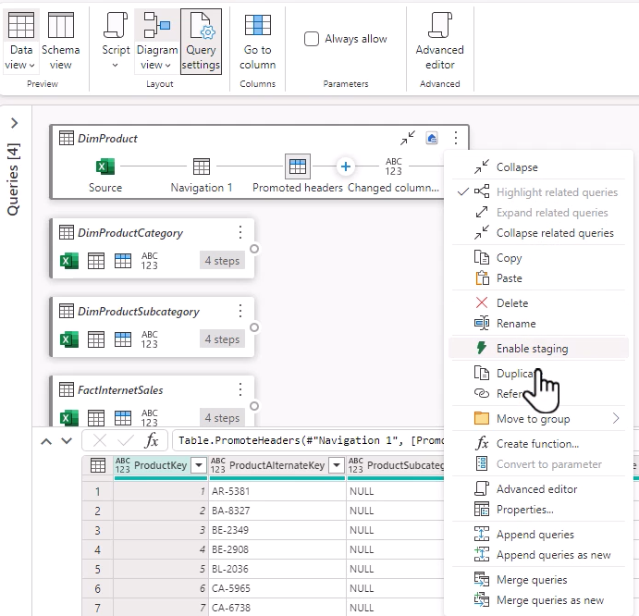
Speacial notes from Lecture 12
1) remember query settings on the Right to see parts of query.
2) Note the Schema view to quickly see the columns and their data types. And change and select columns.
3) Click … to change type or remove other columns.
4) Undo applied steps
Lower half of data view/ View menu can column profile/column distribution
Note on bottom right you have icon of a folw chart ..toggle diagram view. – query settings in diagram mode.
Can expand and compress the diagram view blocks
Note the … to bring up up new menu to do something wit the query (Append etc) ..see below:
Its as if you pressed query settings.
Note the Script View to get full script of the Fx bar.

Slide 4
13.Destimnation …lower right or menu.
1) 5 data destinations ..LH,WH,AZURE SQL ..etc
2) When selet LH , select default selection.
Give table / new existing.
Watch settings as may be error.
YOU CAN ALSO IGNORE COLUMNS when looking at settings..if you forgot.
Append , Repalce , if replace do you want to keep the schema.,
Note there are many queries for many tables , if you want all output then select output for each one (DON’T forget!!@!)

Slide 5
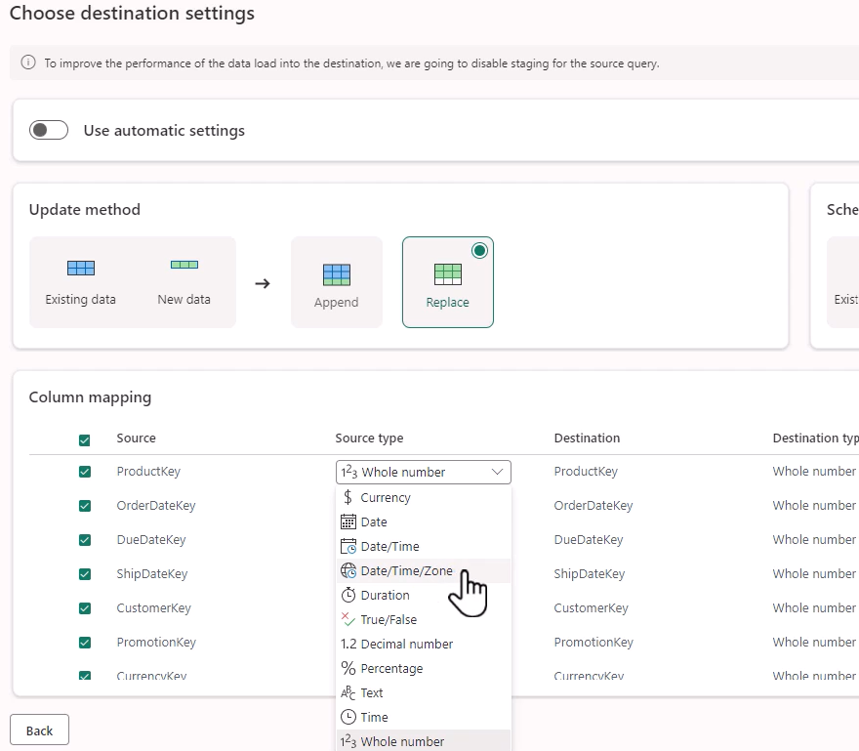
13. Always look through source and destination types

Slide 6
14. Save As template
Home..export template, name it description,
Ends in .pqt, stored as parquet.
Then to use the template..when open new dataflow , near bottom of data options is a url “Import from PQ Template
Then open the template , and give credentials and see the data.= to use elsewhere
Go to wspace to schedule the template , click … on you dataflow , settings , refresh. Configure refresh schedule/ on and refresh frequency. Etc.
If you have source and version control yoy see schedule on …

Slide 7
15.FastCopy.
Copy data in pipelines is best for large data.
How can you have speed of pipeline copy wit a graphical interface
Called fast copy…
Only following connectors –ADLS Gen2..(CSV / Parquet), lakehouese/azure sql db.
Must have lakehouse as destination.
Only some functions..Combine files/ choose columns / change data types . Rename / remove columns.
Enable it ..Home/optiomns/scale tab at bottom..allow fact copy, connectors, it will show in applied steps.
Will only be used in data > 100 MB. In ADLS
Overwtrite by right click on the query on the left , and check require fast copy.
Home options scale and allow use of fast copy.

Slide 8
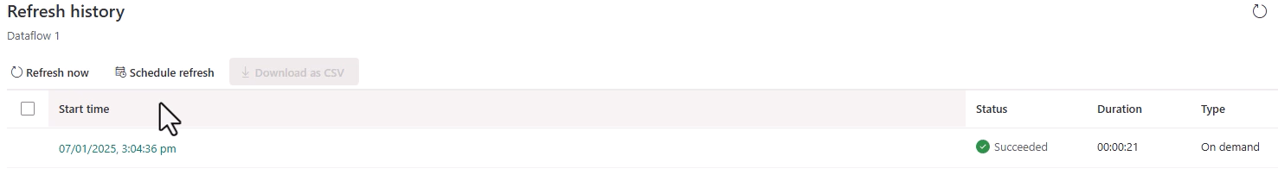
16. Monitor Transformations ,resolve errors
Looking at wspace Gen2, see ellipses , see properties /rename it .., can go to refresh history , can show 50 refresh histories up to 6 months back, can go to 200.
Check and download as csv. Can also schedule refresh, can drill into refresh..shows the history..and can drill not it quite deeply.
Note you may have a problem in load and transforming at the same time , you may want 2 dataflows ..
Ie fast copy to a destination and a separate tx after it.!; you can join 2 dataflows together.
NB: YOU CAN ASK THE DATAFLOW TO PRODUCE A STAGING TABLE!
Right click on query to enable staging , he does this for all the tables , and refreshes the daflow ..then can see dofference in times
Refresh history tells the times of various runs , for comparison.
Can alsp downlodafthe refresh history.

Slide 9
17. Optimize a Dataflow
Break complex df into multiople dataflows.
Asvantage ..you may get timeout errors for complex dataflows , break it up.
In the example he has 1 dataflow , for 4 tables , rather break upo into 4 dataflows.
We can then sequence them using pipelines ,
Separate staging and transforming; brings in copies from the source to preservre , for audit purposes.
Take advantage of query folding ..
Allows DB to do some of the queries

Slide 10
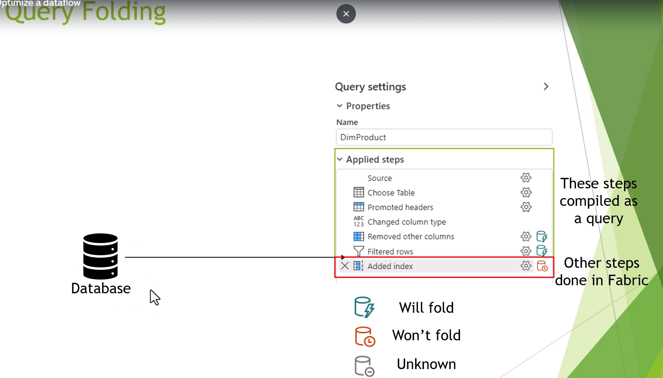
Queries done in DB ..not all by Fabric

Slide 11
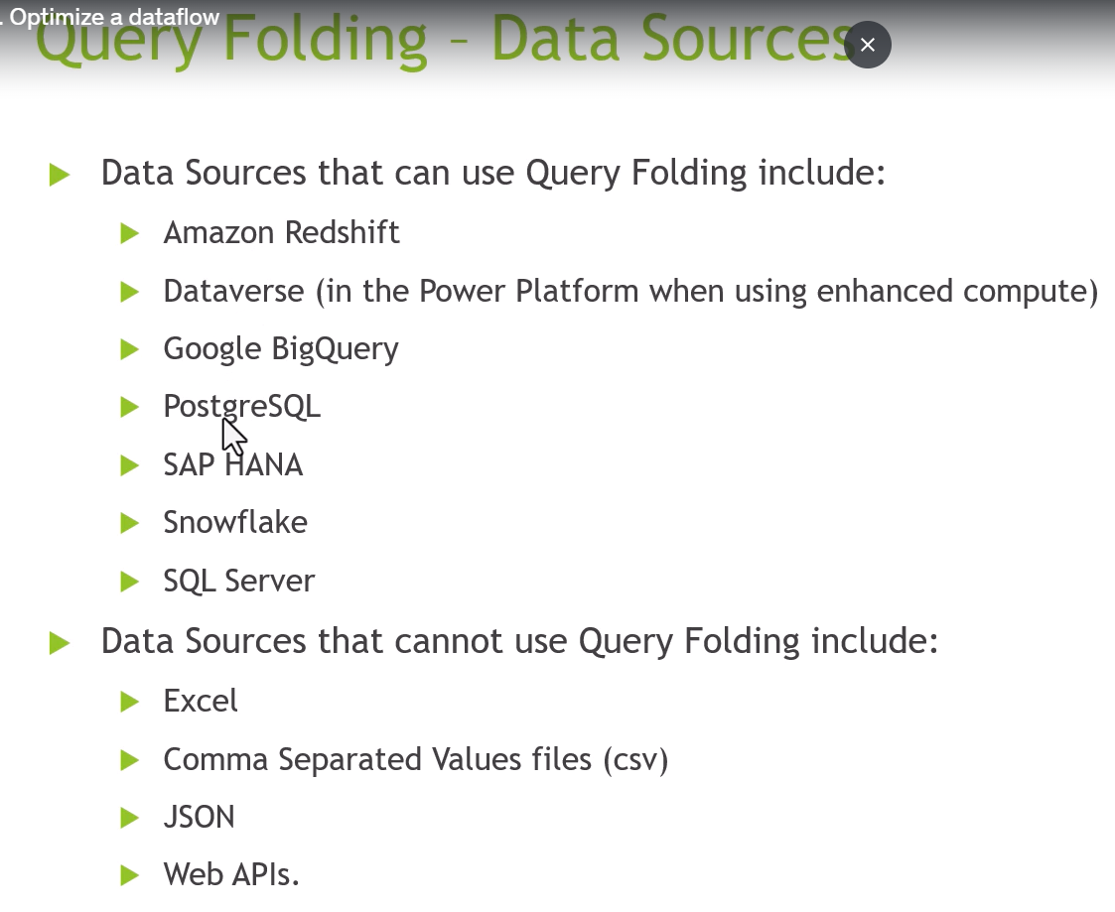
Query folding sources

Slide 12
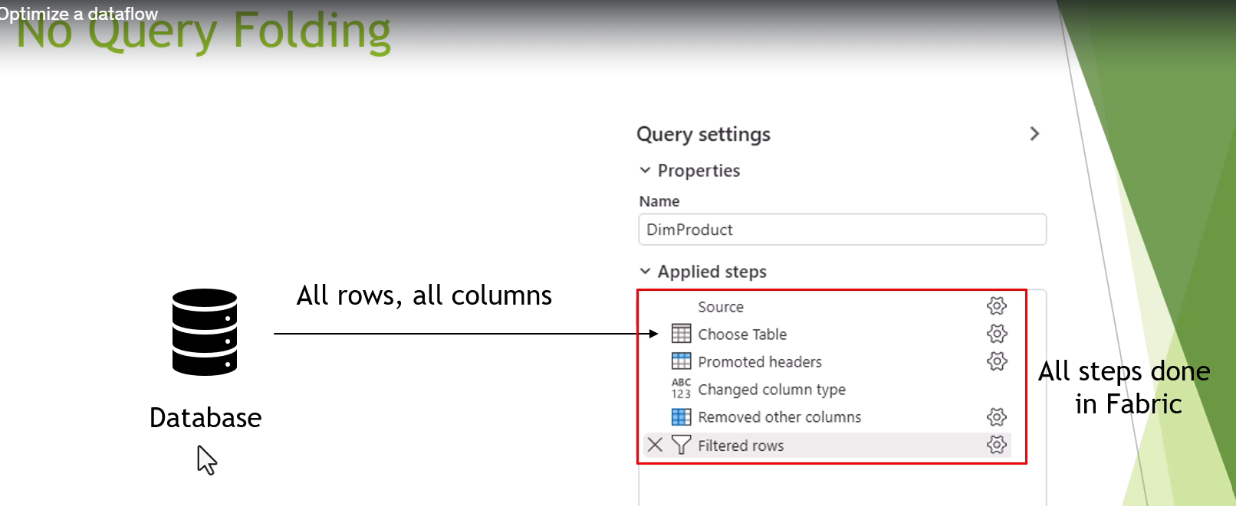
Can ask the db to do all of the steps before getting to fabric

Slide 13
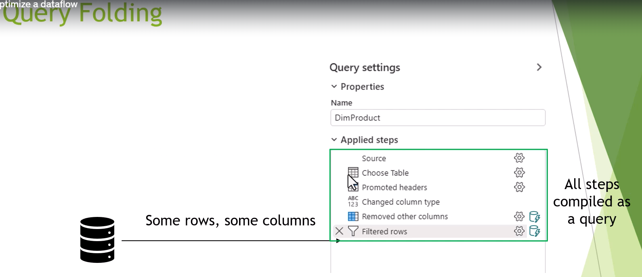
In query folding --- all steps compiled as queryt

Slide 14
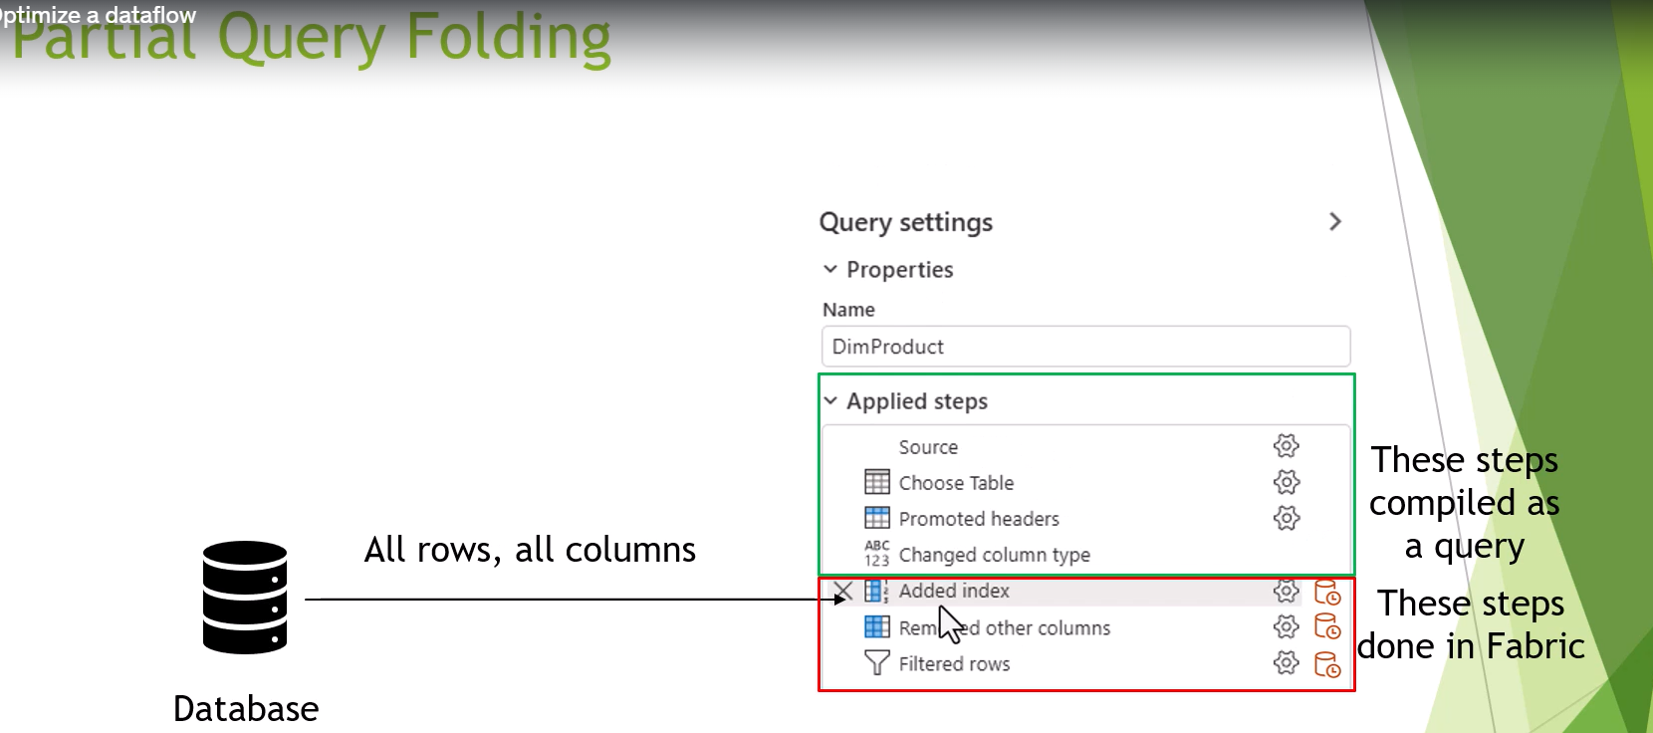
Not all steps eligible for query folding

Slide 15
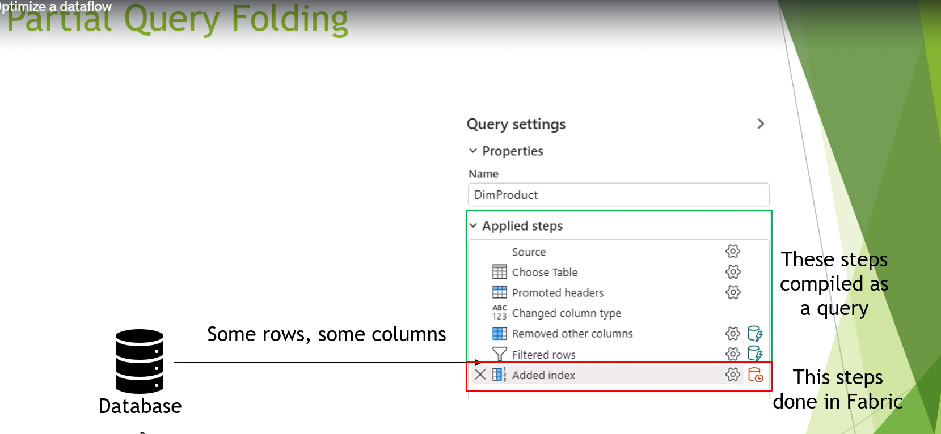
Optimize by moving the add index downwards moving most of the queries into db

Slide 16
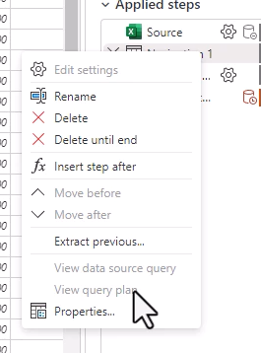
Ho0w to tell…
Right click to see if you can see query plan, if you can then avaolavble for query folding

Slide 17
S4: Transforming Data Using DF Gen2

Slide 18
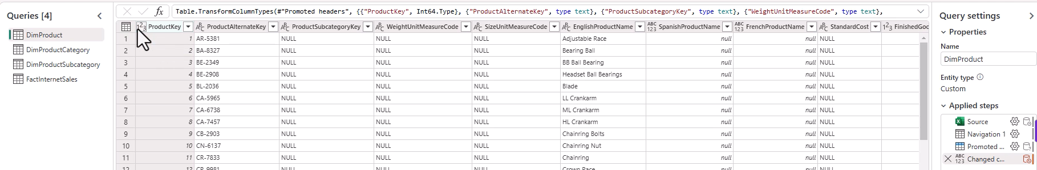
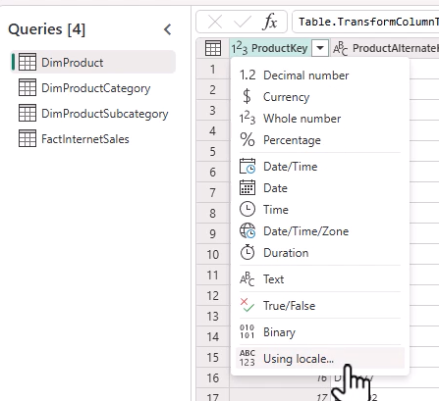
18. Home Menu.
Notes:
1)Each spreadsheet a separates query on lHS,
2) Then seew applied steps for each query.
3) See the first step has all the sources /promoted headers , may have to delete some rows
4) You may want to change the initial steps, computer may have it wroing…,
5) If computer got it wring you can do it manuallly., afterwards for the few you would like to change
6) Mnote using Locale , for dates and decimals transformations.

Slide 19
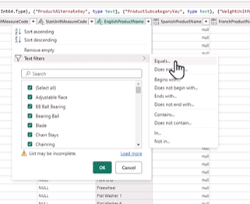
19. Looking at home 9Middle part to do transformations.
Choose cols , choose other cols , go to cols , remove cols
Keep remove and filter rows(drop down filter
Note the text filters on the drop down
Note case sensitivity
Wheel icon on each step take you back to the appropriate settings box.
You can alsp change the Mo formula in a query.
Sort (mkaybe you want to use sort , then filter
Say you want top 20 , sort descending and then filter top 20
Note the DateTime Filters
Notes:
1)

Slide 20
19 continued
Split columns
Transform Menu, you can extract
You can replace values

Slide 21
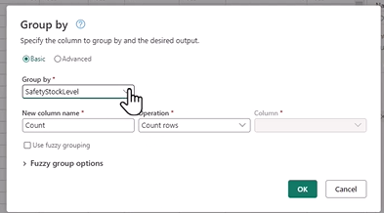
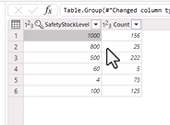
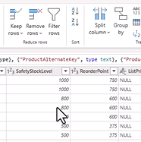
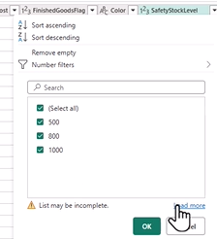
20.Group By
Notes:
Application : how many of each product have a stocl level of each size
Look ata diostinct amounts
Click Group By , if you selected the column its already in GrouipBy ..wew want the number of rows
Now remember that the detail does not exist anymore ..but yoy may want this detail for other queries
So you can get rid of it , and go to the left on the same rtable (Duplicate or Reference)
Duplicate ..creates identical to the existing query
We can also do REFERENCE, Go to Mnage in the home menu , manage reference ,,, THEN 1 appled query!
The source of this query is the previous query. So don’t forget any thing you do to the first query ..will be carried through to the reference
We use Group By here with the duplicate query so we still have the other query with all the recirds to carry on with .

Slide 22
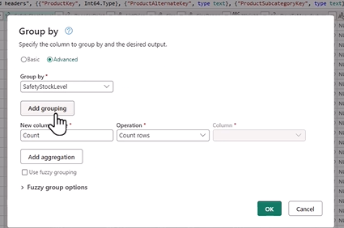
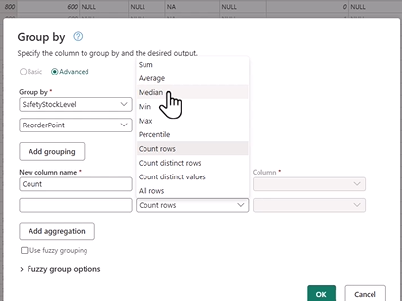
Groupo by 2 columns ..them Inmenue go advancerd
Notes:
Add seconds grouping , can also add aggregation to add a second summarization ,

Slide 23
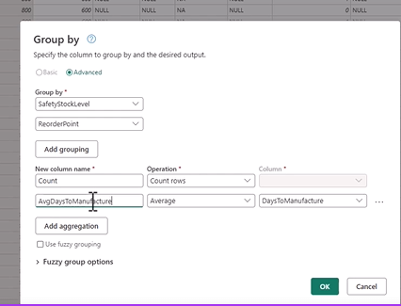
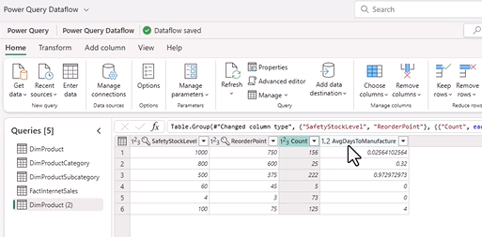

Slide 24
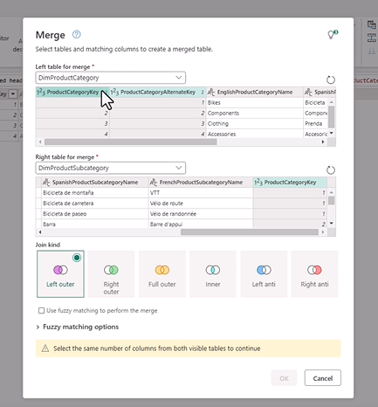
21.Merge , we want one big table to contain Cat and Subcat in One table
Choose Merge Query As New …the first table is the Left one and now the righjt one!
Notes:
3 options ..merge query as new, Can
We also have anti- joins ..
End result in Merge!
Need to expand the Table!
Note that the 2 columns have 2 Key columns …. Must take out oner of the keyts , don’t choose it.
Denorm table contains info over multiple tables., More quicky query but ineffient and difficult visiobility wise .

Slide 25
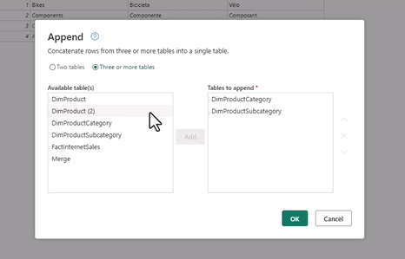
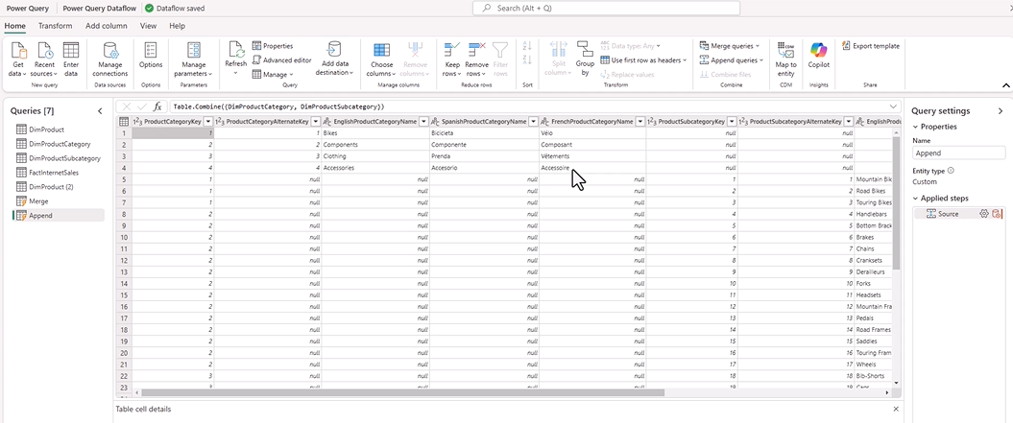
22. Union data using append.
Notes:
Can select many tables ..
Result was many nulls ,
The 2 tables did not have the same recognizable column names.

Slide 26
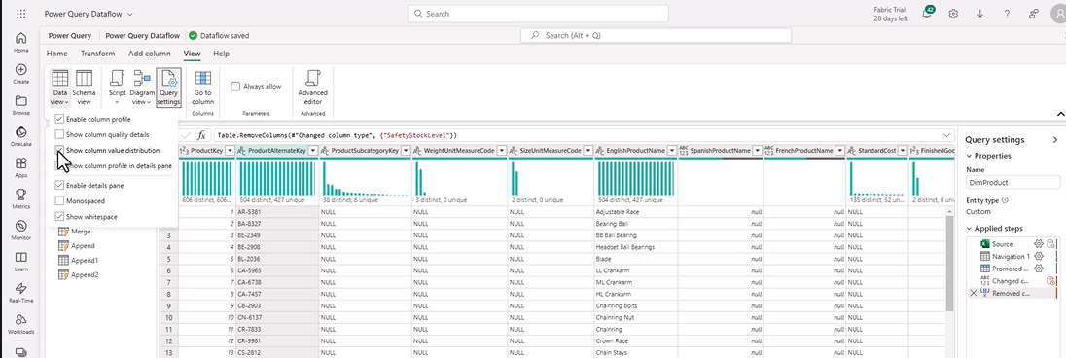
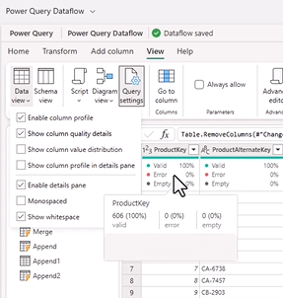
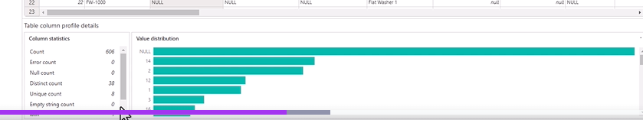
23. Null Values.
Notes:
How to resolve nulls..we can replace values
In data view we have ENABLE COLUMN PROFILE ,
Look at the other options given if you enabler column profile
See % of empty columns , swhow value distributions ..very useful
Unique Vcalues are those that do not have dupliovcates ie they have 1 value in the column.
You can also choose show column profile in details pane.. Only for 1 cxolumn. So see image ,,u get stats on that column.

Slide 27
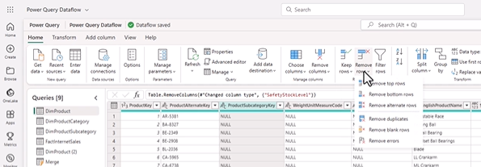
duplicates
Notes:
See remove row/drop duplicates
You get lots of nulls from joins
Example of anti join , all the products that exist and are not sold.

Slide 28
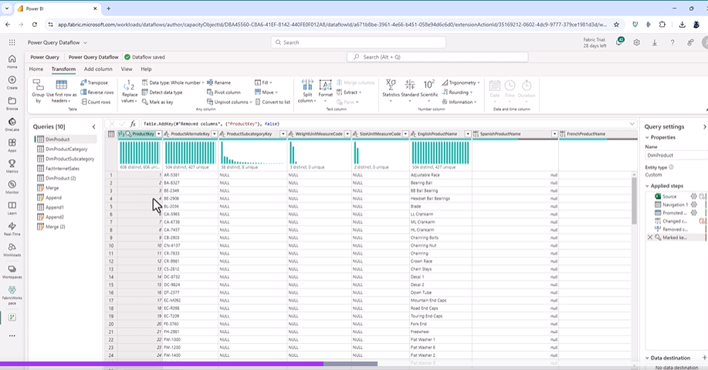
24. Transform Data and Add columns
Notes:
Stratr transform Tab ..lHS.
Detect data type
Marlk as keyt , make a primary Key.
Pivot and Unpivot.
Fill Down,
Extract allows part oda colum.
Add / Subtarct and STATS
Note the Date and Time Functionsd
Time Extract time from date ti,me col

Slide 29
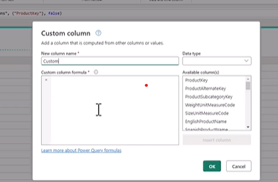
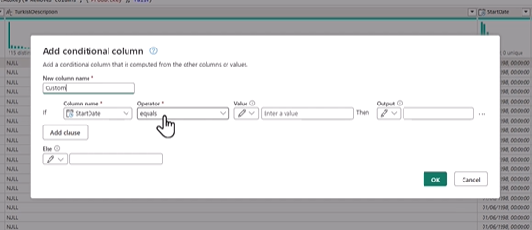
Custom Col..Add new columnsd from formyulae
Notes:
M code

Slide 30
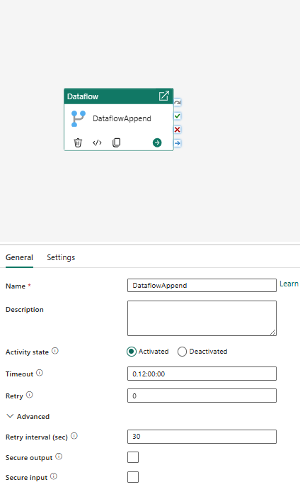
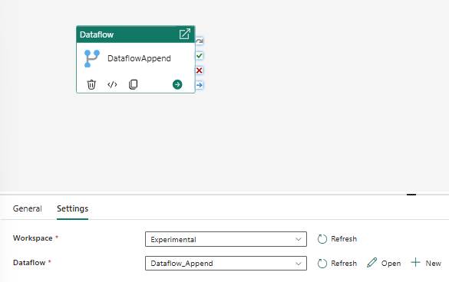
Using Pipelines
Notes:
Note you have retries in a dataflow component
Secure output..output not captured in logging
Many other activities.

Slide 31
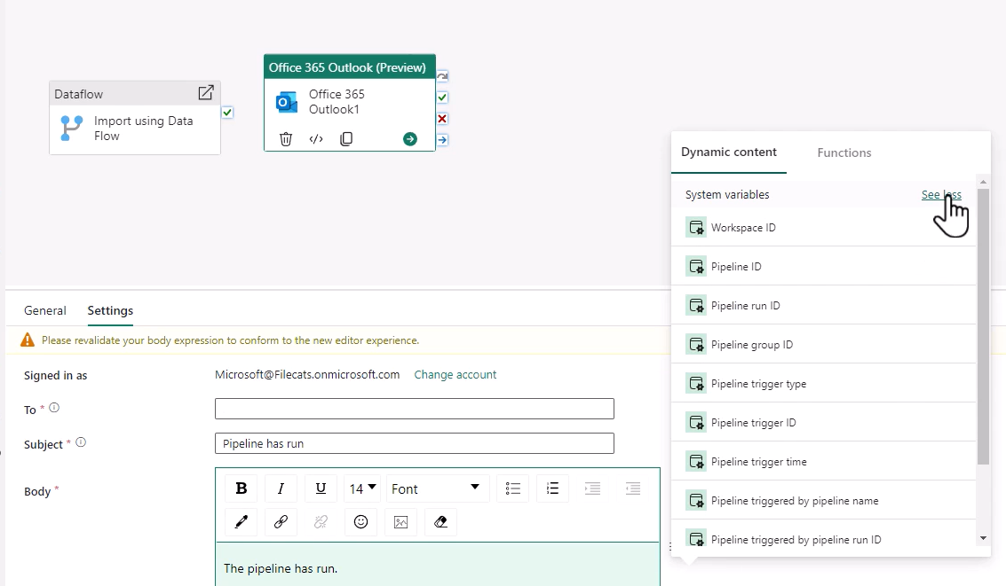
Note what you can add in to the email, parameters
Notes:
Many parameters , you can bring into the emails
Note bring different messages to failurwe and pass

Slide 32
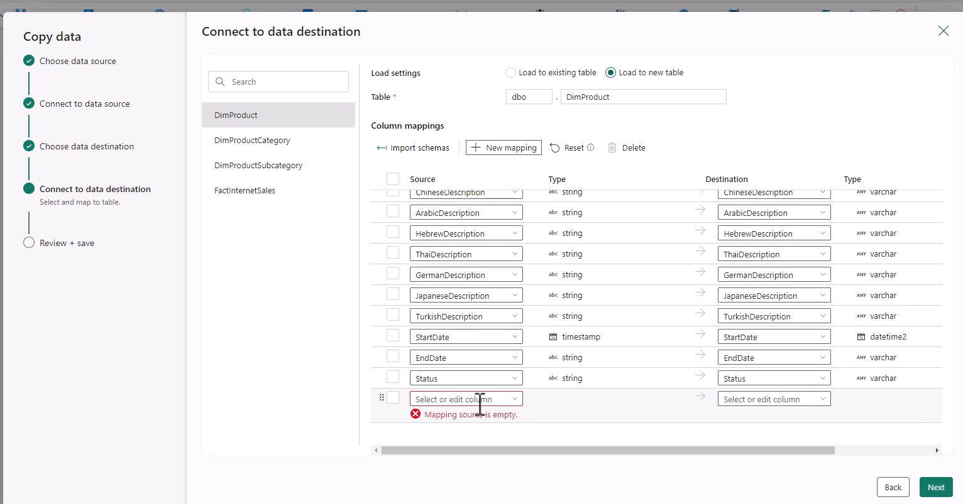
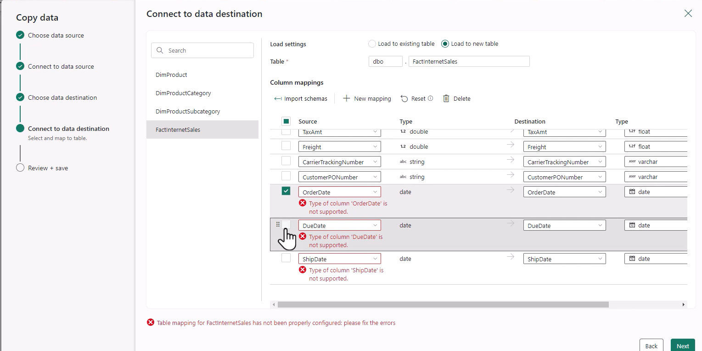
28. Copy Data assistant method
Notes:
Note the mappings and the step by step process , via the data assistant.

Slide 33
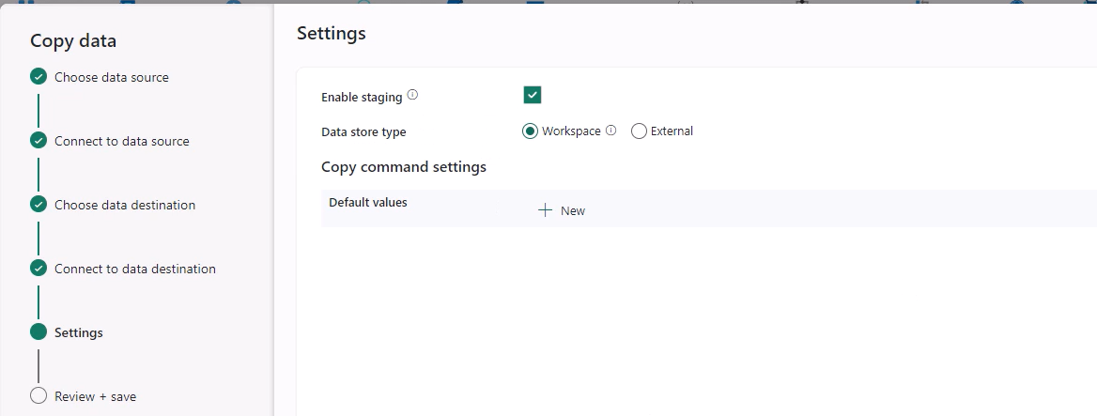
Note in the Settings: Enable staging,,
Notes:
All the files get placed in intermediate folder before being sent onto final destination.

Slide 34
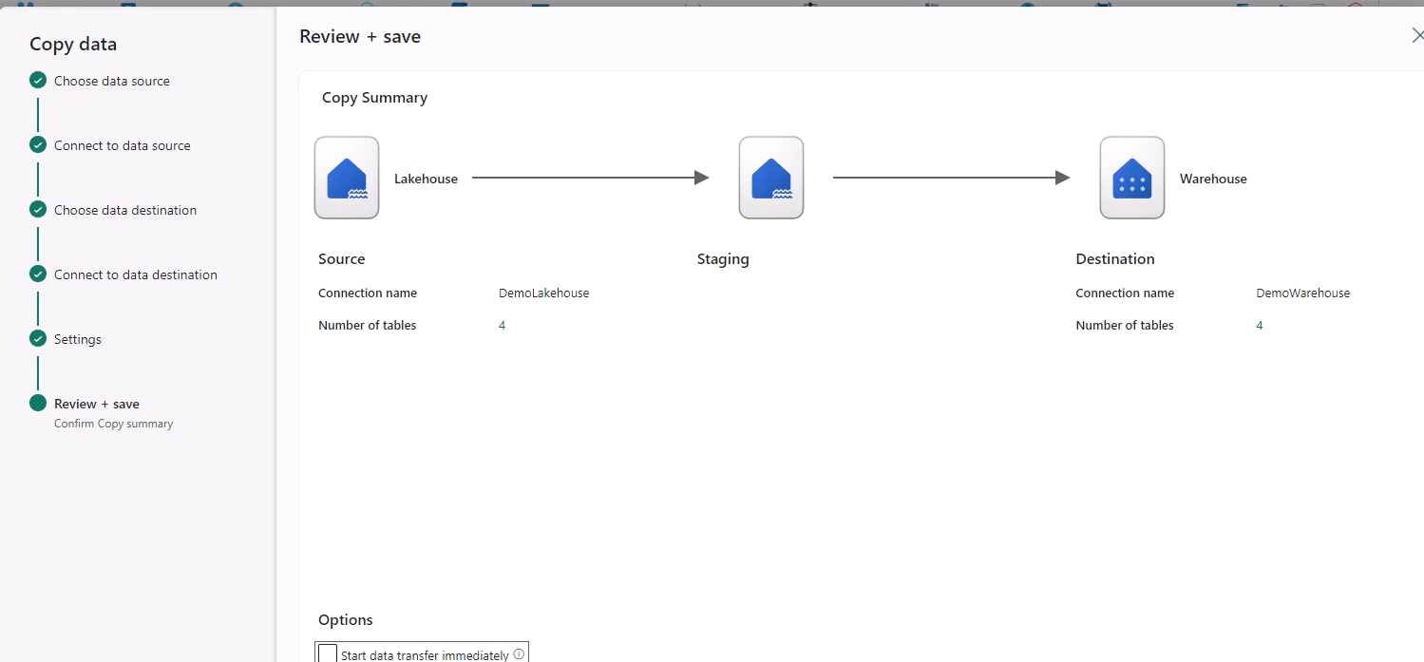
End of copy helper screen
Notes:
He picks a lot of tabl;es

Slide 35
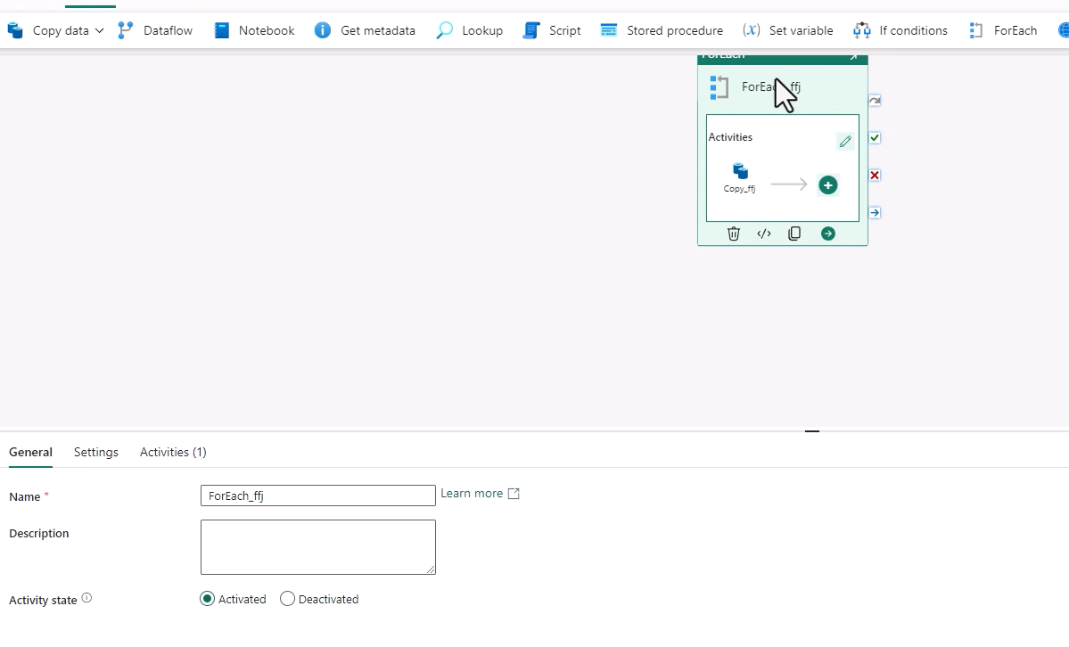
Note that the copy assistant automatically loaded a For Each block in this case Maybe because its tables and not files / folder

Slide 36
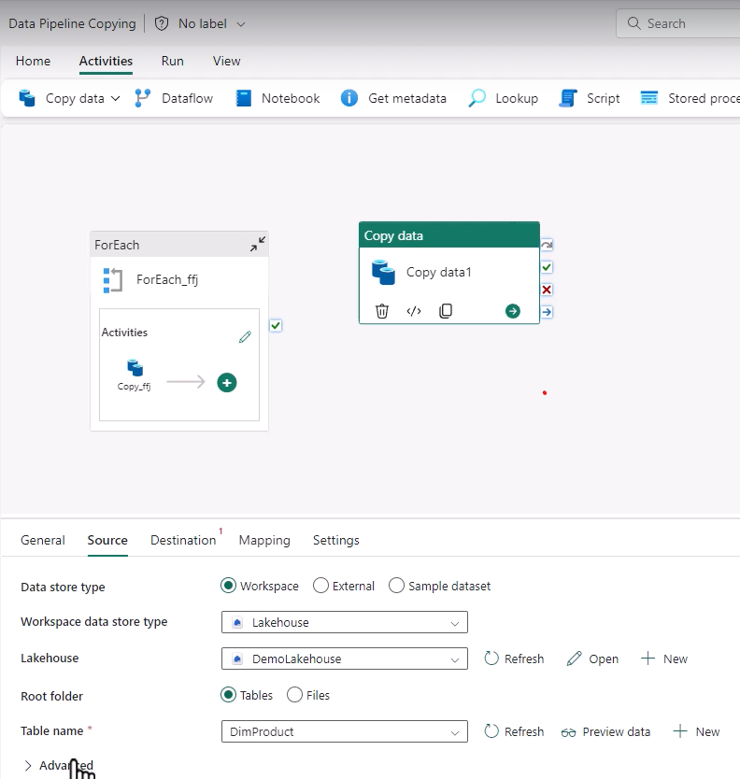
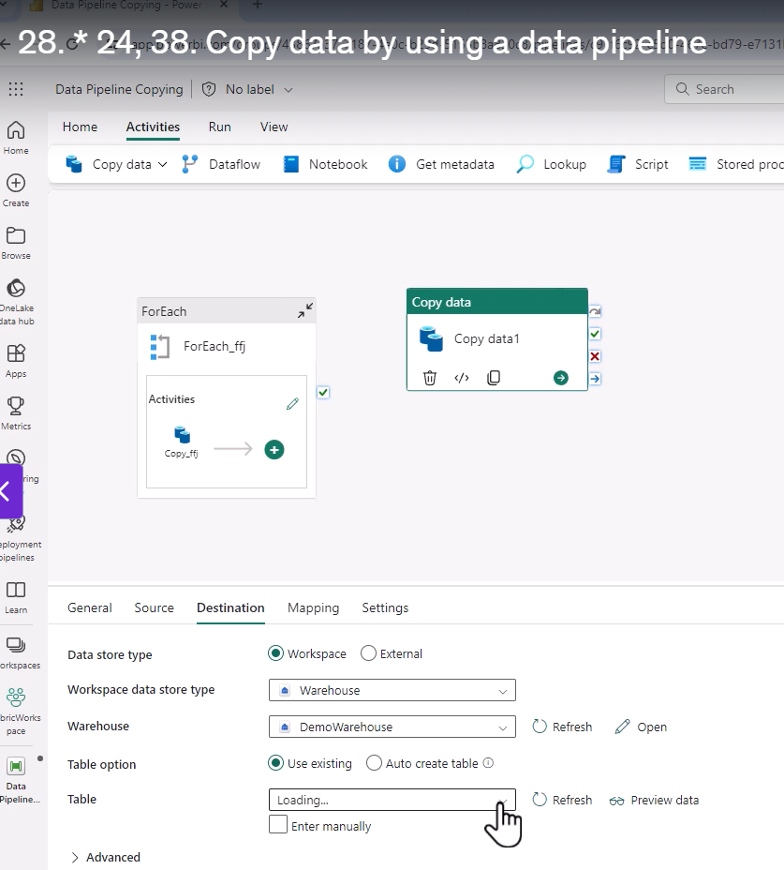
Note in the Copy Block you can only select a single table .. If copy assistant it allows myultiple tables via automated For Each Block
Notes:
See only single table allowed , note the source for the copy block.
Note you can use an existing table in the destination or make a new table (auto create)

Slide 37
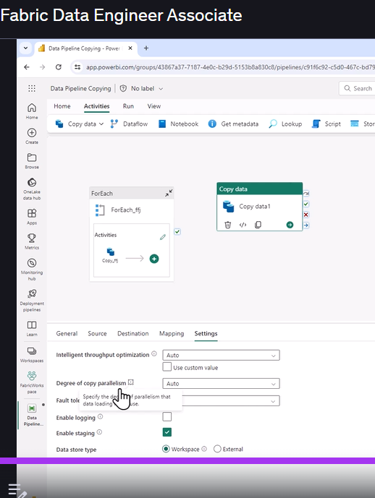
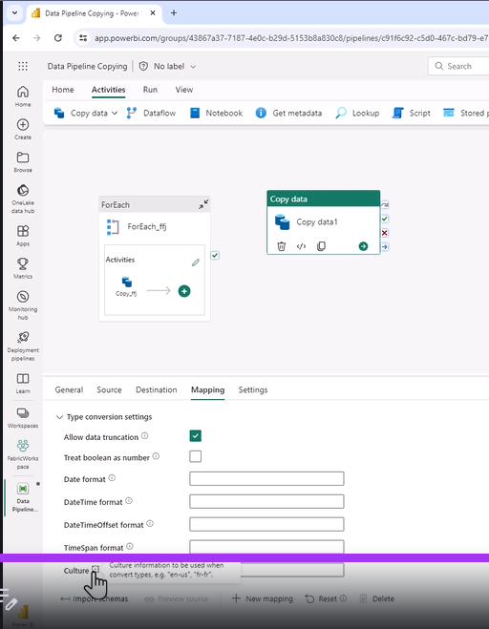
Note the Mappings/ Settings features
Notes:
Especially the date Formats in the mapping settings , see date and time formats lower down,
Lots of settings wrt the throughput optimization, read through these carefully. See the circle on the right.
There are fault tolerance issues ..that you can set , parllelissm and staging
Seems you must put a table name in.

Slide 38
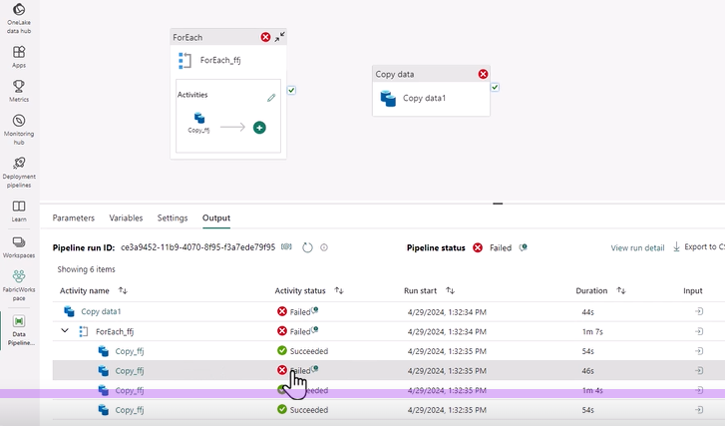
This pipeline failed, now why?
Notes:
You can post output to word to find the errors
You can view run history and export to files.

Slide 39
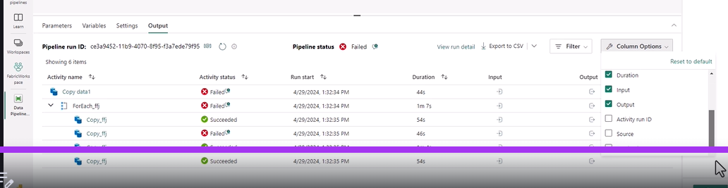
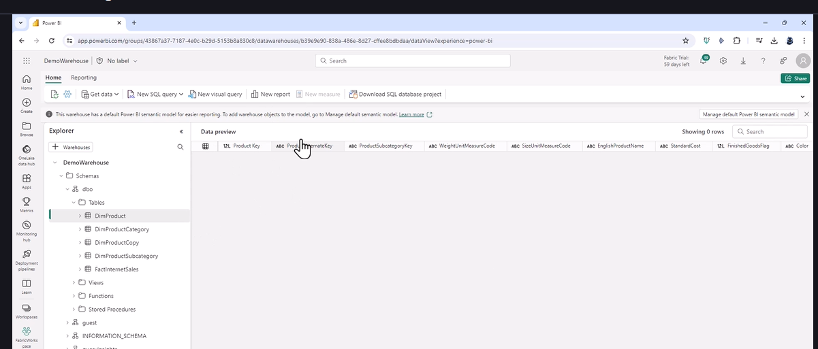
You can do a lot of things on the output ie filter etc under column options
Notes:
Checks to see if tables are there

Slide 40
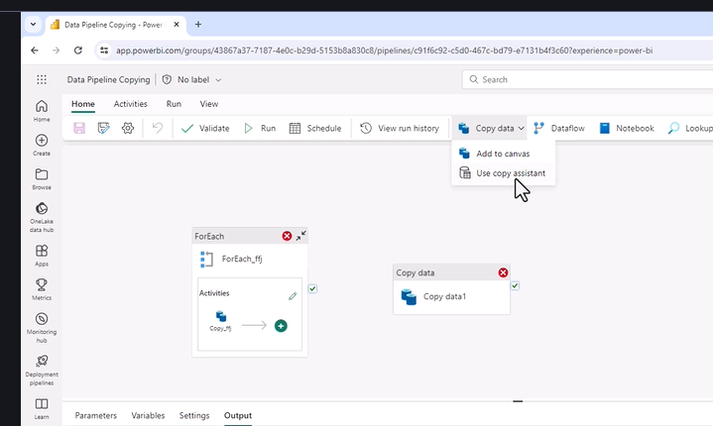
The 2 ways of copying , For Each for multipole tables and the copy assistant (For Each) , for multiple tables

Slide 41
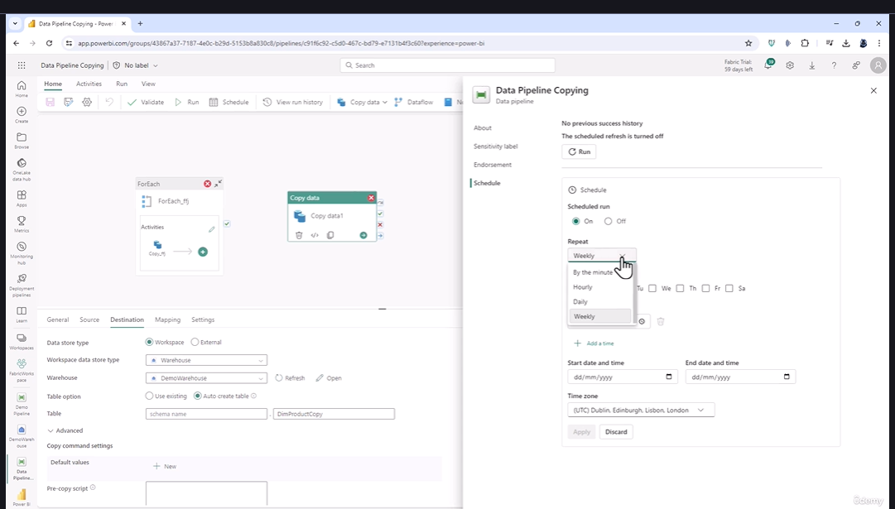
29. Schedule and Monitor Data Pipelines
Notes:
Home Schedule , or run schedule , or ellipses in the workspace
Click on the pipeline schedule , see the schedule options. Hourly , daily weekly.
Dataflows can only start on the hours or half hour, Pipelines (Every minute)
Start , and end , date and time

Slide 42
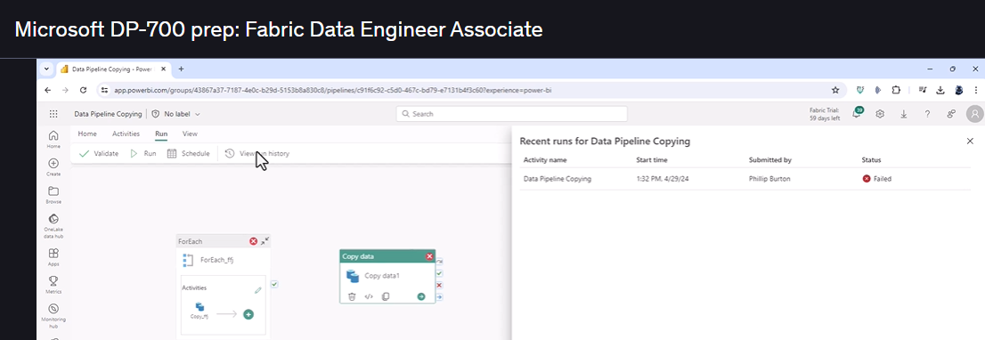
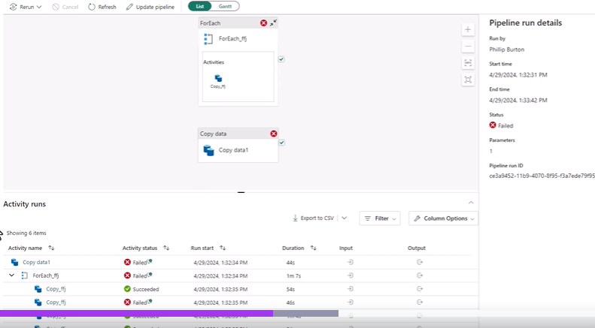
Monitor Pipelines ..go to View run history
Notes:
Click ion that particular run

Slide 43





Click on ellipses in wspace / recent runs
Notes:
You have a goto monitoring at bottom of Viewe Recent Runs , land on the right image view
And you can filter them, se bottom left image , and you can addd many columns

Slide 44



In your Monitoring Hub ..click on ellipses , to retry the pipeline
Notes:
In monirtoring hub I clicked on a pipeline and got , lhs image (Tecxt View) , if I click Gant , I get a gant view (image from Course)
Gannt , see underneath each other
In this screen you can make changes to the pipeline , by clicking update pipeline , top go back to editing canvas.
NB: you need to get to Monitoiring Hub to change filter
Can export records in the Monitoring Hub

Slide 45


30. Identifying and resolving pipeline errors /optimize pipeline
Notes:
We see the Foreach results in an error , click on symbol , says
Also go to view run history ..and get back same screen.
Gp baxk to pipeline from view run history

Slide 46



Get message of failure
Notes:
Go back to pipeline and add email on failure , this particular failure says cant put large sting into warehouse
You can go to mappings and try truncation or leave out the column
OR go to Settings and set intelligent throughput optoiimization , see above default is Autio , but other options , test and see if copying is quicker
Can also set degree of copy parallelism..threads , override defaulat and set 1-32
Faualt tolerance ..see above , can skip rows or files ..see op

Slide 47


31.Explore sample Data(copy data assistance)
Notes:
Cliock on explore sampler data in Copy Data assistant in pipeline ..see above
See the datasets

Slide 48



Look at templates for pipelines
Notes:
Examples:
ADSL GEN 2
Copy BASED ON LAST MODOIFIED DATE (NB )
Delete files older than 30 days
Move Files from one folder to another

Slide 49
S6 Loading and saving using notebooks

Slide 50

34. Ingest by local upload
Notes:
Load to Tables once imported , tables are structurrdd format.
Much better to use tables ,
SQL analytics endpoint ..only have access to Tables
Cant use explorer ?? Much easier to do this !

Slide 51
35. Choose best method to copy to lakehouse
Small files ..local file copy
One lake file explorer
Small data ..Dataflow gen 2, then can use transformnations
Large source ..no transformations ..use Copy/ Pipeline /
Notebook..large data complex transformations., see stage transfomations ..then pipeline

Slide 52




36. Ingest to Notebook, copy to table
Notes:
Must connect to lakehouse.
You can load the data from files , drag and drop and it writes the command for you
See abfs path
There are 3 methods with csvs ..read.format / read.csv, load
The lowest is spark.read.load

Slide 53


Can also run relative path / pandas
Notes:
Pandas way , also use the file path

Slide 54




37.Save to file or table
Notes:
Saving to excel,json or parquet is the same format of statement
Note when you save a file ..its a folder name .. , there are files associated with it , use that name to load it ..DONT USE INTERNAL FILE NAME in the files in that folder ..se above
We also save to a table , format del;ta..

Slide 55


Why tables ..SQL Endpoint , can access with SQL.
Notes:
No Files, Only sql with tables
Also power Bi Semantic Models

Slide 56


Slide 57




38. Loading data from a table in Pyspark or SQL
Notes:
2 methods of reading a table . Read.table ; read.format
Or sql. Change to sql cell. Musty be default lakehouse
SQL is read only!!!
Note what to do with table , on bottom righ , graph or chart etc.

Slide 58

Inspect button in Spark cell, below on bottom right , Graphs , see below
Notes:
Shows stats on the cols ie missiong values etc..you also have a search bar.

Slide 59

Change to a chart and customize it

Slide 60

Customizing a chart

Slide 61


Data frame to list

Slide 62


Practice Notes
Cant Rename a table the same name with capitals ..its the same table , table names are not case sensitive!!
Notes:
When asked to load a table from lake house by the menu ..it used sql , but in a spark frame with spark.sql..notive it namesd the lakehouse ..note lakehouse was default.
Maybe you can load tables from non default lakehouse , as you are naming the lakehouse.!!! Instead of using absolute path.

Slide 63
S7 Manipulating DFs

Slide 64






41. Reducing Columns
41. Reducing Rows
Notes:
Select is not case sensitive! In speech marks.
Can also do df.Country
Renaming with Alias. Must use df. Ie. df.Country.alias(“CountryName”)
Use df.where, or df .filter , notice the whole expression is in “ “ or you can use df.where(“df.Country=‘SA’ “)
Notice in example you use Double and single quotation marks. One or 2 equal signs .. 2 equals when using dot notation, and != when not in string.
Use limit and tail for first and lasty rows

Slide 65




Adding Columns
44. Using Functions
Notes:
.withColumn(newcol,replacement)
Can do 2 columns .., notice just add another .withColumn notice \ to split thye row

Slide 66

44. Functions Continued

Slide 67


Using Functions
Notes:
Notice the word lit to use a literal string in Python.
See sql , must terminate select statements with a semicolon , if there are multiple statements

Slide 68





45.More Advanced Filtering.
Between.
Contains and LIKE with Wildcars
Notes:
Contains in Sparl , LIKE in SQL, like in Spark
See multiple conditions
Note alternative using | and &

Slide 69


isIn /

Slide 70







47. Practice Activity 4.
Notes:
Default load data into Spark..a table uses sql , using spark.sql
Canj also use read.table, note id default its shorter , else just the table name
Normal select , then normal select with name change using alias. Noticve you have to use the .notation, you cant use thestringliteral
Canb use withColumnRenamed instead of alias. Order is oldcol;umn name , new column name in string form.
Note in the where clause oneuses the . Notation df.Geography.
You could also have the whole expression in inverted commas

Slide 71




47. Practice continued
Notes:
Add in new column , notice the use of substr.,
Note: Pyspark is a 1 based programming language
Multiple conditions in speechmark or in dot notation , note the use of single and double qwuotation marks.
You can have sigle on the outside and double on inside
See the dot notation , isin
Using the | symbol

Slide 72
48. Practice activity SQL
Leave for later

Slide 73




50.Converting Data Types
Notes:
Can see actual is text
Using describe ..notice the list in square brackets
Use df. Notation to cast the string as Int ..see its cast as Int
Cast in SQL

Slide 74

Convert Data Types
Notes:
1) In decimal we have precision ..the number of digitds and scale, the number of decimal places ..

Slide 75


51. Import using Explicit Schema.
Notes:
We wish to convert while loading it.
Look at the df.schema construct.
Structypoe/ StructField , he copies that construct into the code and places it intoi a variable.
Must import the type, all the types
Note how he uses thye Schema Target variable in the load. In the .schema construct. Ie .schema(schemaTarget)..where schemaTarget is the variable.
Note thye Actual Field is now an Integer. Then SaveAsTable()
Using Stractype and StrucField.1

Slide 76

Display the table and see the data taype

Slide 77



52. Formating Dates as Strings
Notes:
We have a col data column as a date format ..in y m d format
Now we want it castr asa a string in a specific format.
Use a function date_format.. Ssee the construction to get it in a format different to the one starterd with
Remember date_format is a standalone function ..its not a method. Therefore needs a library. Sewe the import
The result is not a date. Can do a SQL.

Slide 78

All the date formats

Slide 79


Using the function concat
Notes:
Note: A STRING LITERRAL IN A SENTENCE MUST USE lit..see example above
See the SQL version of concat

Slide 80

27. Aggregating data and refiltering
Notes:
Notice Format groupBy(“Country”).sum(“Actual”)
Notice “Having” in SQL.
Notice in HAVUNG you can use the name not the sum in the having . Some sql versions you cant do this.
You can use both alias and the calculation
We used withColumnRenamed.. Here
Notice Having looks at the results of an aggregation.

Slide 81



54. Sorting the Results.
Notes:
Notice ..you put the desc in front of the column and wrap the column in brackets, as if desc is a function?, or is that the format requested by the orderBY
Order by 2 consecutive columns
One can also use Sort , Notice the different constructs of Sort , and ordeBy. OrdeBy is best !!!

Slide 82

55 Using all 6 sql clauses.
Notes:
See all 6 in both ..
2) How to remember the order in SQL , look at the quwert keyboard ..they are all in a line except W.

Slide 83


57. Practice activity (6)
Notes:
1) Notice use of lit(), and we need to import functions from pyspark for concat

Slide 84


SQL Part
Notes:
1) Note you can use the alias in Having and in the order by

Slide 85
90. Resolve issues with Delta Tables File Sozes

