Slide 1
62. Understand Spark
Distributed machines.
Clusters /Pools
One machine is a node. With multiple cores.
Hadoop – drawback..intermediate results to disk.
Spark , write to memory and optimization techniqus
Pyspark, python API wrapper on Spark(Java/Scala)

Slide 2
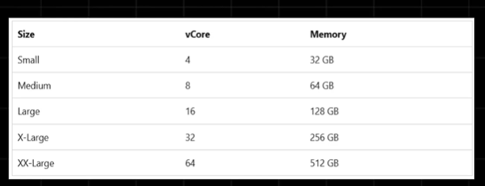
62. Node Sizes
Notes:
Say cluster of 3 machines, define the size ie 8 cores 84GB of Ram (Medium)

Slide 3
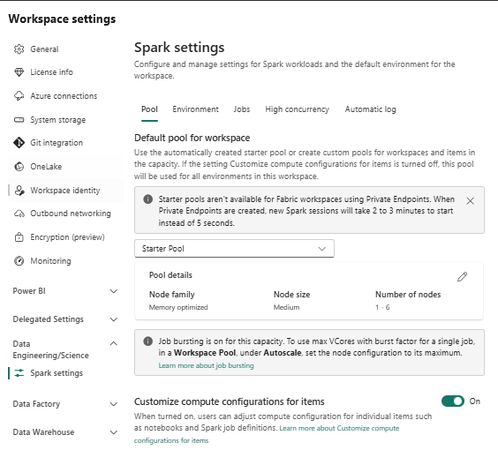
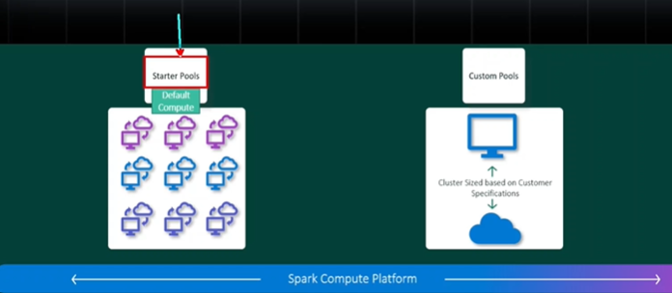
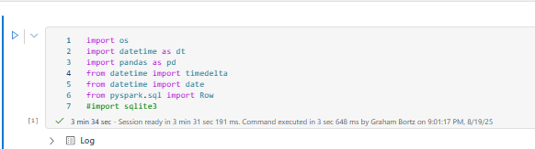
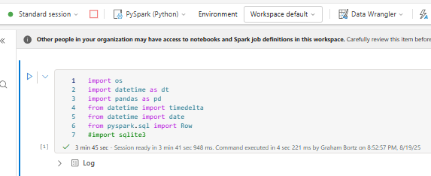
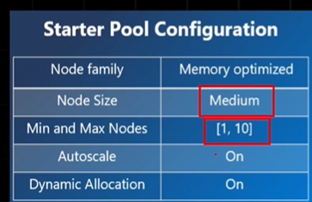
63. Pools (Starter / Custom)
Notes:
Custom pools takes time to initiate
Starter Pools ..default capacity , advantage (1-10 machines , medium , always up and running always???), 5 to 10 seconds !!!
Why is custom turned on ?? I just sawit was on ?.. Didn’t increase speed when changed environment.
Says if private end points are used , starter pools =2 to 3 minutes.
So the machine is not up and running. In Dev you want quicjk config.
In production you create a custom cluster ..you can specify the size. You cant change starter pool settings
ONLY 1 machine runs continuously…cant change that or size. 8 core ..64 Gbyte.

Slide 4
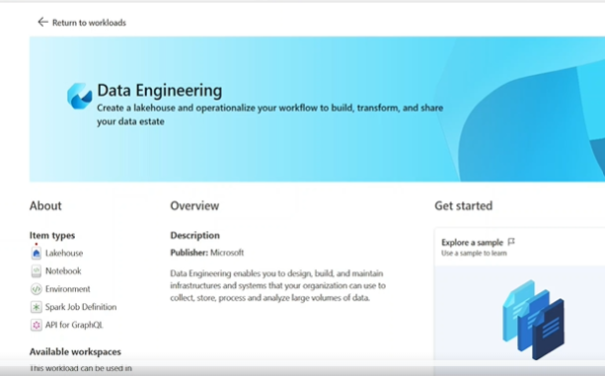
65. Fabric Notebook Overview.
Go to workloads/ data engineering … go through the experience
Notes:
Go to Workloads / dataengineering route
See item types on the left.
He first creates a lakehouse, then notebook.

Slide 5
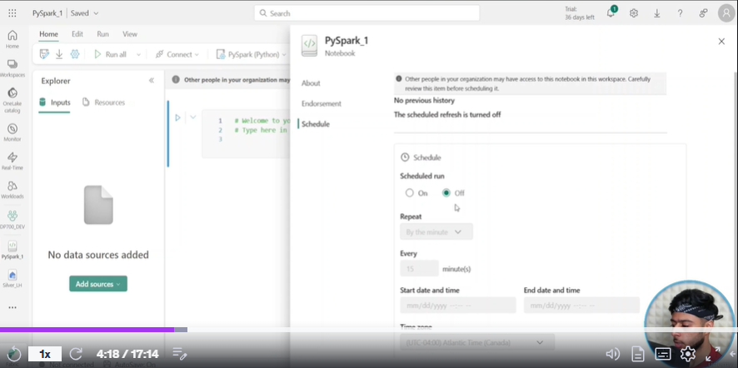
In settings you can schedule a notebook

Slide 6
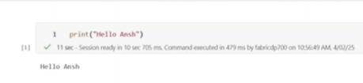
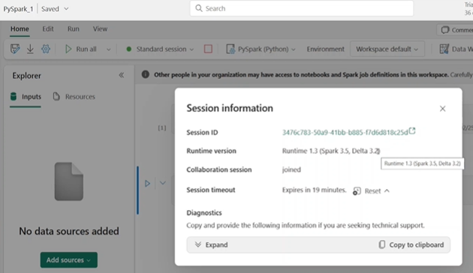
Runs in 11 seconds
Notes:
He is running starter pools I am not
Yu can viewe session info from the standard seession drop down. 19 minutes expiry.

Slide 7
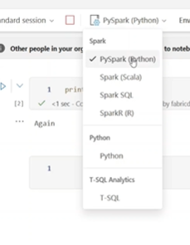
Session info
Notes:
We have pyspark selected ..at the top , hence cells are expecting spark. But hve other , T sql as well.

Slide 8
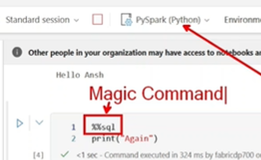
SQL ,,magic commands

Slide 9
Useful tips In nOtebooks
Note the undo in Edit …best to keep edit menu on .
Browse code snippents
Look at data wrangler again .!!
Note line numbers
Whats new..check it out.
Resources Bar … 3 dots upload a file , and then refer to file in notebook..not even in lakehouse
Inputs attach lakehuse , see the pinned icon!
Can attac multiple sources , and destination ..different lakehouses
Always pin destination lakehouse!!!

Slide 10
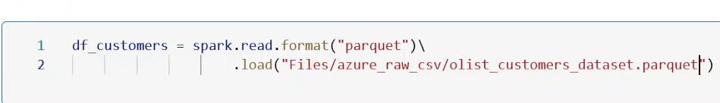
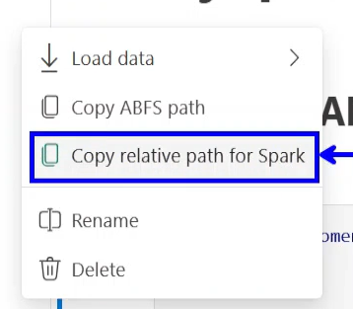
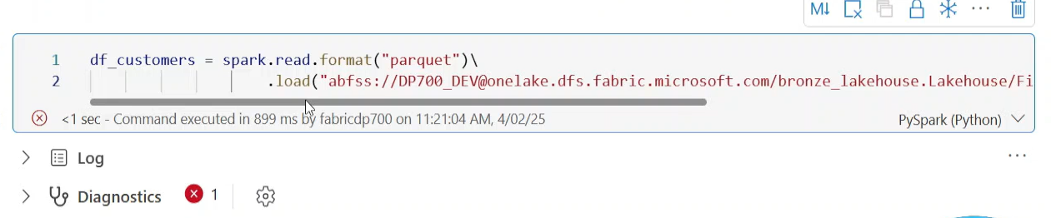
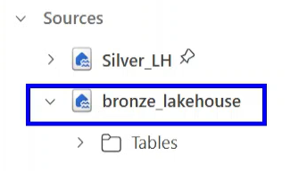
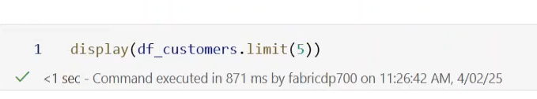
66. PySpark Fundamentals
Notes:
Reading in: Fabric created the spark Session …spark=SparkSession()
Gets Error if use reloative path …Why? Note the pin was on silver lakehouse so that lakehouse is the default… you need to use another lakehouse as we have multile lakehouse here ??..ONLY USE RELATIVE IF YOUR LAKEHOUSE IS SILVER, as that was pinned.
Therefore use abfs path ,,,when you have multiple warehouses.. Thererfore always use full url.
Abfs..Azure Blob Storage….

Slide 11
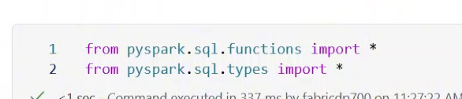
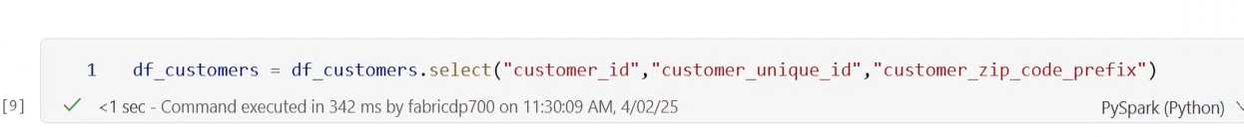
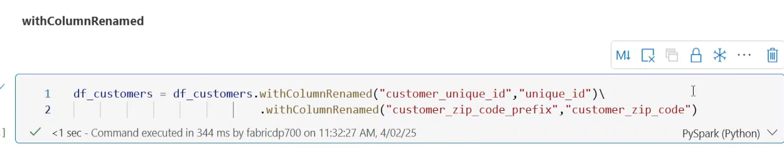
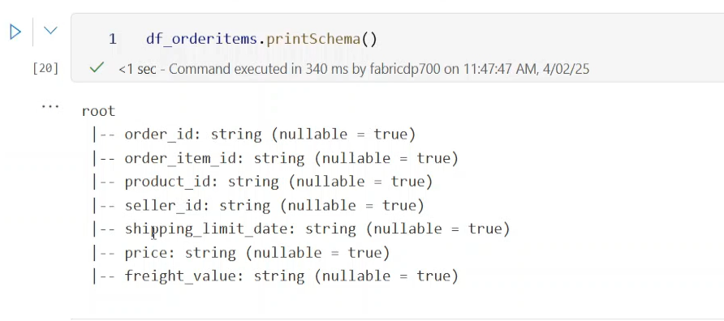
Import Libraries and initial coding
Notes:
In Fabric we just have one lake so its lakehouse @ onelake , see above
Must import libraruies
With column renamed … do it with old then new column
Print the Schema.

Slide 12
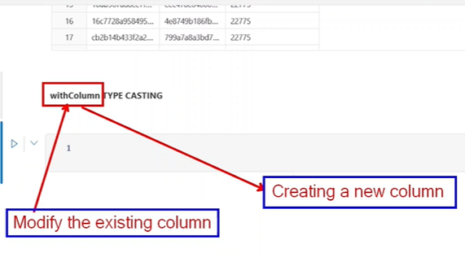
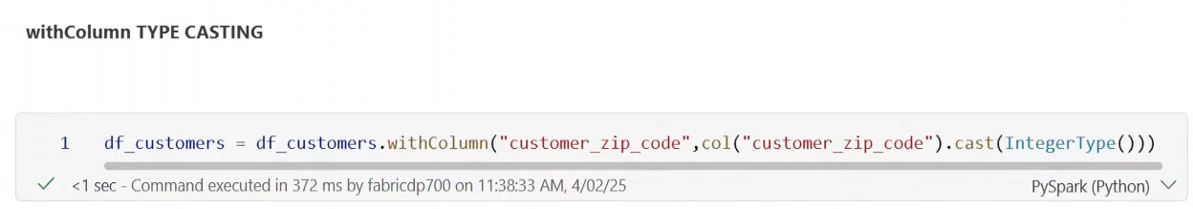
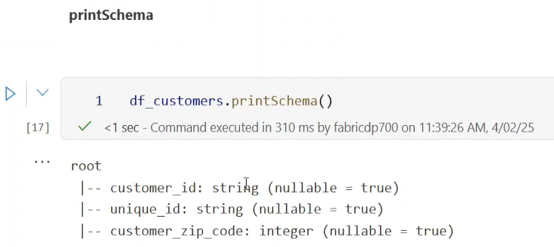
67. Type Casting
Notes:
Test Output with PrintSchema

Slide 13
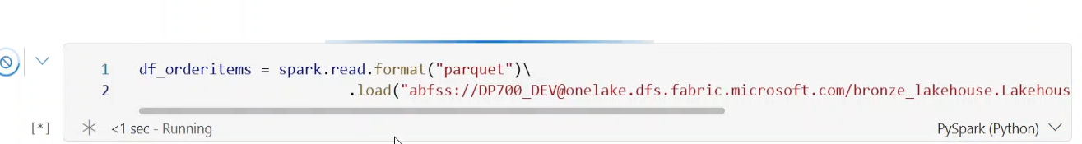
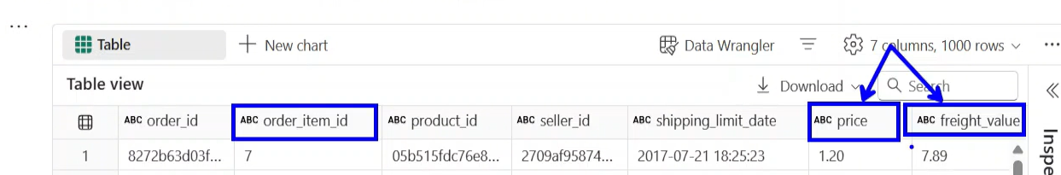
Transform Date Columns
Notes:
Alt Entere ..New Cell.. Look at the data type carefully..numbers cannot be strings

Slide 14
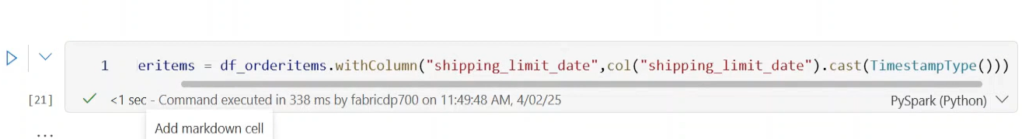
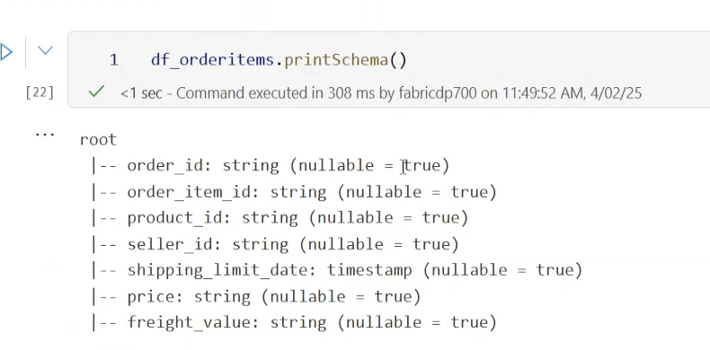
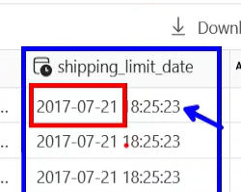
Note the extra problems with the date Format
Notes:
Space in date column. He tried without moving space , checked the schema.
The date string must be in the right format, for the conversion to take place .. So here it was already in the standard format. Ie yyyy-MM-ddsee above ,
Do the concatting to convert that string column.
Be carefull of nulls polluting your columns.

Slide 15
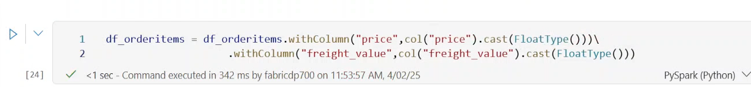
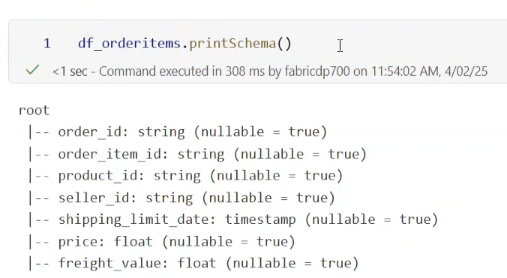
Now we convert other columns. One cell.

Slide 16
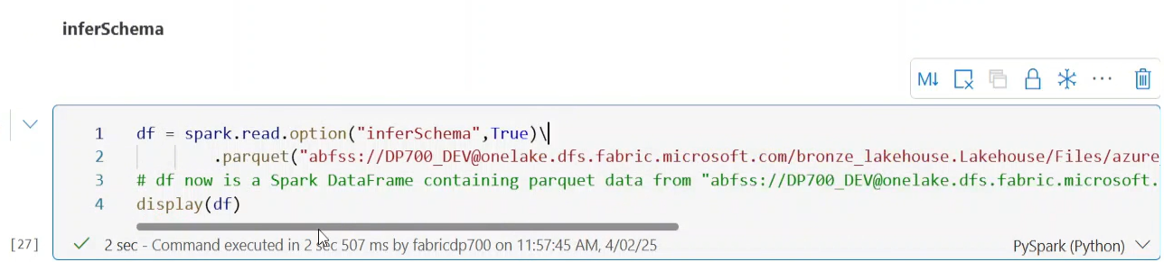
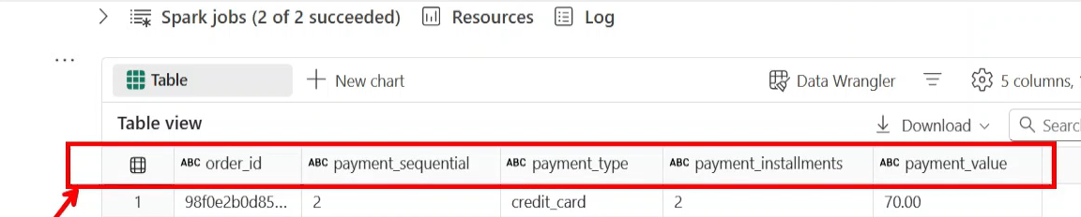
69. Replacing Values
Infer schema , simply guesses what the schema is.
Notes:
If you don’t have inferschema set true… all is strings…, note the option .. Note the \ for the second line
IT DID NOT WORK!!! Why?
INFER SCHEMA ..on top of CSV works !!!
INFER SCHEMA on top of Parquet …DOES not work…, parquet has their own schema!!! At footer.
So you must apply transformations.

Slide 17
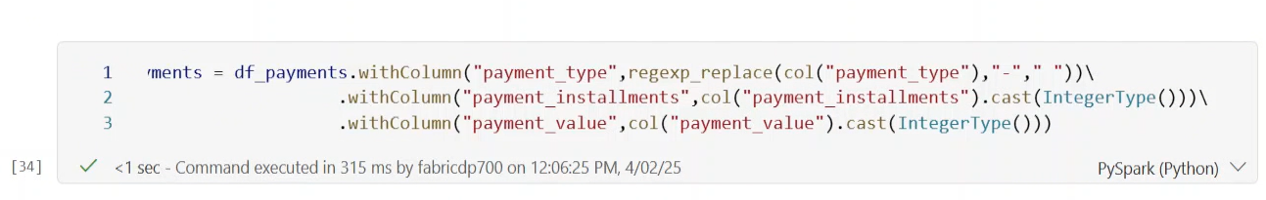
69. Replace Values. Contd.. Using Regex.. Note multiple transformations

Slide 18
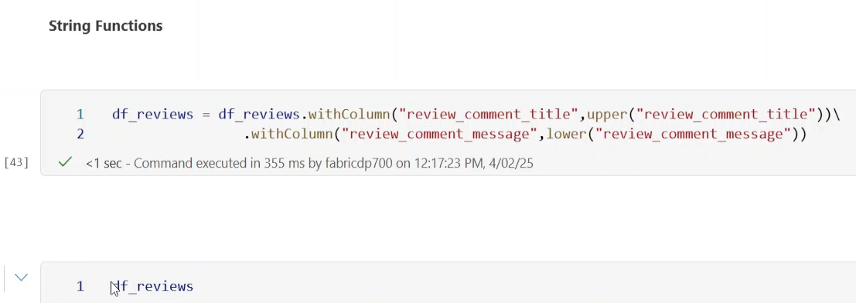
70.PySpark Intermediate Level.
Notes:
Keep Uppercase: String Functions
Df products has many nulls

Slide 19
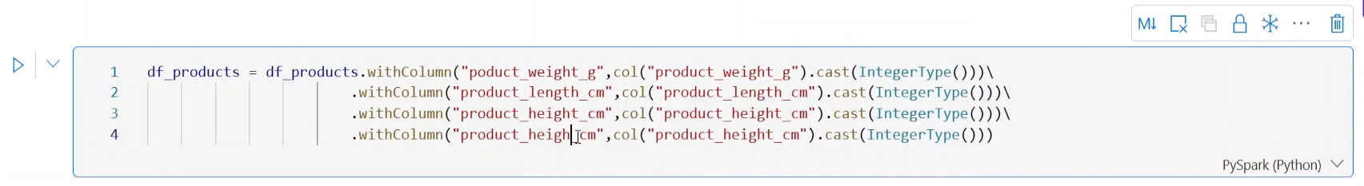
Null Handling and strings
Notes:
Gettinmg rid of nulls using dictionary
Multiple with column replacements

Slide 20
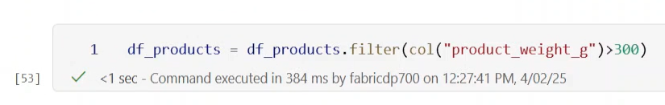
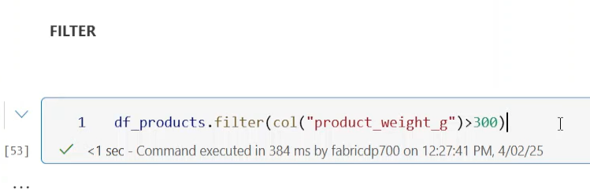
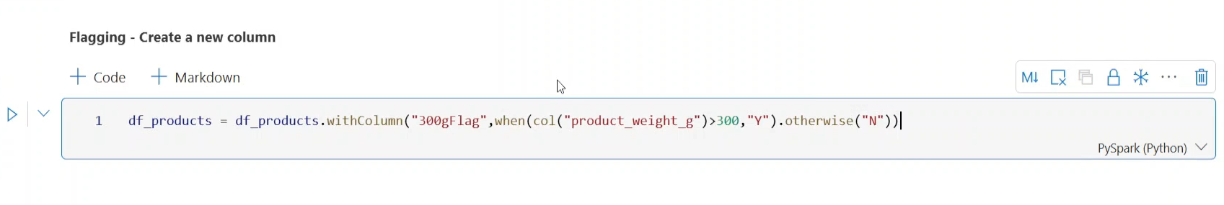
Filter products , creating new columns (if) ,( when otherwise )
Notes:
Don’t put the df infrom of equals we may just want to see the result.

Slide 21

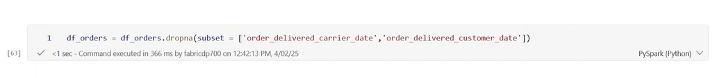
71. Transform time sensitive cols with Timestamp functions
If you have the following, nulls in col you cant transform to date : you need to drop them , those rows.;… use .dropna()
Notes:
Drop na hase options , any, threshold , etc. and what columns you want the dropping of na’s , csan be a lists etc.
So the above wil only remove nulls from either of the columns listed. Oe wew can make it to remove only oif nulls in both columns, above shows either of cols where null is drop that row.
Once removing rows we can cast as Timesrtamp.

Slide 22
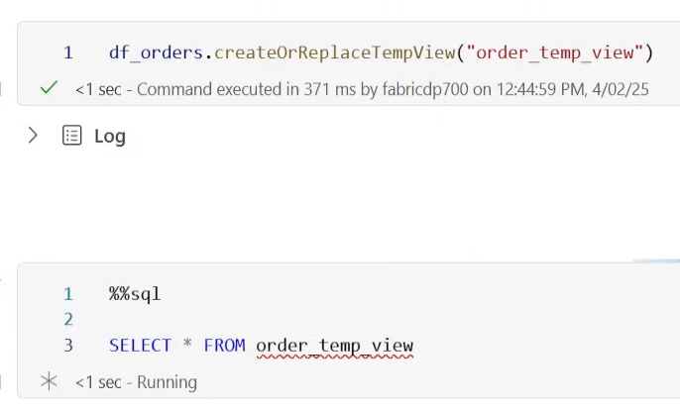
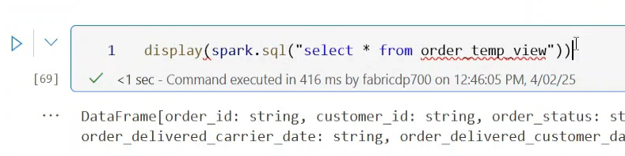
72. SparkSQL
Notes:
Convert dataframe to View..createOrReplaceTempView
Can also use the spark.sql api
Especially useful for sql anal;ytic functions.

Slide 23
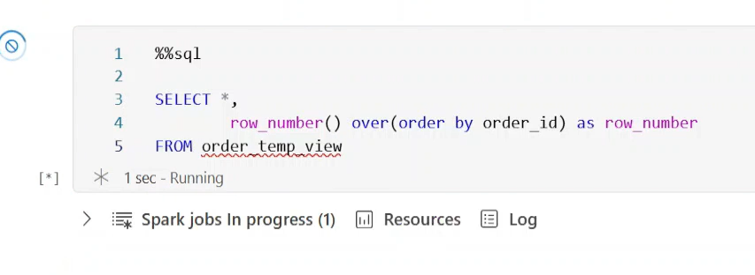
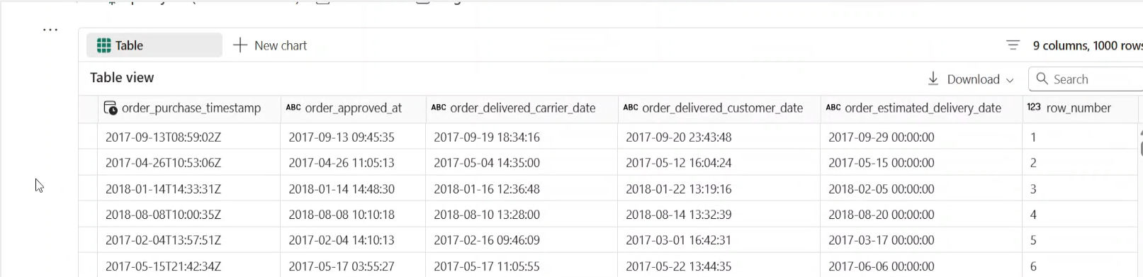
Window function in sql.
Notes:
But how do we make this int a dataframe . We use Spark.sql on the above ..se overleaf.

Slide 24
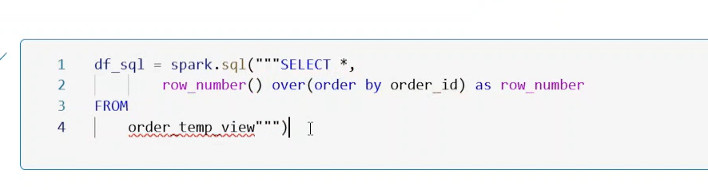
Spark.sql example on getting dataframe
Notes:
Note the 3 double quotes inside the SQL ..must have “”” “””
Note the View is not saved anywhere.

Slide 25
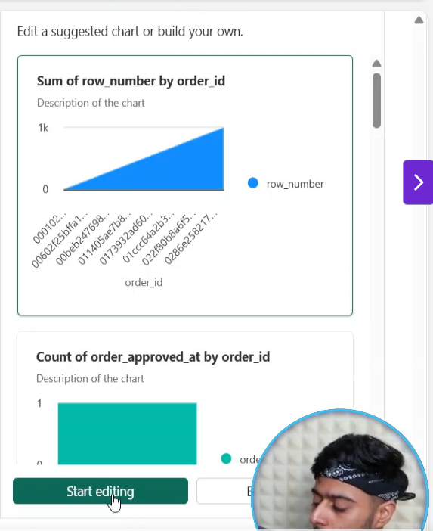
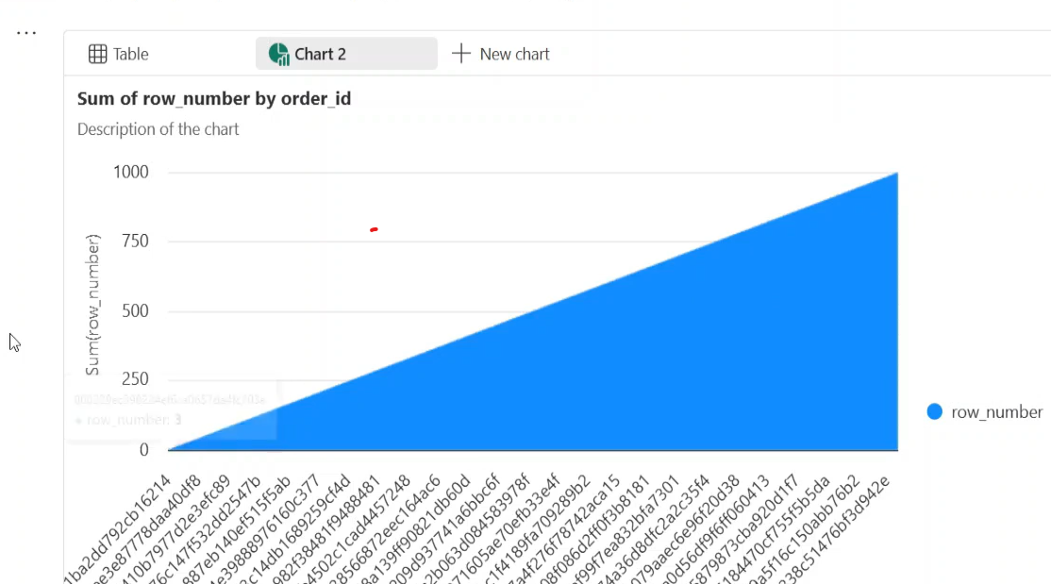
Viz in Spark
Notes:
Click plus new chart once you have a table view of the dataframe, gives an auto viz of the chart , click on Start editing on bottom righy

Slide 26
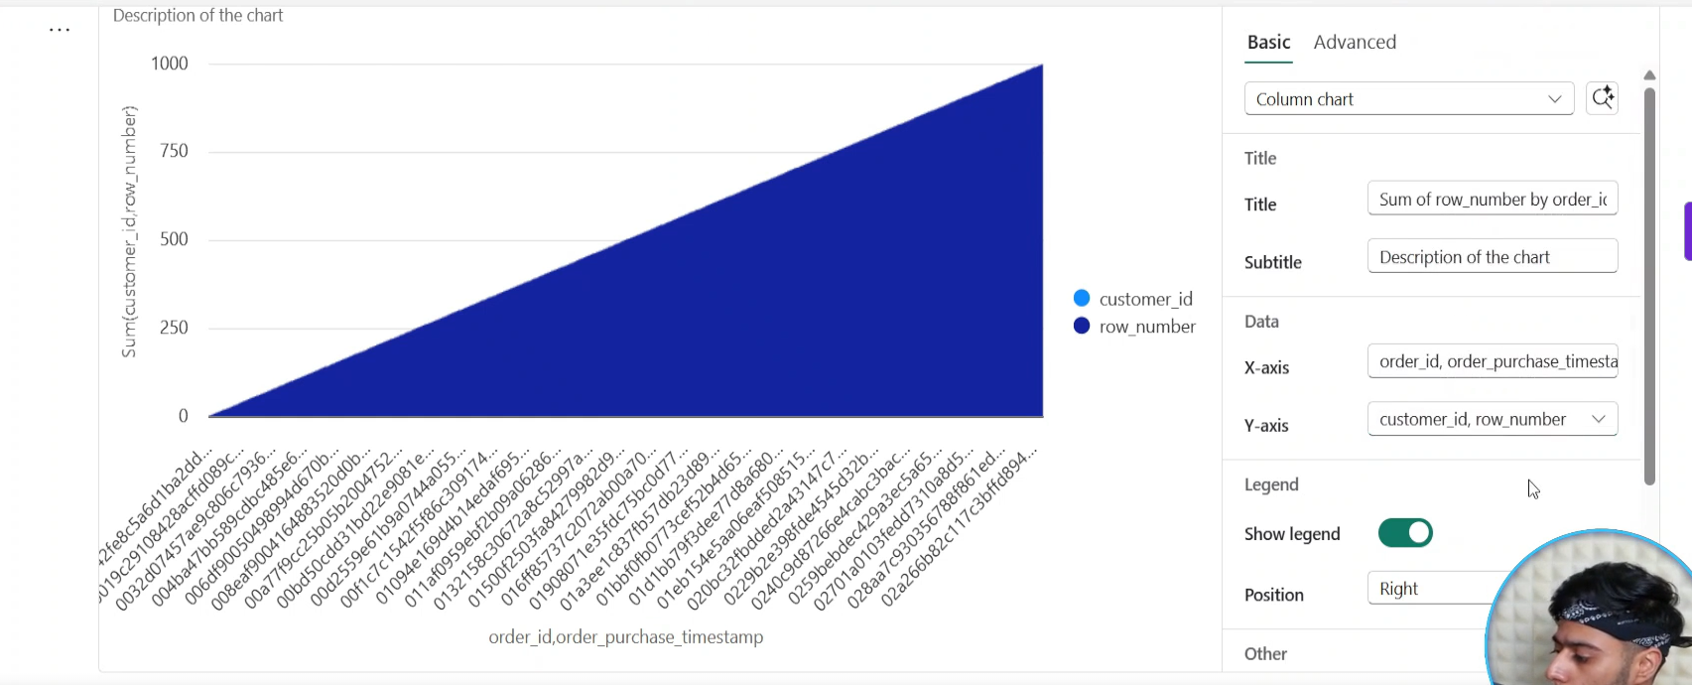
Then Configure the chart

Slide 27
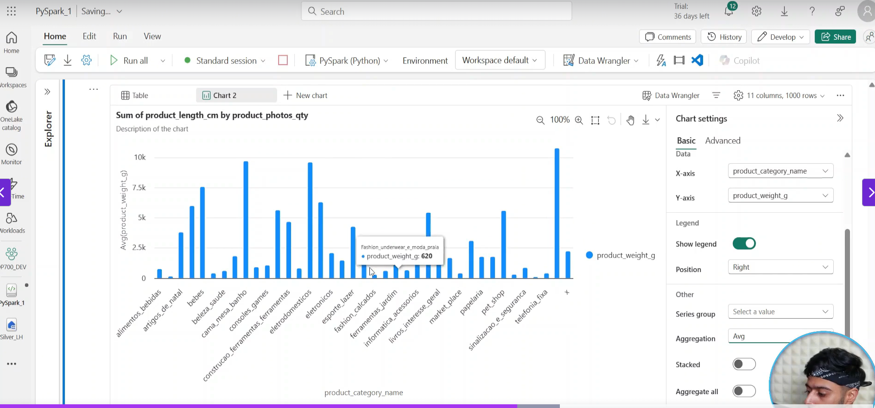
Another example chart:

Slide 28
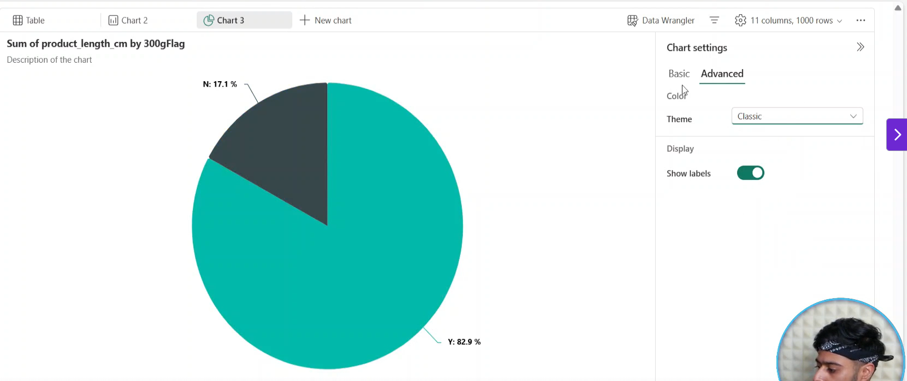

Slide 29




74. External Vs Managed Tables
Notes:
DataFrame writer in Spark.
In our use case we create Managed Tables (Spark).
We have a sql dataframe
All the scenarios , format is delta format :
Error format ..if it sees file it will throw erreor ..ignore wil ignore te file already there
Append is most disciplined .. Just adds the new file.

Slide 30

Manged Tables Continued ; We first write to files not tables. In a folder
Notes:
Note the files are managed by us.. Is an external area.
Must pick relative or non relative / full path.
If it’s a default lakehouse it can be a relative path.
See the name raw source is now a folder name with files in it – we are creating an external location . Managed by us

Slide 31


Now we write top tables (Managed Tables.) – no path required
Notes:
Mustt use lakehouse . Table name – why , well if its default ..u donr need to put Lhouse inj front of table name it will write it there.
Note it will go to default lakehouse
So now if we want it to go to Sbronze ..whatr then?
See above ..we control the lakehouse to where we write. See success in other lakehousew.

Slide 32

Can we create a csv table .. Yes we can see below:
Notes:
Cant create a short cut to csv table .
CSV TABLE IS NOT A DELTA TABLE !!!

Slide 33


Now can we create a external table : Note the .option(“path”) - now external table .. We specify it .
Notes:
I want to save te meatadata in tables and I can specify where I write my files . Can give relative path
Table in same section but data in my specified area. Ie my data in file area.
Validate by going to lake house to see files
For manged table I can see files in the tables area, but not for unmanaged , they are in the files area.S

Slide 34

See where files are and properties for external table

Slide 35

Can yu store files ion a different lake house to the tables (Yes)
Notes:
Must use full path , abs path

Slide 36


Slide 37



Slide 38



75. Notebook_Utils(MSSParkUtils)
Notes:
Look at the bootup time difference
Fs is like your OS module in programming ..most important.
Second most important is notebook itself.

Slide 39

Utils continued

Slide 40

Subfolders

Slide 41


Individual and 01 by 1
Notes:
On;ly one and 1 by 1

Slide 42

Copy and fast copy

Slide 43


MOVE FILE : Make sure file not there
Remove FILE : Make sure file not there

Slide 44


Making a new folder / file

Slide 45

Now we look at notebook category

Slide 46

Help on a Dag method

Slide 47




Running Other Notebooks and exit values
Notes:
On the left is the Run Notebook,
On the right is the calling Notebook , wit the result of the run call..with no parameter..
So it resulted in Bye Bye Graham
Then we called it with a parameter , with 100 timeout parameters , parameter was Peter
See result overleaf MUST PUT THE setting 100 in the second position !!!

Slide 48


Calling parameter with the timeout (100, Peter)
Notes:
What is the use of the parameter ..you canm save the output in a variale. And use it in the calling notebook
Serach for Notebook utils in google

Slide 49

76. Delta Tables

Slide 50


77. Time Travel
Notes:
Using SQL so change to sql programming cell in Notebook.
Is a managed Table else provide location
See Delta Table above

Slide 51



Now we perform DML Operation
Notes:
We now update thye table , wew use an update command
He now deletes a record as well , but make an error and deletes all the records in the table
We ne4ed them back , but which version. Look at describe history command
See version col; every operation in a different version.
In actual fact we want to ignore the 3rd version and go back to V2

Slide 52


Go back to previous version or any version

