Slide 1
PipelineDevForAutomation

Slide 2
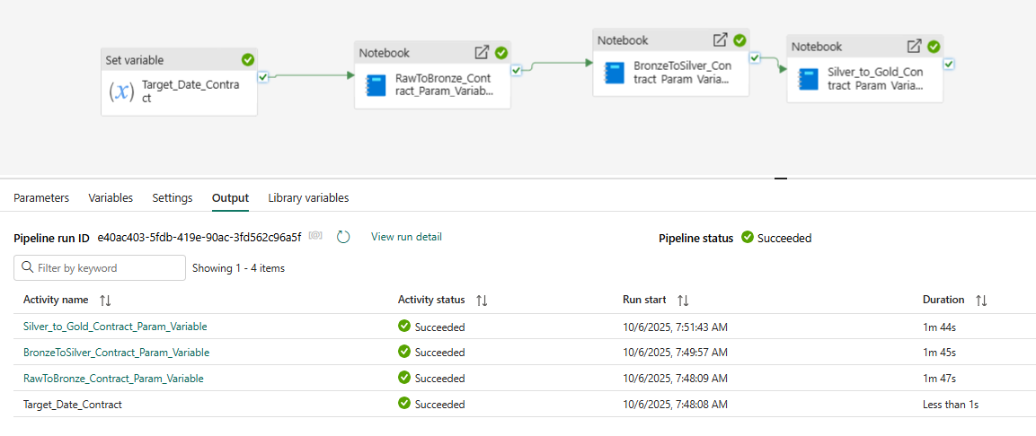
pl__Med_BT_Contract_SetVar
Notes:
A Medallion Pipeline For Contract Backtesting where Variable set manually.
Note How Vars set and passed through to Notebooks

Slide 3
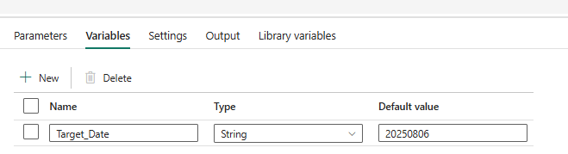
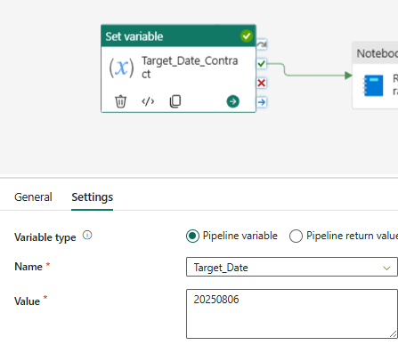
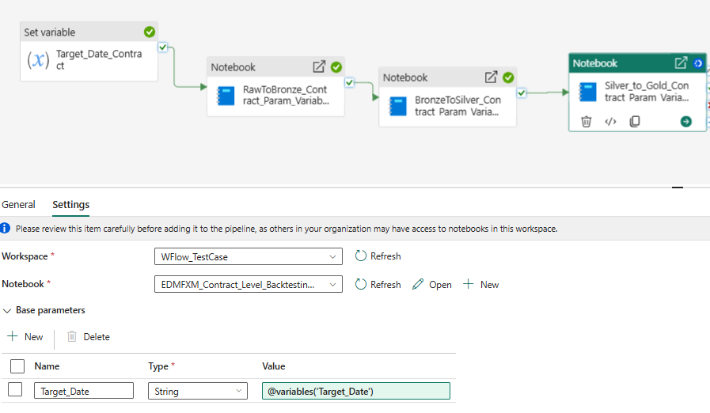
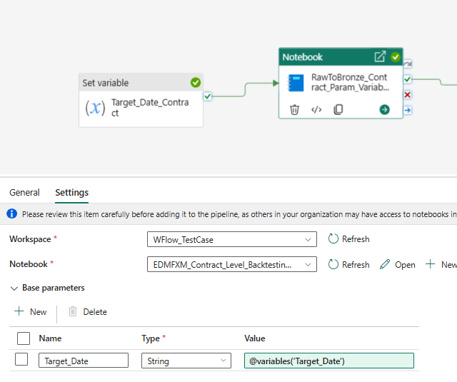
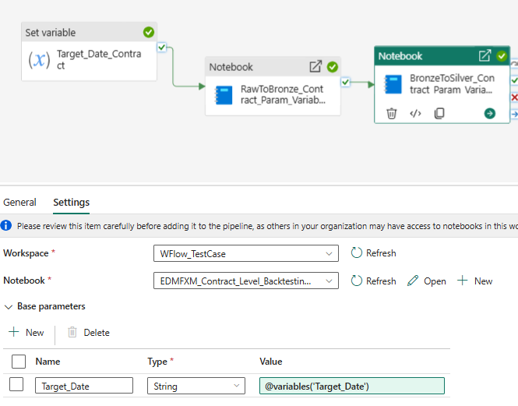
The different settings :
Notes:
Not the settings in the base parametres for each of the Notebooks

Slide 4
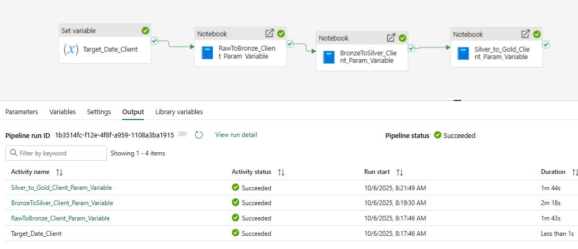
pl_Med_BT_Client_SetVar

Slide 5
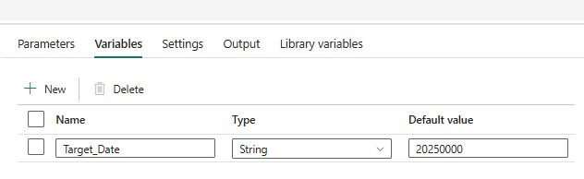
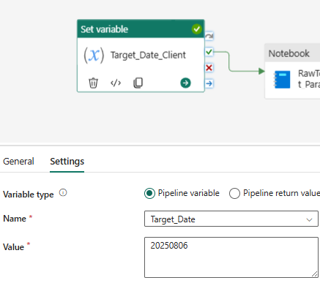
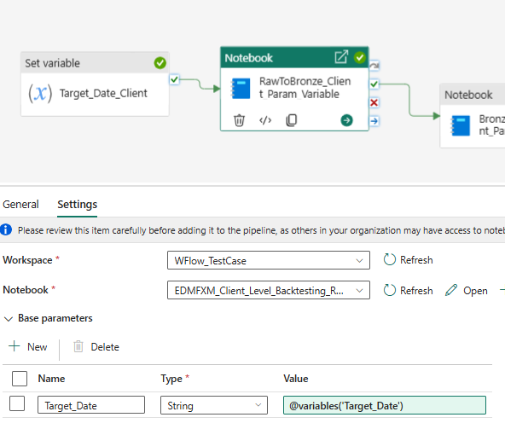
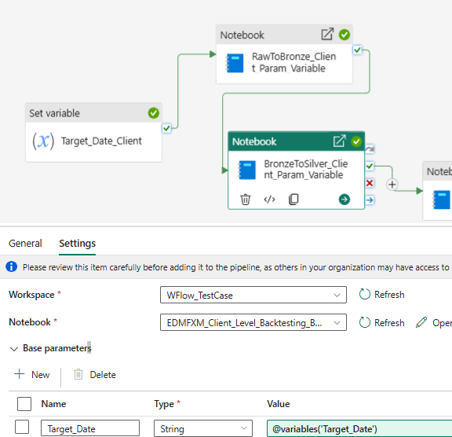
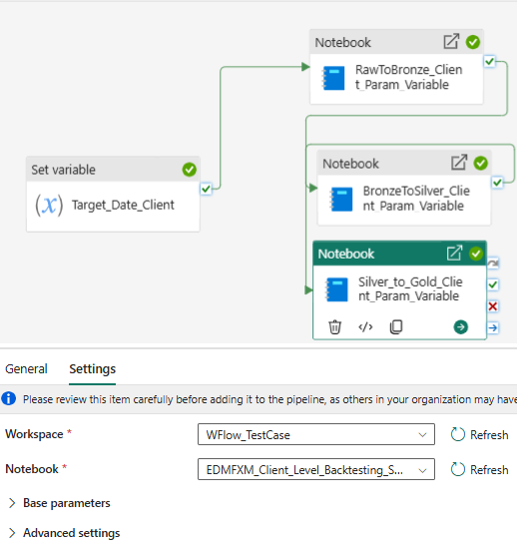
Component Configs

Slide 6
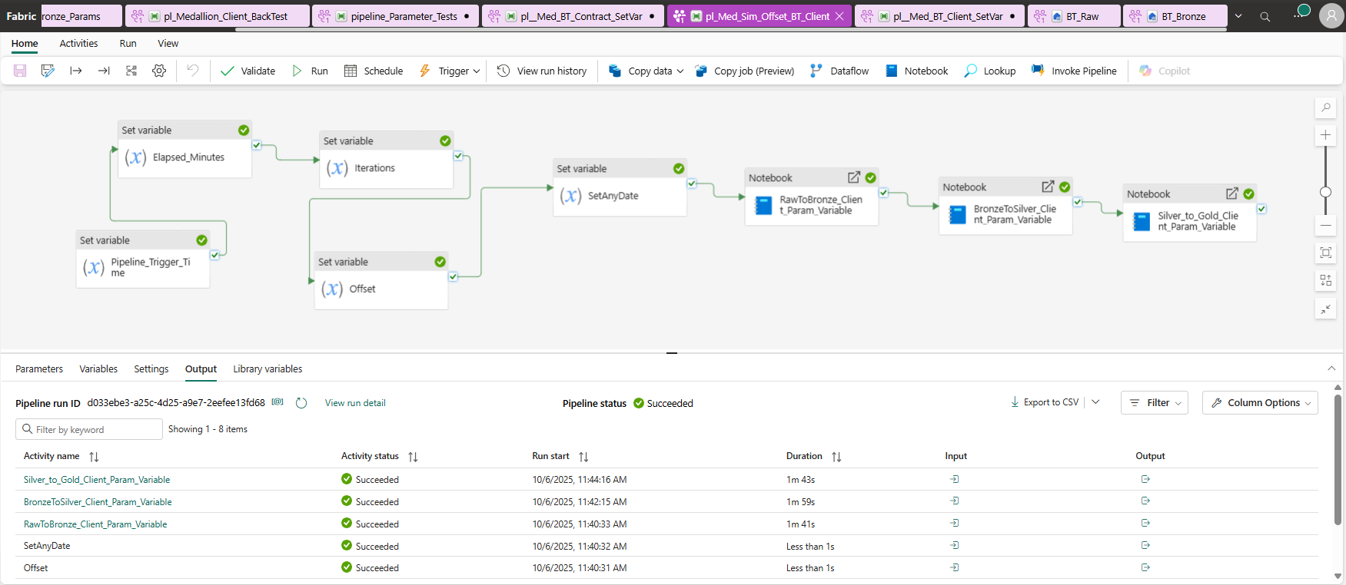
pl_Med_Sim_Offset_BT_Client
NB: Refrence time must be manually set to say 1 minute before the 1st trigger time in the schedule.
Also set the interval minutes of the schedule as a parameter in the parameter settings of main pipeline.
Bothh the above are used to set the iteration number.
Notes:
Now we getting a manual pipeline that now has a real trigger time that we can use to calculate a date
We use an offset as the set variable trigger time is the current trigger time , which we can manipulate to get the date we wantas we want an offset as its not same day, maybe a day behind.. We can set the desired date in a variable. We must set a parameter of the current time so calculate the offset , ie the time close to when we set the Trigger. This is not the actual trigger time. It is slightly before the trigger Time. This is called the reference time and should be set to sat I minute before the 1st trigger time I the schedule.

Slide 7
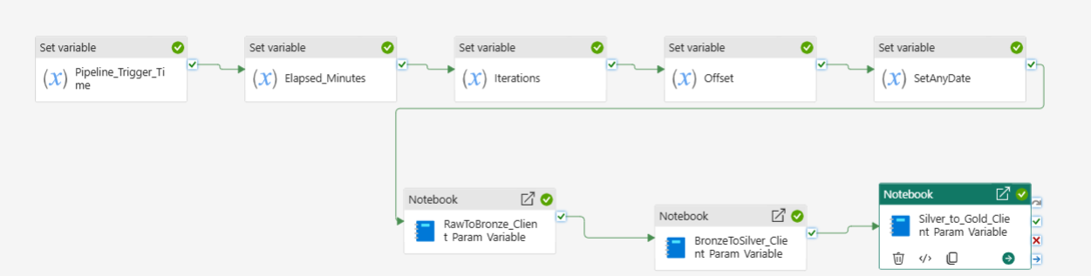
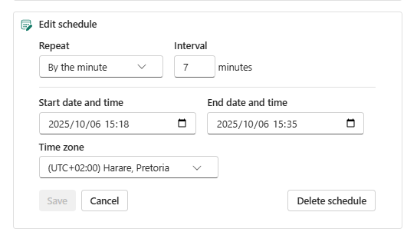
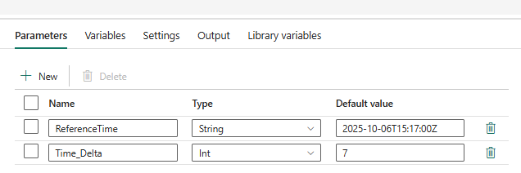
pl_Med_Sim_Offset_BT_Client – w Schedule
Notes:
See the Pipeline with its schedule , it gives 3 runs for 250804/5/6 and see the settings for the parametres to run this schedule
The Parmeters Reference Time ( Set just before the Triger Timer)
The Time Delta , set the same as the Interval..note this is used to derive the iteration number , used to set the date for the Run.

Slide 8
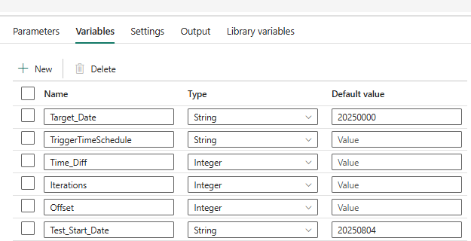
Variables : These are essential variables , set during the run or at the start These variables are explained below , and you will see them referred to in the equations in the settings.
Notes:
The Target date , this is the date that is passed onto the Notebooks, and is formatted as yyyyMMdd, and is the output of a chain of activities from 5 set variabl;e blocks, not a required input
The notebooks consume target date as a base parameter to set the paths and table names(see Notebook settings)
Trigger time schedule is the actual trigger time in Utc +2 (SA time) , the plus 2 is calculated in the set variable block settings , in the default time format, usin @addHours ( not required to input this
Time Difference , is set in the Setvariable block and is the elased time in minutes between the trigger time and the reference time, The reference time is set close to the initial time of the first Trigger time of the schedule. It is used to set the iteration number of the Scheduled Triggers.
Iterations is used in theIteration Block to calculate the iteration number of the loop. Ie the total time divided by the parameter ,Time Delta. It is used to eventually set the date parameter, together with offset. Its calculated and not an input.
Test Start Date; This is the only variable required as an Input, in yyyyMMdd format. It is either the only date of the desired analysis OR the start date of the analysis. This date and calculated dates from this will be the target date.
Offset: this is a calculation used to set the Target date, NB: Remember we are using a current date when we use the Pipeline Trigger Block. The dates required of the analysis are in the past. So Offset (and Iteration) are used to derive the required date based on the trigger time. If the analysis is required at the trigger time , we would not need most of these variables. Note we divide by 8.6 E11..to get the number of days between 2 dates.
Also not that the equations allow you to Set a schedule every X minutes (5 or 7 ), and this allows you to get the historic analysis (for the past ) every X minutes , it accelerates the time to do analysis in the past. We can use the same setup when we go to a Schedule every 24 hours just by setting the Time delta to every 24 X 60 minutes.

Slide 9
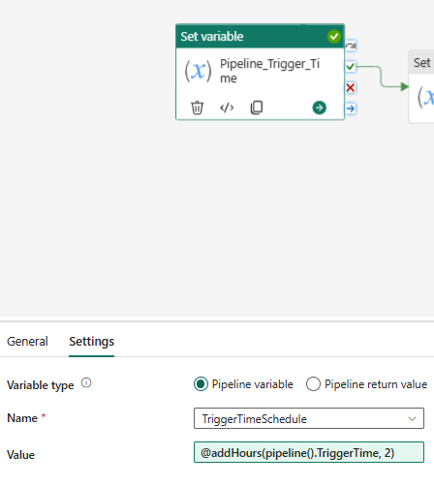
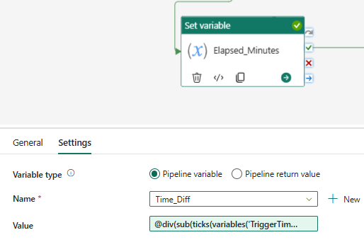
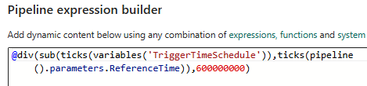
Individual Block Settings (1)
Notes:
Note the division in the expression builder of 6000000000, to get the difference to minutes

Slide 10
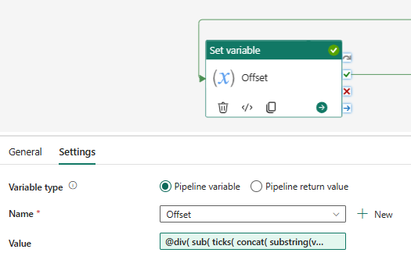
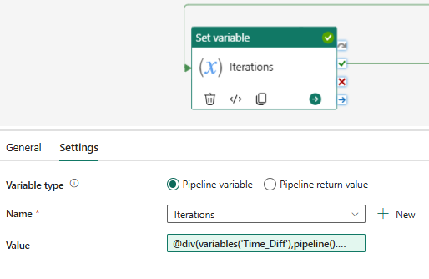
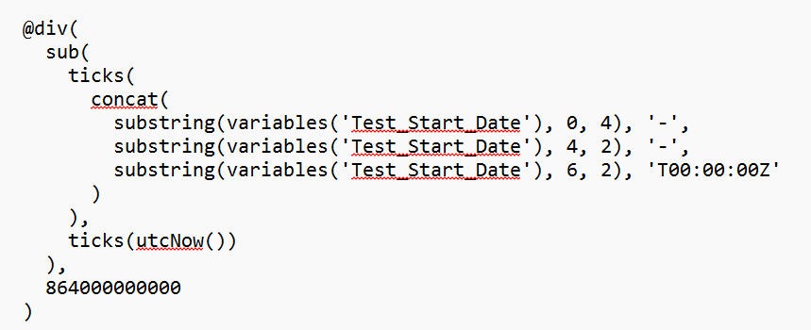
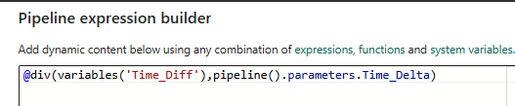
Block Settings (2)
Notes:
Note in the Iterations block we divide the time difference , Time Diff (in minutes) by the number of minutes between iterations of the schedule , Time Delta, an essential input to get the iteation numbet of the loop.
NB: An iteration number can be set in the pipeline , as variables are ephemeral, they only last for that iteration. Therefor an outside reference is used ie set as a fixed parameter, Reference Time, which is not changed during the iterations ( ONE OF THE ESSENTIAL DIFFERENCES BETWEEN THAT AND LOOPS)
OFFSET :As mentioned previously the offset function allows one to set any date from an input Trigger (Current Time) to get any backtest from past data. You set the initial desired start date in yyyymmdd format and this format will cinstruct a day at 0 time and subtract utcNow , to get a time difference in 100’s of nanposeconds , and it willdivide by , the number of 100s of nanoseconds in a day. To get the offset in days from today , in the past, a negative number

Slide 11
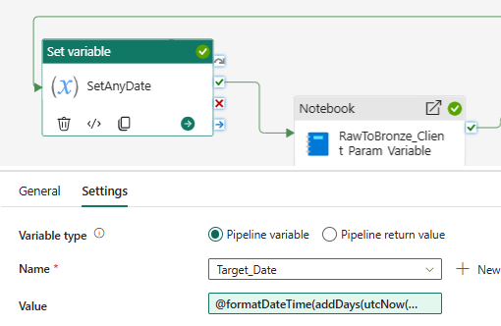
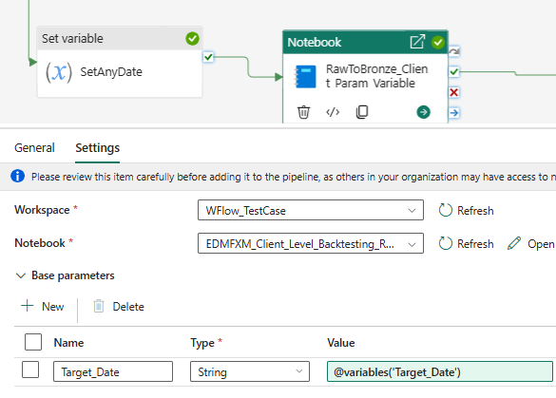
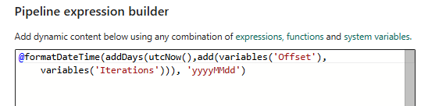
Block settings (3)
Notes:
The set any date caculates the date of the iteration in yyyyMMdd format to send to the Notebooks as a variable , actually a base parameter in the notebook, see the first notebook on the right
See the first Notebook Raw to Bronze on the Right , and the base parameters taking in the Target date from the setAnyDate Varaible Block
Note the Notebook block references the poarameterized notebook.

Slide 12
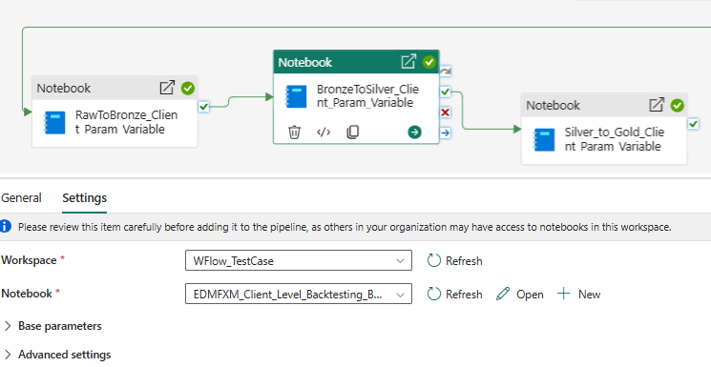
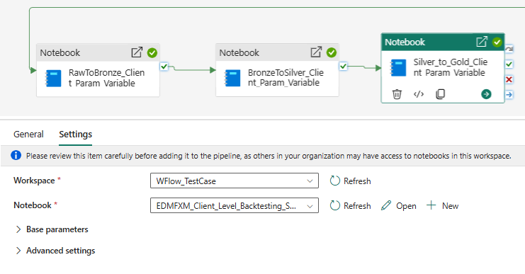
Block Settings (4) For Notebooks

Slide 13
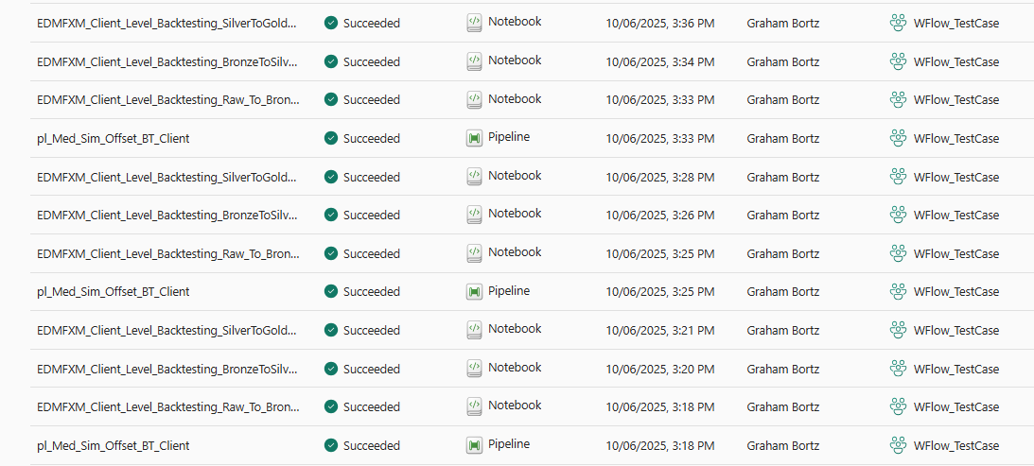
The Monitor Screen for all the runs for Client Backtest Sim

Slide 14
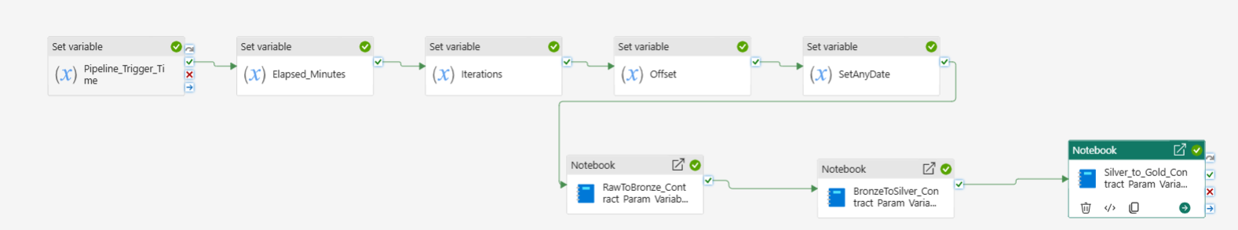
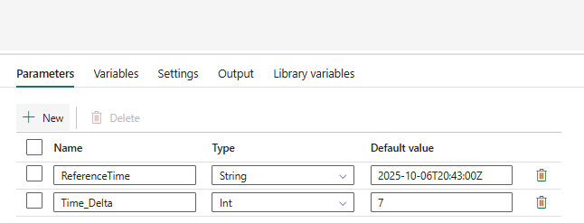
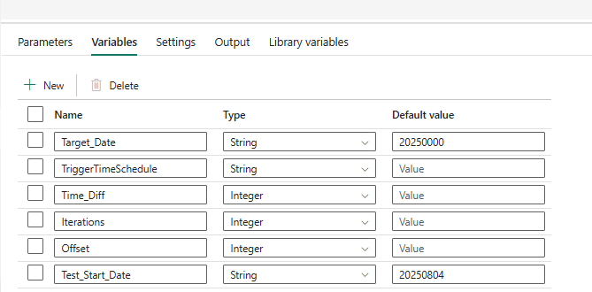
pl_Med_Sim_Offset_BT_Contract– w Schedule
Notes:
As shown above all variables are same as before ie with contract
All Set Var Blocks are same as before
Only the settings for the Contract Notebook elements =dffer , shown overleaf
The notebook params are same as in Client , but the notebooks differ , see overleaf.

Slide 15
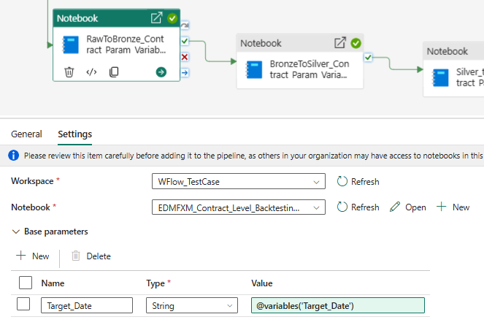
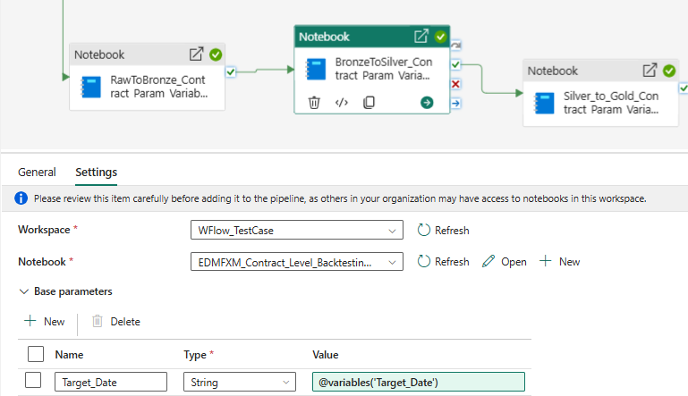
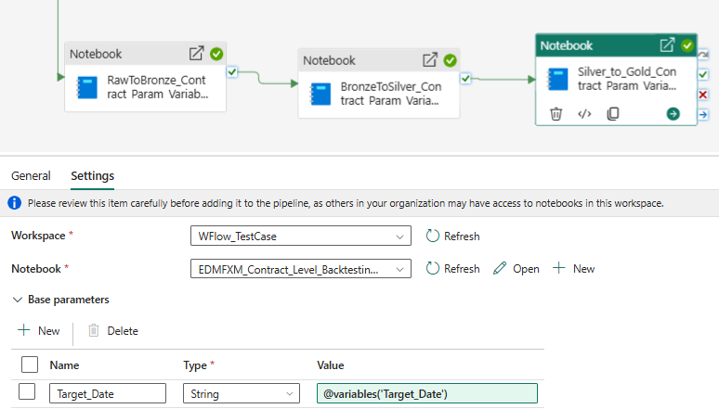
Notebooks for contract same , but call different notebooks

Slide 16
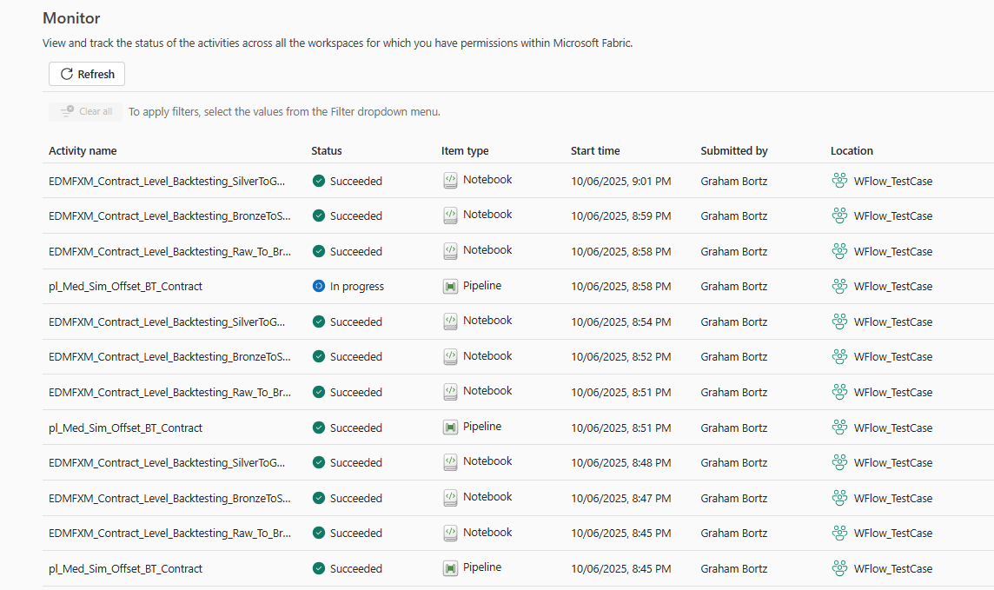
Record of Simulation Results

Slide 17
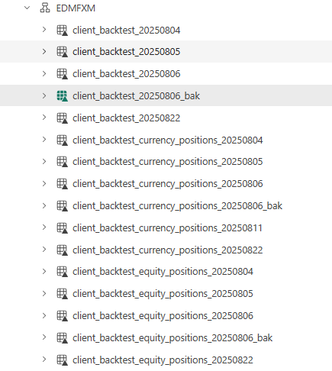
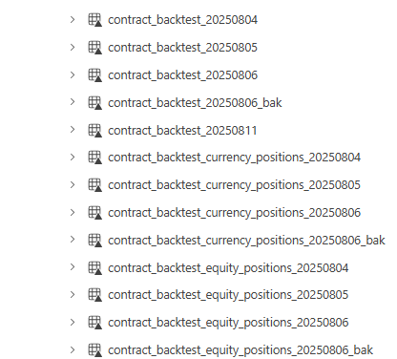
Bronze_Gold_Silver_Lakehouses, Bronze is shown as example , others are identical

Slide 18
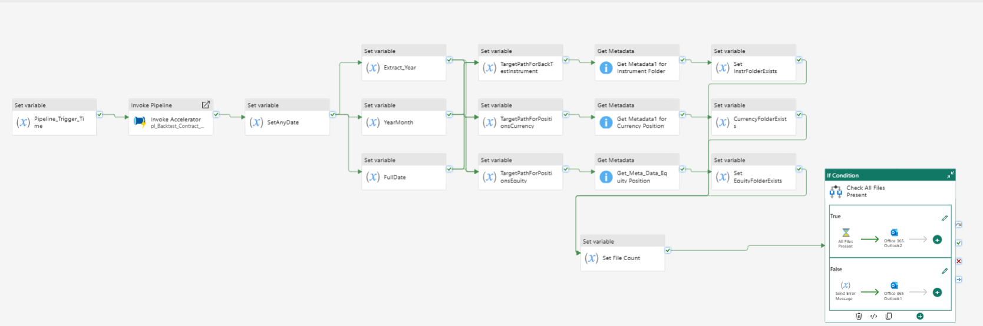
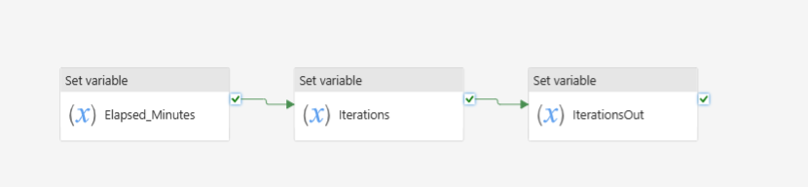
Pl_Simulate_Date_File_Checker
pl_Backtest_Contract_Accelerator
Notes:
This pipeline has the file checker exposed in the main pipeline (there is a further development where we use this in the Invoke block)
The above pipeline uses an Invoke block to do the acceleration , ie Invoke Accelerator , which is shown below.
The pipeline that’s invoked at the moment is called pl_Backtest_Contract_Accelerator, which has calculations to produce consecutive days to do the backtesting, every x number of minutes, which has to be set as a parameter in the main pipeline and passed through to this pipeline.
NB: We will keep this name , and make a copy of this and call it child pipeline later on but it needs to be expanded to include more blocks

Slide 19
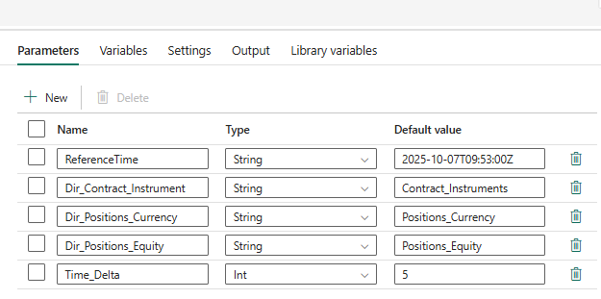
Pl_Simulate _File_Checker At present these are the parametres and variables declared in the main pipeline
Notes:
All these Partameters are required , mainly to set the current date ie Reference Time and Time Delta
NB: Time Delta must be the same as the delta time in Scheduler
Reference Time must be very close to the Starting Time
The others are the Directory Path .. Variables for the 3 files for this we do the contract and the currency and equity positions

Slide 20
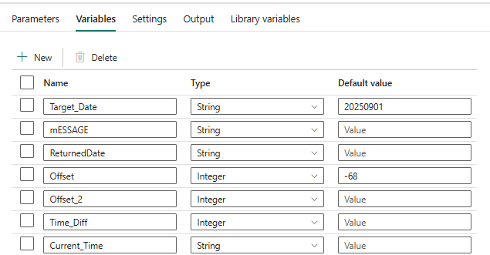
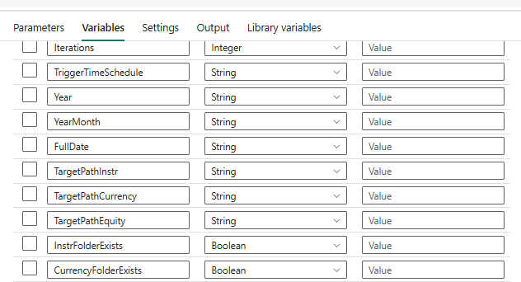
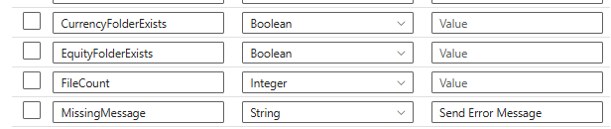
Variables: Many Variables Set in the Different variable blocks and discussed there
Notes:
These variables are set and discussed in the appropriate blocks
The most important of these are the Offset: this is used as an offset to the current date in order to produce the dates being tested ie at the time of writing the offset was set to 68 , the test was done on the 13 October for dates from the 20250806. The schedule was set at 7:46, for startin 7:47 to 7:58.. It would run 3 schedules every 5 mins to extract dates from Aug 6th to aug 8th ie 3 iterations …

Slide 21
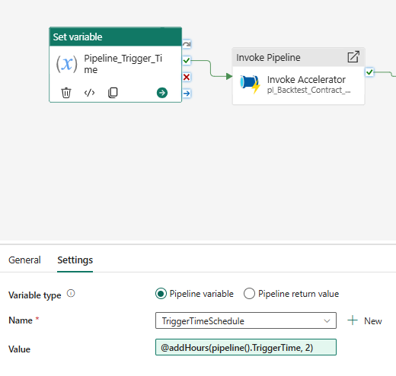
Pipeline Trigger time Block
Notes:
Note we add 2 hours to UTC
This block just sets the variable Trigger time to an offset of 2 hours , as the trigger time is utc

Slide 22
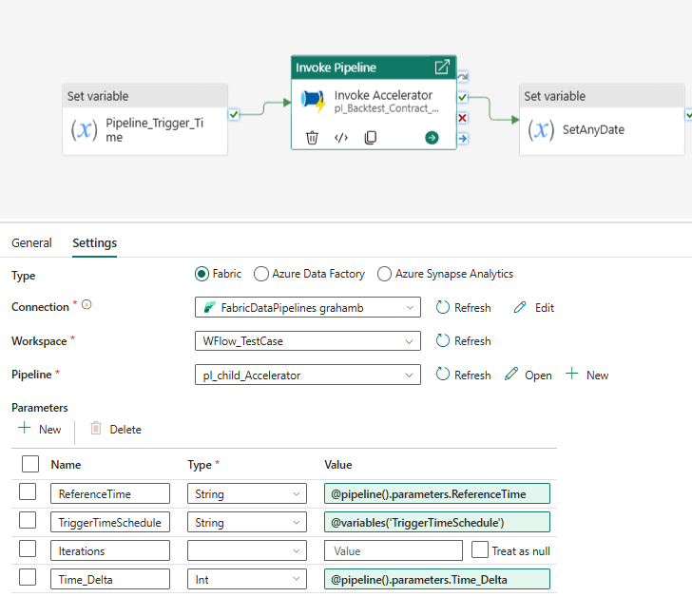
Invoke Accelerator Block.
Notes:
This is an Invoke Pipeline block which has a child Pipeline
This child pipeline accelerates the testing facility and will be discussed in the next few slides.
The invoke block calls another child pipeline called pl_child accelerator which has variables and parameters passed to it. In order to pass these variables from the main pipeline to the child pipeline , you have to pass them into Base parametres in the Invoke Block, so they are all now parametres as far as the child pipeline sees them.
They must be declared as parametres in the child pipeline, They don’t hace to have defaulot values , these will be ignored
referenceTime – a parameter in the main pipeline . Is dynamically referenced here by calling parameters in the dynamic expression]
TriggerTime Schedule is a variable in main pipeline and brought through as a variable in the dynamic expression.
Time Delta isa parmeter in the main pipeline and is brough through as a parameter

Slide 23
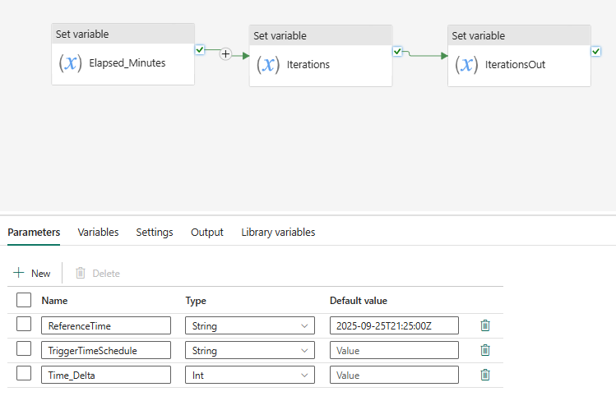
Pl child Accelerator
Notes:
1) Note we bring in the 3 reference parameters , from the main pipeline , they will be used in the calculations

Slide 24
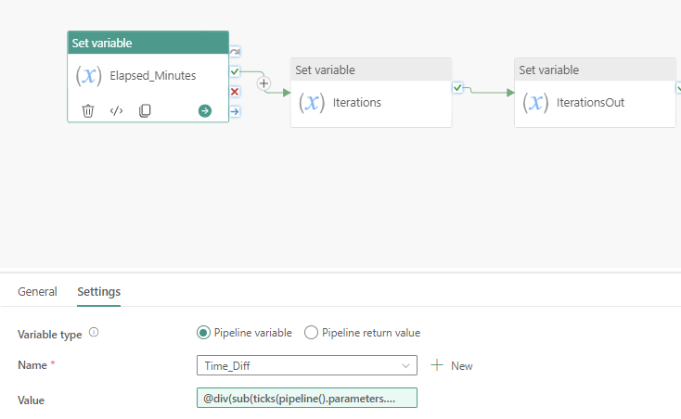
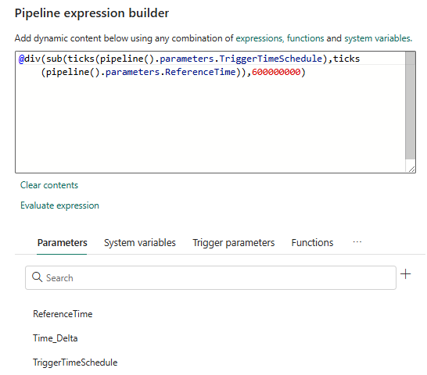
Pl_child_Accelerator :Elapsed Minutes
Notes:
This block is used to calculate the elased time in minutes between the trigger time and a reference time.
The reference time is a constrant through all the iterations ,. The trigger time will change.
Therefore the elased minutes is the time in minutes between the constant ref time ( set close to the first iteration time) and the trigger time. This is usede to get an iteration number to offset the date to retrieve the next days data each iteration , very fast. It simulates say a dat every 5 minutes.
The formula takes the difference between the parameters of trigger time and Reference time and divides bay a factor to get the Time_Diff variable in minutes.. Default time difference is in 100s of nanaoseconds.

Slide 25


Pl_child_Accelerator : Iterations
Notes:
This block works out the iteration number of the loop ,
It divides by the delta Time of the Schedule so it must be kept synchronous.

Slide 26

Pl_child_accelerator:Iterations out : Return Pipeline Varaibales
Notes:
This is a set variable block , Which takes in a variable previously set Nd returns the same variable , note , in the settings it is set to “Pipeline Return Value; NOT Pipeline variable”
Note its an expression: @variables(‘Iterations’)..this is where it is returned.
Note: This pipeline is going to be updated to include an offset. The intention is to provide a dates , ther start date of the simulation , rather than ask a user to set the offset. This child pipeline will calculate the Offset in a block and return that as well, to the main pipeline to change todays date to the date desired.
This will be oin the next iteration.

Slide 27


Continuing with pl_simulate Date File Checker : SetAnyDate
Notes:
This block takes the iterations out , from the Invoke Acceleartor Block’s return value and adds the offset , that was an input required , and the iteration number , representing the added days to the reference time
The offset will come from a block , rather that a variable from the main pipeline (date will be input)
The output format is a Date: yyyyMMdd format that will eventually be put into the Backtest / strsstest algorithm.
Note the expression and how all the variables are achieved.

Slide 28

Pl_simulate_Date_File_Checker:
Notes:
There are 5 parts to this
Extracting the date components to set the path
Setting the paths for the various files ie the instrument path , equity path and the currency path.
Getting the Metadata of all of the paths , this is just a decision , does something exist there , has it been dropped
Setting a variable (Boolean) to capture the exists or not for each file required.
Set the file count , for a futher if Block.
Note: It is envisaged that all of the above will go into one invoke block , to simplify the flow. The input will be the date and the ouput wil be the file count.

Slide 29






pl_Simulate_Date_File_Checker; Part 1 of File Checker
Notes:
We extract the last parts of the path checker ie the year , month and say
See the substring calculations, component settings and the calculation below.
Target Date is the set output of set variable
The full date is actually the folder the file sits in.. Ie the final folder.

Slide 30









pl_Simulate_Date_File_Checker

Slide 31






Pl_Simulate+Date_File_Checker: Get Meta data Part of file checker
Notes:
For each one set the equation to get the path from the input Variables of the main pipeline , they are set in the previous part of the file checker ( Set Variable Targetpathhxxx).
See that the file path settings is to get this variable that has been concatenated to provide the path. See above , its dynamic var setting
Each GetMeta gets the path for its file and then , gets the Exists Argument, from the Get Meta choices

Slide 32









Final setting of exist variable for that file to use in if block (Boolean variable)
Notes:
The variables are InstrFolderExists - For the Instrument Being Backtested
Currency Folder Exists – For the Currency File
Equity Folder Exists – For the Equity positions File
NB: If the folder exists so does the file , their may be corrupt files

Slide 33



Last part of File checker part is to calculate the numbrer of exists to compare to 3 in the if block.
Notes:
Counting the number of files that exist

Slide 34







If condition block, at present it sends messages if and if not there are 3 files
Notes:
So here we have to separate out the activities of wait..describes success or failure to see the decision

Slide 36

Simulations

Slide 37


Slide 38



pl_Simulate_Date_File_Checker_w_Offset
Notes:
We now include a desired start date rather than an offset , which requires now the input date and a setr variable to calculate the offset
We have a working version of this in an example pipeline Parameter Tests , shown above , with the analysis built in ..we are to copy the offset block and insert it
It requires the start date as an in put and the offset to be calculated , so it will affect 32 blocks , the offser block and the setAny Date Block .
We look at the offset block first , note the dynamic expression …Test_Start_Date is a Varaible , and the output of this block is now called Offset , remove this as a variable in

Slide 39

Change set any date , now to take in the offset
Notes:
Set any date now takes as input the offset , and see how it now calculates the date from the offset ,,
Iterations block should not change

Slide 40

pl_Simulate_Date_File_Checker_w_Offset
Notes:
We added the offset block so that we can fill in a Target_Date , so only 2 blocks are affected relative to the pipeline originally ie
Pl_Simulate_Date_File_Checker, so only those blocks are highlighted here
The Above shows the whole stream

Slide 41

New Blocks , Set Variable – Calc Offset from Date
Notes:
Note you now have an input variable Test Start Date , this is used to set the initiall date to what you want by calculating an offset from the actual trigger time of the run , as the trigger time is today , So it runs today but uses historic dates.

Slide 42

Calculate Offset from date
@div(
sub(
ticks(
concat(
substring(variables('Test_Start_Date'), 0, 4), '-',
substring(variables('Test_Start_Date'), 4, 2), '-',
substring(variables('Test_Start_Date'), 6, 2), 'T00:00:00Z'
)
),
ticks(utcNow())
),
864000000000
)

Slide 43

Set Any Data

Slide 44


pl_Simulate_Backtest_Client_w_FileCheck
The file checker was updated to not only send the emails on success , but in the success path run the client Backtesting
The whole execution takes around 10 minutes , so this interval has to be changed in 2 places , in the Scheduler and in the Time Delta. These are shown below.
Notes:
Reference time 11:20 today
Delta 5 mins
Test_Start_Date 20250804
Set the schedule for 11:20 to 11:32..for 3 dates
Pipelineinterval has to be 10 minutes , between iterations ,
See results above

Slide 45

Performance in the successful run (7min about)
Notes:
Note that other people running cfoncurrently on our SKU , affected performance , (~ 13 minutes) . This resukted in failure as interval was set at 10minutes.
After checking for no simultaneous usage , duration was 7 minutes, as in this last run , hence 10 minutes was ok.

Slide 46

More detailed analysis of the run is shown below to show components and their times

Slide 47

pl_Simulate_Backtest_Client_w_FileCheck
Notes:
The whole pipeline is shown above , the bloch requiring change is high;lighted and wil be discussed overleaf. Being the Invoke Pipeline block in the If condition Block.
The File checker component has one path for each file , and there are 3 in this use case of Backtesting Client.

Slide 48

pl_Simulate_Backtest_Client_w_FileCheck
Notes:
f we open the If condition Block er see in the activities , the expression to check the count against 3 (this should become a variable or parameter )
We have added the Invoke Child Block inside the true path ,
We open the true side to insert that block there by pressing on the pencil on the right of the screen .. To the right of Activity at the bottom part , see overleaf

Slide 49


True part of If condition.
Notes:
In the true part we have 3 blocks , the last of which is the Invoke Child Pipeline
Notice in the settings where we set the pipeline , and then especially the target Date , this is the parameter that is expected by the Notebooks.
But notice @variables(Target Date) , dynamic expression … we are in the main pipeline and it come from the Set Date Variable block , hence it’s a variable at this level.
Now on the right of page we go into 1 level down ie the child pipelinne , referred to in the Invoke Block.
Notice its now captured as a parameter, ie @pipeline().parameters.Target_Date
Each of the Blocks settings is identical except for the Notebooks which are Raw To Bronze , Bronze to Silve and Siler to gold respectively
This child pipeline is the existing child pipeline we have used before in the parent pipeline when initially testing the invoke blocfk!.

Slide 50


pl_Simulate_Backtest_Contract_w_FileCheck
The pipeline is identical to client except with very few changes.
Obvoisly the instrument comes from a different directory ,
Also the invoke block call a Contract pipeline with different notebooks.
Notes:
See the Chold Pipeline is Contract now , on the right.

Slide 51

Performance of Contract ( 6mins)

Slide 52

pl_Simulate_JSpan_w_FileCheck_All_5_Check_Blocks
Notes:
The above shows the entire process ,
The difference here is we have to get 5 files and the first one is not date related Ie Calendar dates , dates were therefore taken out of the path

Slide 53

Performance
Notes:
Test Date 2050909 and message received of missing file
Now test for 20250910.

Slide 54

Initial Variables

Slide 55


Variables

Slide 56


Settings
Notes:
Pipeline Trigger
Invoke Block

Slide 57


@formatDateTime(addDays(utcNow(),add(variables('Offset'),activity('Invoke Accelerator').output.properties.returnValue.Iterations_Out)), 'yyyyMMdd')
@div(
sub(
ticks(
concat(
substring(variables('Test_Start_Date'), 0, 4), '-',
substring(variables('Test_Start_Date'), 4, 2), '-',
substring(variables('Test_Start_Date'), 6, 2), 'T00:00:00Z'
)
),
ticks(utcNow())
),
864000000000
)
Notes:
Calculate Offset
Set Any Date

Slide 58



Extraction of Date Components
@substring(variables('Target_Date'), 0, 4)
@substring(variables('Target_Date'), 0, 6)

Slide 59



Target Paths
@concat(pipeline().parameters.Dir_Exchange_Diary,'/')

Slide 60





Slide 61



Slide 62




Slide 63



Slide 64



Folders
@activity('Get_Meta_Data_CMDInstr_Stats').output.exists
@activity('Get Metadata for CMD Instr').output.exists
@activity('Get Metadat ExchDiary').output.exists

Slide 65


Folders
@activity('Get Metadata for INT Instr').output.exists
@activity('Get_Meta_Data_INTInstr_Stats').output.exists

Slide 66

@add(
add(
add(
add(
int(variables('ExchDiary_Exists')),
int(variables('cmd_instr_Exists'))
),
int(variables('cmd_instr_Stats_Exists'))
),
int(variables('interest_instr_Exists'))
),
int(variables('interest_instrStats_Exists'))
)

Slide 67


Slide 68


True part of if block

Slide 69


True part of if block , the child pipeline in the invoke block
Notes:
Note how target date is captured as a parameter passed through from parent pipeline
Only 1 block raw to bronze is shown , the others are identical , except calling different notebook ie Bronze to Silver and silver to gold respectively

Slide 70

False part of if block. Only the mail terminates the run , nothing after mail block , see message – missing files
Notes:
To find which files are missing go through each of the output of the exist blocks (5) in the pipeline run Output , and click on the output arrow , see which is true and which is False..the False tells which folder does not exist and that is the file that does not exist. You could mofify the message using multiple if statement statements.

Slide 71


Jspan pl_Child Pipeline Run.

Slide 72


Slide 73


Slide 74

Engineering

Slide 76
Restesting pl_Parent_BackTest_Client Since Wspace Change
1) This change entailed changing the addressing in Notebooks for the input files and tables
2) The lakehouse mapped to the notebooks did not keep thyeir default statuses so these had to be reset.
3) Tables needed to be deleted prior to the run as there were schema problems

Slide 77

Pl_Pipeline_Parent_Backtest_Client was retested with success after editing notebooks to address new Wspace/Lakehouses and resetting the default lakehouses
Notes:
1_) Note the time taken for the whole run ie ~9 minutes.

Slide 78

pl_Child_Contract_BackTest_Using_Parameterswas retested with success after editing notebooks to address new Wspace/Lakehouses and resetting the default lakehouses
Notes:
This shows Child Working

Slide 79

pl_Parent_BackTest_Contract
Notes:
This shows the main pipeline Working

Slide 80




Jspan ,.. We altered the notebooks for the New Medallion Workspace , Now test First entire pipeline for Jspan ie pl_JSPAN_parameters, blew settings for each block are shown

Slide 81

Run as is pl_JSPAN_parametres

Slide 82




Now we convert to child and parent pipelines: Child is pl_child_Jspan_Parametres
Notes:
Note that in the child pipeline above , the notebook wants a parameter, see the settings for this pipeline above , not a variable .. Whereas when it was in the main pipeline (not as a child ), it was getting the variable directly from the Set variable block
Here the Invoke block .. See next page , gets the value from the set variablke block , and translates it through its base parameters , into a parameter for the Ivoke block.
pl_child does not have an output in its main screen , only in the Monitoring Hub , as shown above

Slide 83



Pl_Parent_JSPAN_parametres
Notes:
Note it’s a variable in the main pipeline , the invoke block reads it as a variable , the children in the child pipeline read it as a parameter.

Slide 84


Slide 85

11/07/2025- pl_IRDCDM_Margin_Detail_Client_CM

Slide 86

Capture the Result: Final.

Slide 87




Process Pl Components
Notes:
Difference Between the 3 Notebooks are the Medallion stage conversions. Raw to Bronze to Silver to gold.

Slide 88

pl_Parent_IRDCDM_Margin_Detail_Client_CM

Slide 89


pl_Child_IRDCDM_Margin_Detail_Client_CM_

Slide 90

Ingest_IRD_CDM_Margin_Detail_Client_CM_auto

Slide 96

Pl_JSPAN_parametres

Slide 97






Slide 99

Backtest..Client Auto

Slide 100

pl__Med_BT_Client_SetVar_RMS_SC_Auto

Slide 101

pl__Med_BT_Contract_SetVar_RMS_SC_Auto

Slide 102

pl_Ingest_IRDCD_JSpan_Params_RMS_SC_Auto

Slide 103

Jspan Ran on New Data Shortcut : pl_JSPAN_parametres_auto

Slide 104

Ingest_IRD_CDM_Margin_Detail_Client_CM_RMS_SC_auto

Slide 105

pl_IRDCDM_Margin_Detail_Client_CM

Slide 107

Contract run Backtesting Latest

Slide 108

pl_Simulate_JSpan_w_FileCheck_All_5_Check_Blocks_w_JSPAN (1 Run with Date =0250910)

Slide 109

pl_Simulate_JSpan_w_FileCheck_All_5_Check_Blocks_w_JSPAN

Slide 110

pl_Simulate_JSpan_w_FileCheck_All_5_Check_Blocks_w_JSPAN (1 Run with 3XDate =0250910/11/12)
Notes:
Note Time Delta is 10 minutes: same as Schedule Delta

Slide 111

Now we monitor

Slide 112

3 Consecutive runs

Slide 113

pl_Simulate_Backtest_Client_w_FileCheck

Slide 114

pl_Simulate_Backtest_Contract_w_FileCheck

