Slide 1
DP700 Exam Prep

Slide 2
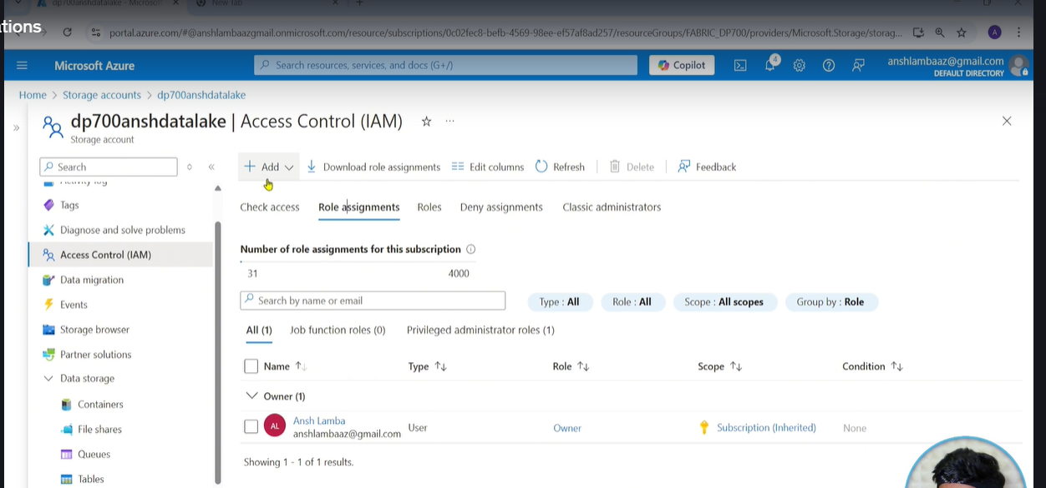
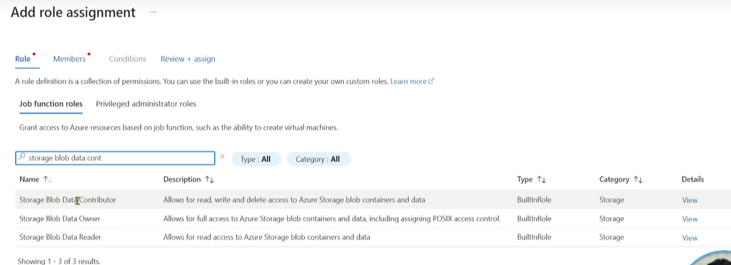
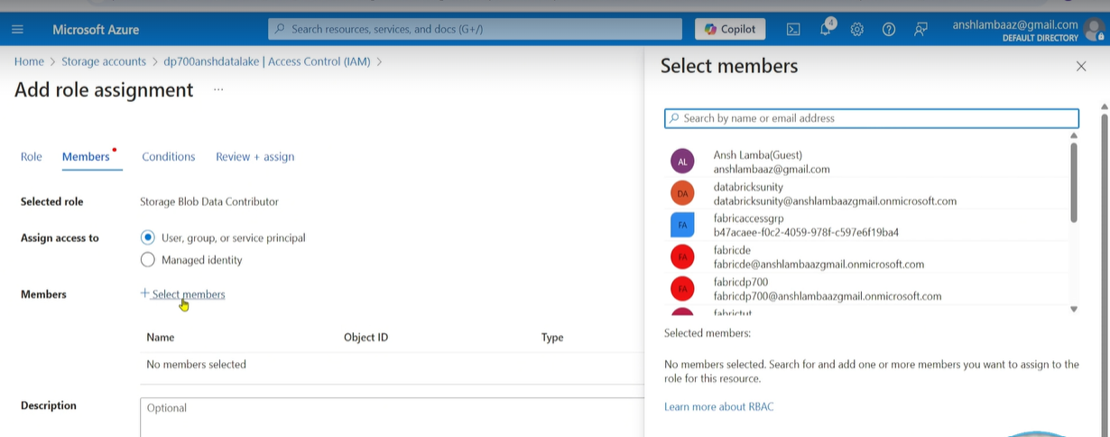
33. External Short Cuts
Notes:
Go to access control / Role Assignments / Oick Storage Blob Contributor in the Add role Assignment / Next ..select Members , and choose that member

Slide 3
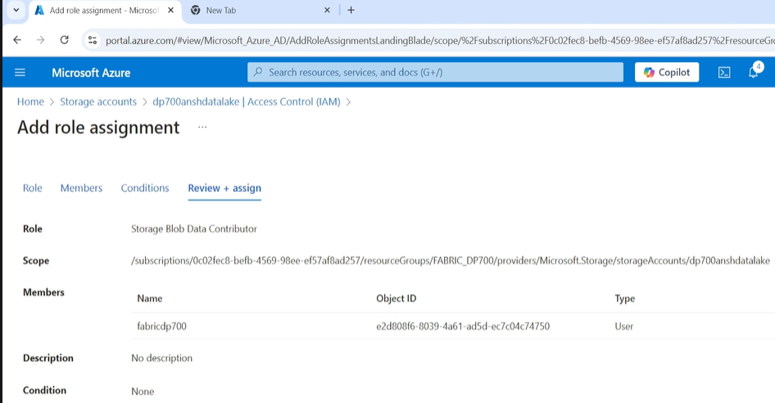
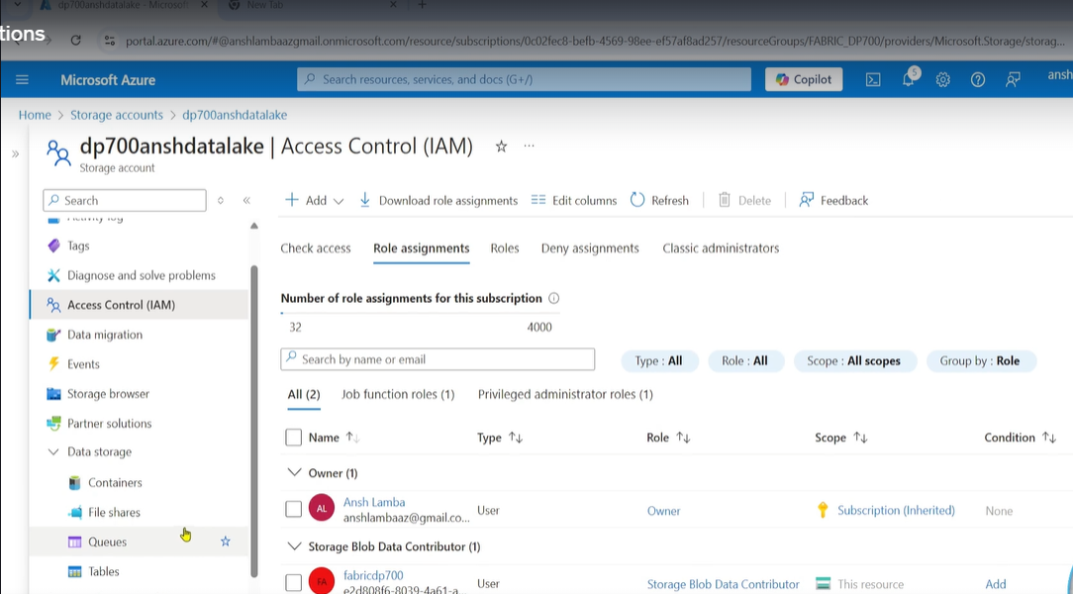
Continued
Notes:
Se;ect Review and Assign and then go back to see it

Slide 4
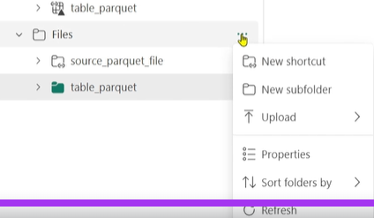
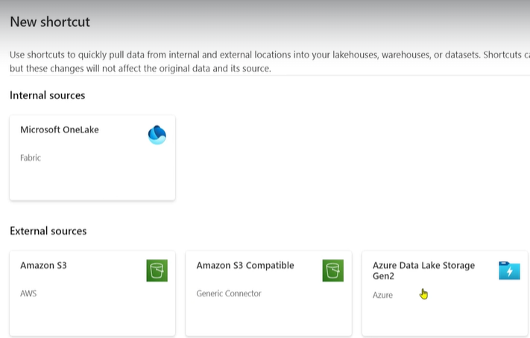
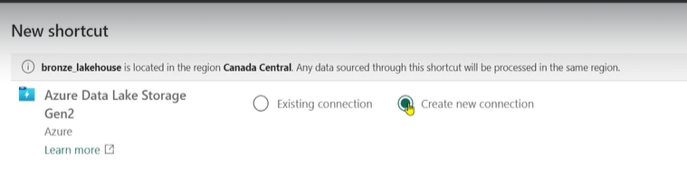
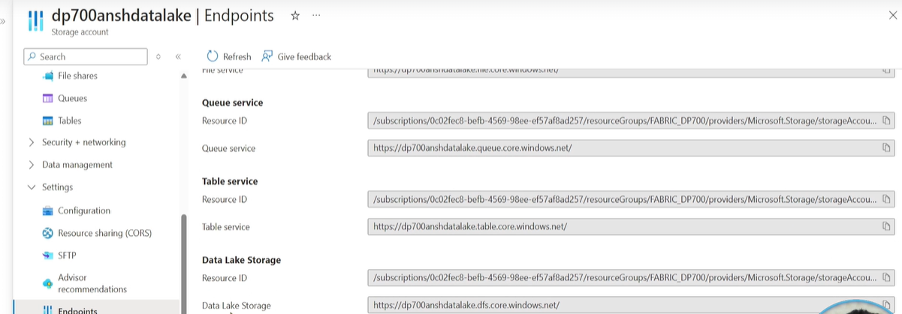
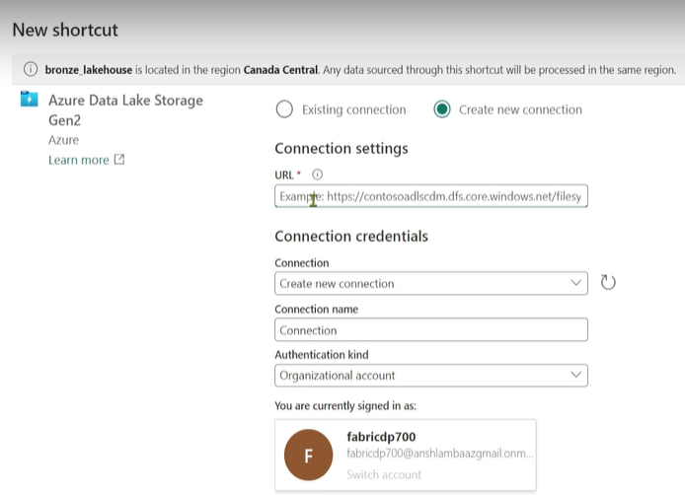
Creating the external shortcut
Notes:
Files/new Shortcut / Create new connection , Asks for URL ..G0 back to ADSL Gen 2 Storage account and copy in URL from settings / end points
See data lake storage URL bottom Left , copy it from there. And paste to url .. And give a good connection name , he uses organizational account

Slide 5
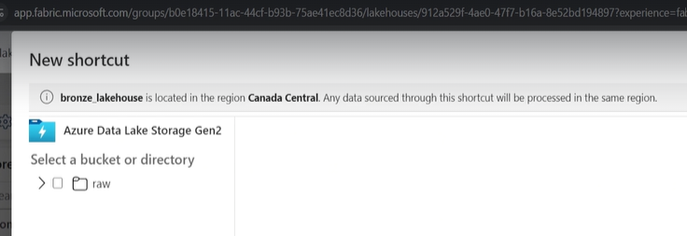
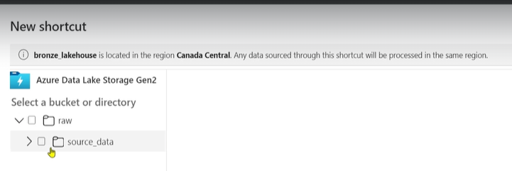
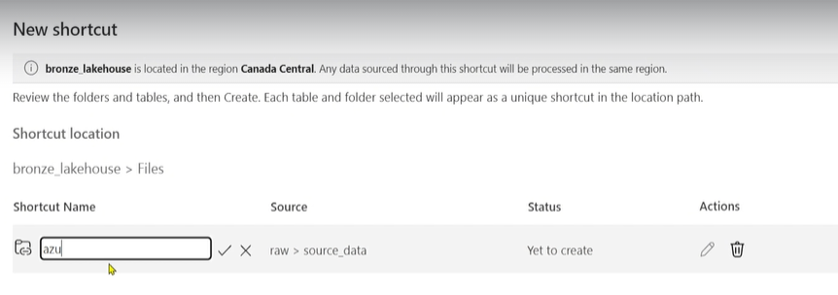
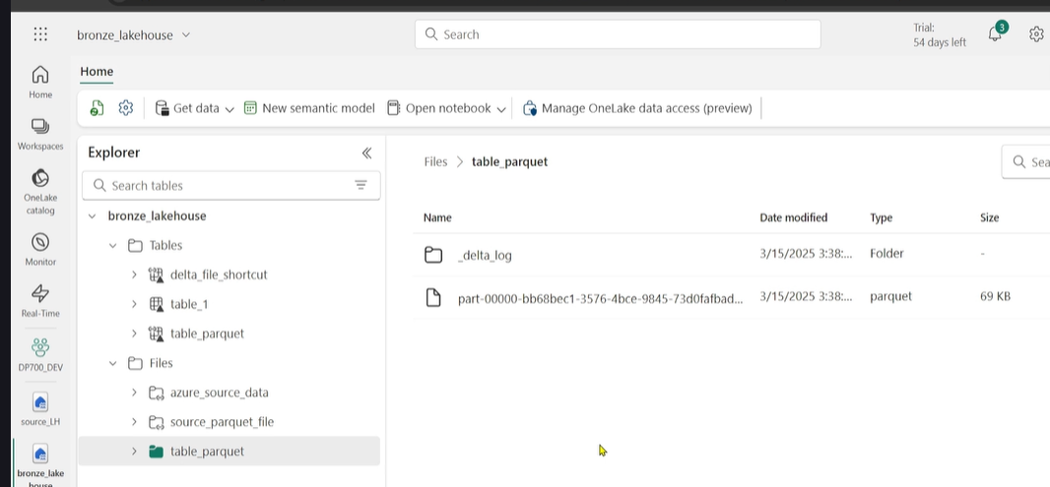
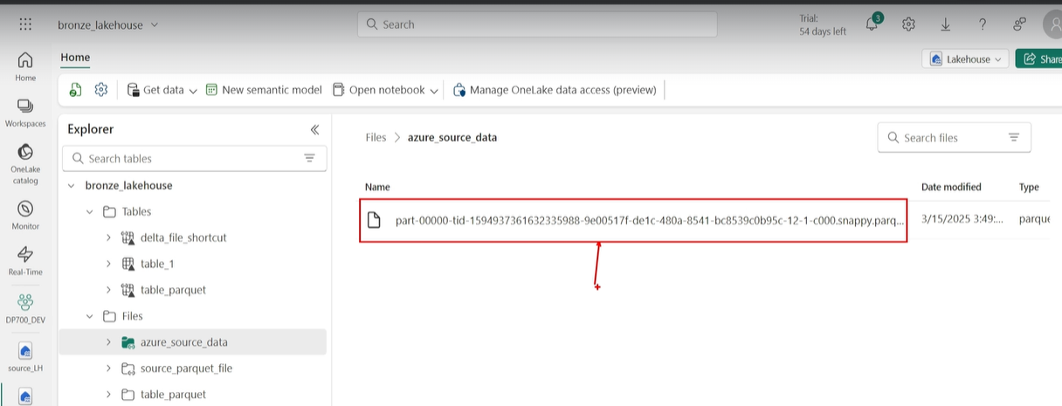
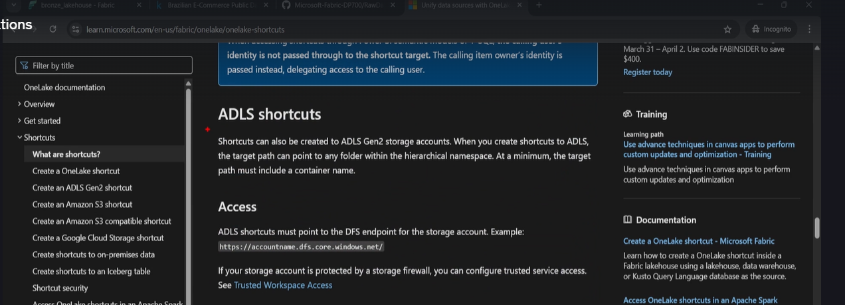
Complete the storage account
Notes:
Either the container (top left ) or the folder , top right.
Next , you can rename it / create
Thye result at the bottom is not residing in the lakehouse but in Azure DL Storage
Search for fabric external shortcuts on google

Slide 6
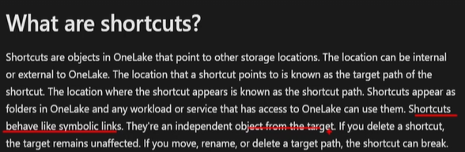
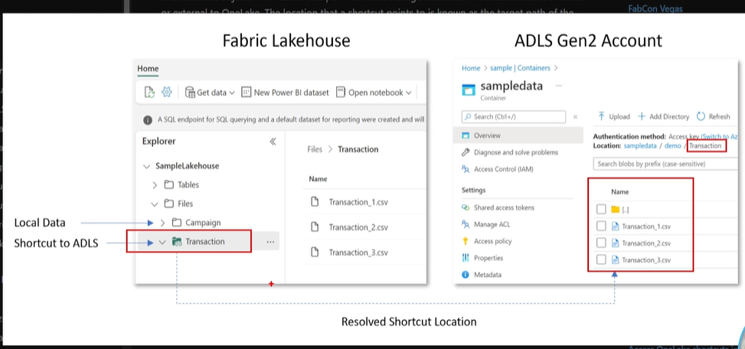
Fabric Lakehouse to ADLS Gen 2
Notes:
He gives a dem where he breaks the shortcut.

Slide 7
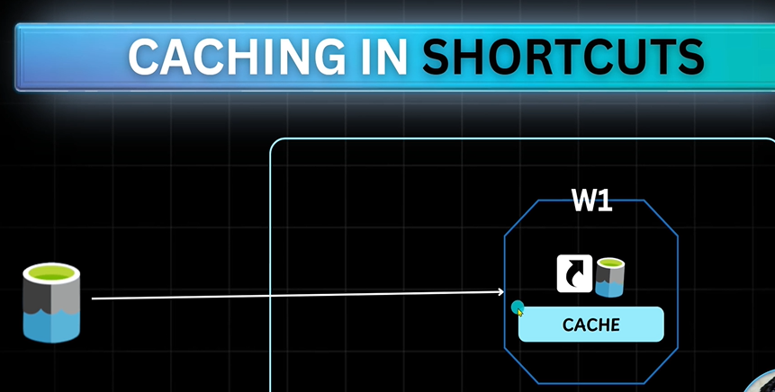
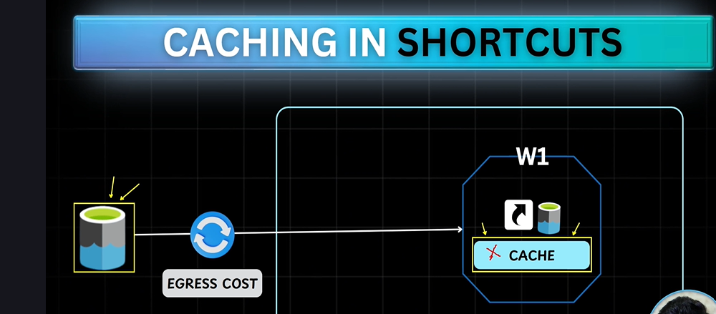
Caching in Shortcuts
Notes:
There is a cost associated with this data / so we need to cache it , as it get transferred to memory ..so to prevent traffic going from source to Fabric we cache it …
If the data is not changing regularly..we can use the cache ie caching in shortcut, to prevent egress costs
Its all automated, selecdt one box
If data is updated , cached data is compared to the source , and will update automatically. Makes a call to the source to update the cache.

Slide 8
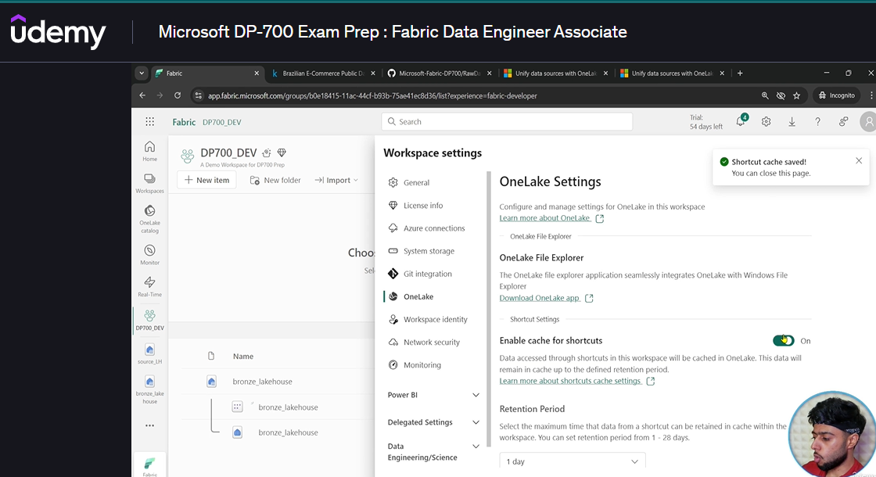
How to set the caching ..go to Workspace , Wspace settings/ one lake
Notes:
Note retention period is for 28 days , if data accessed before 28 days the timer is reset.

Slide 9
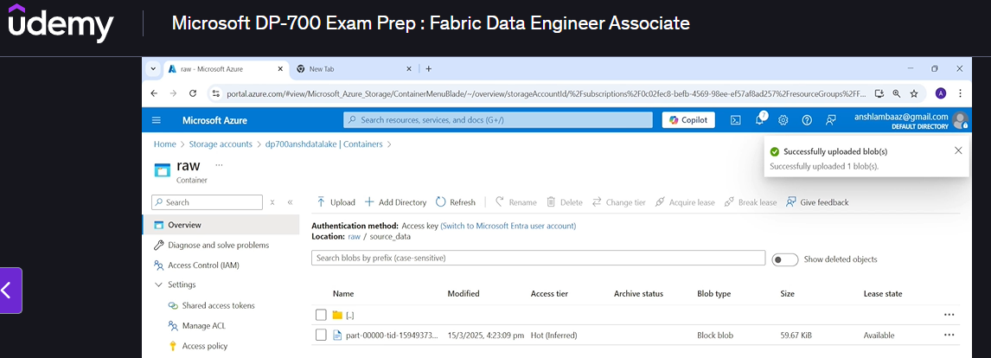
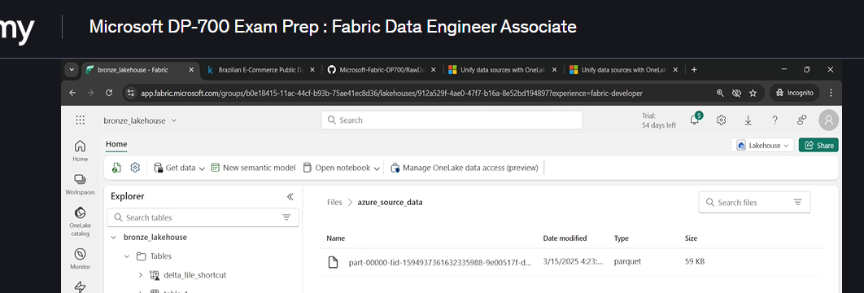
He reupload the parquet filer ..the shortcut appears
Notes:
After refresh …you will see it
If he deletes SC , no impact on source

Slide 10
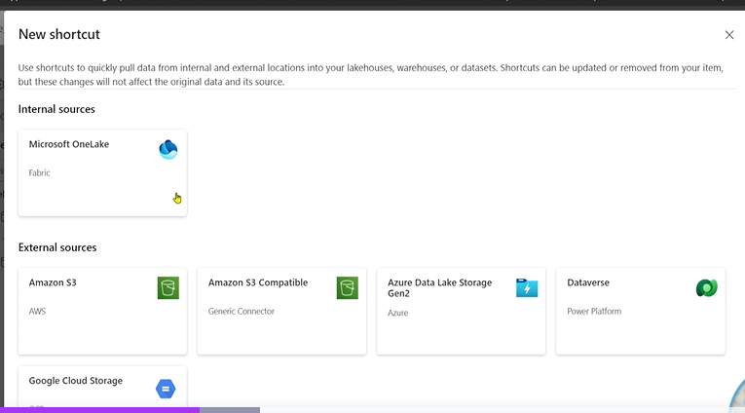
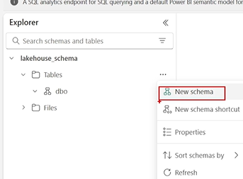
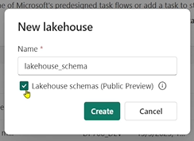
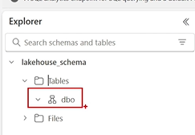
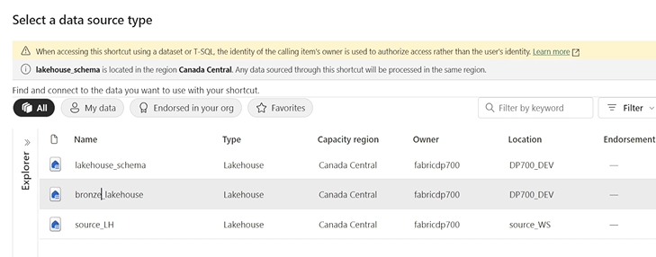
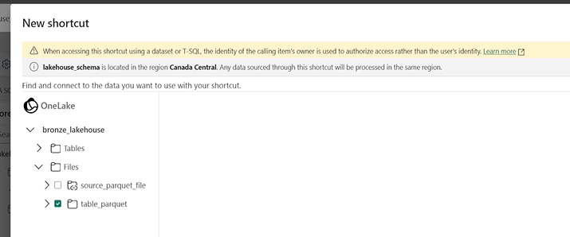
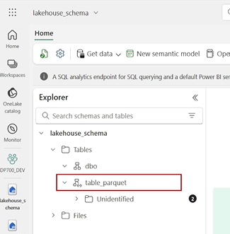
35. Lakehouse with schema.
Notes:
You can also create a new schema. And a new schema shortcut, it will create a shortcut on the whole schema , where you have multiplre data tables, it will create a shortcut on all the tables.
Click on New Schema Shortcut.
Error , you get Unidentified , this is not the schema
Note there is a difference between Lakehouse and Lakehouse with Schema, when dealing with Notebooks.
When you create a shortcut to the schema, you need multiple data files , else it not a schema.

Slide 11
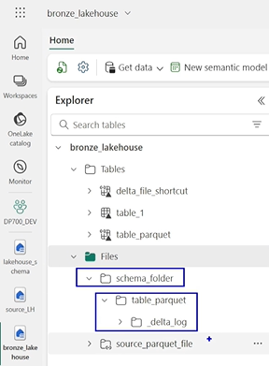
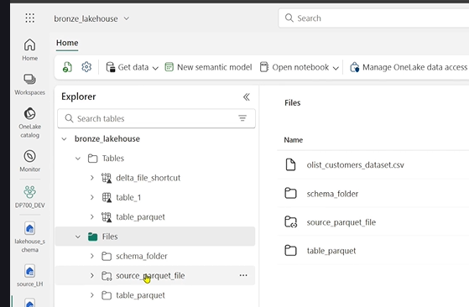
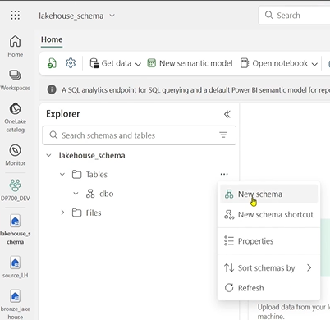
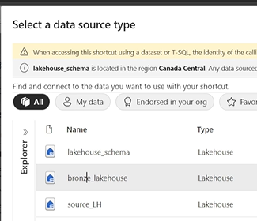
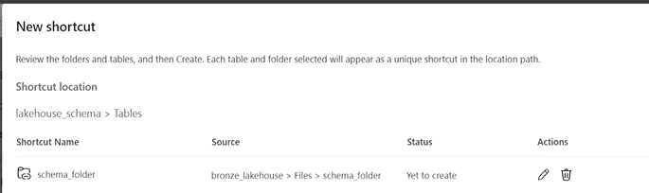
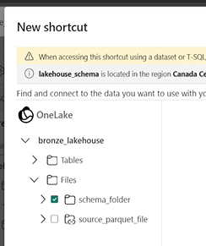
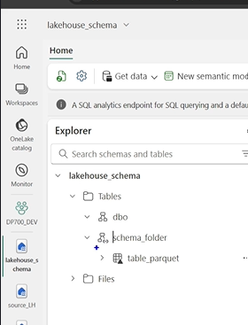
So now we create another folder as schema
Notes:
Create another folder as schema folder, then drag and drop the Parquet table into the schema folder , ie from the left picture to the right , we see table parquet inside schema folder
Now we create shortcut in lakehouse schema. Make the source the Bronze Lakehouse , we pick the schema folder
The result is a parquet file with the schema folder as the schema.
You should havre muiltiple files in that schema , we only had one

Slide 12
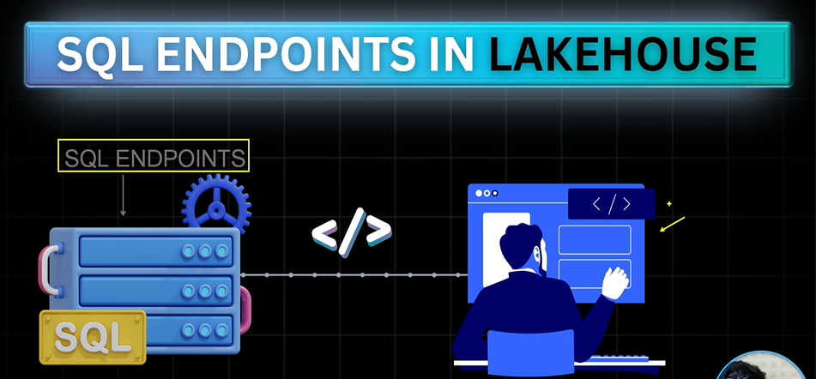
36. SQL Endpoint
Notes:
Users who do not want to alter tables , just run queries and build a report, its only read mode.

Slide 13
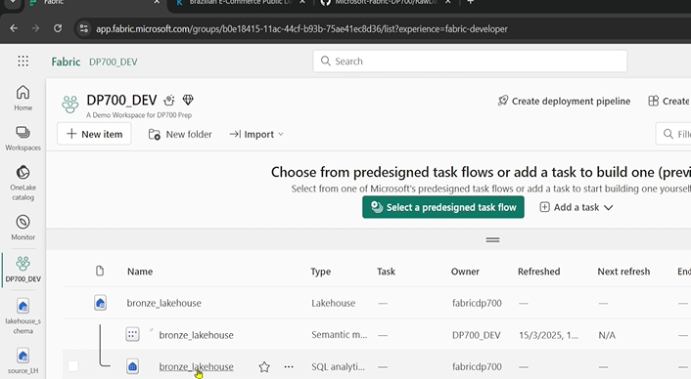
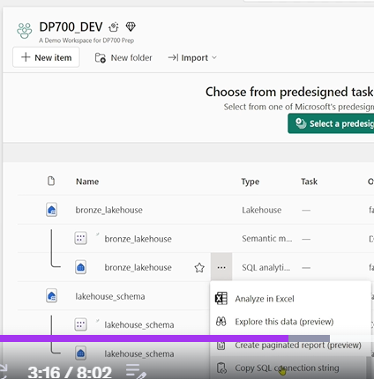
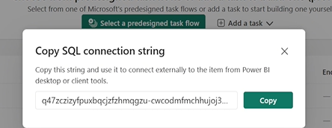
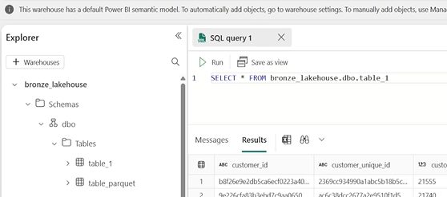
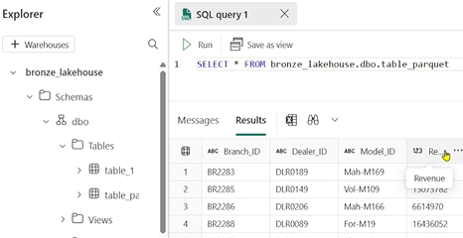
Go to sql endpoint of the Lakehouse
Notes:
You can share the end point using the SQL connection string.
See screen below for sql end point , see the sql workbench
In some instances we see a schema that we did not create this is the default schema.
We specify full path ..see lhs on the table 1
On the right we can query the table shortcut ..table [parquet.

Slide 14
6.0 Fabric Data Factory

Slide 15
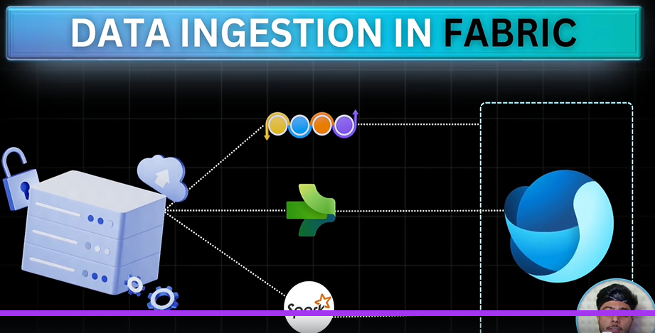
37. Data Ingestion in Fabric (3 Ways)
Notes:
Dat Flows Gen2 , Low Code ETL..ELT..
Much Much Enhanced from azure data factory , Spark Notebooks.

Slide 16
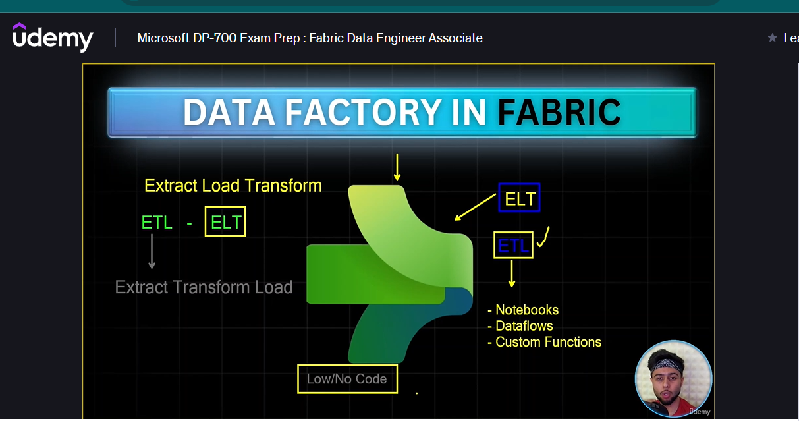
38. What is Data Factory.
Notes:
ETL vs ELT.
Extract Transform and Load
With the rise of Big Data we Focus on ELT. Extract Load and Transform.
Its expensive now to do ETL…Resources , disturb raw data.
Fabric Data Factory ..ELT Directly. ETL Indirectly.
No transformation abilities in Azure DF directly.
Transformation is done on Notebooks. DataFlows. Custom Functions, But you wil first load the data,
Why Fabric so NB. – Low/No Code to write DAGS.. These are the flows in Fabric DF. Unless U want to and it is very Scalable.
No same as Azure DF , new activities , new UI’s

Slide 17
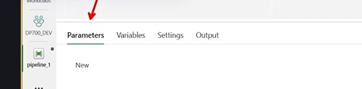
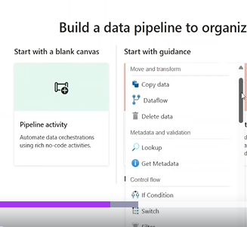
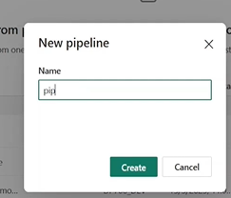
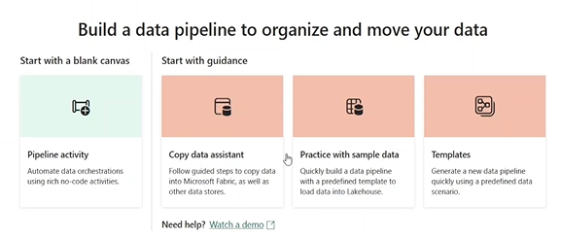
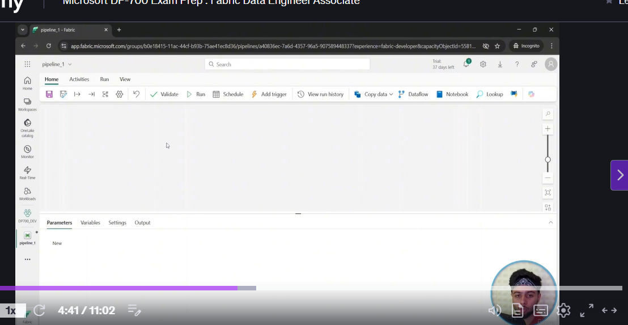






39.0 FDF Overview
Notes:
You can manage ADF from Fabric..its not FDF.!
2 options , start with blank canvass, or start with guidance.(orange), not good if go with guidance ..you will not learn
Click on Green one , with options , we pick copy activity , it will take to canvas and then delete ..route to canvas.
Note you can use pipeline as a template , se circle above
Note you can also View Run History , to right of trigger ..instead on Monitor..
To the righ t are common activities , the activities tab is better , there rare more here , and click on 3 ellipses far more , categorized ones
There is Json Code behind data factory
In the view menu u can edit Jason code , sayas parameter.
Impotant to Patrameterise the code. Dynamic…
Settings just t do with concurrency.
Output of pipelne

Slide 18









40. Copy Activity
Choose OneLake in sidebar
Notes:
Click Copy / Add to Canvas. Extract and Load , must have a connection, Source and Destination.
Note you can convert the file from csv to Parquet in the copy block.
Copy is most fundamental activity in all the blocks.
Move Data one place to another. There is a timkeout of 12 Hours/ min 10min.
He creatsews a new source by clicking on more in the source option.
Choose the lake house , we can browse to the file by clicking file option then browswe and either pick whole folder (don’t click filer)or file
File format Parquet
In the destination block you can put in your own name, and it will create that folder for you. Don’t have to give filename unless you want to
See file format ,
Go to Mappings .. Here is the schema enforcement ..you can change things here if you want to .
Settings, you mau=y have some corrupt data that fails the pipeline, you may want to remove records to enable pipeline to run.
In the fault tolerance you skip incompatible rows. You need to enable logging , and save data to different location !

Slide 19



Now we run it.
Notes:
See the run , input and output .
Shows a whole lot of meta data , at the beginning ouof the ourput.
Check if you are copying everyrthing as it should.
See the result.

Slide 20




41. Ingest data from Azure Data Lake Gen 2.
Notes:
We have done the shortcut ..now we do the copy. From azure DL Gen2.
In the resource Group we have the storage account , go into the storage account ..
See IAM of the left , Check the role assignment for the fabric accpount
It seemed that mine is there?. THAT SHOIULD MEAN WE CAN ACCESS THIS DATA!.
Now go top menu on left , and under data storage see Containers, Click on containers and u can see them
And in the container he has source data, under source data u can see the file
He now creates a new container

Slide 21






Create a new container for a new file in the storage account.
Notes:
He call it source csv, goues into that directory to add files.
Click on upload , and he uploads all the csvs
Go to his github DP 700.. And doewnload.
We are going to load 1 file.

Slide 22




We open a new activity
Notes:
Click on Source Dropdown.
Mahy have to click on view More in the next screen to see Azure DL GEN 2
Yioull see config screen ..u need the url,
Go back to azure screen where you see containers , u may have to go up one level. From rthere we go to settings and endpoints.

Slide 23



Configure link to ADLS Gen 2
Notes:
See the url , in data lake storage at the bottom, and put that url into the connections Url..in New connection in Fabric Lakehouse ,
If the connection has already been made yoy can find its name ..else a new one and you will have to grab the Key , or Organuzational account.
Then Connect ..see drop down he has 2 connections one from previous shortcut.

Slide 24



Check Connections
Notes:
Once we get the connection we must browse to get to the files. Now we see source CSV – the folder , now pic the file, if you want else OK , with none selected
It will copy all the files
Format as delimited text
Must click advanced ; NB
You can add additional columns , along with existing columns if you want.

Slide 25



See source Settings continued
Notes:
Can delay it and can add additional column , can check the file setting to see if delimited is cottect , ie , etc

Slide 26




Destination Settings
Notes:
Don’t pick mapping here .. We are copyting manuy files
But pick destination and see the settings,
You cab add you own directory name inside files folder , if you want a new one
Note he piocks parquet format.
Validate Ruin / Save and Run
So his failed , Why? Bad Datya is Found!!! So Why? How to remedy?
Go back to pipeline , click on Settings afte select copy activity / Fault tolerance , Skip incompoatable rows as shown, and not logging..
Save and RUN !
Read the meat dat on the output at top of the output JSON.
Go back to Bronze and check it .

Slide 27

Problem as of 3/08/2025

Slide 28




42. Loops and Parametres,
Notes:
Why is For Loop Needed, goes to look at files
Lets say along with these files you had More more file , which you did not want to ingest , we leverage the for loop.
Iterations… San array of say numbers , and terxt. Wil run on the iterations of the array. So above we don’t want to read thye last file , as shown above , in the azure folder
We create a new pipeline , we pick copy and delete to get empty pipeline ,
Find the For Each Block , near the bottom.
We need to provide an array of file names , we perform the copy activity 1 by 1
Configure the copy to take the file name from the array.
Go add copy activity and in the settings use Brose to go to the files directory source_csv, there is a folder raw files , go in to look but done pick any files, OK
Note now there is no value for filename

Slide 29





Continued
Notes:
No value for filename in Source settings , the value will be given by For Each
Now we set the destination. New directory in Bronze Lakehouse ..fill in name.
We leave the filenames blank. Filename comes from the loop.
We need to put thew Copy Activity inside the Control Loop. Click on the Copy Block , Contol X , Click on the pencil , to go inside the For Loop
You are now in the For Each Block. , Click on main canvas to go back to ForEach Block
Where is the array.
Go into Settings (Red Mark), where are the items.
Few options to bring in array , see overleaf

Slide 30



Bring in arraty into forloop.
Notes:
Click on the Canvas , go into parameters, for the arry. New, provided names , array , and define the array.
Go to datalake in azure , and copy each of the names into the array , copy and paste , creates it in Notepad. All in double quotes , one by one
[paste in default value , now we have provided the parameter to the foreach and then to copy block

Slide 31



Notes:
Click on For Each Block , to set the settings , Do we want to follow sequence , if yes check sequence, else no.
Lets go non sequential ..its then in parallel.
Now we need to provide the items.
Add dynamic content .. Under items , we have just set the parameter , and it opens the screen
We write expression in expressioin builder. But we see we have menu items , pick parameter, and it automatically writes code for you
Go to activity ..and it shows

Slide 32




WE go to copyblok to provide the source file name
Notes:
WE NEED TO PROVIDE FILENAME , ELSE IT WILL COPY ALL AT ONCE ..there may be unwanted files there
You need to add dynamic content (Expression builder) ..PICK FOR EACH iterator , and See the For Each File
@item is the iterator

Slide 33


Result ..@item is the filename , source block of copy.
Notes:
Source and destination is the iterator , file fornmat csv, Text deliomited

Slide 34




Now we test it .
Notes:
We upload a random file , so that he can show that file wil not be chosen amongst the at @item , in the place of a blank in the source and destination part. The @item represents the array in the Foreach part.
See the product category file was not part of the arry but is in the source folder, the last file
Home Validate and Run
Note that because it’s a parameter value , as it runs it ask for the parameter value.. It has got a default value though. Wre would not want to change this , now.
Note while its running on the output u have this drop down.

Slide 35

Success..
Notes:
Wer could see before the end that only 6 were chosen , an indication that this is correct. All Succeeded

Slide 36

Go Check Bronze Lakhouse folder(6 files)

Slide 37





43.Metadata Activity
Notes:
He has this folder and uploads a parquet file, we have all types
We wnt to fetch the details of a file – Get Metdata, file or folder
Last modified , schema etc for files
What about folders ?, what info you can get , list all the file , wew first pick a file , say we want structure
We can get the file structure , ie the columns and Type which are NB for us. Click on output tab and click on output url.

Slide 38



43. Meta Data of a folder.
Notes:
Leave out the filename. Now its presumed folder , the possible arguments will change ,. Try child items
Can run mulktiple meta dat for different things based on files or folders
Question ..how can we use the output of this activity later on in the pipeline

Slide 39

NB Latest file in a folder.

Slide 40

44. Filter Activity
Notes:
We have an array.from the Get Metadata block,
I want to filter records that are parquet files for our purposes.
Filter activity goues through a for loopp In the above itys csvs, but mor my purposes its parquet,
As shown above we apply a condition, we use an iterator. Shows use of @ item..@item().name
If the name contains .csv , then pass it or ignore it.

Slide 41


Hook up Filter data to the output of the Meta Data
Notes:
Now we add dynamic content ; for items and go to expression builder , and choose the choice
Here it will be child items ie .output.childItems
We now need to put in the condition… in collections there is contains ..ie @contains(item().name,’parquet')

Slide 42

Result ..it took 4 of 5 files , in the metra data.

Slide 43



If condition
Notes:
Now we can do something wit the output of the filter with another for each
Go to settings , items , dynamic expressions , called Filter Parquet
Note in the expression builder ..output.value as the output is Jason and there is a key value pair , must take the value bit, remember wew have to choose all of them , not just one of them. As there are many parquet files , so we iterate through each of the values.
Go inside the canvas , get if condition , go to activities areas (Expression)
Note the If contion , @item()is all the items , we iterate through them , looking for the first file
Note on bottom right you canj perform 1 activity if correct and another of False.
You can choose 1 or the other or both activities. Now we want tpo show a delete activity.

Slide 44

Inside Foreaech – we have if not satisfied , if condition
Notes:
We have adynamic expression , from expression builder (NB: you are taking the @ item.name , from the For Each iterator as the input to the ezpression ie the if expression @equals('yellow_tripdata_2024-02.parquet',item().name), see image above

Slide 45

Now if the condition passes , the Delete activity is added with @item().name as the dynamic expression
Notes:
We now use the Edit pencil to add the delete activity for the true case , see the delete function , @ item.name… we are not looking for the input to the fore each here. Note: what is coming into the If expression is the oiterator value which it item().name - we are using this in the if expression, so the files in the destination of the delete block , must be referred to as item().name, and it can only delete the one file that matched the expression. @ item()..is already Value…sole we want the name associated with Value.

Slide 46

wE use aseyt variable actiovity
Notes:
We select a set variable activity , to count the num,ber of files her , we are going to set the variable. Activity.

Slide 47



Set Variable activity
Notes:
We got the deleted file back
Go to the variables and create v-files…, then go to canvas, ask for variable block and join it onto the filter block. Then go to settings option and set the v_files to the right and the value is the length of the array (dynamic as shown above , OK , it will store number of files into your variable

Slide 48


Run the activity (Variablr
Notes:
See output of number of variables

Slide 49


Email alerts and orchestration / Invoke Activity
Notes:
Look for notifications acttibvity , based on failure or success..get the email and click on the failure node of foreach , red , we need to be notiufied
Orchestration:

Slide 50



49. Parent and Child Pipelines
Notes:
Bring in the Invoke Pipeline Preview mode example: This activity runs the whole pipeline ..(Select Fabric and More / Fabric Data Pipelines

Slide 51



Continue Parent Child / Invoke
Notes:
We call the data ingestion Pipeline , note we have parameters

Slide 52


Invoking the second pipeline
Notes:
Note they joined and the second pipekline was wait and complete the other pipeline , they are joined and depend on each other
Error , Could Not invoke the Ingrsetion Pipeline, from Parent but it runs by itself…Try renaming that pipeline ..and begin again

Slide 53


Slide 54

Meta Data Ingest Pipeline(Parmetrized)
Notes:
I developed the meta data ingest pipeline to parameterize the file I wanted to delete (pipeline called Metadata_After_Ingest_VarFilename)
This file was in the list of files, that came out of the filtered data for parquet.
Thye file was previously set inside the comparison field as a dynamic expression ie
Inside the if block in the expression it was @equals('yellow_tripdata_2024-03.parquet',item().name)
Now we make that filename a variable , and set it in the Set variable block and at the start .
Shown above is the full pipeline , showing all succeeded ..mainl;y the delete file at the end ..
At this stage there were only 3 files coming in , of which one was deleted

Slide 55


Variable Inputs
Notes:
Here you can see there are 2 variable inputs.. Ignore v_files ..it comes from another pipeline which will be joined to this
We just register the variable here (see image to right): Note that the file is not in inverted commas , as will be in the set variable block
We have now put a set variable block into the previous pipeline NB: NOTE THE FILENAME IS NOT IN COMMAS: yellow_tripdata_2024-03.parquet

Slide 56

Foreeach block expression
Notes:
In the ForeAch bloch we still have same expression

Slide 57

Note in the If comparison statement the variable is put in instead of the filename ie var_file_name..the one we registered in the beginning . Note the construct where we use the variables function ie @equals(variables('var_file_name'),item().name)

Slide 58

The Delete file remains the same

Slide 59

Orchestrate Multiple Pipelines
Notes:
Workspace ..new item

Slide 60


Slide 61


Slide 62

Note the Wait on Completion as dependent

Slide 63

Pipeline V2 Succeded

Slide 75

Connection Settings 1 Secret Keys/Provate

Slide 76


Slide 77

Org Account

Slide 78


Slide 79

Backtesting Notebook Bronze Data Settings

Slide 80

Backtesting Notebook 2 Settings

Slide 81

Gold Settings

Slide 82

Last Run Results

Slide 83

Inputs and Outputs

Slide 84

Auditing From Fabric

Slide 85
Result of Auditing

Slide 86

50. Triggers – Schedule
Notes:
Schedule Run , everyt hour …se examp;le above , every hour every day.

Slide 87

Akso click Add Trigger ,
Notes:
What events , what to do , bit different to what I get ..he is running older version

Slide 88

51. Monitoring
Notes:
View , view run history

Slide 89


Click on the Monitor on left menu!
Notes:
And you see all the runs, Or you can filter for those you want ie say pipelines!
You canm apply filter on Status to get all failed pipelines

Slide 90

Also click on Column Options
Notes:
Time and duration , time , lots of filtering options.

