Slide 1
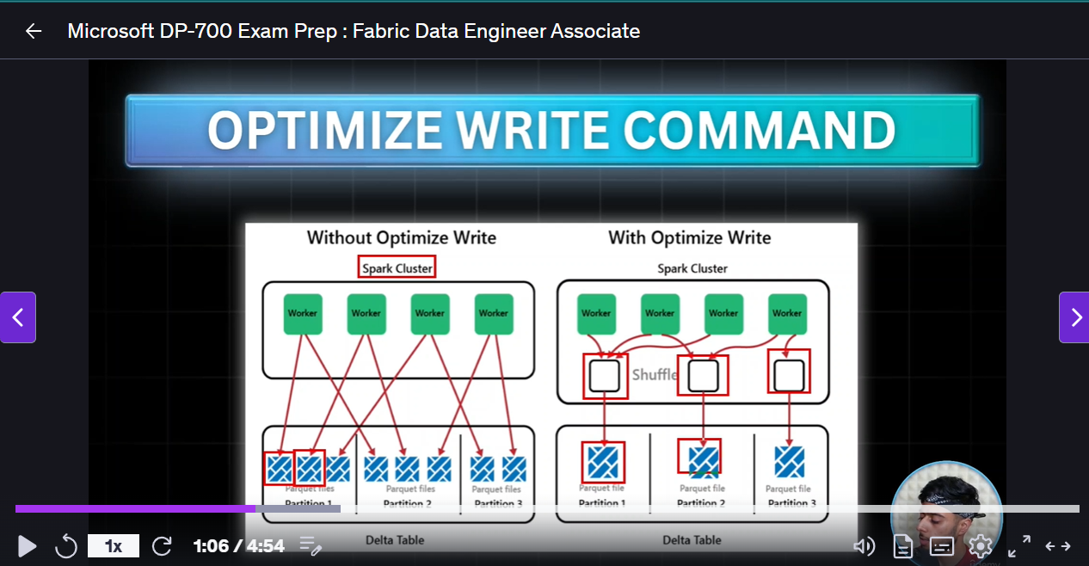
Vacuum and optimize write
Notes:
Optimize Write : Takes small partitions and makes them into bigger partitions
Optimize write combines files before writing to disk, optimize , is after writing to disk
You must use both.

Slide 2
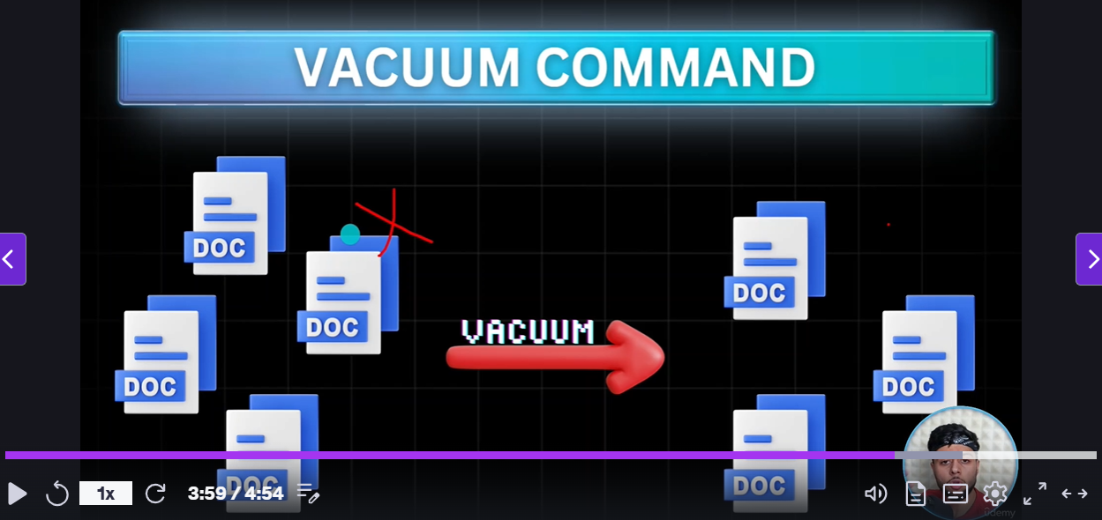
Notes:
Vacuum..older files that have been updated ie the old versions are still there , after the update command. For dat aversioning , but we want them to go after X number of days. Use Vacuum with a preset lifetime to remove those files.

Slide 3
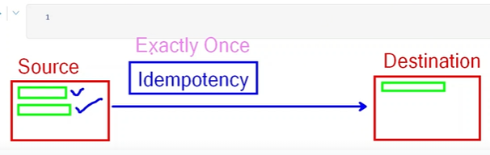
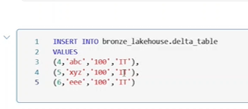
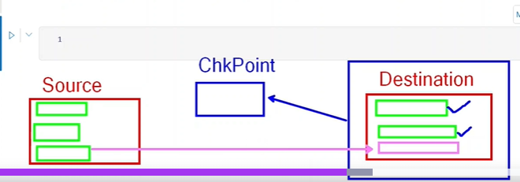
80. Streaming.
Notes:
We want immediate availability of data when it lands in source.
As files come in they are made available in destination.
We only want t process the first file once ..we don’t want to read both again.
Itempotency.
We create streaming queries; Spark,readStream
The df command above just defines the query ..we need to action it to run it.
He sees the table of 3 records and prepares more data ..her inserts more recors 4,5,6 to the table of 3 records
Note these are not managed tables..see path
How does it manage to put the second file after the first ..checlpoint location.
Saves the state of Table ina checkpoint.
Only copies the latest file .
See code overleaf for streaming.

Slide 4
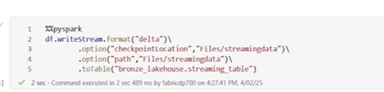
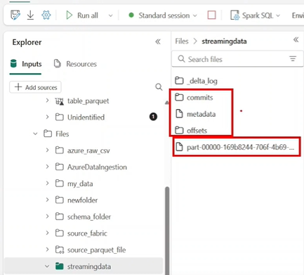
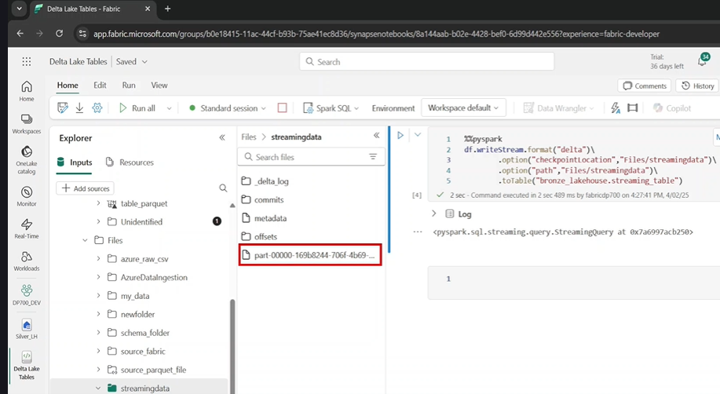
Notes:
Result ..see the streaning data folder in lakehouse above and the file , automatically.
sEe the folders for checkpoint location, on bottom right

Slide 5
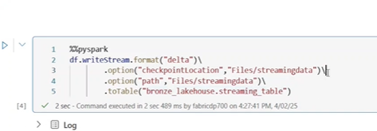
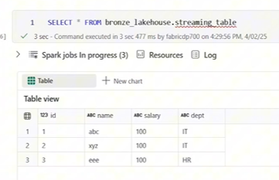
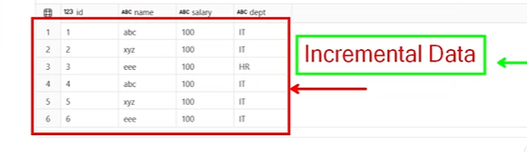
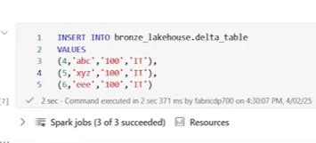
Now you want the results
Notes:
Do the initial select you se the initial 3 records , now insert the data , then perform streaming..when you select it only does the updates , not all the records

Slide 6
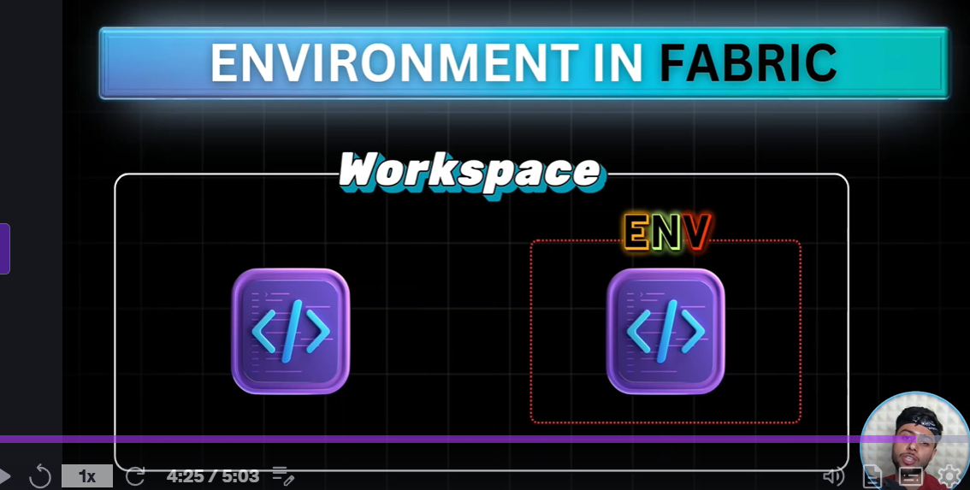
81. Isolated Environment.
Notes:
Virtual Environment. We have configs at w space level.
Are all the notebooks using the same env ie Compute and runtime??
Using the default env.
But lets say 1 user wants a custom pool…he has bigger notebooks/and specific runtime.
I cant change thre notebook default settings for my other 19 notebooks.
We create a virtual env. (Spark Runtoimer , Delta version and compute with Libraries./
Therefore we create an environment with all the compute ..etc we don’t have to worry about the default settings , they wont be applied to notebooks using the special env.
Can create many env in same wspace.

Slide 7
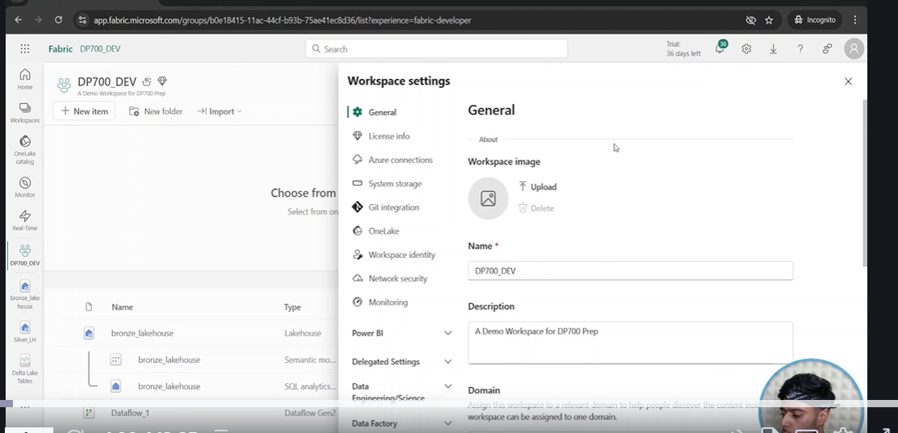
Lets go back tp Wspace Settings

Slide 8
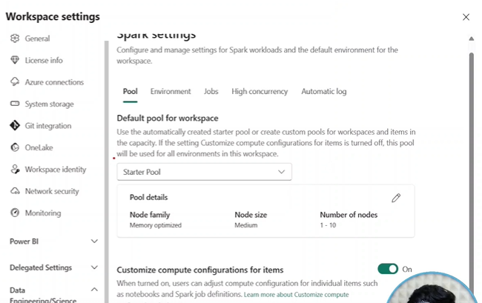
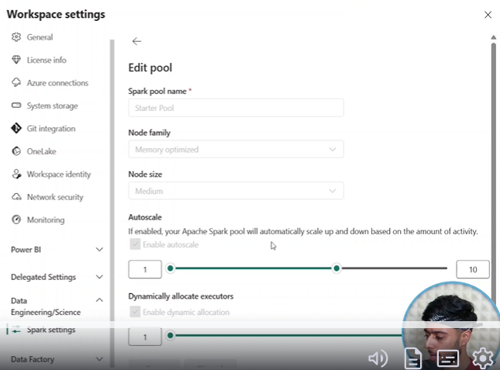
Click on Data Science Data Eng / Spark settings
Notes:
Se, you ca click on edit to change it e starter Pool , you can only change the Scaling bars , you can oncrease from 10 to 16 .
To create a custom pool go top statrter Pool drop down / New Pool/ rename it../ Change node size./
Can increase min number of machines / Creat and Save
It wil take 2 to 3 mins to turn this on as its not starter pool anymore.
This is just starter pooll/ custom pool..not env.
You should not create Custom Pools Here ..not good practice.
Alwasys keep this as starter pools. Youy don’t know how big requirements are
Go back to env we created.

Slide 9
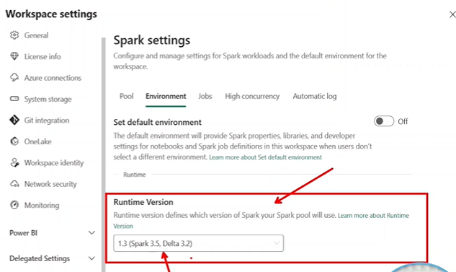
Go to Environments
Notes:
Rather go to environments , we are using latest one
Now we go back to the environment we created

Slide 10
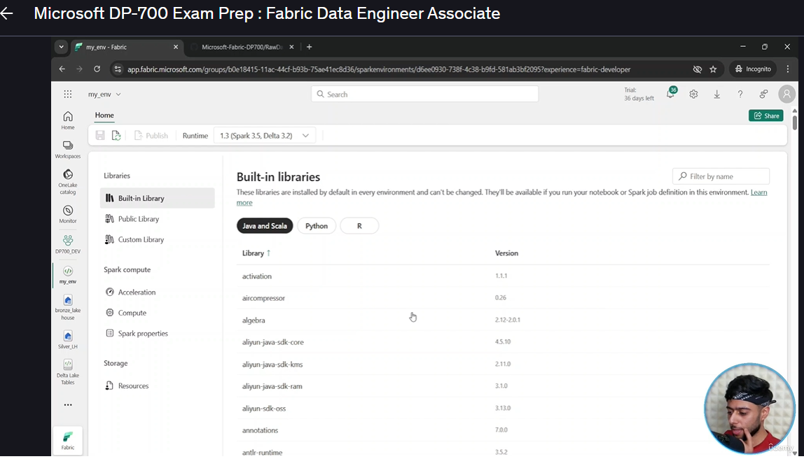
82. To Create envs.
Notes:
You need to have the secrets.py file ..he has on his github.
Create a New Item in Wspace called Environment .. See result above
You have these libraries loaded by default.

Slide 11
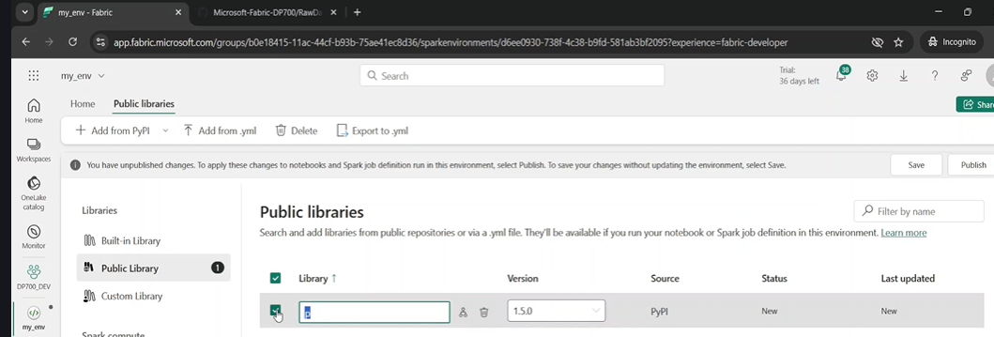
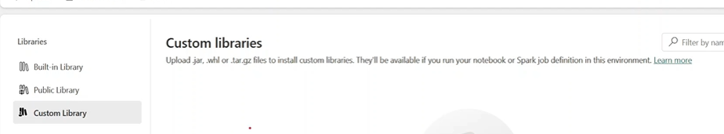
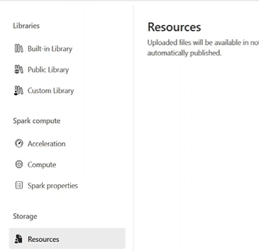
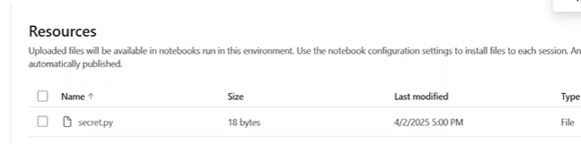
Add own libraries (PyPyetc) from Public Libraries
Notes:
Add library if you want from public , sabve and publish, you an also add a custom library
Resources , can upload any python file or csv etc.
He uploaded secrets file into resources

Slide 12
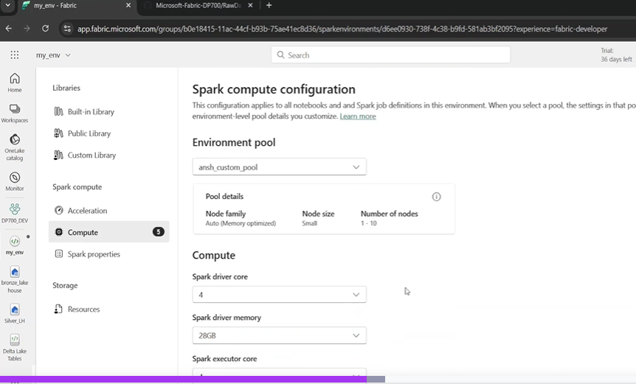
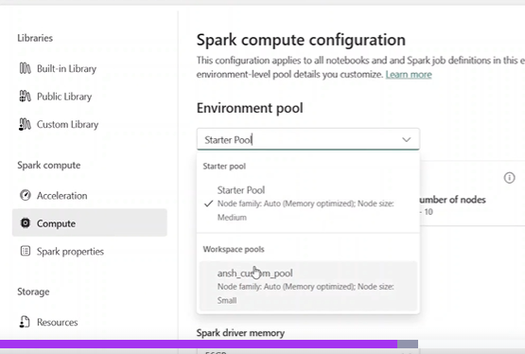
Config Compute for this environment.
Notes:
He has an ansh pool from before and now he picks his requirements.

Slide 13
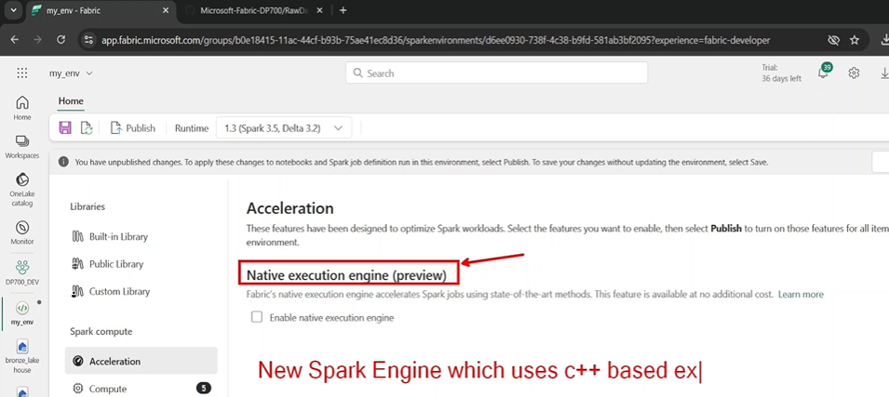
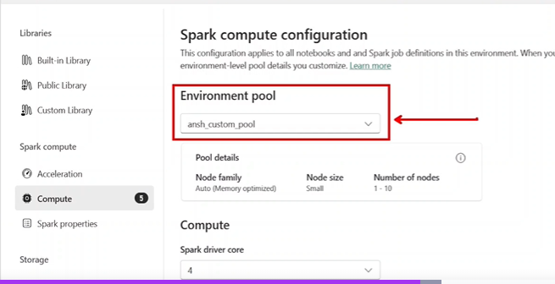
We are making small tweeks on top of the previous pool we created
Notes:
We asked for a small pool from the Worksoacew env settings , when we created the Custom Pool.. Cant change that.
We attach that pool we created as the deafuklt pool for this environment.
We also have something called acceleration. ..see native execution engine . C++ based executors.
Then Save and PUBLISH.
NOW ..overleaf.

Slide 14
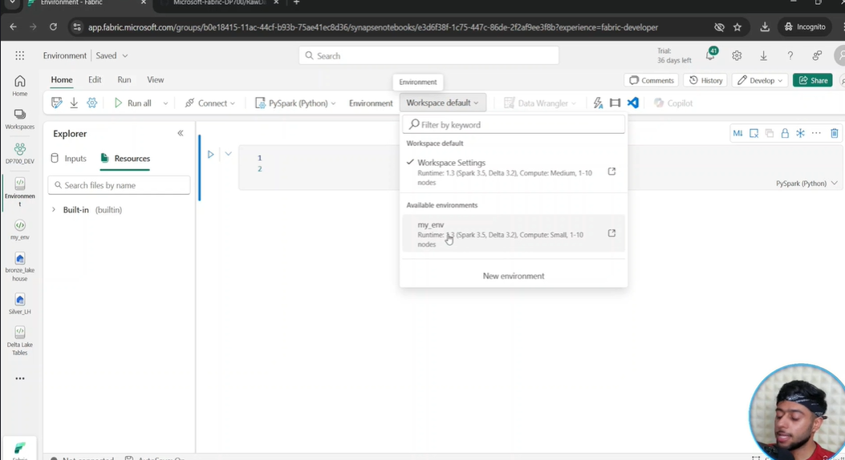
Create new notebook to use the environmemt.
Notes:
Click on environment in new notebook
You now have 2 options to choose from ..deafualt and your own..

Slide 15
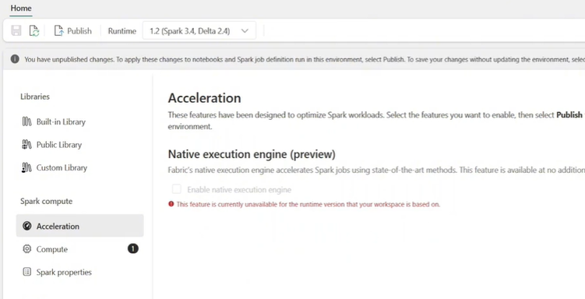
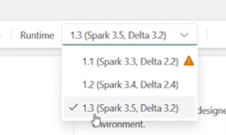
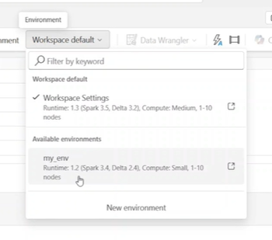
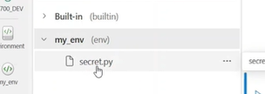
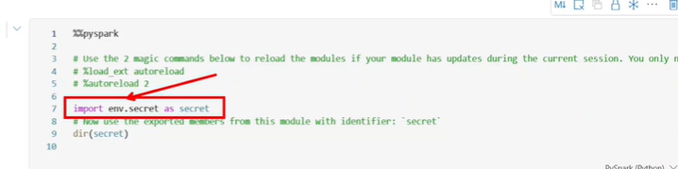
You can go back to env and change it!
Notes:
For instance you can go pick a new option ..1.2 Spark3.4 if you want to!.
And Save it.
Go back to notebook..a specific One and change it to new environment.
Now you go and initiate the notebook in a new standard session; WE MUST DO THIS TO INITIATE THE NEW ENV.
This will now take 3 to 4 minutes.
On the left you wil se built in and my env ..in the Resources tab , you wil be able to bring them intoi the notebook. Note his py file when he clicks on the drop down.
Instead of reloading resources all the time for the notebook.. Load the resources into that environment and bring up that environment,
If you want to use the secret , just drag it across.. See the prefix used ..”.env infront of the file name, when you drage it into a python cell.

Slide 16
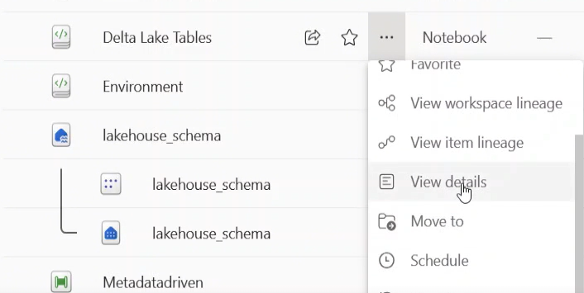
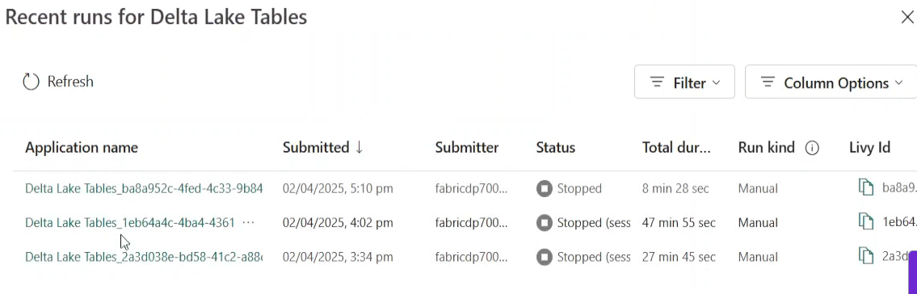
823. Monitoring and Scheduling Spark Notebooks.
Notes:
Just want to monitor notebook, go to notebook and view details ,
Click on recent runs, and you will see all the recent runs of the notebooks – high level overview.

Slide 17
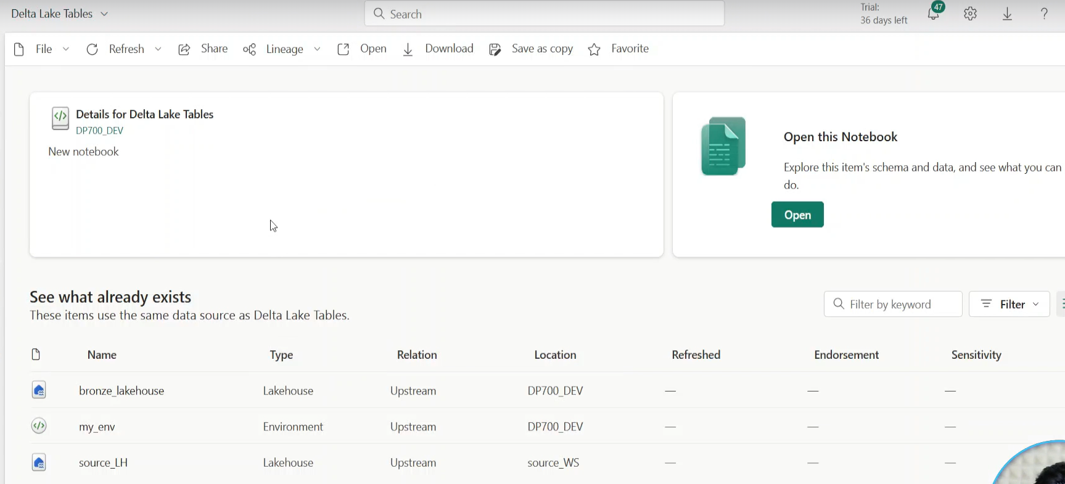
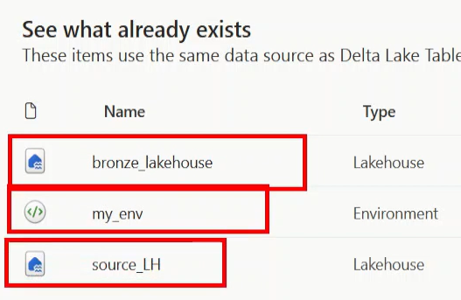
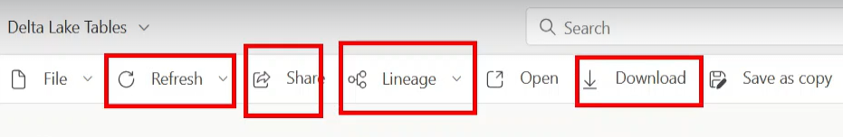
Now click on View Details…
Notes:
Note the environments, the source lakehouse etc in the bottom left. You can open the notebook, you also have refresh, share , Lineage

Slide 18
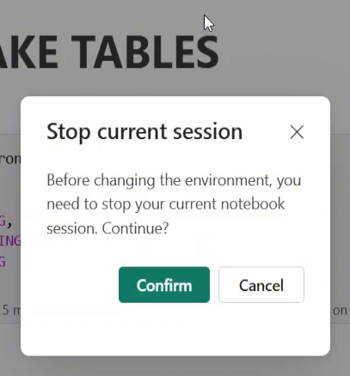
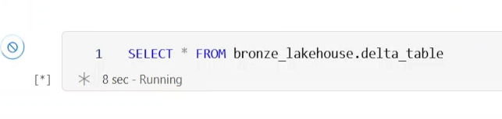
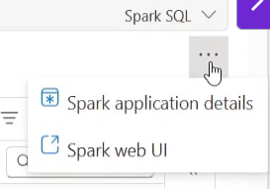
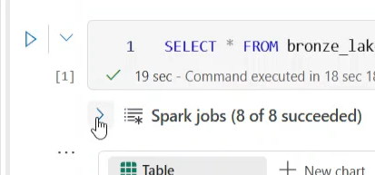
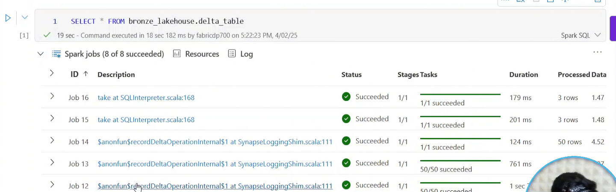
Notes:
Go to notebook in wspace and open it. Connect to standadard session. You have to stop if you are working in another session
So you run a particular cell. And you want to monitor it.. Click on the 3 dots on bottom right of cell. See image above / Spark Web UI.
OR ..click on the drop down next to spark Jobs .. The arrow.. See image above. You will see all the jobs submitted so far .
Click on the job and it will take u to Spark UI , as before

Slide 19
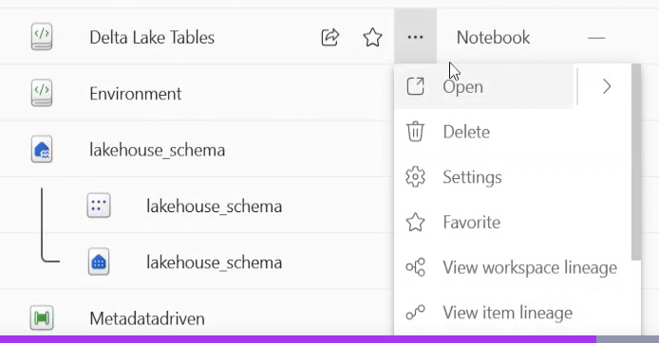
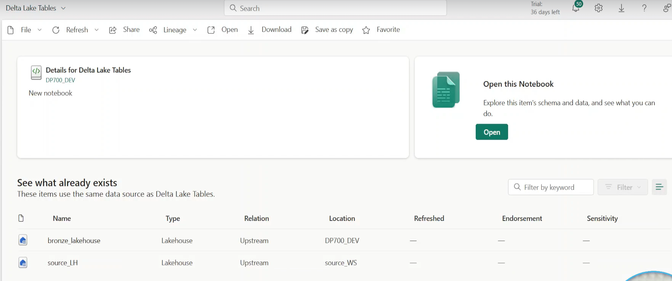
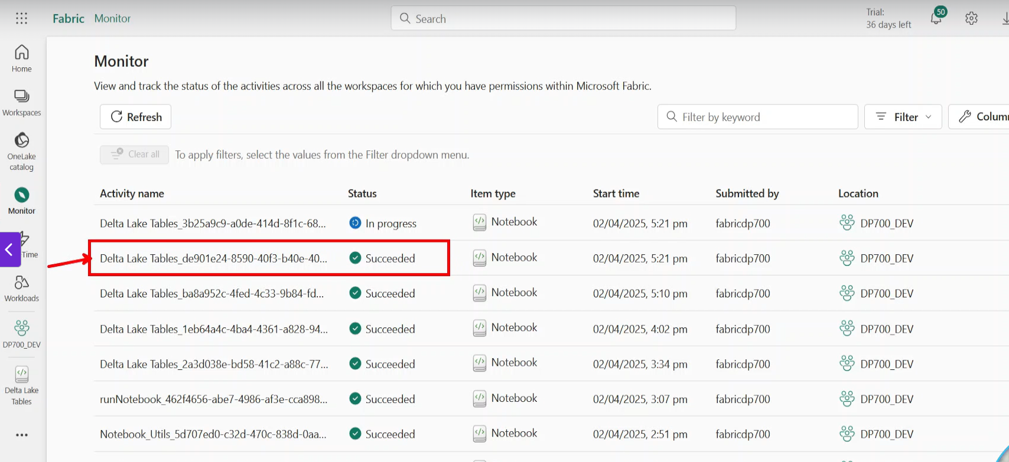
Again go to w/space
Notes:
Click drop down next to notebook/view details
Go to monitor Tab on LHS .. And you will see all the rund of that notebook. You see everything
But you have the filter tab,to filter on what you want to see.

Slide 20
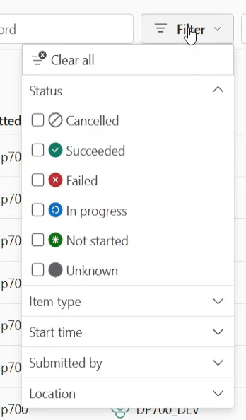
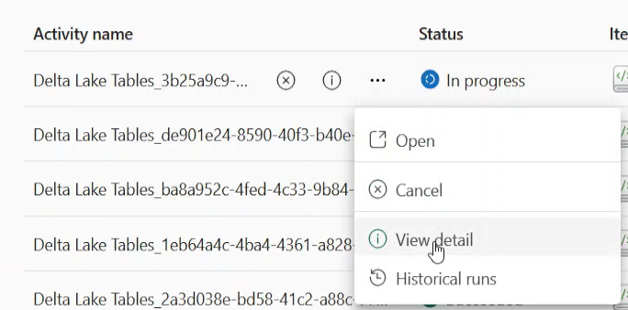
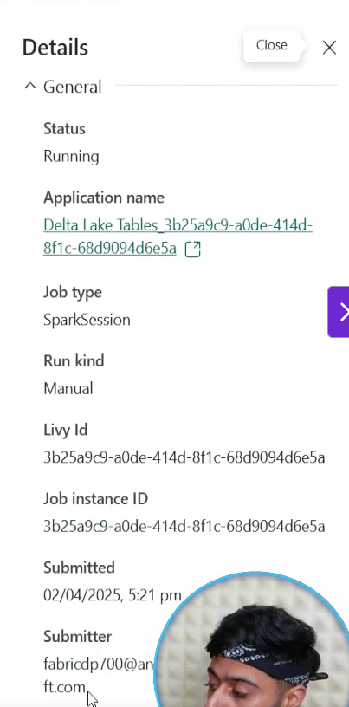
Notes:
While NB is running click on View Details , result is on RHS ..see status submitted duration.

Slide 21
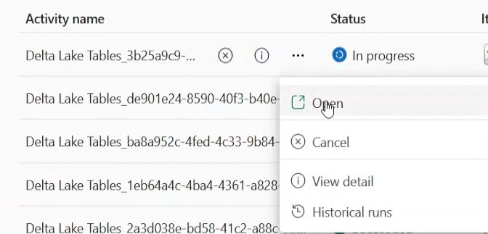
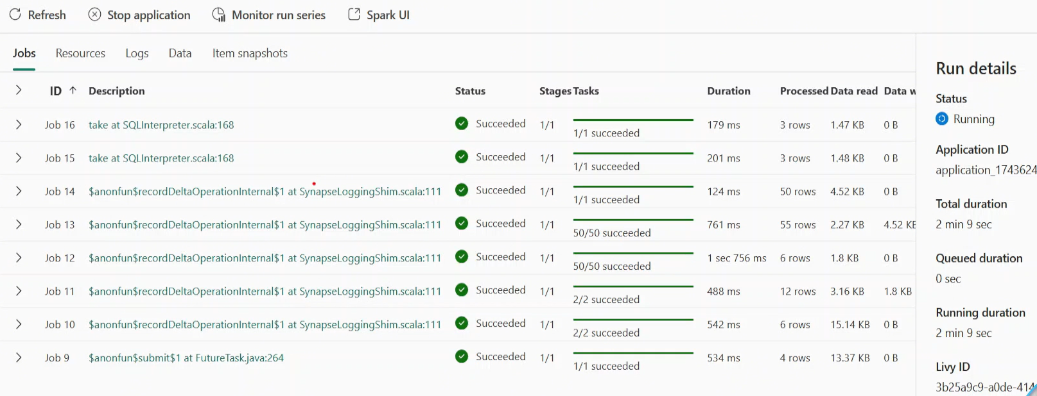
You can also click on OPEN
Notes:
Now we have monitoring for that cell of that notebook
But best to go through monitor hub.
You can also just go to Spark UI in Monitor Hub. See above and then Overleaf.

Slide 22

Land up in Spark UI.
Notes:
You can see the DAG of your query.
You can click on the job of the cell. See arrow above SQL dataframe (on RHS) ..click on it.

Slide 23

Click on one of these jobs

Slide 24


This is the DAG for the Job.

Slide 25



In Monitor I open the Notebook..Aufdit Backtesting
Notes:
Click Monitor Run Series , see the resulting graph.
Remember you can click on the spark UI , below the cell at the ellipses on bottom right to get to the same place!

Slide 26


Now to Schedule Notebook.
Notes:
Click on 3 dots to the right of notebook, schedule notebook
Same as data pipelines, we can schedule it
But he stated he only wanted pipeline orchgestartions not separate entities

Slide 27

Integrate notebooks with pipelines
Notes:
Go back to data pipeline , now he has a datftransformation flow , he wants to run the pipeline and notebook.
Better to do it like this ,

Slide 28




84. Spark Job Definition.
Notes:
Search Spark Job, click and name it .. See result above
Upload a local python file ..if job written there. Or ADLS GEN 2 or a notebook
Or you can upoload a local file ..i presume in to the lakehouse , which you must specify
Reference file is the import of a library or a file that you call from the main file.
Must provide a lakehouse if using a relative url. ..if you have a main path , just pick any lakrehouse
Now save and run it.

Slide 29

Go to Workspave and schedule the job.definition.
Notes:
Click on 3 dots and schedule.

Slide 30

You can implement the spark job definition in a pipeline as a component.
Notes:
Pick the job in the settings , he prefers nmotebooks

Slide 31

Import from PC (notebook
Notes:
Go to wspace and press import as shown above to import notebook.
Can use Github to do this.

Slide 32


S10: Fabric Data Governance

Slide 33



Slide 34



Slide 35



Slide 36


Endorsements

Slide 37



Slide 38

Pipeline Orchestration
Notes:
Controlling the Life Cycle of the application
For changing it continuously
How do we perform CICD in Fabric

Slide 39

CI, Continuous Integration in Fabric
Notes:
CI , more important than Deployment , Fabric takes care of deployment…/ wew have a DEV wspace
We add to this w/space the vesion control. Azure Devops is the recommended one / or GIT is open source
When we co0nnect to Devops ..we get a main branch, now associated with wspace ..This is the master branch/main branch /collaboration branch.
If I want to make changes I must open a feature branch ie feature 1, it’s a dev you want to do.
You will create a copy of this wspace , and in the feature branch you will work on your wspace
You worked on notebook and committed it (saved changes)
You created a pipeline and committed that one.
After all the changes you want to merge branch into main branch.
So now you merge into your Degv w/space main branch.. Create a pull request , all these changes arer available in the main branch..\developer repo
Next Developer (2) , creates a new branch , for another feature (2)..copy of wspace , that will have feature 1 in it as well.
The dev2 wants to merge changes to main branch ..create a pull request , see above.
To make the changes visible you need to update button. Only then are changes made to the Live Worksopace
Must have strong conceptual knowledge before building it.

Slide 40



Create Azure Dev Ops Account
Notes:
Click on My Dev Ops Organizations
We are asked to create an account based on Microsoft account. We want the account which is the accopunt use toi create azure services.
Click on default directory..

Slide 41

Create new project.

Slide 42

JSE Clear is a Project and within this project therte ius JSE Clear Risk Wiki
Notes:
This is thye page to go to. This project has been creates

Slide 43



Here he creates a project , we don’t have to
Notes:
Notice the GIT and Basic at the bottom , then create project
Maybe you don’t see all the options on the left as shown here on the left.

Slide 44

Go to settings and switch them on !
Notes:
Boards for project managers
Repos are NB for is.
Pipelines , for Deployment for other Azure services. .. Not Fabric , we have a better option in Fabric.

Slide 45



Now we go to Repos
Notes:
We have a Repo already built
But we createa a new one , creates a repo that is empty
If you go to Branches ..on the left you will go to main Branch

Slide 46

Attach main branch to dev wspace

Slide 47




Now we go to Fabric Wspace, why createa newpace ?,
Notes:
Answer: You should start with afreash wspace to keep track of version control. We never enables git at beginning of starterd w/space.
You should always give same name to Repo and wspace.
We must go to w/space settings to enable GIT , press Git integration , see azure dev ops , click connect
We don’t see an organization!!!, go back to settingsand see who the user is!!!
The same user in Fabric musr be user of Devg Ops.
So now we must add user , to the project etc. Se overleaf.

Slide 48



Must add the user
Notes:
Then manage the user to contributor

Slide 49



Now back to Fabric ..Git Integration
Notes:
Now under Org you can allocate the user
Put in details and create a Folderr , Connect and synch
We now see source control at the top of wspace

Slide 50

Connected and want to make changes

Slide 51
Don’t make changes to main branch !!!

Slide 52





137. Feature Branch and Bug!
Bug here as button is greyed out!
But click cancel and the branch is created.
Click on small Icon on the right..like the share image
Notes:
Note you are making a copy of the wspace when you branch out.
The screen where you branch toi new workspoace has a bug
Sometimes it does fail ..just refresh/cancel and it will work.

Slide 53





137. Continued.. Now in Feature Wspace Branch
Notes:
This would be an isolated wspace ,, He creates a notebook in thus wspace , so this is in feature 1 wspace , now go back to the Dev wspave … the colaboarative wspace
Its empty ..this is the main branch and we haved not done anything there yet,
Go back to feature 1 wspace to the asset
Go to Google ..to your Devops account and your project , go into your project and your repos

Slide 54



137. Feature Brabches
Notes:
Go to Brabnches , select all and you will see the feature branch.. Go to the Folder , You see nothing but the readme , Why , you have not committed it ..
There are no asserts in the feature branch yet,
Go back to Fabric , your feature wspace ..to the Source Control Buttoin … see next page.

