Slide 1
Patrt 3 b

Slide 2
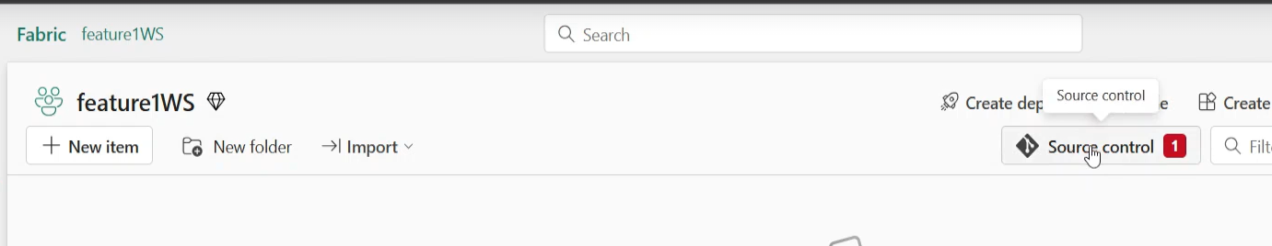
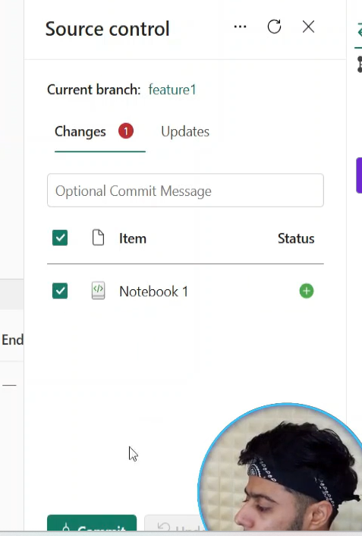
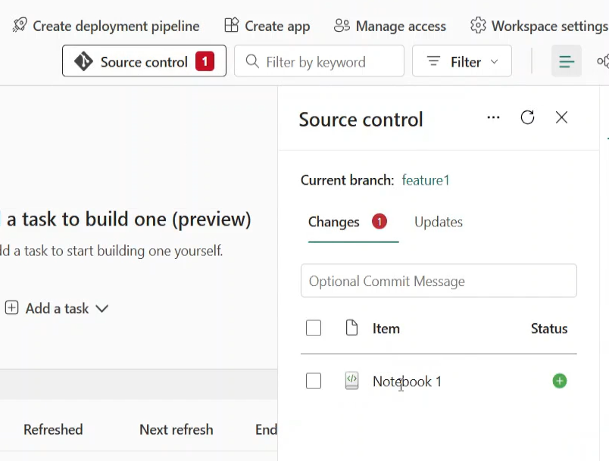
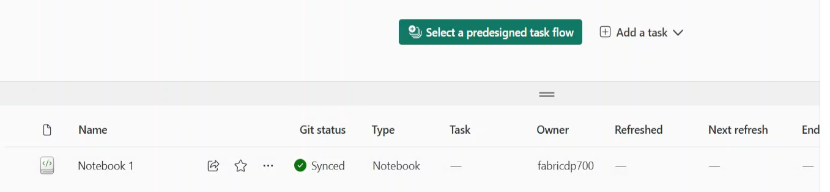
137, Feature Branches
Notes:
Clickj on Source control and you will see your notebook , Select the Notebook…and commit and you see Git Status Synched

Slide 3
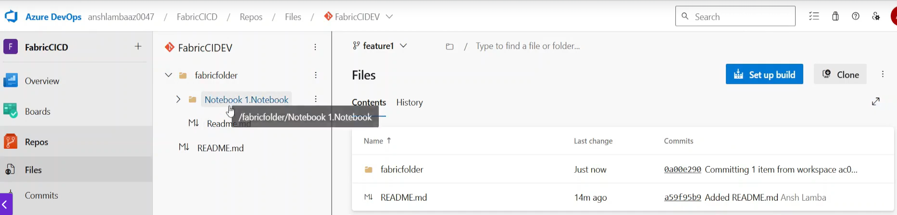
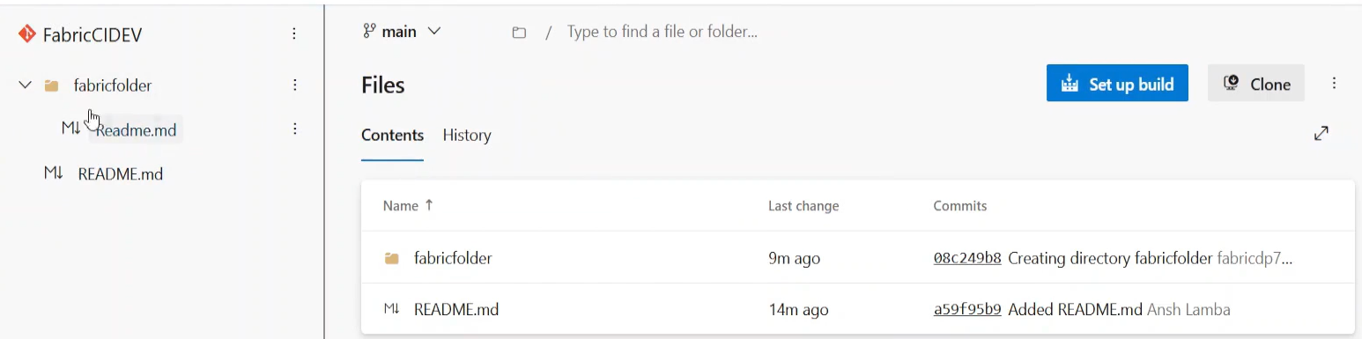
Go back to main wspace and see the notebook now in your Gir Repo FabricCIDEV
Notes:
1) Go to Branch Main … , on the Left in FabricDev ,,you do not see anything .. Above it was in the feature Brancjh in your Dev Wspace ..
See where arrow is the Notebook does not appear there. Ie IT IS NOT IN THE MAIN BRANCH.!!! We have not done a PULL reqiuest.
We need to get it to the main branch WE NEED TO MASKE THE PULL REQYEST.
Go to Branches on the LEFT Panels and go to all in ther central panel;.. See next page.

Slide 4
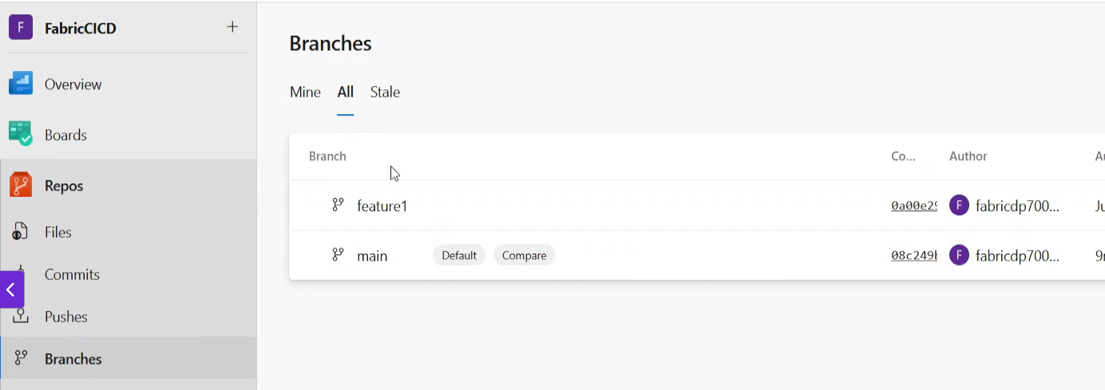
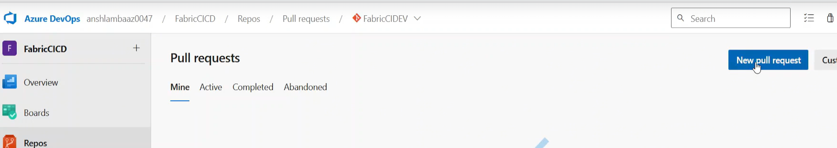
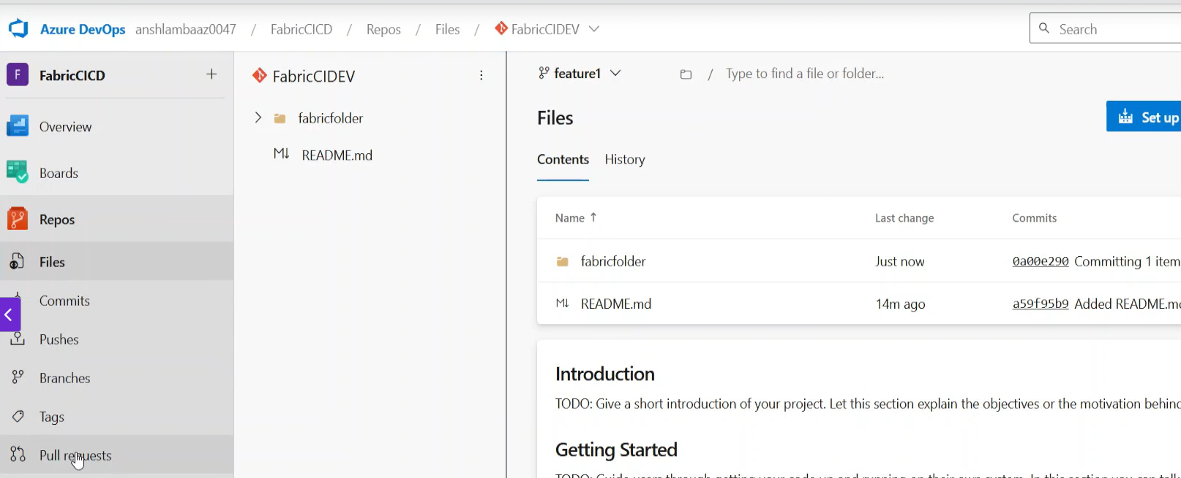
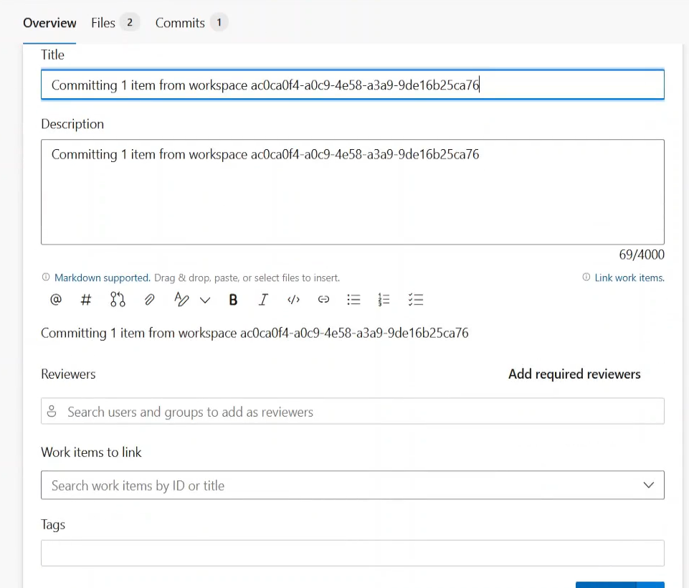
Branches All..
Notes:
Click on Feature under branch, and then go to pull request.. See bottom left, Middle see New Pull request
You wiiol thern see a title description and at the bottom you see a Create Button.

Slide 5
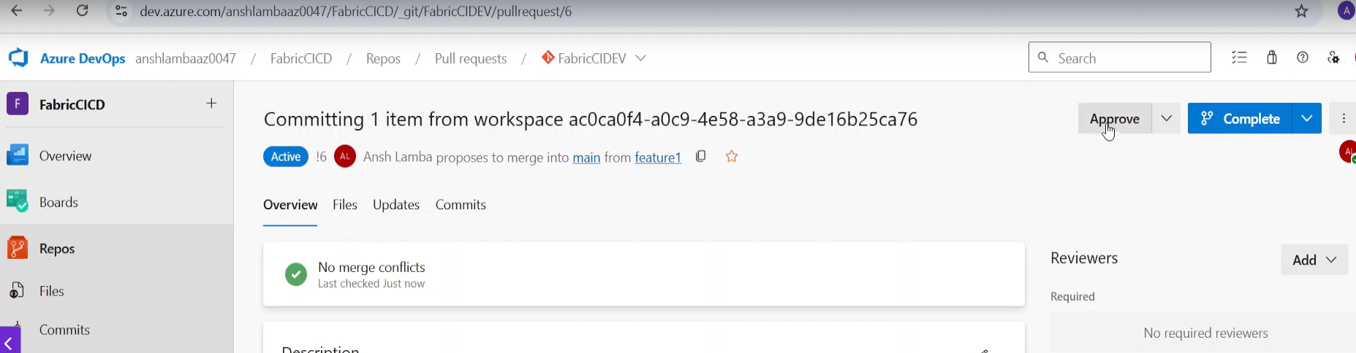
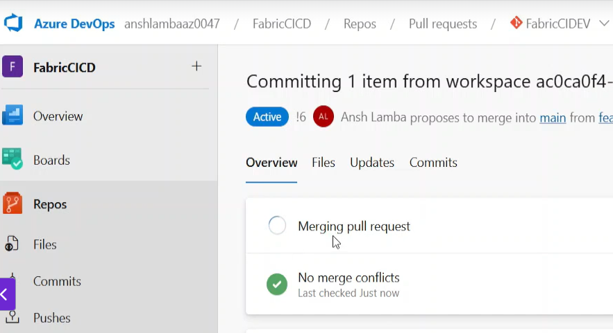
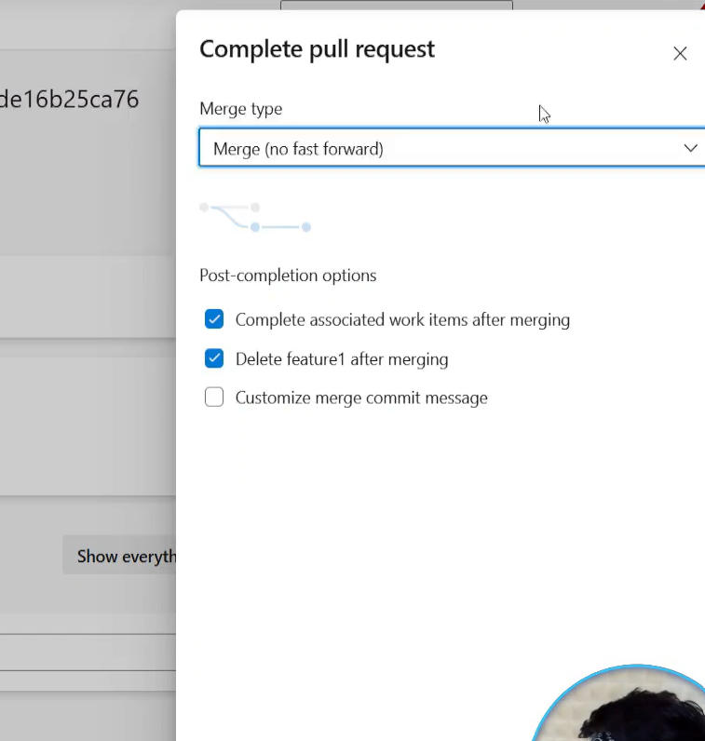
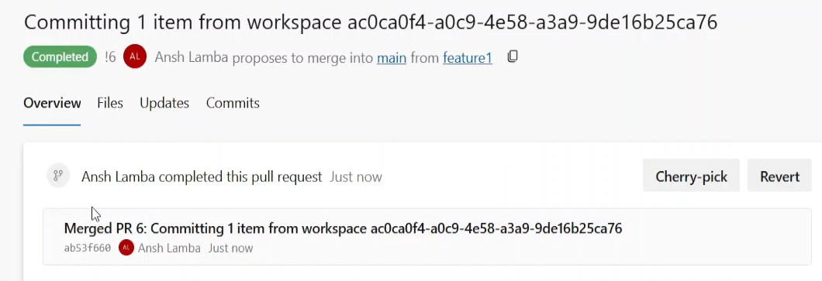
Clickj on Approve on the Right
Notes:
Click on Approve and Click on Complete..
See the ticked Boxes , Note the delete ..you have merged the feature1, no need to keep it.
Click on Complete Merge /… see Merging Pull Request.
Results in Merged ..bottom Right.

Slide 6
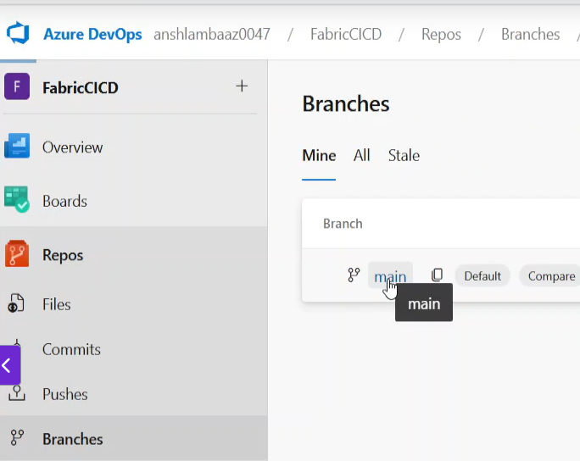
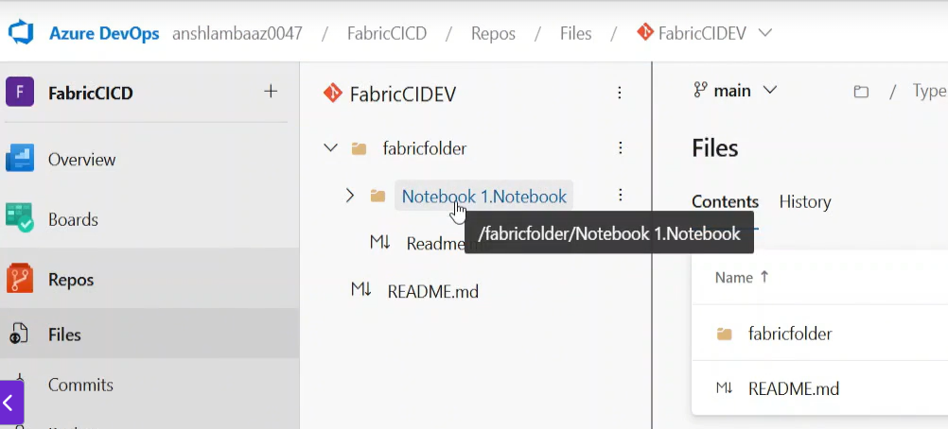
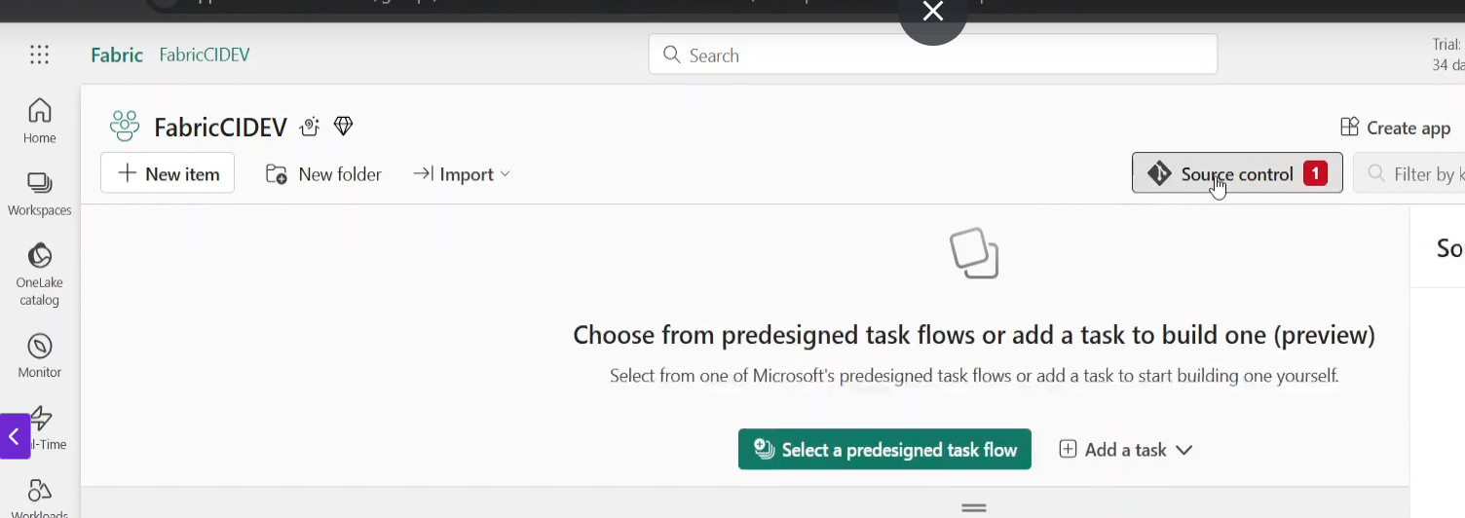
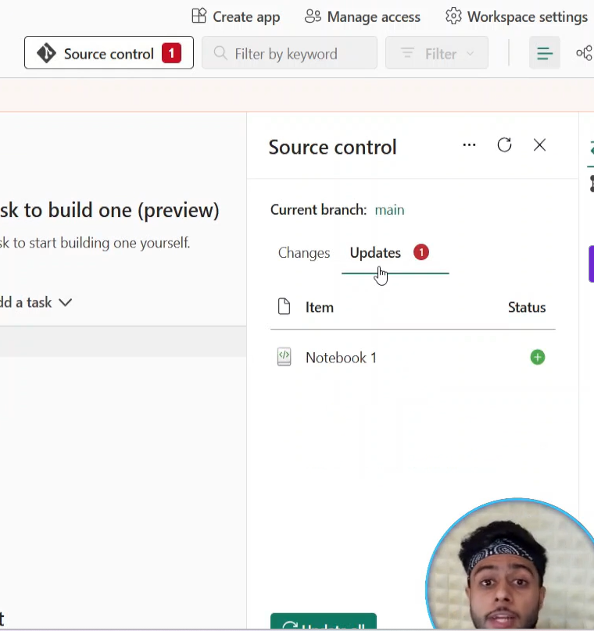
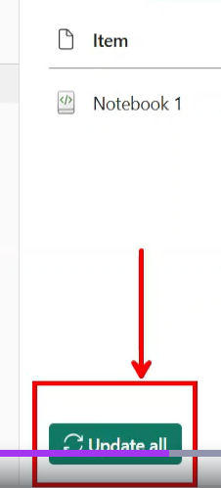
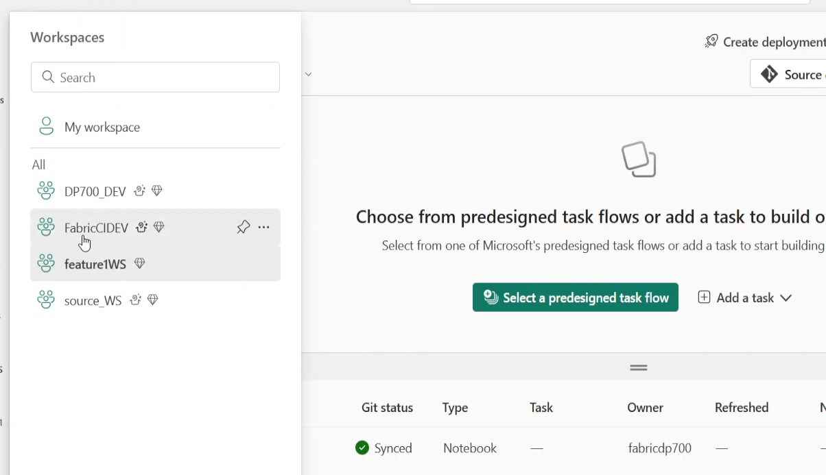
Now he proves its done…
Notes:
Go to Branches / Main
Now click on the folder and you see the notebook appears under “main”, it did not appear there before!
Now we go back to Live Mode in the Fabric CICD Wspace …REMEMBER WE SHOULD NOT SEE THE ASSET IN THE LIVE MODE UNTILL WE PRESS UPDATE !!!
See middle bottom..No Notebook there yet !
See the Source Control in Live Mode has an aleret …red ..click on it and you will swee updates ..bottom right , click on update all button ..see result overleaf
All the updates in the main branch will go to the Main Workspace. See overleaf.

Slide 7
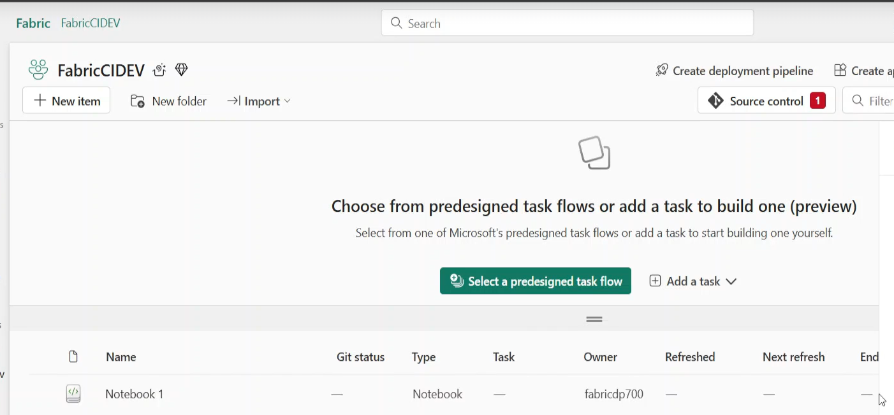
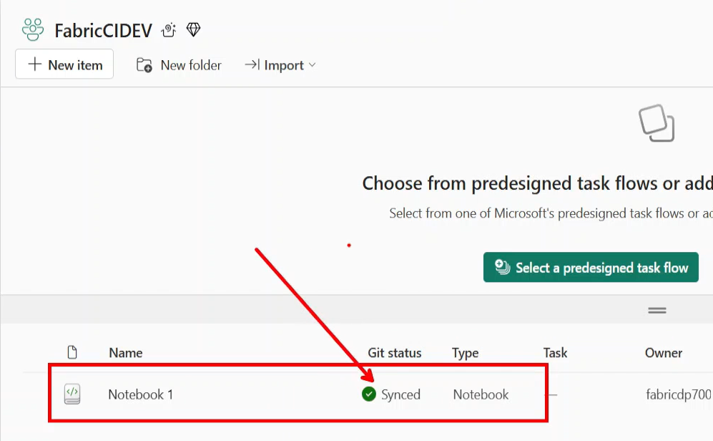
Notebook appears in the workspace
Notes:
Eventually you should see Synched

Slide 8
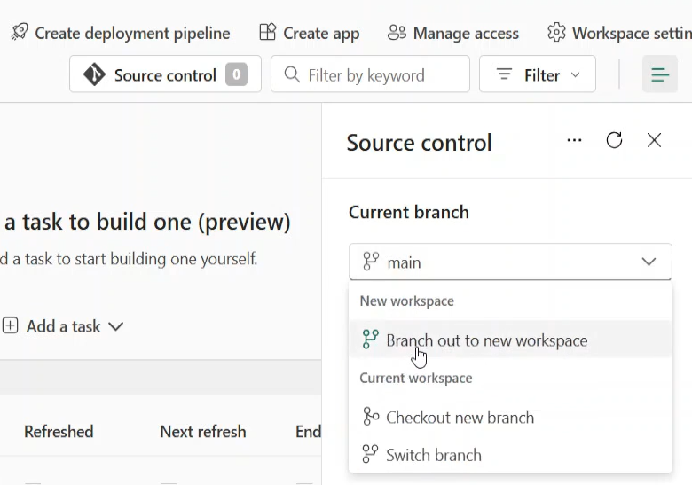
Now another developer ..Go to Source Control, Brack out to new Workspace

Slide 9
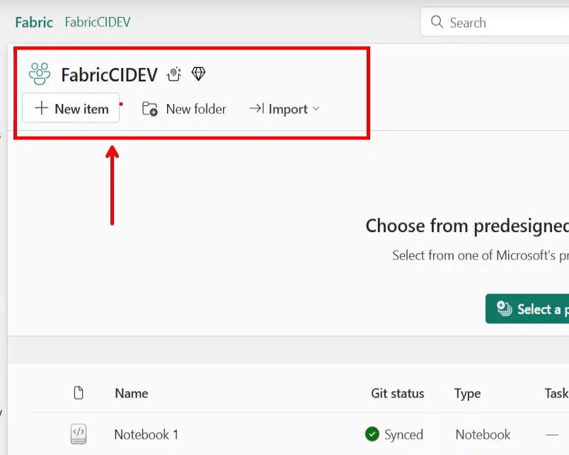
Next is to go to CD part ..DEV – top TEST and THEN PROD ..The deployment

Slide 10
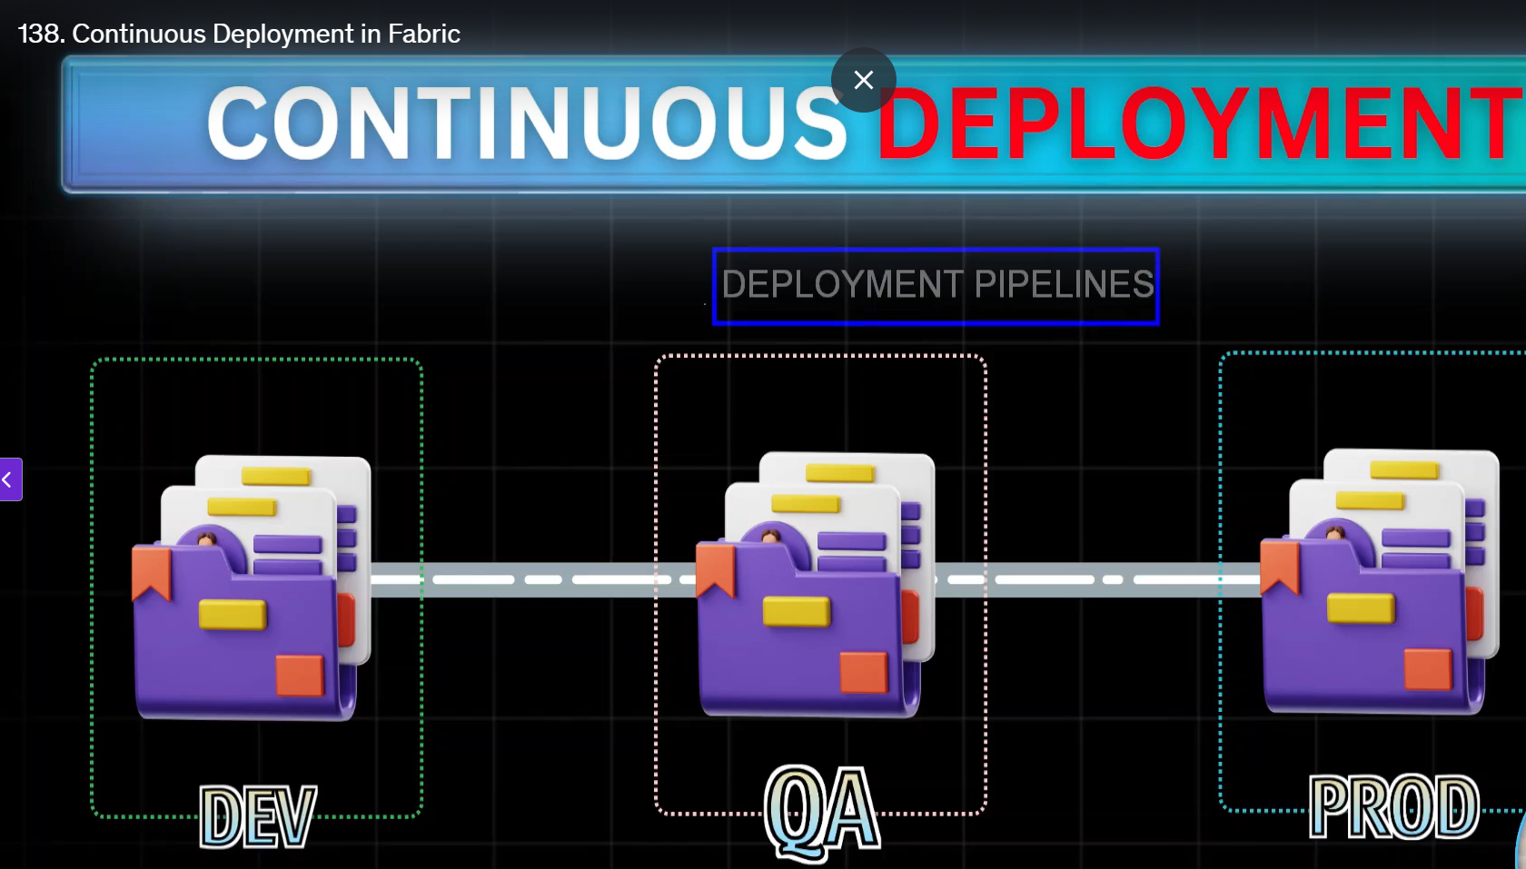
138. Continuous Deployment/Delivery.
Notes:
Not Everything can be deployed.
Lets see how these deployment Pipelines work.

Slide 11
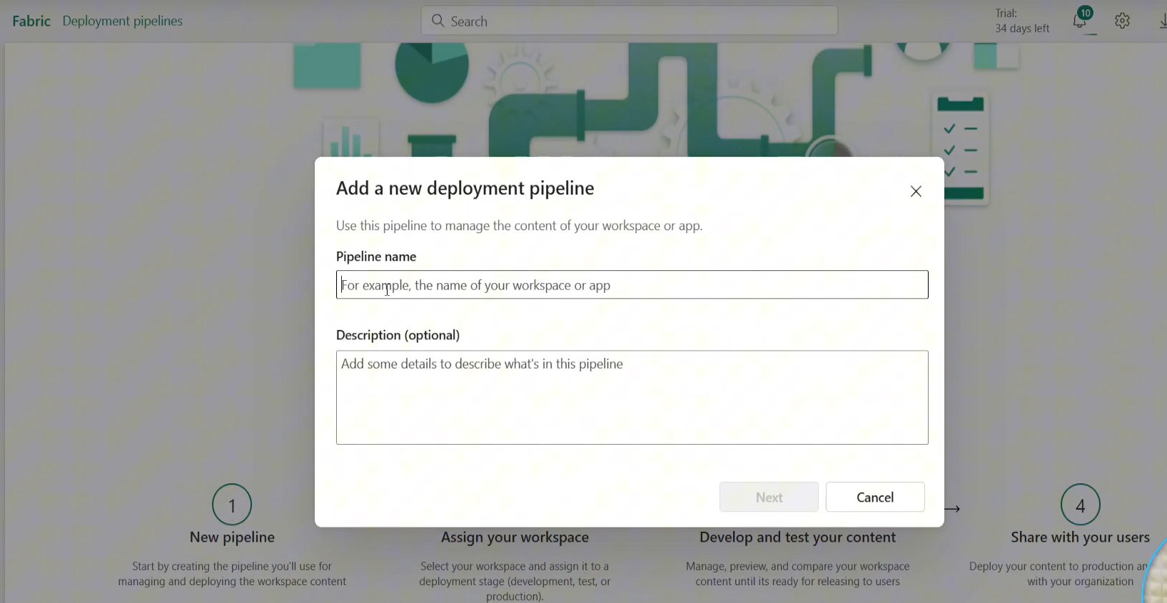
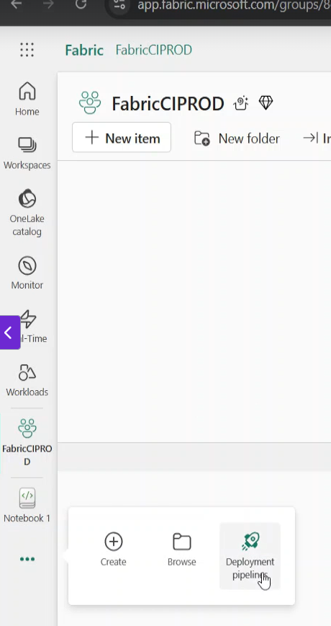
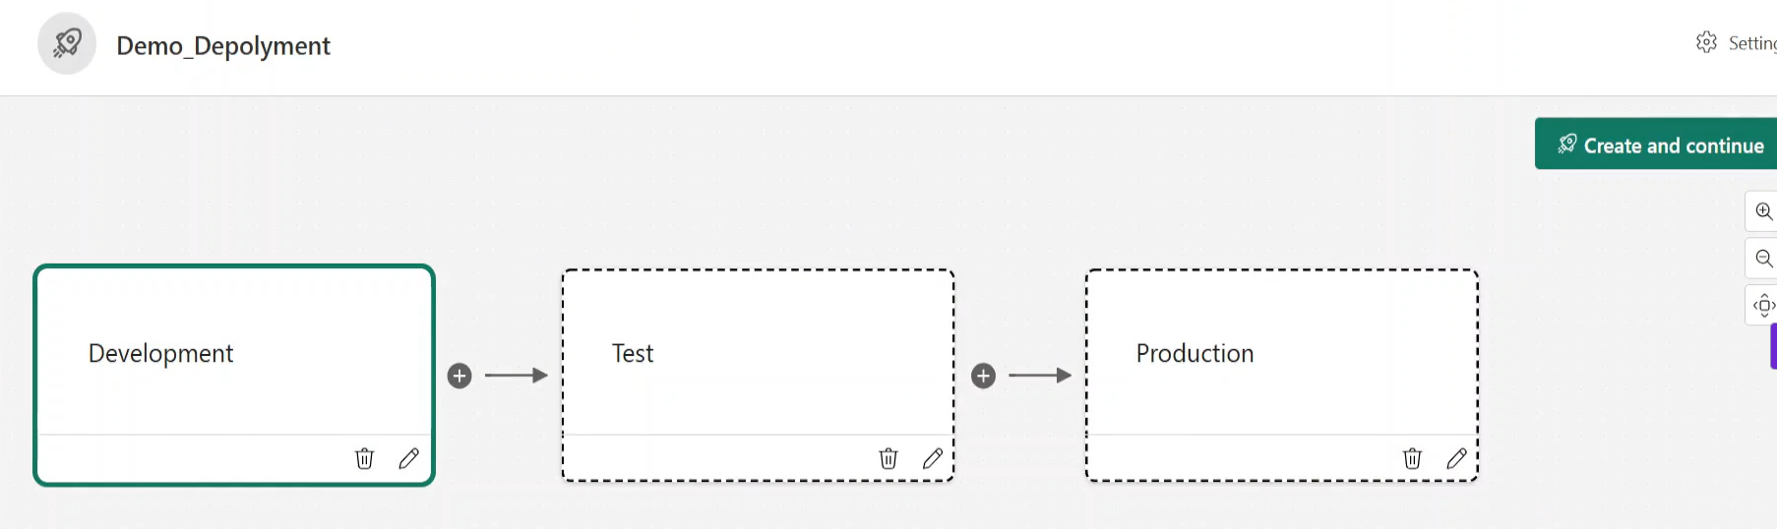
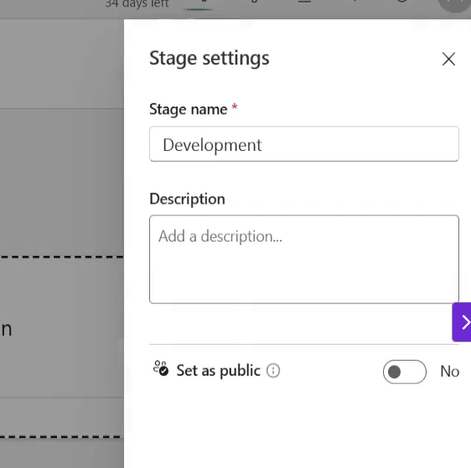
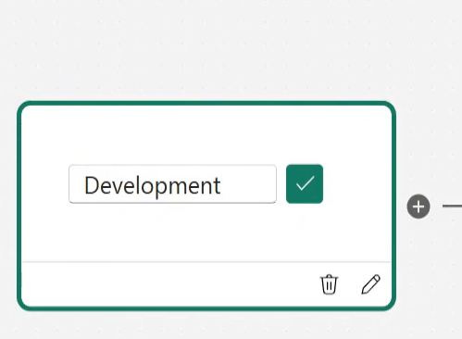
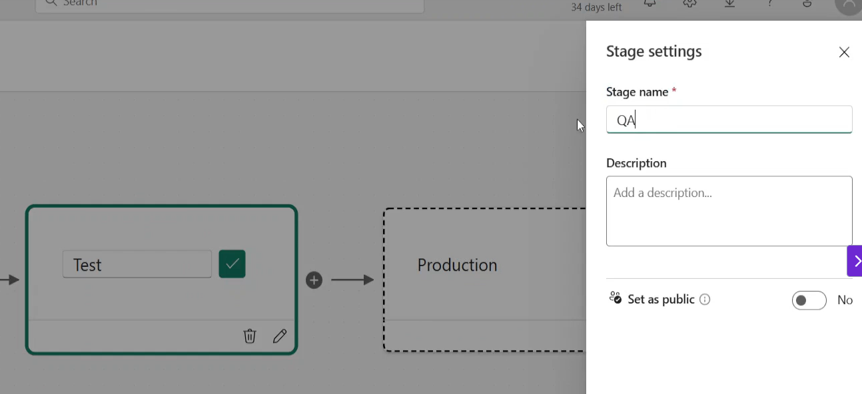
139.Deployment Pipelines Setup
Notes:
We need to create new workspaces ie QA / Prod
Shown above is Prod.
See Deployment Pipelines, Click New Pipeline
Dev_Test_Prod is generic stabdard to follow.
Now we =need to attache the workspace to Dev.. Get the pencil in Dev .. See Stage Settings , Development , set as Public .. See the tick
Then Go to Test ..etc and Proiduction ..CREATE and CONTINUE!

Slide 12
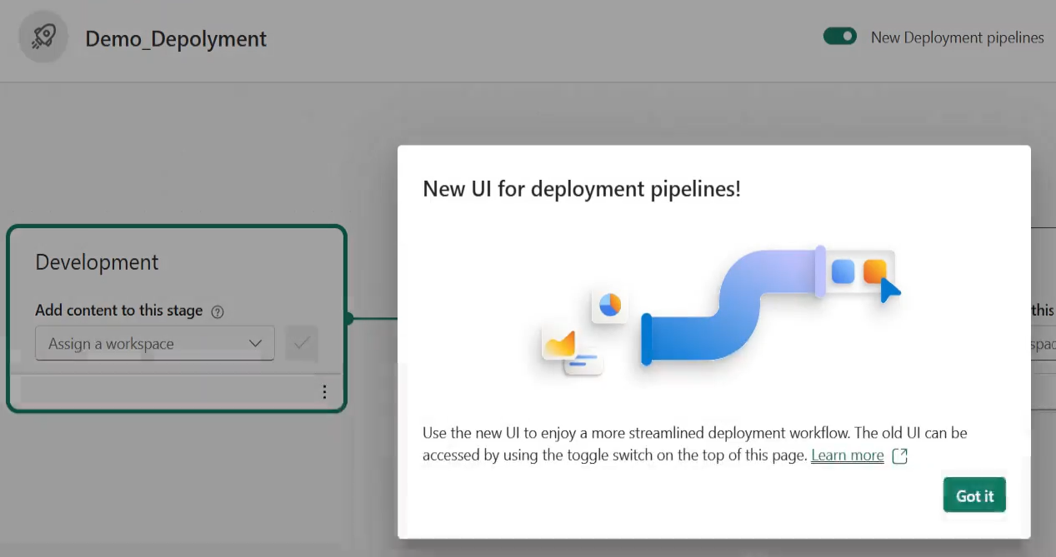
Deployment Pipeline

Slide 13
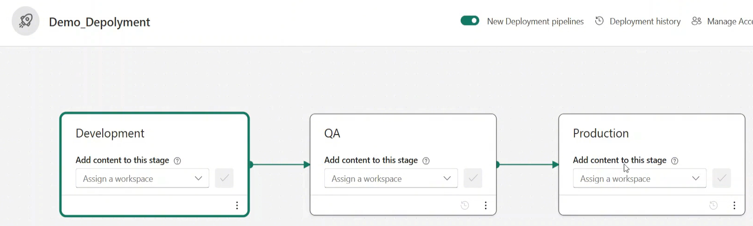
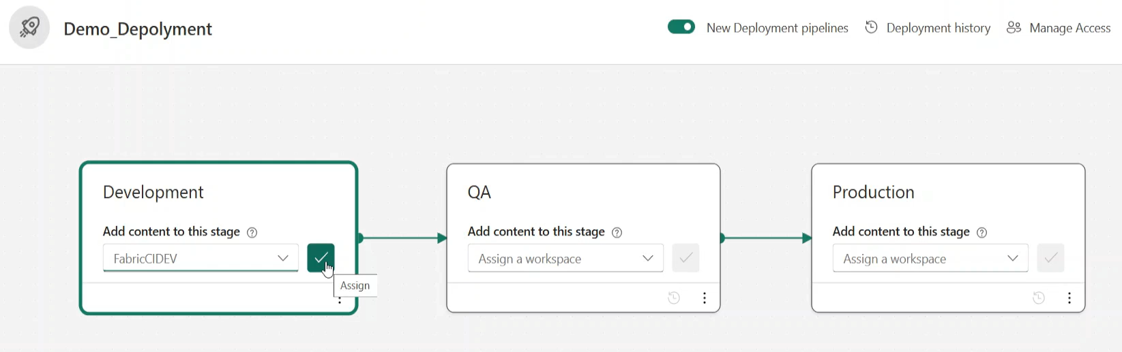
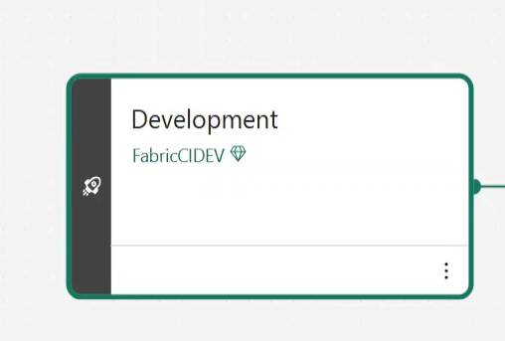
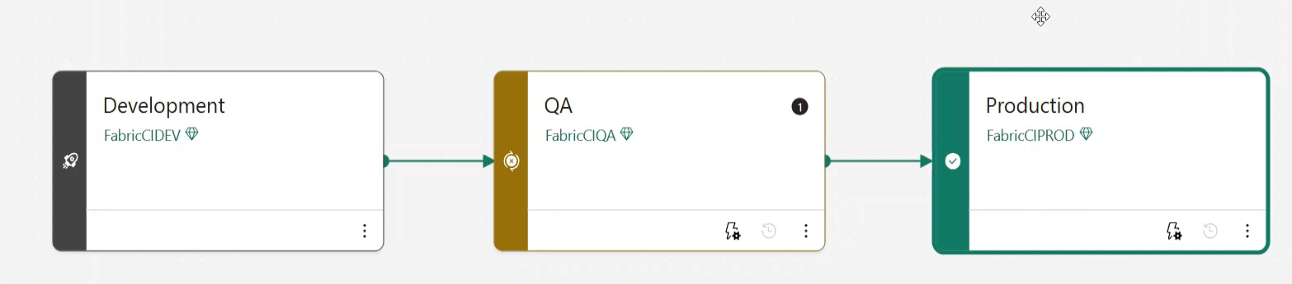
Result is the 3 environment
Notes:
Now we assign the previous empty workspaces to the 3 blocks and click the tick in all 3
After each stage it will be assigned

Slide 14
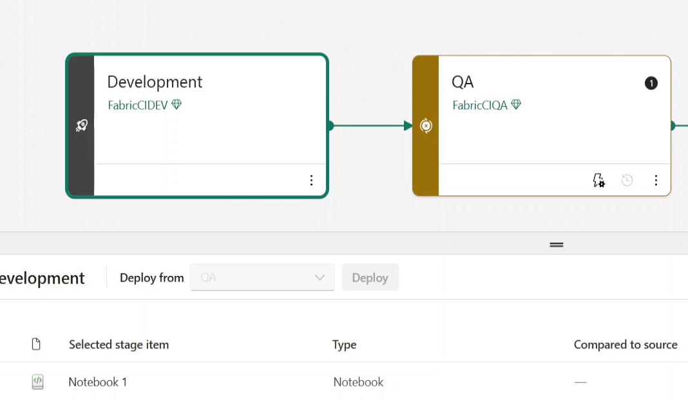
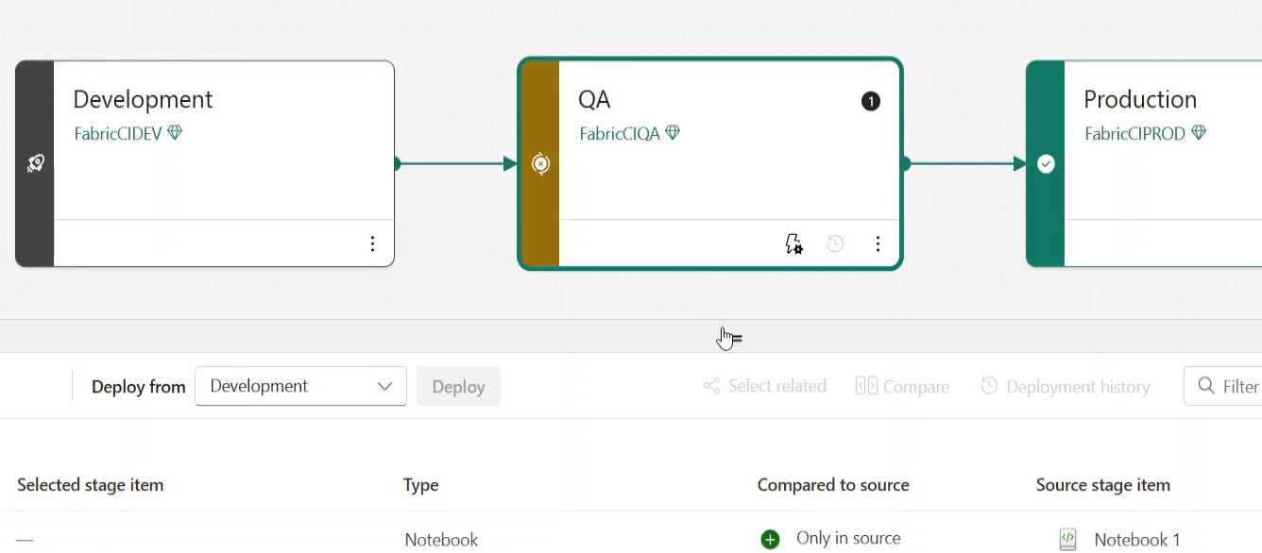
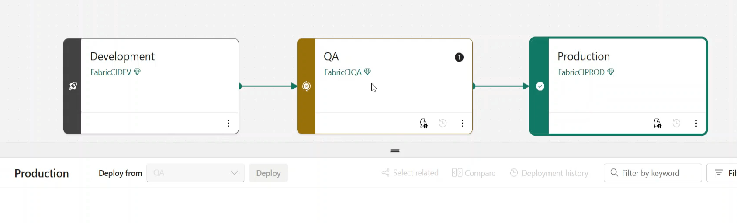
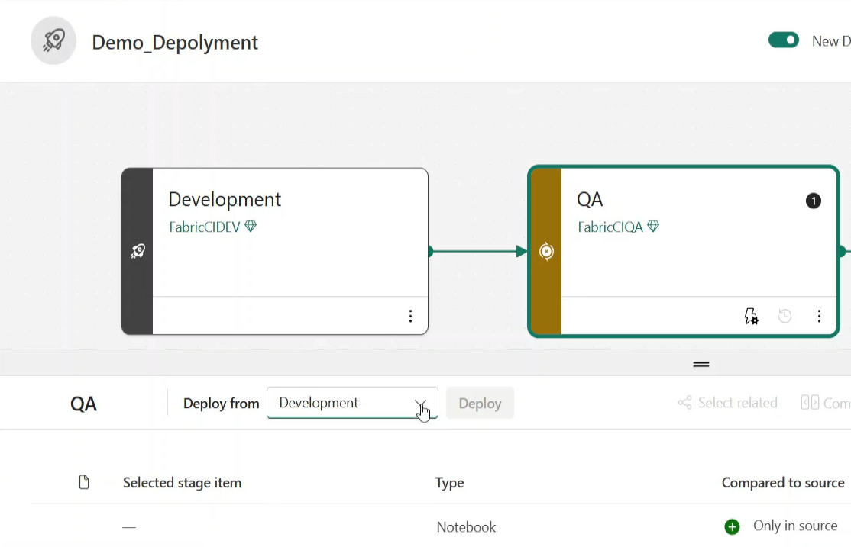
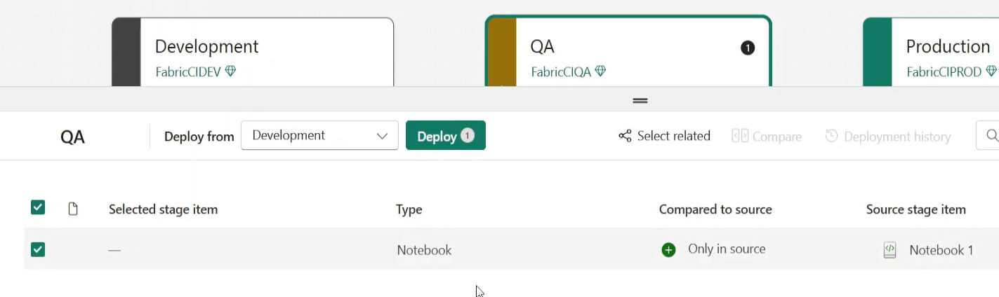
Now we synch the changes to each of the workspaces
Notes:
Click on Dev First , you will see the notebook and all assets as they are in that wspace .. Only in the Dev ..Note the other 2 were empty.
So we click on Dev. And see its notebook…Now we click on QA and see its notebook., see what it says. .. Only in Source which means is needs to be INSERTED into that wspace
If you go to production ..there is nothing as it does not see Dev ..only QA
So now click on QA and Deploy from Development in the drop downm above the stage item
Now we go back to Dev .. Seer the Notebook ..then back top QA, Deploy from Dev and click on the Select Stage Item Box , click on box to choose the item or all the items
The box is visible on Hover, notice the button Deploy! ..Click on it! See overleaf

Slide 15
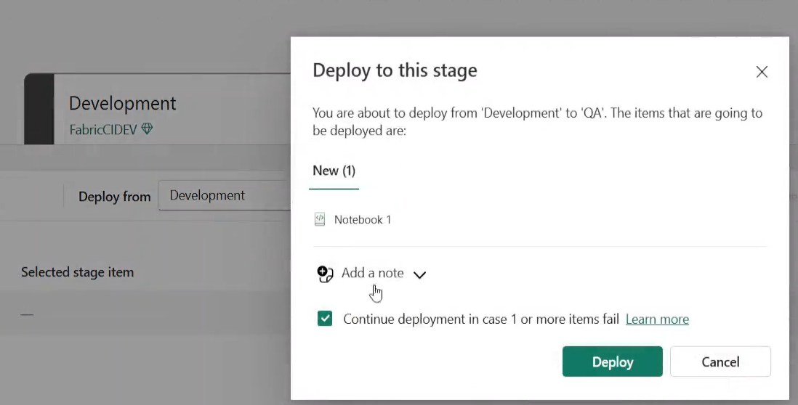
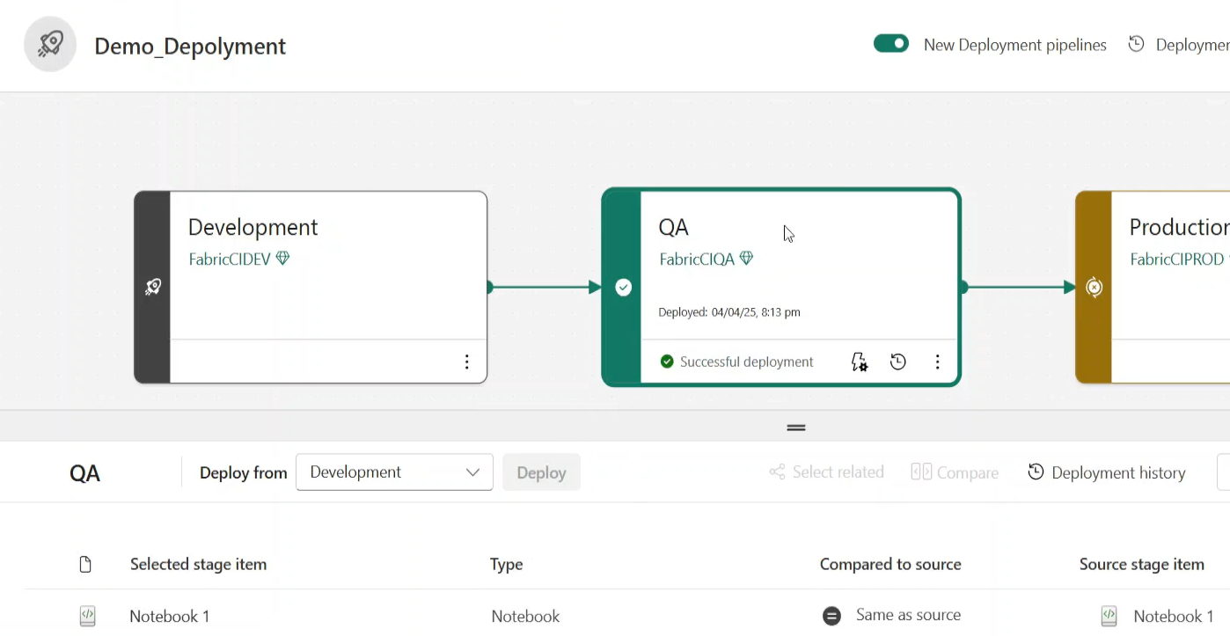
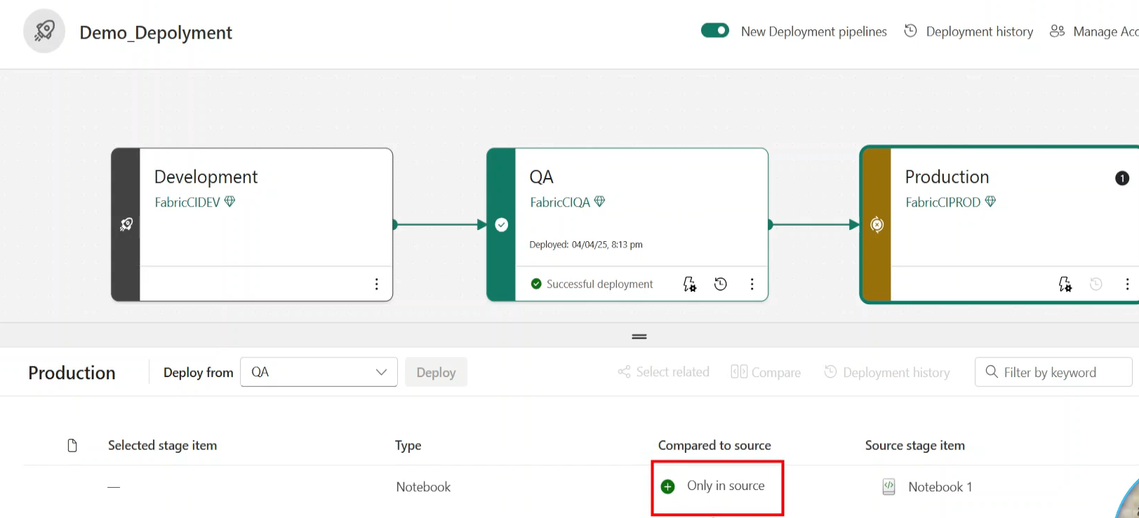
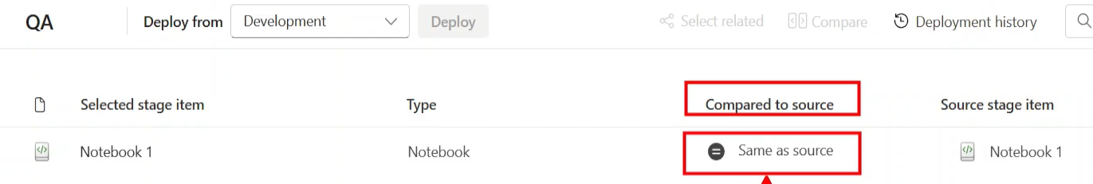
Message Deploy to this stage
Notes:
Click Deploy. The results shows the Notebook now deployes to QA. Now see thye Notebook in QA environment. Notice message in QA Deployed… successful deployment..
Same As Source ..
See now only in Source . As the assests are available in QA..

Slide 16
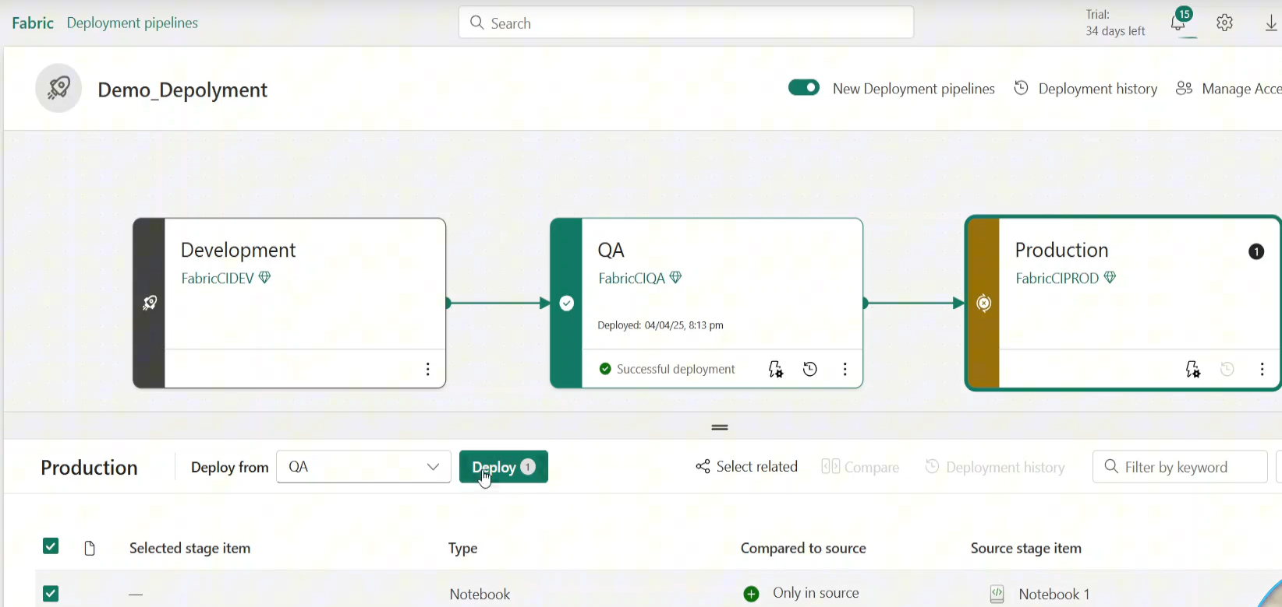
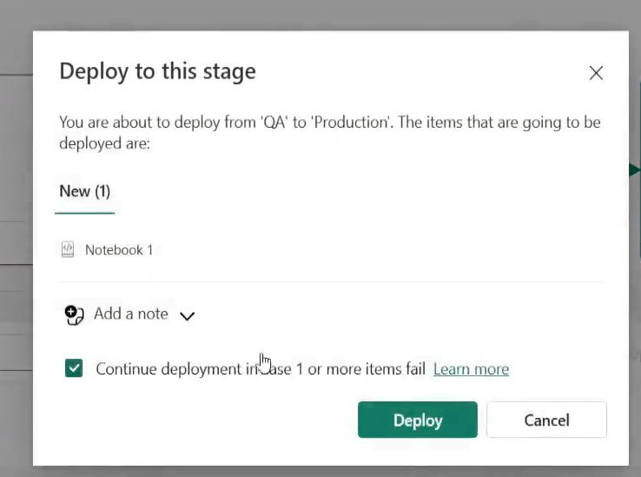
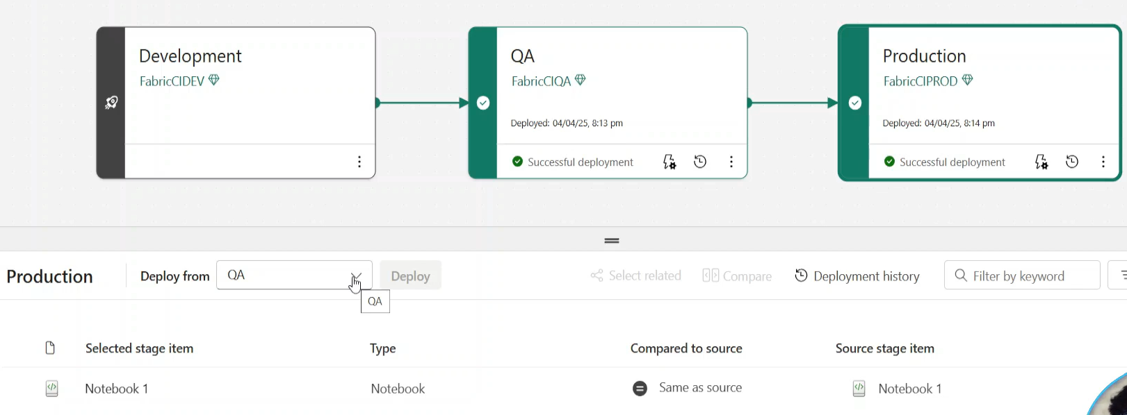
Go to Prod and deploy to Prod
Notes:
You should test the deployment in QA before deploy to Production , now all changes are in production
See same as source , when click on Production.
We are now going to Deploy to Production my environment
Everything is tracked in the notebook , if I change something.

Slide 17
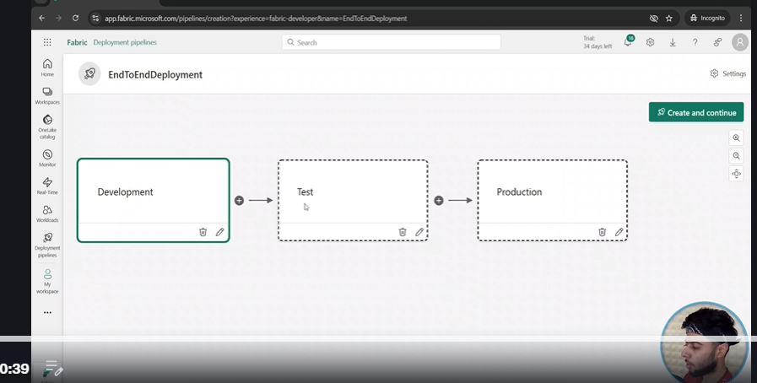
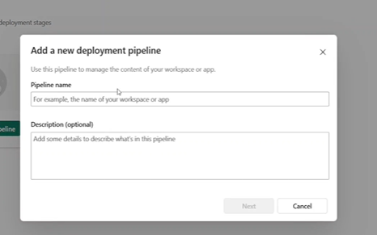



141..End to End Deployment
Notes:
He has a main workspace DP700 Dev ..where he has many assets. He wants to deploy this one throughout…
We make a QA wspace and Prod Space for our wspace..ie Say WFlowTest
The 3 dots ansDeplyment Pipeline , New Pipeline
Next Rename the Test to QA , save an create and continue

Slide 18









Go Back to the Pipeline to Dev and Assign the wspace to the block. By drop down
Notes:
Set up the existing wspace and the ther 2 , QA and Prod. Then assign them to the blocks
May get a message .. Dataflow1 , not supported , Continue
THEN QA and assign , Then Production …
The go back to DEV and see long list of assets , GO Back to QA , and again you will see only in source as before , see centre bottom!
Now we want to put all the items if they are ready , we don’t have to deploy all ..pick what you think is ready. And Click On Deploy.. And you get a list prior to actual deploy so that u can check
Some stuff may be unsupported ..sql endpoints etc
You may get some errors / this is in preview …Turn off the top button and redeploy , see bottom right , New Deployment Pipeline , OR refresh the page

Slide 19


Result of deployment ..Unsupported etc
Notes:
Why are some of things unsupported ; just a sql endpoint ..no problem..
Sometimes u will see errors , it’s a new Ui ie new deployment pipelines
Sometimes it will show different from source..
The ones that we did not deploy(on purpose) ..will show only in Source still. Allows you to keep track continuously.
We then go to production and select all, then deploy.

Slide 20


Slide 21

Notes:
Even though it shows unsupported it will deploy all of them.

Slide 22


142. Deployment Errors
Notes:
See old interface , you cn presss on button and compare the resources between pipeline stages
The oprange cross means there is a mismatch …
QA and Prod are fine
Always compatre before you deploy , but you can do the deploy without coparing.

Slide 23



Notes:
Can get error messages
Go to documentation on Deployment pipelines and see message
Get list of supported items , many in Preview,
Don’t deploy activator or environment ..these rae in Prebview..

Slide 24

Some artifacts will result in errors

