Slide 1
Vscode Images

Slide 2
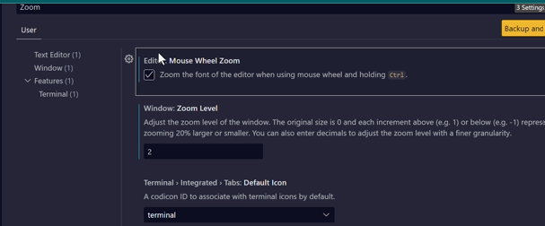
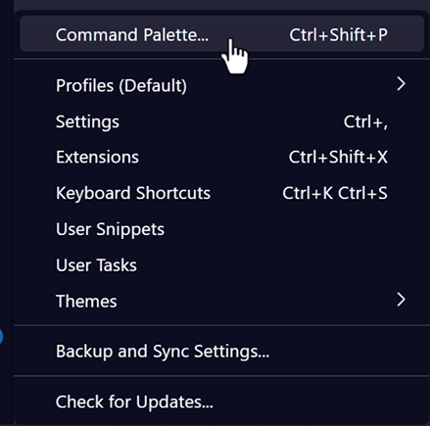
Settings
Notes:
Command Pallette – all different commands
Usefull is Zoom and Glyph Settings

