Slide 1
Lab 8

Slide 2
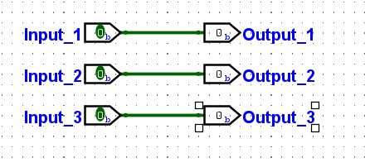
RGB Light Control with switches

Slide 3
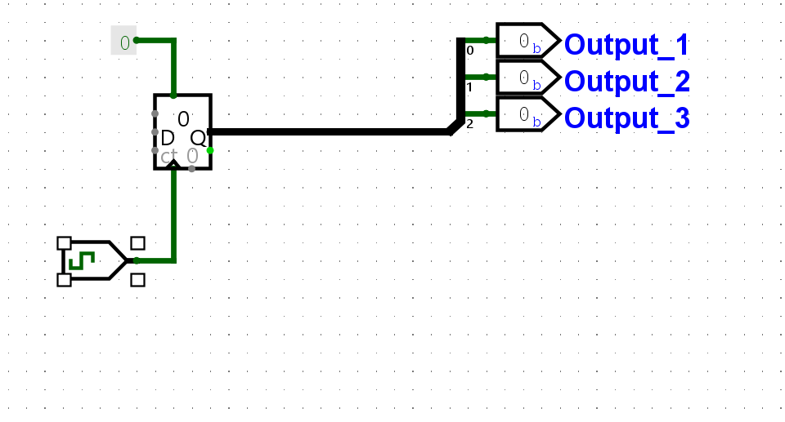
Color Cycle

Slide 4
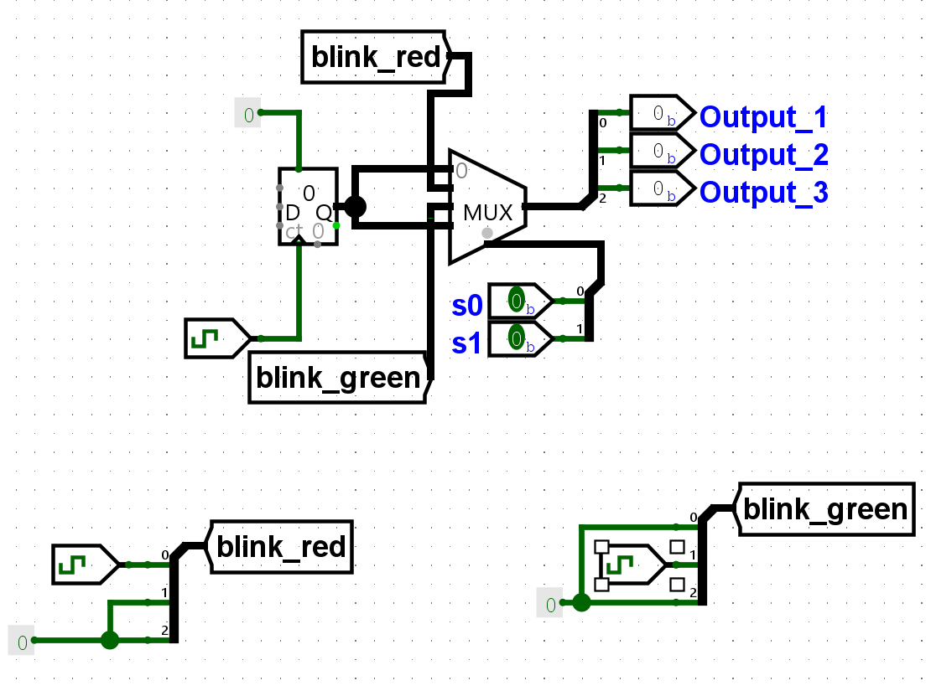
Switched red/green lights with cycle

