Slide 1
Final Project

Slide 2
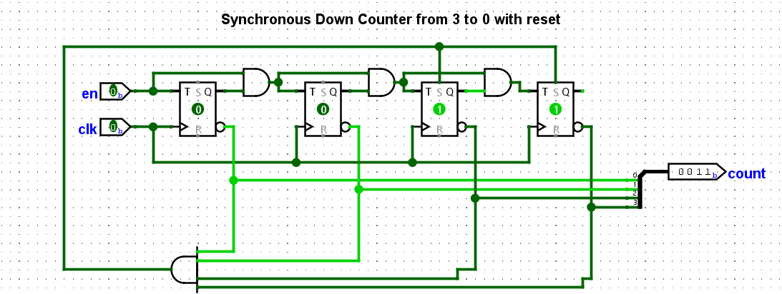
3 to 0 countdown, all versions

Slide 3
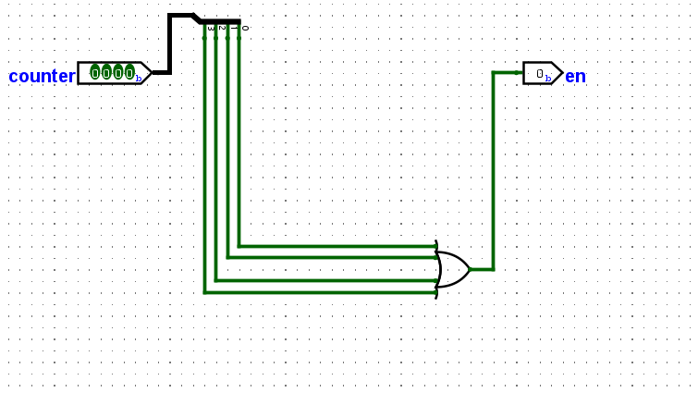
Pedestrian_button module, all versions

Slide 4
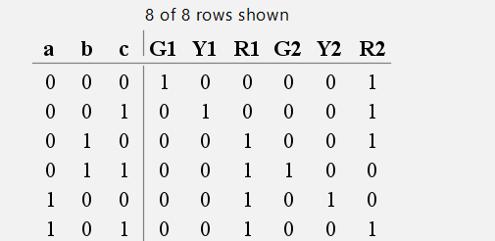
Initial truth table
Used to generate FSM machine prototype

Slide 5
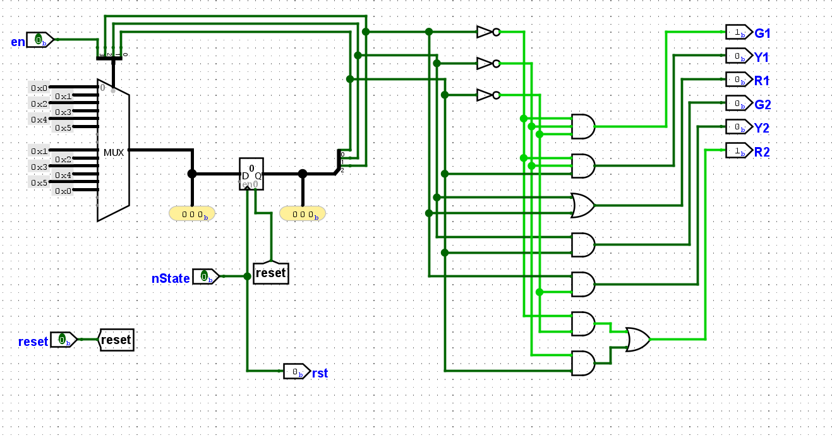
FSM V1(no cross button)

Slide 6
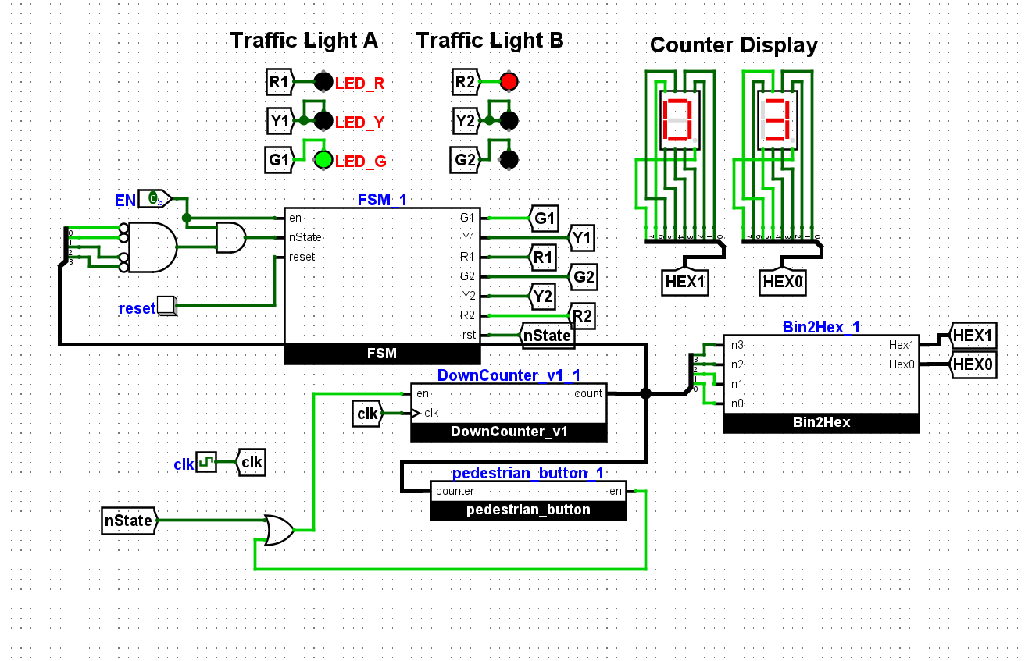
Main Circuit v1 (no cross button)

Slide 7
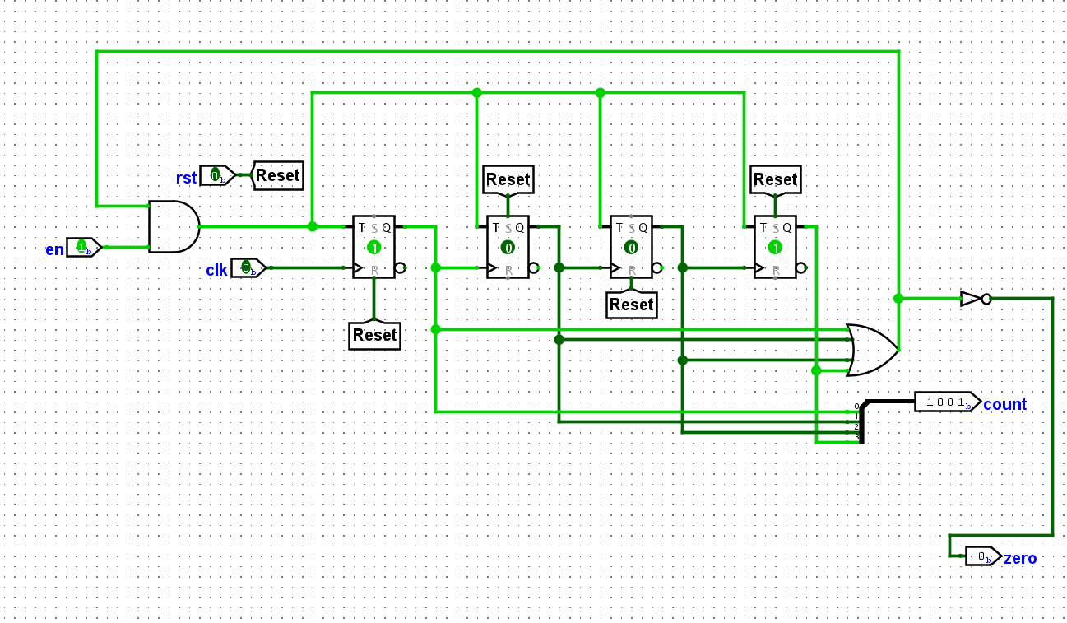
10 to 0 counter, v2 only

Slide 8
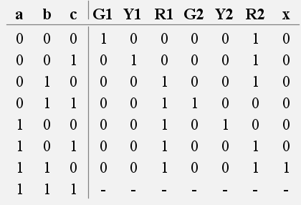
FSM truth table

Slide 9
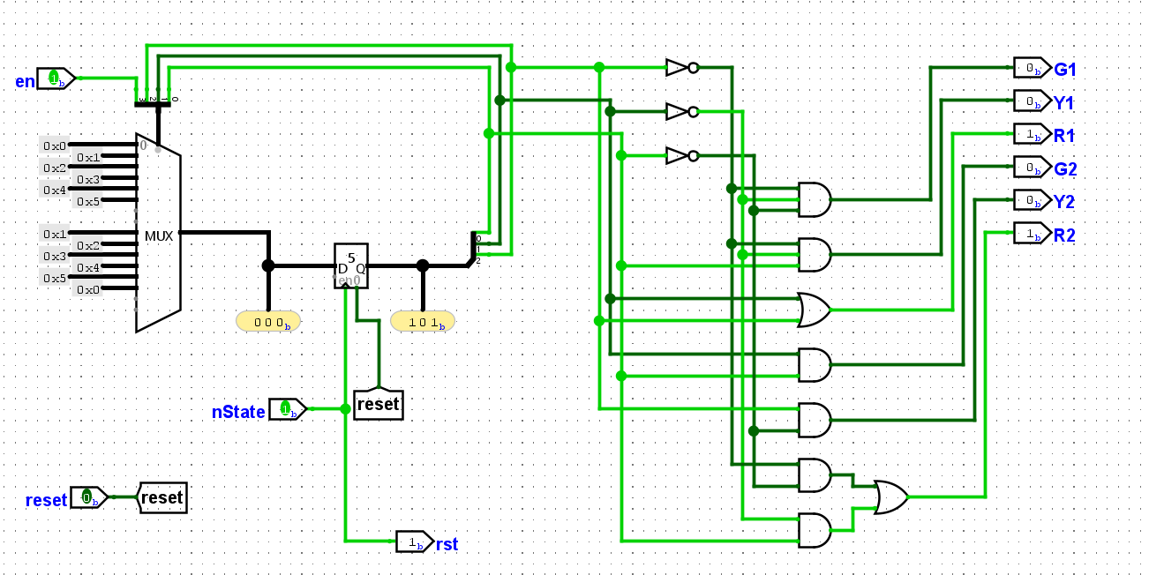
Final FSM (with cross Button)

Slide 10
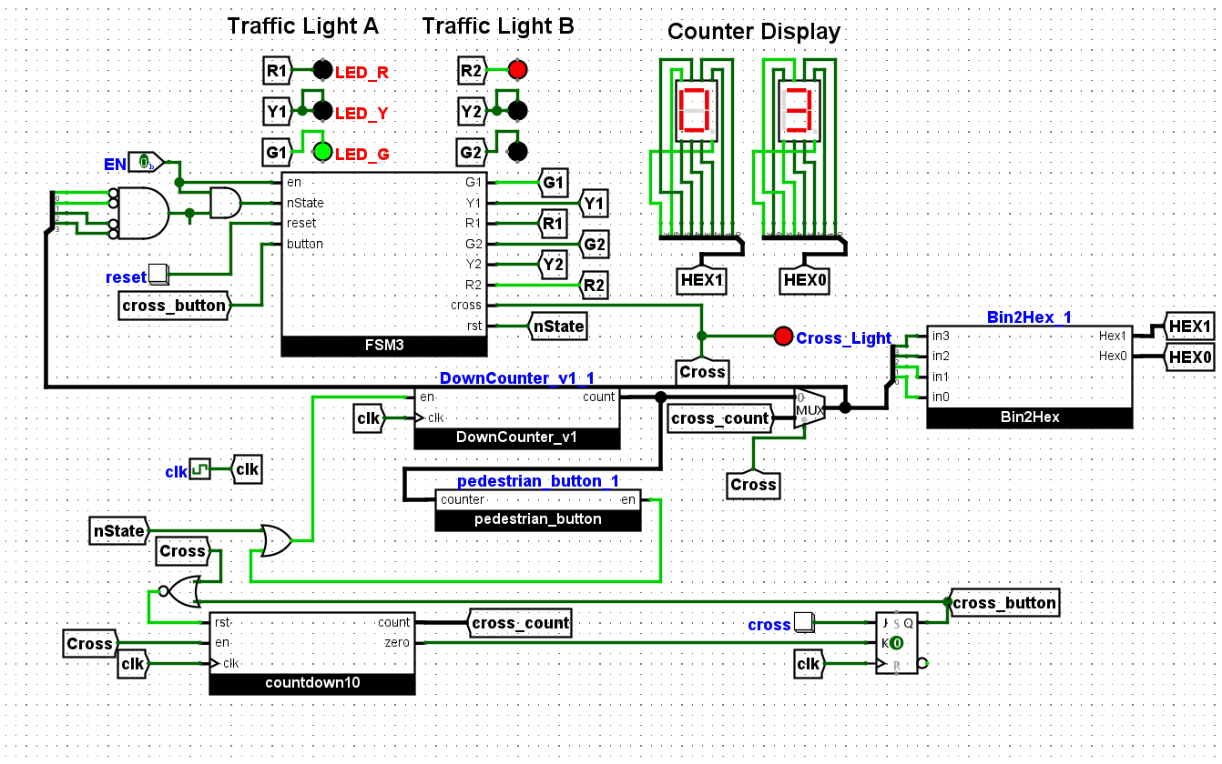
Final Main Circuit (with cross button)

