Slide 1
N Frames, concentration
Compare to 1st frame using datcmp
p
< 0.01
≥ 0.01
Discard
Average
Averaged file
Buffer before & sample
Buffer after?
yes
AutoSub
no
Subtracted file
SAXSAnalysis
ISPYB
Notes:
smartmerge

Slide 2
2 buffer file , 1 Sample file
Compare buffers using datcmp
p
< 0.01
≥ 0.01
Subtract
individually
Average
AutoRg
Subtract
Discard
higher R_{g} data
Best buffer
Average buffer
Subtracted file
Notes:
autosub

Slide 3
Subtracted file
AutoRg
no
stop
Success?
yes
datGnom
datPorod
Vc
Create plots
Notes:
analysis

Slide 4
Gnom output file
8 dammif runs
above cutoff
χ
discard
below cutoff
Pairwise supcomb
above cutoff
nsd
discard
below cutoff
damaver
damfilt
damstart
dammin
ISPYB
Notes:
modeling

Slide 5
HPLC run overwiew

Slide 6
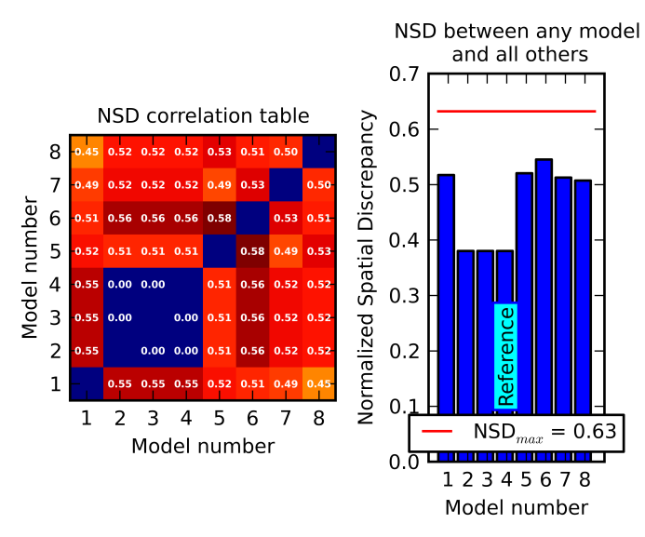
Pipeline plots - Models

