Slide 1
Grant Bourzikas Homework Case Study 1
Doing Data Science MSDS 6306 – Fall 2018 Sadler

Slide 2
Executive Summary for BeerMeUp
Subsidiary of "Sadler, Bourzikas and Beer"
What do we want to accomplish?
Desired Outcome
Strategic Approach to utilize a Data Science
Gain an Understanding of the Competitive Landscape
How will we navigate the discussion?
Comparison of Beers and Breweries
Key Comparison of IBU vs ABV
Executive Conclusion Takeaways

Slide 3
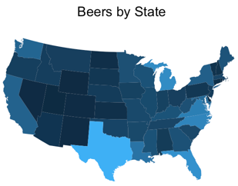
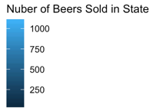
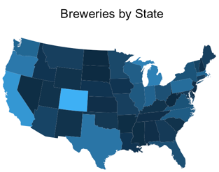
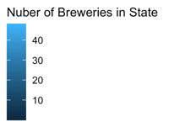
Comparison of Beers and Breweries
Key Points
Number of Beers and Number of Breweries per state are different
Texas and California have many Beers and Breweries and might be oversaturated.
Florida has a high number of Beers but a limited number of breweries

Slide 4
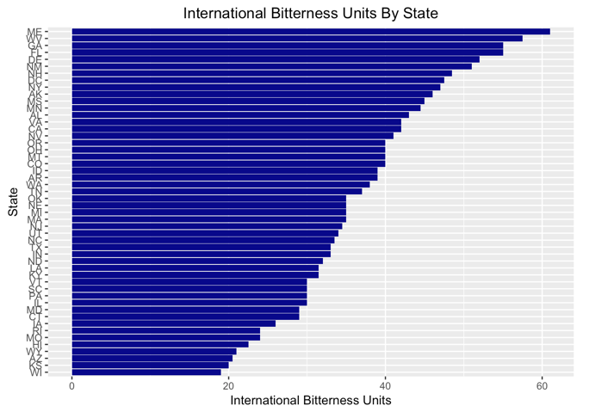
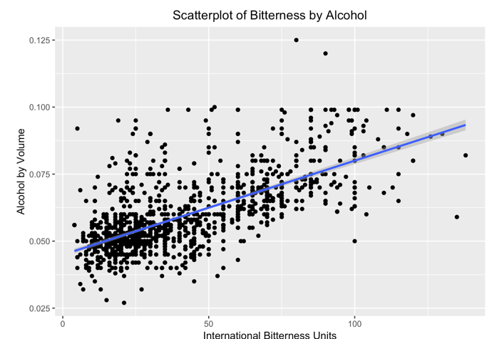
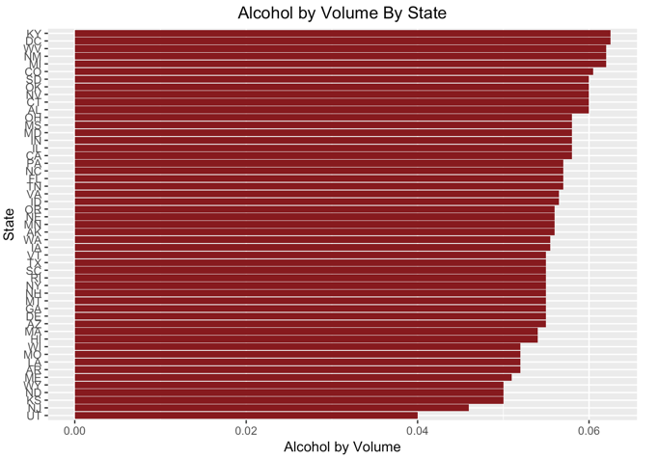
Key Comparison of IBU vs ABV
Key Points
Wyoming and Maine have the highest IBU by State
Utah has the lowest ABV per state
Utilize this data set to target IBU and ABV for BeerMeUp’s newest brewery and beers

Slide 5
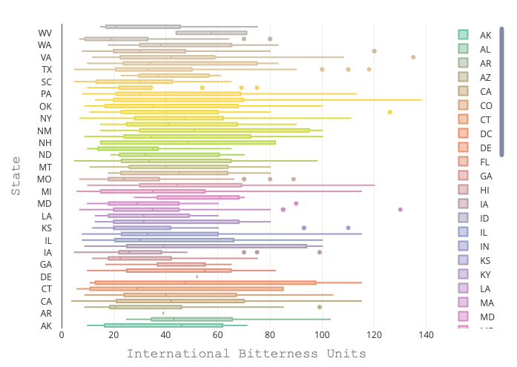
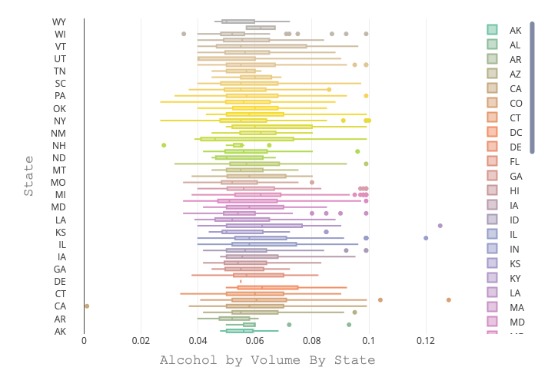
Key Comparison of IBU vs ABV (cont.)
Key Points
Upon selection of a Beer, review the IBU and ABV for Median’s of the Market
While outliers exist, our recommendation would be to say in these bounds
However, BeerMeUp could target a ”Gimmicky” Beer that would be greater than 140 IBU or .13 ABV
Samuel Adams Just Unleashed a $200 Beer That's Illegal in Some States because of its 28% ABV

Slide 6
Executive Conclusion Takeaways
Vast difference in the number of Breweries per State and the Number of Beers Sold in State creating good market opportunities in Florida, Kansas, and Alabama
Wyoming and Maine have the highest IBU by State and Utah has the lowest ABV per state so it is important to understand Market dynamics
Leverage the Linear Relationship of IBU and ABV for new beers and breweries
Target a ”Gimmicky” Beer that would be greater than 140 IBU or .13 ABV as seen by Samuel Adams

