Slide 1
Final Project
TIVI - A Productivity Application
Giuliana Bouzon (1940108)
Chilka Joy Libut Castro (2030864)
Jiahui Xia (2044092)
420‐331‐VA : Application Development (Sec‐01)
Teacher: Syed Naseem Afzal
Thursday, December 09, 2021
Vanier College Computer Science Department

Slide 2
Interactive Features:
Login
Sign up
Menu
Calendar
To do list
Stopwatch
Finance
Countdown
Notes
Vanier College Computer Science Department

Slide 3

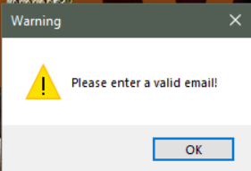
Login page
The user has to enter a unique email in order to access his or her account. Once the information has been entered, the user can press “Enter” to login.
Vanier College Computer Science Department

Slide 4
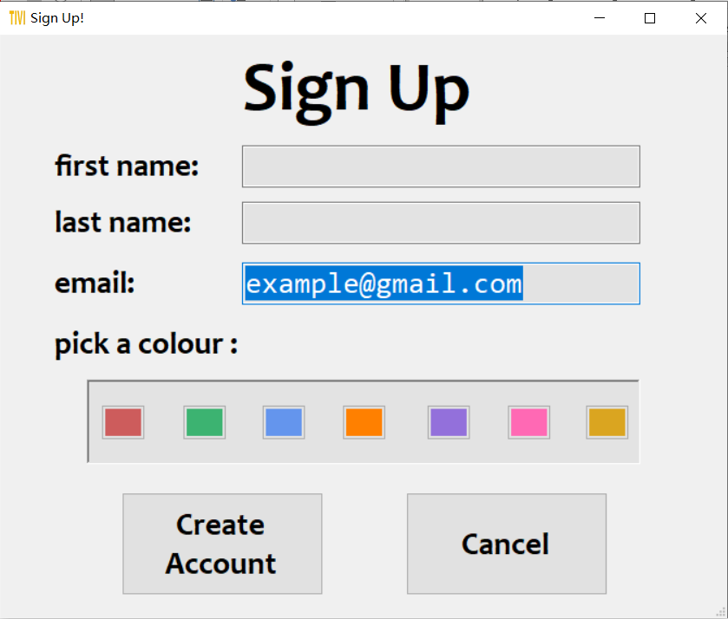
Sign Up page
In the sign-up page, it will automatically save the email entered during login page. The user can pick the color he/she prefers as the background color of the application. The default color is white
Vanier College Computer Science Department

Slide 5
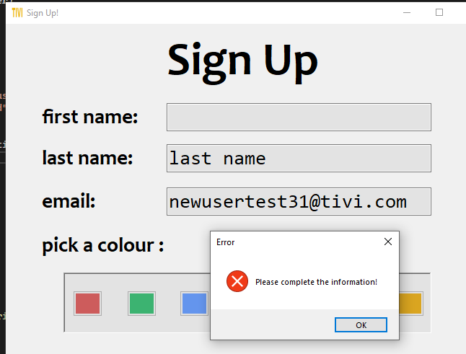
Exception Handling in sign up page:
Vanier College Computer Science Department

Slide 6
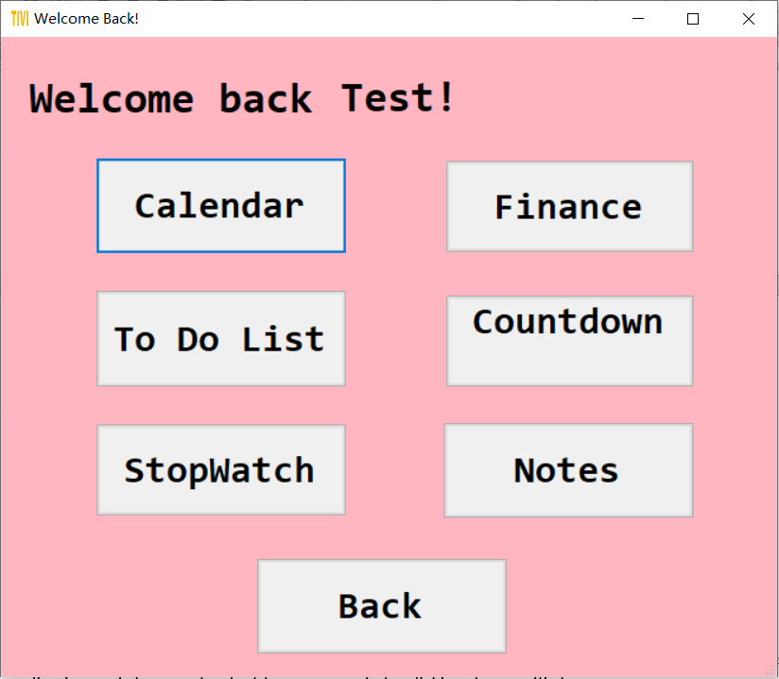
Menu page
In the menu page, it will display the user’s first name and the user can see all the function in this application and choose what he/she wants to do by clicking the specific button.
Clicking “Back” button to go back to login page.
Vanier College Computer Science Department

Slide 7
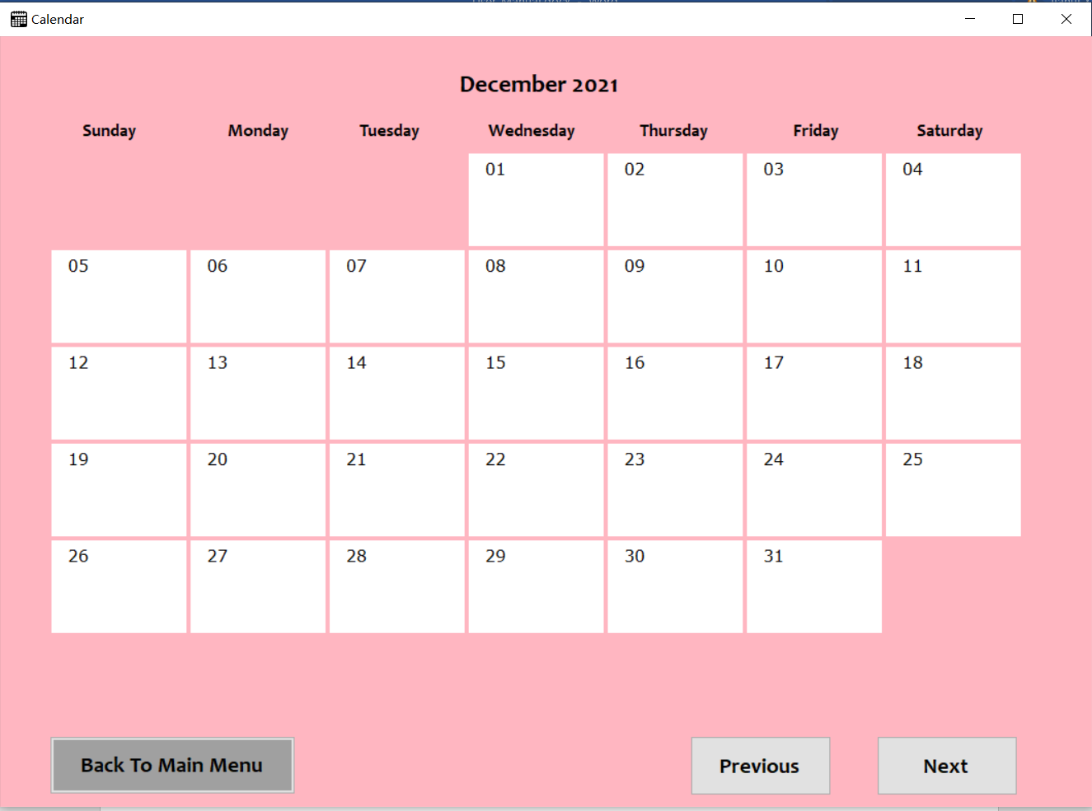
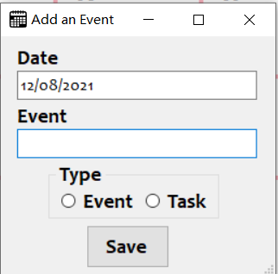
Calendar page
In the calendar page, it will display and updated each month’s events and tasks.
Vanier College Computer Science Department

Slide 8
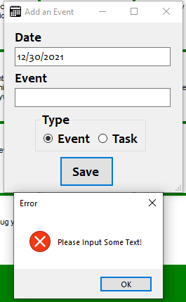
Exception Handling in Calendar page:
The user cannot input empty when add an event or task
Vanier College Computer Science Department

Slide 9
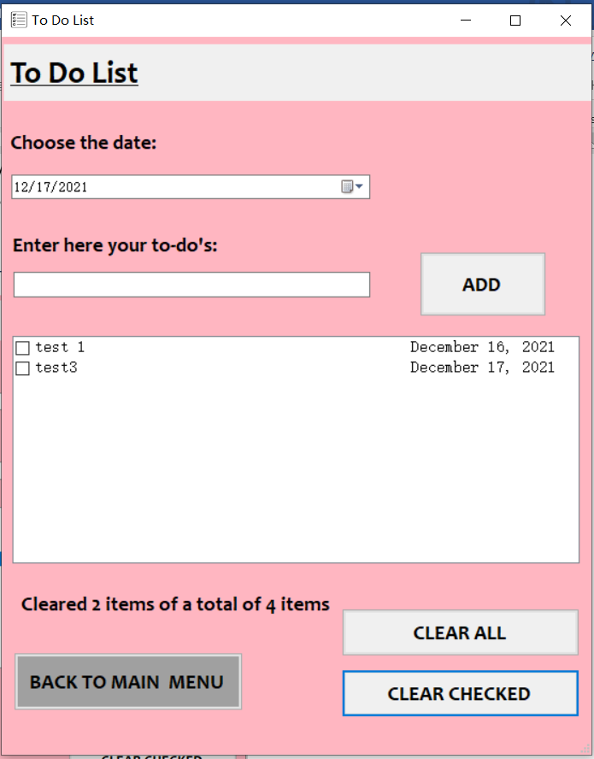
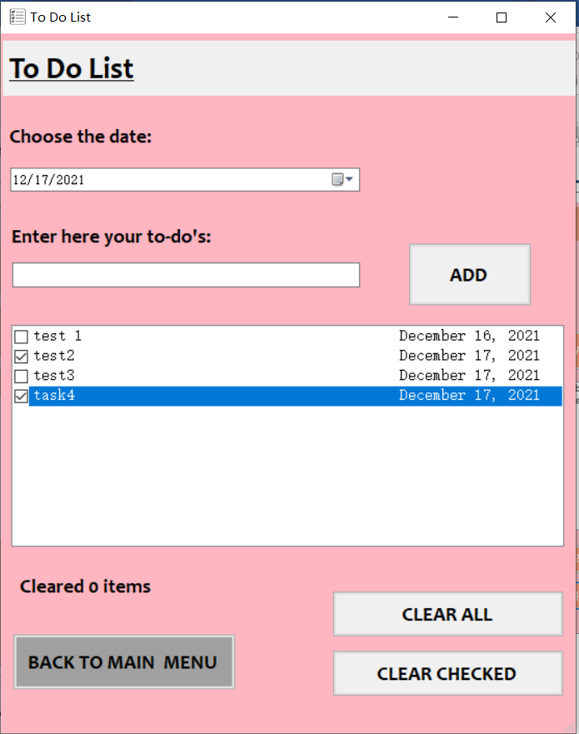
To do list page
In to do list page, the user can choose the date of the task and add the task, remove the tasks that have been completed and remove all the tasks.
Vanier College Computer Science Department

Slide 10
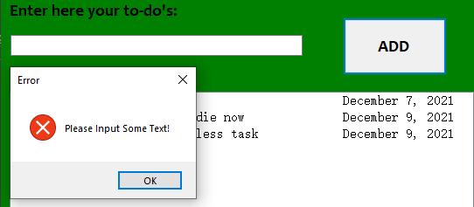
Exception Handling in To DO List page:
The user cannot input empty when add a task
Vanier College Computer Science Department

Slide 11
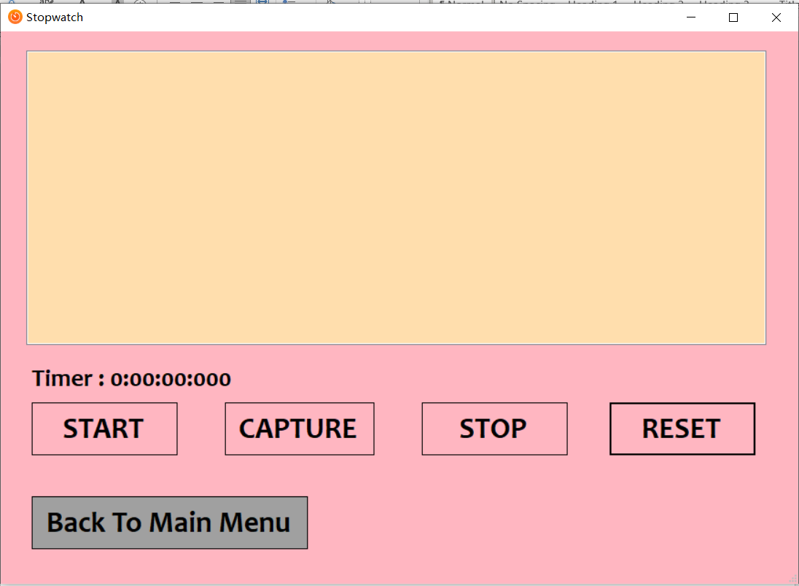
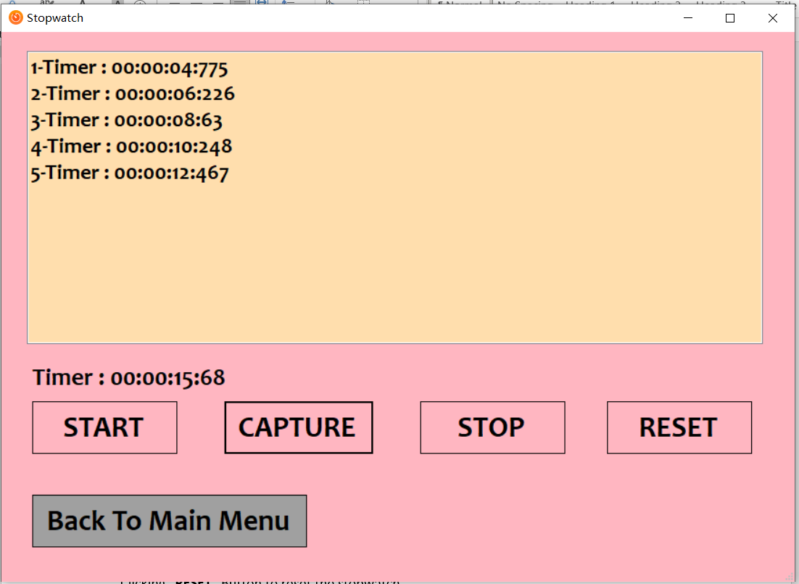
Stopwatch page
In the stopwatch page, the user can measure the amount of time and capture any time (similar to “lap”). The time of capture will be displayed.
Vanier College Computer Science Department

Slide 12
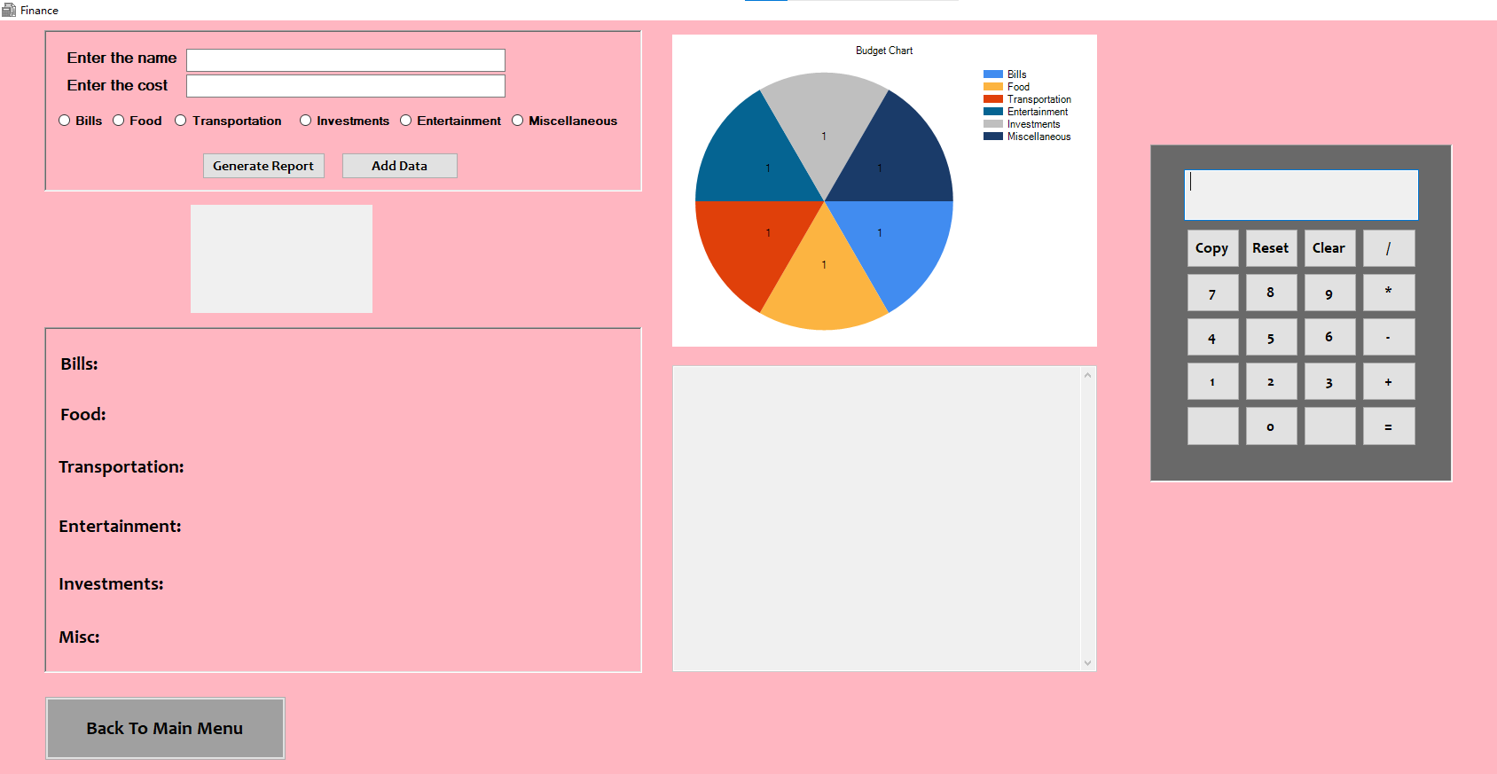
Finance page
User can add his/her expenses and generate the report.
Vanier College Computer Science Department

Slide 13
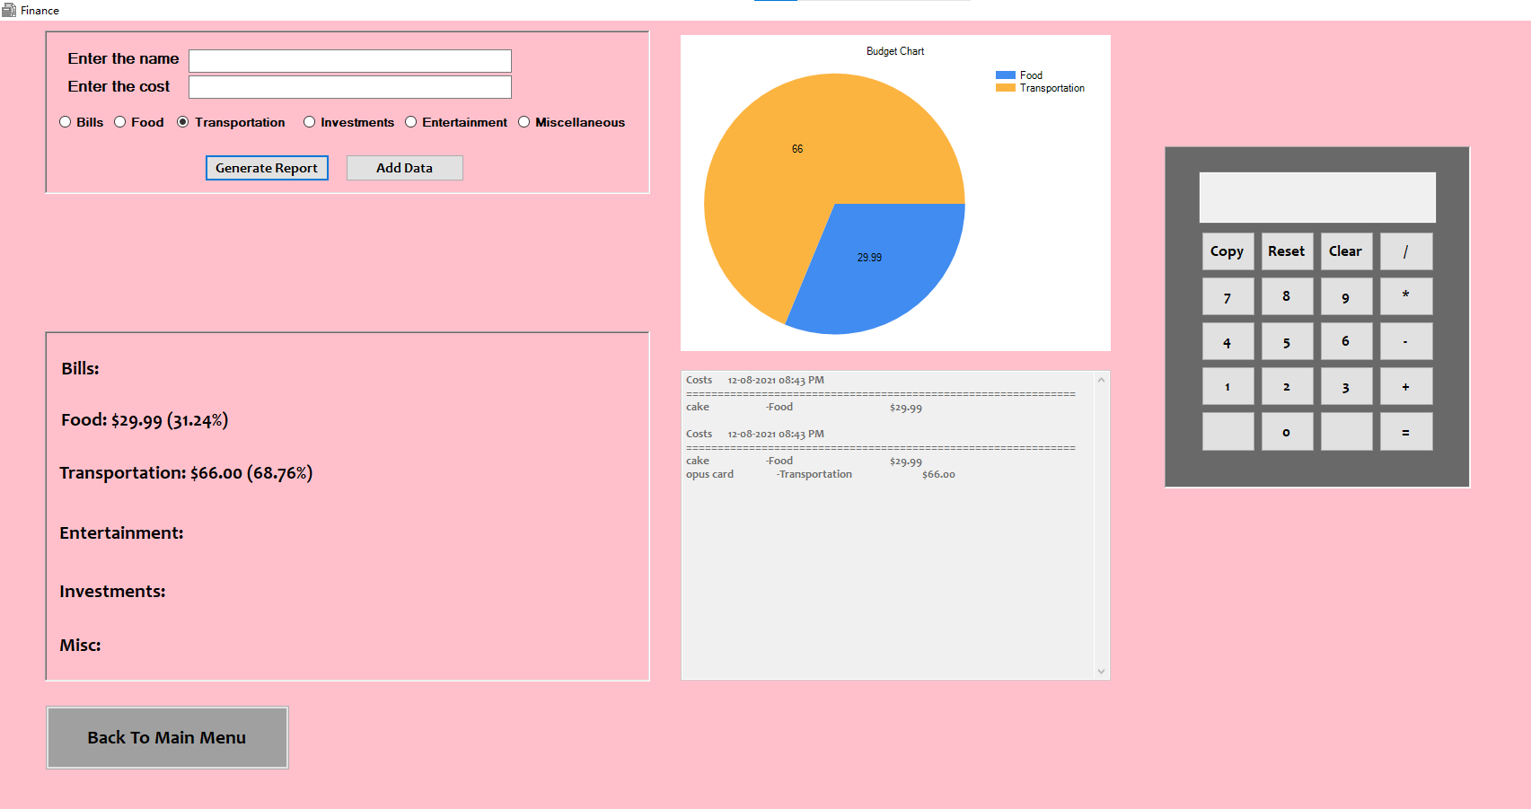
Generate the report.
Vanier College Computer Science Department

Slide 14
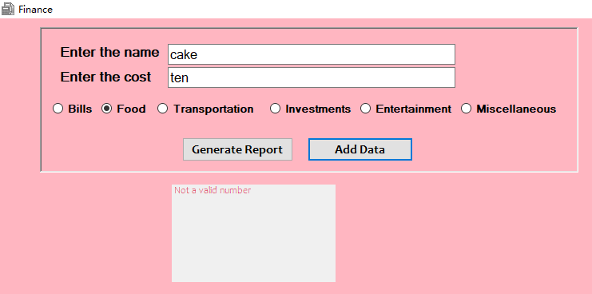
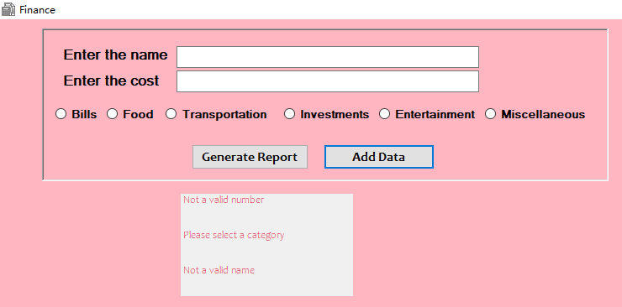
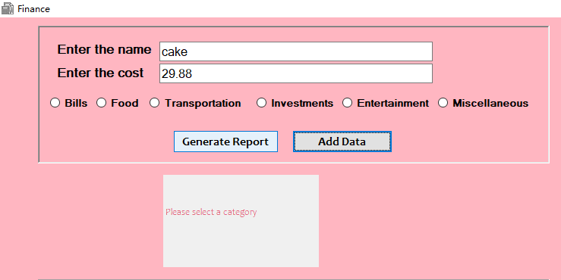
The cost needs to be a number
Exception in Budgeting page
The input data cannot be null
Must to choose a category
Vanier College Computer Science Department

Slide 15
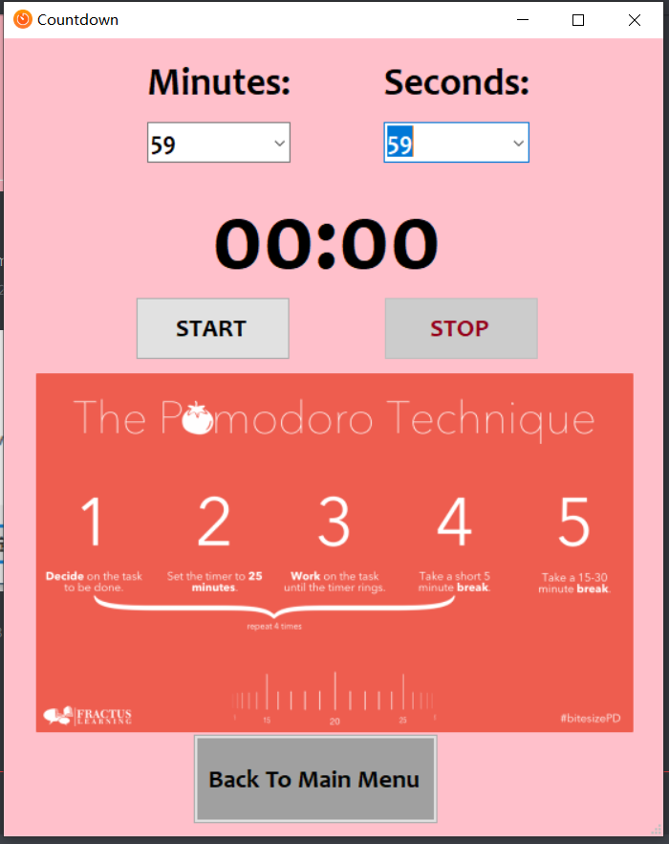
Countdown page
In the countdown page, there is a virtual clock that counts down from the time chosen by the user.
Vanier College Computer Science Department

Slide 16
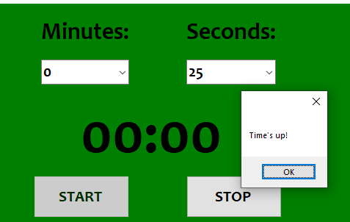
Countdown page
When the time is up, the popup message will display “Time’s up” to remainder the user and play a sound.
Vanier College Computer Science Department

Slide 17
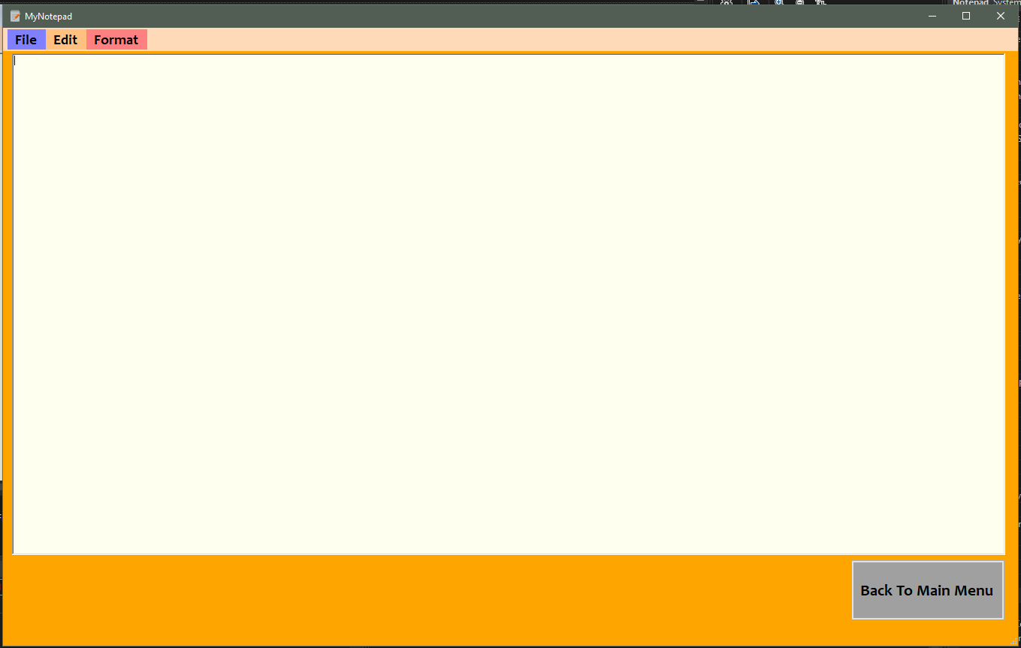
Notepad Page
In the notepad page, user can create new file, open an existing file, edit the file and format the font and color of the text.
Vanier College Computer Science Department

Slide 18
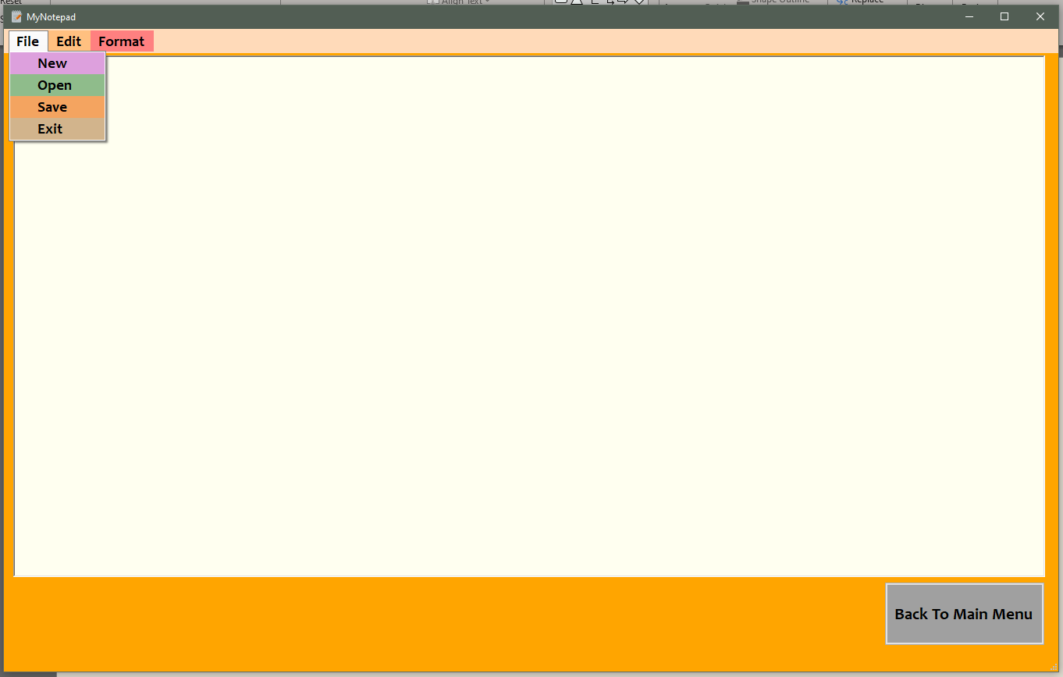
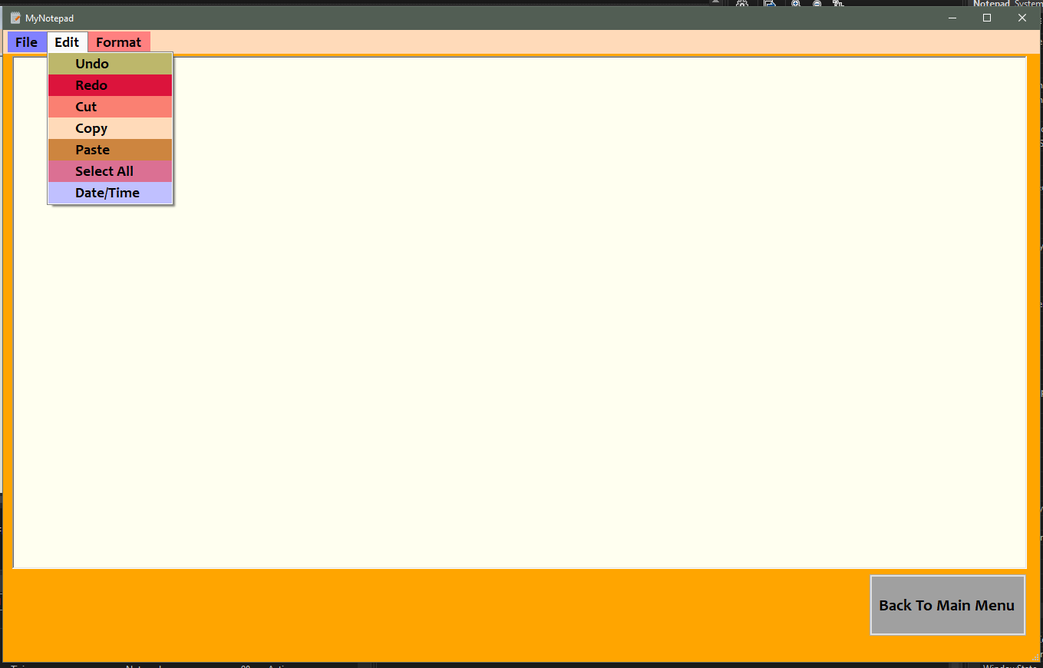
Edit
Undo – reverse the action of an earlier action
Redo – restores any actions that were previously undone using an undo
Cut – removes the currently selected text and places it on the clipboard
Copy – copies the selected text
Paste – paste the copied text
Select All – select all the text
Date/Time – inserts the current date and time
File
New – create new note
Open – open an existing file
Save – save current note
Exit – exit the notepad
Vanier College Computer Science Department

Slide 19
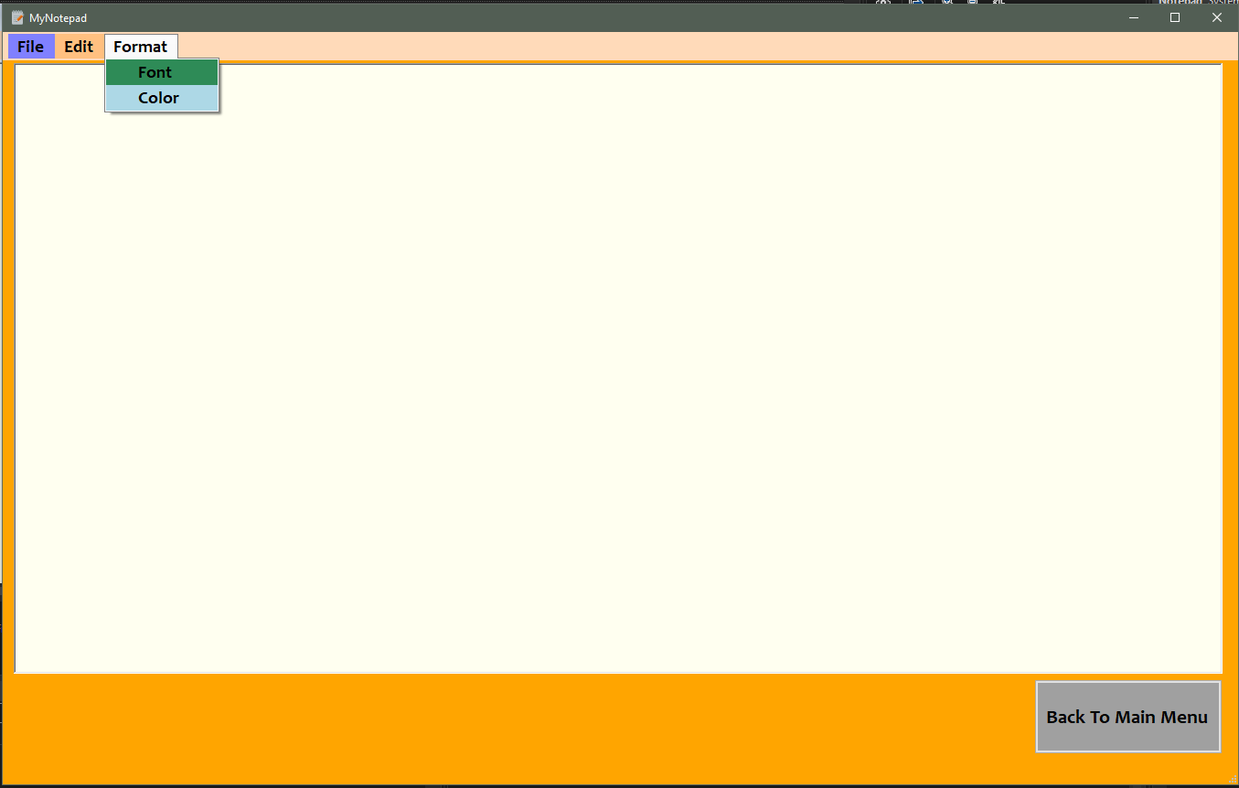
Format
Font – the change default font of the text
Color – to change default color of the text
Vanier College Computer Science Department

Slide 20
“ Thank You ”
Vanier College Computer Science Department

