Slide 1
Euclid MER VIS adaptive geometry outcomes
2,777 galaxy cutouts
2773 disc measurements; 4 failures or exclusions
2320 accepted candidate bar measurements
Centres checked from the images. Disc and bar outcomes reported separately.
Current run 20 October 2026
1 / 14
Notes:
Sources: verified adaptive v2 MER_VIS_local_geometry_manifest.csv, MER_VIS_v2_summary.json, MER_VIS_report_verification.json. Pipeline version MER_VIS_adaptive_v2_2026-10-20 plus explicit failure-only centre recovery. Raw science images unchanged. PA is North towards East modulo180. Numbers refer to the current sample.

Slide 2
Fitting outcomes by counted quality flags
Percentage of all 2,777 galaxies. Face-on is informational.
No flags: 93 (3.3%)
1 flag: 591 (21.3%)
2 flags: 931 (33.5%)
3 flags: 748 (26.9%)
4 flags: 297 (10.7%)
5 flags: 67 (2.4%)
6 flags: 39 (1.4%)
7 flags: 6 (0.2%)
9 flags: 1 (<0.1%)
Failed: 4 (0.1%)
Recovery and missing-bar warnings are counted. QI also includes partial cutout coverage.
2 / 14
Notes:
Sources: verified adaptive v2 MER_VIS_local_geometry_manifest.csv, MER_VIS_v2_summary.json, MER_VIS_report_verification.json. Pipeline version MER_VIS_adaptive_v2_2026-10-20 plus explicit failure-only centre recovery. Raw science images unchanged. PA is North towards East modulo180. Numbers refer to the current sample.

Slide 3
Current quality issues and information
59 nearly face-on fits: informational, not a defect. Disc PA instability is ignored for them.
3 / 14
Notes:
Sources: verified adaptive v2 MER_VIS_local_geometry_manifest.csv, MER_VIS_v2_summary.json, MER_VIS_report_verification.json. Pipeline version MER_VIS_adaptive_v2_2026-10-20 plus explicit failure-only centre recovery. Raw science images unchanged. PA is North towards East modulo180. Numbers refer to the current sample. Flags overlap. Chart shows the eleven most frequent issues; the Word report and manifest retain every flag. A no_bar_detected warning does not invalidate the disc estimate. Individual PA scatter is not a formal independent uncertainty.

Slide 4
Comparison with Euclid geometry
Median absolute difference | Current run
Adjusted Euclid detection PA | 8.05°
Detection inclination proxy | 6.52°
Sérsic inclination proxy | 5.50°
Codex PA: North towards East. N = 0°, E = 90°, modulo 180°.
Counterclockwise on a North-up, East-left image. WCS handles local orientation.
Euclid comparison retains the adopted additional +90° after WCS conversion. A detection-image y-axis reference is plausible but unconfirmed.
4 / 14
Notes:
Sources: verified adaptive v2 MER_VIS_local_geometry_manifest.csv, MER_VIS_v2_summary.json, MER_VIS_report_verification.json. Pipeline version MER_VIS_adaptive_v2_2026-10-20 plus explicit failure-only centre recovery. Raw science images unchanged. PA is North towards East modulo180. Numbers refer to the current sample. Supplied fitted-manifest comparison: {"disc":{"n":2773,"median_abs":2.76077815661057,"median_signed":0.021808524369362203,"within10":2169},"bar":{"n":2292,"median_abs":0.4539355276748722,"median_signed":-0.0040814688521066955,"within10":2237},"inclination":{"n":2773,"median_abs":2.3744889759578527,"median_signed":-0.9662639215711621,"within10":2428}}. Supplied inclination uses intrinsic q0=.2; ours remains q0=0. Euclid whole-object shapes are proxies, not independent outer-disc measurements. No Euclid bar PA is available.

Slide 5
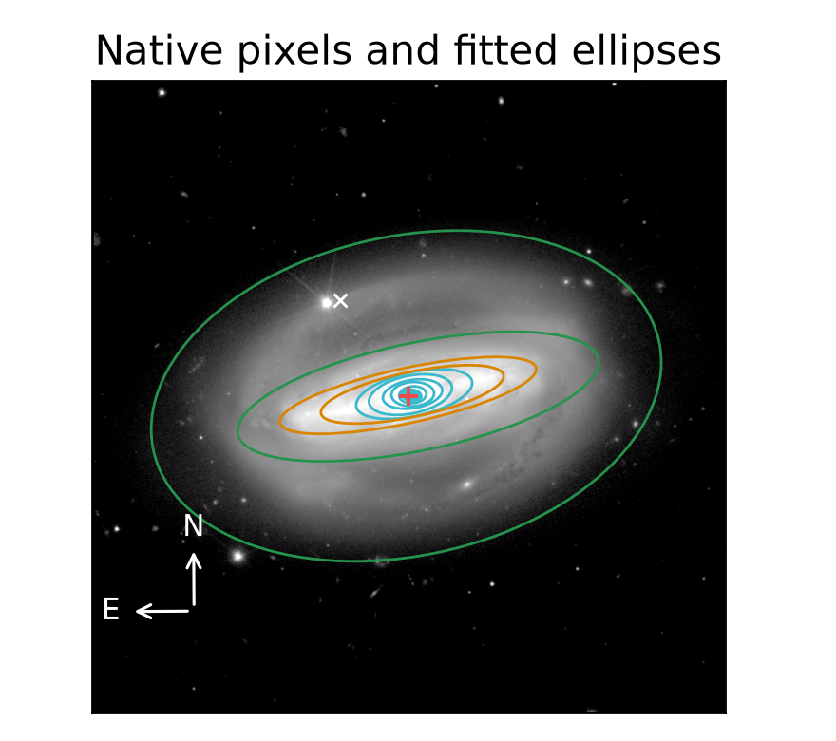
Galaxy centres are measured and checked
A catalogue position can lie on off-centre light rather than the galaxy centre.
White x: catalogue position.
Red +: fitted disc centre.
This example: 17.32 arcsec shift.
Sample median: 0.083 arcsec.
Large offsets and centre changes across radius remain flagged for review. The catalogue and fitted positions are both retained.
Synthetic check recovered the known centre within 0.01 pixel and PA/inclination within 0.01°.
5 / 14
Notes:
Sources: verified adaptive v2 MER_VIS_local_geometry_manifest.csv, MER_VIS_v2_summary.json, MER_VIS_report_verification.json. Pipeline version MER_VIS_adaptive_v2_2026-10-20 plus explicit failure-only centre recovery. Raw science images unchanged. PA is North towards East modulo180. Numbers refer to the current sample. Centre example (multiple flags, not an isolated-flag demonstration): {"id":"2700376345666189458","image":"C:\\Users\\gordo\\Documents\\Github\\PythonScripts\\Foreground Masking\\MER_VIS_pipeline_v2\\current_report\\images\\2700376345666189458.png","full_card":"D:\\Dropbox\\Public Documents\\UCLAN\\MSc Research\\Euclid\\MER_VIS_galaxy_reports\\all_2777\\png_QI\\2448_Euclid_2700376345666189458_MER_VIS_geometry_report_QI.png","disc":101.52336049391899,"bar":101.48498053450594,"inc":71.05369315170853,"centre_offset":17.320432011634527,"method":"recentred","flags":["centre_offset_large","disc_axis_ratio_unstable","disc_PA_sparse_sampling"],"bar_status":"detected_A","error":"","n_good":"43","n_disc":"5","n_bar":"4","disc_scatter":0.9310092684915722,"disc_span":0.3545431996625442,"bar_end":19.181222769615243,"information":"","detail_image":"C:\\Users\\gordo\\Documents\\Github\\PythonScripts\\Foreground Masking\\MER_VIS_pipeline_v2\\current_report\\images\\centre_detail.png"}

Slide 6
Galaxy review collection
Review group | PNG reports
QI | 2694
NoQI | 83
Total | 2777
47 PDFs; 463 pages; six galaxies per page.
Each card includes selected ellipses, profiles, angles, Euclid deltas, centre offset and recovery method. No accepted bar leaves bar PA blank.
Examples show individual review issues. Isolated examples are used where available.
6 / 14
Notes:
Sources: verified adaptive v2 MER_VIS_local_geometry_manifest.csv, MER_VIS_v2_summary.json, MER_VIS_report_verification.json. Pipeline version MER_VIS_adaptive_v2_2026-10-20 plus explicit failure-only centre recovery. Raw science images unchanged. PA is North towards East modulo180. Numbers refer to the current sample. Isolated example counts (full coverage): {"no_bar_detected":57,"disc_PA_unstable":30,"disc_axis_ratio_unstable":38,"small_bar_sensitive_to_resolution":176,"disc_PA_sparse_sampling":262,"disc_range_fallback":0,"bar_disc_ranges_close":0,"small_disc":0,"weak_ellipse_bar_signature":5,"centre_offset_large":1,"relaxed_fit":0,"iteration_limited_samples":0,"star_mask_removed":0,"neighbour_mask_removed":0,"centre_unstable":0,"short_accepted_profile":0,"high_inclination":0}. Flags without two isolated cases are not represented as single-flag examples. Bar acceptance requires a stable PA plateau.

Slide 7
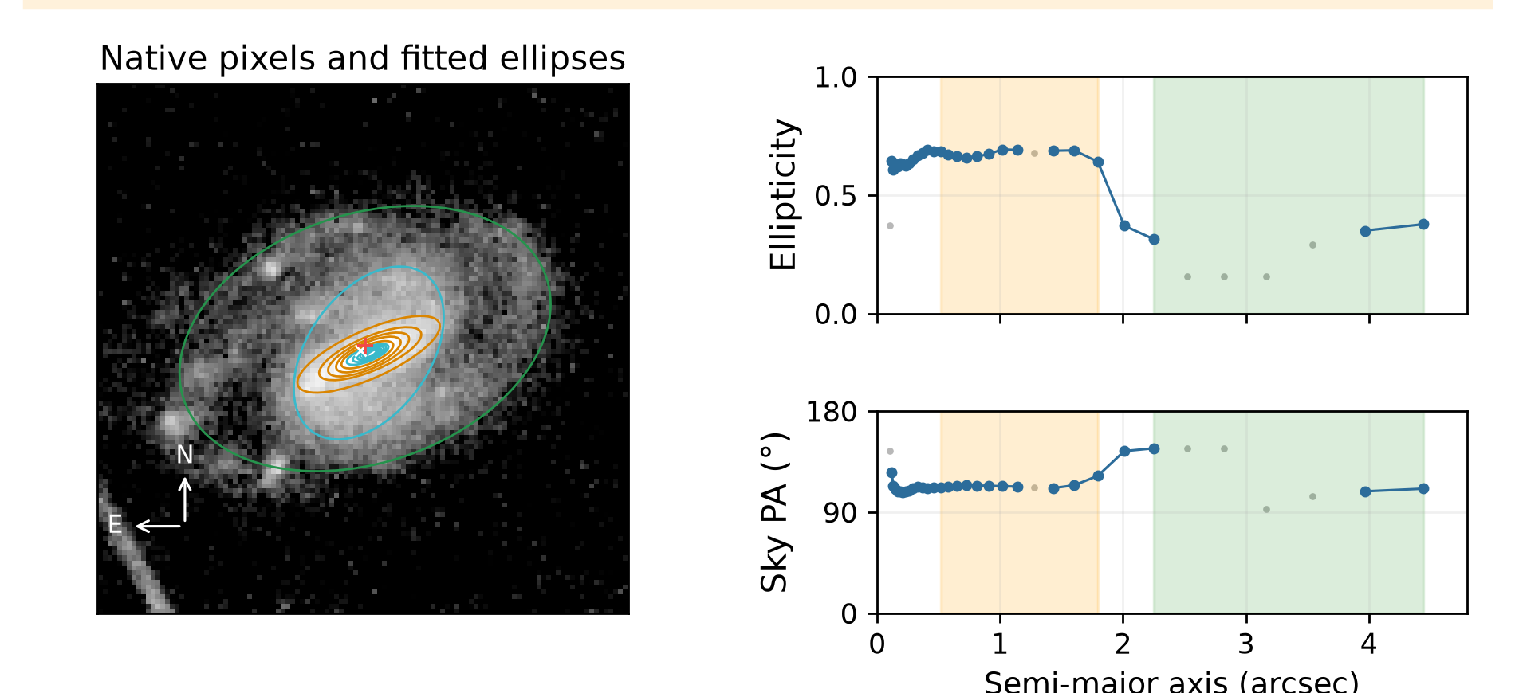
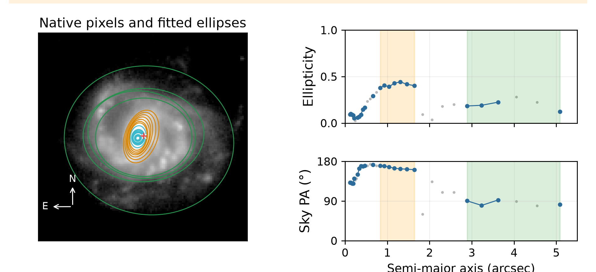
Sparse disc sampling
Exactly one counted quality flag in each example; full cutout coverage.
Galaxy -518633776290631360
Galaxy -591772188508612550
Disc 113.69°; bar 113.87°; i 49.48°
3 accepted disc ellipses; centre shift 0.15 arcsec.
Disc 86.44°; bar 164.63°; i 35.70°
4 accepted disc ellipses; centre shift 0.03 arcsec.
Too few accepted disc samples (<6), or a radial gap >50% of span. PA scatter is retained, but no instability claim is made.
7 / 14
Notes:
Sources: verified adaptive v2 MER_VIS_local_geometry_manifest.csv, MER_VIS_v2_summary.json, MER_VIS_report_verification.json. Pipeline version MER_VIS_adaptive_v2_2026-10-20 plus explicit failure-only centre recovery. Raw science images unchanged. PA is North towards East modulo180. Numbers refer to the current sample. Example records: {"key":"disc_PA_sparse_sampling","title":"Sparse disc sampling","kind":"isolated_flag","examples":[{"id":"-518633776290631360","image":"C:\\Users\\gordo\\Documents\\Github\\PythonScripts\\Foreground Masking\\MER_VIS_pipeline_v2\\current_report\\images\\-518633776290631360.png","full_card":"D:\\Dropbox\\Public Documents\\UCLAN\\MSc Research\\Euclid\\MER_VIS_galaxy_reports\\all_2777\\png_QI\\0005_Euclid_-518633776290631360_MER_VIS_geometry_report_QI.png","disc":113.69021016263804,"bar":113.86950382756103,"inc":49.47781434213959,"centre_offset":0.15091616609311526,"method":"standard","flags":["disc_PA_sparse_sampling"],"bar_status":"detected_A","error":"","n_good":"28","n_disc":"3","n_bar":"11","disc_scatter":17.55097022310975,"disc_span":0.06326608973174502,"bar_end":1.7950070214699363,"information":""},{"id":"-591772188508612550","image":"C:\\Users\\gordo\\Documents\\Github\\PythonScripts\\Foreground Masking\\MER_VIS_pipeline_v2\\current_report\\images\\-591772188508612550.png","full_card":"D:\\Dropbox\\Public Documents\\UCLAN\\MSc Research\\Euclid\\MER_VIS_galaxy_reports\\all_2777\\png_QI\\0052_Euclid_-591772188508612550_MER_VIS_geometry_report_QI.png","disc":86.43656085258868,"bar":164.63490061547776,"inc":35.695330342099226,"centre_offset":0.02832371713181012,"method":"standard","flags":["disc_PA_sparse_sampling"],"bar_status":"detected_A","error":"","n_good":"23","n_disc":"4","n_bar":"7","disc_scatter":5.250885360677478,"disc_span":0.1029346552749289,"bar_end":1.6382758850469108,"information":""}],"available":262}

Slide 8
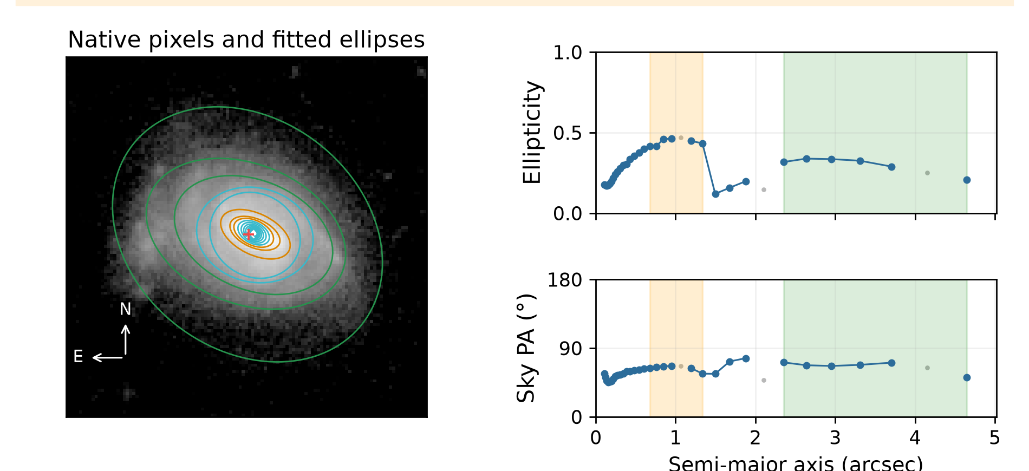
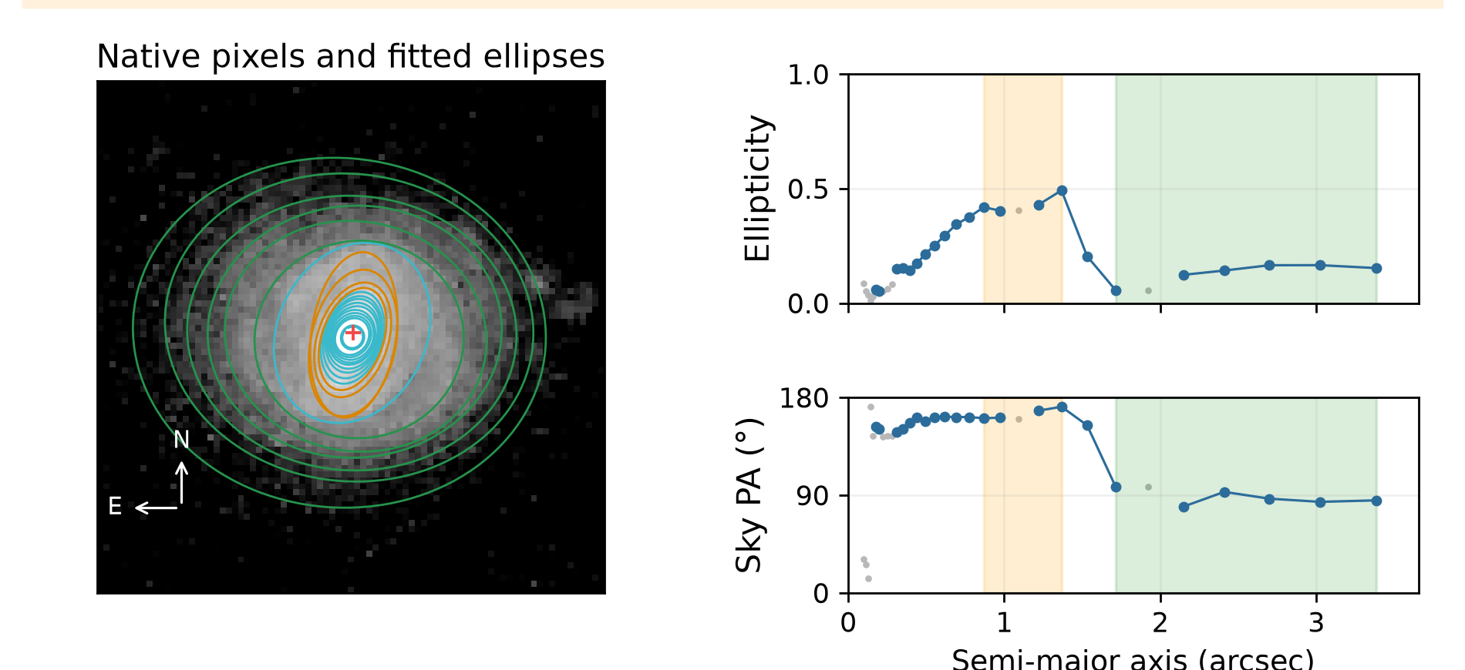
Bar identification uncertain: small interval
Exactly one counted quality flag in each example; full cutout coverage.
Galaxy -518659917291205827
Galaxy -518003489287870292
Disc 67.98°; bar 63.85°; i 47.29°
6 accepted disc ellipses; centre shift 0.07 arcsec.
Disc 87.46°; bar 167.23°; i 31.57°
6 accepted disc ellipses; centre shift 0.04 arcsec.
Candidate interval ends below 1.5 arcsec. This may be an unresolved bar or a different structure; bar identification remains uncertain.
8 / 14
Notes:
Sources: verified adaptive v2 MER_VIS_local_geometry_manifest.csv, MER_VIS_v2_summary.json, MER_VIS_report_verification.json. Pipeline version MER_VIS_adaptive_v2_2026-10-20 plus explicit failure-only centre recovery. Raw science images unchanged. PA is North towards East modulo180. Numbers refer to the current sample. Example records: {"key":"small_bar_sensitive_to_resolution","title":"Bar identification uncertain: small interval","kind":"isolated_flag","examples":[{"id":"-518659917291205827","image":"C:\\Users\\gordo\\Documents\\Github\\PythonScripts\\Foreground Masking\\MER_VIS_pipeline_v2\\current_report\\images\\-518659917291205827.png","full_card":"D:\\Dropbox\\Public Documents\\UCLAN\\MSc Research\\Euclid\\MER_VIS_galaxy_reports\\all_2777\\png_QI\\0004_Euclid_-518659917291205827_MER_VIS_geometry_report_QI.png","disc":67.98049109589249,"bar":63.85453266313511,"inc":47.29360925833979,"centre_offset":0.06901554767367604,"method":"standard","flags":["small_bar_sensitive_to_resolution"],"bar_status":"detected_A","error":"","n_good":"31","n_disc":"6","n_bar":"6","disc_scatter":6.536223807890531,"disc_span":0.1305755018371826,"bar_end":1.3365451794213465,"information":""},{"id":"-518003489287870292","image":"C:\\Users\\gordo\\Documents\\Github\\PythonScripts\\Foreground Masking\\MER_VIS_pipeline_v2\\current_report\\images\\-518003489287870292.png","full_card":"D:\\Dropbox\\Public Documents\\UCLAN\\MSc Research\\Euclid\\MER_VIS_galaxy_reports\\all_2777\\png_QI\\0007_Euclid_-518003489287870292_MER_VIS_geometry_report_QI.png","disc":87.46210239608925,"bar":167.22729398125324,"inc":31.574961051993903,"centre_offset":0.043422001129307254,"method":"standard","flags":["small_bar_sensitive_to_resolution"],"bar_status":"detected_A","error":"","n_good":"22","n_disc":"6","n_bar":"4","disc_scatter":5.924727031910115,"disc_span":0.11007119226523457,"bar_end":1.3673627605688643,"information":""}],"available":176}

Slide 9
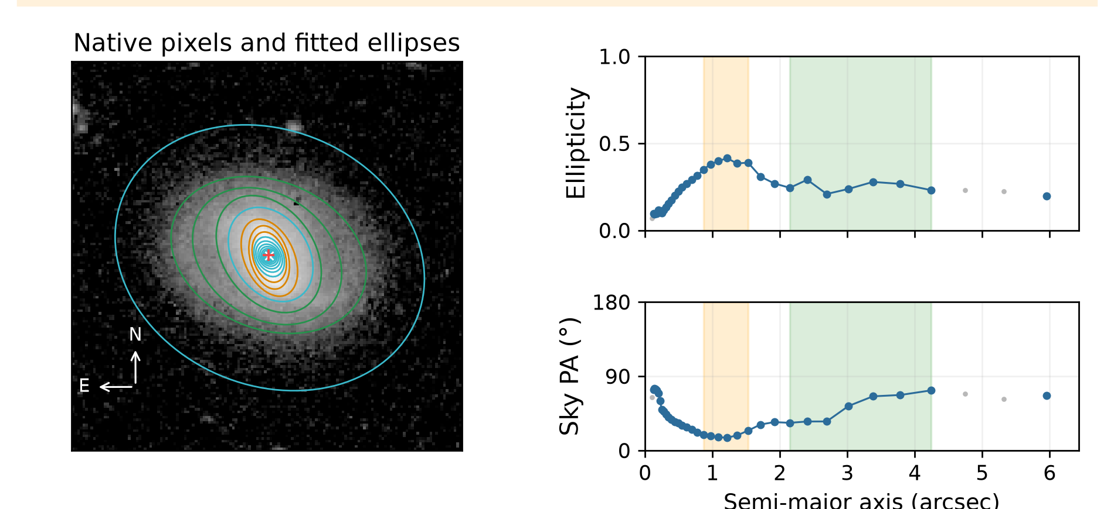
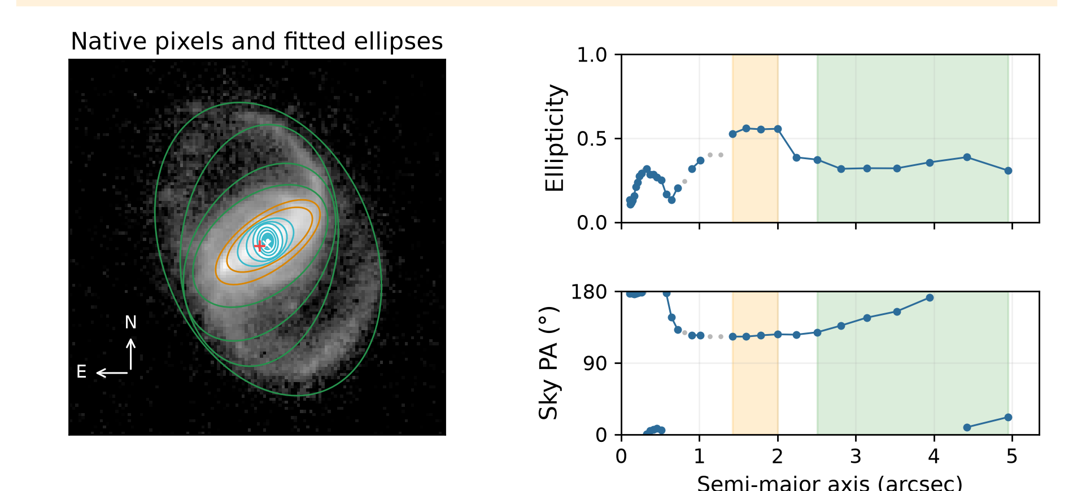
Disc PA varies across radius
Exactly one counted quality flag in each example; full cutout coverage.
Galaxy -601121275504424227
Galaxy -610687143492806705
Disc 60.75°; bar 20.23°; i 40.93°
7 accepted disc ellipses; centre shift 0.04 arcsec.
Disc 158.36°; bar 125.23°; i 47.29°
7 accepted disc ellipses; centre shift 0.23 arcsec.
At least 6 accepted disc ellipses, no radial gap >50% of span, and PA scatter >10°. Correlated samples: a review screen, not a confidence test.
9 / 14
Notes:
Sources: verified adaptive v2 MER_VIS_local_geometry_manifest.csv, MER_VIS_v2_summary.json, MER_VIS_report_verification.json. Pipeline version MER_VIS_adaptive_v2_2026-10-20 plus explicit failure-only centre recovery. Raw science images unchanged. PA is North towards East modulo180. Numbers refer to the current sample. Example records: {"key":"disc_PA_unstable","title":"Disc PA varies across radius","kind":"isolated_flag","examples":[{"id":"-601121275504424227","image":"C:\\Users\\gordo\\Documents\\Github\\PythonScripts\\Foreground Masking\\MER_VIS_pipeline_v2\\current_report\\images\\-601121275504424227.png","full_card":"D:\\Dropbox\\Public Documents\\UCLAN\\MSc Research\\Euclid\\MER_VIS_galaxy_reports\\all_2777\\png_QI\\0118_Euclid_-601121275504424227_MER_VIS_geometry_report_QI.png","disc":60.75482419435342,"bar":20.23373226136634,"inc":40.93111225561656,"centre_offset":0.038965526533334946,"method":"standard","flags":["disc_PA_unstable"],"bar_status":"detected_A","error":"","n_good":"33","n_disc":"7","n_bar":"6","disc_scatter":15.878385450188937,"disc_span":0.08169376743863846,"bar_end":1.5289036078363487,"information":""},{"id":"-610687143492806705","image":"C:\\Users\\gordo\\Documents\\Github\\PythonScripts\\Foreground Masking\\MER_VIS_pipeline_v2\\current_report\\images\\-610687143492806705.png","full_card":"D:\\Dropbox\\Public Documents\\UCLAN\\MSc Research\\Euclid\\MER_VIS_galaxy_reports\\all_2777\\png_QI\\0333_Euclid_-610687143492806705_MER_VIS_geometry_report_QI.png","disc":158.36096695742282,"bar":125.22937713244133,"inc":47.29362942331274,"centre_offset":0.2338082376742416,"method":"standard","flags":["disc_PA_unstable"],"bar_status":"detected_A","error":"","n_good":"31","n_disc":"7","n_bar":"4","disc_scatter":25.28294471714209,"disc_span":0.07966992794101968,"bar_end":1.9994762262228183,"information":""}],"available":30}

Slide 10
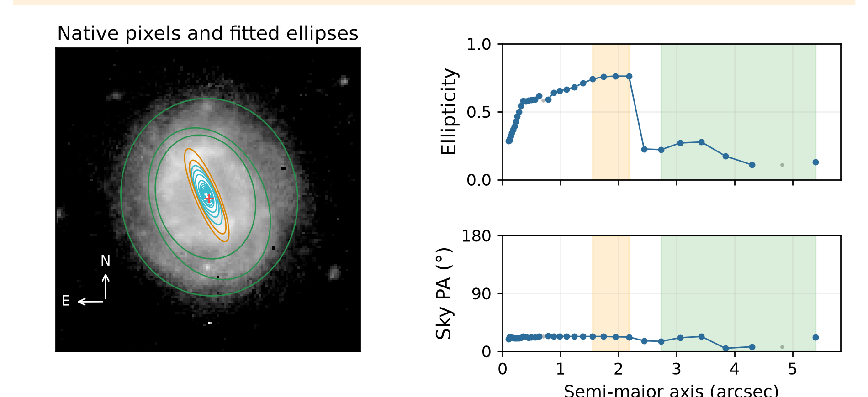
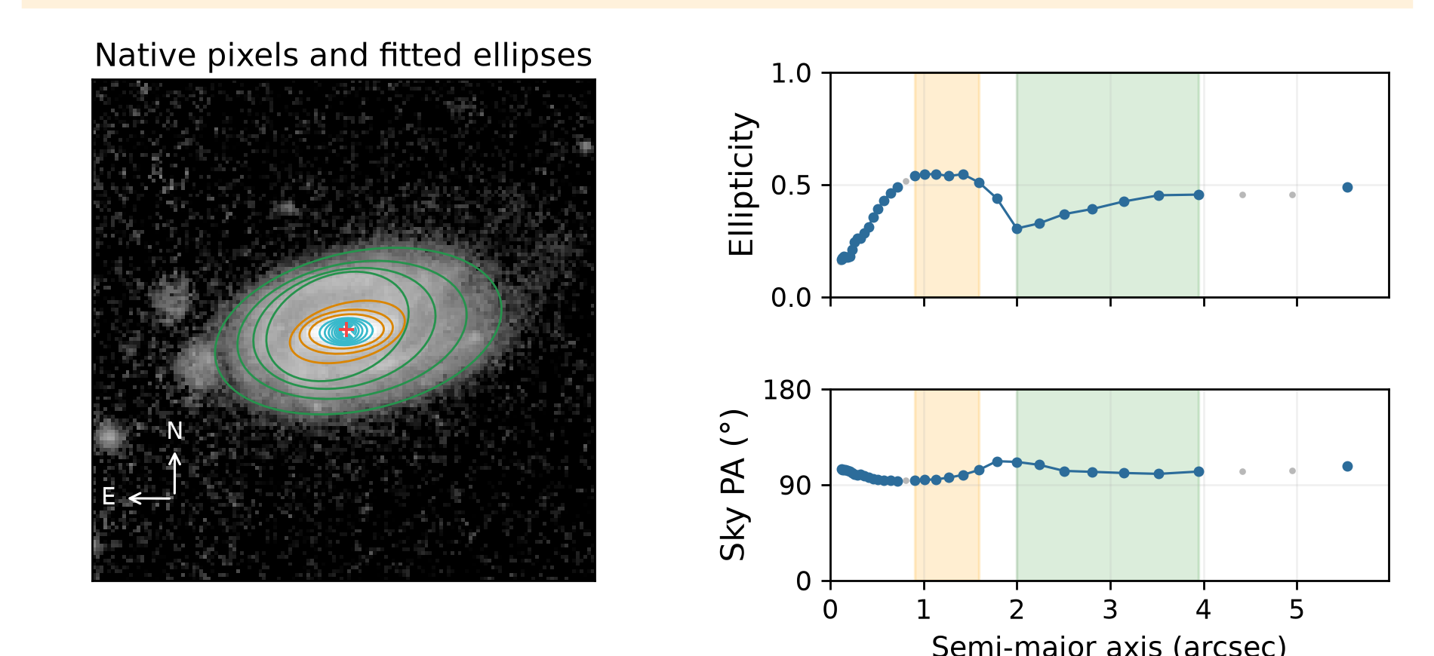
Changing disc ellipticity
Exactly one counted quality flag in each example; full cutout coverage.
Galaxy -591287408514481131
Galaxy -566750185501100067
Disc 17.53°; bar 22.81°; i 36.63°
6 accepted disc ellipses; centre shift 0.11 arcsec.
Disc 102.79°; bar 96.43°; i 52.54°
7 accepted disc ellipses; centre shift 0.09 arcsec.
38 isolated cases available. Orange: selected bar. Green: selected disc. Blue: accepted samples. Grey: rejected samples.
10 / 14
Notes:
Sources: verified adaptive v2 MER_VIS_local_geometry_manifest.csv, MER_VIS_v2_summary.json, MER_VIS_report_verification.json. Pipeline version MER_VIS_adaptive_v2_2026-10-20 plus explicit failure-only centre recovery. Raw science images unchanged. PA is North towards East modulo180. Numbers refer to the current sample. Example records: {"key":"disc_axis_ratio_unstable","title":"Changing disc ellipticity","kind":"isolated_flag","examples":[{"id":"-591287408514481131","image":"C:\\Users\\gordo\\Documents\\Github\\PythonScripts\\Foreground Masking\\MER_VIS_pipeline_v2\\current_report\\images\\-591287408514481131.png","full_card":"D:\\Dropbox\\Public Documents\\UCLAN\\MSc Research\\Euclid\\MER_VIS_galaxy_reports\\all_2777\\png_QI\\0034_Euclid_-591287408514481131_MER_VIS_geometry_report_QI.png","disc":17.53323680563758,"bar":22.81336189671468,"inc":36.63266403692604,"centre_offset":0.11119406232473457,"method":"standard","flags":["disc_axis_ratio_unstable"],"bar_status":"detected_A","error":"","n_good":"34","n_disc":"6","n_bar":"4","disc_scatter":7.239400804142461,"disc_span":0.16838843455844482,"bar_end":2.1798696595074465,"information":""},{"id":"-566750185501100067","image":"C:\\Users\\gordo\\Documents\\Github\\PythonScripts\\Foreground Masking\\MER_VIS_pipeline_v2\\current_report\\images\\-566750185501100067.png","full_card":"D:\\Dropbox\\Public Documents\\UCLAN\\MSc Research\\Euclid\\MER_VIS_galaxy_reports\\all_2777\\png_QI\\0159_Euclid_-566750185501100067_MER_VIS_geometry_report_QI.png","disc":102.79246432693091,"bar":96.42893198907605,"inc":52.53634125610519,"centre_offset":0.08662419418159002,"method":"standard","flags":["disc_axis_ratio_unstable"],"bar_status":"detected_A","error":"","n_good":"32","n_disc":"7","n_bar":"6","disc_scatter":3.9332905839691543,"disc_span":0.15097490297862415,"bar_end":1.593205928470762,"information":""}],"available":38}

Slide 11
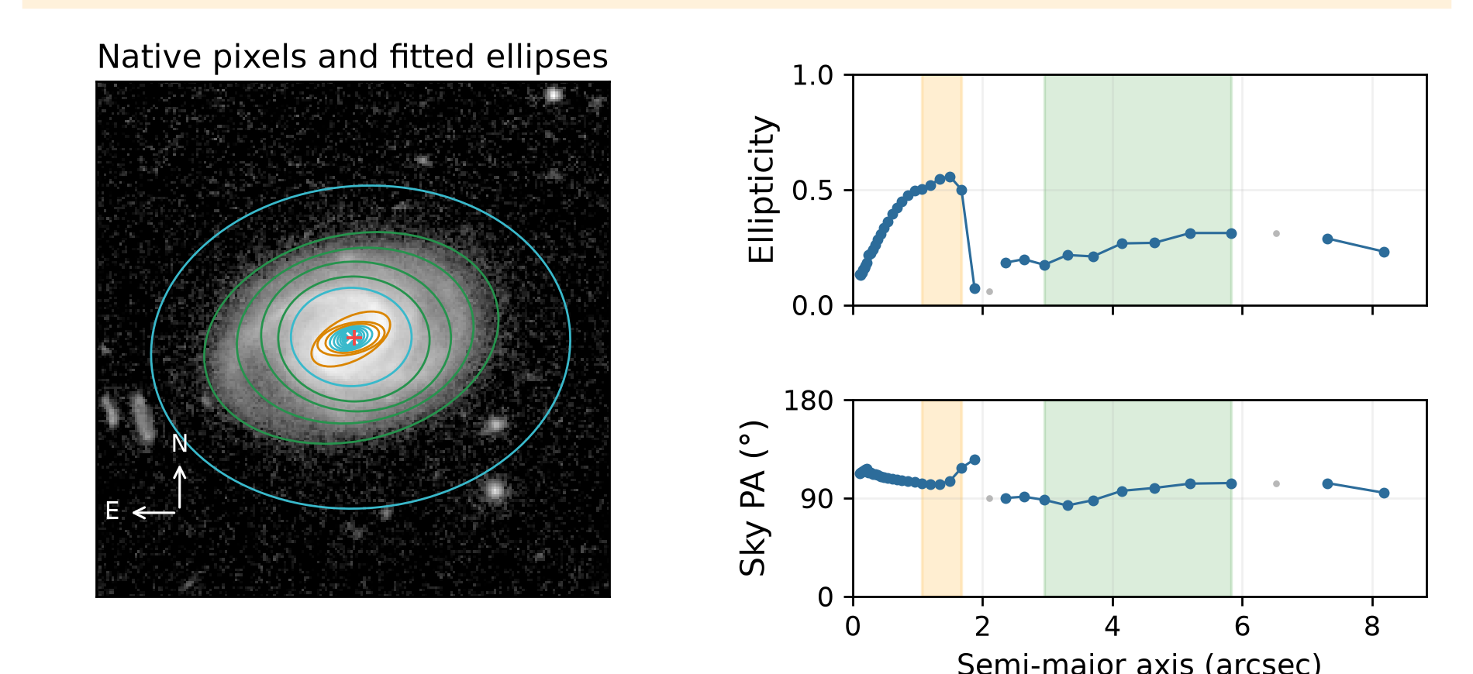
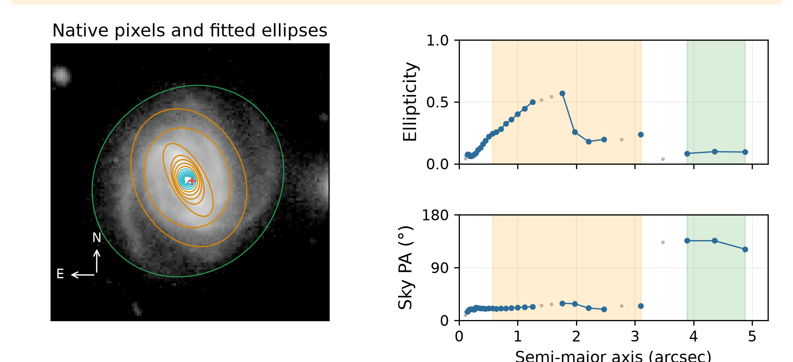
Weaker accepted bar signature
Exactly one counted quality flag in each example; full cutout coverage.
Galaxy -555209522496440415
Galaxy -567651923481293863
Disc 100.26°; bar 105.11°; i 42.90°
7 accepted disc ellipses; centre shift 0.09 arcsec.
Disc 133.58°; bar 23.00°; i 25.24°
3 accepted disc ellipses; centre shift 0.17 arcsec.
Class A: peak ellipticity ≥0.30, drop ≥0.10, PA scatter ≤5°. Class B passes the broader test but misses ≥1 A threshold. Neither confirms a bar.
11 / 14
Notes:
Sources: verified adaptive v2 MER_VIS_local_geometry_manifest.csv, MER_VIS_v2_summary.json, MER_VIS_report_verification.json. Pipeline version MER_VIS_adaptive_v2_2026-10-20 plus explicit failure-only centre recovery. Raw science images unchanged. PA is North towards East modulo180. Numbers refer to the current sample. Example records: {"key":"weak_ellipse_bar_signature","title":"Weaker accepted bar signature","kind":"isolated_flag","examples":[{"id":"-555209522496440415","image":"C:\\Users\\gordo\\Documents\\Github\\PythonScripts\\Foreground Masking\\MER_VIS_pipeline_v2\\current_report\\images\\-555209522496440415.png","full_card":"D:\\Dropbox\\Public Documents\\UCLAN\\MSc Research\\Euclid\\MER_VIS_galaxy_reports\\all_2777\\png_QI\\0261_Euclid_-555209522496440415_MER_VIS_geometry_report_QI.png","disc":100.26081295628182,"bar":105.11218163316383,"inc":42.90154861988472,"centre_offset":0.0903332976252752,"method":"standard","flags":["weak_ellipse_bar_signature"],"bar_status":"detected_B","error":"","n_good":"37","n_disc":"7","n_bar":"5","disc_scatter":7.517163372934988,"disc_span":0.13826008157628691,"bar_end":1.6744832428633671,"information":""},{"id":"-567651923481293863","image":"C:\\Users\\gordo\\Documents\\Github\\PythonScripts\\Foreground Masking\\MER_VIS_pipeline_v2\\current_report\\images\\-567651923481293863.png","full_card":"D:\\Dropbox\\Public Documents\\UCLAN\\MSc Research\\Euclid\\MER_VIS_galaxy_reports\\all_2777\\png_QI\\0728_Euclid_-567651923481293863_MER_VIS_geometry_report_QI.png","disc":133.5783320289558,"bar":23.001901678884632,"inc":25.238239011239592,"centre_offset":0.17164453119414078,"method":"standard","flags":["weak_ellipse_bar_signature"],"bar_status":"detected_B","error":"","n_good":"28","n_disc":"3","n_bar":"13","disc_scatter":6.795861954450147,"disc_span":0.01434370836758432,"bar_end":3.1004653606061714,"information":"nearly_face_on_disc_PA_uncertain"}],"available":5}

Slide 12
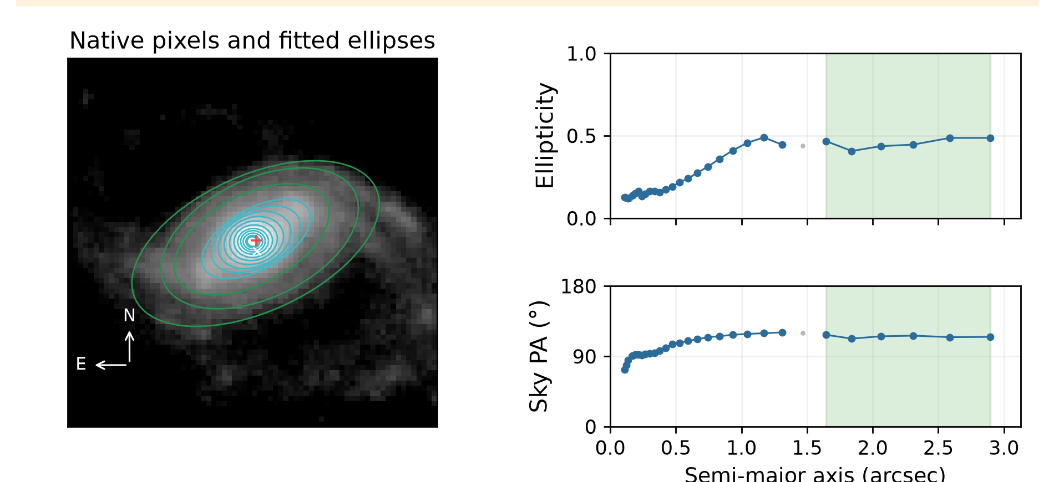
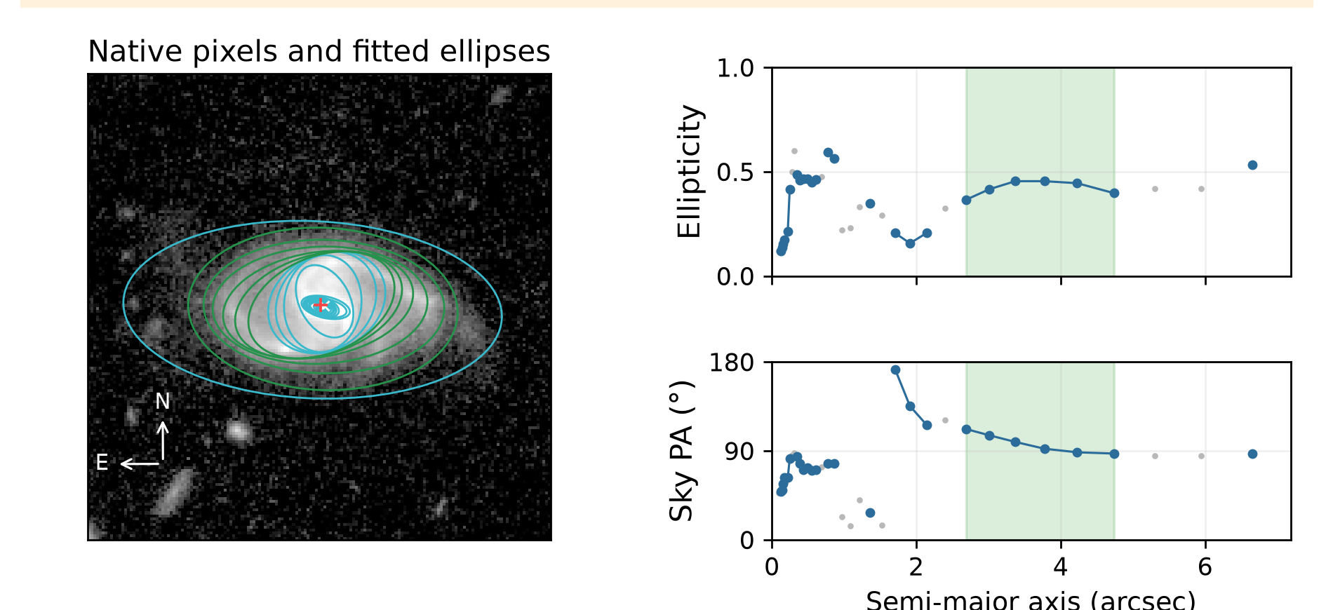
No accepted bar; disc retained
Exactly one counted quality flag in each example; full cutout coverage.
Galaxy 2693239635649457485
Galaxy -600909396508240903
Disc 115.27°; bar unavailable; i 57.11°
6 accepted disc ellipses; centre shift 0.21 arcsec.
Disc 95.79°; bar unavailable; i 55.30°
6 accepted disc ellipses; centre shift 0.12 arcsec.
57 isolated cases available. Orange: selected bar. Green: selected disc. Blue: accepted samples. Grey: rejected samples.
12 / 14
Notes:
Sources: verified adaptive v2 MER_VIS_local_geometry_manifest.csv, MER_VIS_v2_summary.json, MER_VIS_report_verification.json. Pipeline version MER_VIS_adaptive_v2_2026-10-20 plus explicit failure-only centre recovery. Raw science images unchanged. PA is North towards East modulo180. Numbers refer to the current sample. Example records: {"key":"no_bar_detected","title":"No accepted bar; disc retained","kind":"isolated_flag","examples":[{"id":"2693239635649457485","image":"C:\\Users\\gordo\\Documents\\Github\\PythonScripts\\Foreground Masking\\MER_VIS_pipeline_v2\\current_report\\images\\2693239635649457485.png","full_card":"D:\\Dropbox\\Public Documents\\UCLAN\\MSc Research\\Euclid\\MER_VIS_galaxy_reports\\all_2777\\png_QI\\0030_Euclid_2693239635649457485_MER_VIS_geometry_report_QI.png","disc":115.27426229228769,"bar":null,"inc":57.10822351022106,"centre_offset":0.20803110605860703,"method":"standard","flags":["no_bar_detected"],"bar_status":"no_bar_detected","error":"","n_good":"28","n_disc":"6","n_bar":"","disc_scatter":1.534821119062622,"disc_span":0.07954589557362018,"bar_end":null,"information":""},{"id":"-600909396508240903","image":"C:\\Users\\gordo\\Documents\\Github\\PythonScripts\\Foreground Masking\\MER_VIS_pipeline_v2\\current_report\\images\\-600909396508240903.png","full_card":"D:\\Dropbox\\Public Documents\\UCLAN\\MSc Research\\Euclid\\MER_VIS_galaxy_reports\\all_2777\\png_QI\\0061_Euclid_-600909396508240903_MER_VIS_geometry_report_QI.png","disc":95.78575386450234,"bar":null,"inc":55.30004037390356,"centre_offset":0.11559495870650695,"method":"standard","flags":["no_bar_detected"],"bar_status":"no_bar_detected","error":"","n_good":"25","n_disc":"6","n_bar":"","disc_scatter":9.116555930006143,"disc_span":0.08951454268036535,"bar_end":null,"information":""}],"available":57}

Slide 13
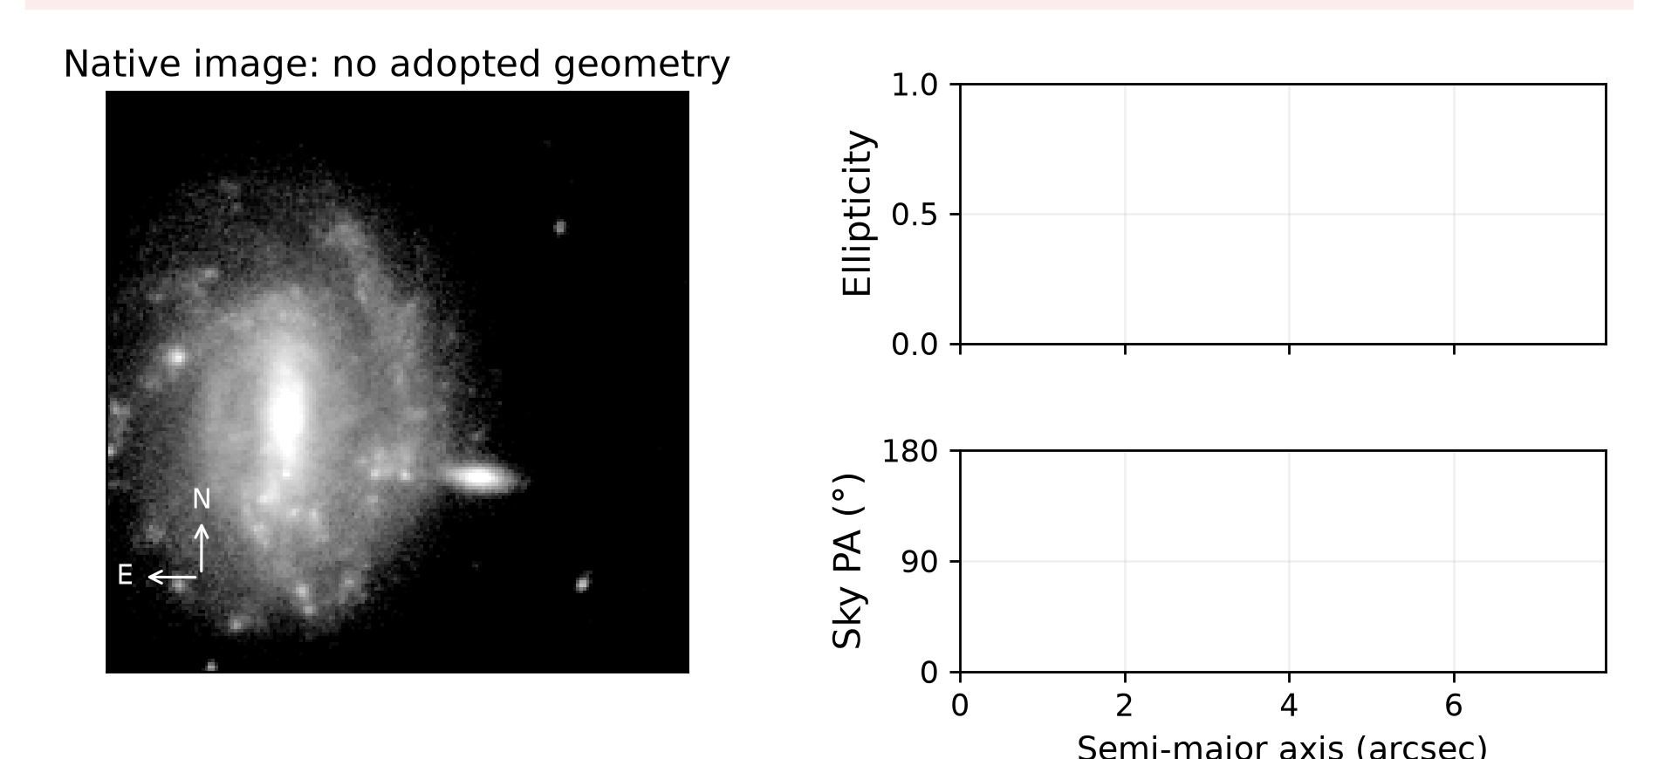
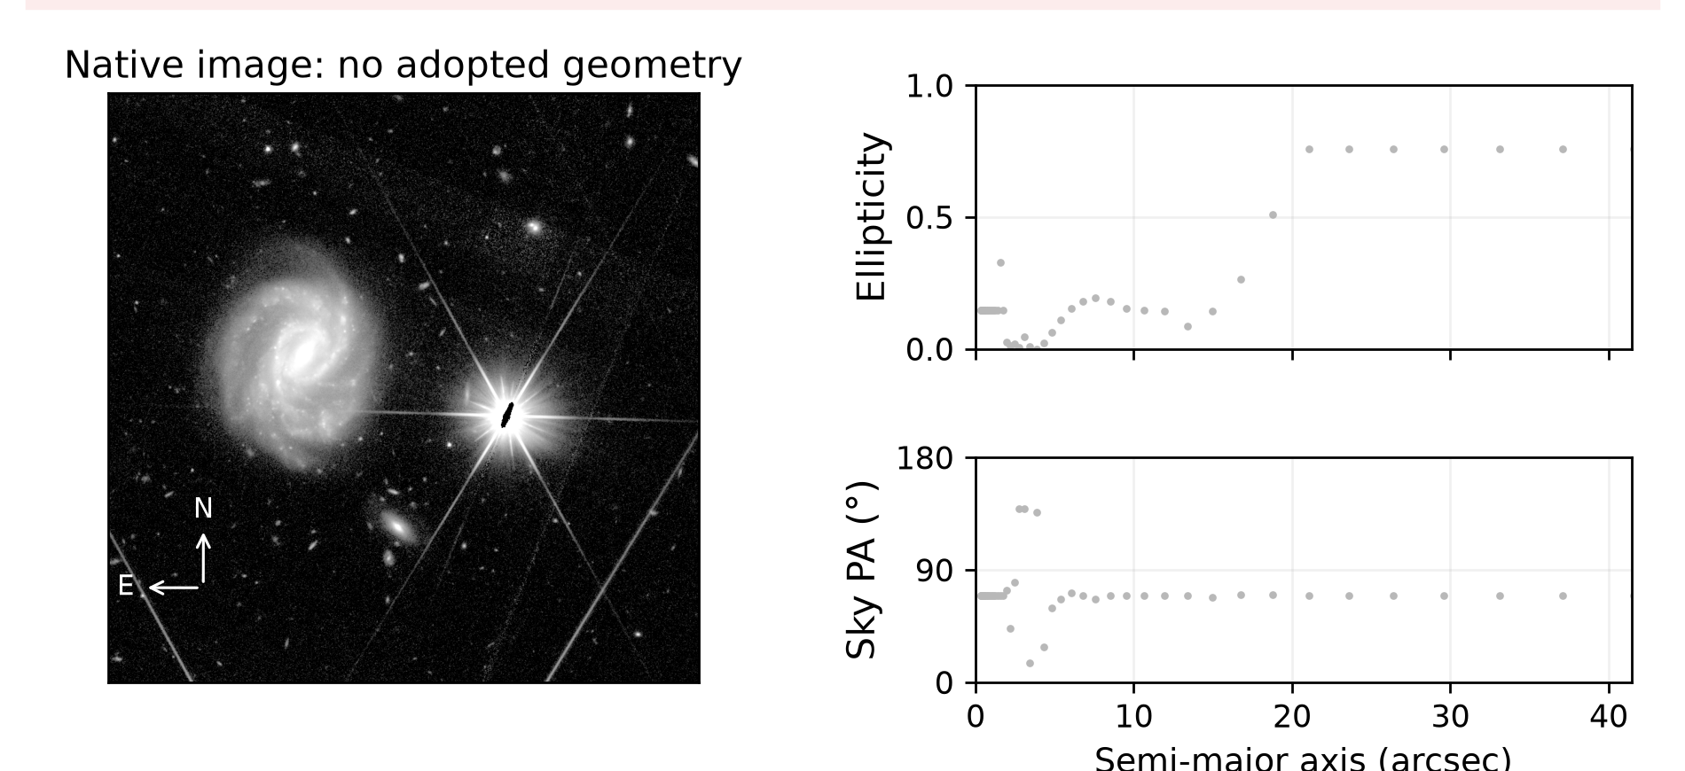
Remaining fit failures
No adopted geometry. Fallback centres and rejected ellipses are omitted.
Galaxy -586374330510251740
Galaxy -524824554283124036
No disc or bar geometry adopted.
No accepted ellipse fit after retries.
No disc or bar geometry adopted.
Rejected trial centred on a foreground star.
Foreground stars, unresolved cores or failed fitting prevent adopted geometry. Individual review is required.
13 / 14
Notes:
Sources: verified adaptive v2 MER_VIS_local_geometry_manifest.csv, MER_VIS_v2_summary.json, MER_VIS_report_verification.json. Pipeline version MER_VIS_adaptive_v2_2026-10-20 plus explicit failure-only centre recovery. Raw science images unchanged. PA is North towards East modulo180. Numbers refer to the current sample. Example records: {"key":"failure","title":"Remaining fit failures","kind":"failure","examples":[{"id":"-586374330510251740","image":"C:\\Users\\gordo\\Documents\\Github\\PythonScripts\\Foreground Masking\\MER_VIS_pipeline_v2\\current_report\\images\\-586374330510251740.png","full_card":"D:\\Dropbox\\Public Documents\\UCLAN\\MSc Research\\Euclid\\MER_VIS_galaxy_reports\\all_2777\\png_QI\\0057_Euclid_-586374330510251740_MER_VIS_geometry_report_QI.png","disc":null,"bar":null,"inc":null,"centre_offset":null,"method":"smoothed_relaxed","flags":[],"bar_status":"not_measured","error":"ValueError: Only 0 accepted isophotes after recovery; need at least 3","n_good":"0","n_disc":"","n_bar":"","disc_scatter":null,"disc_span":null,"bar_end":null,"information":""},{"id":"-524824554283124036","image":"C:\\Users\\gordo\\Documents\\Github\\PythonScripts\\Foreground Masking\\MER_VIS_pipeline_v2\\current_report\\images\\-524824554283124036.png","full_card":"D:\\Dropbox\\Public Documents\\UCLAN\\MSc Research\\Euclid\\MER_VIS_galaxy_reports\\all_2777\\png_QI\\1557_Euclid_-524824554283124036_MER_VIS_geometry_report_QI.png","disc":null,"bar":null,"inc":null,"centre_offset":null,"method":"extended_light_centre_recovery","flags":[],"bar_status":"not_measured","error":"Visual review: broader peak search switched to a saturated foreground star with diffraction spikes; no valid target-disc geometry adopted.","n_good":"0","n_disc":"6","n_bar":"","disc_scatter":null,"disc_span":0.05319752342879874,"bar_end":null,"information":""}],"available":4}

Slide 14
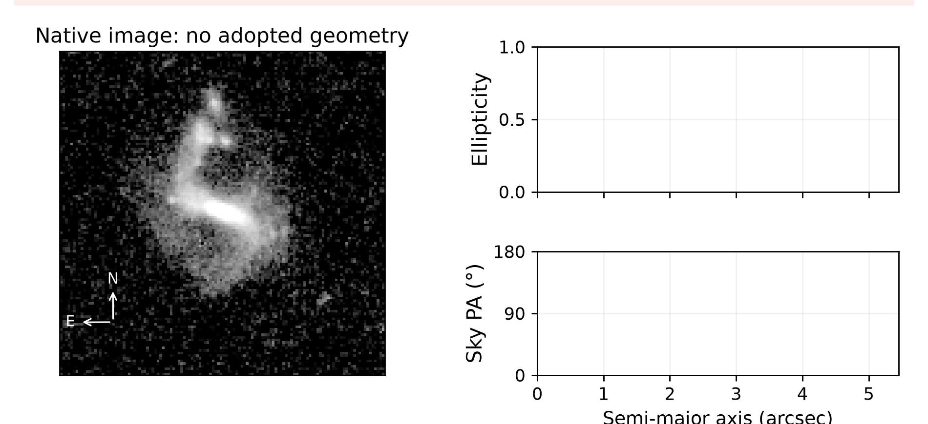
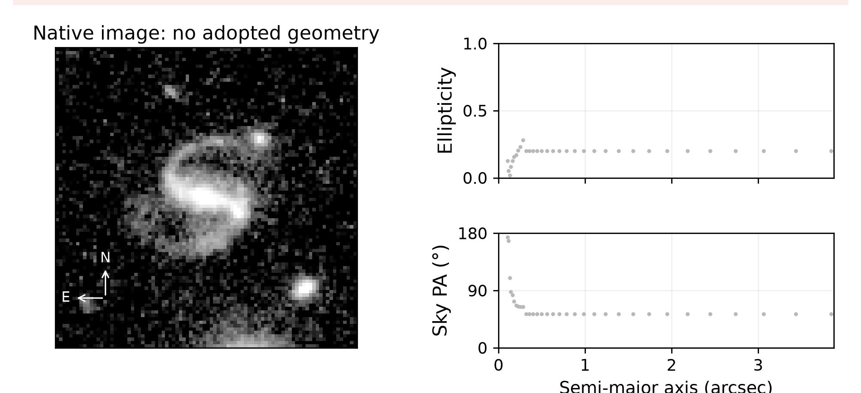
Remaining fit failures
No adopted geometry. Fallback centres and rejected ellipses are omitted.
Galaxy 2645436353651870062
Galaxy 2697242050653408730
No disc or bar geometry adopted.
No accepted ellipse fit after retries.
No disc or bar geometry adopted.
Only an unresolved core was fitted.
Foreground stars, unresolved cores or failed fitting prevent adopted geometry. Individual review is required.
14 / 14
Notes:
Sources: verified adaptive v2 MER_VIS_local_geometry_manifest.csv, MER_VIS_v2_summary.json, MER_VIS_report_verification.json. Pipeline version MER_VIS_adaptive_v2_2026-10-20 plus explicit failure-only centre recovery. Raw science images unchanged. PA is North towards East modulo180. Numbers refer to the current sample. Example records: {"key":"failure","title":"Remaining fit failures","kind":"failure","examples":[{"id":"2645436353651870062","image":"C:\\Users\\gordo\\Documents\\Github\\PythonScripts\\Foreground Masking\\MER_VIS_pipeline_v2\\current_report\\images\\2645436353651870062.png","full_card":"D:\\Dropbox\\Public Documents\\UCLAN\\MSc Research\\Euclid\\MER_VIS_galaxy_reports\\all_2777\\png_QI\\2079_Euclid_2645436353651870062_MER_VIS_geometry_report_QI.png","disc":null,"bar":null,"inc":null,"centre_offset":null,"method":"smoothed_relaxed","flags":[],"bar_status":"not_measured","error":"ValueError: Only 0 accepted isophotes after recovery; need at least 3","n_good":"0","n_disc":"","n_bar":"","disc_scatter":null,"disc_span":null,"bar_end":null,"information":""},{"id":"2697242050653408730","image":"C:\\Users\\gordo\\Documents\\Github\\PythonScripts\\Foreground Masking\\MER_VIS_pipeline_v2\\current_report\\images\\2697242050653408730.png","full_card":"D:\\Dropbox\\Public Documents\\UCLAN\\MSc Research\\Euclid\\MER_VIS_galaxy_reports\\all_2777\\png_QI\\2221_Euclid_2697242050653408730_MER_VIS_geometry_report_QI.png","disc":null,"bar":null,"inc":null,"centre_offset":null,"method":"extended_light_centre_recovery","flags":[],"bar_status":"not_measured","error":"Visual review: accepted contours cover only the unresolved central region below 0.5 arcsec; no resolved disc geometry adopted.","n_good":"0","n_disc":"7","n_bar":"","disc_scatter":null,"disc_span":0.1968873533678872,"bar_end":null,"information":""}],"available":4}

