Slide 1
NEOMART STORES
Sales Growth, Profit Decline:
A Data-Driven Investigation
Annual performance review across regions, categories, and operations • 2,000 transactions analyzed
Prepared by the Data Analytics Team | Junior Data Analyst Capstone

Slide 2
EXECUTIVE SUMMARY
Sales are up. Profit isn't keeping pace.
+25%
12.5%
1 region
-0.45
Sales growth
Overall profit margin
South drags down the average
Discount-to-profit correlation
Jan to Dec, driven by H2 momentum
Below the 18-20% healthy retail benchmark
36% of sales, only 24% of profit
Heavier discounts are quietly eating margin
SITUATION
COMPLICATION
RESOLUTION
Sales climbed steadily through the year, peaking in Q4 — demand and market reach are clearly growing.
Profit grew far slower than sales. One region, one category, and heavy discounting are the main drags on margin.
Fix South's delivery operations, rebalance the Furniture mix, and cap discounting above 20% to recover margin.
NeoMart Sales & Profitability Review
2

Slide 3
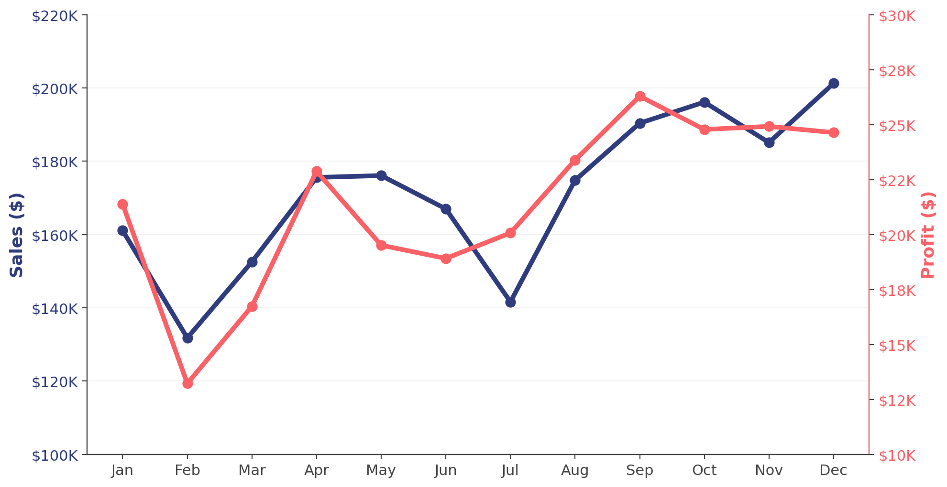
FINDING 1 · THE CORE PROBLEM
Sales and profit have decoupled
Monthly sales rose 25% across the year, but profit grew only 15% — and flattened entirely after September.
WHY IT MATTERS
Sales growth is real — Q4 hit $201K, the year's high.
But profit has barely moved since August, hovering near $24-26K a month.
Every extra dollar of revenue from H2 onward earned far less margin than earlier in the year.
NeoMart Sales & Profitability Review
3

Slide 4
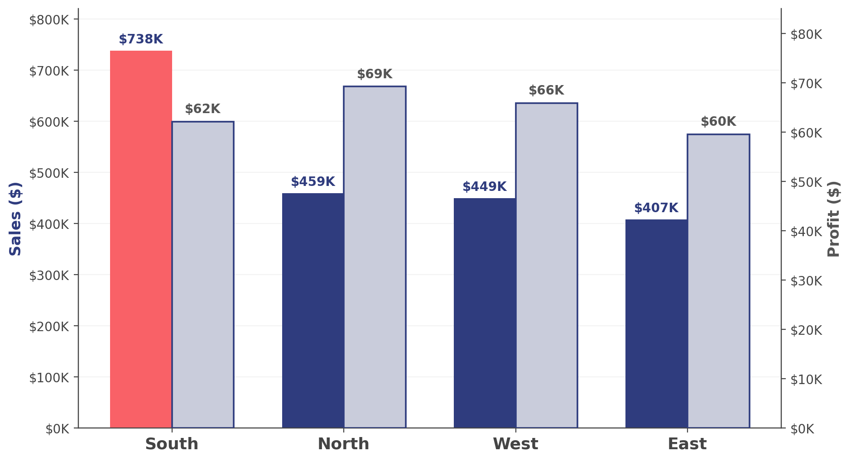
FINDING 2 · REGIONAL BREAKDOWN
South sells the most — and profits the least
South generates $738K in sales (36% of total) but only $62K in profit — an 8.4% margin versus 14-15% everywhere else.
SOUTH REGION RED FLAGS
Avg. satisfaction: 3.15 / 5
vs. 4.2+ in every other region
Avg. delivery time: 7.6 days
Nearly double the 4.0-day average elsewhere
Margin: 8.4% vs. 14-15%
Slow delivery and low satisfaction are coinciding with the weakest margin in the business
NeoMart Sales & Profitability Review
4

Slide 5
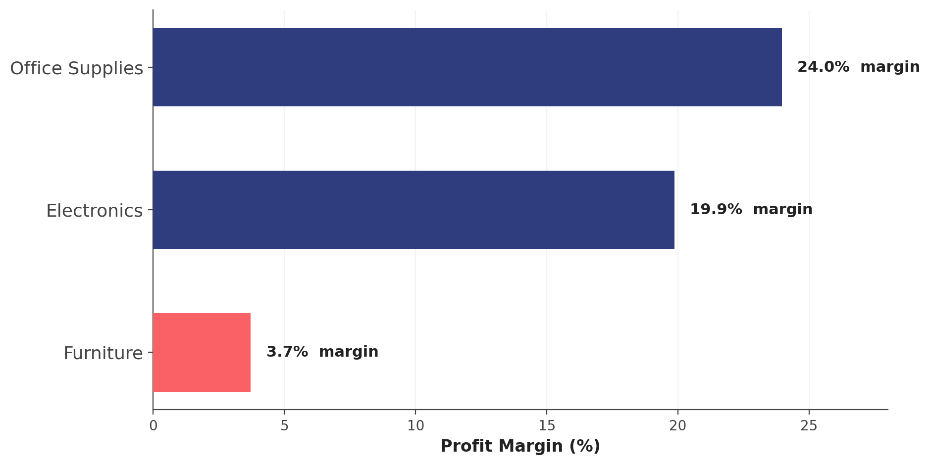
FINDING 3 · PRODUCT MIX
Furniture sells big, earns little
Furniture is the top revenue driver ($1.02M) but converts only 3.7% to profit — versus 20-24% for Electronics and Office Supplies.
Office Supplies
Sales $330K · Profit $79K
24.0% margin
Electronics
Sales $704K · Profit $140K
19.9% margin
Furniture
Sales $1,019K · Profit $38K
3.7% margin
NeoMart Sales & Profitability Review
5

Slide 6
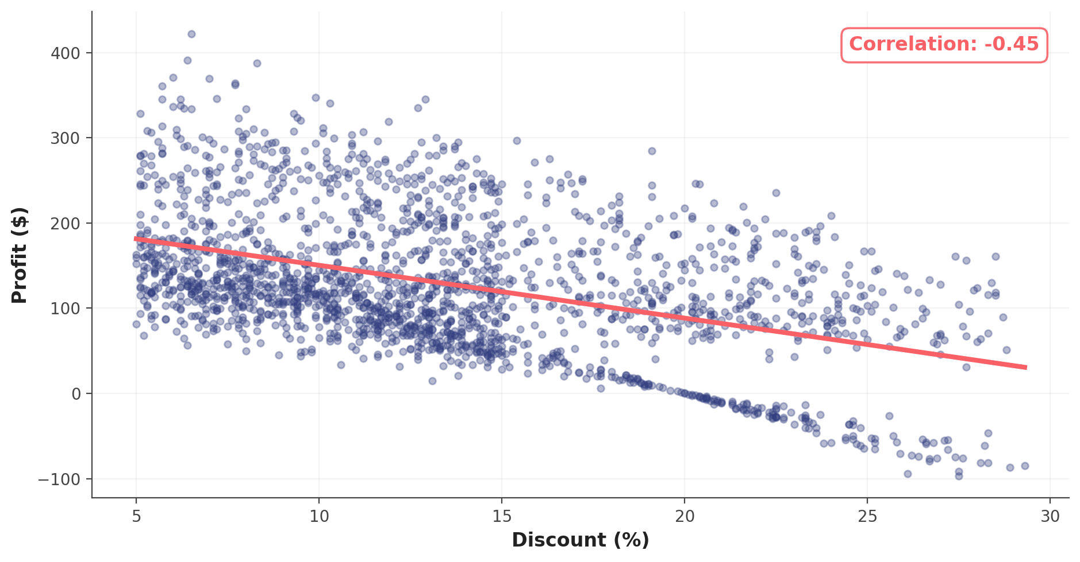
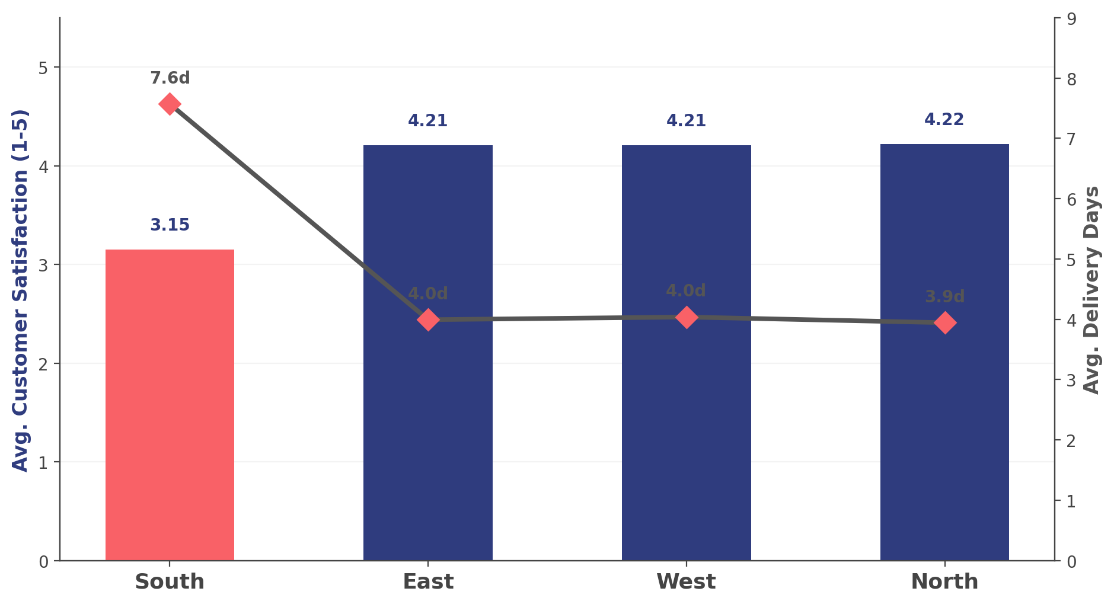
FINDING 4 · WHAT'S DRIVING IT
Discounting and delivery delays explain the gap
Heavier discounts shrink profit per order
Slower delivery tracks with lower satisfaction
Orders discounted 20%+ average just $65 profit, vs. $164 at 0-10% discount
Satisfaction and delivery time correlate at -0.62 — South's 7.6-day average lines up with its 3.15 rating
NeoMart Sales & Profitability Review
6

Slide 7
RECOMMENDATIONS
Four moves to close the profit gap
01
02
Fix South's delivery operations
Cap discounts above 20%
Investigate logistics bottlenecks driving the 7.6-day average; this region alone could add meaningful margin if it matched the 4-day network average.
Orders past the 20% threshold average under half the profit of lightly-discounted ones. Set a margin floor before approving deep discounts.
03
04
Re-price or re-source Furniture
Track margin, not just revenue
At 3.7% margin against 20-24% in other categories, review supplier costs and pricing — or shift marketing spend toward Electronics and Office Supplies.
Add profit-margin KPIs to monthly reviews alongside sales totals so a repeat of this sales-up/profit-flat pattern is caught early.
Together, these four actions target the exact gaps the data identified — region, discounting, product mix, and reporting visibility.

