Slide 1
Open Source
and Linux on Windows
Presented by
Gerard Braad
CC-BY-SA

Slide 2


Who am I?
Principal Software Engineer
Developer Experience (Red Hat)
Cross-platform development
Fedora

Slide 3
Open Source

Slide 4
Open Source
A way to develop software
Not bound to a platform

Slide 5
Windows

Slide 6
Windows
Oh ? $#&@!

Slide 7
Windows
Cool… of course, you can help

Slide 8
Windows can run ...
Open Office
Inkscape
Firefox
Gimp
Git
...

Slide 9
I want bash ...

Slide 10

Windows can run ...
Cygwin
API compatibility layer
Unix-like environment
  … limited packages
  … compatibility not ensured

Slide 11
Windows can run ...
Virtualization
full system
  … init/systemd
  … compatibility ensured
  … resource usage

Slide 12
I heard about ...

Slide 13

I heard about this ...
… thing called Bash on Windows
Android runtime
LXSS / WSL
  Linux subsystem
  Windows subsystem for Linux

Slide 14
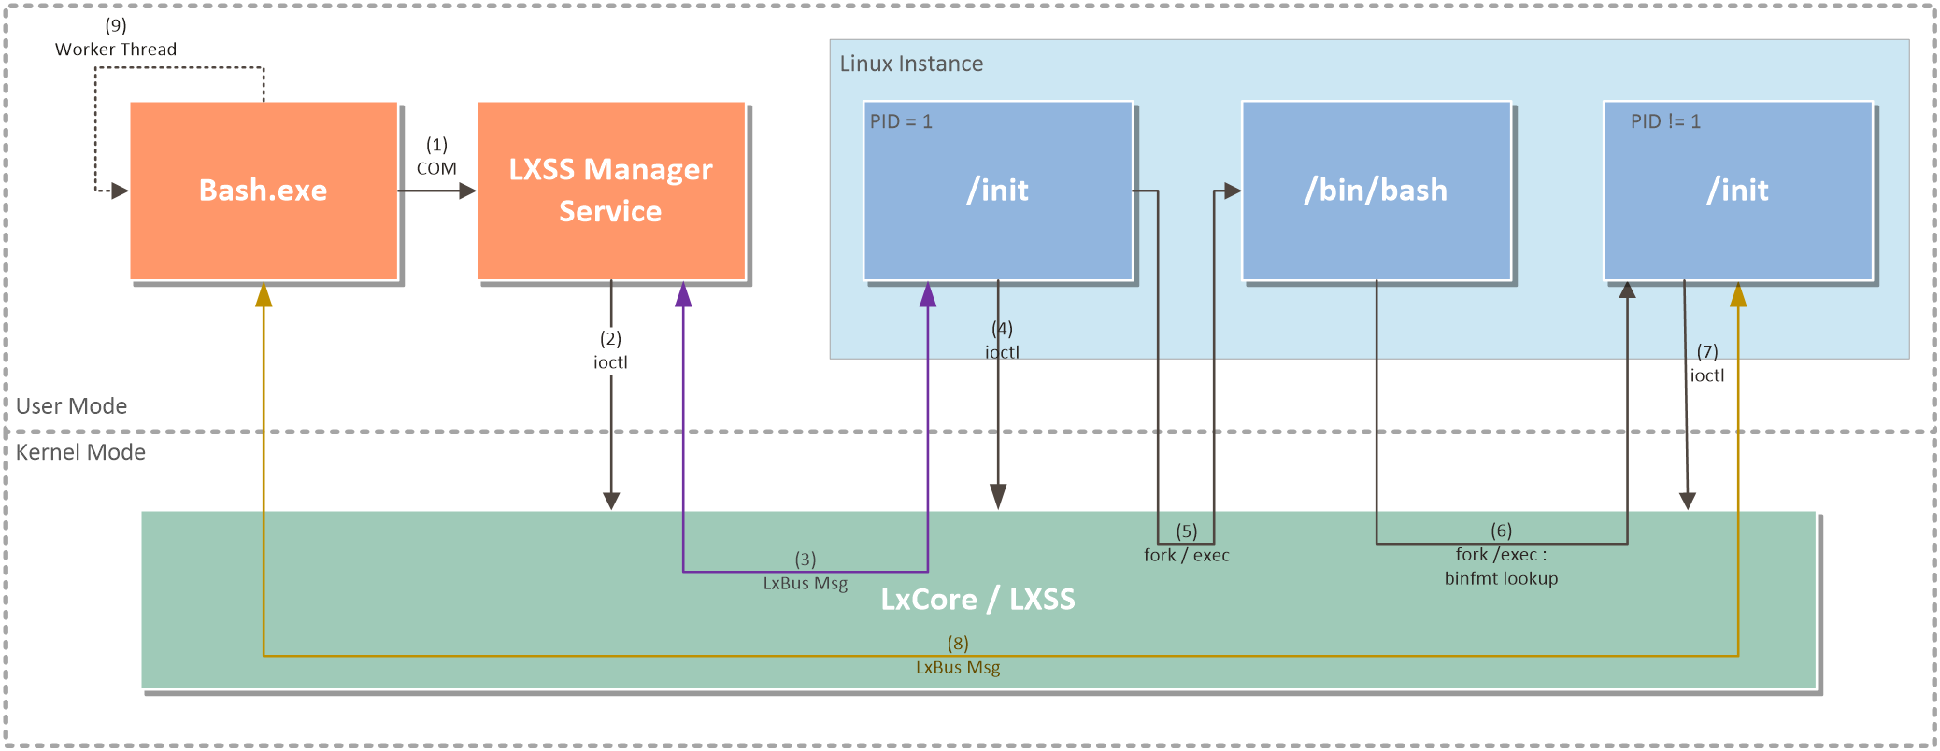
How does it work ...

Slide 15

WSL as beta
Originally a Ubuntu runtime
  WSL-Distribution-Switcher
    Replaced rootfs (userspace) with ‘any’ docker image
In the next update of Windows 10, runtimes are offered from the Windows Store
  Fedora.appx

Slide 16
Fedora/WSL
Userspace (rootfs)
  close to Docker image, but needs sudo, etc.
  https://gitlab.com/gbraad/fedora-wsl
Distro launcher
  wrapper application
  packaged with the rootfs
  signed, for upload to the Windows Store

Slide 17
Demo

Slide 18
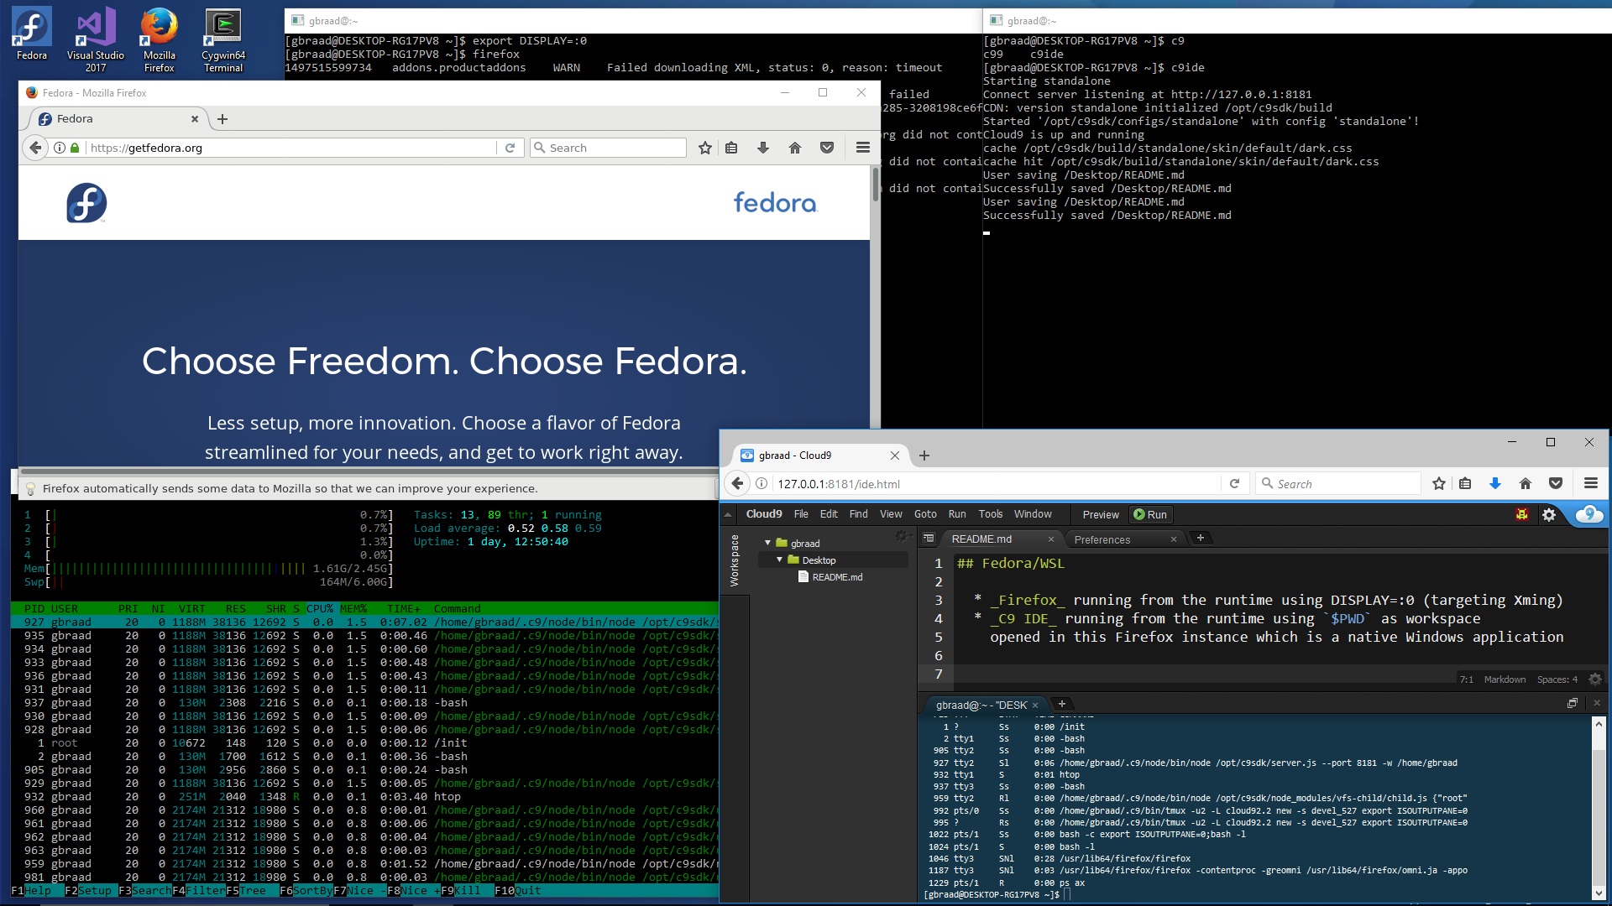

Slide 19
Limitations
currently no full system init
  much like Docker works → execute an application
No system integration for executables
  PS> fedora run [command]

Slide 20
Conclusion
Compatibility not fully ensured (yet/if ever)
  but very close (impressive!)
  Linux ABI re-implementation
It does not replace Cygwin yet …

Slide 21
Questions?
Contact:
gbraad@fedoraproject.org

