Slide 1
Syntax & Songbirds a duet for avian vocal synthesizer and oboe
Kyler Brown, PhD candidate, Computational Neuroscience
Geoff Brookshire, PhD candidate, Psychology
Marcelle Pierson, PhD candidate, Music History and Theory

Slide 2
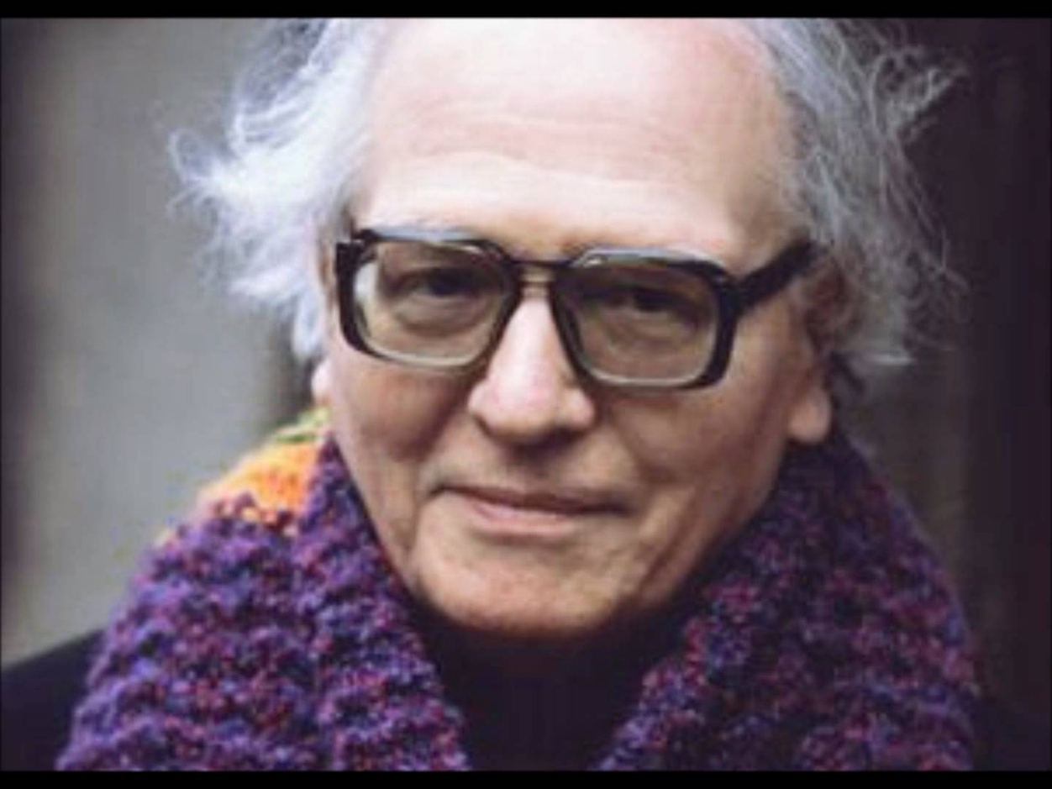

Birds in composition
Olivier Messiaen (1908-1992)
Quartet for the End of Time, Mvt. 1

Slide 3
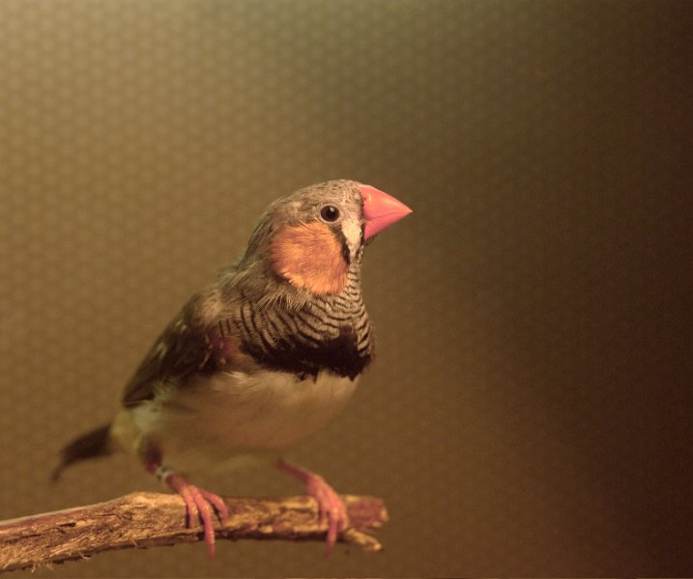
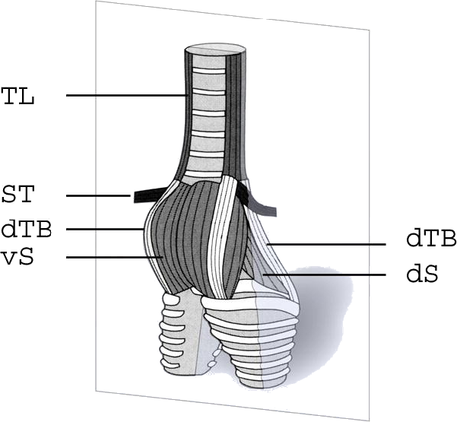

Slide 4
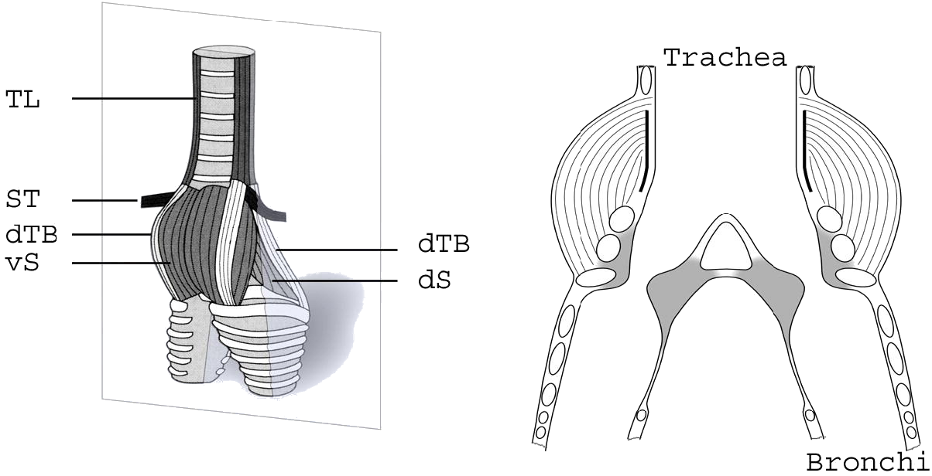
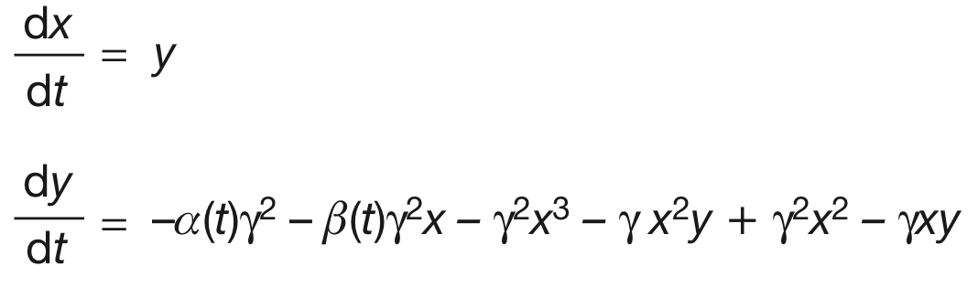
dx
=
y
,
dt
dy
2
2
dt
= αγ
+ βγ
2
x
− γ
x
3
− γ
x
2
y
+ γ
2
x
2
− γ
xy

Slide 5
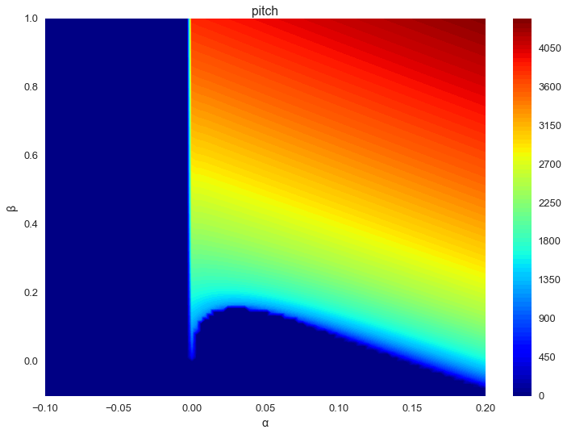

Slide 6
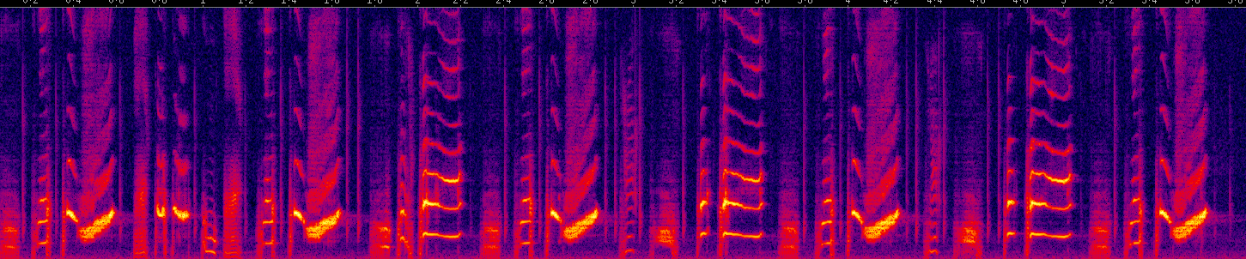

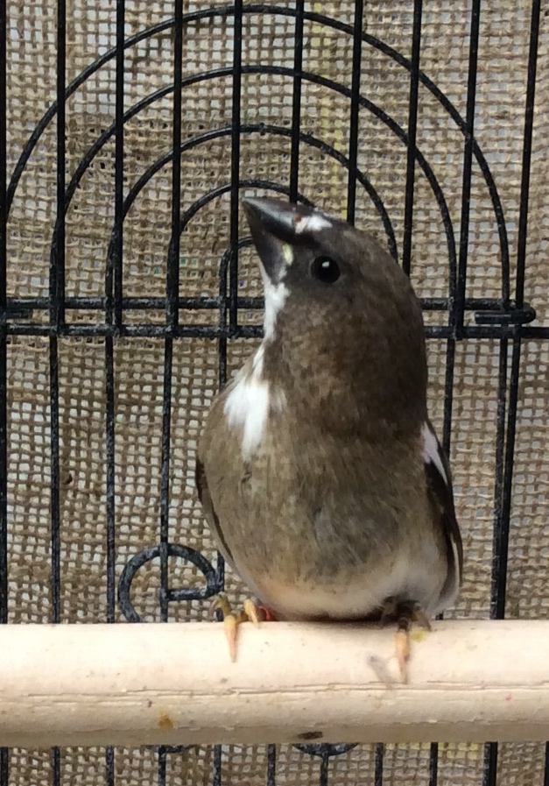
Birdsong is modeled as a Markov chain
*
*
*
Bengalese finch
b
c
d
a
g
h
i
e
f

Slide 7
