Slide 1
Introduction
Messian blah blah blah
Want to make music informed by the way birds sing, without just making music that sounds like birds
In two ways: biophysics and cognition

Slide 2
Kyler
Intro finch kyler stuff
Take 10 seconds to say: we wanted to build a way to let people play a virtual finch by manipulating the parameters of this model.

Slide 3
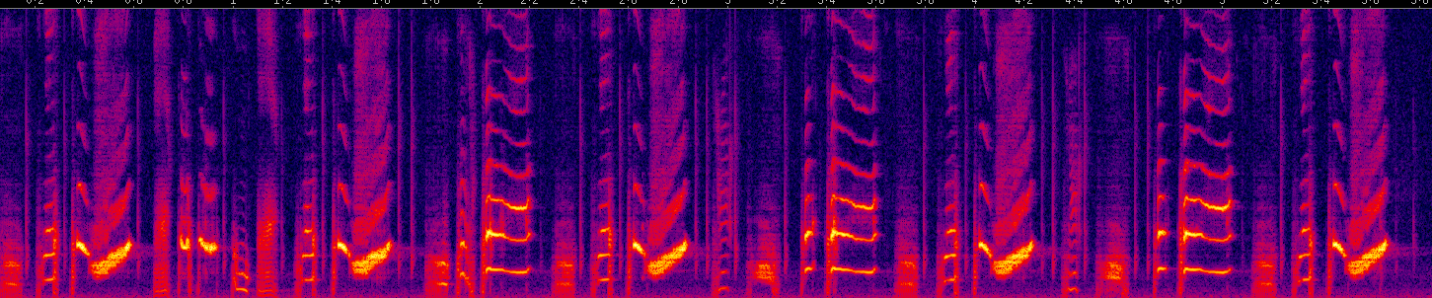

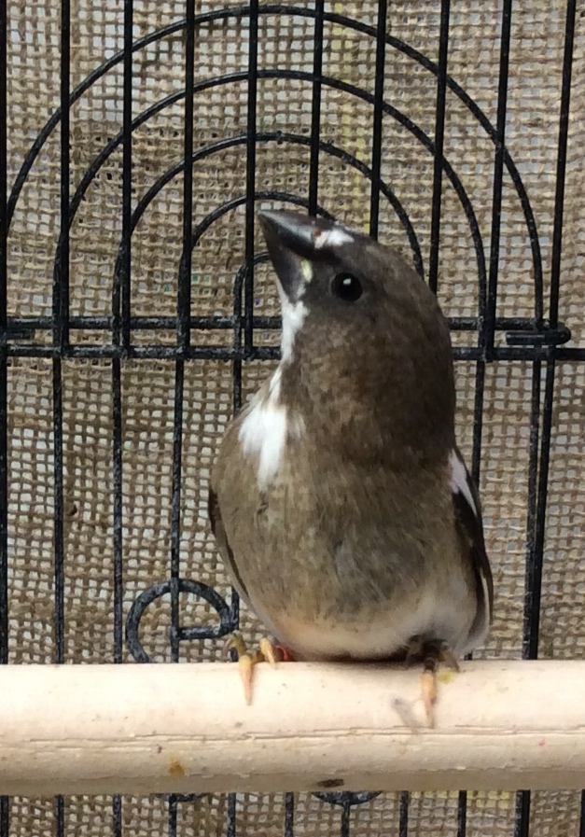
Birdsong is modeled as a Markov chain
*
*
*
Bengalese finch
b
c
d
a
g
h
i
e
f
Notes:
Kyler just told you about using a biophysical model of birds’ vocal tracts to make noises in music. In addition to analyzing the sounds that birds make, we’re interested in how they string those sounds together. And for this project, we wanted to string sounds together in a way that’s similar to how birds sing.
In many species of songbirds, the birds sing a small number of distinct syllables, with brief pauses in between them.
[[DESCRIBE WHAT A SYLLABLE IS.]]
Here’s an example of a the song of a Bengalese finch. I’ve put stars under a few instances of the same syllable.
People often model these songs using what’s called a Markov chain. In a Markov chain, you have some number of states, and transitions between those states. In the Markov chain illustrating this bird’s song, for example, you can see that after singing syllable E, the bird can sing either F or G.
A transition matrix is a way to represent the graph in a grid. And that’s a way to play this instrument.
[[A few words about why this is interesting, for language, music, etc.]]

