Slide 2
Birdsong syntax is modeled as a Markov process
a
d
iacd
iace
ibcd
ibce
i
c
b
e
No memory, no non-adjacent dependencies.
The book that the cat pushed fell over.
Notes:
Crystallized adult song is often modeled as a Markov process.
A Markov process is a system that includes a finite number of states, and transitions between those states.
No memory – all they know is the current state. If this process is at state C, the history of the system doesn’t affect what it does next.
This is quite different from human language, where words at the end of a sentence refer back to things in the beginning of the sentence.
Many researchers assert that all non-human vocalizations are fully described by memoryless Markov processes. But actually no one has tested whether non-human animals can learn to produce non-Markovian syntax if they’re exposed to it when young.
And prior research shows that they can perceive non-adjacent structures.

Slide 3
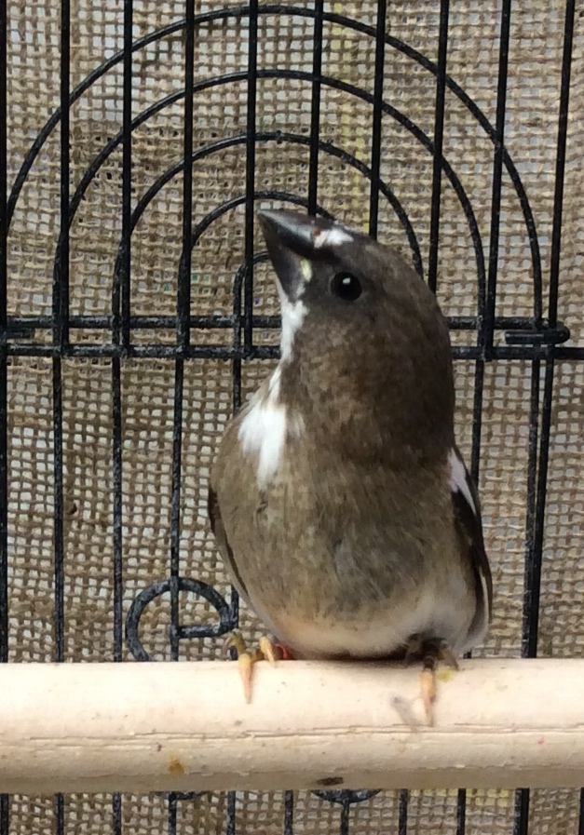
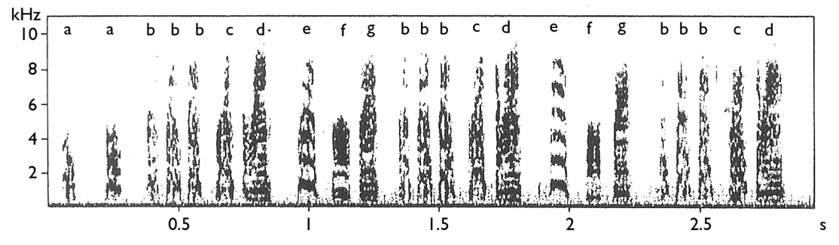
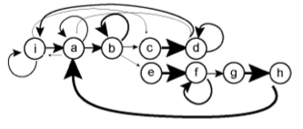
Bengalese finch
Lonchura striata domestica
Notes:
Sing variable songs.
Learned the center-embedded grammar in perception.
Hosino, Okanoya (2000, NeuroReport) – Spectrogram
Hampton, Sakata, Brainard (2009, J Neurophysiol) – Markov Chain picture
Transition probabilities are stable over time (Warren et al, 2012)

Slide 4
Two ways to show a Markov Process
Graph
Transition matrix
 | a | b | c
a | 0 | 1 | 0
b | 0 | 0.5 | 0.5
c | 1 | 0 | 0
a
b
c

