Slide 1
Notes
Notes:
In addition to modeling the noises after the way they’re produced by songbirds, we wanted to try to put sounds together like they do.
The songs of some songbirds are commonly modeled as what’s called a Markov process.
In a Markov process, you have a number of elements – syllables of the bird’s song, in this case – connected to each other. For example, this graph tells you that after it sings syllable B, this bird sometimes sings C, sometimes E, and sometimes another B.
We’ve used Markov processes to compose music.

Slide 2
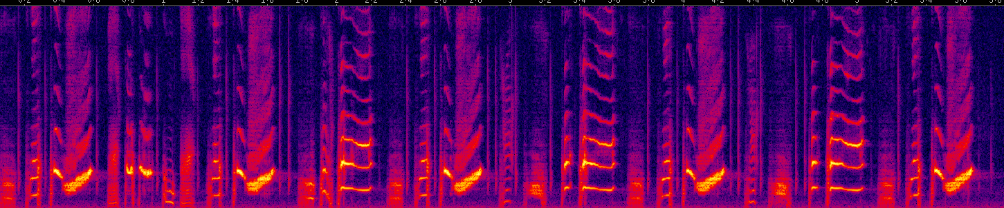

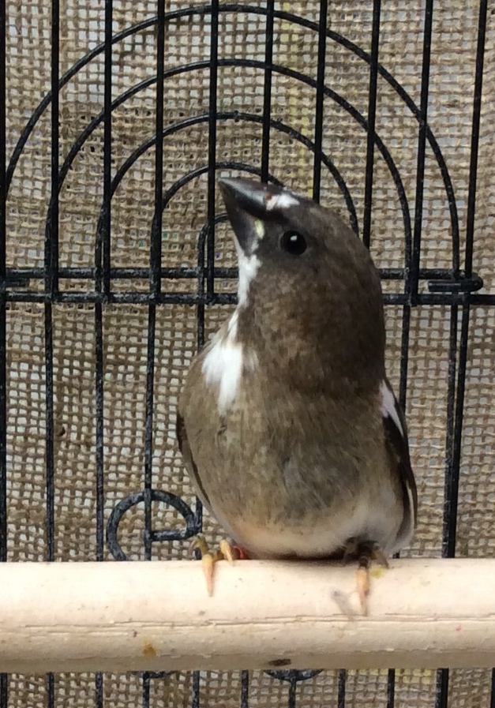
Birdsong is modeled as a Markov chain
Bengalese finch
b
c
d
a
g
h
i
e
f

Slide 3
Two ways to show a Markov process
Graph
Transition matrix
 | a | b | c
a | 0 | 1 | 0
b | 0 | 0.5 | 0.5
c | 1 | 0 | 0
a
b
c

