Slide 1
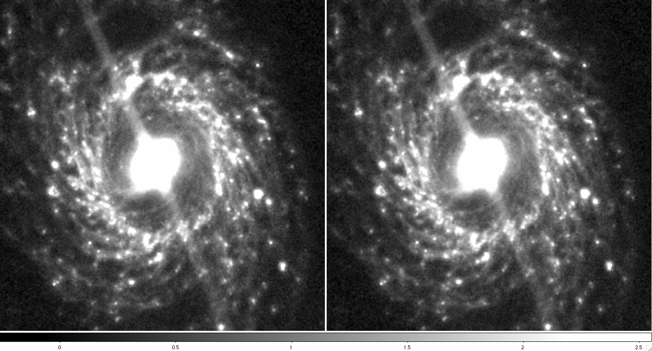
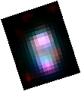
IRAC 8 μm image
NGC3351
6.2 μm PAH - Green
[Ne II] 12.8 μm - Blue
H₂ S(2) - Red

