Slide 1


Lidar in ArcGIS: LAS Datasets
Gregory Brunner

Slide 2
Supporting Data structures and Tools
Vector features
  points
  multipoints
  lines
  polygons
Raster
TIN
Terrain Dataset
Point File Information
LAS To Multipoint
ASCII 3D To Feature Class
Point To Raster
Terrain To Raster
Terrain To TIN
Input
Function
Output
Workflow

Slide 3
Supporting Data structures and Tools
LAS dataset
  LAS Dataset Statistics
  LAS Dataset To Raster
  LAS Point Statistics As Raster
  LAS Point Statistics By Area
  LAS Dataset To TIN
  Set LAS Class Codes Using Features
LAS dataset…
  Change LAS Class Codes
  Classify LAS By Height
  Classify LAS Ground
  Extract LAS
  Locate LAS Points By Proximity
Mosaic dataset
  Extensive collection of raster tools
Input
Function
Output
Workflow

Slide 4
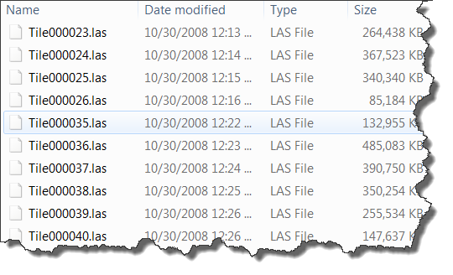

Lidar Point Coverage and Sample Density
Basic QA/QC before loading data into geodatabase
Verify xy and z extent
Examine point spacing

Slide 5
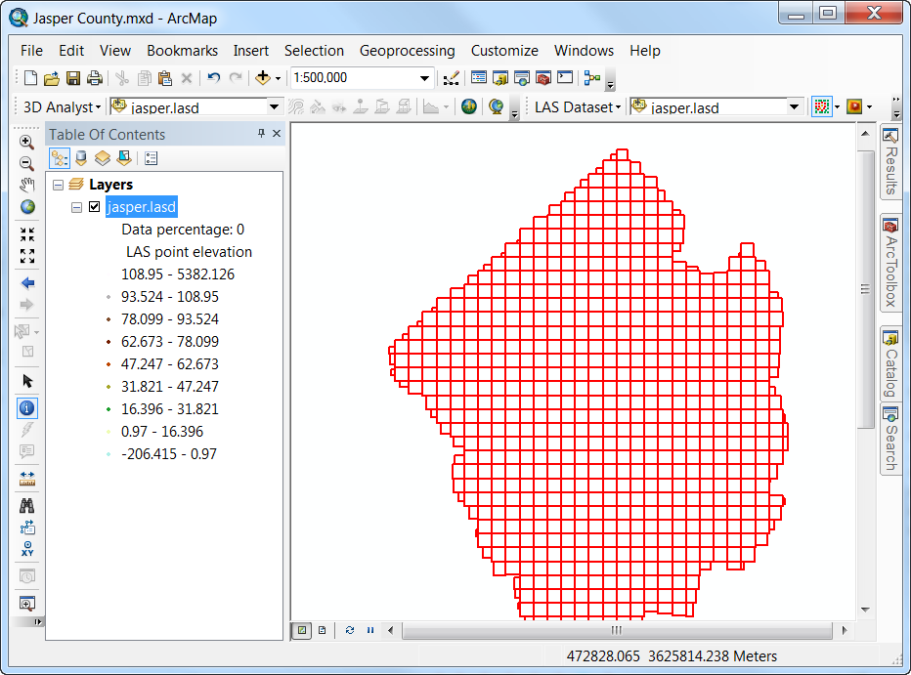
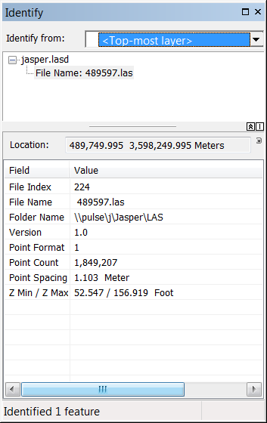
LAS Dataset Layer

Slide 6
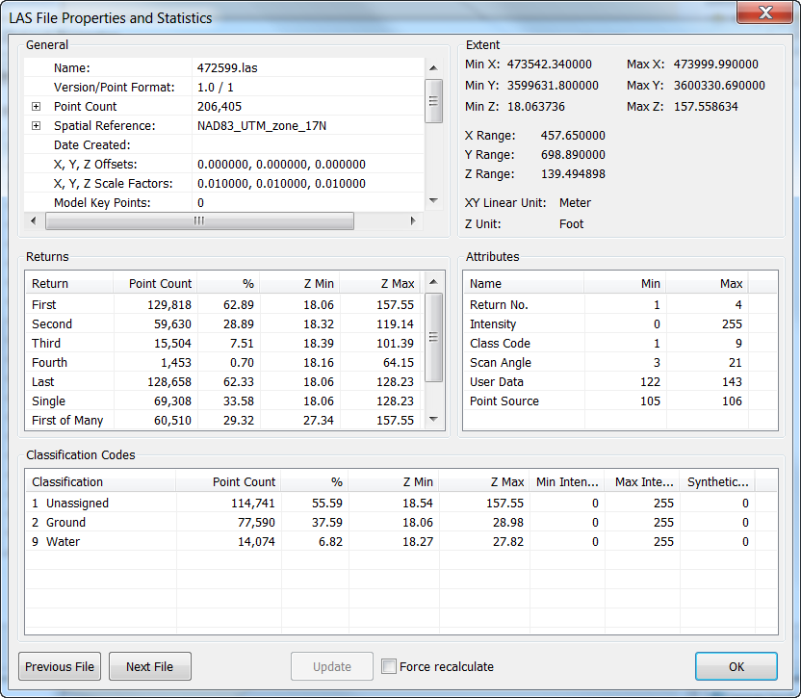
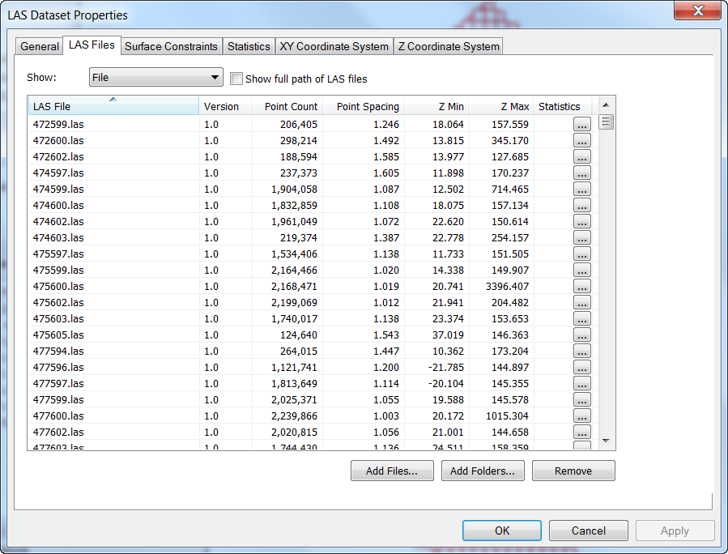
LAS Dataset Properties

Slide 7
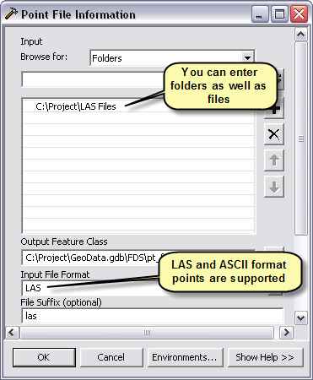
Point File Information Tool
Inputs files (LAS and ASCII) and folders of files and outputs a polygon feature class.
Each output record includes
  Polygon of file’s data extent
  Source filename
  Point count
  Point spacing estimate
  Z min
  Z max

Slide 8
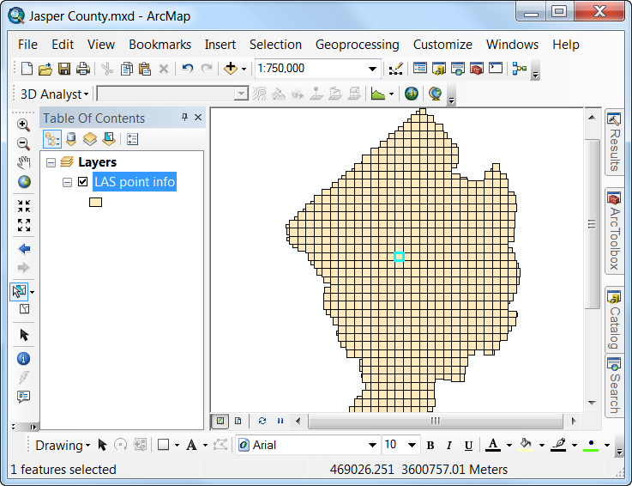
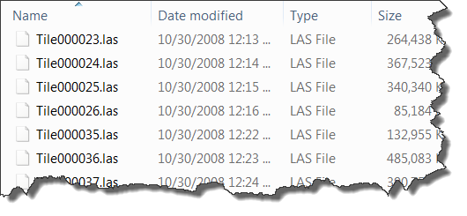
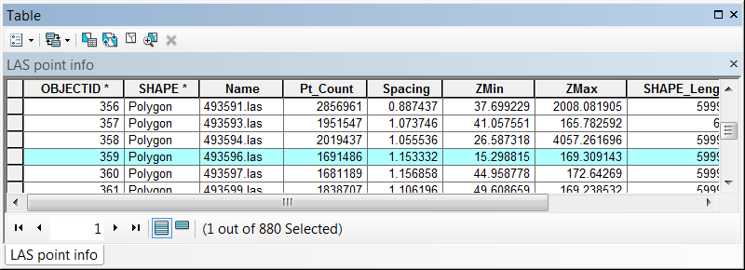
Point File Information Tool

Slide 9
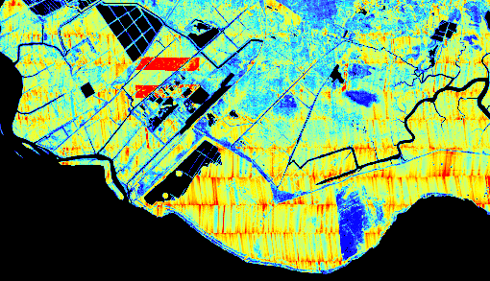
LAS Point Statistics As Raster Tool
Pulse/sample density

Slide 10
Demo

