Slide 1
Obstacle sensing bot

Slide 2
Chennai institute of technology
TEAM :- SURENDAR G B & SHIVA RAMALINGAM V
REGISTER NUMBER :- 210421106105 & 210421106089
DEPARTMENT :- ELECTRONICS AND COMMUNICATION Engineering

Slide 3
INTRODUCTION
A sensor acquires a physical parameter and converts it into a signal suitable for processing.
By that the sensors for useful in mechanical based products and plays a important roll in those units.
Sensors are omnipresent. They embedded in our bodies, automobiles, airplanes, cellular telephones, radios, chemical plants, industrial plants and countless other applications.
Without the use of sensors, there would be no automation.

Slide 4
Principle
Photoconductive Effect :-
When light strikes certain semiconductor materials, the resistance of the material decreases (e.g. photoresistor
The alteration of electric conductivity produced by the absorption of varying amounts of radiation composed of photons
Photoconductivity is an optical and electrical phenomenon in which a material becomes more electrically conductive due to the absorption of electromagnetic radiation

Slide 5
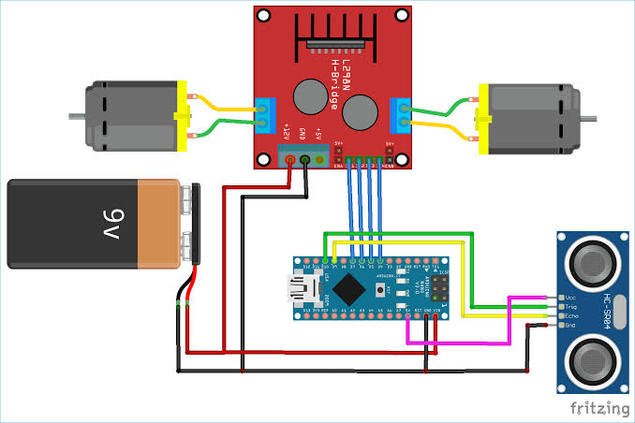
Circuit Connections

Slide 6
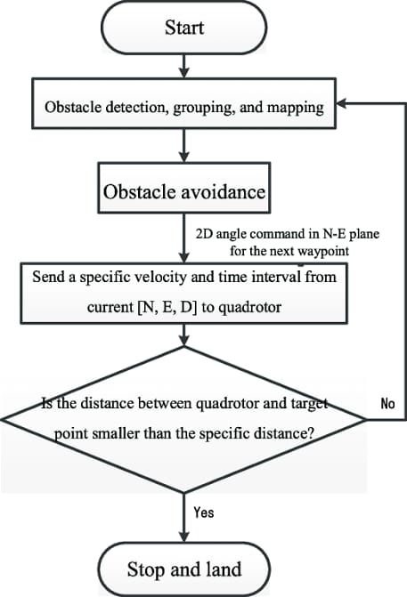
Flow chart

Slide 7
Working
To run the system.
When the battery connected to the system then the circuit is now closed.
The motors are driven and wheels are meshed with the motor rotates in similar directions with respect to the rest wheels.
If any object detected in front of the vehicle the sensor will sense the object pass the signal to controller where it stops the system by cutting of the supply.
If only the obstacle is removed the system will return to the work.

Slide 8
COMPONENTS
MS FRAME
WHEELS
SERO MOTOR
SENSOR
BATTERY

Slide 9
Application
It can be used in the industrial applications.
Ex :- used in forklift
Can be used in automobile
advantages
reduction in damage
increase in transportation time
it can be used as a movable surveillance

Slide 10
Thank you!!!

