Slide 1

Convolutional Neural Network (CNN)
Cunshi Wang (Chinese Academy of Sciences)
Yes! It’s me!

Slide 2
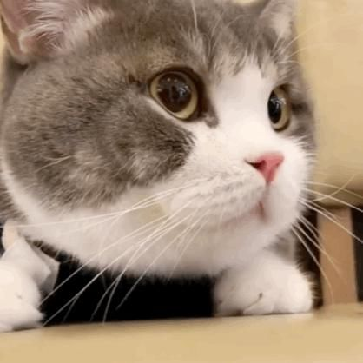
Image
II’m good at processing images!
418 x 418 x 3
418 x 418 x 1

Slide 3
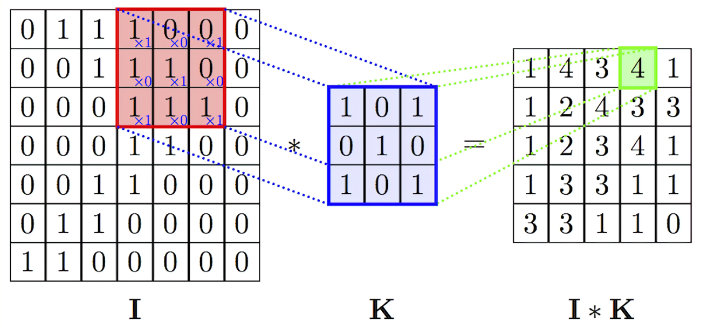
Convolution
Filter size
Stride
Padding

Slide 4
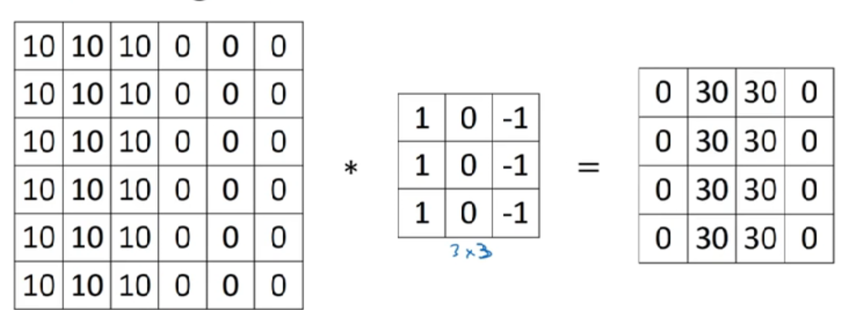
Boundary Detection

Slide 5
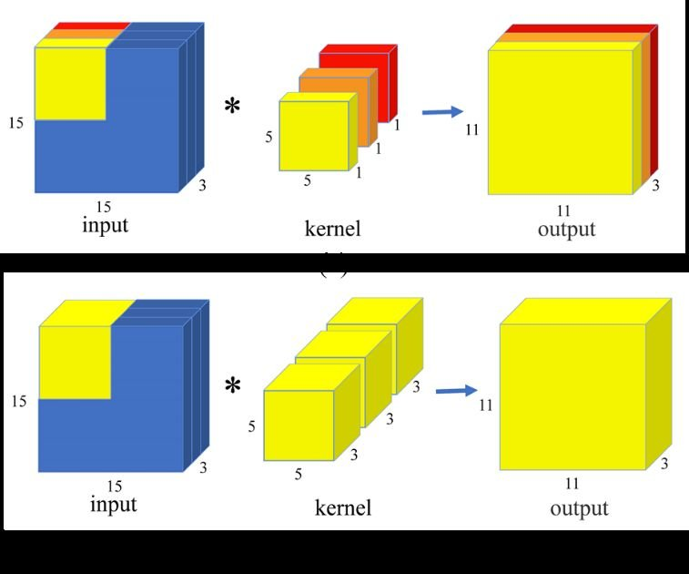
Convolution
Filter size
Stride
Padding

Slide 6
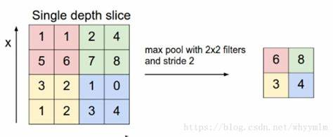
Pooling layer
Max pooling: If somewhere detected the feature, keep it; if not, the number will be small.
Average pooling: dimensional reduction

Slide 7
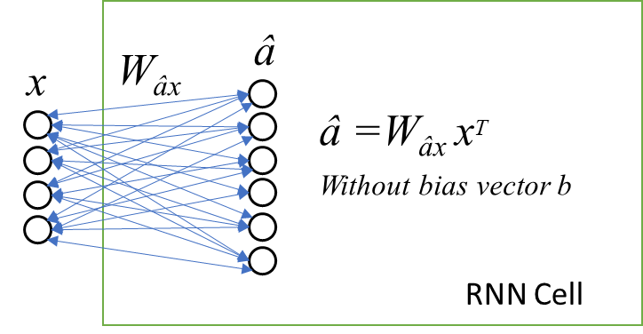
Fully Connected layer
A layer that matches one feature to another feature space.
Cost a lot of parameters

Slide 8
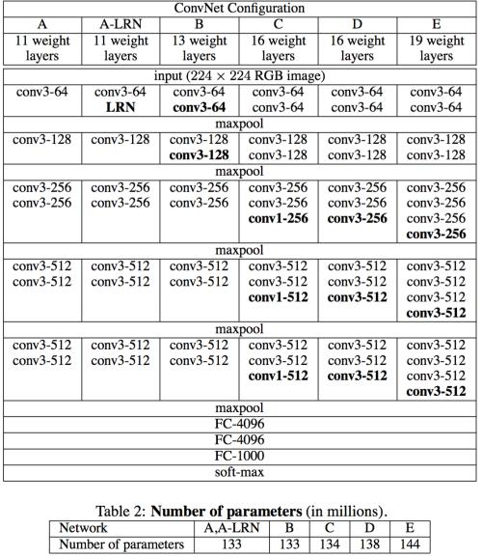
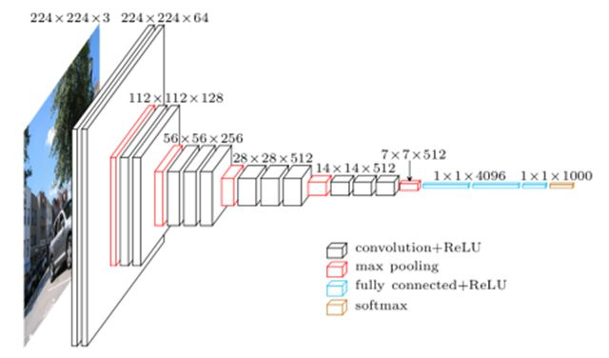
VGG: Oxford Visual Geometry Group
The deeper the network, the better the performance

Slide 9
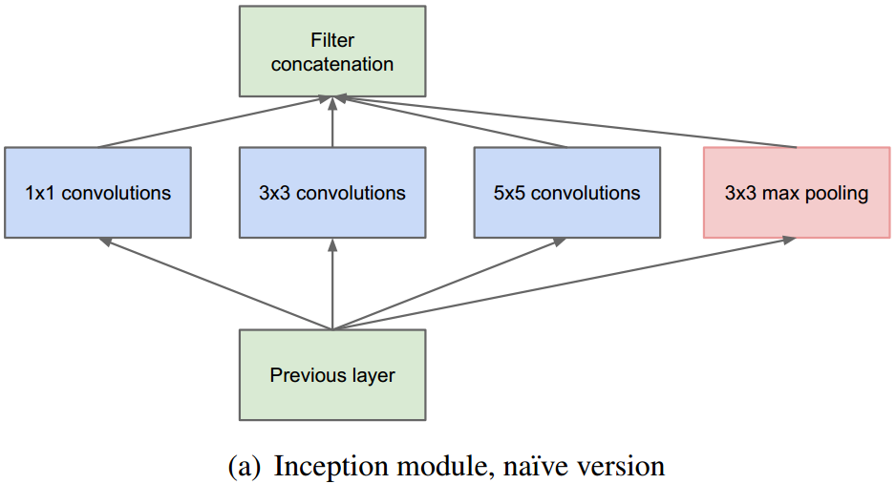
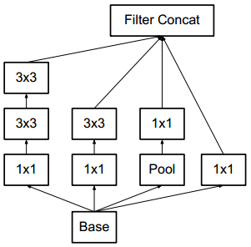
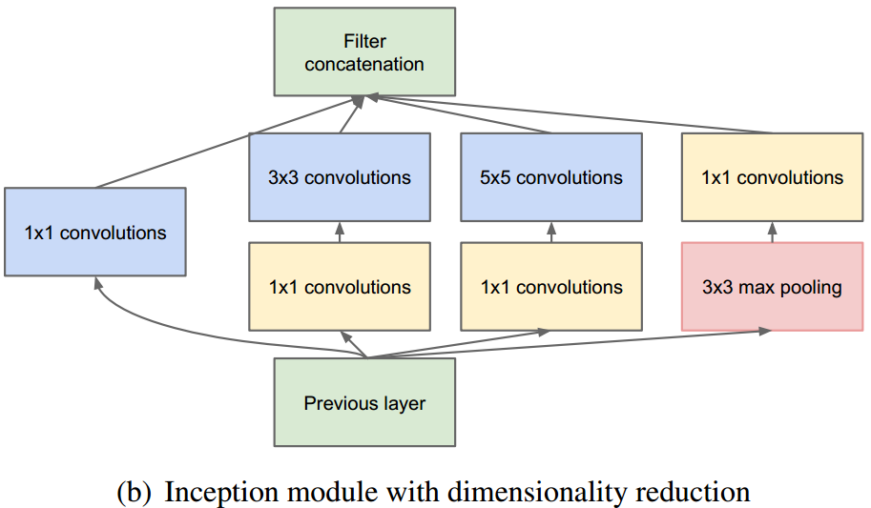
Inception
Parallel each convolution together

Slide 10
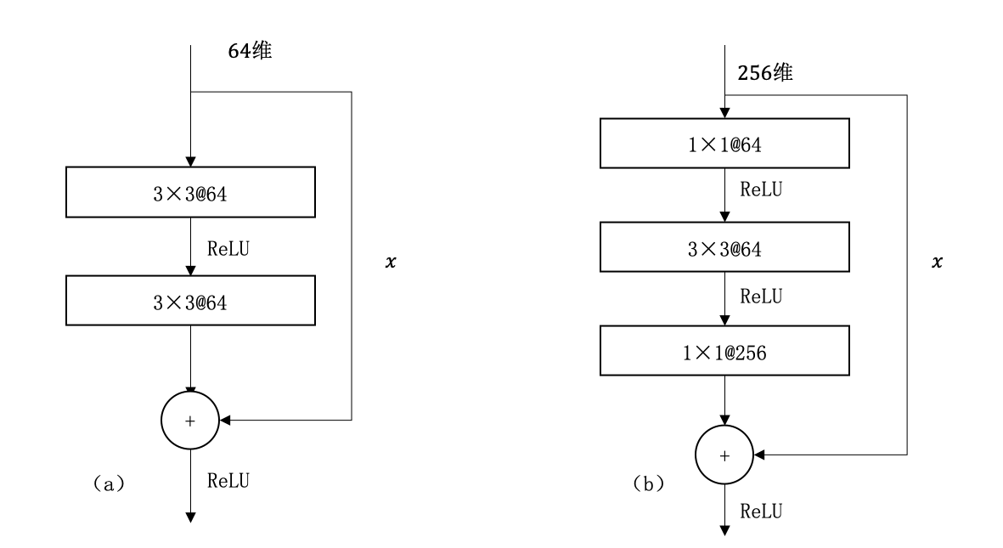
ResNet
Residual to prevent gradient vanishing

Slide 11
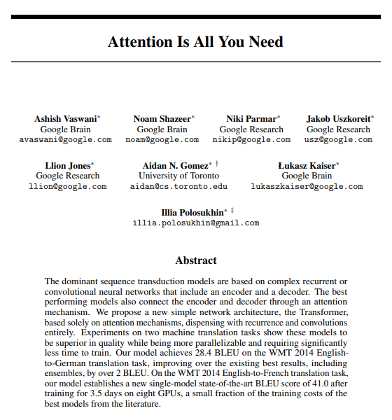

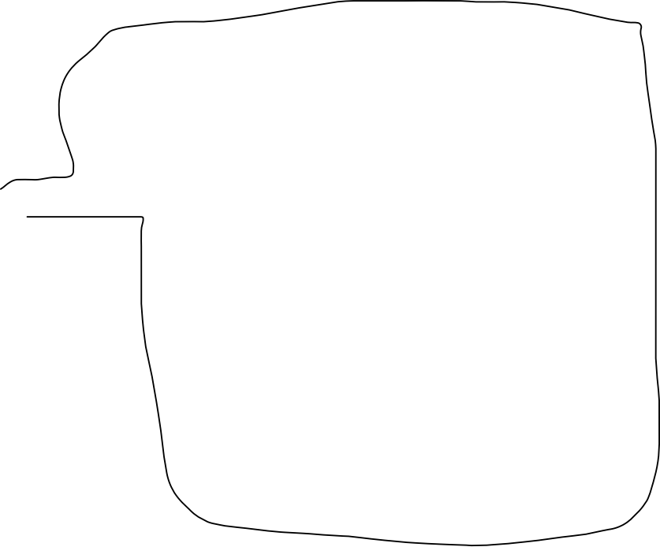

Transformer

