Slide 1
120 Years of
Olympic History
Presented by Gianna Burgess

Slide 2
TABLE OF CONTENTS
01
04
02
05
03
06
Introduction
Visualizations
Basic info about the goals of the project.
7 specific visualizations and their interpretations.
Data Cleaning
Insights
Breakdown of data cleaning methodology.
Trends and generalizations in the data.
EDA
Additional Findings
Initial exploration of the dataset.
3 additional research questions and visualizations.

Slide 3
INTRODUCTION
This project analyzes 120 years of Olympic history (1896-2016) using athlete and NOC region datasets. The goal is to analyze trends, demographics, medal distribution, the impact of physical attributes on Olympic success, and overall participation.

Slide 4

Data Cleaning
Merging Datasets
The two raw datasets were merged for better analysis.
Missing Value Imputation
Missing values were imputed in the age, weight, height, and medal columns.
Duplicate Handling
1385 duplicate entries in athlete participation in same events were dropped.
New Feature Creation
BMI and age group columns were created for more specific analysis of the dataset.
Type Conversion
Season and Year columns were converted into categorical data.

Slide 5
Exploratory Data Analysis
01
02
03
04
Scope
There are 135,571 unique athletes, 205 countries, and 66 unique sports represented in the data.
Gender participation
Male participation has historically dominated, but the gender gap is closing.
Popular Sports
Gymnastics and athletics are the most popular in terms of participation.
Distribution of Medals
Nearly equal distribution of medal types.

Slide 6
Exploratory Data Analysis
01
02
Overall Olympic Participation
Olympic participation has increased from the first games in 1896 to the last one in 2016.
Physical Attributes of Athletes
The median athlete is 25 years old, 178 cm tall, and weighs 73.5 kg.

Slide 7
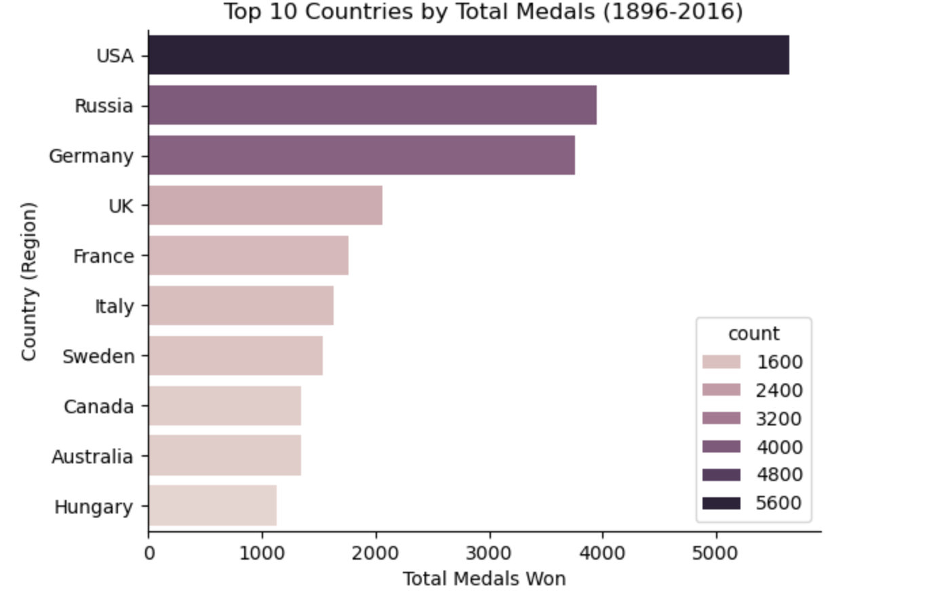
Top 10 Countries by Total Medals

Slide 8
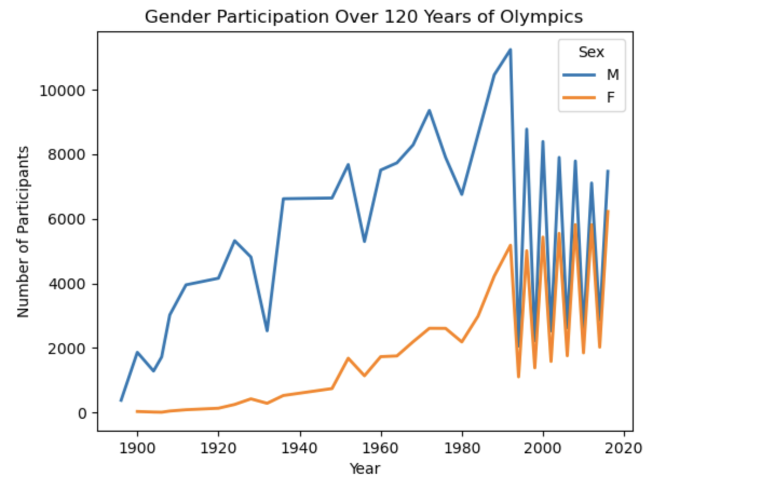
Gender Participation Over Time

Slide 9
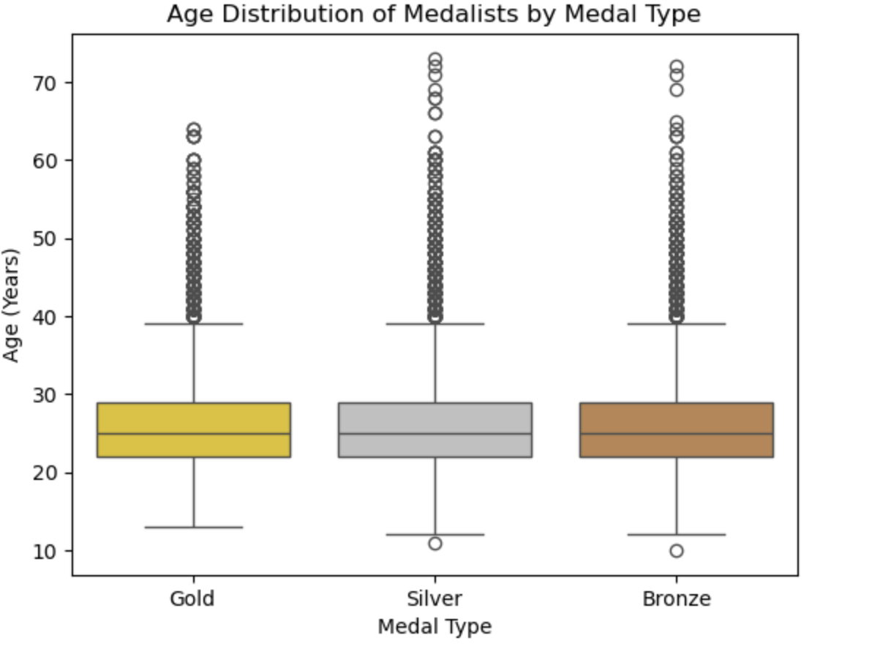
Age Distribution by Medal Type

Slide 10
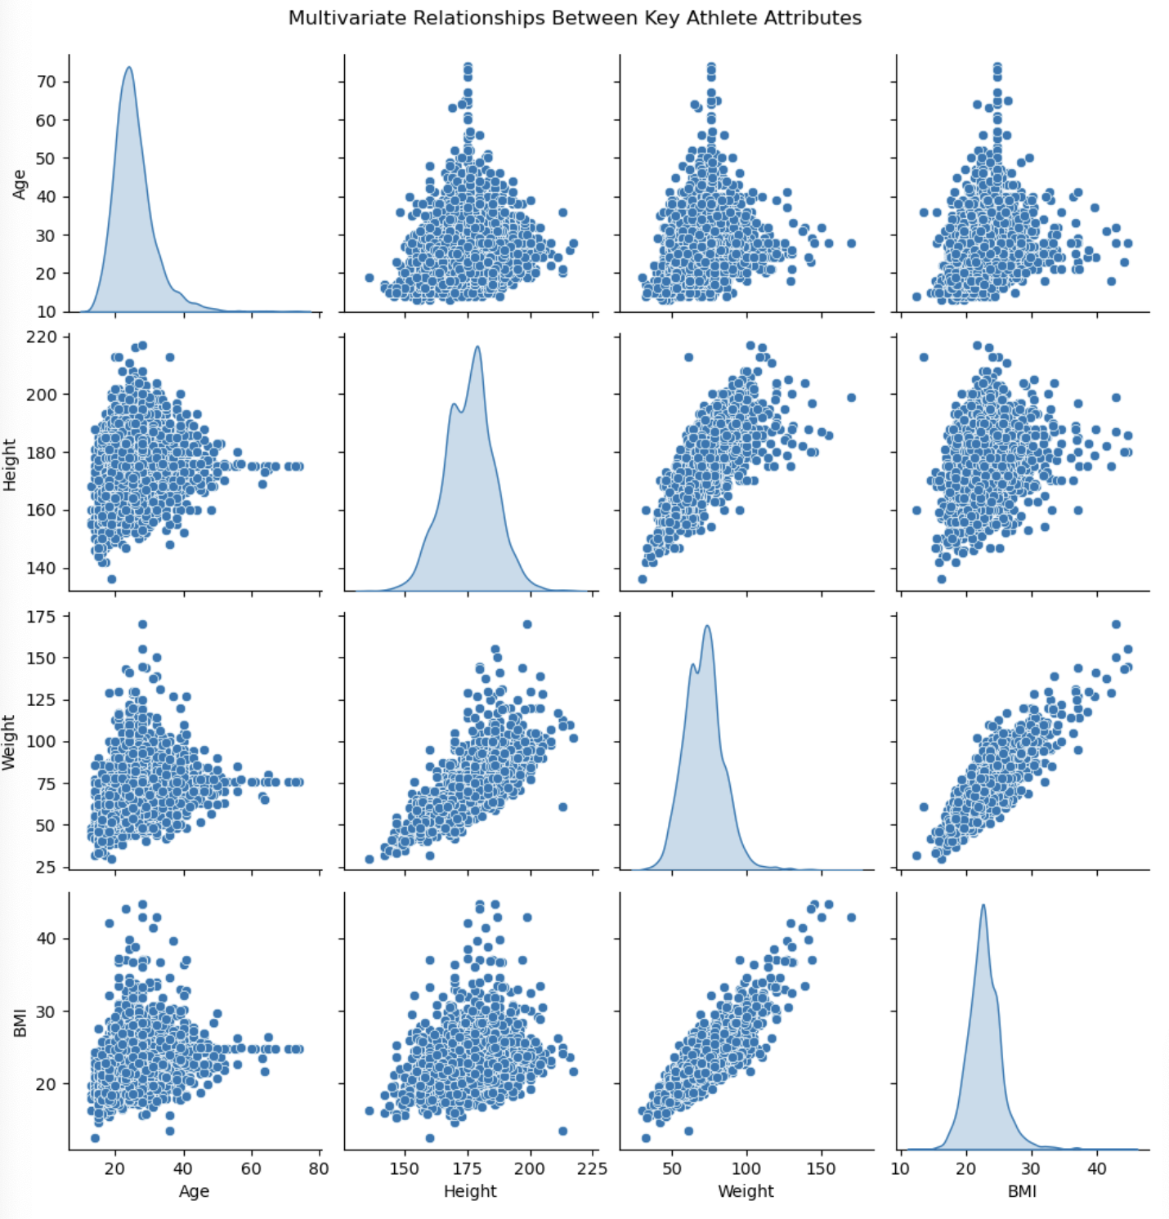
Pair Plot of Physical Attributes

Slide 11
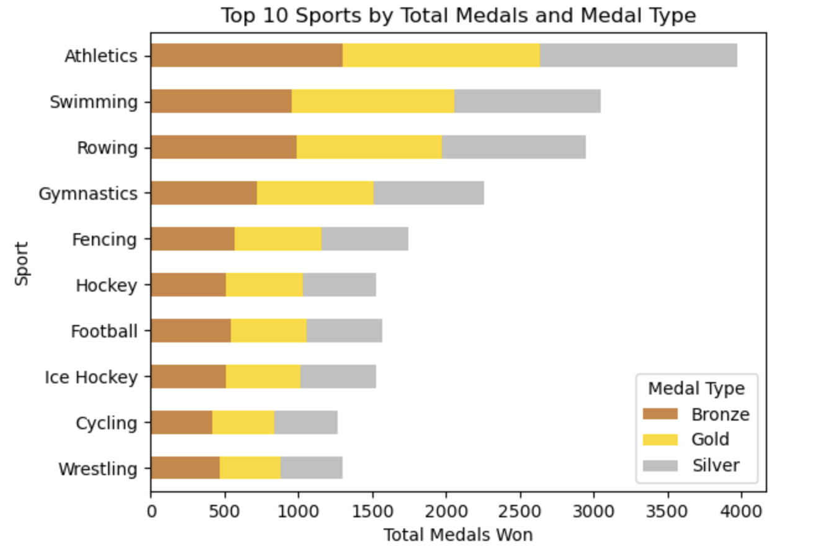
Medal Count by Sport

Slide 12
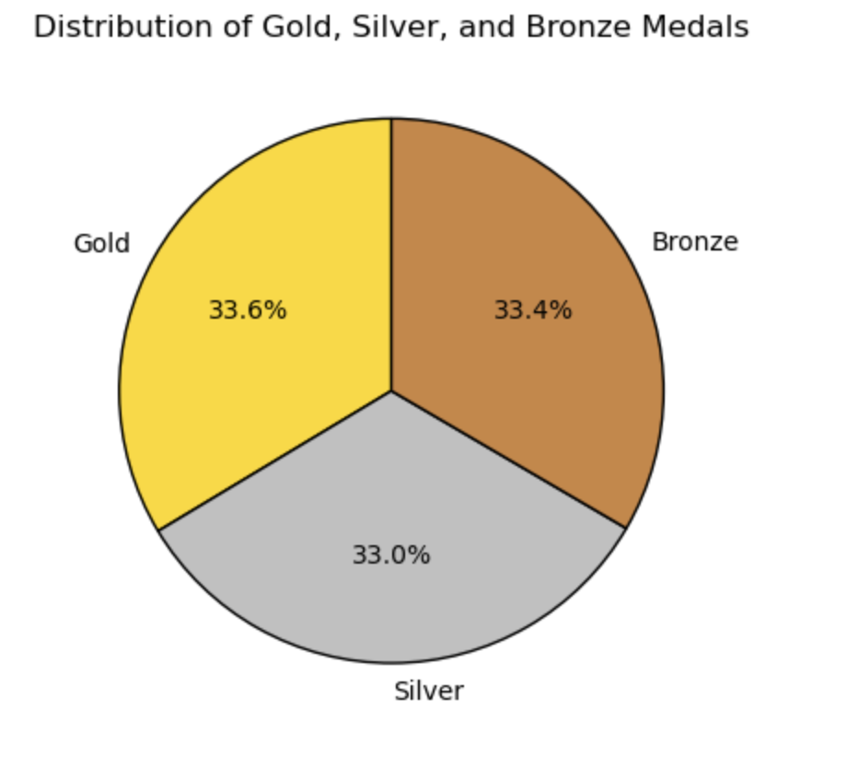
Medal Distribution

Slide 13
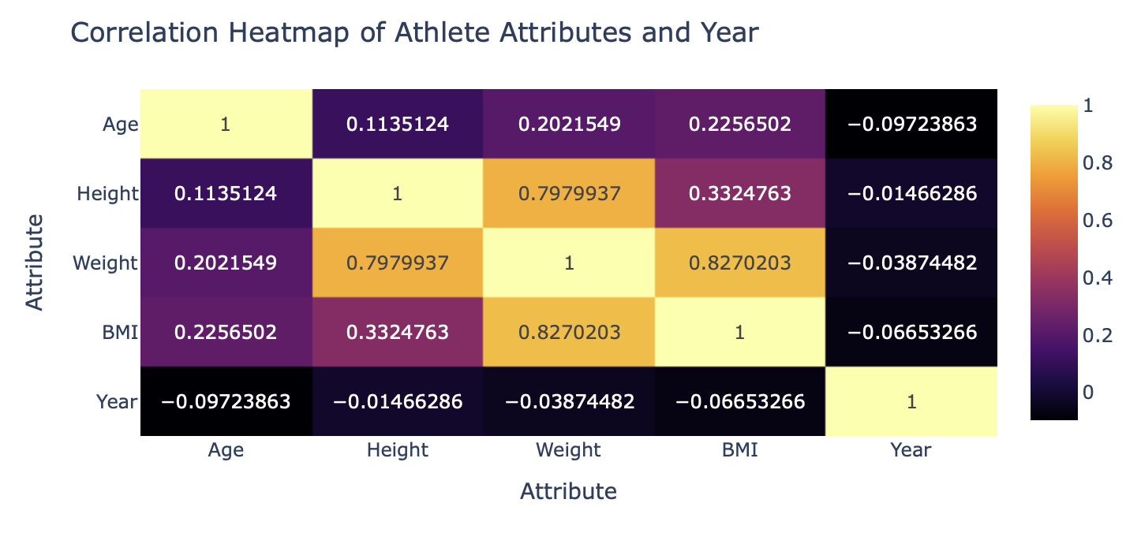
Heatmap of Correlation

Slide 14
Insights
Gender, Age, and Physical Attributes
Medal Dominance
USA dominates
Sports with more events dominate
Medal success peaks at 25
The gender gap is closing
Medalists are bigger than non-medalists
Participation Trends
Limitations
Significant increase in participation
The average athlete is not bigger than in past athletes
NaN values
Structural bias
Total medal count favors certain countries and sports

Slide 15
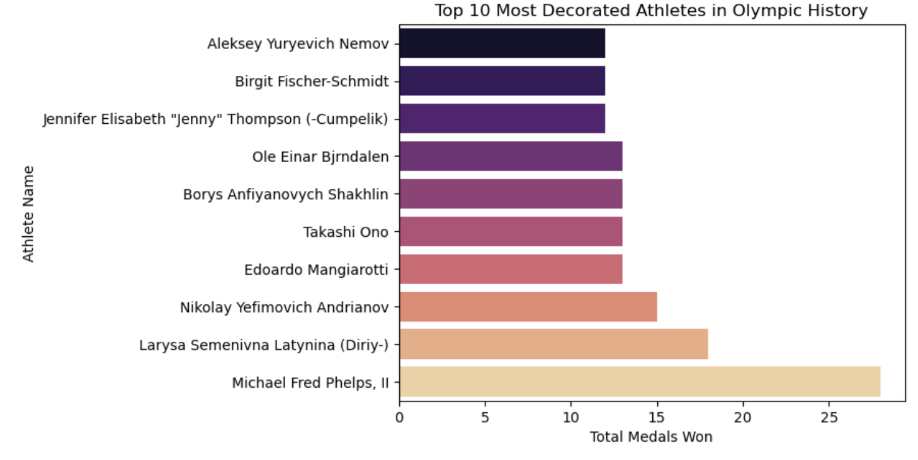
Who are the most decorated athletes?

Slide 16
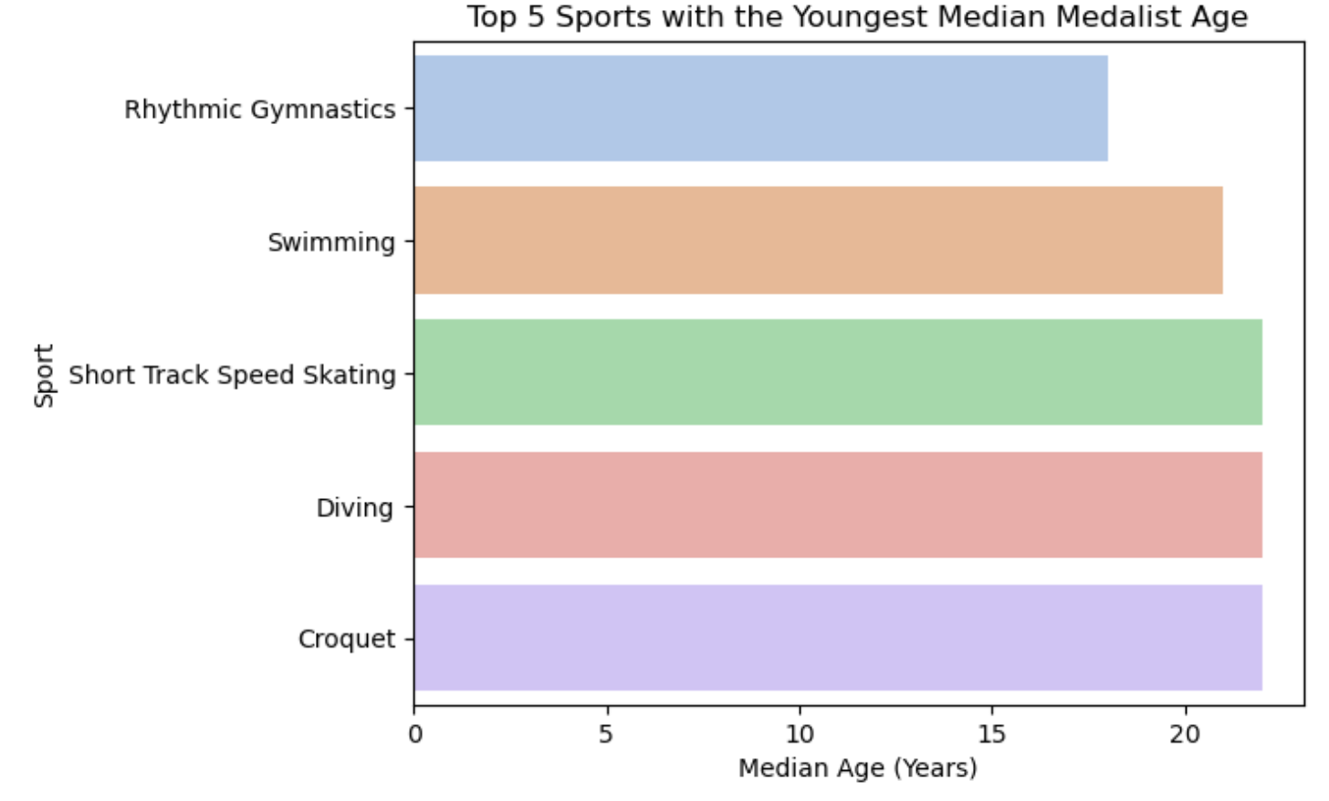
Which sports do young people dominate?

Slide 17
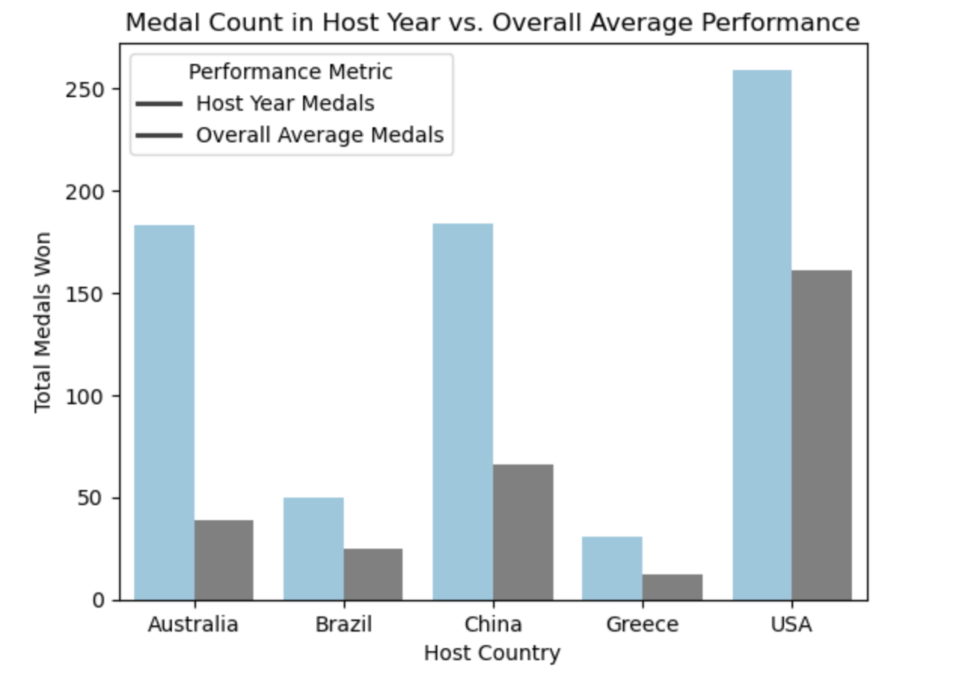
Do host countries win more medals?

