Slide 1

Budget Allocation To Maximize Efficiency
across online and offline activities

Slide 2









KPIs for ad channel efficiency
Online metrics
conversion rate
bounce rate
branded searches
social sentiment
engagement
likes, shares, comments, video views
Tools

Slide 3


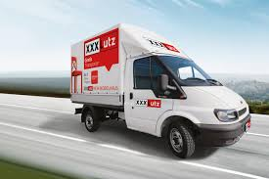
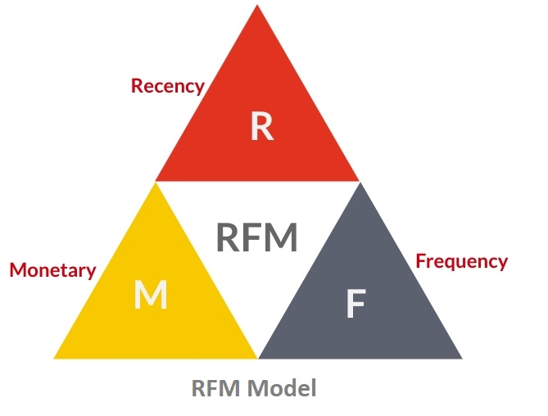


KPIs for ad channel efficiency
Offline metrics
incremental revenue, ROI
CPA or CPL
CLV or LTV
attribution-weighted sales
products viewed
brand awareness
brand recall scores
Tools

Slide 4

Statistical models Methodological Approaches
STATISTICAL MODELS
MTA A/B test
LogReg Hypergeometric Test
Pearson’s Chi-square Test Markov Chain
MMM
LGBM
Bayesian Hierarchical Models
DATA SOURCES
online data
offline data
KPIs
ROI
CPA
conversion rate
awareness
….
OPTIMIZING BUDGET ALLOCATION

Slide 5
Statistical models Methodological Approaches
What-if Analysis Dashboard
Use:
slicers/filters/sliders for date, cost-per-channel channel, activity type, region
Build:
interactive time-series KPI charts
budget scenario simulators
MMM (Marketing Mix Model)
Target variable: Sales (EUR)
Regressors: adstocked, lagged, cost-per-channel
MTA (Multi-Touch Attribution)
Target variable: Purchase Binary Variable
Regressors: one hot encoded customer touchpoints
A/B Test
Target variable: Number of Conversions
Regressors: test, control group identifiers

Slide 6
Data Samples
MMM (Marketing Mix Model)
Date | Channel | Channel_Type | Spend_EUR | Impressions | Clicks | Conversions | Sales__EUR | Adstocked_Spend | Lag_1_Sales | Brand_Awareness | Brand_Search_Volume | NPS | Region | Promo_Flag | Holiday_Flag
2025-01-01 | Google Search | Online | 10,000 | 1,000,000 | 50,000 | 3,000 | 60,000 | 9,000 | 55,000 | 62 | 8,200 | – | DE | 0 | 0
2025-01-01 | TV Campaign | Offline | 50,000 | 5,000,000 | – | – | 90,000 | 46,000 | 85,000 | 68 | 9,100 | 45 | DE | 0 | 0
2025-01-01 | Email Campaign | Online | 1,500 | 500,000 | 10,000 | 1,500 | 20,000 | 1,400 | 18,000 | 59 | 7,200 | – | DE | 1 | 0
... | ... | ... | ... | ... | ... | ... | ... | ... | ... | ... | ... | ... | ... | ... | ...

Slide 7
Data Samples
MTA (Multi-Touch Attribution)
user_id | journey | converted
1 | Email > Social > Direct | 1
2 | Email > Direct | 0
3 | Social > Direct | 1
4 | Paid Search > Email > Direct | 1
5 | Direct | 0

Slide 8
Data Samples
A/B Testing
Group | Converted | Not Converted | Total
A | 20 | 80 | 100
B | 30 | 70 | 100
Total | 50 | 150 | 200

